Slide 1
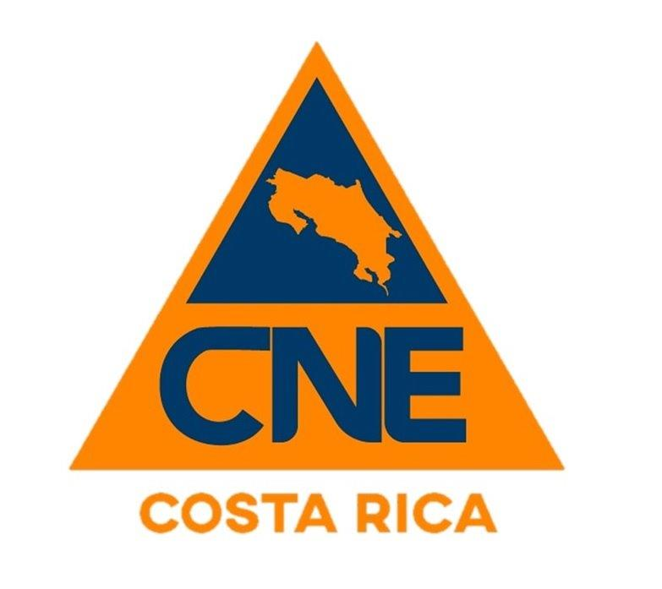
Tsunami Community Preparedness in Costa Rica
Silvia Chacón Barrantes (SINAMOT)
Ricardo Salazar Cruz (CNE)
Fabio Rivera Cerdas (SINAMOT

Slide 2
Background
1998 RONMAC Program
Sea level stations
Participation in IOCARIBE and ICG/PTWS
2007 coordination between CNE and UNA for tsunami warning
Beeper
Basic communication procedures
2014 SINAMOT was created
Communication procedures
Threat analysis procedures
Donations from UNA president and USAID

Slide 3
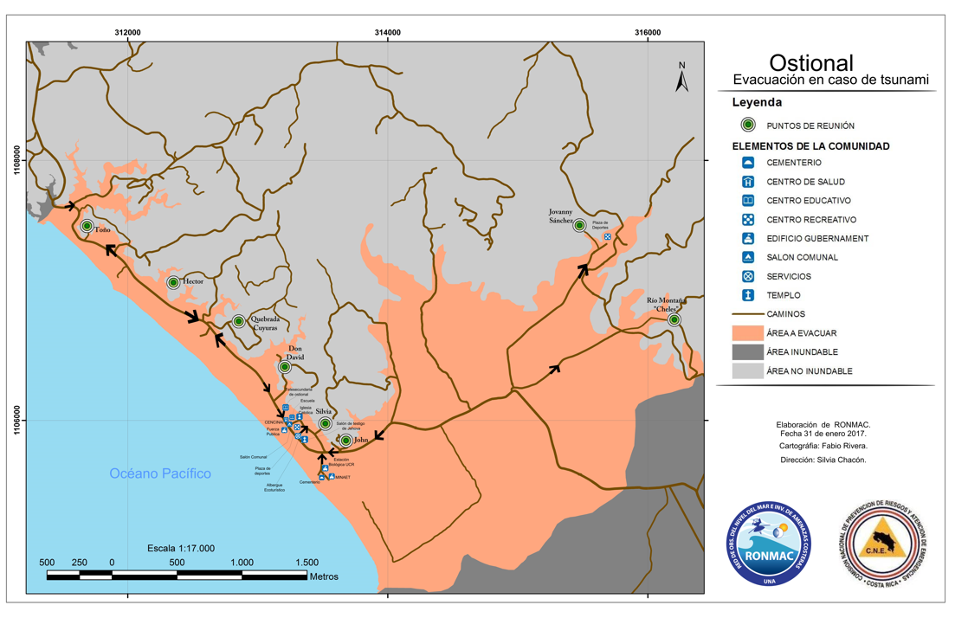
Tsunami Evacuation Maps Project
Formulated by Silvia Chacón e Isabel Arozarena
Only tsunami evacuation maps

Slide 4
Tsunami Evacuation Maps Projects
Approved by CNE for funding
Agreement negotiation (CNE & UNA)
1st stage:
North and Central Pacific
2nd stage:
South Pacific and Caribbean
3rd stage:
5 new maps,
5 maps updated,
5 plans
2013
2014
2015
2019
2022

Slide 5
Tsunami Evacuation Maps Projects
So far we have
54 maps for the Pacific coast
9 maps for the Caribbean coast
Inundation area defined by
Bathtub approach
Inundation modeling
Some maps have required updating due to
New sources
New bathymetric data

Slide 6
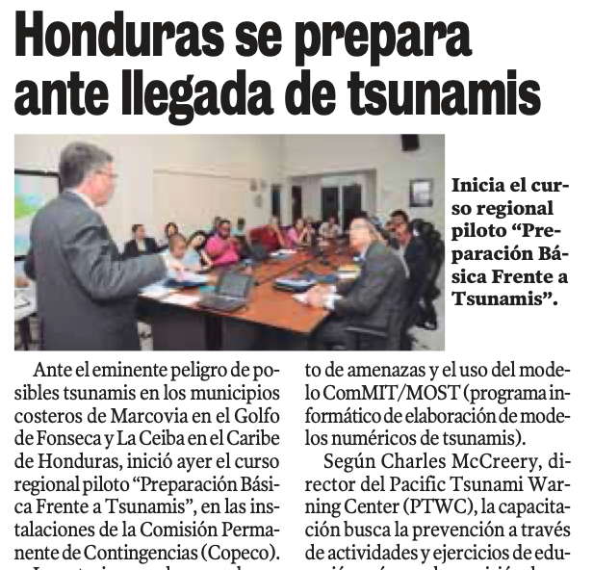
So, we started in 2015
Almost at the same time as TEMPP (Tsunami Evacuation Maps, Plans and Procedures) Pilot in Honduras
The rest of Central American countries were invited as observers
Jorge Álvarez (CNE) participated and proposed to replicate Tsunami Ready in Costa Rica

Slide 7
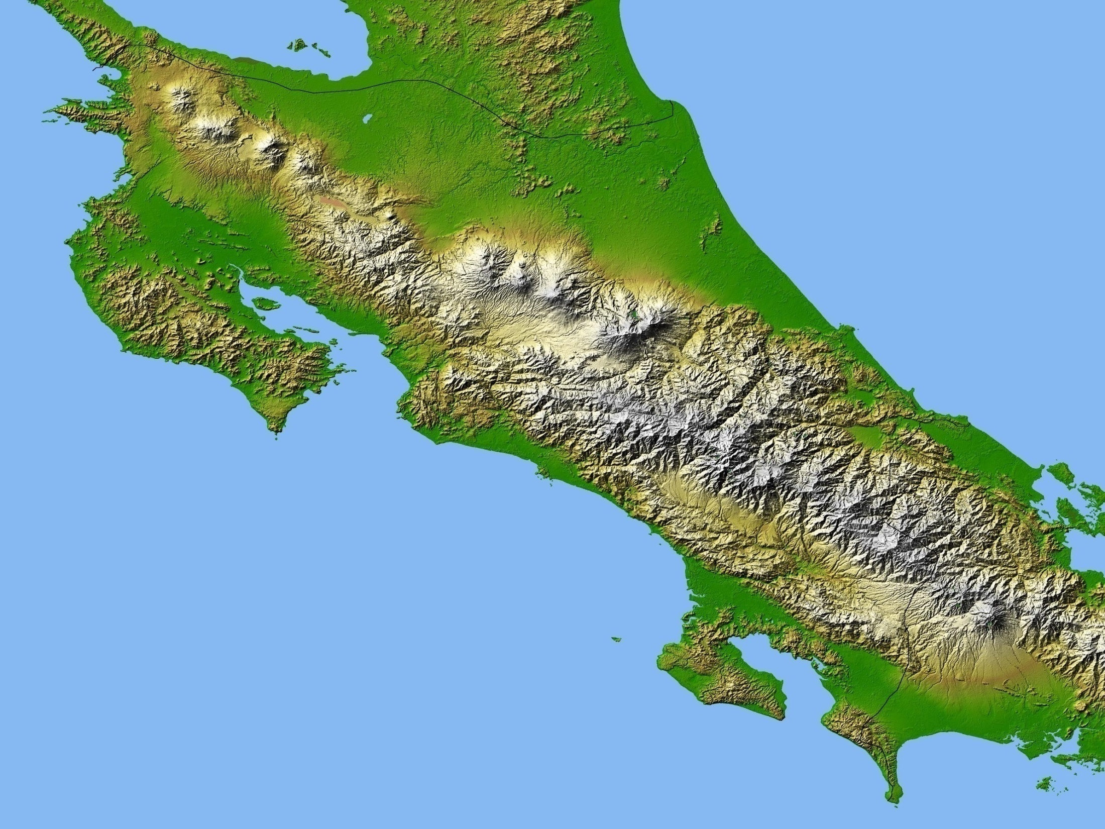
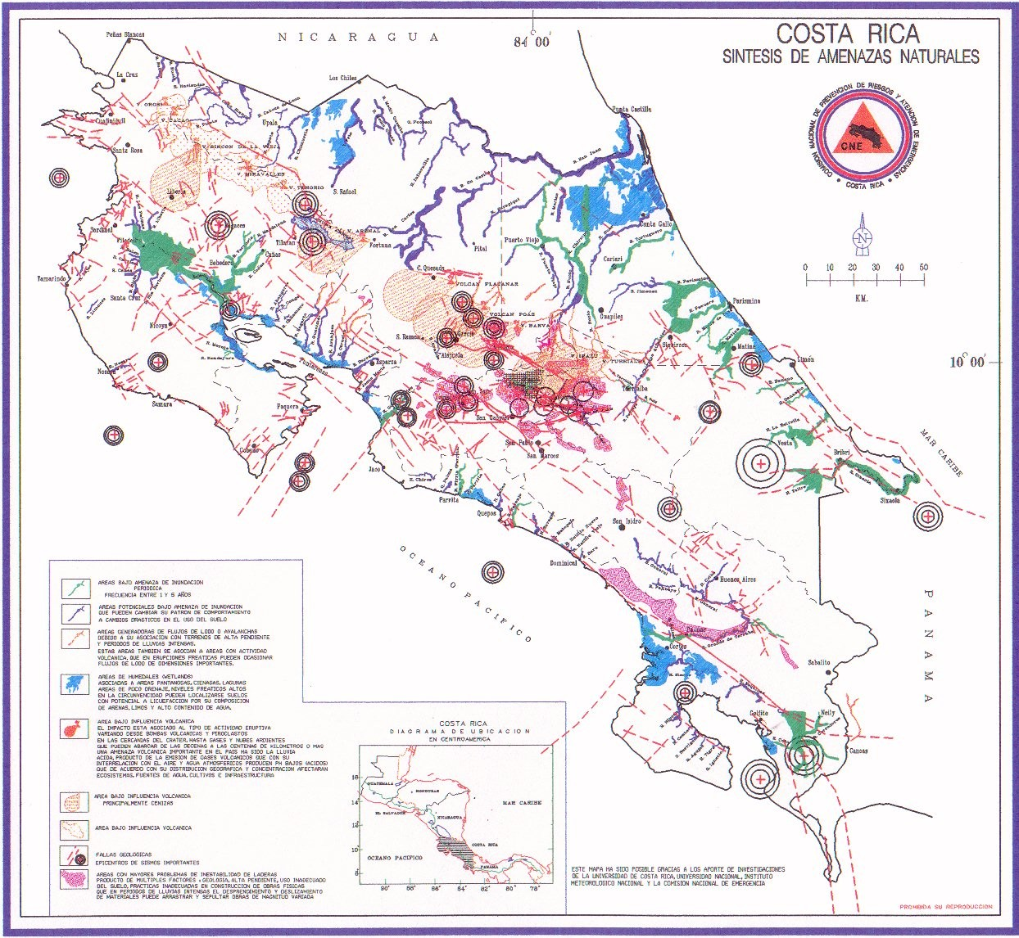

Slide 8
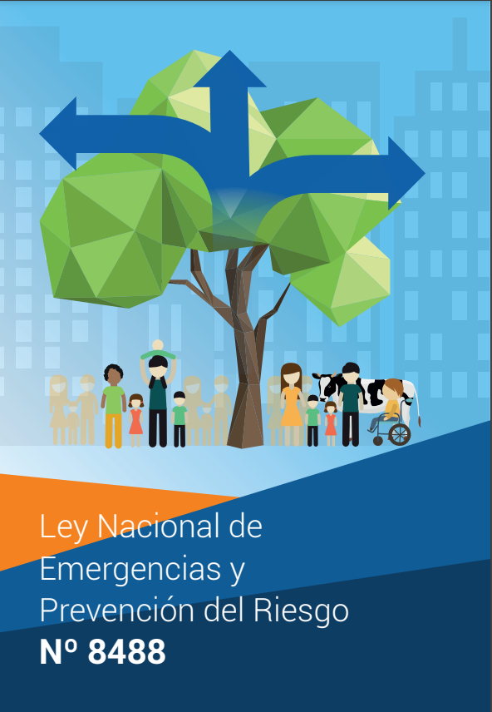
Risk Management in Costa Rica
“CNE will oversee everything related to risk prevention and preparatives to respond in emergency situations.”
“La Comisión será la entidad rectora en lo que se refiera a la prevención de riesgos y a los preparativos para atender situaciones de emergencia”

Slide 9
Sub-System
Preparations and Response
CNE
FORO NACIONAL DE GESTIÓN DEL RIESGO
COMITÉS DE SEGUIMIENTO
A LOS SUBSISTEMAS
COMITÉS
SECTORIALES
COE
COMITÉS
ASESORES
TÉCNICOS
COMITÉS
INSTITUCIONALES
COMITÉS
REGIONALES
REDES
TEMÁTICAS
Niveles:
Superior
Sectorial
Institucional
Técnico
Operativo
COMITÉS
MUNICIPALES
REDES
TERRITORIALES
COMITÉS
COMUNALES

Slide 10
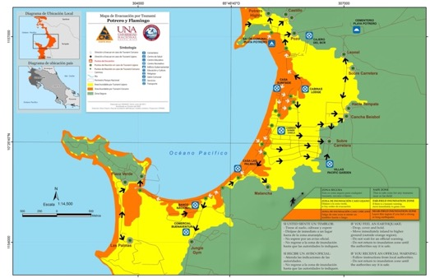
Technical-Scientific input from SINAMOT Aporte Técnico-Científico del SINAMOT

Slide 11
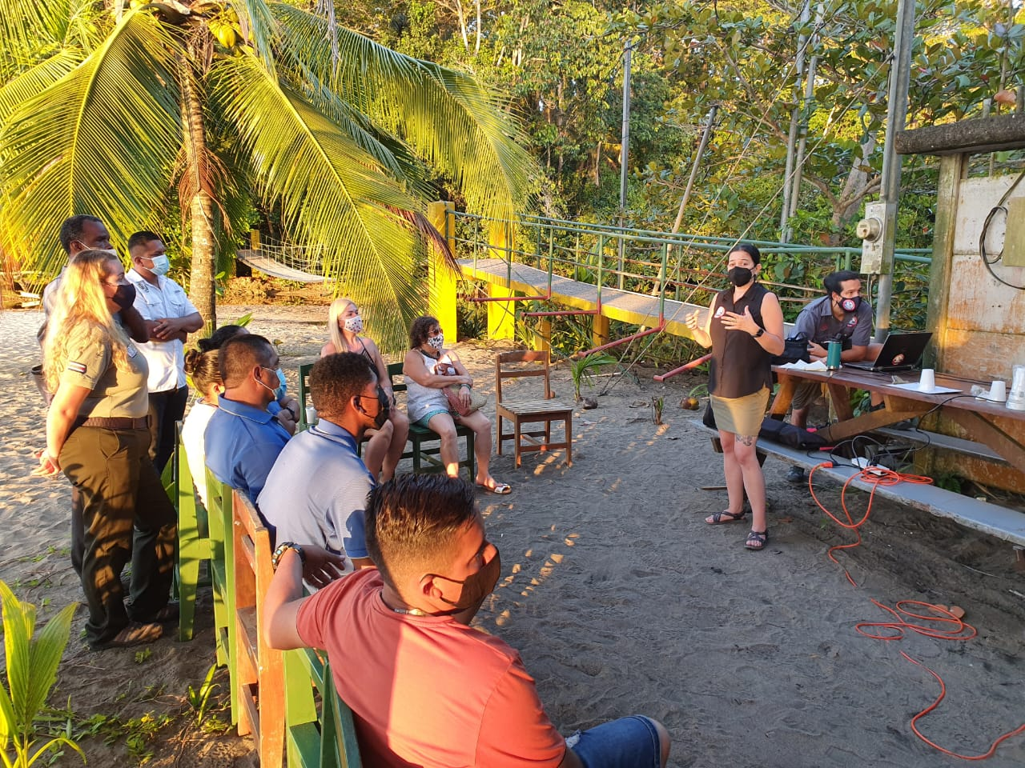
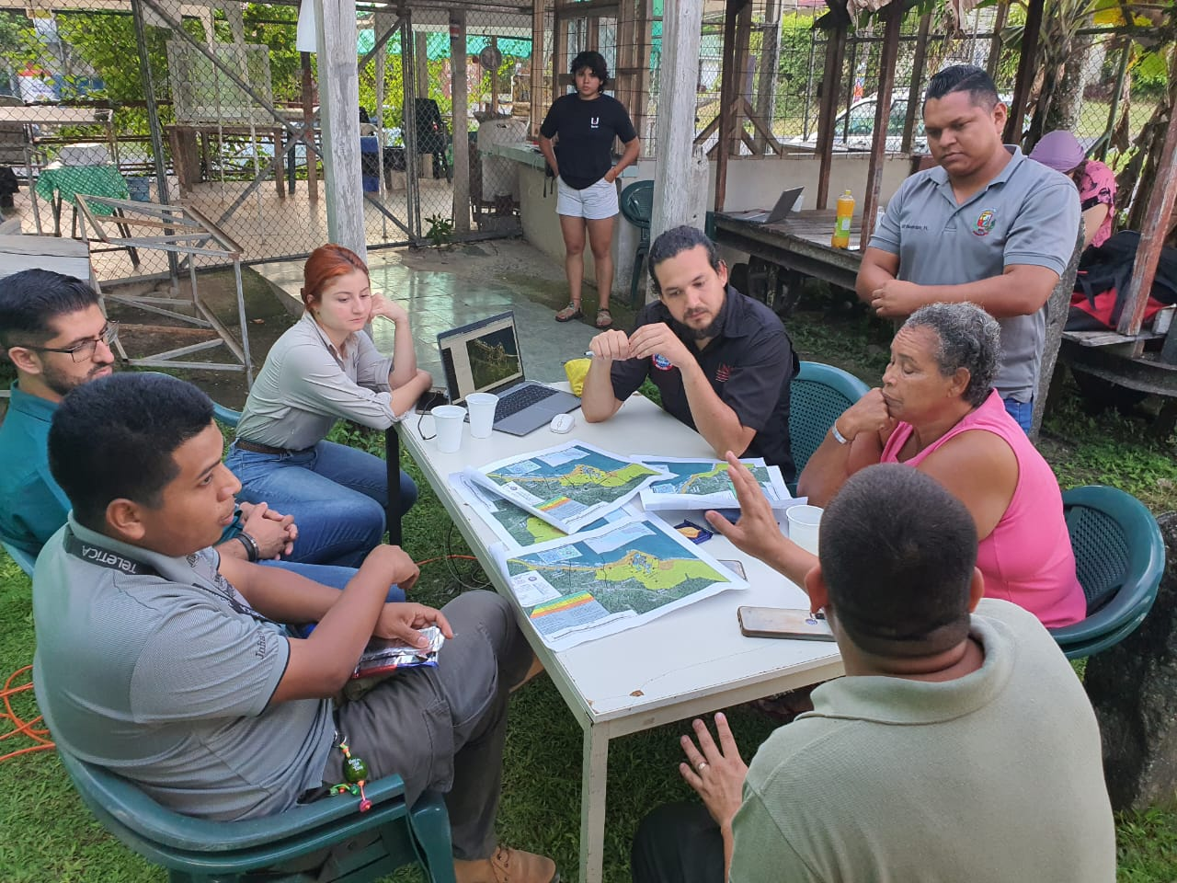
Technical-Scientific input from SINAMOT Aporte Técnico-Científico del SINAMOT

Slide 12
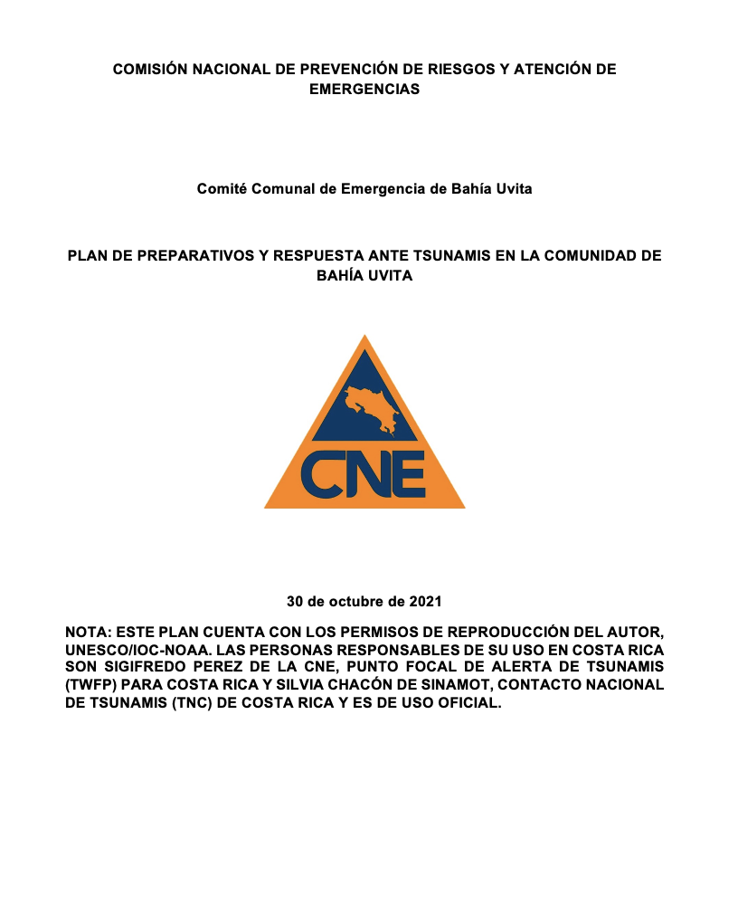
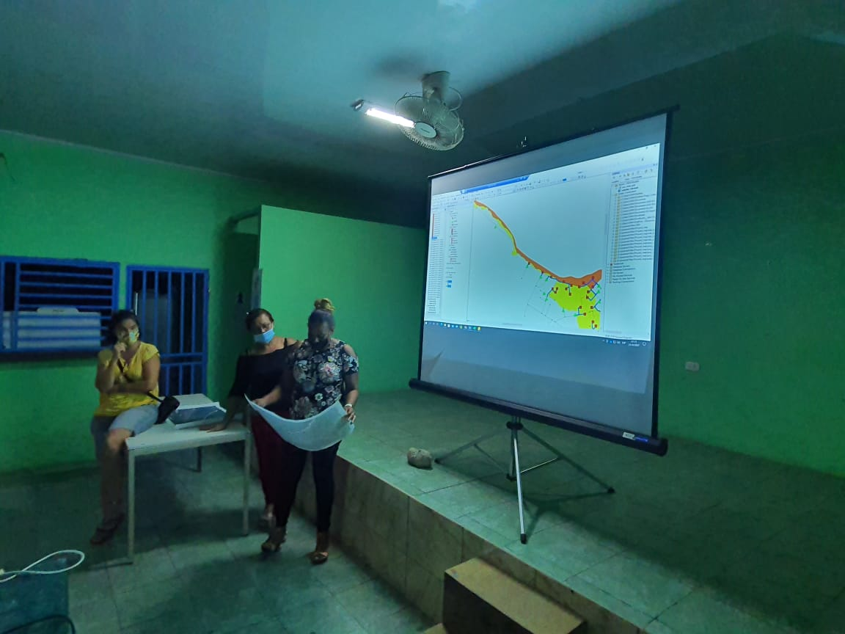
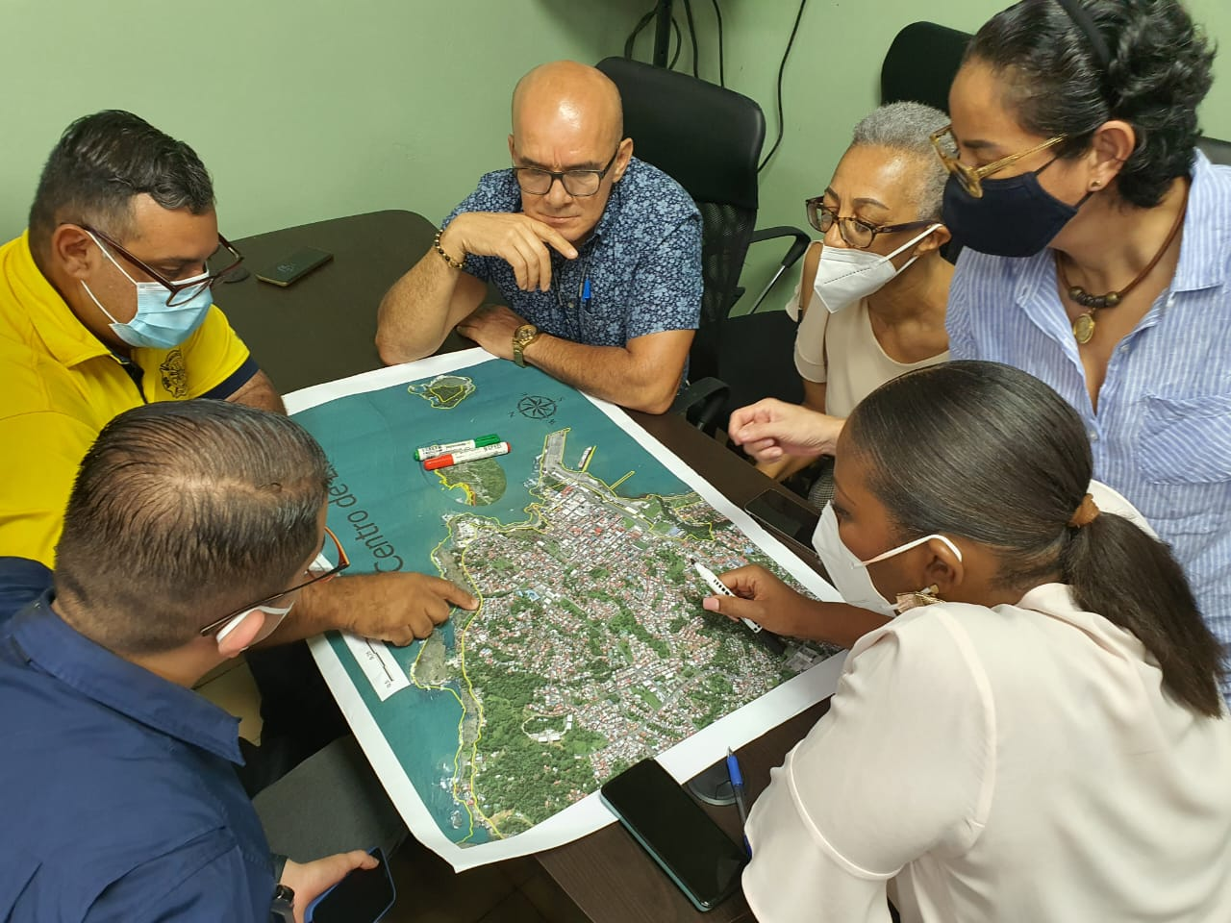
Preparatives and Communal Action Preparativos y la Acción Comunal

Slide 13
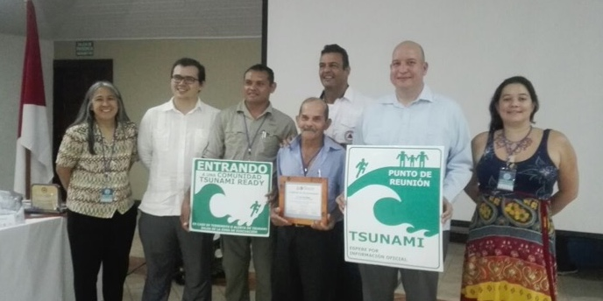
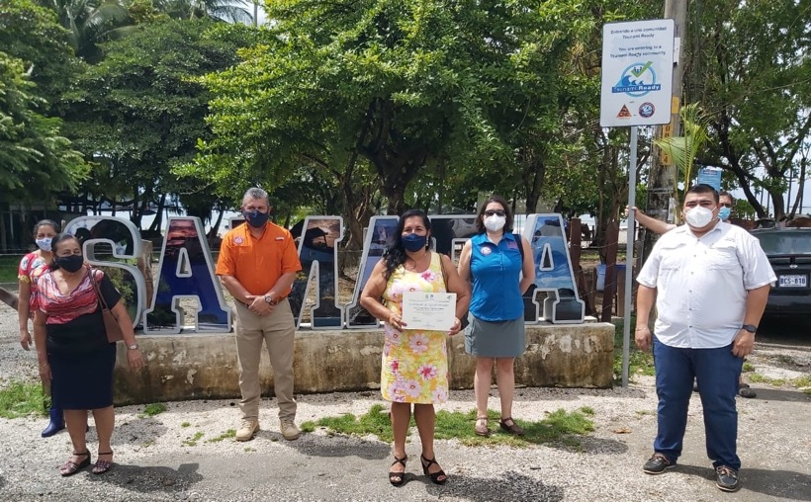
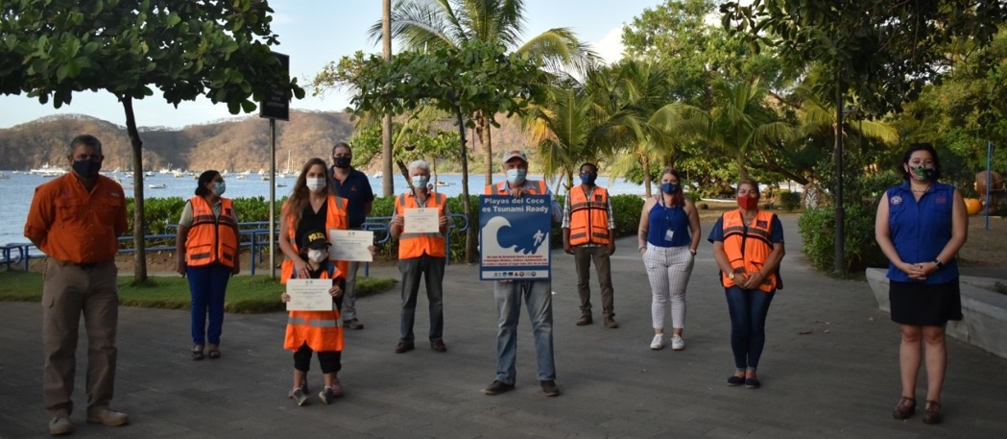
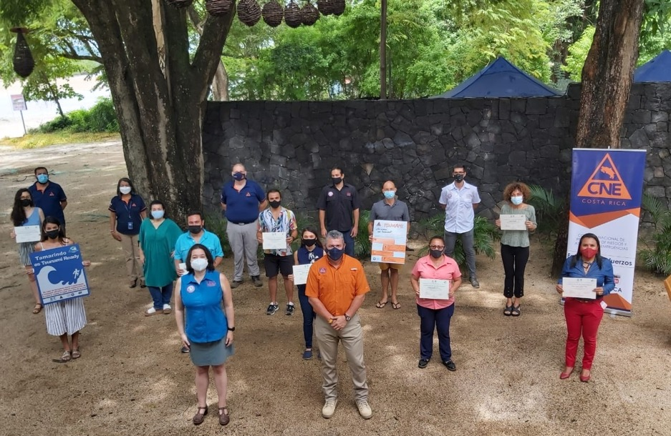
Results
Ostional
Samara
Playa del Coco
Tamarindo

Slide 14
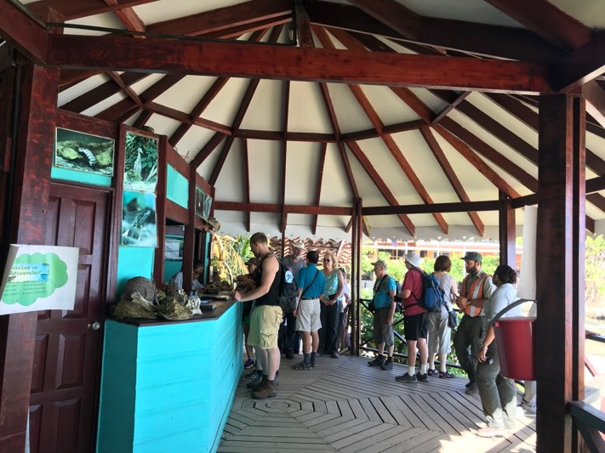
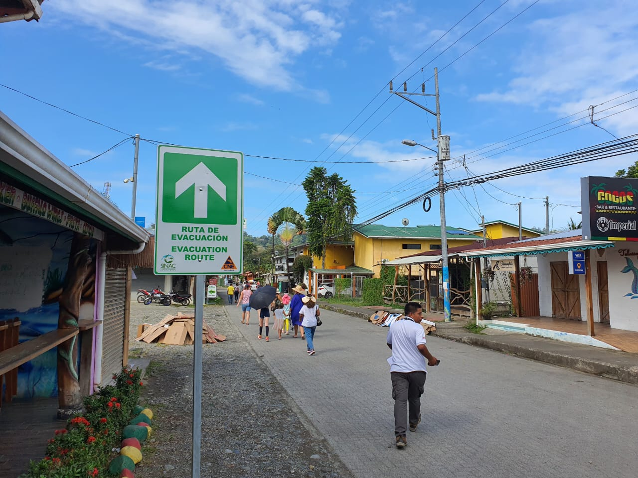
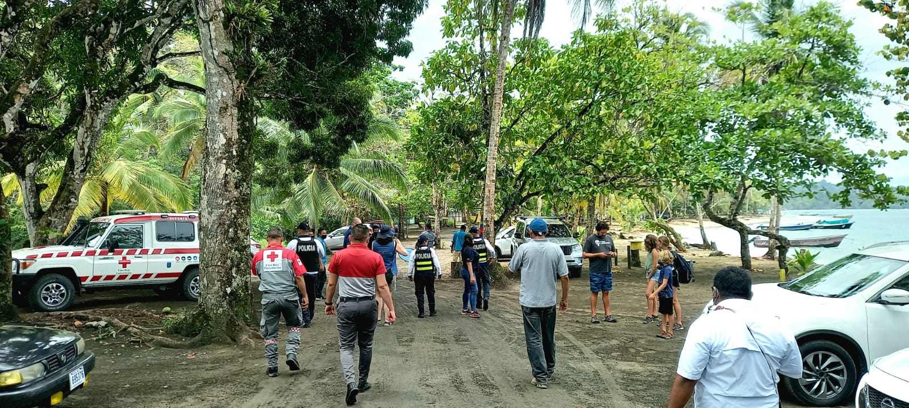
Community Participation in Caribe Wave
2020-2021
2022
2019
2023

Slide 15
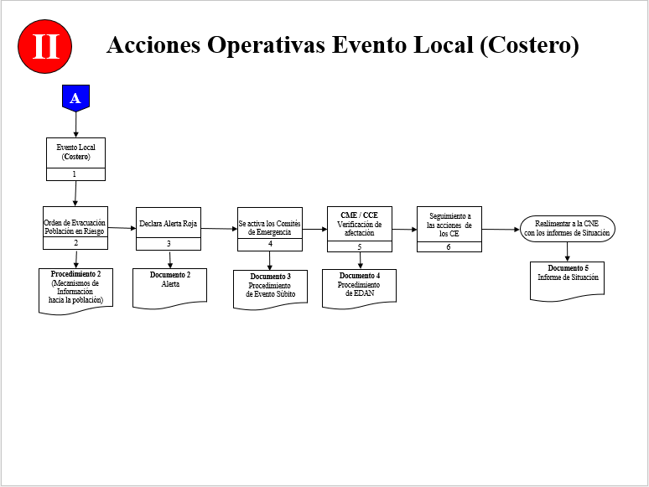
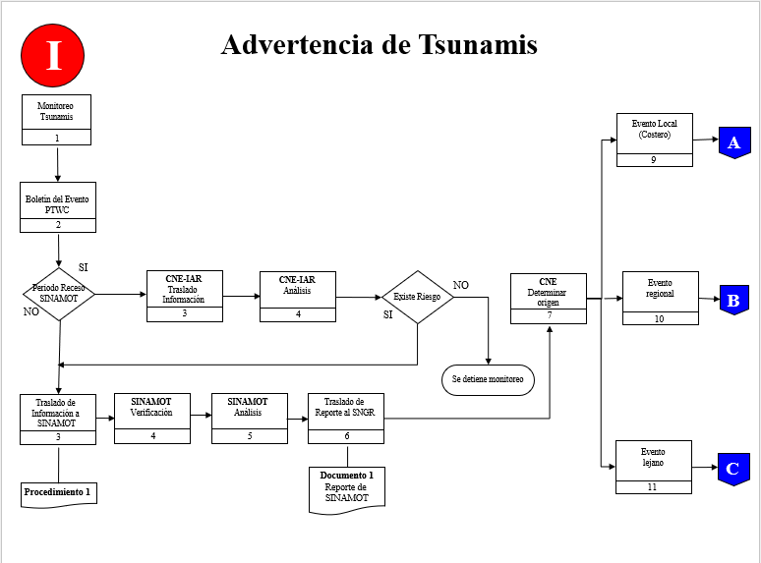
National Procedures for Activation of the National System of Risk Management in the event of Tsunamis
Los Procedimientos Nacionales de Activación del Sistema Nacional de Gestión de Riesgo para Evento de Tsunami

Slide 16
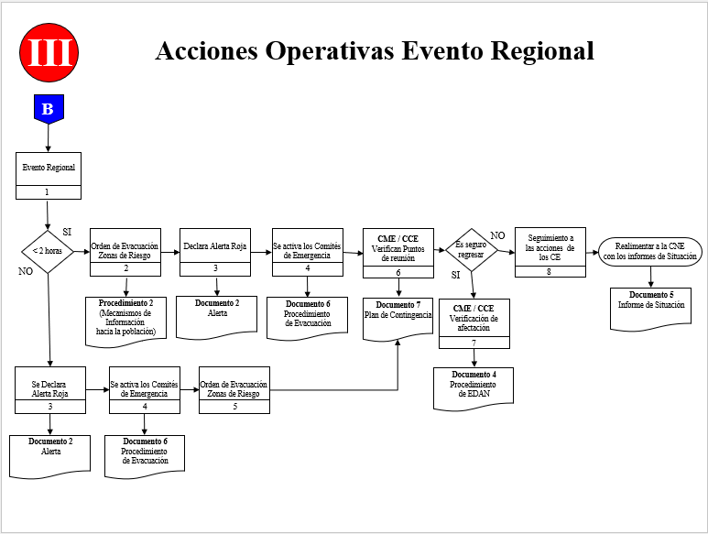
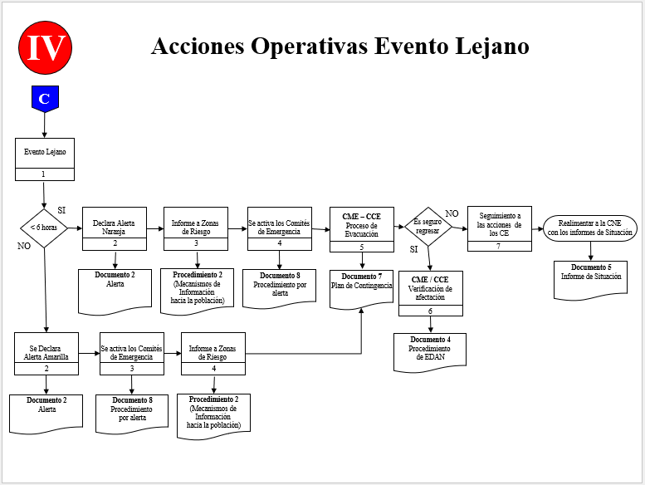
National Procedures for Activation of the National System of Risk Management in the event of Tsunamis
Los Procedimientos Nacionales de Activación del Sistema Nacional de Gestión de Riesgo para Evento de Tsunami

Slide 17
WARNING LEVELS
NIVELES DE ALERTA
GREEN
verde
YELLOW
amarilla
ORANGE
naranja
ROJA
red
Information
Información
Preparation
Preparación
Movilization
Movilización
Response
Respuesta

Slide 18
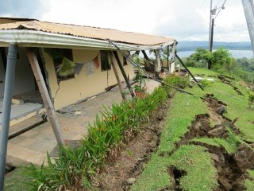
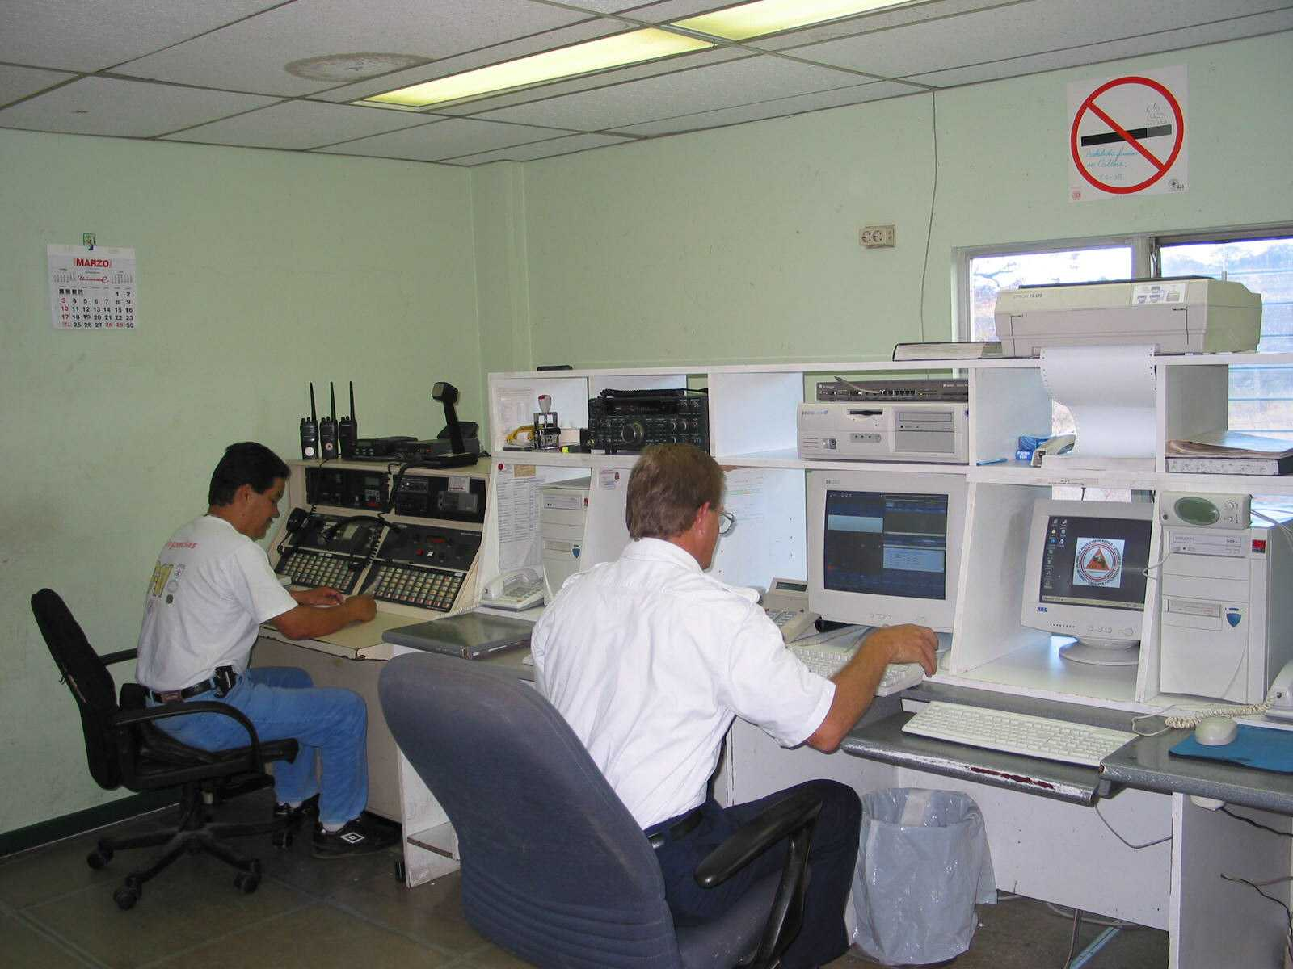
ACTIVATION AND RESPONSE
FASE DE ACTIVACIÓN Y RESPUESTA
SUDEN
SUBITA
BY RECEIVING A WARNING
A TRAVÉS DE UNA ALERTA

Slide 19
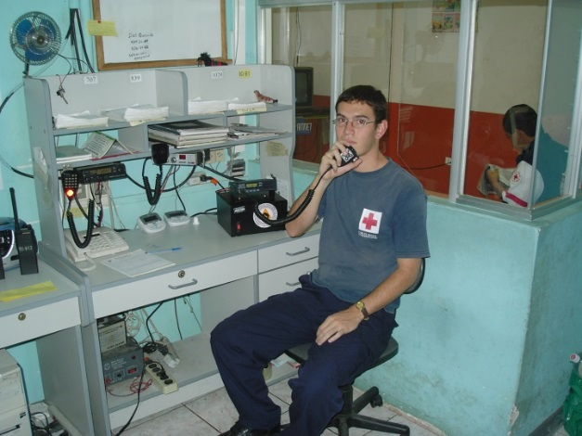
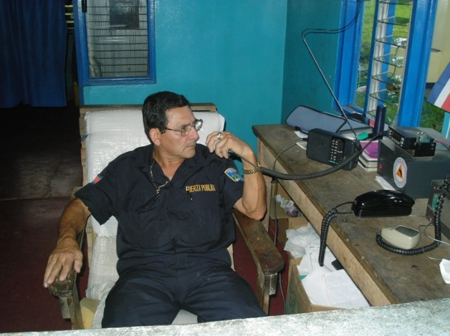
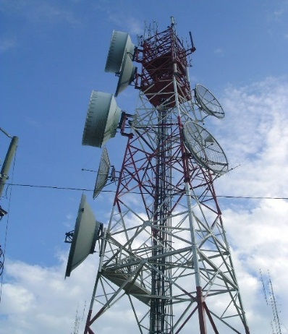
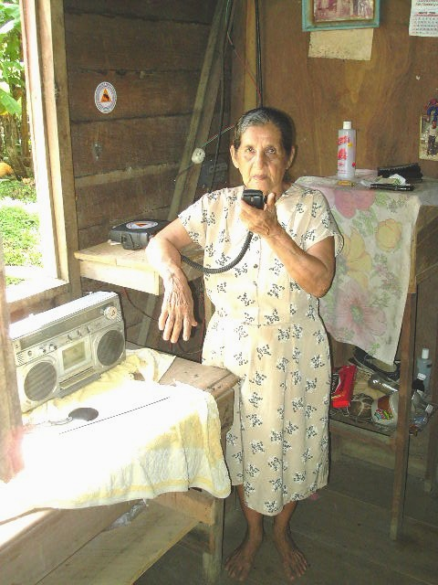
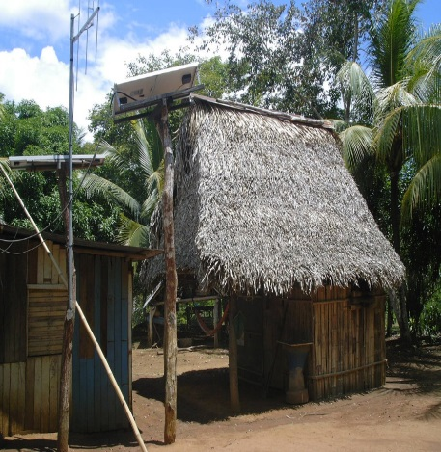
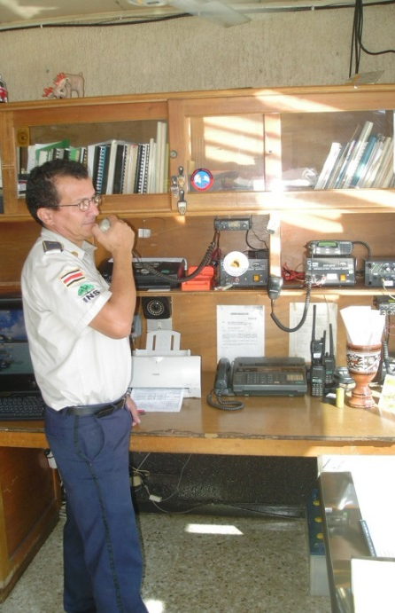
MONITORING AND EVENT FOLLOW-UP
MONITOREO Y SEGUIMIENTO DEL EVENTO

Slide 20
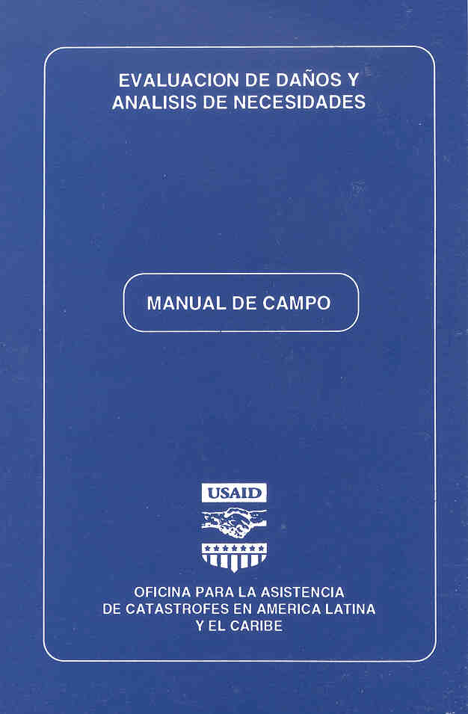
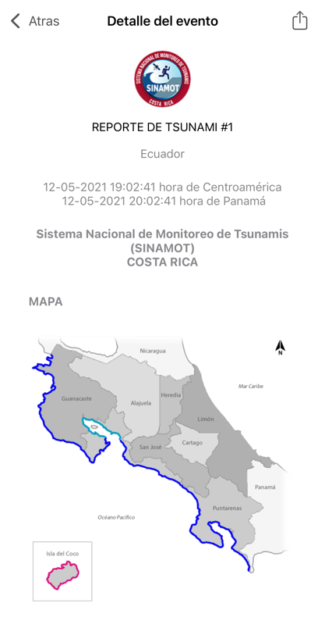
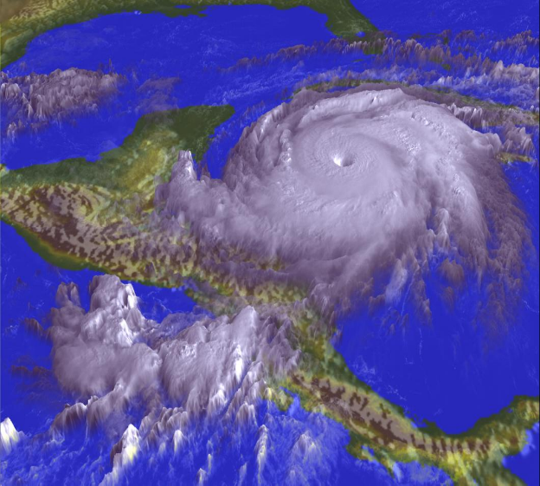
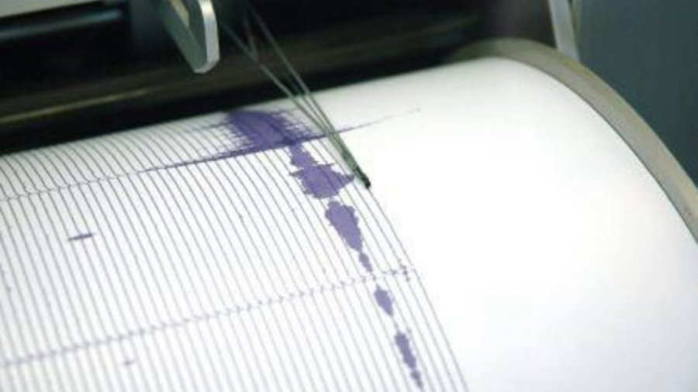
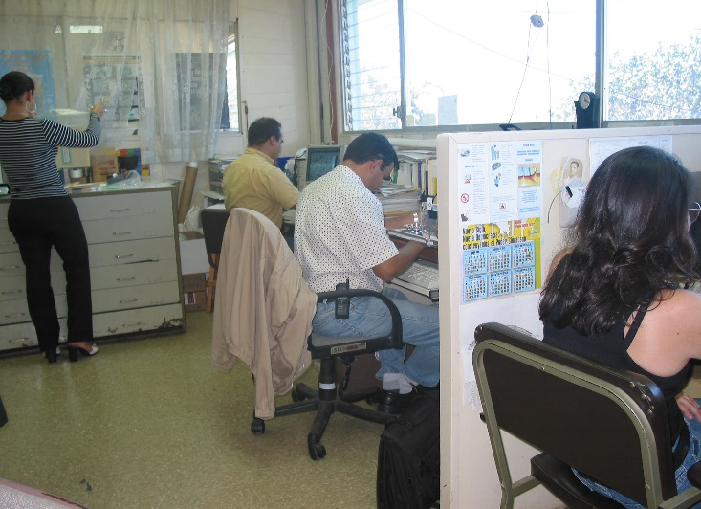
INFORMATION MANAGEMENT
MANEJO DE INFORMACIÓN
E
D
A
N
T
É
C
N
I
C
O
C
I
E
N
T
Í
F
I
C
A
DAMAGE ASSESMENT
SCIENTIFIC
REPORTS
I
N
F
O
R
M
E
S

Slide 21
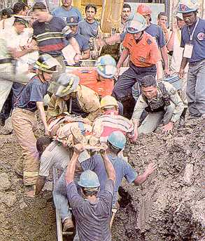
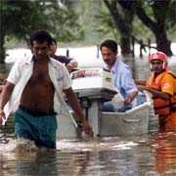
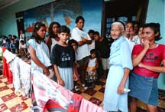
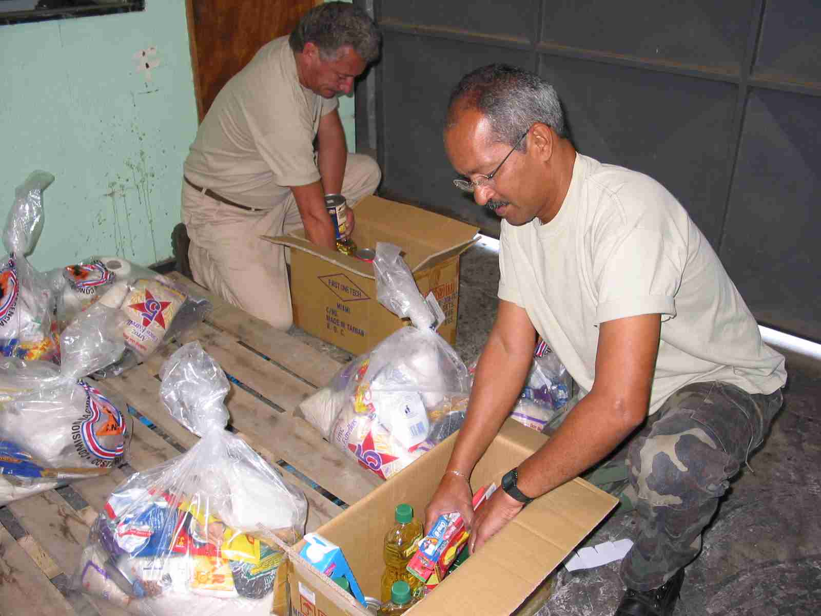
RESPONSE
RESPUESTA
SEARCH AND RESCUE
BUSQUEDA Y RESCATE
MOVILIZATION TO SHELTERS
MOVILIZACIÓN A SITIOS DE ALBERGUE
EVACUATION
EVACUACIÓN
HUMANITARIAN ASSISTANCE
ASISTENCIA HUMANITARIA

Slide 22
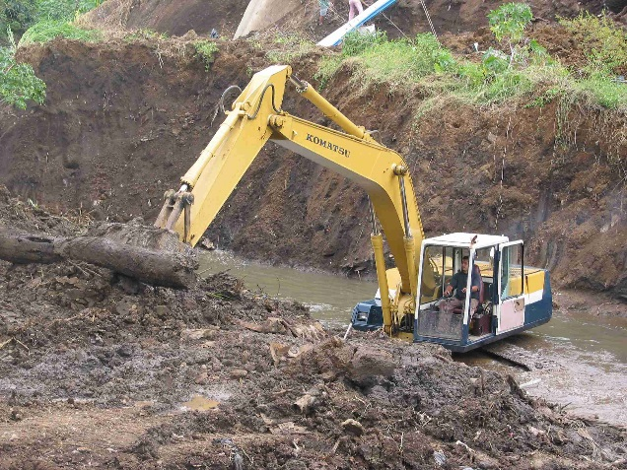
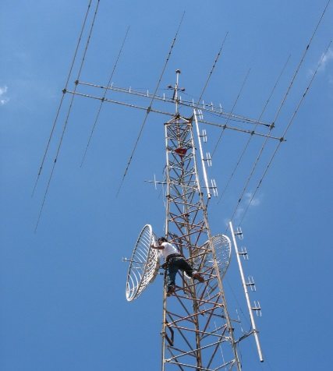
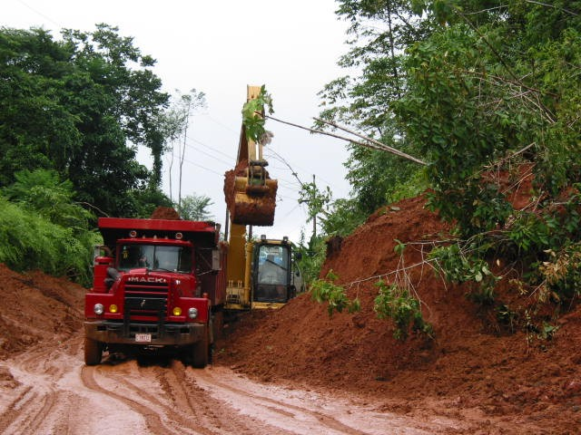
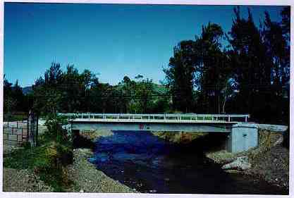
REBUILDING
REHABILITACION
CHANNEL CLEANING
LIMPIEZA DE CAUCES
SERVICES
SERVICIOS
ROADS
CAMINOS
ROAD INFRASTRUCTURE
INFRAESTRUCTURA VIAL

Slide 23
So, we started in 2015 (cont.) with all that support, and
We hired an undergrad Geography student to work in the project
He proposed many improvements
And went beyond the original Project’s scope assisting communities on:
Tsunami preparedness and response plans
Tabletop exercises
Tsunami drills
And in 2018, after graduation, became researcher in the Project, as the UNA President office gave us additional resources for staff.

Slide 24
Characteristics of the communities

Slide 25
All communities are different
Vulnerability conditions vary by community
It is important to diagnose the community before starting to work with them

Slide 26
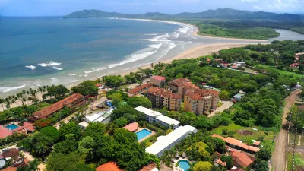
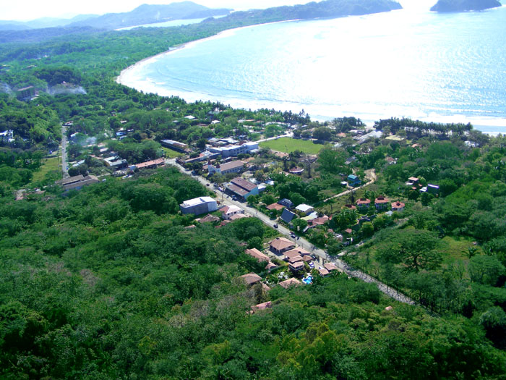
Economics
Motivation to invest in risk management issues.
Economic activities of the population

Slide 27
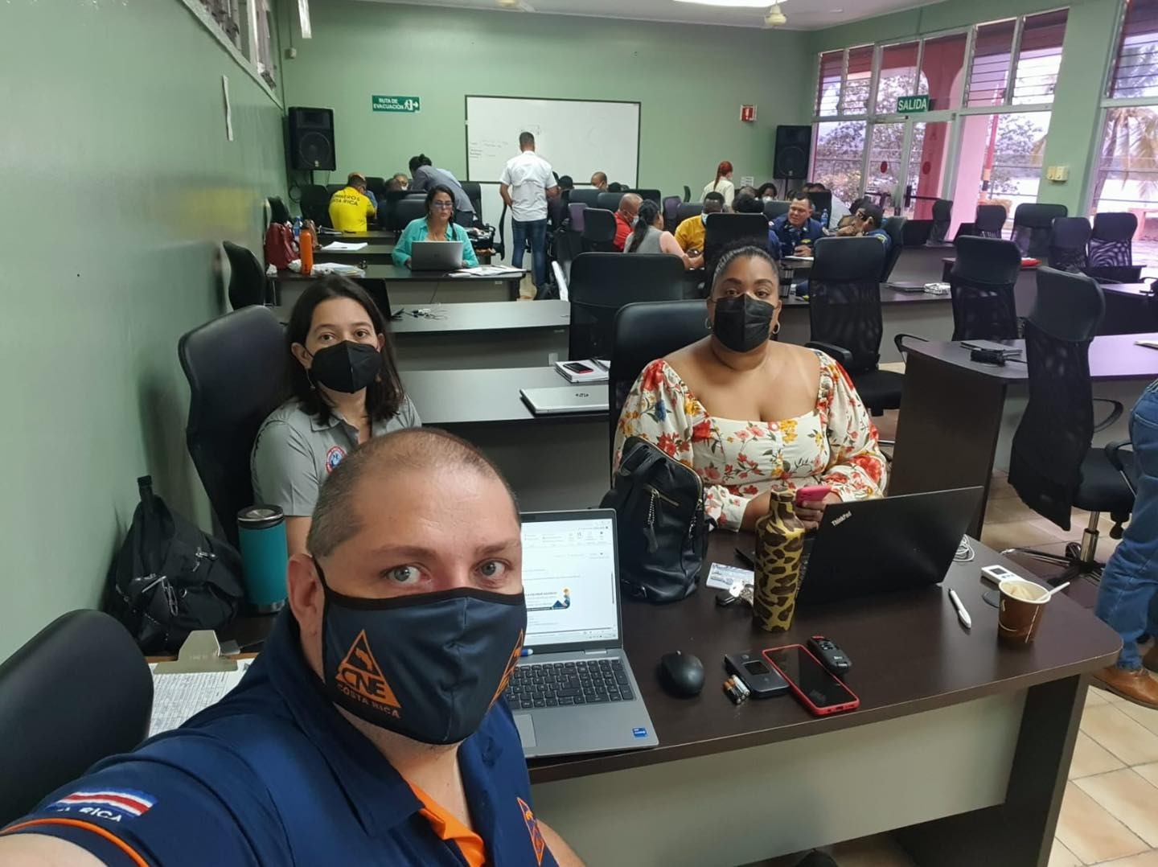
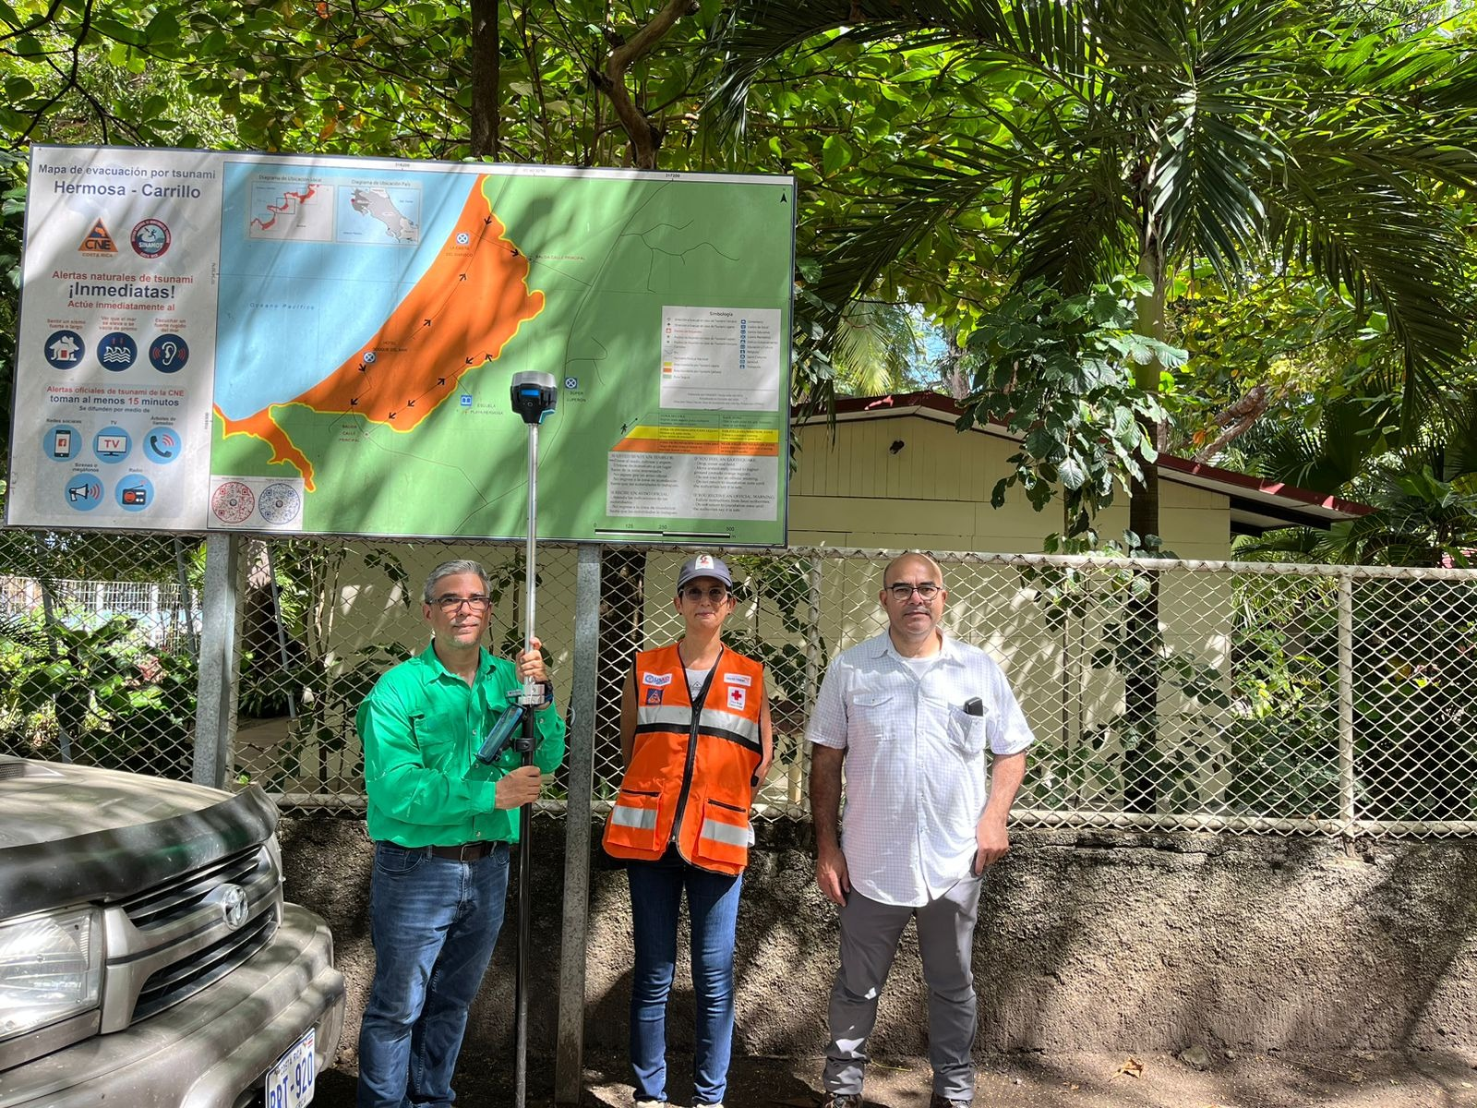
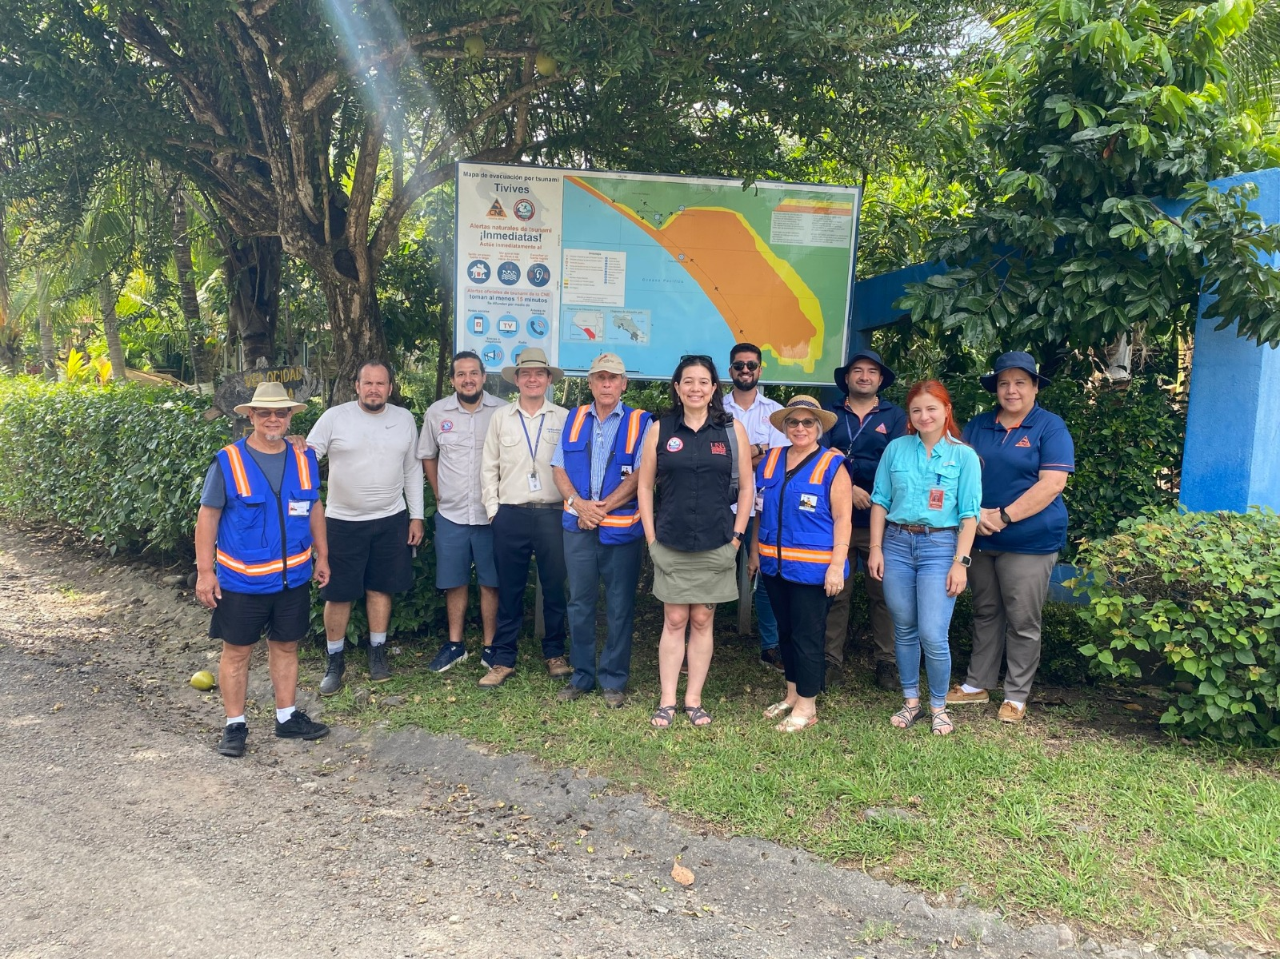
Political interest
There are municipalities that do not have a risk manager.
All municipalities take a different stance: participatory, welfarist, in some cases even indifferent.

Slide 28
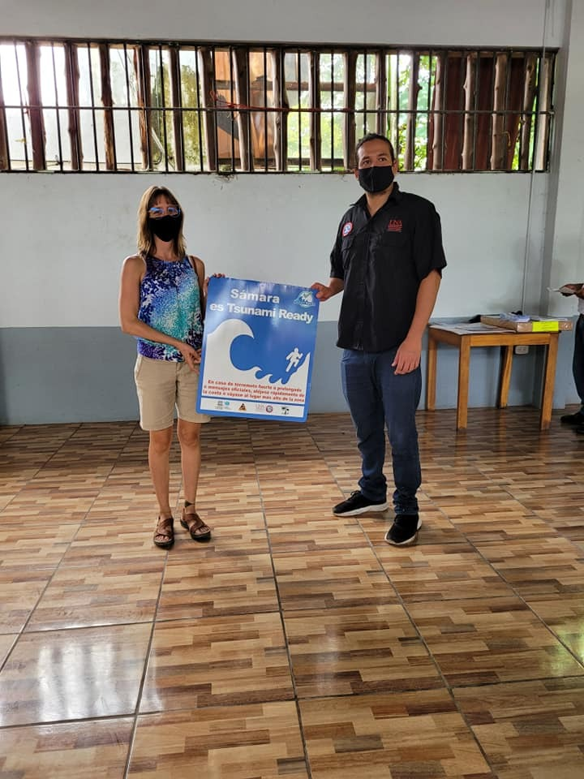
Community involvement

Slide 29
Exhibition

Slide 30
Alert dissemination capacity :
Type of road network.
Arrival time.
Population distribution.

Slide 31
Some hypotheses
It is necessary to carry out a diagnosis and mapping of stakeholders before starting the process.
It is necessary to delimit the tasks of each organization before starting the work.

Slide 32
¡Muchas gracias!
www.sinamot.una.ac.cr
www.cne.go.cr

