Slide 1







Biogeochemistry
Panel
A communication and coordination service for marine biogeochemistry
Kim Currie (co-Chair, NIWA, New Zealand), Véronique Garçon (co-Chair, LEGOS, France)
Maciej Telszewski (Director, IO PAN, Poland), Artur Palacz (Officer, IO PAN, Poland)
Institute of Oceanology of Polish Academy of Sciences, ul. Powstańców Warszawy 55, 81-712 Sopot, Poland
Phone: +48 58 731 16 10 / Fax: +48 58 551 21 30, www.ioccp.org
Biogeochemistry
Panel

Slide 2
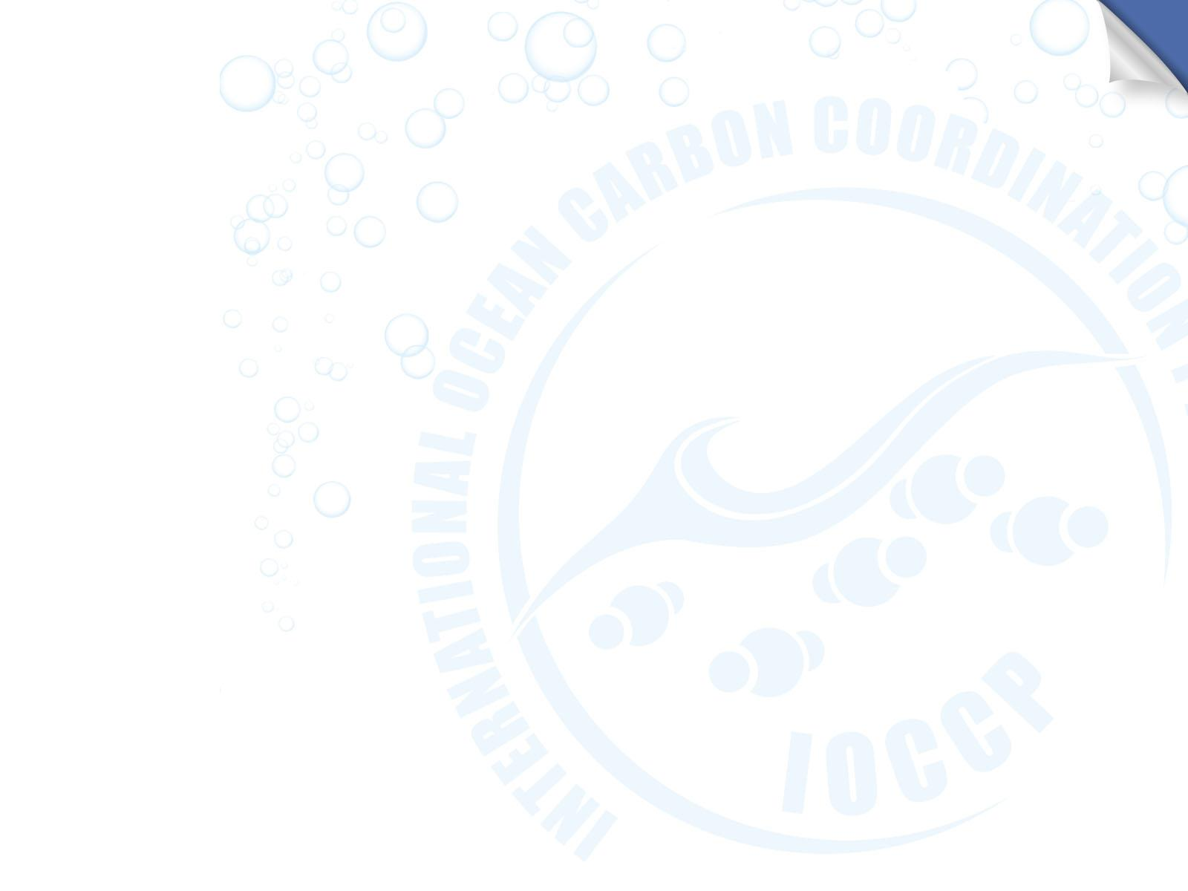
Operationalizing the value chain of Surface Ocean Carbon Observations
We have all the components of the value chain and when they occasionally work together, they have a demonstrated ability to estimate surface ocean CO₂ uptake to very high precision in near real time.
Much of the system is supported by short term research funding rather than longer term operational funding (similar to Met obs.), which is rather counterproductive at the time of the climate emergency when we most need to know ocean carbon uptake in near-real time for a wide variety of purposes.
Significant data gaps are appearing and key parts of the chain operate on a best endeavours basis – we are sliding back down the curve, just when we need to be climbing it.
We are in a process of describing a fully operational Ocean Carbon Observing System capable of operationally delivering ocean carbon flux information. Strategy will include a tailored investment in suport of this operation.
Near real time delivery of global ocean carbon flux estimate to UNFCCC through interconnected resilient
components
individual components coupled but system lacks coverage and resilience
Effectiveness
science driven fragmented system
PAST
PRESENT
FUTURE
Cost
Effectiveness of operational value chain
fit-for-purpose design
speed of delivery
operational links between components
system resilience

Slide 3
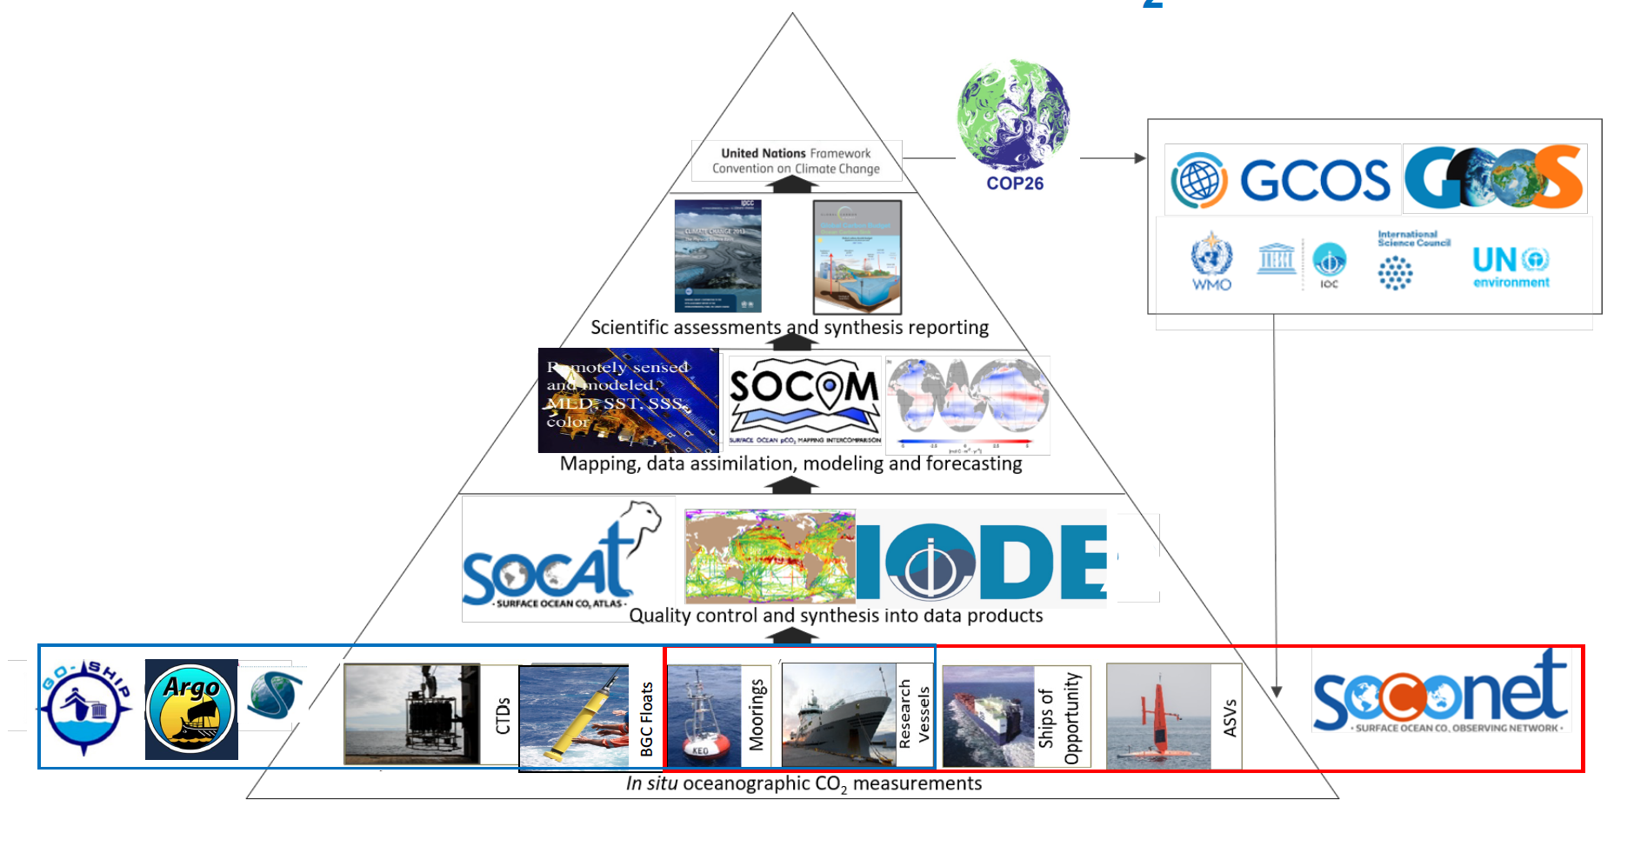


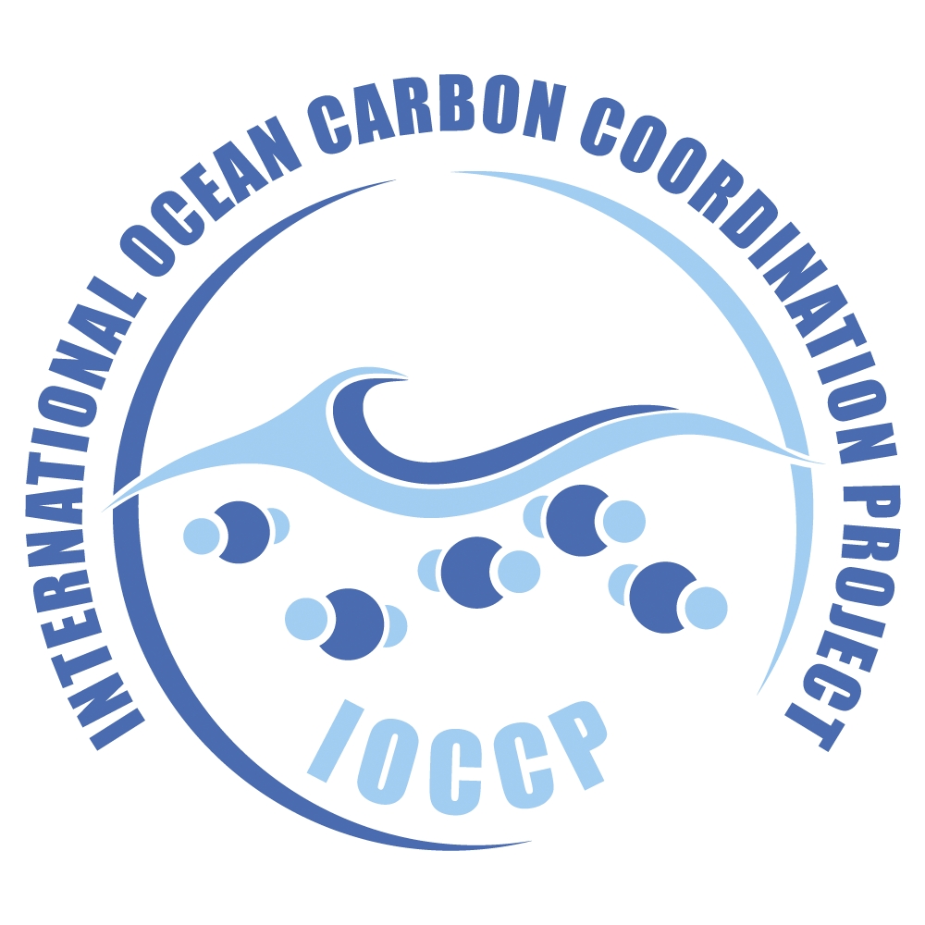
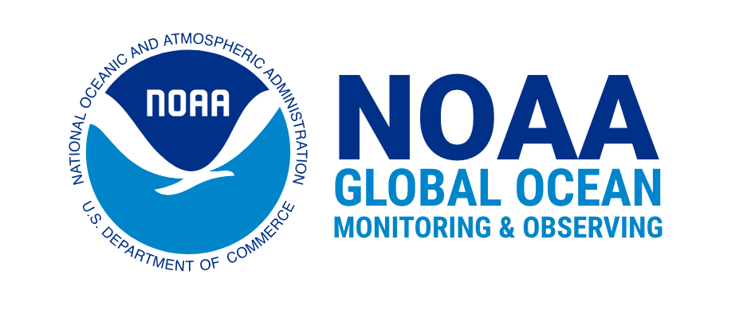


Requirement to rapidly and operationally link ocean data through to policy makers and minimize mitigation/adaptation costs
The Value Chain of Surface Ocean fCO2 Measurements
Drivers
Past variability of ocean carbon flux is known to be large
Future behaviour is uncertain, once we reach Net Zero ocean has potential to become a source of CO₂ back to the atmosphere
Big implications for size, cost and timing of mitigation and adaptation measures
Urgent decisions on climate mitigation, marine carbon dioxide removal, ocean health and emission reduction require a trustworthy, observation based air-sea CO₂ flux product
Tools
Measure ocean carbon across planet
Quality control data and assimilate into data products
Blend with satellite and float data to map, model and forecast current and future sink
Report to policy makers in support of societal response

Slide 4
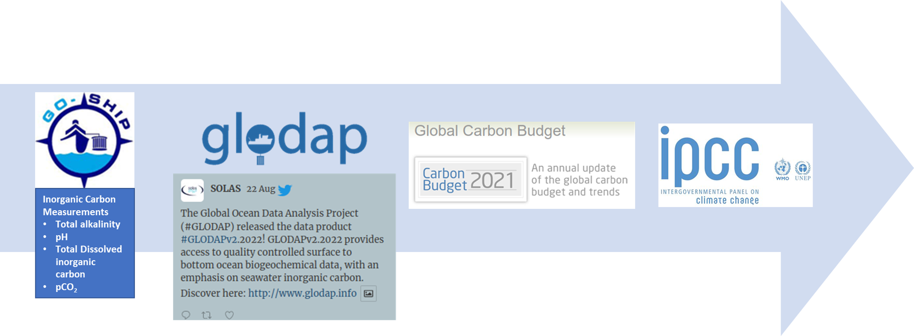
Seawater carbonate system RMs critical for ocean carbon science and policy
Using RMs enables ocean carbon measurements with known quality.
These measurements allow assessing changes in the ocean carbon cycle, quantifying ocean acidification and informing the IPCC and global environmental policies.
Notes:
As most of you know, the availability and consistent use of reference materials over the past three decades have enabled comparable measurements of seawater total alkalinity and, total dissolved inorganic carbon with known quality. These measurements underpin our ability to assess changes in the ocean carbon cycle and quantify trends in ocean acidification, and are ultimately populated into data products that inform the Intergovernmental Panel on Climate Change, which helps to shape global environmental policies. Therefore it is crucial that we continue to produce seawater carbonate system measurements of the best quality.

Slide 5
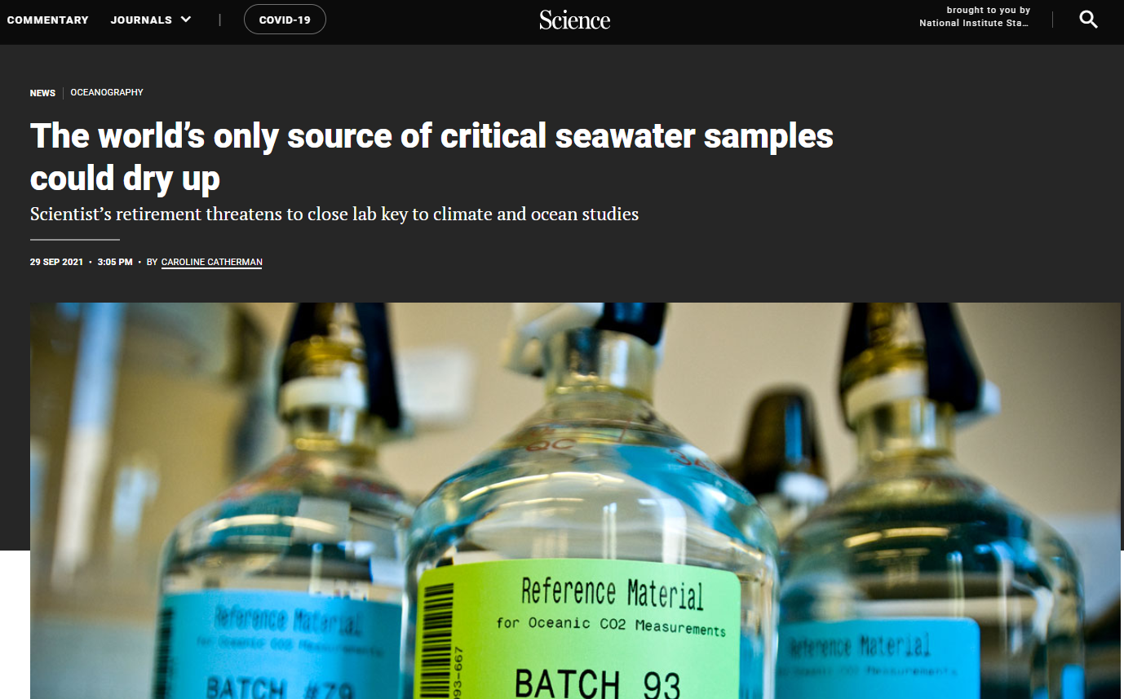

Global access to RMs is vulnerable
A single production and supply centre at Scripps Institution of Oceanography (USA) provides RM’s and other reagents needed for seawater carbonate system measurements:
Total alkalinity (TA)
Total dissolved inorganic carbon (DIC)
Tris buffer for pH
Standardized HCl (for TA titrations)
https://www.science.org/content/article/world-s-only-source-critical-seawater-samples-could-dry
Notes:
However, the supply of seawater carbonate system reference materials relies on one single laboratory managed by Dr Andrew Dickson at Scripps Institution of Oceanography.
The covid pandemic highlighted the failings of the current system, as stated in the Science News article published in September of 2021.

Slide 6
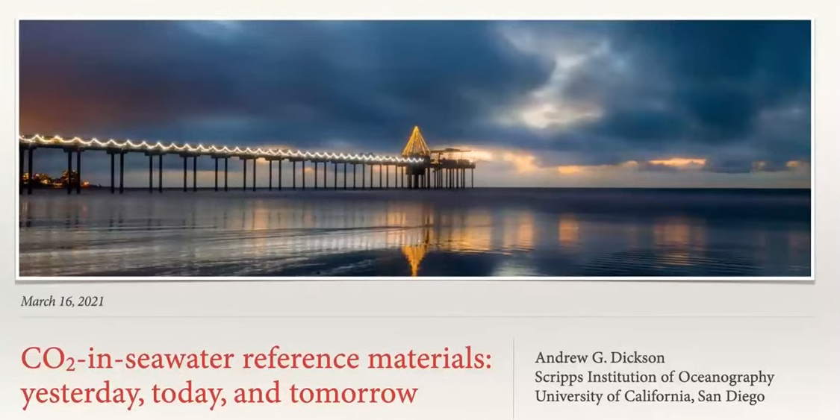
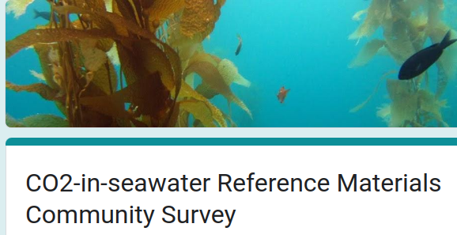
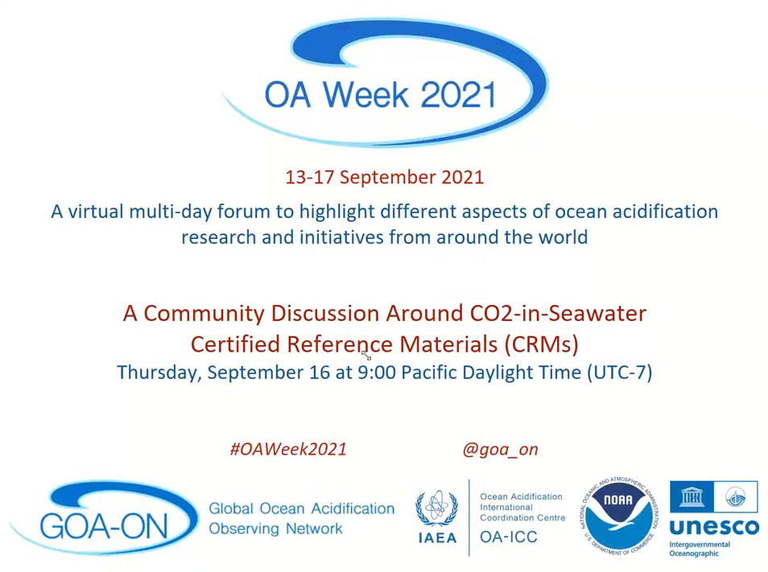
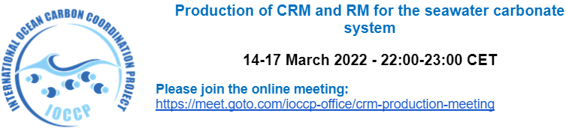
Bringing the international community together
Over the past three years, targeted events with stakeholders took place to plan for a more resilient distribution and production scheme of seawater RMs:
Scripps Institution of Oceanography, Andrew Dickson
U.S. Interagency Working Group on Ocean Acidification
International Ocean Carbon Coordination Project (IOCCP)
Global Ocean Acidification Observing Network (GOA-ON)
Integrated Carbon Observation System - Ocean Thematic Centre (ICOS-OTC)
International Atomic Energy Agency (IAEA)
The IOCCP workshop broaden the discussion of a global RM production network.
Notes:
Several targeted events and meetings have focused on this issue, involving different stakeholders.
In the spring of 2022, as one of the members of the scientific steering committee of the IOCCP, I organized a workshop on behalf of IOCCP to bring together the international community of stakeholders and broaden the discussion of creating a more robust system to distribute seawater carbonate reference materials. The group began planning to create a global production network for seawater reference materials for the carbonate system and to write a position paper to push for the need for a new scheme for their production.

Slide 7
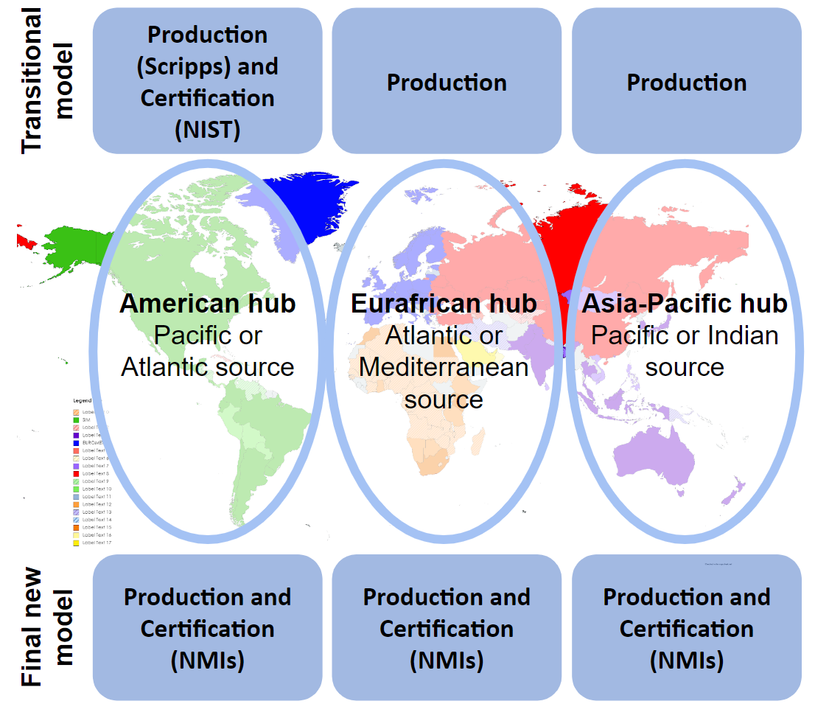
Possible structure of a global RM system
Notes:
A potential structure of this global network of production and certification of seawater carbonate reference materials would involve the establishment of spaces capable of bottling and distributing seawater in geographically strategic locations with one hub remaining in the United States, and the creation of at least two additional hubs, one in Europe, and one in the Asia-Pacific region. In this model, regional hubs could send their samples to a highly qualified lab such as the Dickson lab or to a National metrology institute where they will perform the certification. The hubs would be responsible for conducting an initial characterization of the material and likely to continue performing stability testing. In order to ensure the quality of the hubs’ analytical capabilities, cross validation interlaboratory studies or quality assurance programs will need to be established.

Slide 8
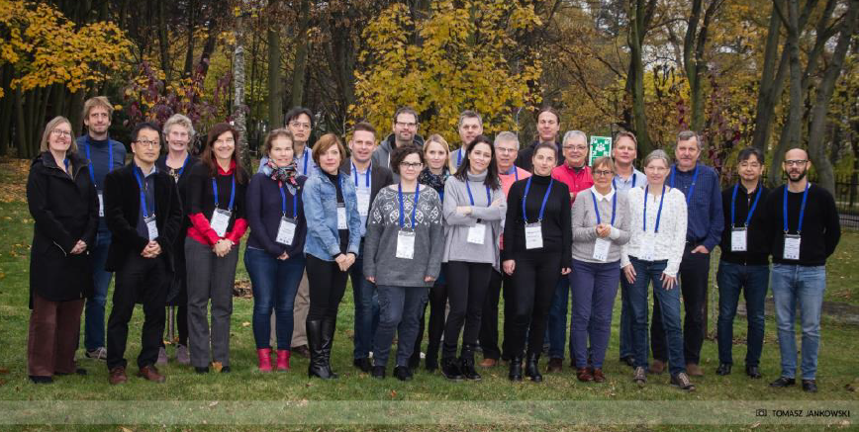
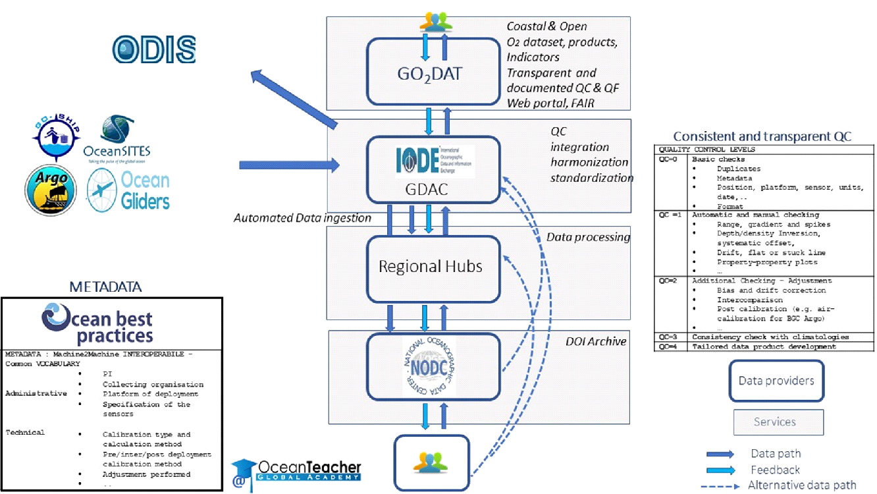
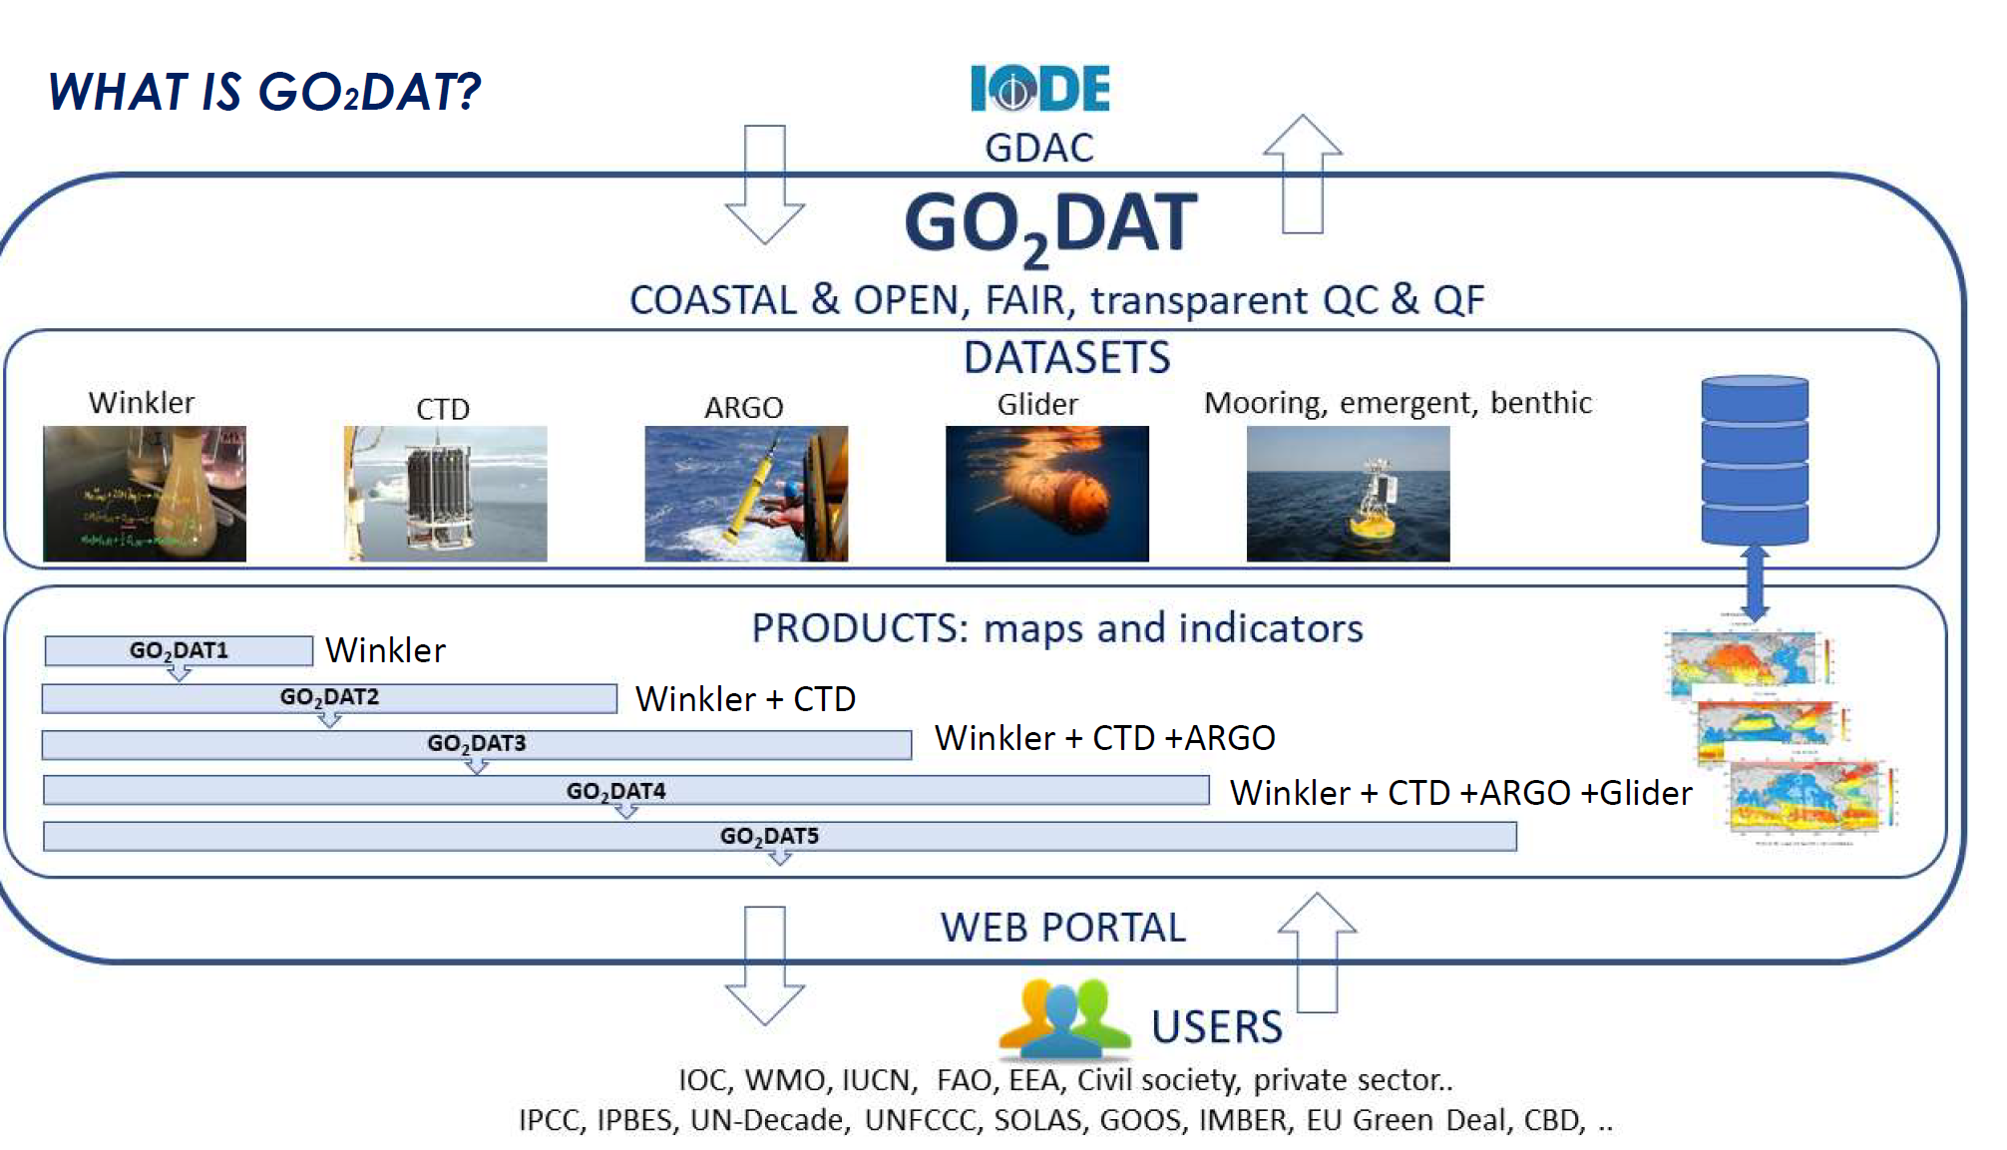
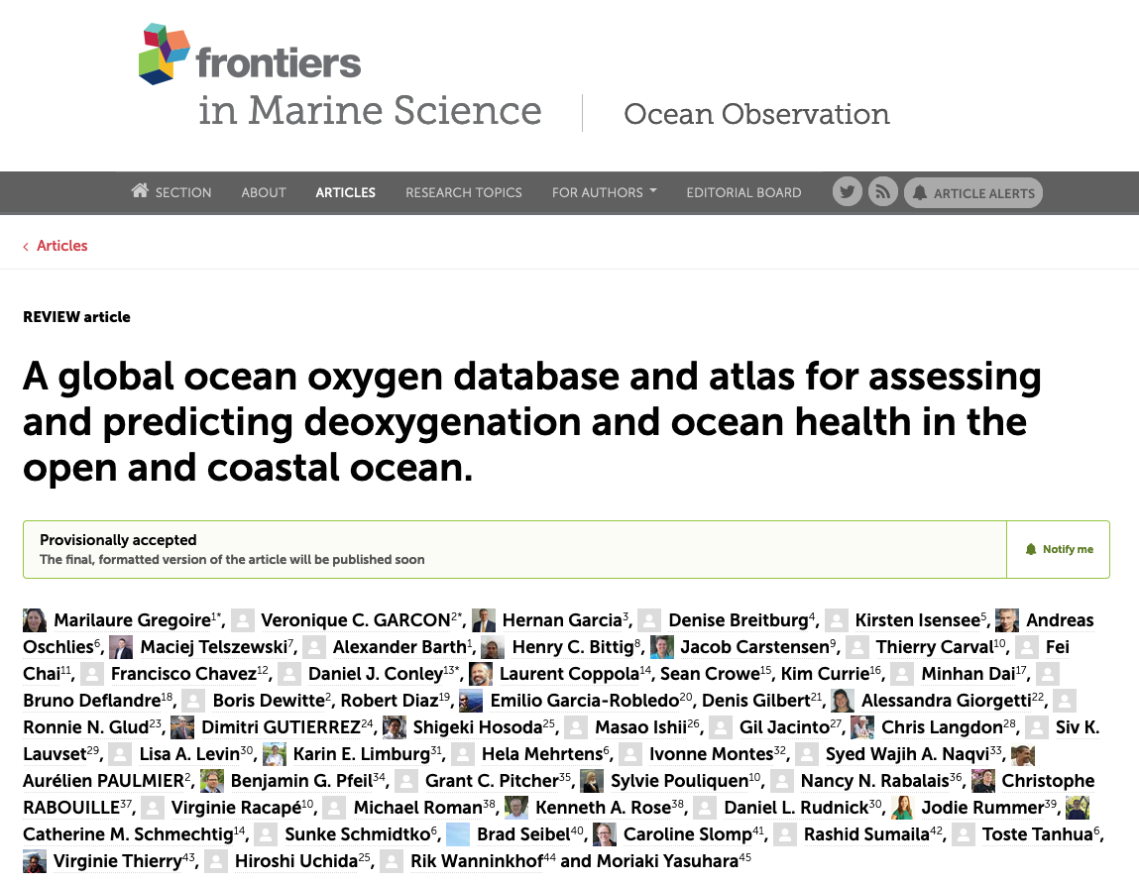
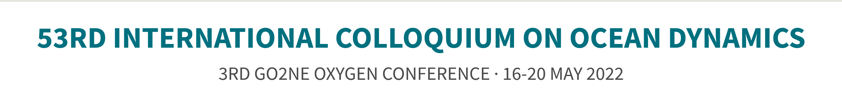
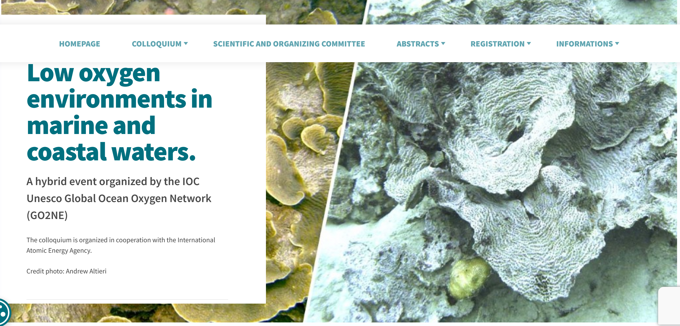
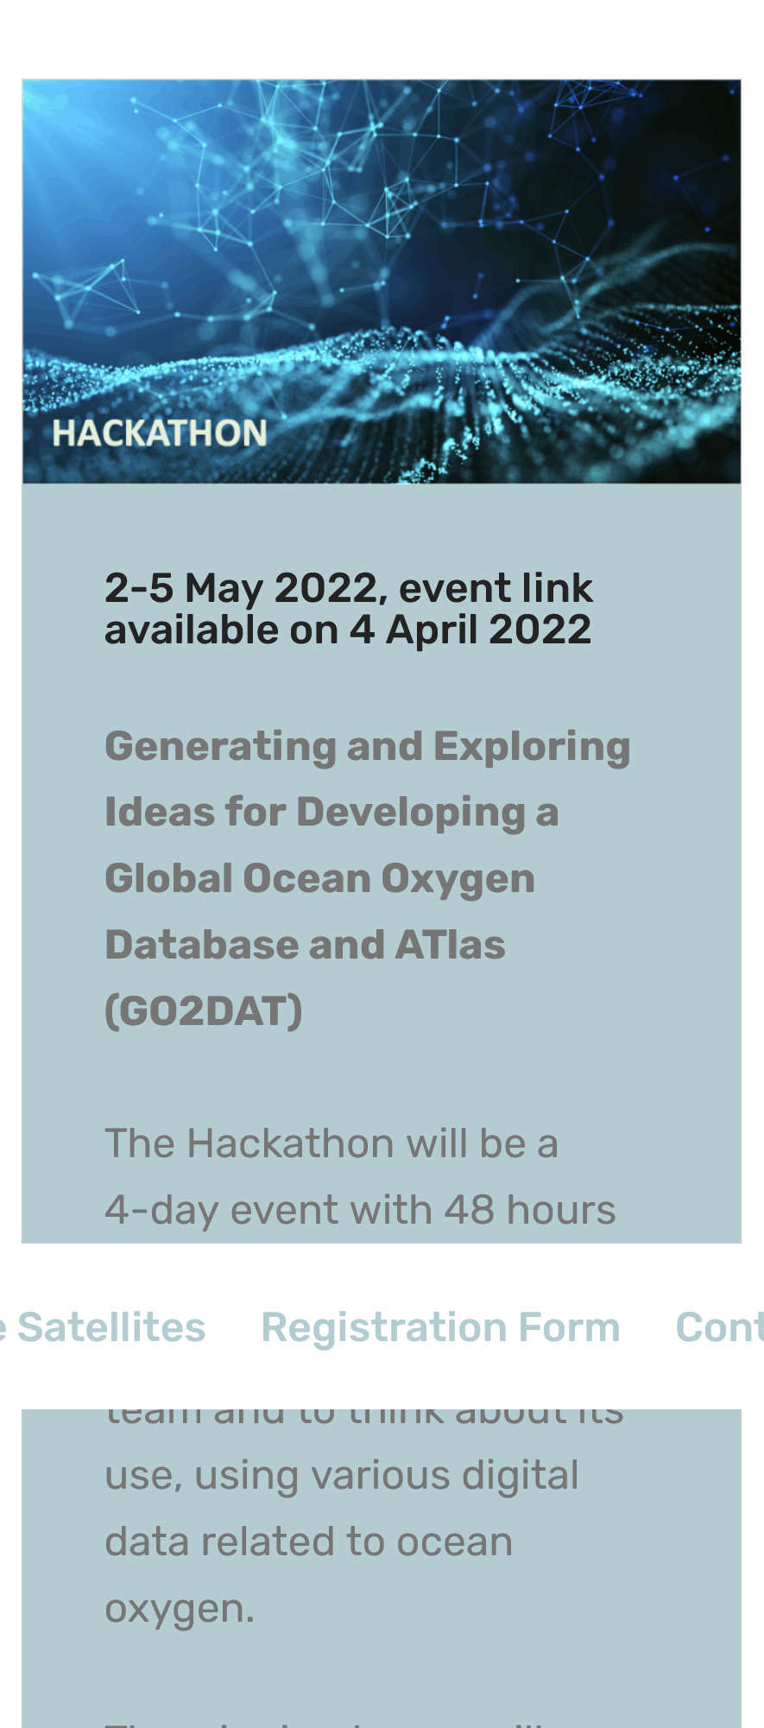

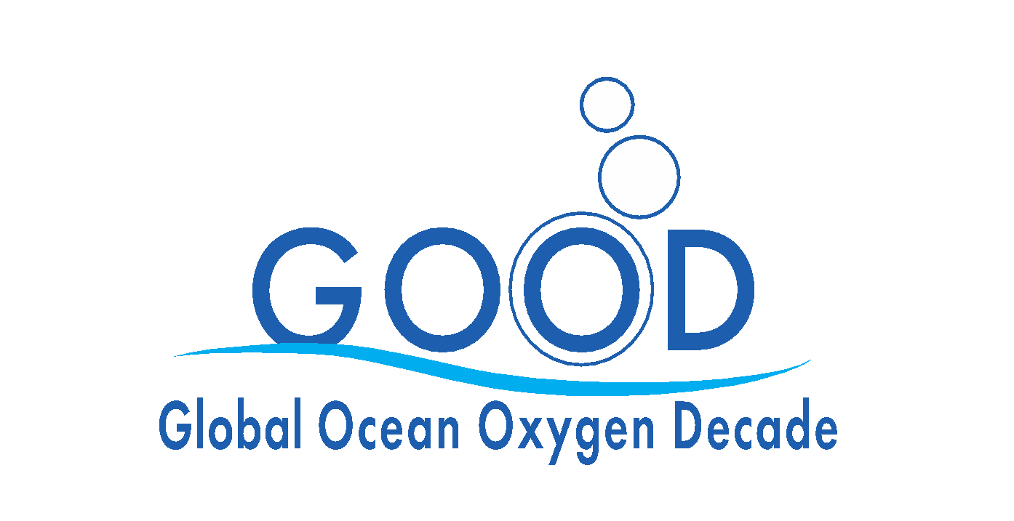

Oxygen Data Portal / Synthesis Product
Liège Belgium
May 2022
May 2022
Notes:
Joint effort by IOCCP, GO₂NE, IOC-UNESCO, NOAA NCEI, WOC, IODE
Aim to include all oxygen data from all relevant eulerian and lagrangian platforms
IOCCP engaged in building the framework in terms of aims, end users, structure, funding sources, community coordination, etc.

Slide 9

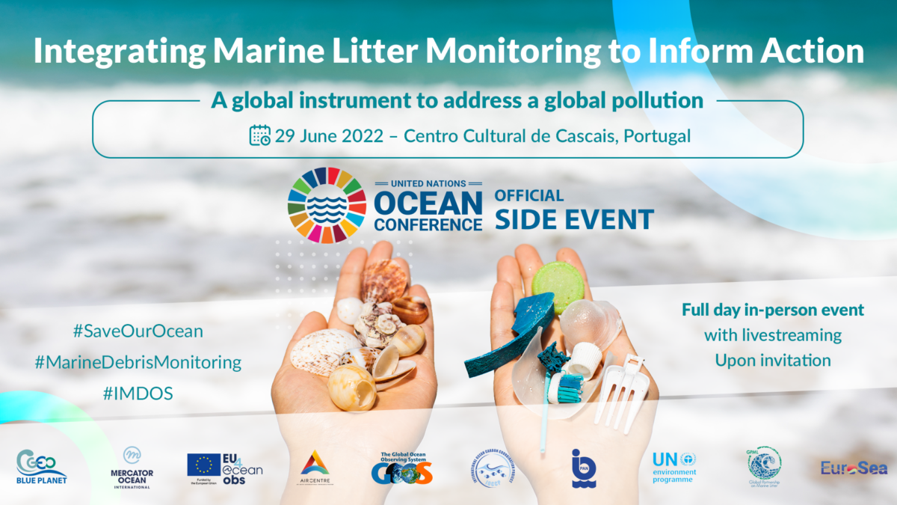
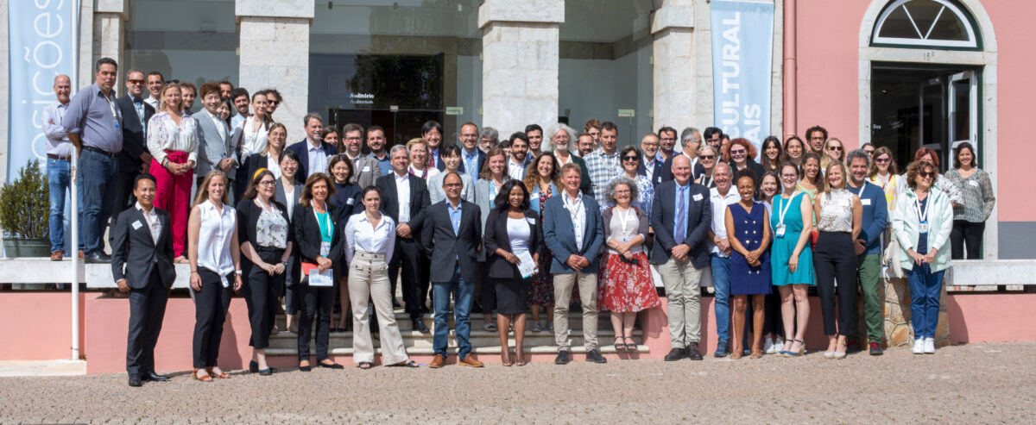
Integrated Marine Debris Observing System (IMDOS)
at the UN Ocean Conference Side-Event
IMDOS as a joint project of the GOOS, GEO Blue Planet & UNEP Global Partnership on Marine Litter (GPML) among other partner organizations
Presentation of IMDOS Terms of Reference and interim Steering Committee with leading role of SCOR WG FLOTSAM members (Aliani, Maximenko, Lavender Law + Hanke, Corradi)
Coordination support provided by IOCCP & Mercator Ocean International
Identification of actions in support of the UNEP GPML Digital Platform
Stimulating discussions among 86 people from 23 countries across the globe
More about the meeting at: https://www.eu4oceanobs.eu/marine-litter-monitoring-to-inform-action/
Notes:
IOCCP has been working hard to support the marine debris community in their quest to establish an Integrated Marine Debris Observing System (IMDOS) as envisioned in an OceanObs’19 Community White Paper by Maximenko et al.
A significant milestone towards implementing the community vision came earlier this year when IOCCP together with Mercator Ocean International and in partnership with UNEP Global Partnership on Marine Litter (GPML) organized a very successful 1-day event during the UN Ocean Conference in Lisbon. 86 members of academic and non-academic organizations from 23 countries across the globe came for a whole day to learn about IMDOS and engage in a large collaborative network that would promote its development at this still very early stage.
During the meeting, also attended by SCOR Executive Director, we presented the initial IMDOS Terms of Reference and the interim international Steering Committee which is led by several members of SCOR WG FLOTSAM: Stefano Aliani, Nikolai Maximenko, Kara Lavender Law and two WG observers Georg Hanke and Paolo Corradi.
While coordination support is currently partially supported by GOOS, through IOCCP Project Officer, and GEO Blue PLanet, we are in the process of hiring a dedicated coordinator to strengthen global coordination of IMDOS in the near future.

Slide 10
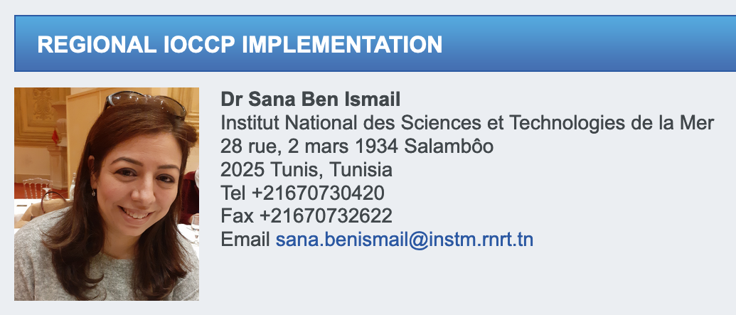
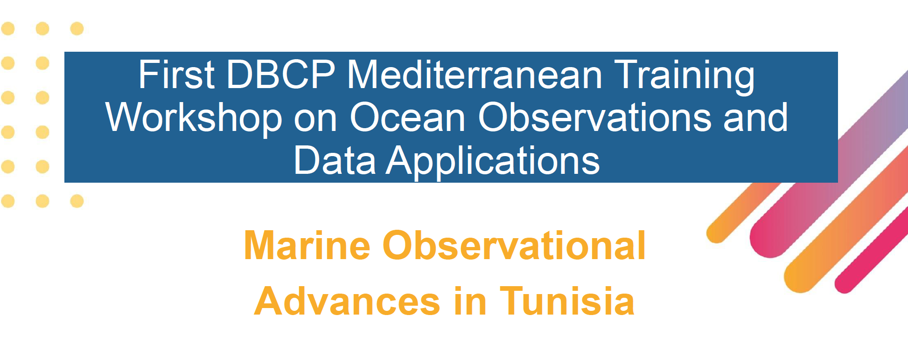
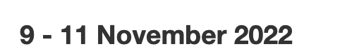
Regional Implementation of GOOS Biogeochemistry
Goals for the region:
Free, open and FAIR access to data
Regional contribution to global data synthesis products;
Status of regional observations: building regional coordination, promoting regional PIs, support in joining OCG networks;
Augmenting regional observing capability with regards to regional needs
Technical capacity building: use of sensors, access to intercomparison exercises, QA&QC methods, metadata standards, etc.
Actionable outcomes identified:
Strong thematic contribution to an in-person workshop in May 2023
Need to use this opportunity to augment regional efforts with focus on biogeochemistry
Need to work with GOOS Central and DBCP to engage multidisciplinary PIs in the region

Slide 11
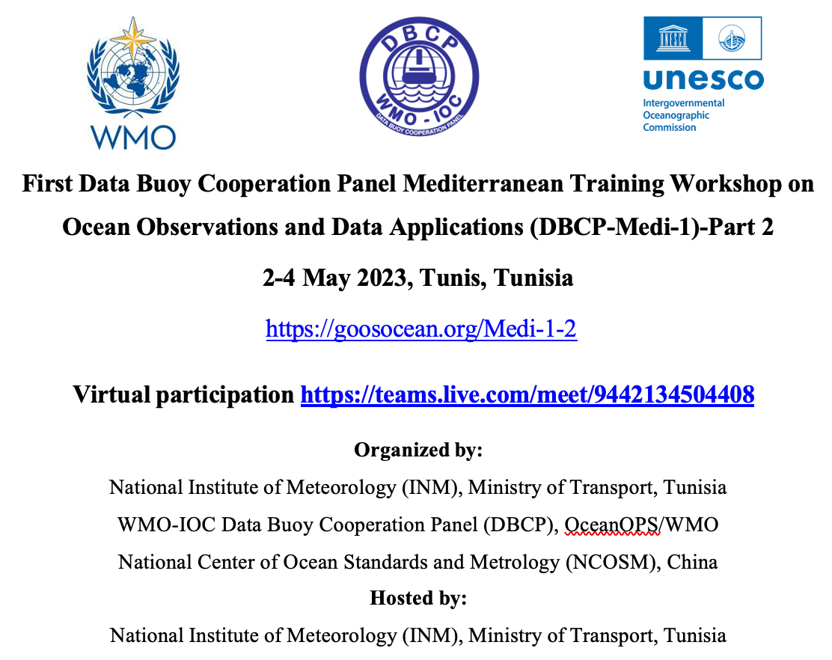
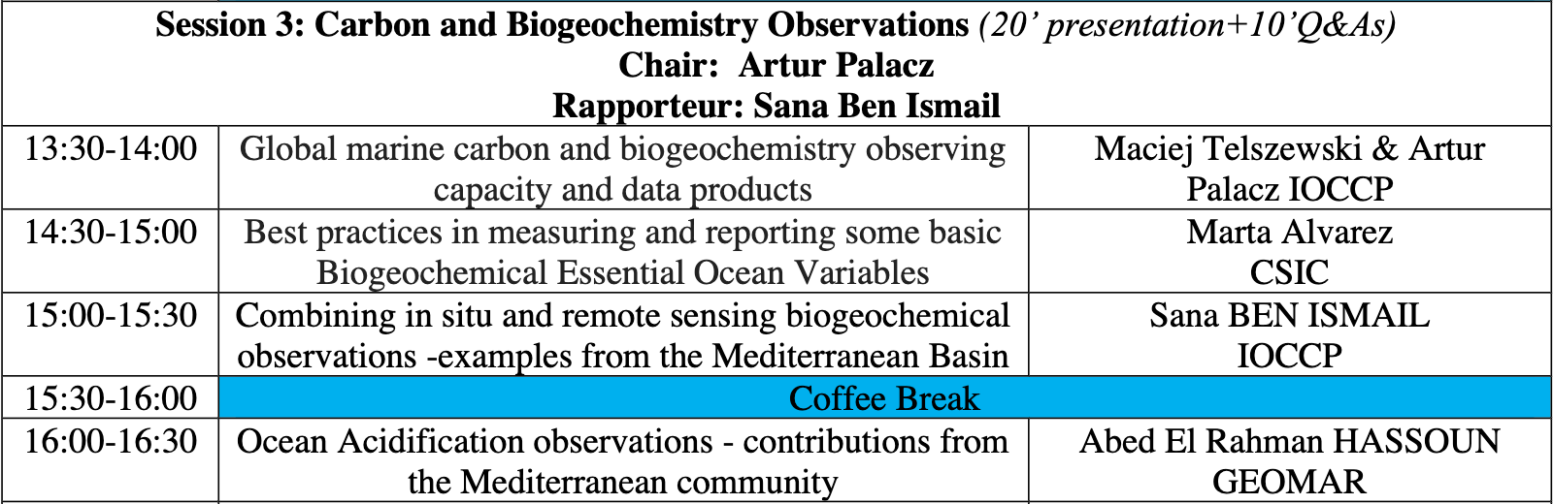
Regional Implementation of GOOS Biogeochemistry
In person Workshop:
The objective of the workshop is to enhance Mediterranean Region capacity to apply ocean observations for societal and economic benefit, and to improve related forecasts.
The themes for the workshop will include the role of ocean observations for regional weather prediction, societal and economic benefits of ocean observations , best practises, data quality and ocean observing with new technologies.
Biogeochemistry at the Workshop:
Our session features presentations from and discussions led by a number of colleagues (agenda)
We plan to cover a broad range of topics related to global and regional observing capacity, best practices, availability and use of data products, as well as data synthesis and coordination activities.
We encourage any interested members of the community, especially from around the Mediterranean region, to join the workshop online through MS Teams link.
Notes:
Our session features presentations from and discussions with Maciej Telszewski (IOCCP Director), Marta Álvarez (CSIC, Spain), Sana Ben Ismail (INSTM, Tunisia), Abed El Rahman Hassoun (GEOMAR, Germany) and Houssine Nibani (AGIR, Morocco), covering a broad range of topics related to global and regional observing capacity, best practices, availability and use of data products, as well as data synthesis and coordination activities. We encourage any interested members of the community, especially from around the Mediterranean region, to join the workshop online through this MS Teams link. More information below and on the event page here.

Slide 12
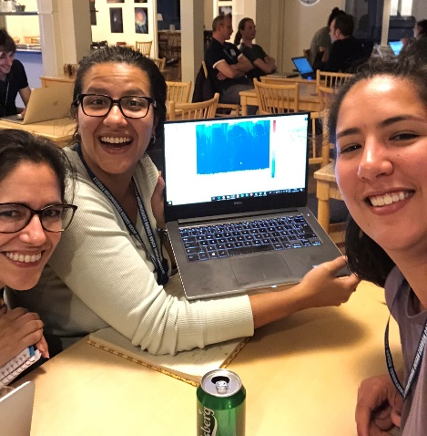

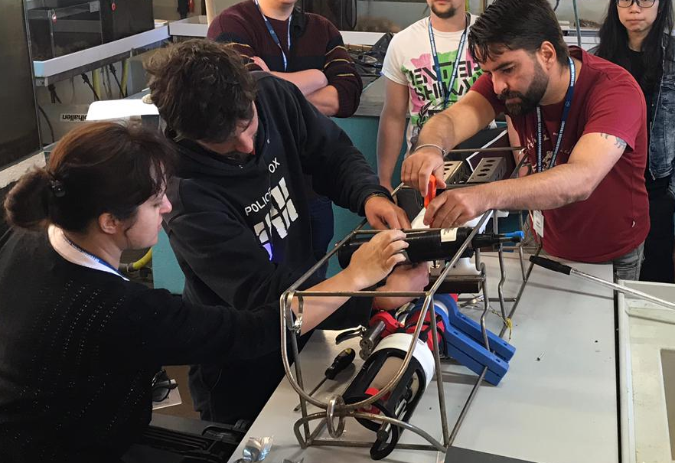
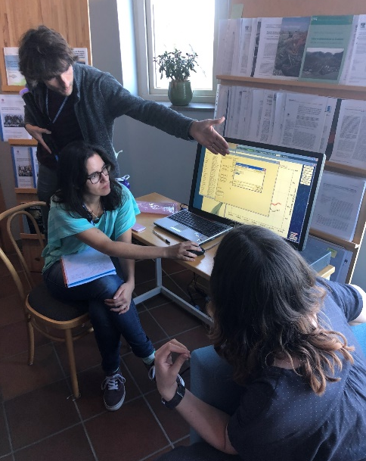
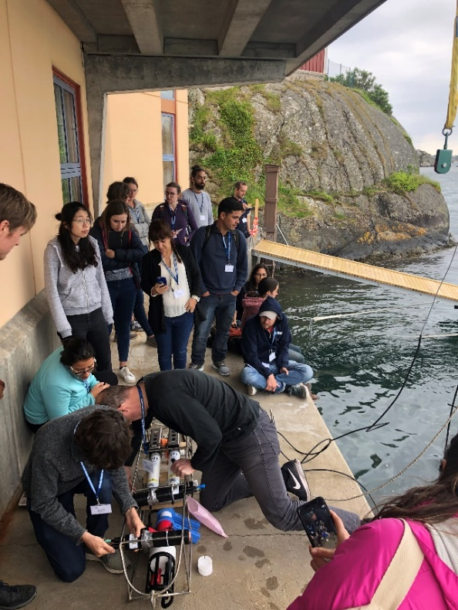
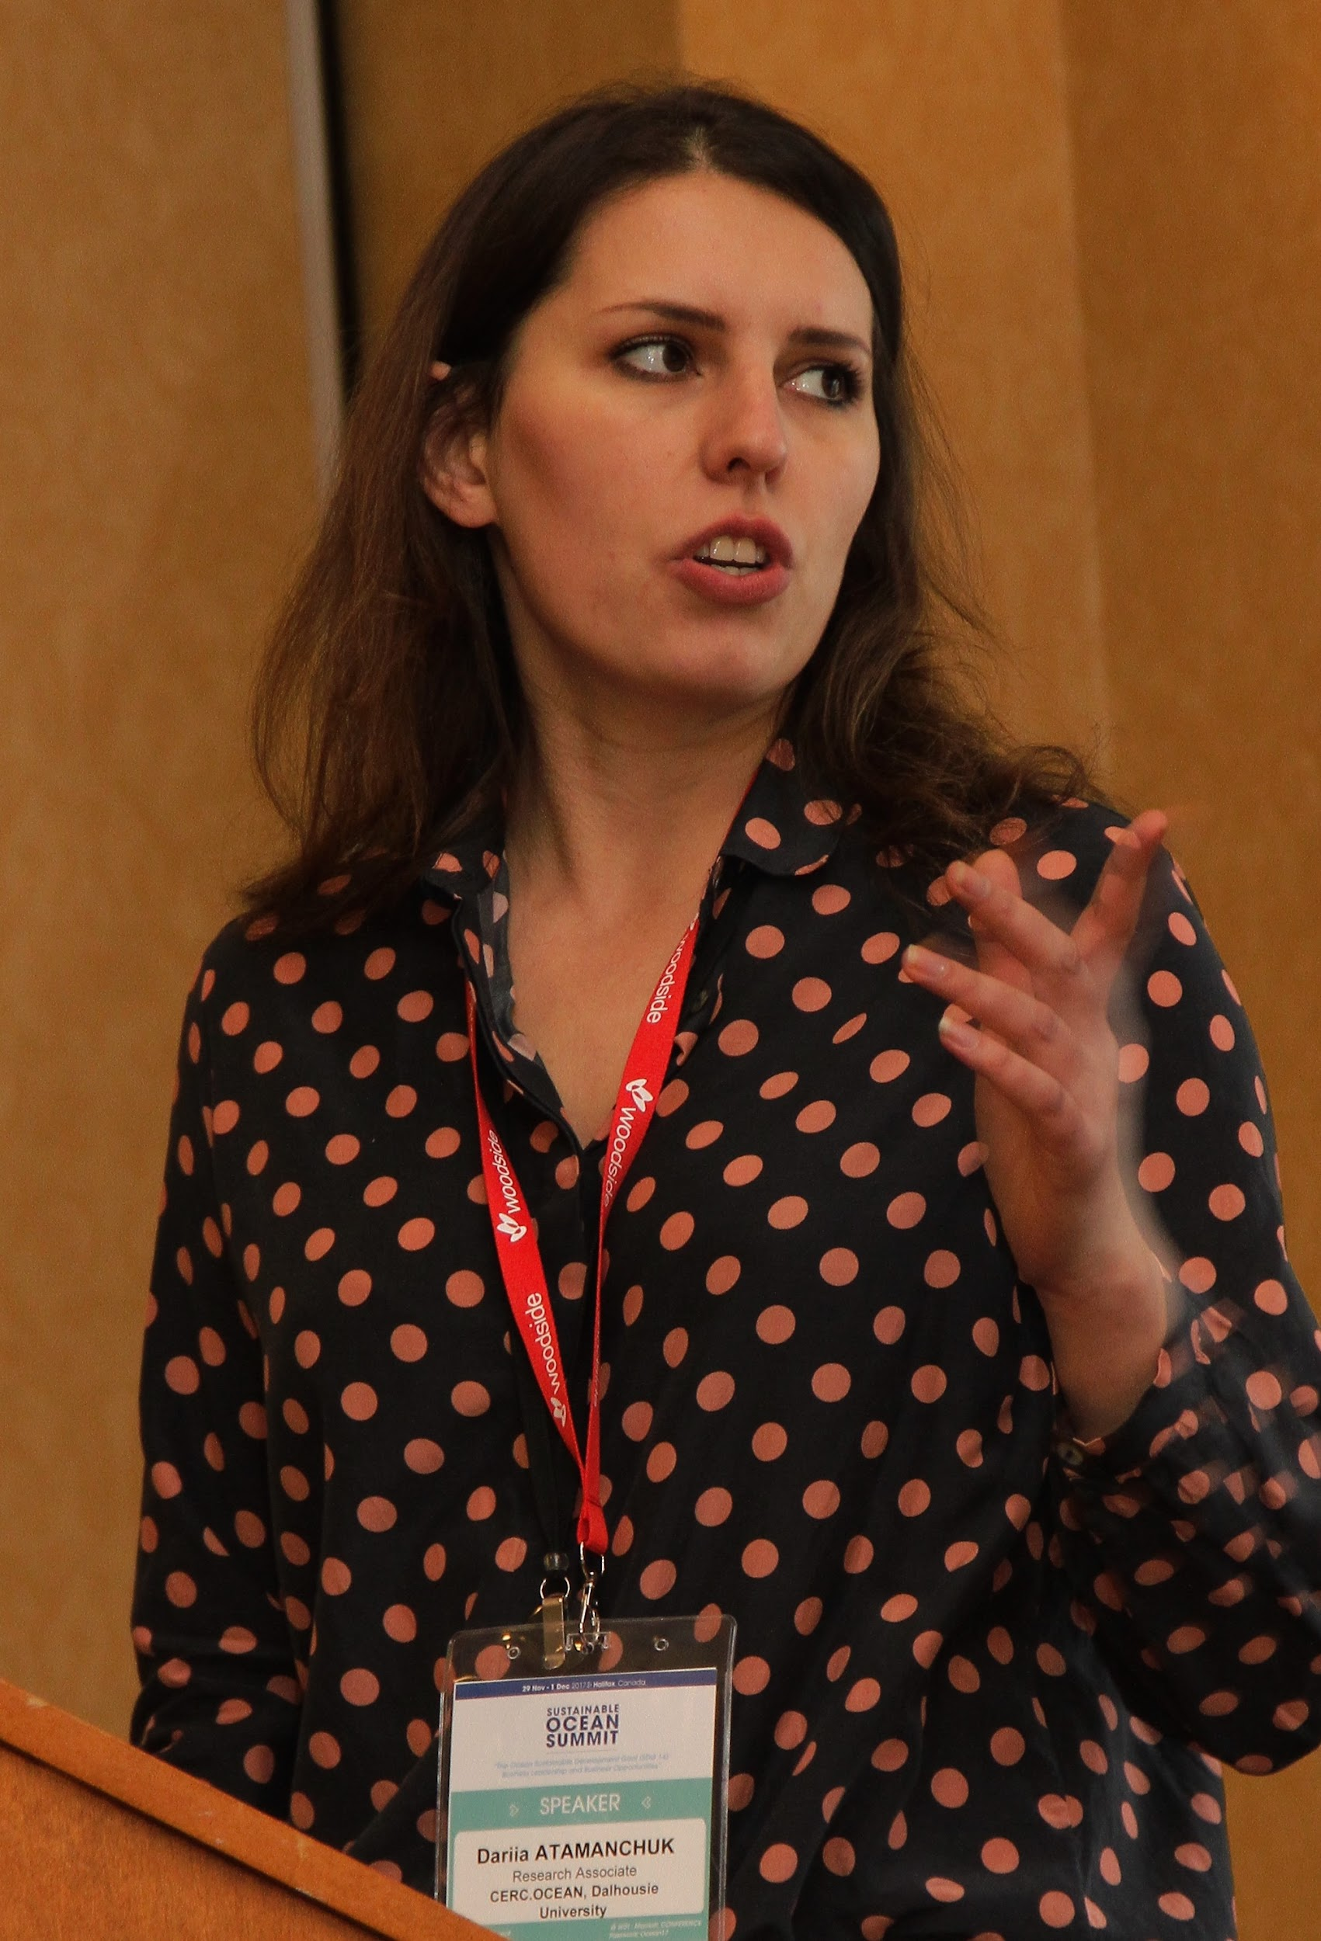
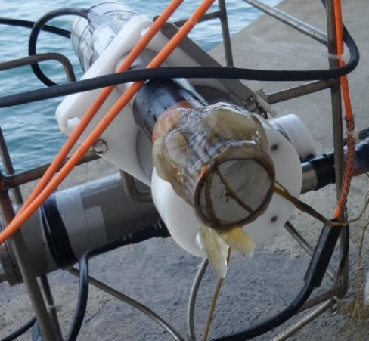
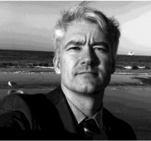
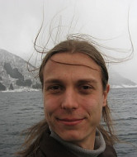
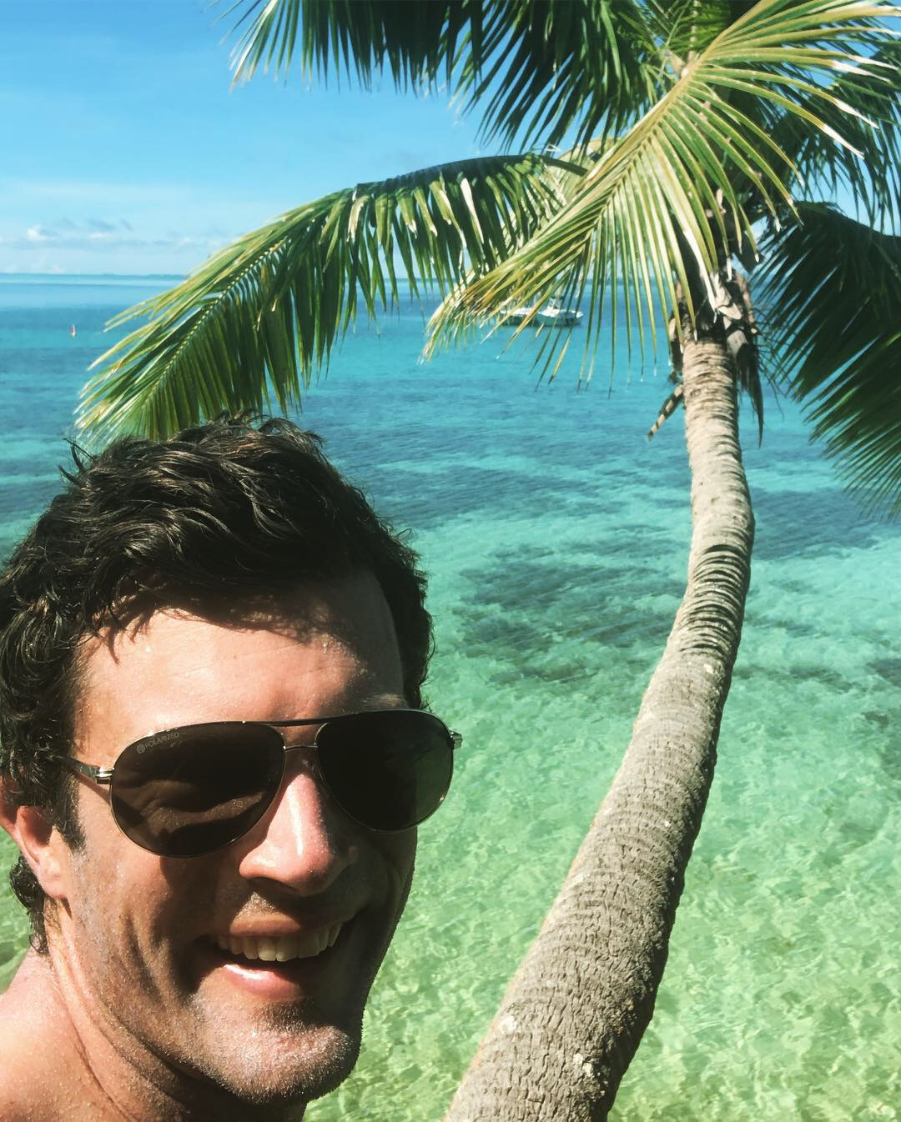
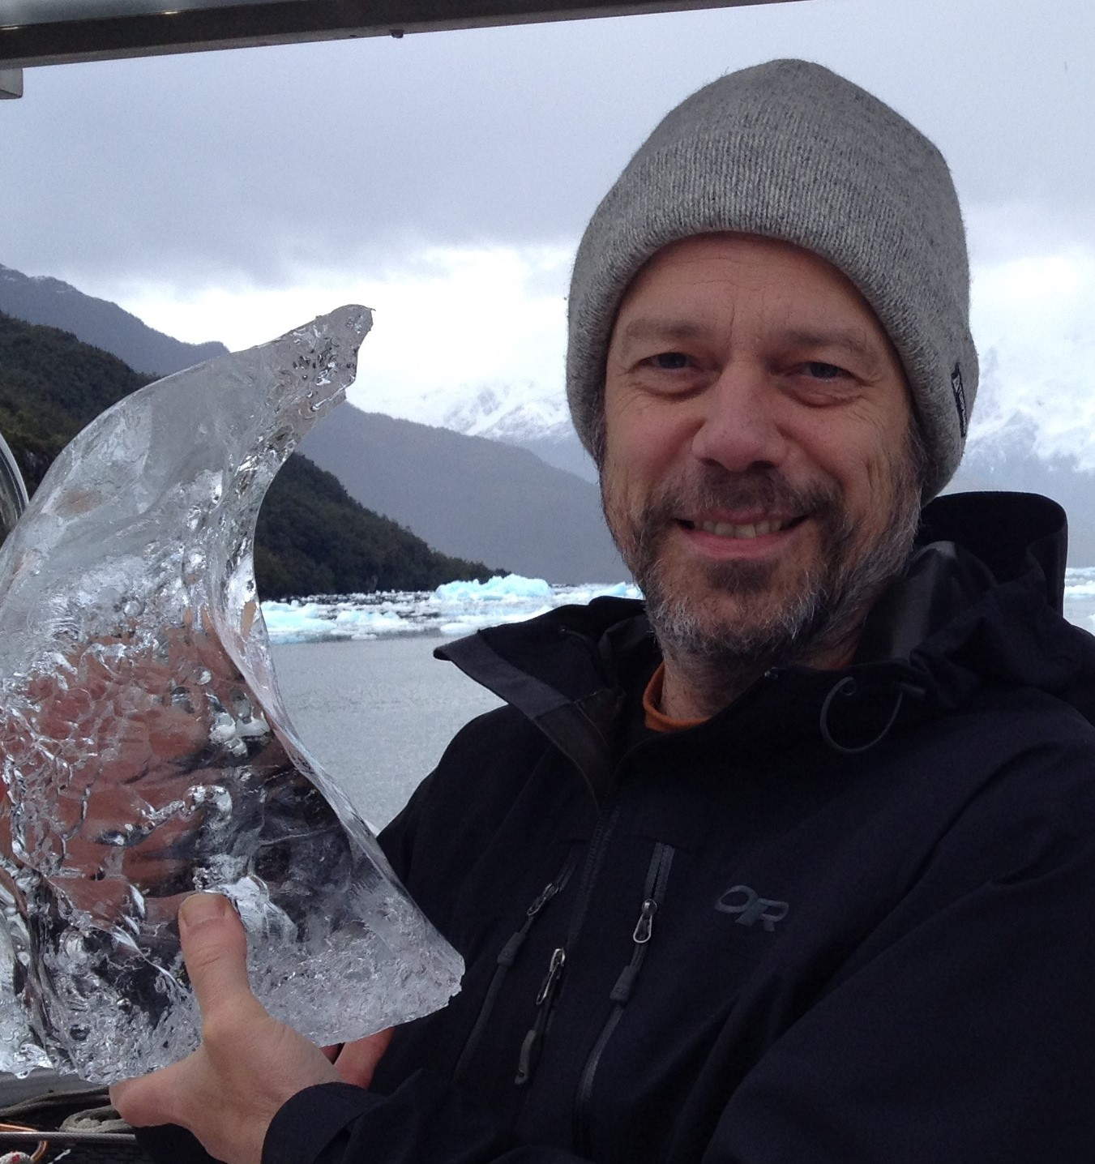
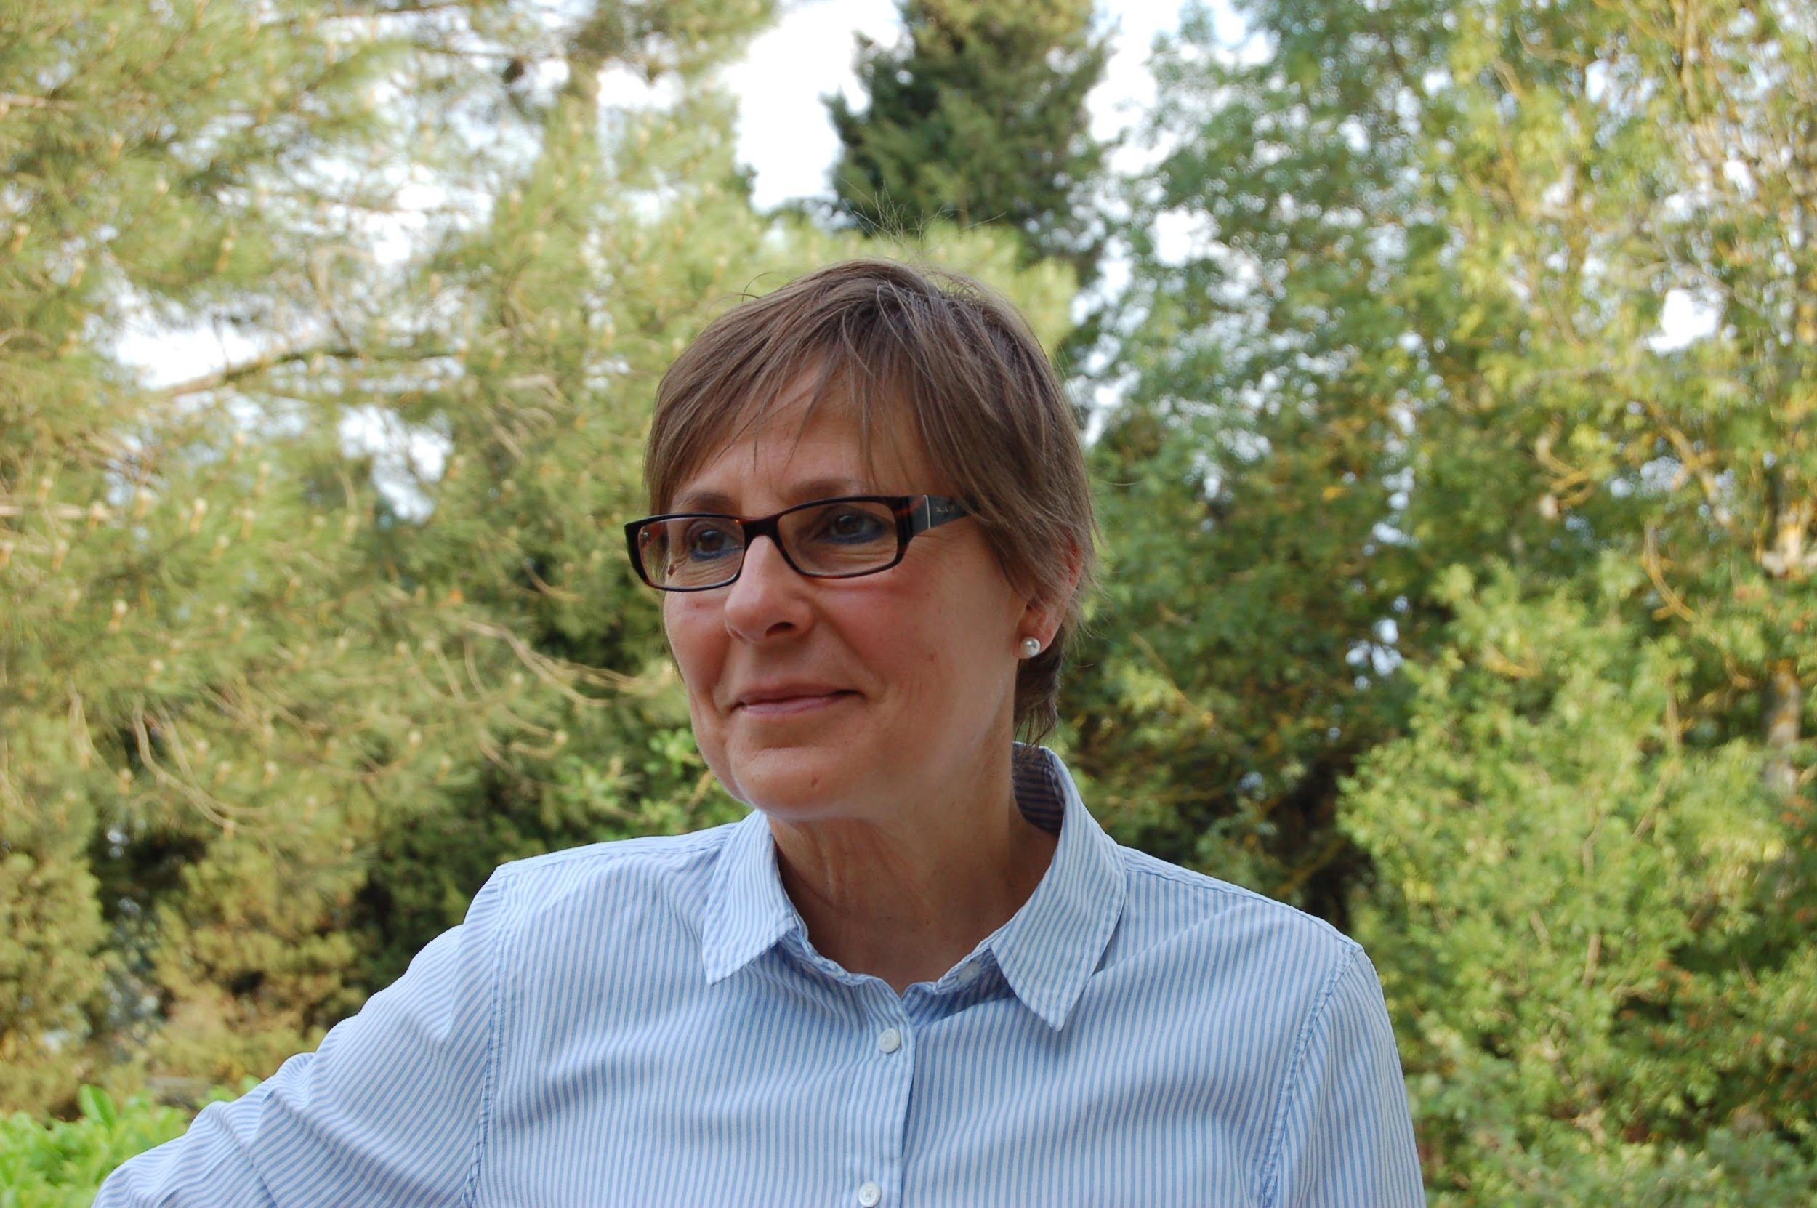
Continued focus on technical capacity building
June 2021 and 2022 Kristineberg, Sweden
3-18 June 2023, Kristineberg, Sweden
Venue booked for 2 weeks in June 2023
Expanded 14-day course allowing to include practicals and lectures for the full suite of sensors (O₂, Bio-optics, pH, pCO₂)
Long-term co-sponsorship at 20% of event budget agreed!
Lecturers, technical experts and scientific advisors agreed to work together to refine the agenda, pre-workshop tasks and post-workshop metrics.
Notes:
13 days
4 EOVs & 15 sensors
50 people, 19 countries, 26 nationalities, 6 continents
16 instructors
28 participants
>100 applications
~120,000 USD (increase from 100k 4 years ago)
Variables: pH, pCO₂, oxygen, bio-optics (chl-a & backscatter)
Sensors: CONTROS, Aanderaa, RBR, Sunburst, Sea-Bird, ProOceanus
Focus on open ocean applications (e.g. BGC Argo, underway systems)
Practicals around deployment & retrieval; GO & VINDTA instruments
Lectures and exercises on: cal-val, uncertainty estimates, data handling, extrapolation, combination with satellites, modelling, emerging technology, best practices, and more...

Slide 13
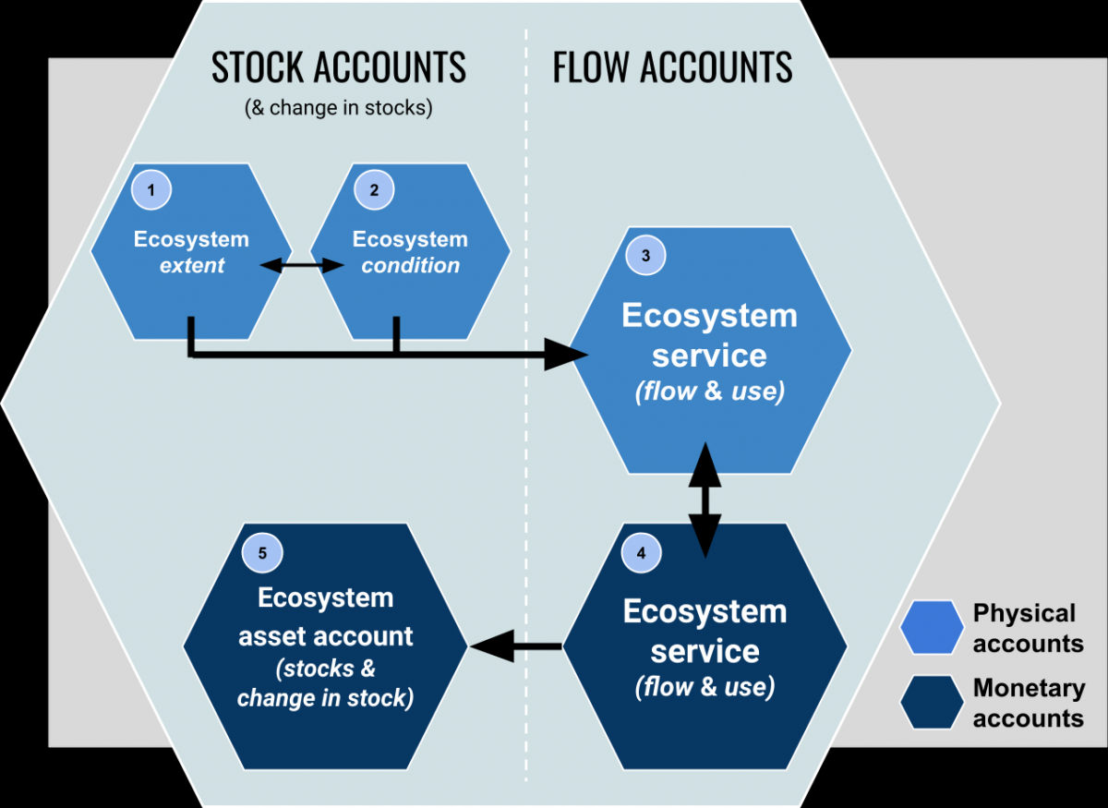
Economic evaluation of various elements of the FOO
Why do we need to know an economic value of providing
observations-based information?
Efficiencies – design, operation, management, financial,
Strategic Planning
Part of a Business Case for funders
Evaluation of success or otherwise (is it fit-for–purpose?)
Justification to stakeholders (tax payers)
How would we quantify an economic value? – there exist other examples
Commercial value of information
Cost of a system versus cost of non-action
Social cost-benefit analysis
Environmental degradation
Cost of lack of information (global warming, tsunami risk)
Who? Discussion in an expanded format during next GOOS SC meeting
Other systems have done this, do we have expertise in GOOS?
IPCC already includes some aspects of this for the climate system
Adams, V. et al., 2011: Analyzing the Socioeconomic Impacts of the Use of Earth Observations, A Primer.
Prepared for NASA by Booz Allen, 40pp.
We think that this kind of focus is badly needed (as indicated on all previous slides). For most part we do not even have an idea how to start considering various aspects of economic evaluation concept
Example: Ecosystem accounting
Potential challenges in valuation
(SEEA Experimental Ecosystem Accounting, 2015)
Target of valuation,
Distinction between the valuation of ecosystem services and the valuation of ecosystem assets (and the related issue of valuing ecosystem degradation),
Valuation of intermediate services
Consistency in the use of valuation concepts and techniques
Scaling and aggregation
Valuation of regulating services.
The measurement of non-use value
The valuation of biodiversity and resilience.
Uncertainty in measurement

Slide 14



Biogeochemistry
Panel
A communication and coordination service for marine biogeochemistry
www.ioccp.org @ioccp_org
Thank You!
Institute of Oceanology of Polish Academy of Sciences, ul. Powstańców Warszawy 55, 81-712 Sopot, Poland
Phone: +48 58 731 16 10 / Fax: +48 58 551 21 30, www.ioccp.org
Biogeochemistry
Panel

