Slide 1

Reports from GOOS components:
GOOS Regional Alliances (GRAs)
Carl Gouldman (U.S. IOOS - GOOS Regional Council Chair)
Michelle Heupel (IMOS - GOOS Regional Council Vice Chair)
GOOS 12th Steering Committee meeting 25 - 27 April 2023

Slide 2
The Request
10 minute report followed by 15 minute Q&A session
The format will be a 5 minutes 10 minutes moderated discussion
Send your presentation to Forest Collins (f.collins@unesco.org) for posting on the meeting website
Purpose
Give the SC opportunity to focus the components of GOOS:
Many of the actions should have been covered under the Strategic Objectives and so this is a chance to look at challenges and opportunities through the lens of the GOOS components - and to pose questions, ask guidance from the SC. Could include:
Achievements/Highlights (details in report - suggest only 1 slide)
Opportunities & Issues
Future plans
Questions for the Steering Committee

Slide 3
Notes to the template Using image placeholders
The picture slides are predefined with picture placeholders that help you to manage the image you add into the field.
Click the button in the middle of the field to select and import the picture you want to use. The picture field will automatically fill the field with the image.
You can edit the position of the image using the crop tool, which is in the ‘Picture Tools > Format menu. This menu appears when you click on an image.
The crop tool allows you to enlarge, adjust position or crop the image to fit.

Slide 4
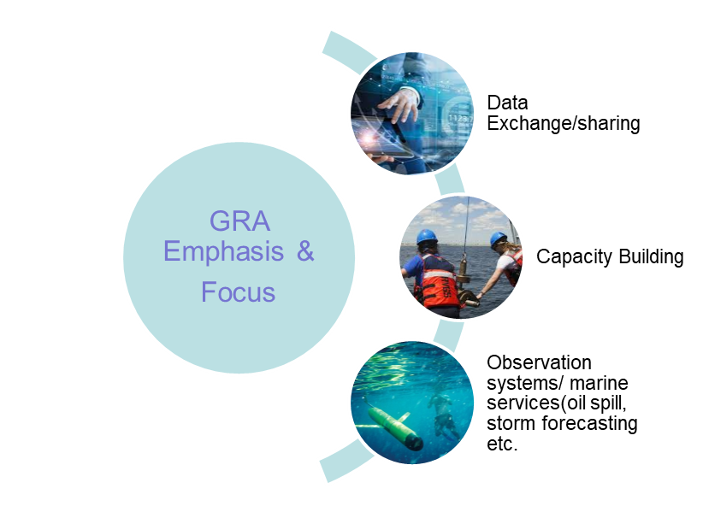
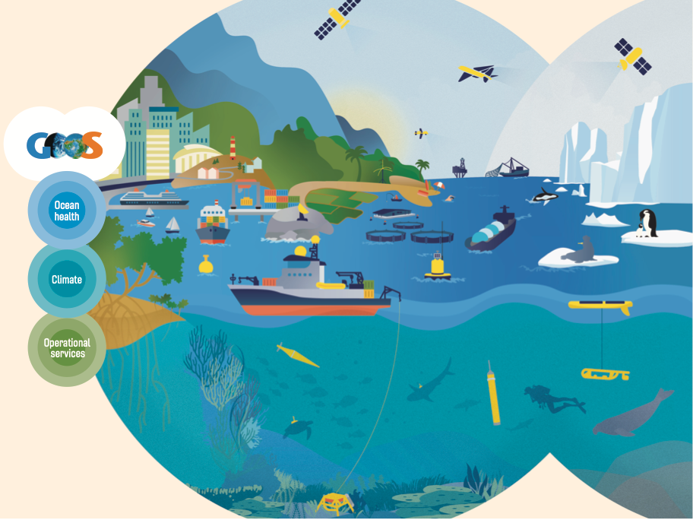
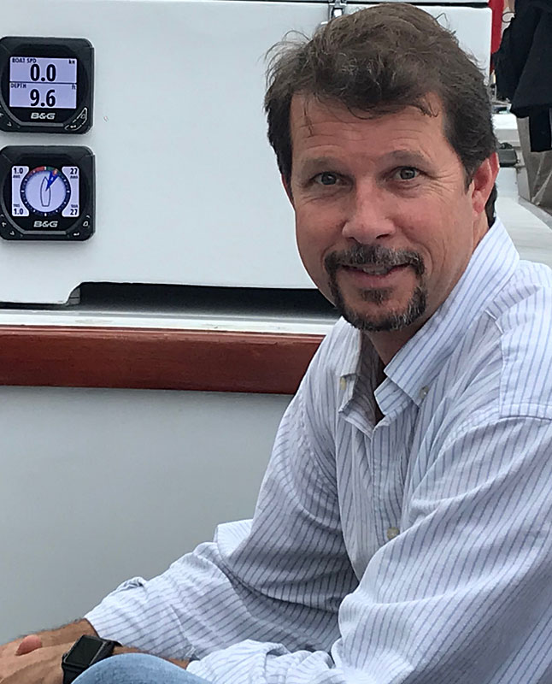
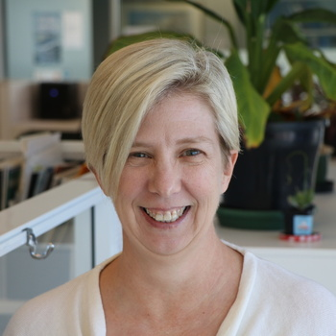
Status Updates
GRA Council Leadership
Carl Gouldman (U.S. IOOS), Chair
Michelle Heupel (IMOS), Vice Chair
Revitalization of GRAs
GOOS Regional Policy
GRA Forum Planning
GRA Foci:
Data Exchange Standards
Emerging Observing Networks
Best Practices and Capacity Building
GRAs and GOOS:
GOOS 2030 Strategy
GOOS Implementation
UN Decade
Notes:
The key achievements of the GRAs in the last year range from the launch of new web portals and bulletins, participating in high level UN Ocean Decade meetings, the publication of a the new European Ocean Observing System Strategy 2023-2027, improving the visualization of sea level through digital tools, the integration of glider data, funding harmful algal bloom monitoring and forecasting, collecting time series data on microplastics, and celebrating sustained ocean observations through the recovery of a long-term 10 year mooring.
I have a few examples in my slides today but our component report contains additional achievements and highlights from the GRAs.

Slide 5
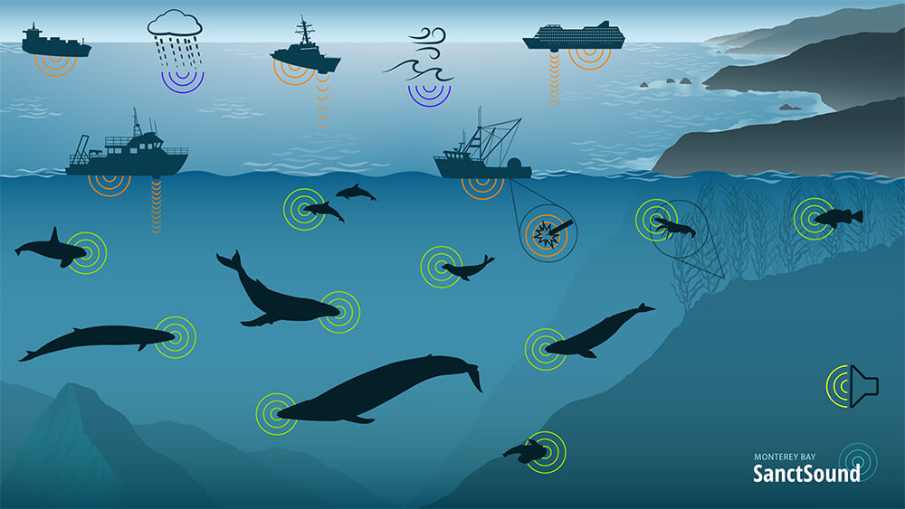
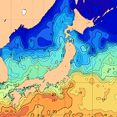
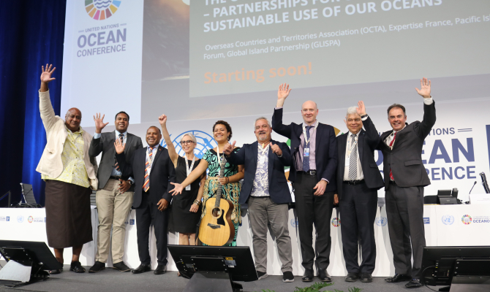
Achievements and Highlights
New Sanctuary Soundscape Monitoring Project Web Portal Launched: https://sanctsound.ioos.us/
Quick Bulletin of Ocean Conditions: Bulletin with near-real time data on the ocean current (Kuroshio etc.) and sea surface temperature around Japan
Pacific Science and Traditional Knowledge Highlighted at UN Ocean Conference Side Event
Notes:
The key achievements of the GRAs in the last year range from the launch of new web portals and bulletins, participating in high level UN Ocean Decade meetings, the publication of a the new European Ocean Observing System Strategy 2023-2027, improving the visualization of sea level through digital tools, the integration of glider data, funding harmful algal bloom monitoring and forecasting, collecting time series data on microplastics, and celebrating sustained ocean observations through the recovery of a long-term 10 year mooring.
I have a few examples in my slides today but our component report contains additional achievements and highlights from the GRAs.

Slide 6
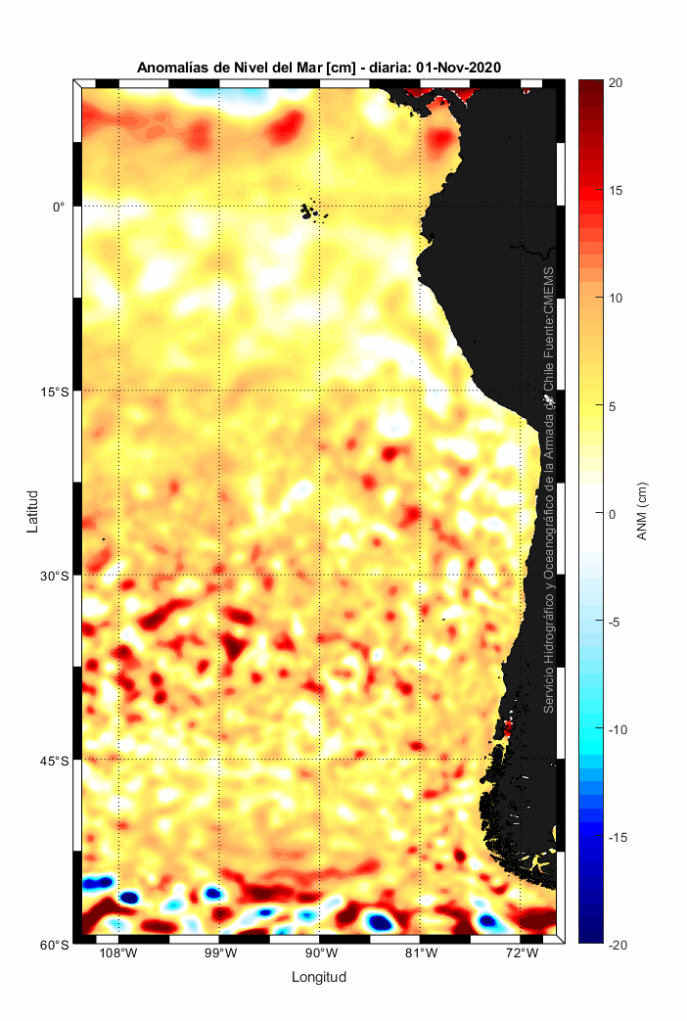
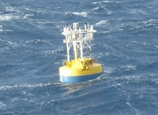
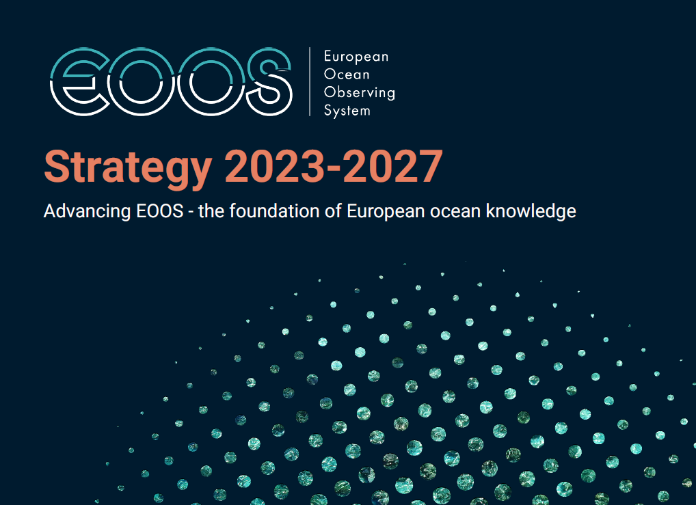
Achievements and Highlights
A decade of Southern Ocean observing: Recovered IMOS Southern Ocean long-term air-sea flux and biogeochemistry mooring
European Ocean Observing System Strategy 2023-2027
Improving the visualization of sea level through digital tools
Notes:
The key achievements of the GRAs in the last year range from the launch of new web portals and bulletins, participating in high level UN Ocean Decade meetings, the publication of a the new European Ocean Observing System Strategy 2023-2027, improving the visualization of sea level through digital tools, the integration of glider data, funding harmful algal bloom monitoring and forecasting, collecting time series data on microplastics, and celebrating sustained ocean observations through the recovery of a long-term 10 year mooring.
I have a few examples in my slides today but our component report contains additional achievements and highlights from the GRAs.

Slide 7
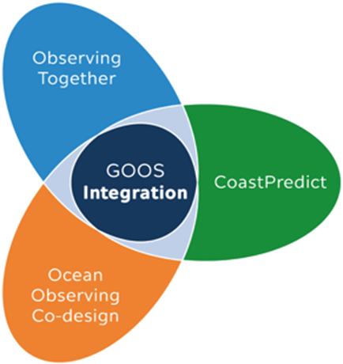
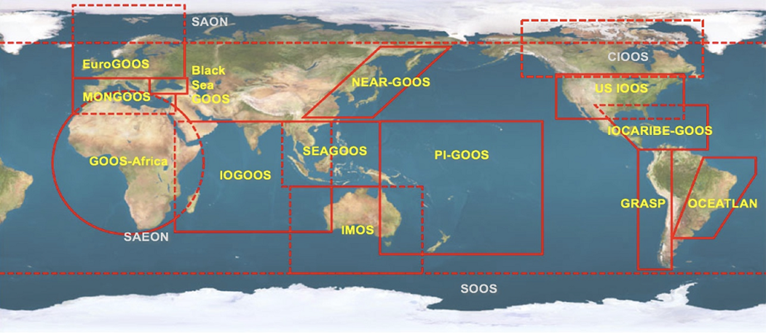
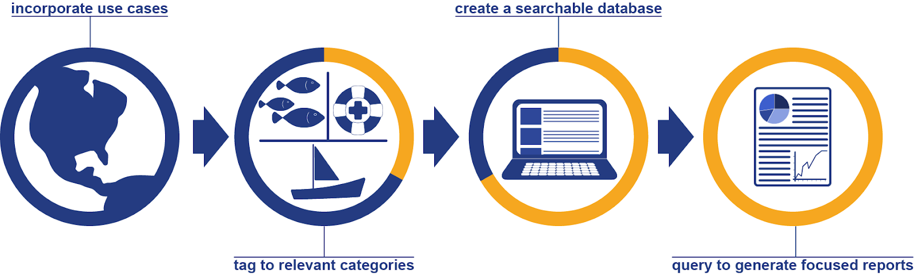
Opportunities
Benefits of Ocean Observations Catalog Development
As a web-based catalogue, the BOOC will provide a valuable resource for the ocean observation, measurement and forecasting community illustrating the ways in which different types of ocean information delivers benefits in a region or for a type of use.
Revitalization of GRAs
PI-GOOS
IOCARIBE-GOOS
GOOS Africa
Participating in GOOS Planning Next Steps –
including actions for implementation of GOOS 2030 Strategy and GOOS UN Decade Programmes
Notes:
Benefits of Ocean Observation Catalog (BOOC)
Progress:
Contract placed to transition the prototype to an operational system
Working with an initial collection of use-cases from across NOAA
Operational system being build as a cloud based application
Digital Commons based use-case review process being designed and tested
Next steps:
Testing of operational system
Testing of use-case review process
Drafting of user documentation
Outreach to wider community for use-cases
Revitalization of GRAs:
PI-GOOS - calls for expression of interest to host PI-GOOS. GOOS Secretariat in discussion with the GOOS SC to review expressions of interest and assist with establishing institutional agreements.
IOCARIBE-GOOS - Dr Lorna Inniss was appointed in Jan 2023 as the new Head IOC-UNESCO Regional Secretariat for IOCARIBE, IOC of UNESCO Sub-Commission for the Caribbean and Adjacent Regions. The group is working on reorganizing leadership and working groups and focused on organization, awareness, and needs assessments for the member states in the region.
GOOS Africa - AFRICA GOOS has a new action plan in line with the GOOS Implementation Plan. Good cooperation with IOC AFRICA for mutual reinforcements towards achieving the goals of the IOC-UNESCO, but still lack in situ technical support/coordination.

Slide 8



Future Plans
Coordinate development of the next GRA Forum
Update GOOS
Regional Policy
Refresh Societal Benefits of GRAs paper
GOOS Regional Alliance Capability Assessment
Notes:
GOOS Regional Policy
Status update:
During the 10th GRA Forum, the GRAs discussed regional approaches, vision, and policy for a thriving regional coordination ecosystem. From this workshop a report is being prepared to support the establishment of the new GOOS Regional Alliance Policy.
In addition, discussions have started on the constitution of a sub-task team which will include members of the Governance Task Team, GOOS Steering Committee, GRA leadership and regional projects.
A series of workshops will be organized to discuss with the sub-task team members to be constituted about the revised policy. An outline of the revised policy will be prepared and members can be assigned responsibilities to lead the revision.
Updating Paper “Societal Benefits of GOOS Regional Alliances, Challenges and Opportunities” with recent achievements, examples, and upcoming opportunities.
GRA Capability Assessment:
In preperation for the next GRA Forum, will continue discussions on approach to capability assessment of the GRAs.

Slide 9
Thank you
GRAs
Black Sea GOOS EuroGOOS GOOS Africa GRASP IOCARIBE-GOOS IMOS IOGOOS MONGOOS NEAR-GOOS OCEATLAN
PI-GOOS SEAGOOS U.S.IOOS SOOS|SAON
goosocean.org

