Slide 1

Strategic Objective 3
Regularly evaluate system to assess fitness-for-purpose
Presenter: David Legler, NOAA GOMO Director, OCG Chair, GOOS SC ex officio
GOOS 12th Steering Committee meeting, 25 - 26 April 2023

Slide 2
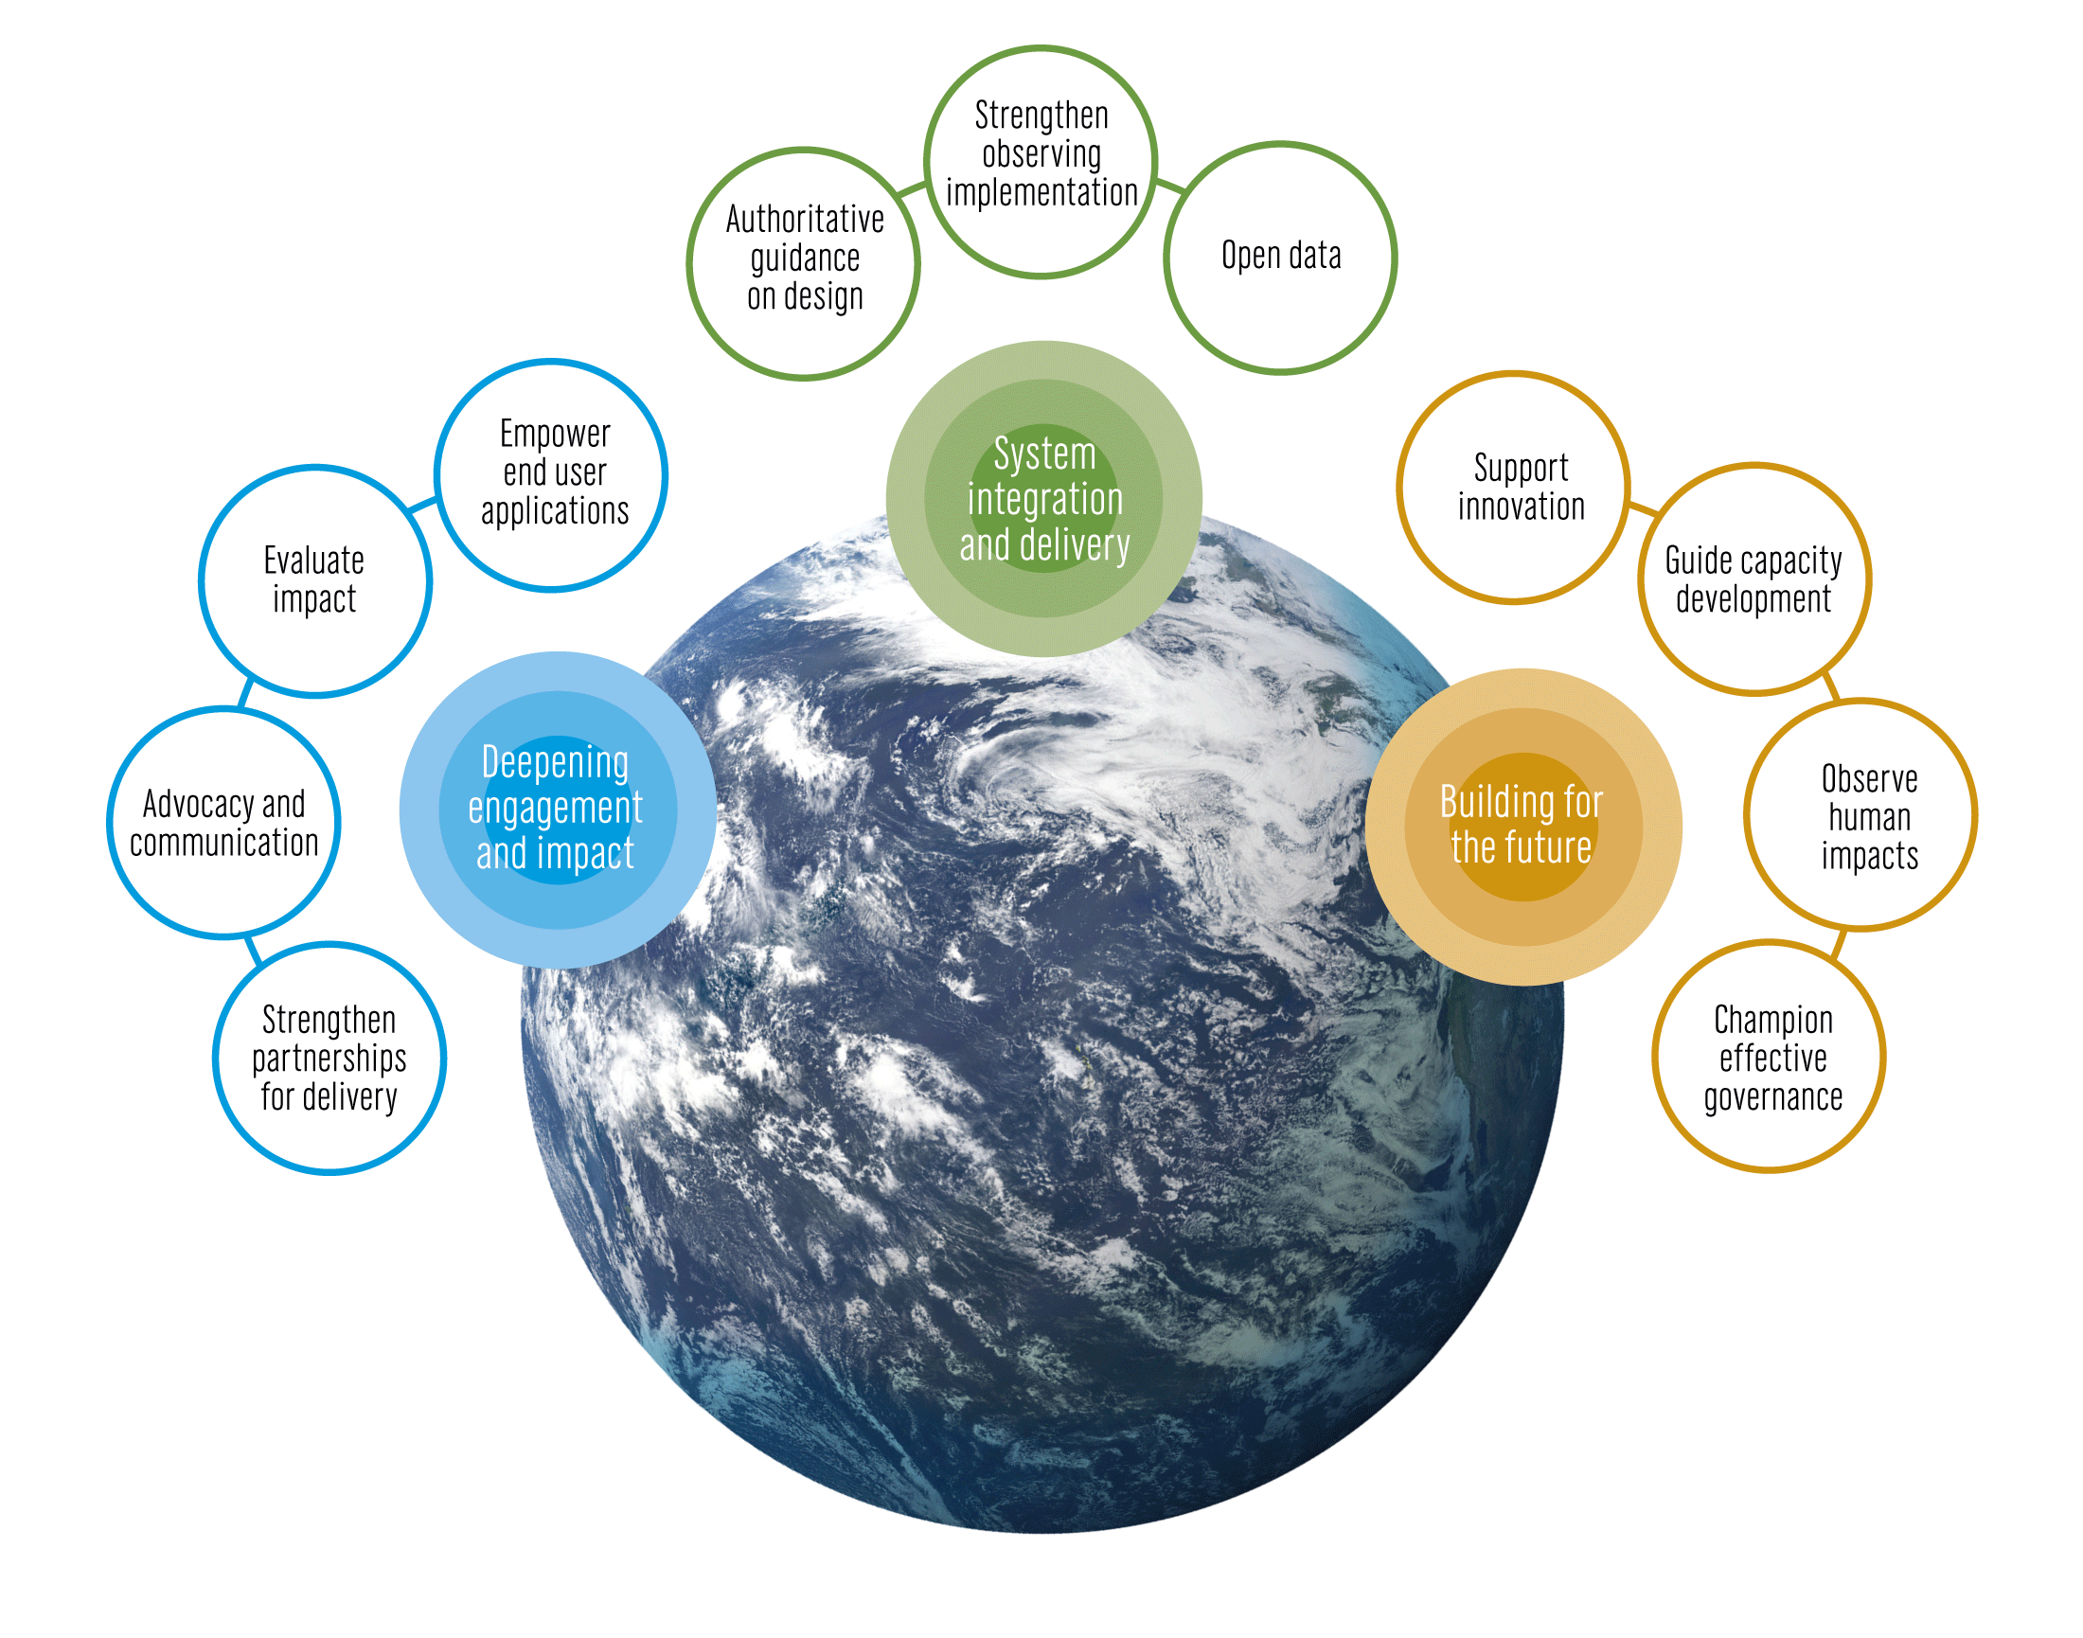
The GOOS 2030 Strategy
Notes:
The Global Ocean Observing System or GOOS is led by the Intergovernmental Oceanographic Commission of UNESCO and is co-sponsored by the World Meteorological Organization (WMO), United Nations Environment Programme UNEP and the international science council
The IOC Assembly in 2019 adopted a Global Ocean Observing System 2030 Strategy which now informs our work.
[vision] [mission]
Suite of Strategic Objectives which have become important to our planning:
System integration and delivery are the ‘core’ of GOOS ‘business’ today
Deepening engagement and impact are key priority areas for work – including developing partnerships for delivery, advocacy and communications
Building for the future are about building the additional pieces we need for a fully integrated system, including capacity development and innovation, and leading the development of a governance system for the future system that includes say partners and other stakeholders

Slide 3
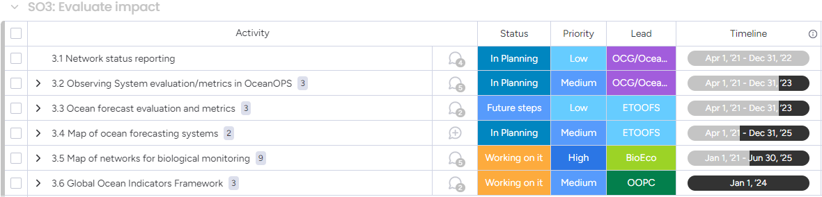
Actions
Regularly evaluate the system to assess fitness-for-purpose
Notes:
Probably 3.6 Should be moved to SO4

Slide 4
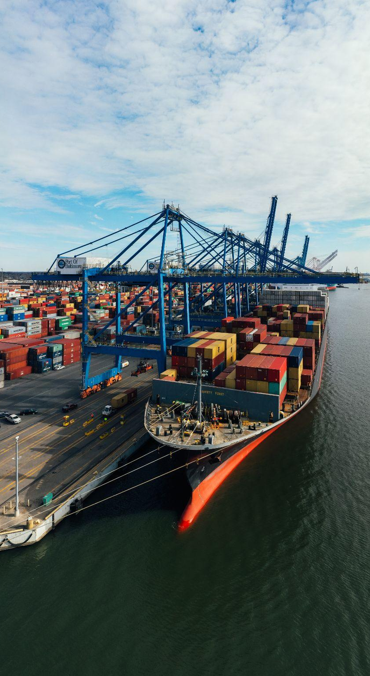
Action Progress 1
Improved Report Card 2022 by including more robust calculation of KPIs and refined status (3 stars include half stars per category) and inclusion of BioEco observing capacity | ACTION 3.1
Metrics are being development within OCG for network maturity assessment | ACTION 3.1
Plan developed but not implemented to provide gap analysis tools by EOV / ECV versus applications in the context of the RRR by OCG and OceanOPS | ACTION 3.2
Released Guide on Ocean Forecast evaluation and metrics | ACTION 3.3
[NEXT] Implementation of a first series of KPIs
[NEXT] Assess the internal performance of each simulation/forecast with KPIs
[NEXT] Intercompare simulations and forecasts from different centres in a consistent ways (comparison forecast/forecast)
Map of Ocean forecasting systems | ACTION 3.4
Map by ETOOFS
[NEXT] DCC implementation - co production with WMO - does GOOS need to do anything to push this forward? Best practices development?
Notes:
The IOC Executive Council at its Fifty-third Session adopted Decision IOC/EC-55/3.4, pertaining to Ocean Observations in Areas under National Jurisdiction. This decision requested the Executive Secretary to invite Member States to provide information on their experiences regarding sustained ocean observations in Areas under their National Jurisdiction including on the issues identified by GOOS through the Expert Workshop on “Ocean Observations in Areas under National Jurisdiction” (OONJ, GOOS Report, 246).
In the same decision, the IOC Executive Council also invited GOOS to provide detailed information on the issues regarding sustained ocean observations in areas under national jurisdiction identified in the report of the OONJ Experts Workshop. A survey to the global ocean observing networks has been undertaken to receive such information.
The Decision IOC/EC-55/3.4 also requested the Executive Secretary to compile and summarise the information received and report back to the IOC Assembly in 2023. Accordingly, responses to this letter and information received from GOOS will be compiled and summarized for reporting to the IOC Assembly in June this year

Slide 5

Action Progress 2
Development of GOOS capacities for BioEco network and (meta)data mapping - OBIS completed | ACTION 3.5
Recruited GOOS BioEco Data Manager to perform the tasks, management and maintenance of the newly developed GOOS BioEco portal
Launched GOOS BioEco portal 1.0 in collaboration with OBIS
[NEXT] Version 2.0 to launch in June 2023
Developed ODIS-Architecture pattern for EOVs | ACTION 3.5
Cross-GOOS TT, multidisciplinary, series of interviews, perspective paper presenting the Ocean Indicator concept and methodology, workshop planned in Oct 2023 | ACTION 3.6
Ocean Observing Co-Design endorsed by the UN Decade of Ocean Science as a Program | POTENTIAL NEW ACTIONS for Co-Design and Others in GOOS:
Develop monitoring and performance evaluation of all observing networks carrying out EOV observations and synthesize findings
Develop system metrics at an EOV level through requirements and cross-GOOS Panels and WMO collaboration
Development of system assessment and requirements from user needs perspective through exemplar projects
Notes:
Co-Design workshop - lessons learned and develop principles for co-design practices and develop exemplar areas
Co-Design legacy workshop to determine assessment tools and develop exemplars further

Slide 6
Outcomes & Assessment
No | SO3 Outcomes | Assessments
1 | Operational tracking of the observing system against targets for climate, operational services, and marine ecosystem health. | On track (50%) Progress on report card, KPIs, development of clear metrics, assessment of biological capabilities. [Co-design and assessment for societal outcomes, Bio Eco portal]
2 | Identification of gaps across the observing system (disciplines and domains) and at global, regional, and local scales. | Limited progress. Not consistent across the observing system. Plan being developed to scale up to other regions through exemplar projects under co-design program. [TPOS, Co-design exemplars].Some gaps will be indicated in WMO RRR/Statements of Guidance
3 | A view of the status of the observing system to meet societal goals, including real-time view of status for short term response. | Progress on next steps. No investment to implement but being pursued. [RRR, Co-design exemplars, OOPC, IOCCP]
4 | Guidance on how to evaluate observing systems from a global, regional and national perspective. | Some progress in specific cases but not formal best practices or guidance. [Co-design, TPOS, TAOS]
5 | Increased efficiency of information to evaluate the application of resources to meet requirements. | Good initial progress but lacking resources. [Co-Design]
6 | [NEW] Observing system evaluation and metrics. | On track with global OCG networks. Implementation and delivery metrics in development of emerging and mature networks. BioEco portal available but no tracking service yet. [OCG, BioEco, Co-design]
7 | [NEW] Forecasting system evaluation and metrics. | On track. Working on specific metrics. [ETOOFS]
Notes:
5. A lot of things on going? Local to global gaps
7. On track
8. Happy to work with communication. Find a way to . piece of information. Generating stakeholders? To put into the gap

Slide 7
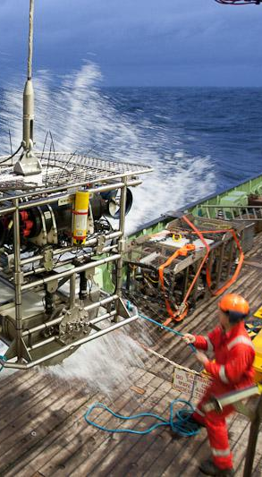
Major challenges
Stakeholder and end user need engagement to identify and co-design the observing system to better serve society. How can the Co-Design program work with others across GOOS who are also pursuing co-design?
Metrics of success and network KPIs should be developed to assist in ensuring the progression and evolution of the observing system. How can networks be incentivized to complete these?
Capacity and funds are required to support the development of assessment tools for the observing system. GOOS should work through co-design exemplars and the panels to develop these and utilize OSE/OSSE and modelling / data assimilation teams to inform guidance.
Continued erosion of resourcing of ocean observations and lack of funds to engage with stakeholders.
Notes:
Emerging networks…. Which(from BGC and BIOECO and GRAs) are ready to join OCG… (resource limitations within OCG and OceanOPS)...?

Slide 8

Potential actions/decisions
Further develop stakeholder assessment and define reach and communication strategy to engage stakeholders in the observing system assessments, impact and modification.
Implementation of a first series of observing KPIs and development of measured of success and goals for observing system assessments.
Move forward with the Ocean Observing Co-Design Exemplar projects implementation, ensuring GOOS panels are updated and integrated into the efforts.
Get more engaged in teams (eg Ocean Predict/Synobs) that are producing observing system assessments
Seek resource support for assessment tool development and setting of requirements.
Move Indicators Framework (3.6) action to SO-4
Notes:
MOU between GOOS and MBON and OBIS need to be renewed, Panel would like to propose the MOU that GOOS Exec can implement
The BioEco Panel co-chairs are currently discussing potential attendance at the GRA Forum (date still being decided but likley to be early 2024) to discuss emerging BioEco networks and to further facilitate uptake of BioEco EOVs into the GRAs.

Slide 9

Thank you
goosocean.org

Slide 10
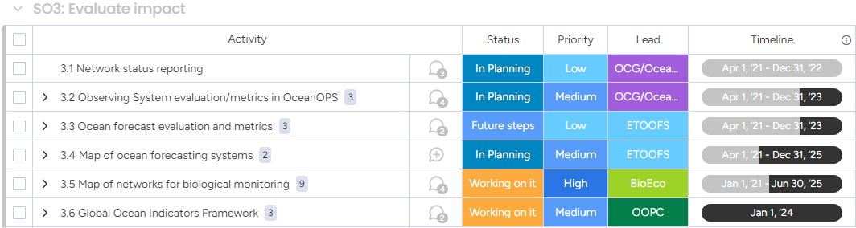
Actions
Regularly evaluate the system to assess fitness-for-purpose
Notes:
Probably 3.6 Should be moved to SO4

