Slide 1

Strategic Objective 2
GOAL 1
GOOS 12th Steering Committee meeting, 25 - 26 April 2023
Laura Stukonyte (GOOS Jr Communications Consultant) and Anya Waite (GOOS Co-Chair)

Slide 2
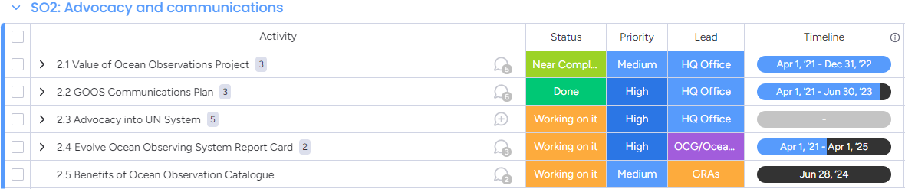
Actions
Build advocacy and visibility for the observing system with stakeholders, communicating with key users and national funders

Slide 3
Progress/Achievements
Produce / enable production of data
Consume /
leverage data
GOOS Communications Plan has been developed by Wolf&Player, many of its recommendations are being implemented / are planned to be implemented in the next biennium
GOOS communications have reached stability: regular news and feature stories, planned campaigns, social media activity and a growing audience
A strong relationship with the IOC communications team developed, allowing to streamline IOC and GOOS communications, amplify our messages and reach a wider audience
  Strengthen the ocean observing community
  Demonstrate
  the value of
  global
  coordination
  Make the business case for sustained ocean observing
Show how critical ocean observing is
to the success of the Ocean Decade
Core value propositions which align with GOOS communications objectives (Wolf&Player GOOS Communications Plan)
Notes:
It divides our audience into two main groups - the producers or enablers of ocean data, and those who consume or leverage the data. And through our communications, we then want to strengthen and champion the first group, mainly the ocean observing community, and make the business case for sustained ocean observing to the second group. An overarching objective is to demonstrate the value of global coordination, or the work of GOOS, as well as show how critical ocean observing is to the success of the Ocean Decade.

Slide 4
Reaching our audiences
TARGET AUDIENCE
Ocean observing community | Beneficiaries of ocean data
Mailing: Bi-monthly GOOS Updates and irregular GOOS Notes (~1850 subscribers) | Feature stories with ocean observers as champions: Med-SHIP, Zooplankton, COP15 biodiversity story
Social media posts: Twitter, Facebook, now also LinkedIn | UN Advocacy: flyers for UN Ocean Conference, COP27, COP15
Information articles: e.g. Ocean Best Practices, Dialogues with Industry, GCOS conference, Highlights from COP etc. | GOOS-OceanOPS annual Report Card

Slide 5
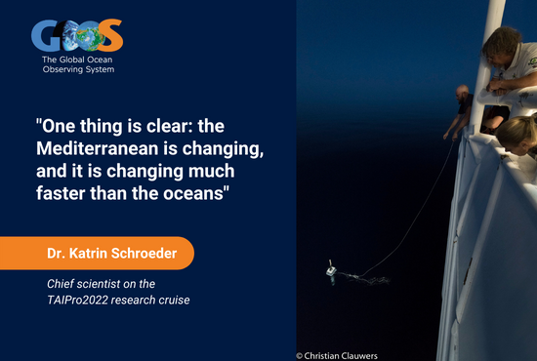
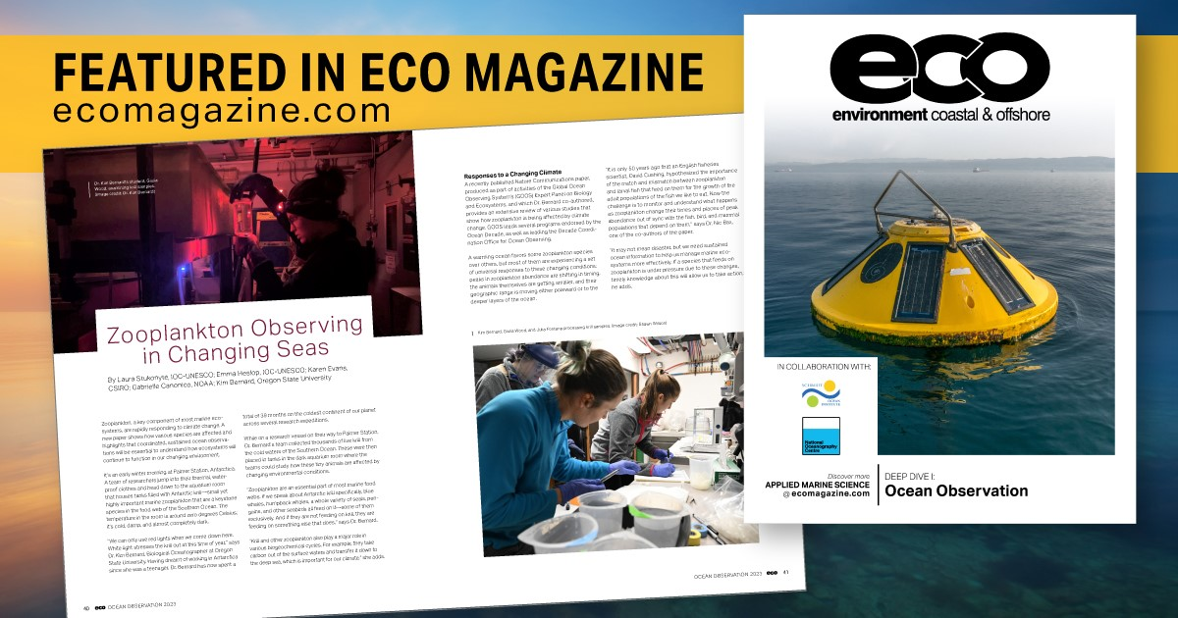
GOOS stories and social media
2022 in numbers:
17 original GOOS articles, also shared on the IOC news
4 feature stories picked up by external news portals (CBS news, Nautilus, Mongabay, ECO magazine, Ocean Science & Technology News) and shared on the UNESCO main website
45% increase in GOOS mailing clicks since 2021
~50% more followers on social media since 2021
GOOS is now active on LinkedIn, with a growing audience
2023 so far:
3 original GOOS articles, all picked up by external news portals (ECO magazine, Meteorological Technology International)
Notes:
Most popular stories - featuring work and experiences of scientists in the field + newsworthy scientific discoveries enabled by ocean observations. We aim to use such stories as a hook, and infuse them with messages about the importance of coordinated ocean observing.

Slide 6
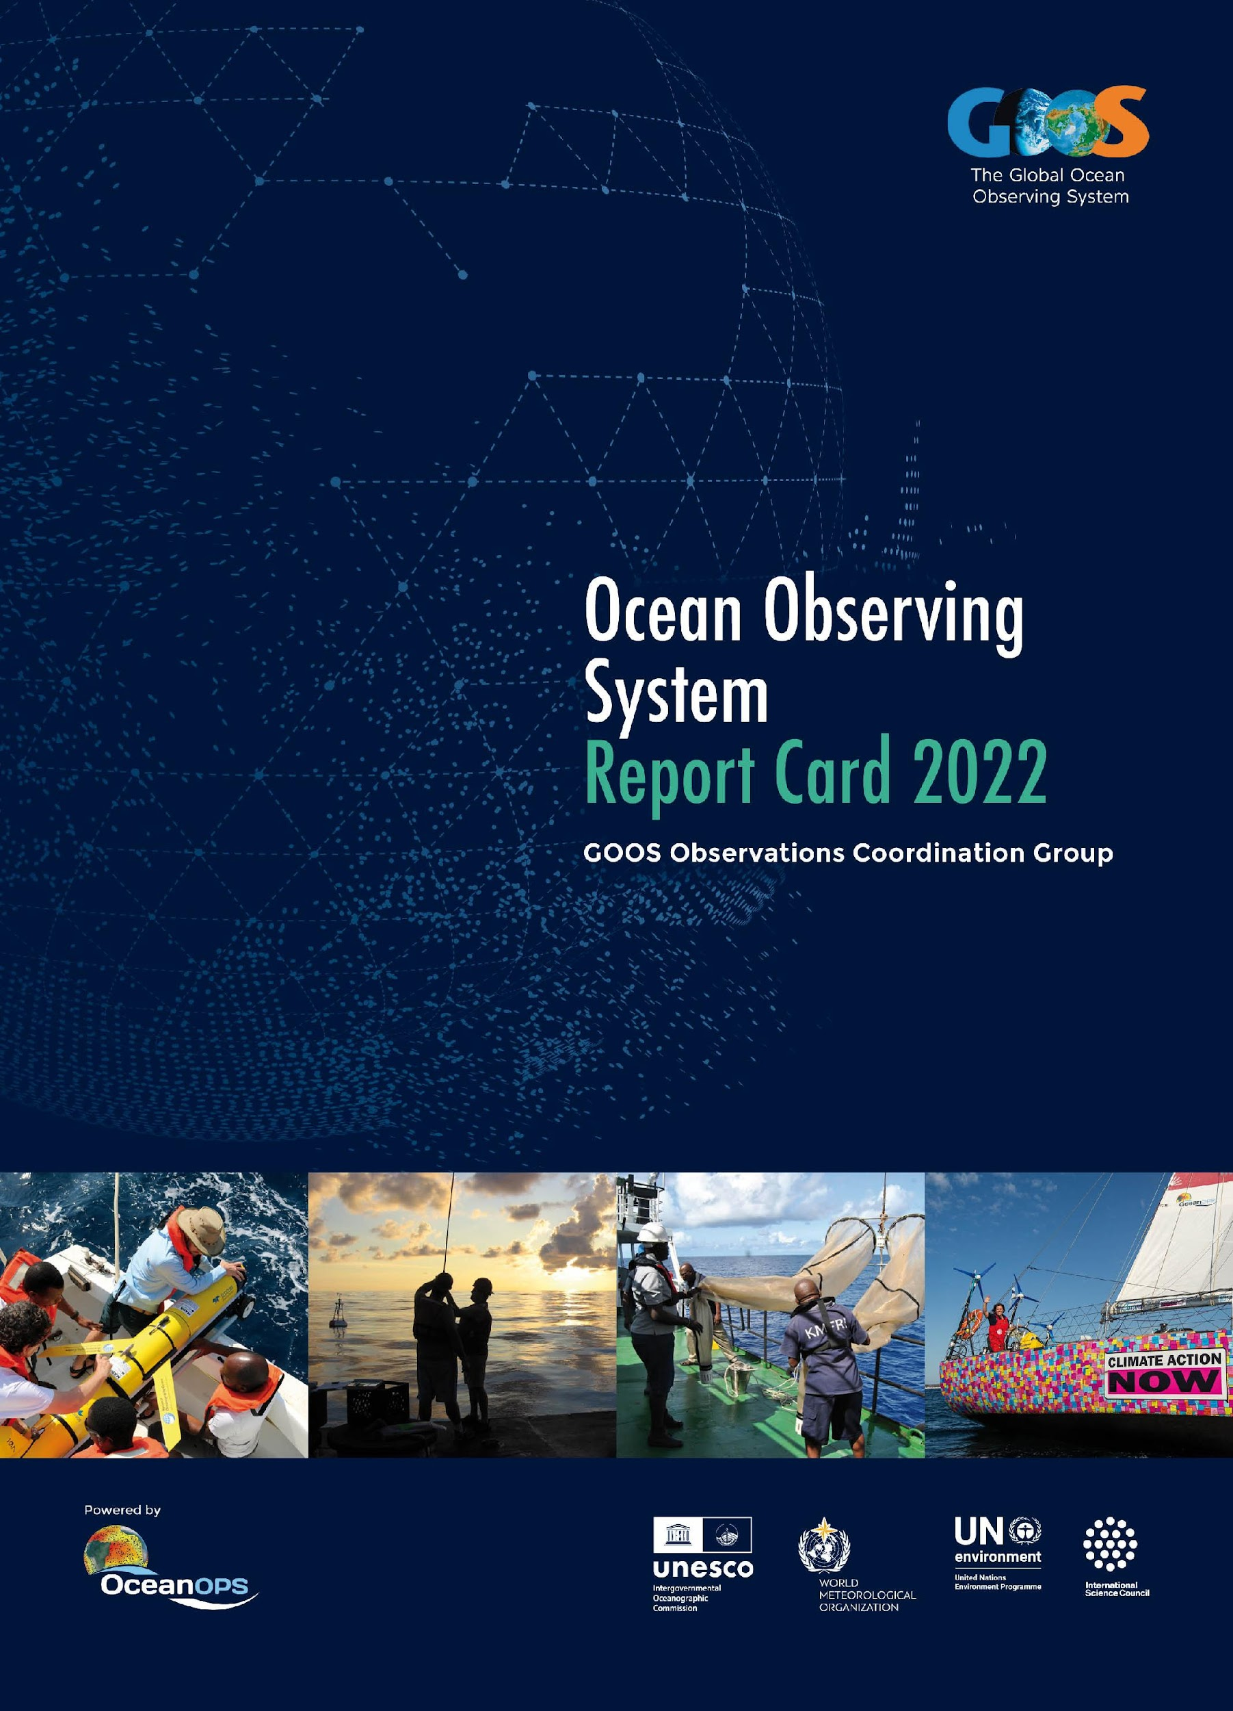
Report Card 2022-2023
Report Card 2022 published Sept 2022, 6th edition and first truly cross-GOOS
Focuses on how an integrated ocean observing system adds value to society across the three GOOS Delivery areas: climate, operational services, and ocean health
2,000 visitors from >100 countries consulted the new interactive web version since publication.
Promoted through a web release, video (effective), social media, mailed to key stakeholders
Report Card 2023 planning:
  Editorial Board volunteers first meeting April 05
  ID new stories topical & illustrate cross-network/cross-GOOS integration
  Network status table more factual/increase links with BioEco Portal
  Release Sept 2023

Slide 7
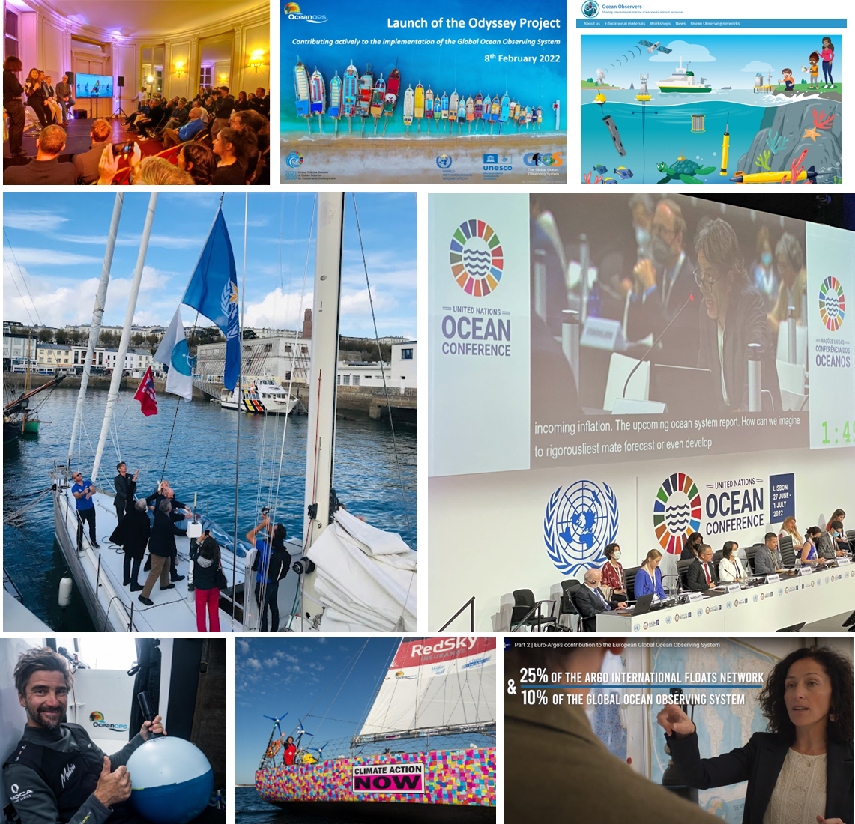
OceanOPS communications
Cooperation with civil society (operational and promotional goals) - relative access to mass medias.
Promoted with IOC, WMO and GOOS office.
Odyssey launch meeting aside OneOcean summit.
Contribution of diving, surfing, fishing ,sailing, shipping, etc to the GOOS.
Iris sailing charter departure ceremony with IOC, GOOS and WMO delegates and French elected officials.
95 Argo floats deployed in Atlantic (for US, CA, EU).
Several outreach & comm activities (PR, news, tweets) focusing on the engagement of skippers (e.g. The Ocean Race).
Few drifters/floats deployments, weather stations, ocean packs.
Contribution to educational and awareness campaigns with European partners.

Slide 8

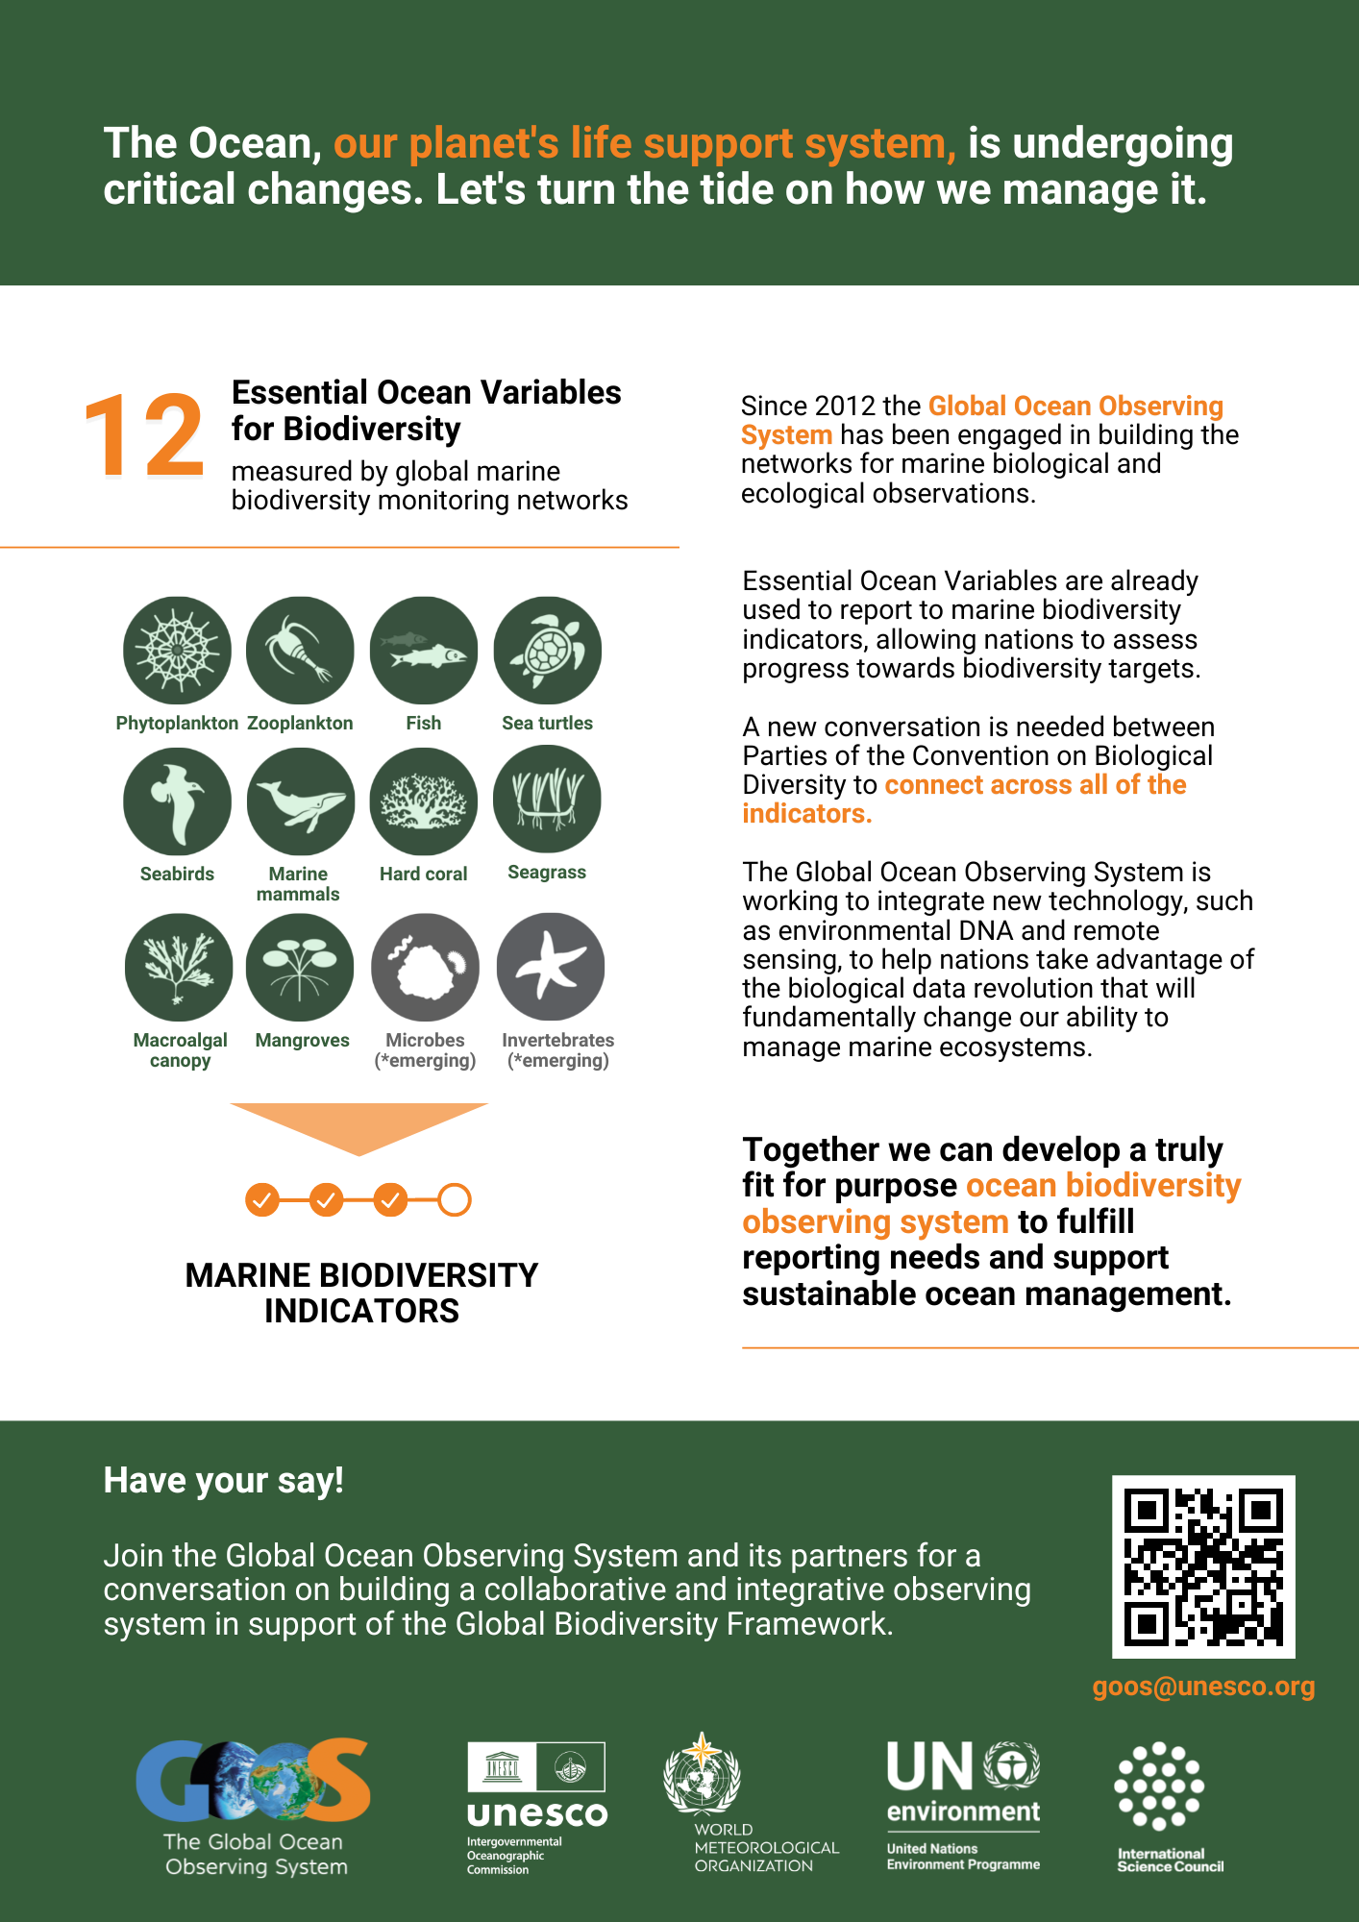
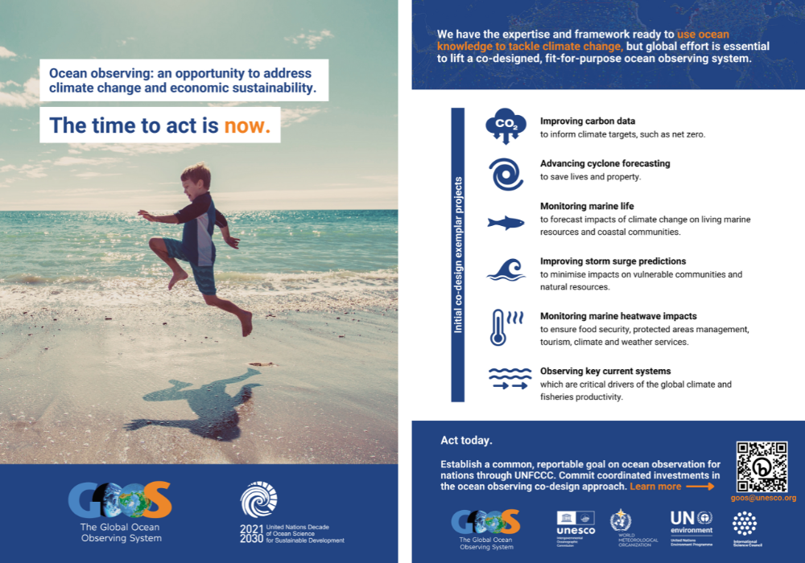
UN Advocacy
In 2022 there was a clear focus on advocacy across the UN (GOOS Office, Co-Chairs, Expert Panels, OceanOPS)
GOOS flyers developed for UN Ocean Conference, COP27 & CBD COP15 - simple messages for target audiences, action oriented, well received, provided talking points for meetings
Live tweeting from relevant events at the conferences was carried out together with IOC comms
“Catch GOOS at/GOOS update from...” type articles developed and received a very high engagement rate, showing people are highly interested in hearing about GOOS at these events
Through IOC, engagement continues with UNFCCC (COP, Ocean and Climate Dialogue, SBSTA), CBD, WOA
Notes:
MIC TO ANYA HERE

Slide 9
Outcomes & Assessment
No. | SO2 Outcomes | Assessments
1 | Significant step-up in the external recognition of value of the global ocean observing system in climate, operational services, and marine ecosystem health areas | On track (50%) Criteria: recognition in the GCOS IP, UN Ocean Conference, COP27, CBD COP15
2 | An increase in longer-term sustained funding for ocean observations and an external vocal community who are advocates for the need for sustained ocean observation | Low progress (10%) External vocal community: On track (30%) Criteria: a growing community of vocal partners, such as the Ocean Frontier Institute, Marine Technology Society, The Ocean Race, Industry partners, OECD, etc.
3 | Increase in nations participating in the observing system | On track (30%) Criteria: Increasing activity in GOOS GRAs, communications being developed for GOOS NFP
4 | Recognition for the role that GOOS, WMO, IOC, and our partners play in supporting the global development of an ocean observing system | On track (40%) Criteria: Recognition in UN ICP, GCOS IP
Notes:
Funding: there are no indications about an increase in sustained funding during the last year, however, we have only had the GOOS communications plan for less than half a year, and until now we have only implemented a part of it due to financial reasons. We hope to dedicate more resources to the remaining recommendations of the communications plan, as well as work in the philanthropy sector during the next biennium.
GRAs: There is increasing activity in GOOS GRAs, with new GRAs joining. We anticipate that this will lead to an increase in nations participating in the observing system.

Slide 10



Gaps
Fundraising focus
Messaging capability
Website
Supporting reaching funders through our communications (Connection to SO11)
Strong, refined messaging for GOOS, its components and SC to use
A more engaging, modern, user-friendly website with easily accessible documents

Slide 11
Next/Future Steps
2023
Moving the current GOOS website under a new content management system
Updating current web content
Finalizing a set of slides about GOOS and its components
Develop metrics / understanding of success
Expanding the GOOS media contact list (continuous)
Strengthening comms relationships with partner organizations (continuous)
UN Advocacy work, e.g. UN ICP on maritime tech. in June, COP28 in Nov (continuous)
2024
Refining GOOS messaging - contract and in-house implementation, address some of the gaps
Visual identity (GOOS components) - contract and interaction with GOOS components, strengthen GOOS collective identity
2025
Full website redesign
GOOS logo?
Assess success of Communications Plan - next steps

Slide 12
Resources required
Moving website CMS - costs yet unknown
Refining messaging and developing GOOS component branding ~€10,000
Website redesign ~€50,000 (possibly less after the CMS move)
In-house resources will:
Continue communications content creation - news articles, stories, social media, newsletters, flyers and brochures
Updating current website content
Expanding GOOS media contact list
Strengthening relationships with partner communications teams
A set of slides about GOOS and its components

Slide 13

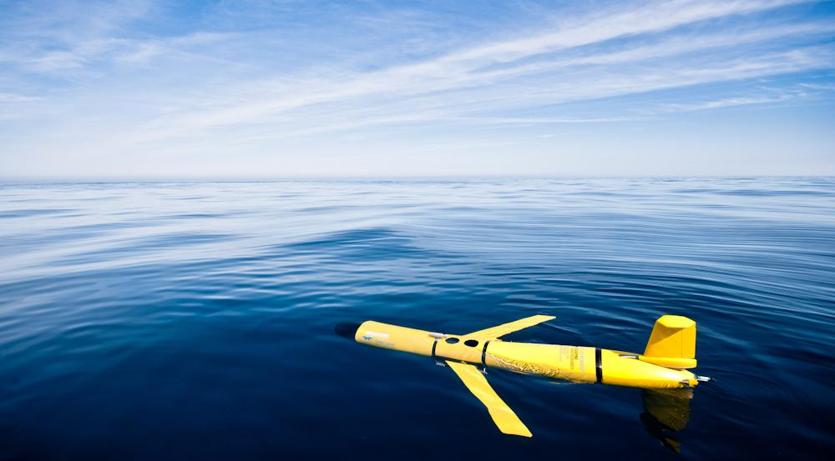
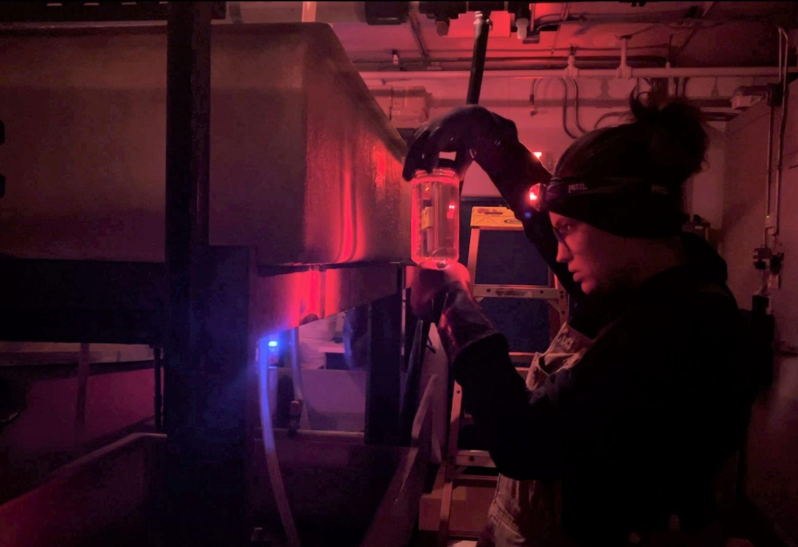
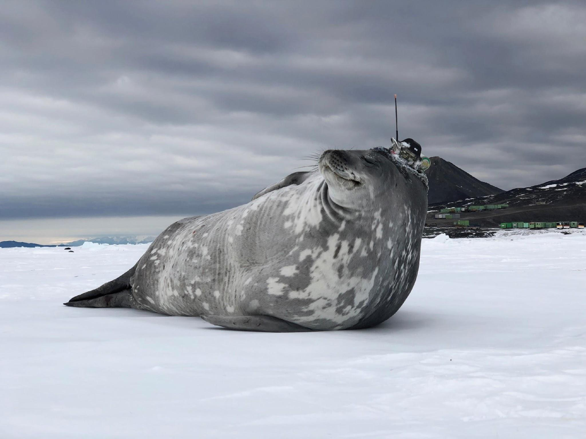
Thank you
goosocean.org

