Slide 1

Strategic Objective 1
GOAL 1
GOOS 12th Steering Committee meeting, 25 - 26 April 2023

Slide 2
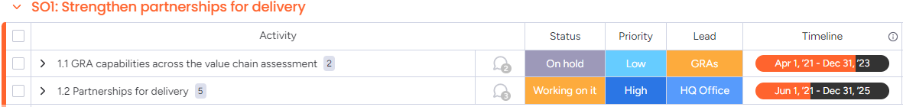
Actions
Strengthen partnerships to improve delivery of forecasts, services, and scientific assessments

Slide 3









Progress
WMO - sponsor and partner – a major focus placed on defining functional and strategic connections - RRR, work of OOIS (see later)
POGO – MOU, however needs some agreed actions
IODE - strengthened OCG/Data Strategy, OBPS, BioEco Panel/OBIS and Portal, ODIS Architecture
GCOS - strong connection maintained by OOPC for GOOS - IP, ECVs, request to provide a timetable for needs
GEO and GEO MBON - BioEco Panel, CBD, and work in Europe, not formal, however we could seek to formalise there is some interest, GEO Week in Nov 2023 in South Africa
UNEP - GEMS Ocean (update here), Regional Seas could be strengthened (CBD discussion), connection for marine debris EOV
Projects with partners OECD and MTS
Satellite community - CGMS and CEOS - GOOS Office has attended meetings, NASA connection to Co-Design, ESA connection to CoastPredict – new call SC members satellite contact

Slide 4








Progress
Modelling community – ETOOFS connected with new DCC (see Session 7), OceanPredict good relationship, SynObs and ECMWF in Ocean Observing Co-Design, EuroSea, CoastPredict, and Co-Design all work to connect for service delivery, GRAs and other regional systems are often observing and forecasting – GOOS could review with ETOOFS whether any learning, best practice or formalisation would help?
MSP community (IOC) - collaboration for a new project scoped (May)
UNFCCC – engagement via IOC
WOA – engagement via IOC
CBD – engagement via IOC
DOALOS – connection for EEZ issues
Racing yachts – IMOCA, Ocean Race (IOC, GOOS & OceanOPS) for remote deployments and communications
GESAMP - ocean plastic/marine debris strong connection
IOC Science Section – meeting to discuss more or better links for IOC-R, Blue Carbon, GOA-ON, HABs, often seem disconnected

Slide 5
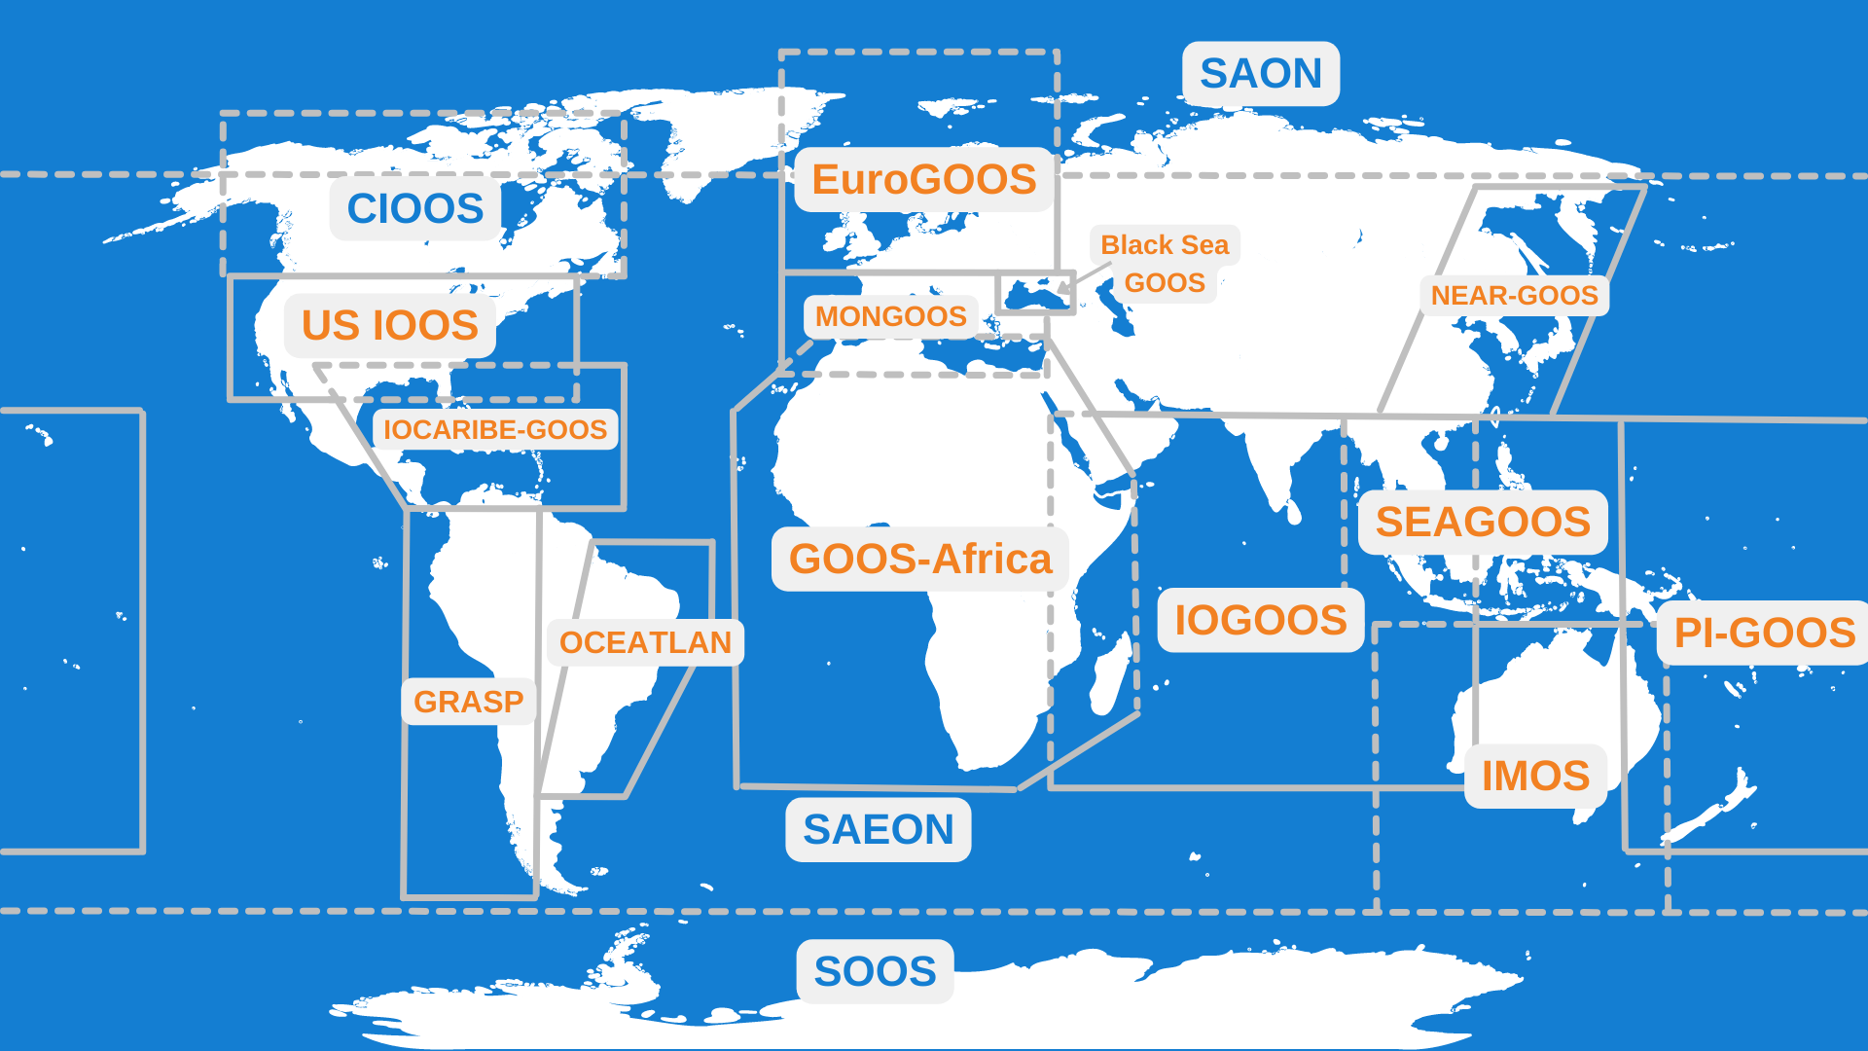
Progress/Achievements
GRAs
Assess GRA capabilities across the value chain - questionnaire prepared but not identified as a priority action for the GRAS so - ON HOLD

Slide 6
Outcomes & Assessment
No. | SO1 Outcomes | Assessments
1 | A strengthened, responsive and delivery-focused observing system | On track (40%) - systematic effort in this regard Co-Design, CoastPredict and projects like EuroSea, connection to UNFCCC, CBD, GCOS, national/regional observing and forecasting systems Argo undertake design assessment
2 | Established strong partnerships with key intermediary user organizations across climate, operational services and ocean health delivery areas | On track (30%) WMO perhaps largest single partner - underway but resources required to support this, developing with others
3 | An increase in fit-for-purpose ocean information products (forecasts, indicators, coastal warning) based on sustained observations | On track (30%) - not sure how we would monitor this, this a major component of Co-Design, CoastPredict and projects like EuroSea
4 | Ability to evaluate system for adequacy in meeting societal needs | Progress but slow (10%) - capability to do this through/with OceanOPS tools - need resource and work but possible - RRR work and Co-Design look to do this BUT will not possible without resource
5 | Improvement in the sustainability of the observing system individual components, through clarity on how observational data contributes to providing critical services | Progress but slow (20%) improvement, but not at stage where partners are stating strongly enough the need for observations

Slide 7
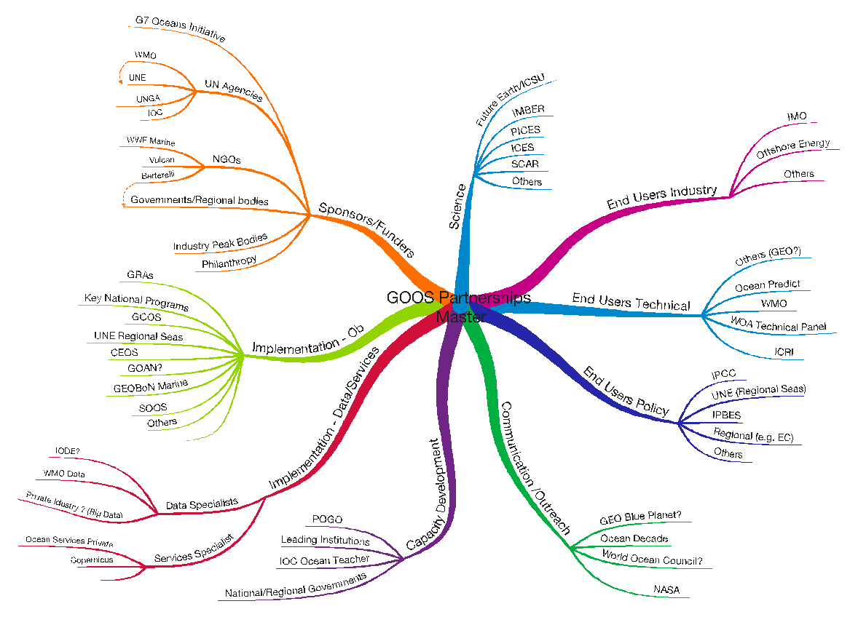
Gaps
1. No cross-GOOS map/visualisation of partners by type
2. GOOS Office has taken a prioritisation approach, other elements have happened organically as work on SOs and Decade Programmes progressed – but could this be more systemic?
3. Do we need more formalisation of some of these relationships?
4. Users not regularly engaged
5. GOOS Office should seek to interact with some end user communities

Slide 8






Next/Future Steps
Most partners are delivery partners in some sense
Identify our partner priorities (see end slide) through SC/Exec and the lead
Revise the partner mapping with key sectors for partnership and import for GOOS to have some spread of activity cross key sectors
Assess needs for WMO engagement and carefully set priorities - Agenda item 8.1, and others as they develop
For those underway, such as WMO, some regular review mechanism to ensure works for both parties - evaluation criteria e.g. from HBR Article (Kanter, HBR, 2009)

Slide 9
Next/Future Steps
Identify our partner priorities
WMO
UN Policy instruments (CBD, UNFCCC, BBNJ, WoA)
GCOS
IODE
GEO/MBON
MSP
Satellite community/actors
Modelling community actors
POGO
Other?
GSAMP?
3CS/CMEMS

Slide 10
Resource required - new
Consider a dedicated resource for partner engagement - as partnerships deepen and increase there will be a need for management of these links - this can perhaps be assessed by the partnership sectors and responsibility divided?
For now this is a GOOS Office function to take the lead or support component leads.

Slide 11

Partnership development (GOOS SC-8)
Evaluation criteria e.g. from HBR Article
Individual excellence. Both parties must have strengths on their own, weak players cannot prop each other up
Importance. The relationship must have strategic significance. If it is just casual, don’t bother.
Interdependence. The strongest and most enduring alliances occur when the parties are different in some respects and need each other to carry out an activity they would not otherwise do.
Investment. One sign of commitment is a willingness to invest something in the partner’s success, such as equities or personnel swaps (business “hostages for peace”).
Information. Transparency aids relationship formation. If you don’t want a partner to know too much about you, why are you in the alliance?
Integration. There must be many points of contact that tie the organizations together in joint activities.
Institutionalization. A formal structure and governing board ensures objectivity, and that alliance interests are considered, not just each company’s interests.
Integrity. Trust is essential. Alliances fall apart in conflict and lawsuits when partners do not act ethically toward one another nor strive to contribute to the other’s success.
Kanter, R.M. 2009. HBR

