Slide 1

Strategic Objective 7
Ensure GOOS ocean observing data and information are findable, accessible, interoperable and reusable, with appropriate quality and latency
Presenter: Mathieu Belbeoch, OceanOPS Manager, World Meteorological Organization, GOOS Office
GOOS 12th Steering Committee meeting, 25 - 26 April 2023

Slide 2
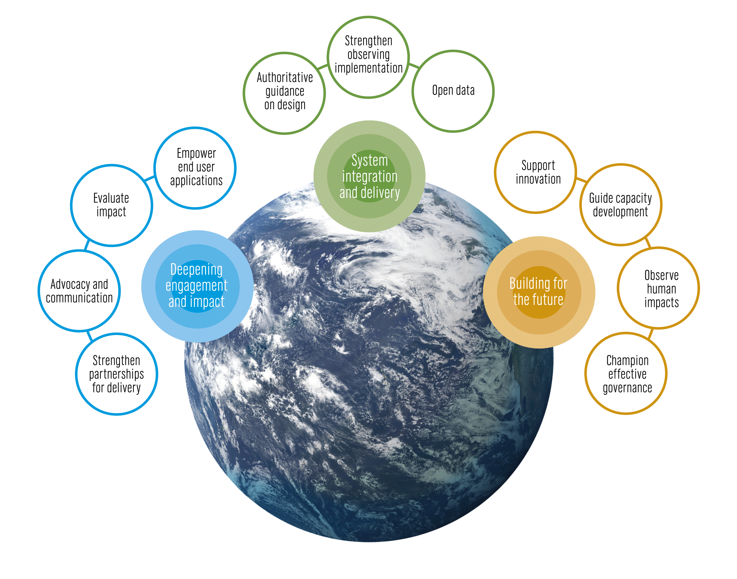
The GOOS 2030 Strategy
Notes:
The Global Ocean Observing System or GOOS is led by the Intergovernmental Oceanographic Commission of UNESCO and is co-sponsored by the World Meteorological Organization (WMO), United Nations Environment Programme UNEP and the international science council
The IOC Assembly in 2019 adopted a Global Ocean Observing System 2030 Strategy which now informs our work.
[vision] [mission]
Suite of Strategic Objectives which have become important to our planning:
System integration and delivery are the ‘core’ of GOOS ‘business’ today
Deepening engagement and impact are key priority areas for work – including developing partnerships for delivery, advocacy and communications
Building for the future are about building the additional pieces we need for a fully integrated system, including capacity development and innovation, and leading the development of a governance system for the future system that includes say partners and other stakeholders

Slide 3
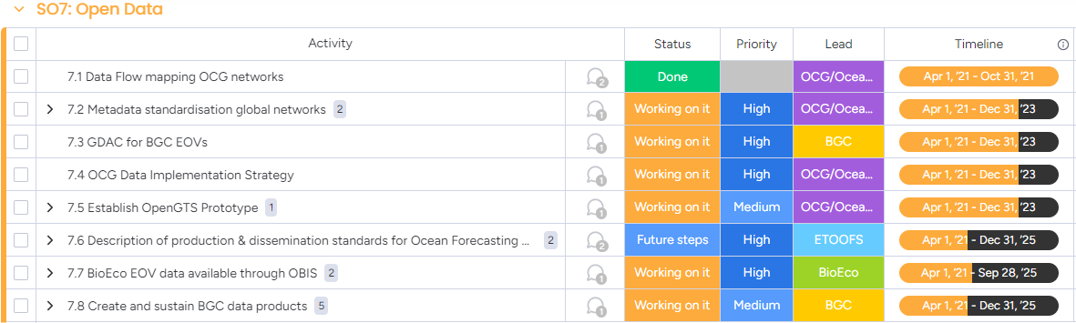
Actions
Ensure GOOS ocean observing data and information are findable, accessible, interoperable, and reusable, with appropriate quality and latency.

Slide 4
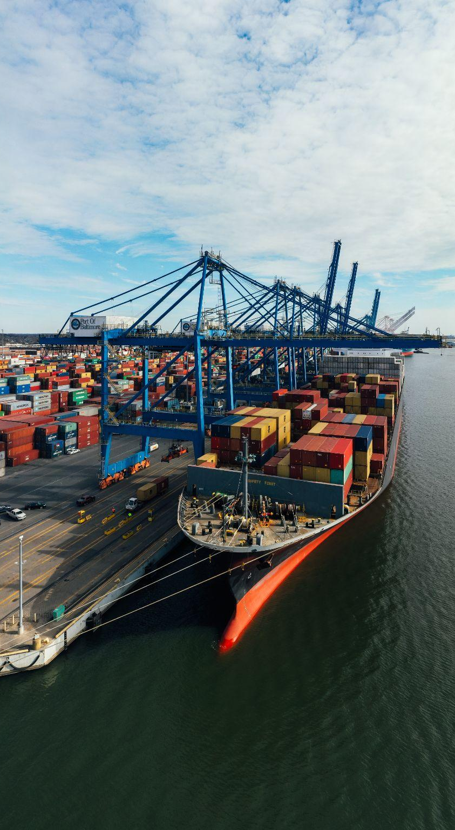
Action Progress-1
7.1 Data Flow Mapping OCG networks
Mapping the data and metadata flow across the OCG networks has been completed and provided to networks for verification
Mapping used for development of OCG Data Implementation Strategy and Recommendations
Initial dialogue with BioEco panel to support consistency in variety areas
Mapping should expand to (gridded) products, and result from metadata (agencies/roles)
7.2 Metadata standardisation global networks
harmonize metadata across networks through OceanOPS (monitoring capabilities/efficiency) - substantial contribution to WMO/OSCAR.
Fixed systems need progress (including coastal)
Work with IRSO (R/V metadata via MFP)
Initial discussions with OBIS
7.3 GDAC for BGC EOVs
Support creation and maintenance of a GDAC for BGC EOV data and where relevant design new data repositories capable of integrating EOV data from many heterogeneous sources. Value added product.
EOV access will be granted by federated data nodes
Notes:
7.2 - i) networks monitoring and coordination, ii) completing data distribution systems and iii) better serve user needs.
The IOC Executive Council at its Fifty-third Session adopted Decision IOC/EC-55/3.4, pertaining to Ocean Observations in Areas under National Jurisdiction. This decision requested the Executive Secretary to invite Member States to provide information on their experiences regarding sustained ocean observations in Areas under their National Jurisdiction including on the issues identified by GOOS through the Expert Workshop on “Ocean Observations in Areas under National Jurisdiction” (OONJ, GOOS Report, 246).
In the same decision, the IOC Executive Council also invited GOOS to provide detailed information on the issues regarding sustained ocean observations in areas under national jurisdiction identified in the report of the OONJ Experts Workshop. A survey to the global ocean observing networks has been undertaken to receive such information.
The Decision IOC/EC-55/3.4 also requested the Executive Secretary to compile and summarise the information received and report back to the IOC Assembly in 2023. Accordingly, responses to this letter and information received from GOOS will be compiled and summarized for reporting to the IOC Assembly in June this year

Slide 5

Action Progress-2
7.4 OCG Data Implementation Strategy
Draft implementation of the OCG Data Strategy developed and under revision
Development underway to improve discovery and access of distributed OCG data endpoints by uniting them through federated, uniform data services.
Evaluation of progress by network in Report Card (developing readiness levels)
7.5 Establish Open-GTS Prototype
Open-GTS pilot established the ability of ERDDAP services to support oceanographic communities to upload and download data from the GTS.
Open-GTS has been upgraded to a WMO WIS II Pilot project. Currently in discussions with WMO regarding how best to integrate these services into the WIS II structures. Pilot project will use data from Saildrone missions and Ship AIS metocean data going to GTS.
The Open-GTS was endorsed by the UN Ocean Decade as a formal activity in March 2023.
Integration of Open-GTS services with WIS II will ensure a smooth transition from GTS to WIS II over the next decade.
Open-GTS services are also piloting the use of alternative data formats to exchange in near-real time. This will benefit communities that prefer to use, for example, NetCDF data rather than BUFR.
Notes:
7.2 - i) networks monitoring and coordination, ii) completing data distribution systems and iii) better serve user needs.
7.6 There seems to be still a confusion. The GOOS BioEco portal is only programme level metadata (who is measuring what, where, how, when). To download EOV data you have to go to the OBIS portal, which is a completely different data system, and not yet connected to the GOOS BioEco portal.
The IOC Executive Council at its Fifty-third Session adopted Decision IOC/EC-55/3.4, pertaining to Ocean Observations in Areas under National Jurisdiction. This decision requested the Executive Secretary to invite Member States to provide information on their experiences regarding sustained ocean observations in Areas under their National Jurisdiction including on the issues identified by GOOS through the Expert Workshop on “Ocean Observations in Areas under National Jurisdiction” (OONJ, GOOS Report, 246).
In the same decision, the IOC Executive Council also invited GOOS to provide detailed information on the issues regarding sustained ocean observations in areas under national jurisdiction identified in the report of the OONJ Experts Workshop. A survey to the global ocean observing networks has been undertaken to receive such information.
The Decision IOC/EC-55/3.4 also requested the Executive Secretary to compile and summarise the information received and report back to the IOC Assembly in 2023. Accordingly, responses to this letter and information received from GOOS will be compiled and summarized for reporting to the IOC Assembly in June this year

Slide 6

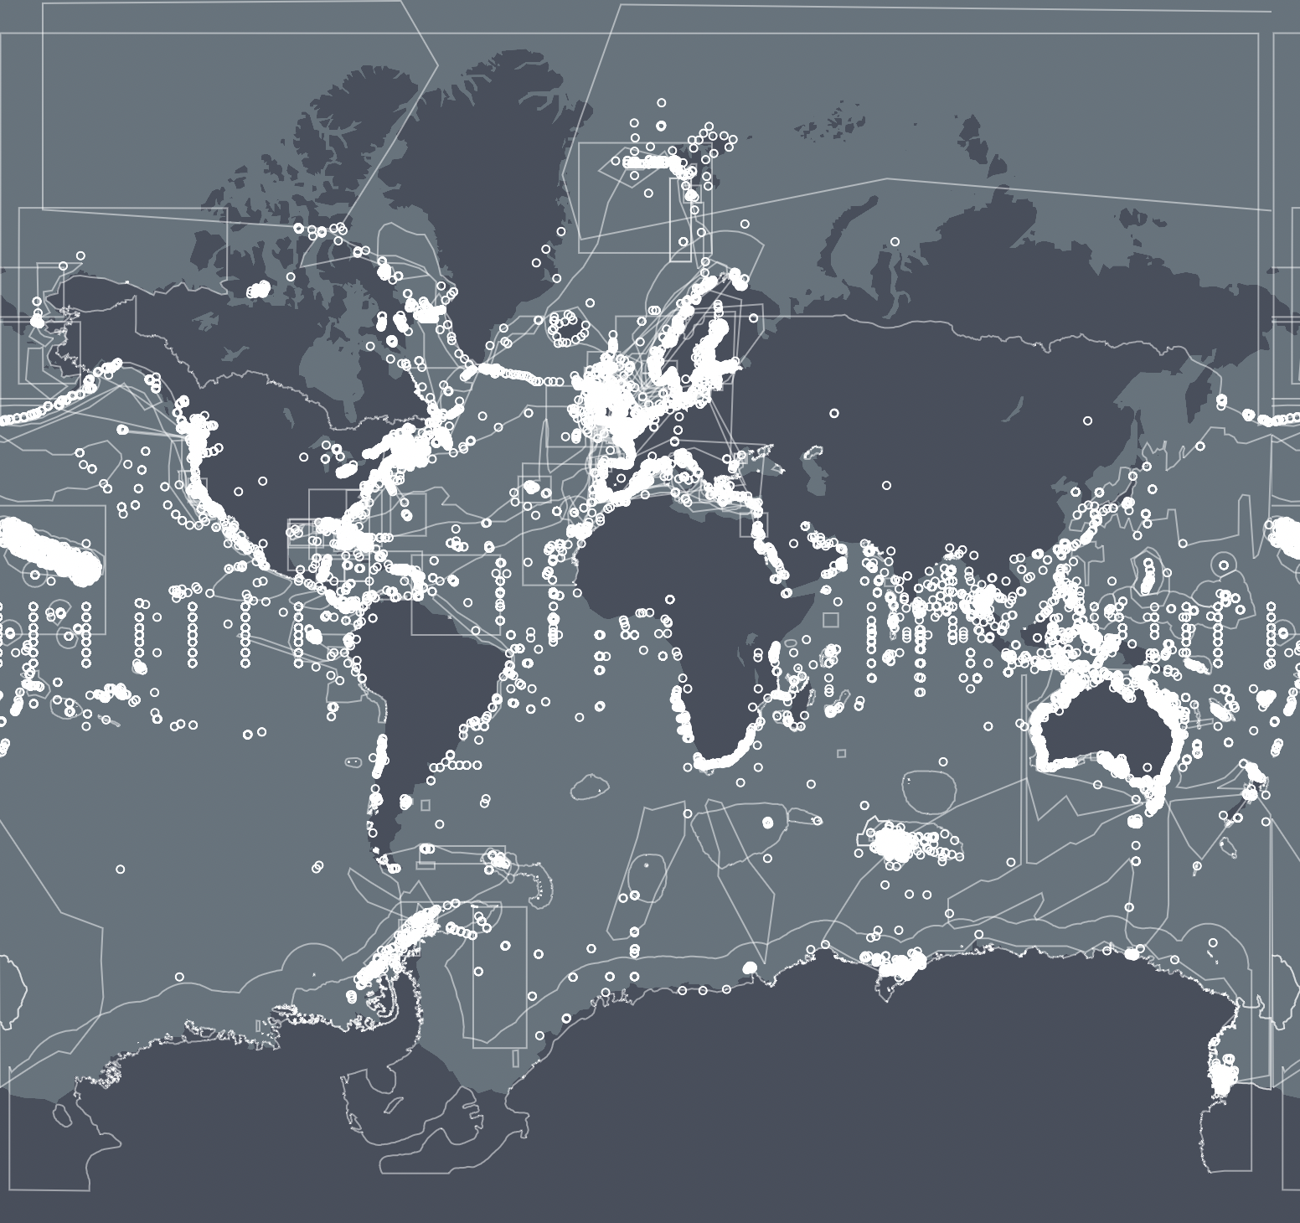
Action Progress-3
7.6 Description of production & dissemination standards for Ocean Forecasting
Released Guide on Ocean Forecast evaluation and metrics released
Reviewing existing and relevant standards applied within the GOOS network of operational ocean forecast centres and document them in a single document to serve as reference for the whole community.
7.7 BioEco EOV data available through OBIS
Launched GOOS BioEco portal 1.0 in collaboration with OBIS to provide metadata and information on networks monitoring BioEco EOVs. This is separate from the OBIS portal where data can be downloaded. ID issues in data availability (e.g. 65% macroalgae observations are not in the public domain with only 35% of data publicly available) [BIOECO input].
7.8 Create and sustain BGC data products
Working towards a sustainable multi-EOV and multi-platform system needed to fulfil the end user product requirements for various applications globally and regionally.
Notes:
7.2 - i) networks monitoring and coordination, ii) completing data distribution systems and iii) better serve user needs.
7.6 There seems to be still a confusion. The GOOS BioEco portal is only programme level metadata (who is measuring what, where, how, when). To download EOV data you have to go to the OBIS portal, which is a completely different data system, and not yet connected to the GOOS BioEco portal.
The IOC Executive Council at its Fifty-third Session adopted Decision IOC/EC-55/3.4, pertaining to Ocean Observations in Areas under National Jurisdiction. This decision requested the Executive Secretary to invite Member States to provide information on their experiences regarding sustained ocean observations in Areas under their National Jurisdiction including on the issues identified by GOOS through the Expert Workshop on “Ocean Observations in Areas under National Jurisdiction” (OONJ, GOOS Report, 246).
In the same decision, the IOC Executive Council also invited GOOS to provide detailed information on the issues regarding sustained ocean observations in areas under national jurisdiction identified in the report of the OONJ Experts Workshop. A survey to the global ocean observing networks has been undertaken to receive such information.
The Decision IOC/EC-55/3.4 also requested the Executive Secretary to compile and summarise the information received and report back to the IOC Assembly in 2023. Accordingly, responses to this letter and information received from GOOS will be compiled and summarized for reporting to the IOC Assembly in June this year

Slide 7
Outcomes & Assessment
# | SO7 Outcomes | Assessments
1 | An identified and tracked global observing system data architecture as part of broader oceanographic, atmospheric, and earth system data architectures. | In progress. Initial data flow mapping complete, shared with OCG networks for verification. OCG working on improving access to distributed data endpoints through federated, uniform data services. [OCG]
2 | Data products based on Essential Ocean Variables and Essential Climate Variables available in a timely manner, with appropriate quality. | Needs clarification on
3 | More data available, more appropriately, to more users. | Slow progress. Data availability to users is being addressed through the OCG data implementation strategy. Developed but not implemented. This will be relevant and implemented for panels and needs to be ensured to cut across the observing system at large. More work to do on BioEco public data availability. [BioEco, OCG]
4 | Availability of meaningful data metrics. | In progress. Being developed for OCG global ocean networks but not finalized or verified. [OCG, BioEco]
5 | [NEW] Updated and verified metadata standards for biological observations. | Need to progress on fixed points and BioEco. [BioEco]
6 | [NEW] GDAC for BGC EOVs. | GDAC Implementation has stalled since the collapse of data management in Bergen. [BGC]
7 | [NEW] Open-GTS Prototype and interactions with WIS/WIS2.0. | Open-GTS formally endorsed as UN Ocean Decade Activity. Discussions with WMO are ongoing regarding the integration of Open-GTS services as part of WIS 2.0. [OCG]
8 | [NEW] Production and dissemination standards for Ocean Forecasting. | On track. Lacking in requirements and biology. Progress with WMO RRR. [OCG, BioEco, Co-Design]
9 | [NEW] BioEco EOV data availability | On track. 50~60%
8 | [NEW] BGC data products | GLODAP and SOCAT mature, but lack sustained funding. Ship-based BGC time-series data product development on track. Global Ocean Oxygen Atlas development on track (roadmap published, Steering Committee formed and kick-off meeting took place). [BGC]
Notes:
DATA AVAILABILITY BIOECO: for example of the macroalgae 47 programmes ID in Europe run by 35 different organisations:
65% did not have their data in a public domain
67% said they were not obliged to put their data in the public domain
Reasons for not publishing in open access: their publications first (29%), not allowed (12%), not standardised
(12%), and others (48%).
OCG data strategy - to be published after review

Slide 8

Major challenges
FAIR data principles are not uniformly implemented in global networks and need endorsement and support. This includes real-time data sharing across ALL network etc.
Enhanced resources and support for data management activities.
BioEco resources for activities depleted amongst others, restricting the work that is able to be accomplished [BioEco portal work, IPO etc.].
Metadata management gaps across the networks and panels are stagnant. More support is needed to ensure successful integration of other network metadata into OceanOPS and the support of other panels.
Notes:
Emerging networks…. Which(from BGC and BIOECO and GRAs) are ready to join OCG… (resource limitations within OCG and OceanOPS)...?

Slide 9

Potential actions/decisions
Expand data flow mapping to include products and national data centers.
Publish and implement data strategy across the OCG global ocean observing networks and into WMO WIS 2.0 and IODE/ODIS efforts.
Utilize Horizon Europe projects “MARine COastal BiOdiversity Long-term Observations” and “Blueprint for Integrated Ocean Science” to advance data delivery, data flows and metadata specifications of biological data.
How do we leverage and bring together global and coastal data challenges across all GOOS disciplines?
How do we incentivise publicly open data sharing among the community, improve adoption of data management best practices and what resources would be required?
How do we incentivise support for data activities [processing, metadata etc.] or collaboration with other initiatives?
Notes:
MOU between GOOS and MBON and OBIS need to be renewed, Panel would like to propose the MOU that GOOS Exec can implement
The BioEco Panel co-chairs are currently discussing potential attendance at the GRA Forum (date still being decided but likley to be early 2024) to discuss emerging BioEco networks and to further facilitate uptake of BioEco EOVs into the GRAs.

Slide 10

Thank you
goosocean.org

