Slide 1

Strategic Objective 6
Strengthening and expanding system
Presenter: David Legler, NOAA GOMO Director, OCG Chair, GOOS SC ex officio
GOOS 12th Steering Committee meeting, 25 - 26 April 2023

Slide 2
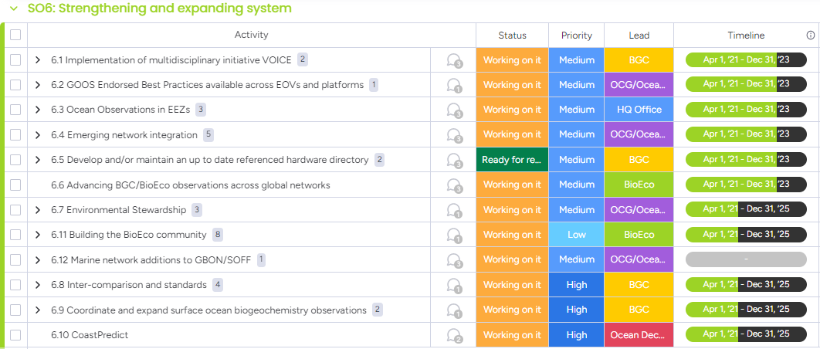
Actions (12 of them!)
Sustain, strengthen and expand observations coordination through GOOS and partner communities, promoting standards and best practices, and developing metrics to measure success
Notes:
For GBON/SOFF integration, we have a deadline of Dec 31 , 2023, to provide finalized Technical specifications (SST, SLP) and integration mechanism of identified ocean requirements in the EEZ.

Slide 3
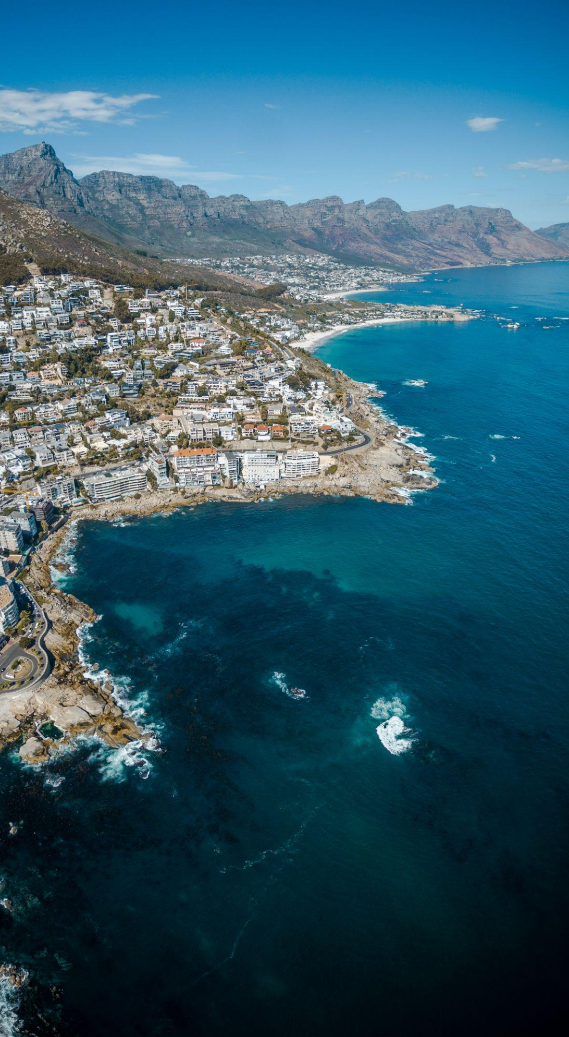
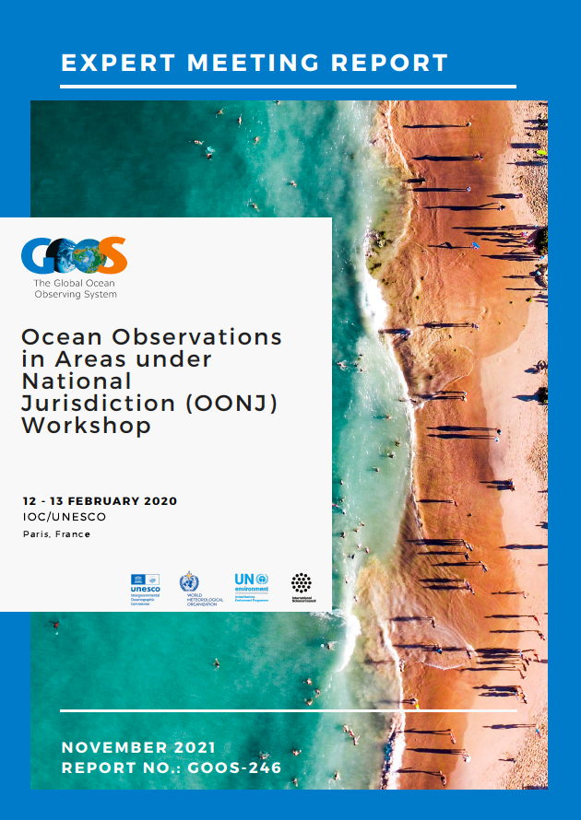
Progress/Achievements-1
6.3 Ocean Observations in EEZs
Published the OONJ Workshop Report (GOOS Report No. 246)
Raised at IOC-55 - Decision IOC/EC-55/3.4
IOC GOOS Network Survey completed (for all OCG networks)
IOC CL 2938 to collect feedback from member states
WIGOS Manual section 3.2.2.11
6.4 Emerging network integration
3 emerging networks transitioning from pilot to mature status [AniBOS, OceanGliders, HF Radar]
Potential new networks interacting with OCG [Smart Cables, Ship based ocean time series, USV OASIS, Marine Debris]
IRSO (connected through OceanOPS)
6.12 Marine network additions to GBON/SOFF
For GBON/SOFF integration, by Dec 31, 2023, to provide finalized technical specifications with DBCP and SOT (SST, SLP), integration mechanism of identified ocean requirements for EEZ.

Slide 4
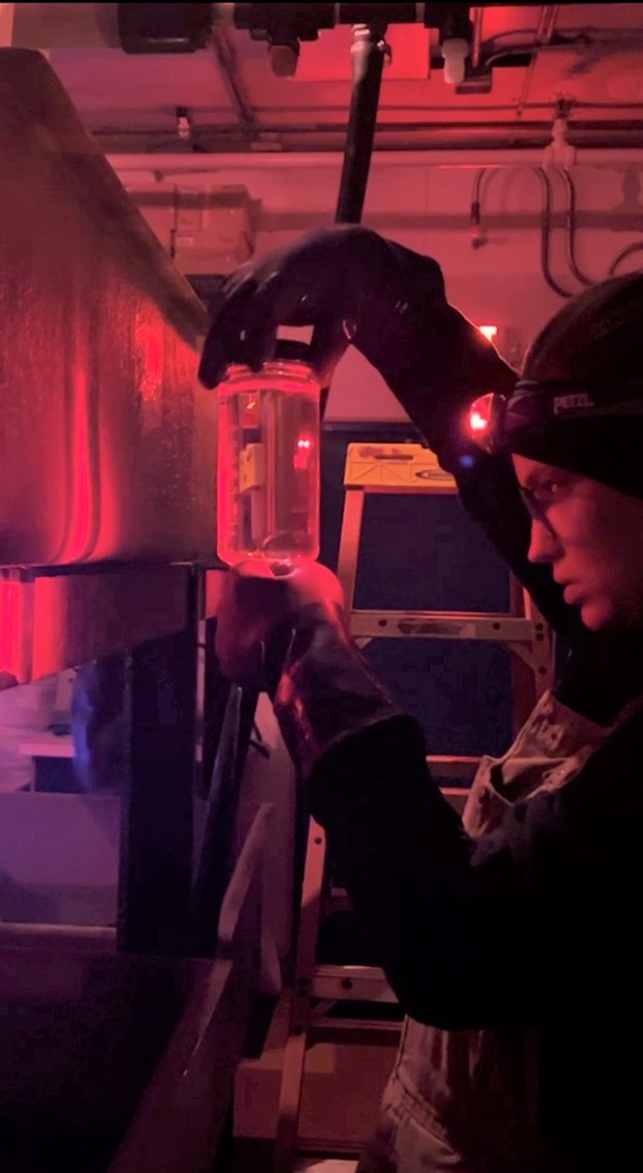
Progress/Achievements-2
6.6 Advancing BGC/BioEco observations across global networks
  Piloting Bio-GO-SHIP on cruises (https://biogoship.org/cruise-plans/) and Data Workshop
  Euro-GO-SHIP initiative
  Development and launch of BioEco Portal 1.0 for access to metadata and information on BioEco networks
  OneArgo - 500+ BGC floats are being deployed
6.11 Building the BioEco community
  G7 FSOI includes Marine Life priority theme
  Inter-sessional workshop in Europe focused on plankton (Sept)
  Zooplankton paper published after workshop in 2021
  GRA: Regular meetings with IMOS, pursuing more routine interaction with broader GRA, support to GOOS Exec in re-establishing PI-GOOS.
  Contribution to the EuroSea project
  D1.2 Map of BioEco Observing networks/ capability >> portal
  D1.4 Report on European BioEco networks
  New EU Horizon proposal building a blueprint for implementing BioEco observations
Dr. Kim Bernard’s student, Giulia Wood, examining krill samples. Credit: Dr. Kim Bernard
Notes:
Bio-GO-SHIP Data workshop included discussion of mapping Bio-GO-SHIP data repositories and data flows

Slide 5
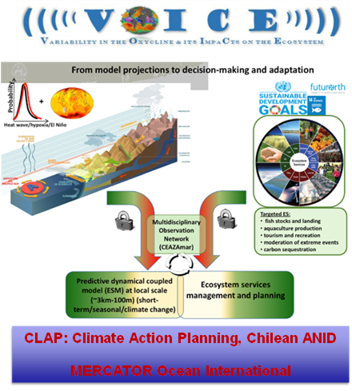
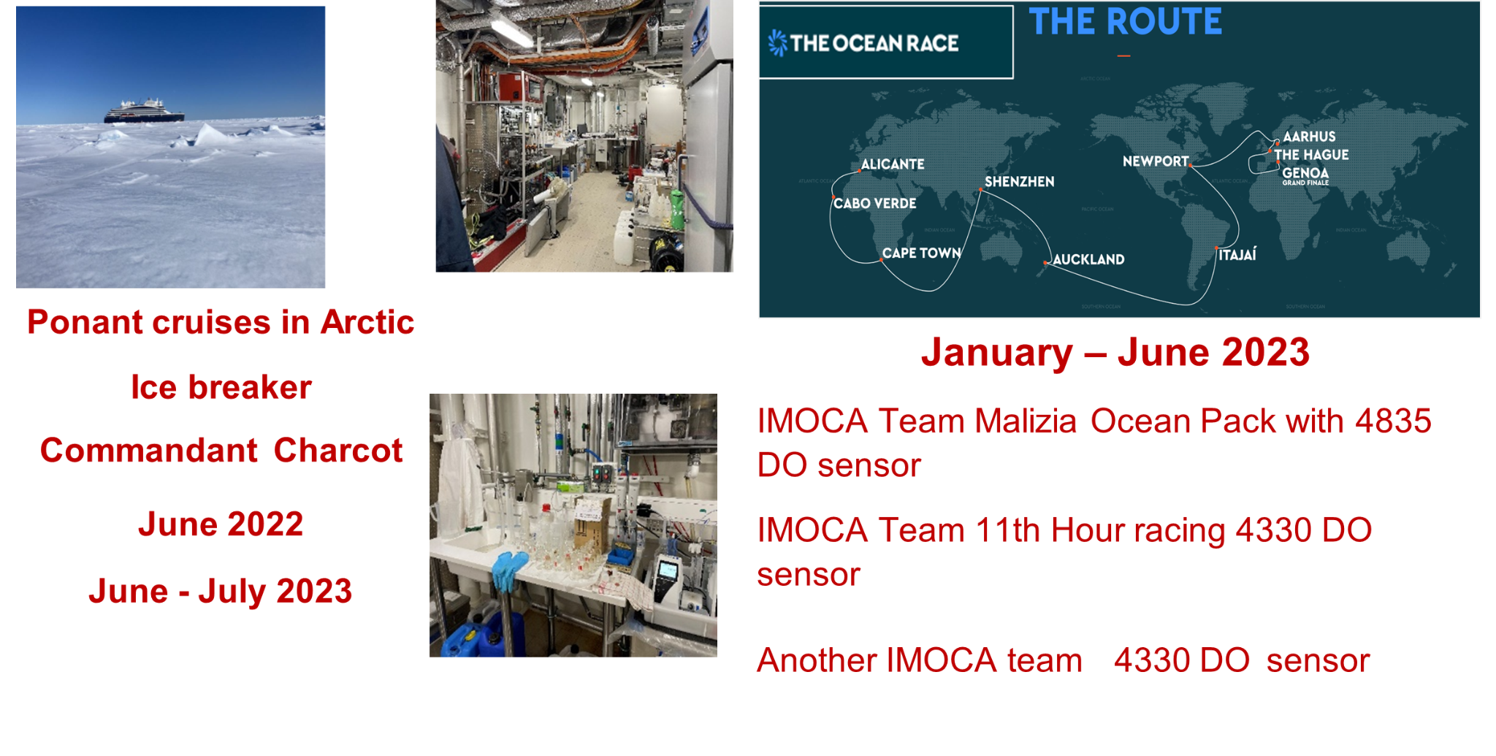
Progress/Achievements-3
6.1 Implementation of multidisciplinary initiative VOICE
Now integrated into the UN Ocean Decade Programme GOOD (Global Ocean Oxygen Decade) to which IOCCP contributes
6.5 Develop and/or maintain an up to date referenced hardware directory
OOS BGC Panel continues to maintain such a directory available from
6.8 Inter-comparison and standards
Organize a pCO2 intercomparison exercise
Address the global crisis in supply and distribution of seawater carbonate chemistry Reference Materials (crucial task, working on it)
Nutrients in the seawater (on going)
6.9 Coordinate and expand surface ocean biogeochemistry observations
Establishing the Surface Ocean CO2 Reference Network (SOCONET)
A series of workshops on pCO2 observations, synthesis and data products to be held in Belgium November 6-9, 2023, to address gaps and move forwards on an integrated surface ocean CO2 observing system covering:
  - data acquisition (SOCONET and beyond);
  - data collation and QC (SOCAT); and
  - data synthesis and product development (SOCCOM, (two C's), and beyond).
Notes:
6.1 The regional implementation of VOICE is being pursued in collaboration with the ANID Chilean project CLAP. During the GOOD-OARS-CLAP-COPAS International summer school to be held at La Serena in Chile in November 2023 (http://www.ceaza.cl/summerschool/), there will be a 1 day workshop with local stakeholders. There is a network of coastal moorings along the Chilean coast acquiring multidisciplinary observations and since 2021 BGC-ARGO and Argo with O2 sensors are being deployed from Peru to central Chile. During this stakeholder day, the readiness levels of the three FOO pillars with respect to the fit for purpose of observing variability of the oxycline and its impact on the ecosystem will be discussed and assessed.
6.9 This is to be carried out through the Surface Ocean Carbon Reference Network (SOCONET) to achieve targets set by SOCONET as an observing network under SOOP; the effort would also contribute to the wider Strategy for Surface Ocean Observations as described in the SCOR WG OASIS proposal. This is to be carried out through the Surface Ocean Carbon Reference Network (SOCONET) to achieve targets set by SOCONET as an observing network under SOOP; the effort would also contribute to the wider Strategy for Surface Ocean Observations as described in the SCOR WG OASIS proposal.
Surface ocean biogeochemistry observations have been expanding through citizen science actions: partnership of GOOD/OARS with the Ponant cruises in the Arctic and with the Ocean Race (see https://www.theguardian.com/environment/2023/mar/25/southern-ocean-race-science-sailing)

Slide 6
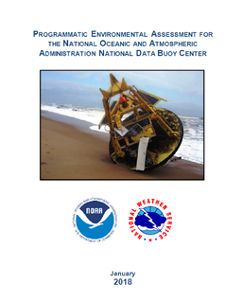
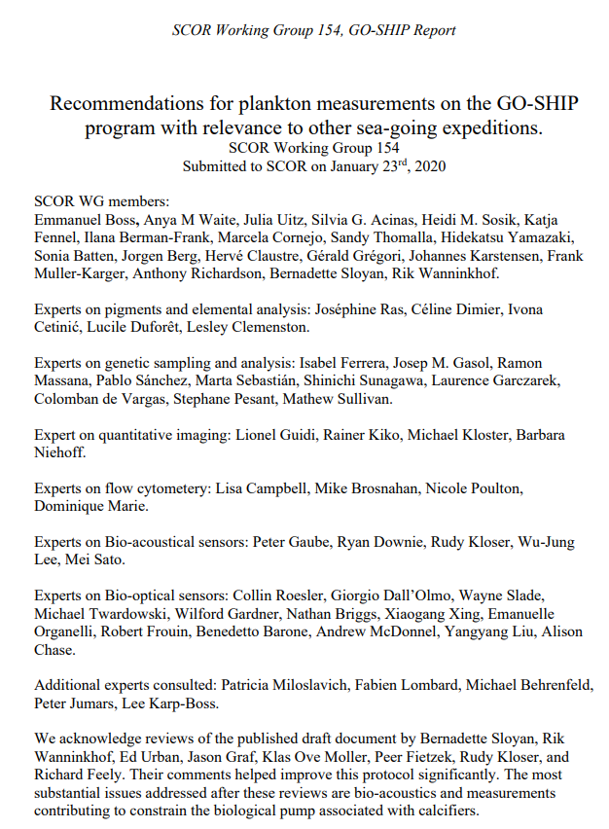
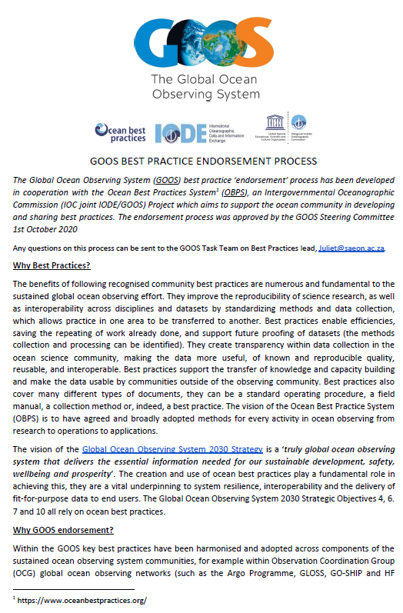
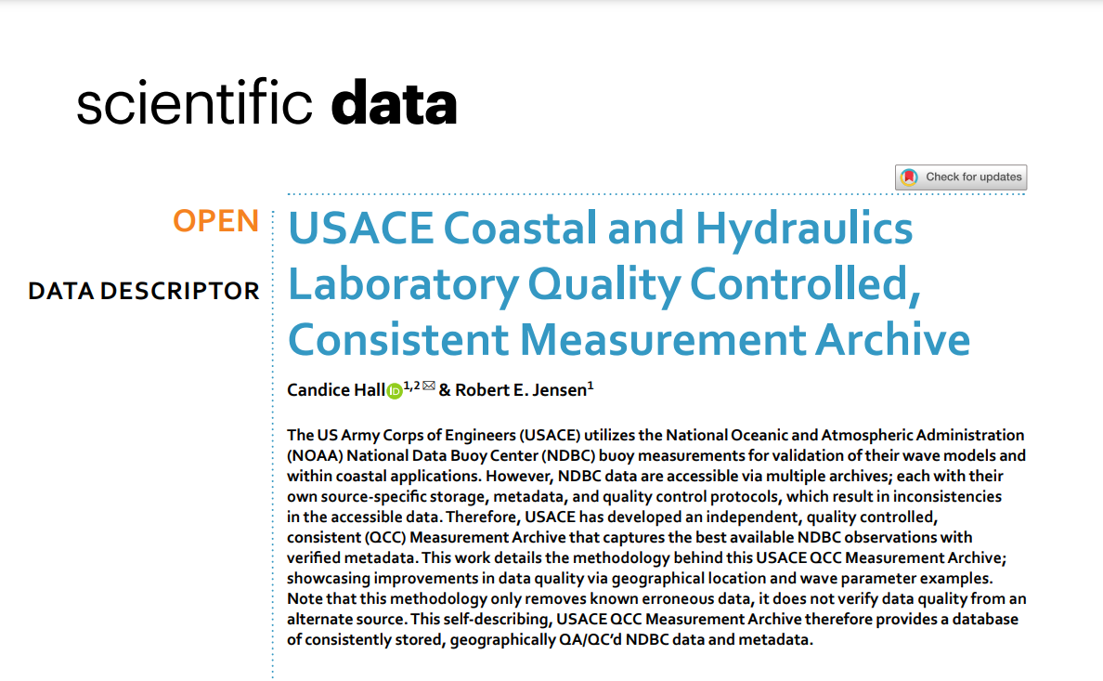
Progress/Achievements-4
6.2 GOOS Endorsed Best Practices available across EOVs and platforms
  6 Best Practices endorsed, 3 in process
  Strong links with OASIS and further development of BPs there
  Request for people to contact Juliet with recommended BPs
6.7 Environmental Stewardship
DBCP is making progress, and a survey to go out
Connected with SC-ON rep on ES, and potential contribution to World Meteorology Technology Expo in Oct 2023
Overview assessment of already existing for Argo and needed ES statuses in development for OCG Networks
Notes:
OBPS: Recommendations for plankton measurements on the GO-SHIP program with relevance to other sea-going expeditions (SCOR Working Group 154 GO-SHIP Report) was endorsed.
as a side note BP is actually taking long as in a number of cases the BP have to be written first

Slide 7
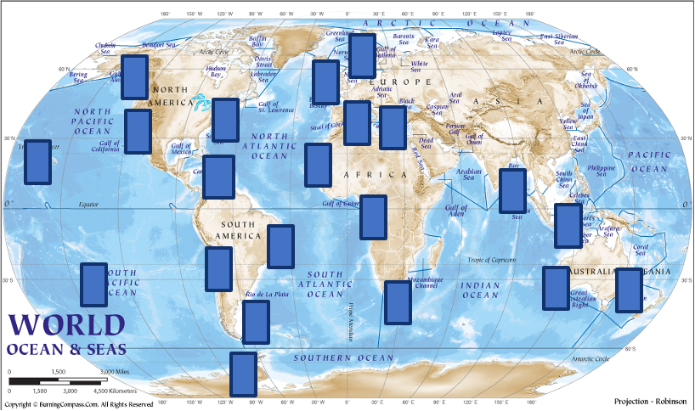
Progress/Achievements-6
6.10 CoastPredict (continue)
CoastPredict is contributing to redefine the science of observing and predicting the Global Coastal Ocean. It focuses on common worldwide features of the coastal ocean to design systems and solutions that can be implemented locally in coastal locations worldwide, in a global framework.
General Assembly, Bolonia, 17-19 January 2023;
3 Projects & 4 Affiliated Projects endorsed by UN Ocean Decade with scientific strategies for potential solutions.
The Global Coastal Experiment has been developed to establish fit-for-purpose coastal observing and prediction systems;
  Will coordinate the implementation of the CoastPredict Focus Area science and technology advancements in several coastal areas of the world ocean using guidance principles and common protocols
  Planning well underway: criteria for selection of the first 5-10 coastal/regional areas being defined
  Structure of the Digital Platform for the different Test Sites being defined with relevant stakeholders: working towards PPP
The Global Coastal Ocean Experiment
~10 coastal world ocean test areas
Notes:
6.10 CoastPredict
Co-design and implement an integrated coastal ocean observing and forecasting system adhering to best practices and standards, designed as a global framework and implemented locally
For nations: responsive & fit-for-purpose systems into coast to address many challenges: 30x30, carbon sequestration, shipping/ports, hypoxia, storm surge, climate impacts
The Global Coastal Experiment developed to establish fit-for-purpose coastal observing and prediction systems for new process understanding and in support of an innovative value chain that will produce better services and solutions for coastal resilience.

Slide 8
Outcomes & Assessment
No. | SO6 Outcomes | Assessments
1 | Increased efficiency in use of resources. | Slowly progressing (behind)
2 | More uses of data and more users served - enhanced delivery to end users across an integrated observing system. | Slow progress. Data flows mapped, uniform metadata standards/content in progress, data implementation strategy under review. Work needed on BioEco open data availability. Visibility of an integrated system lacking. No systematic approach to documenting use/users.
3 | A system for identifying and sharing of best practices and adoption of common approaches. | On track, system in place, needs more action to complete. Updating of BioEco EOVs will lead to ID of BP and common approaches, still some work to be done and support needed.
4 | Increasing the number of observing networks, sensors and platforms with a Technology Readiness Level of 7 or more. | Slowly progressing. Negative impact of COVID, but recovering. Working on expand the attributes based on the FOO and report card, 3 tiered OCG network readiness level. TRL level of BioEco EOVs need work and support to improve.
5 | Coordination towards achieving common goals across global, regional and national systems. | Behind. Support and improved mechanisms for activities and coordination across GOOS components is needed. [Co-Design / agreed priorities ]
6 | Expansion and evolution into new areas, identified through requirements and supporting emerging communities focused on solving global needs. | Lacking. More support needed for BioEco community to advance requirement setting and increase coordination and TRL improvement.
7 | Increased interoperability of ocean data from variety of sources. | Big challenge. Steady, slow progress with data mapping/data strategy as first steps. Integration across OCG, BioEco, and BGC panels needs more work. [OCG, BioEco, BCG]
8 | Support for sustainability through participation in a global integrated system. | Not yet (message is not strong enough. Report card is a good job, but not enough for sustainable funding)
Notes:
5. A lot of things on going? Local to global gaps. EH comment: we don’t really have a mechanism to set common goals, Implementation Plan Impact and Co-Design is doing some of this - do we need some overarching priority areas for lifting the observing system?
6. Progress in microplastics . a number of activities outside the boundary of GOOS, we are not engaged.
7. On track
8. Happy to work with communication. Find a way to . piece of information. Generating stakeholders? To put into the gap

Slide 9
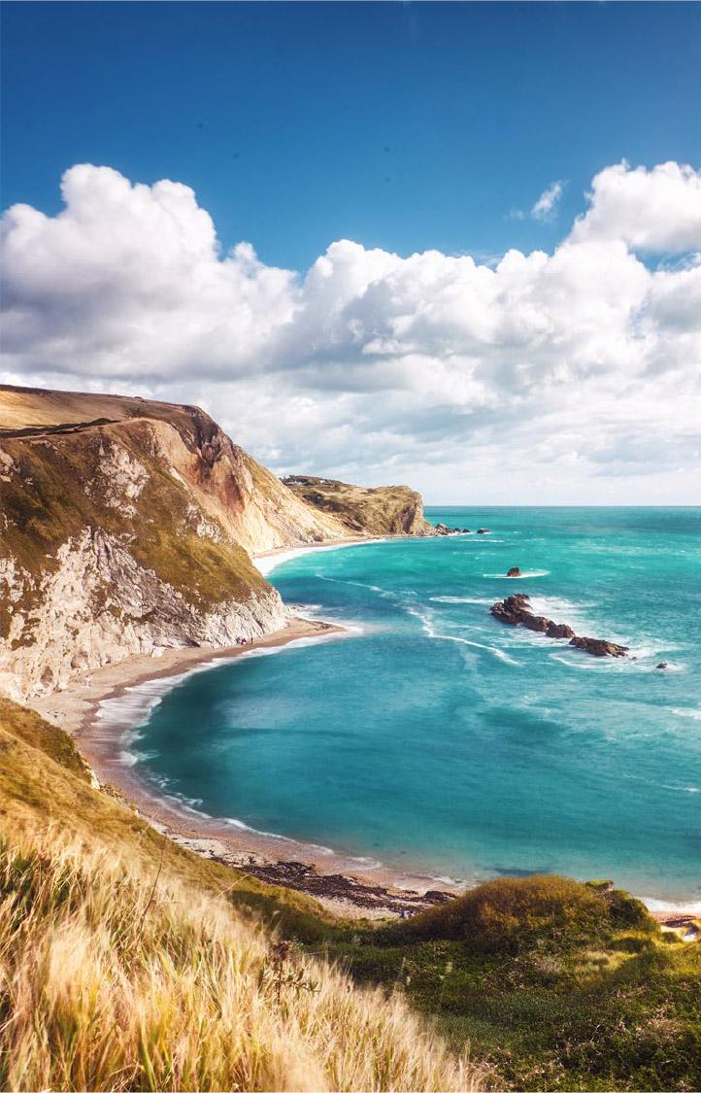
Major challenges
Continued erosion of resourcing of many ocean observations (inflation will make it worse).
We have no guide or process to prioritize observing activities (and OCG/OceanOPS time/attention) that serve different requirements and standards. How do we coordinate/prioritize? Will GOOS prioritize?
Respective roles of OCG in support of/contrast to the BioEco, BGC (no effective dialogue) panels and communities. Contrast communities of practices around networks (OCG) vice variables. There needs to be more dialogue and coordination around a shared organizational vision.
Developing an integrated, interoperable and highly functional data management framework that provides discoverability and access to metadata and data of known quality across a broad range of communities and stakeholders. Much work remains to create a fully integrated data system.
Engaging and guiding private sector interests and resources (Challenge and Opportunity).
Notes:
EH: GOOD CHALLENGES
Emerging networks…. Which(from BGC and BIOECO and GRAs) are ready to join OCG… (resource limitations within OCG and OceanOPS)...?

Slide 10

Potential actions
Enhance current partnerships through establishment of MOU between GOOS, GEO BON/MBON and OBIS, building on 2016 partnership agreement
Continue with OCG data strategy development (expand across GOOS?), network reporting (eg via report card), & Best Practices
Encourage panels, UND projects/programmes, and other in GOOS to work with modelers to catalyze studies for WMO Impacts Workshop in 2024. Does we need a complementary workshop to fill in gaps?
We need a process across GOOS to assess readiness and prioritize observing actions (eg new networks, invest in advancing TRLs).
Work closely with regional organizations, national governments, and local communities to develop integrated observing strategy, for example OCG, Bio-Eco Co-Chairs could attend GRA meetings.
Develop a strategy to engage the private sector/industry (following GOOS/MTS Industry Dialogues)
Notes:
MOU between GOOS and MBON and OBIS need to be renewed, Panel would like to propose the MOU that GOOS Exec can implement
The BioEco Panel co-chairs are currently discussing potential attendance at the GRA Forum (date still being decided but likley to be early 2024) to discuss emerging BioEco networks and to further facilitate uptake of BioEco EOVs into the GRAs.
https://obis.org/2016/12/15/goosgeobonobis/

Slide 11

Thank you
goosocean.org

