Slide 1

SO5: Authoritative guidance on design
GOAL SYSTEM INTEGRATION AND DELIVERY
GOOS 12th Steering Committee meeting, 25 - 26 April 2023
Notes:
The activities under this strategic objective respond to the need to work towards an integrated global system, where design maximises impact. The only clearly-stated global GOOS design responds to climate and is not yet fully integrated.
(reminder for us, not to read aloud)
Aims of the SO Reporting:
Provide to the SC a view of progress after 4 years of development in the line of the 2030 Strategy, receive input, ideas, and advice on priorities.
Find areas for better collaboration or combined action, remove dormant actions, evaluate progress, gaps, next steps, complete actions/add actions, integrate and work with the Ocean Decade Programmes
Opportunity through discussion to identify key questions, barriers and opportunities across GOOS – are the outcomes defined in 2019 still relevant, do we have the right structure and focus?
Outline PPTs for each SO in this folder this week, the PPTs (10 or 15 slides/minutes depending on the MAX to give to help gather the information – achievements, assessment of where GOOS is, next steps, and questions/insights/suggested changes

Slide 2
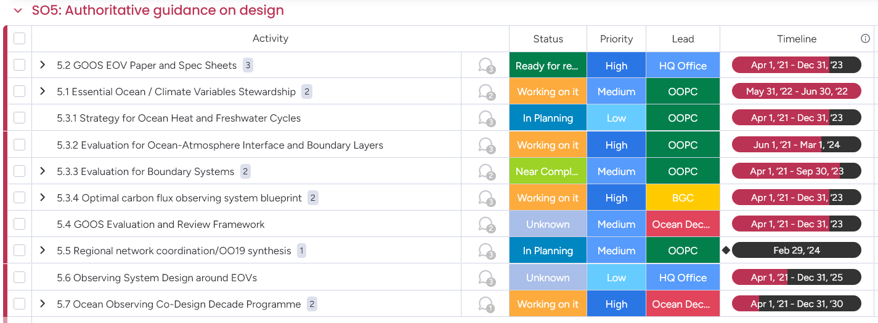
Actions
Provide authoritative guidance on integrated observing system design, synthesising across evolving requirements and identifying gaps
Notes:
This slide does not really need explanation beyond saying that OOPC leads most of this, and this shows that there is a bias towards climate/physical variables. But in fact, there are many other activities taking place lead by BGC and BioEco that probably need to be better reflected. Obviously, even if these activities are lead on paper, by OOPC, most of them are in partnership with OCG and the BGC and BioEco panels. Thanks to them for the input they provided.
---→ comment from BioECO----May be necessary to point out that there is no lead by BIOECO, which is a big gap, there has been development of BioEco EOVs providing guidance of what variables need to be observed in this space, how do we guide update? (BIOECO PANEL INPUT]

Slide 3
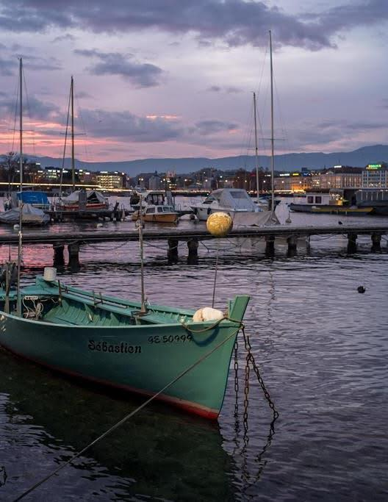
1- Achievements(1)
5.1 Essential Ocean/Climate Variables Stewardship
New template produced, which can be used both to EOV and ECVs
ECVs requirements publicly reviewed and updated in 2022 including 11 physical, 6 geochemical and 2 biological)
Ocean Actions in GCOS IP, COP27
5.2 GOOS EOV Paper and Spec Sheets
1st draft ready for a discussion with GOOS Exec.
New EOVs and EOVs subvariables: Marine Debris, Ocean Sound, Seagrass, Bottom Pressure.
5.3.1 Strategy for Ocean Heat and Freshwater Cycles
Preparatory work: concept paper being written; this needs interaction across GOOS panels and with CLIVAR
5.3.2 Evaluation for Ocean-Atmosphere Interface and Boundary Layers (OASIS)
OASIS is funded as a SCOR Working Group and endorsed as a UN Ocean Decade programme. It has engaged a large multidisciplinary community to advance capacity to monitor air-sea interactions globally
Notes:
YOU CANNOT GO INTO DETAILS HERE!!! I would say very briefly that the requirements for climate, reflected in the ECVs, have been updated and published, and this concerns the three panels, that there are efforts to provide clarity and “easy of use” to the EOV framework (new templates, paper), and that there are also a number of activities well developed and looking at different aspects of the observing system and providing recommendations: boundary currents, air-sea fluxes , carbon flux blueprint… and that it is all connected to the development of the Observing Co-Design programme, and you jump to the third slide (Observing Co-Design) and explain that there has been a very strong mobilization and that, if successful, Observing Co-Design programme could be fulfilling many of the activities under this strategic objective, leveraging other efforts.

Slide 4

1- Achievements(2)
5.3.3 Evaluation for Boundary Systems
Dialogue Webinars (observation and modeling) around 6 boundary systems, papers in Conferences
Change of leadership and connection with Boundary Current exemplar in Observing Co-Design programme
Community White paper presenting main recommendations (close to final draft)
5.3.4 Optimal carbon flux observing system blueprint
This activity is well underway in collaboration with G7/FSOI, ICOS-OTC, US NOAA among others, and connected with WMO GHG monitoring initiative, submitted to WMO Congress (June 2023).
5.4 GOOS Evaluation and Review Framework 🡪 integrated in Observing Co-Design programme
5.5 Regional network coordination/OO19 synthesis
Preparatory work Attempt a truly global pan-tropic ocean observing system design. It requires a strong coordination with CLIVAR, and a high-level meeting took place in March 2023.
5.6 Observing System Design around EOVs🡪 integrated in Observing Co-Design programme

Slide 5
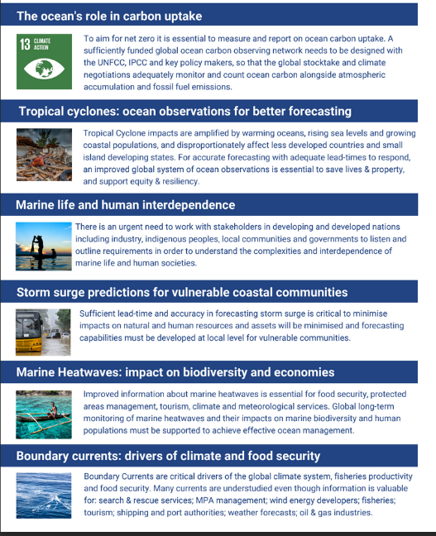
1- Achievements(3)
5.7 Ocean Observing Co-Design Decade Programme
HUGE mobilisation of communities around 6 exemplars up and running
Strong efforts to engage with stakeholders (Forum)
Complementary to other GOOS efforts focused on climate
High visibility and connections with other GOOS components.
  Boundary currents —> connected with 5.3.3 Evaluation for Boundary Systems
  5.4 GOOS Evaluation and Review Framework and 5.6 Observing System Design around EOVs are integrated in the Observing Co-Design umbrella and process.

Slide 6
2. Outcomes & Assessment
  SO5 Outcomes
Refined designs for observing the essential global observations required for global societal needs that maximize return on investment
A modular design approach to guide and support implementation decisions at regional and national level
Greater efficiency in investment towards enhancing observing capacity
Transparency in establishing and communicating on design requirements
  Assessmentssment
  1. More progress is needed (30%)
Criteria: There are examples of refined designs in different degrees of accomplishment: TPOS, TAOS, IndOOS, OASIS, BSTT… however, this is mostly around climate applications. BGC and BioEco variables are less well covered, and improved design does not always lead to implementation.
2. Low progress (10%)
Criteria: only a few steps have been taken. E.g. GOOS/CLIVAR Workshop and Observing Co-Design approach
3. On track (50%)
Criteria: progress made, amongst other means, through the EOV process and building observing networks around EOV, which also foster new developments.
4. More progress is needed (30%)
Criteria: EOVs and ECVs specification sheets available. ECVs reviewed publicly and updated regularly, but guidelines not published and there isn’t a homogeneous approach to system reviews
Notes:
So now, how far have be got towards the achievements of the 4 outcomes for this strategic objective that you see there? The assessment was “tempered” (we had been too optimistic) after the preparatory meeting we had a couple of weeks ago and after receiving feedback from BioEco.
Just some extra NOTES
TPOS:
TPOS 2020 has completed its mission on re-designing the Topical Pacific Observing System by taking into accounts of
(1) the response to the increasing user requirements (both climate, weather and S2S service),
(2) expanding over the western Pacific Ocean in response to the concerns on typhoon and Asian monsoon monitoring and forecasting,
(3) enhancing the system integration (double Argo over tropics, in situ+satellite observation, stronger buoy resolution of ocean mixed layer and air-flux enhancement),
(4) exploring the new technology (such as sail-drone) and multi-disciplinary observation
TPOS 2020 is successful in engaging the stakeholders into the re-design process, including NOAA, JAMSTEC/Japan, SOA/China, IRD/France, BMKG/Indonesia and others. This makes the recommendations easily taken by the implementers. Still TPOS 2020 has the weak engagement with the Pacific Island countries, eastern Pacific coastal region.
It now evolves into its implementing phase, called TPOS.

Slide 7
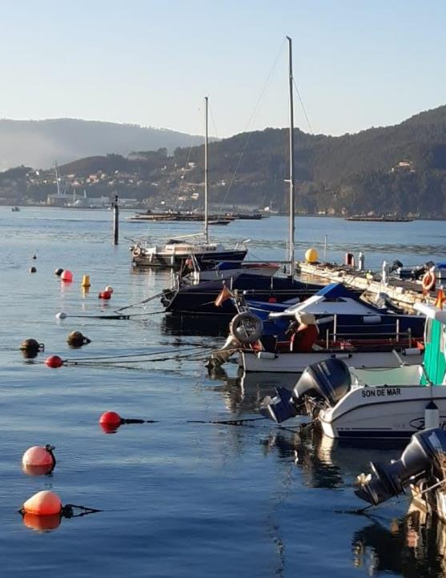
3. Gaps (around outcomes)
1.A Publishing recommendations does not suffice to change the observing system
While many reviews are published, this does not mean that implementing agents react to them. Still progress in needed for non-climate applications.
1.B The observing system needs to consider the modeling community
More engagement is needed with different operational services (not only ocean) SynOPS is taking part of this challenge now.
Need to include other disciplines, e.g. BioEco and modeling needs in this space are we observing what is needed to improve models? ]
2 From global to local: not so straightforward
The recommendations from the global system are not necessarily ready to be used by national/regional actors. Observing Co-Design can help here.
3 Optimising investment: yes but still not sustained…
Investment from nations/funding agencies will not be easy if 2 does not happen and the benefits of global systems are made clearer.
4 Requirements definition still not fully transparent
EOVs and ECVs requirements are published online, but still lacking visibility to the operational agencies, unless we embark in the WMO RRR process.
Selection criteria is not totally transparent.
Notes:
In my opinion, we should focus more on the gaps, in particular in those gaps that we can fix by ourselves more or less confidently.
Probably the transparency (4) is the outcome which should be more easily “fixed”, if we finalise the EOV paper, update the EOVs specification sheets etc; it is something that requires work, but it is not so dependent on external factors.
The 1.B (modelling) is, in my view the most original one… I think we do not talk enough about this within GOOS. BioEco added a line on this part.

Slide 8

4. Future steps (around outcomes)
1. In terms of refined design:
Activities continue: OASIS, BSTT, Regionalization of Earth Cycles etc/Heat and Freshwater budget and fluxes. Most of them are cross-GOOS.
Focus the cross-panel efforts on specific activities. E.g provision of input into GCOS Status Report and Implementation Plan (Climate Application area) or provision of guidance/input on potential EOVs new platforms could observe (e.g. surface vehicles)
Bridges need to be consolidated between the in situ and the modeling (different domains) community around a clear activity
Improve connection between panels and OCG
2. In terms of implementation by nations/regions
Encouraging the creation of national GOOS and/or better connection with GOOS National Focal Points
Taking advantage of EU grants (if successful), where several projects are related to GOOS, namely using the EOV/ECVs requirements and explore other sources at national level.
Notes:
This slide is a little bit repetitive with the previous one when you read it. The previous ones highlights the gaps and here we say how to solve those gaps. I think you can say read the previous one (gaps) a little bit faster and expand more on the solutions we suggest in the following two slides. I think we can also already indicate what things are more feasible or at least, what things fall under OOPC responsibility.
For instance, I think we can do 1 and 4. and get some result. I do not think we can do 2. Number 3 (investment) and everything that has to do with cost-assessment also seems difficult.
We should also expect some comment from BioEco and BGC here, they should have things to say also under 1!!!

Slide 9

4. Future steps (around goals)
3. In terms of greater efficiency of investment
Following with the approach using EOVs to focus investment, a more integrated, cross-domain approach could be pursued
Connections with OECD could be explored (cost-benefit analysis)
4. In terms of transparency on establishing and communicating on design requirements
Important to get the EOV paper published, after sufficient discussion at the level of GOOS Exec.
The (probably) new EU-funded projects on EOVs/ECVs will improve the visibility of the requirements process at a European level. But we need to identify how this could be expanded in other regions for adoption.
The engagement in the WMO RRR process (including ocean carbon requirements) will probably have a large impact, as it will be reflected in regulatory material which is binding for WMO members.
Notes:
I really see 3, as kind of far away. 4 seems more feasible, but we must make sure BGC is happy about it (providing their requirements and embarking in the RRR process). Same with ETOOFS. They should be providing requirements for ocean mesoscale forecasting and real time monitoring, are they willing to do this?

Slide 10
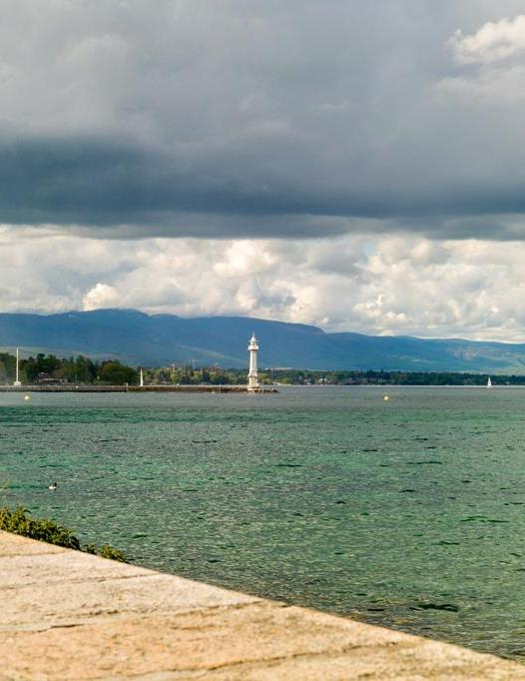
5. Resource implications
More personnel is needed to support the establishment of linkages between the myriad of on going activities and to ensure that synergies are taken advantage of, communication is in place etc.
This applies very particularly to the Observing Co-Design programme but also GOOS components

Slide 11

6.Questions/Thoughts
Suggested changes
Are there alternatives to meetings? The activities are proliferating, and greater communities are getting involved, how can we manage that?
In particular, how can we make sure we keep each other informed, between the panels and with OCG, to work together towards and integrated truly global ocean observing system?
If we envisage that we will not be able to get more resources to support coordination, where should we prioritize?
Notes:
BIOECO input---Can we map out how the different GOOS components interact to implement GOOS 2030 strategy to ID common activities that involve more than meetings? If so, how could these be funded? Relevant also for 3, how do we prioritize with limited funding?

Slide 12

Thank you
goosocean.org

Slide 13
SO5. Provide authoritative guidance on integrated observing system design, synthesizing across evolving requirements and identifying gaps - (from GOOS Road map) – REMINDER of TEXT in ROADMAP
Issue
The requirements for the ocean observing system are expanding rapidly, with users in different economic sectors requiring information at different levels of quality and latency. Creating individual observing systems focused on the needs of each delivery area is clearly not sustainable nor economic. An integrated global system needs guidance on design to maximize impact, balanced with the feasibility of implementing different options - both technical and for resourcing. The only clearly-stated global GOOS design responds to climate and is not yet fully integrated.
Implementation
GOOS will enhance its undertaking of multidisciplinary assessment and synthesis across a range of evolving requirements, in order to guide and support implementation decisions from global to regional, and across platforms, networks and technologies. This starts with an understanding of the needs for ocean information for public policy, government, citizen and private sector decision-making, to respond to questions related to our understanding of the complex whole earth system, and the information products and services that serve these applications. Requirements then are expressed against scientific or operational applications, the ocean phenomena, Essential Ocean Variables (EOVs), Essential Climate Variables (ECVs) and Essential Biodiversity Variables (EBVs), and time and space scales, that need to be sustainably observed to inform those applications defined; also considering the complementary design of satellite and in situ observing networks. Through cycles of assessment, defining requirements, providing implementation planning/guidance, and tracking, the design of the system is evolved. The process of triggering and supporting these reviews needs to evolve in the next years.

Slide 14
Outcomes
Refined designs for observing the essential global observations required for global societal needs that maximize return on investment
A modular design approach to guide and support implementation decisions at regional and national level
Greater efficiency in investment towards enhancing observing capacity
Transparency in establishing and communicating on design requirements
Role of GOOS (to stimulate discussion)
Authoritative advice is expressed through the EOV Specification Sheets and reviews from the GOOS Panels and Projects. The three GOOS Expert Panels provide scientific oversight on Physics and Climate, Biogeochemistry, and Biology and Ecosystems. They are involved in horizon-scanning and dialogue with the community over emerging areas of need for coordinated and sustained observations, and the subsequent development of EOVs and on focus areas for community evaluation and review. The GOOS Projects have a key focus on improving system design around specific areas. This is a part of GOOS current core coordination activity. The Observation Coordination Group global observing networks develop network targets and are influenced by the information and requirements identified in the reviews, as well as factors such as new technology, operational feasibility and resource. Current reviews include, the Tropical Pacific Observing System 2020 Review, the Heat and Freshwater Review.
Potential partners (to stimulate discussion)
Global Climate Observing System is a key partner for climate, with the Intergovernmental Panel on Climate Change (IPCC) Working Group 1 (The Physical Science Basis) and Working Group 2 (Impacts, adaptation and Vulnerability), and the United Nations Framework Convention on Climate Change (UNFCCC). The WMO, specifically the Integrated Global Observing System (WIGOS), Observing Systems Capability Analysis and Review Tool (OSCAR), the National Meteorological and Hydrological Services and ocean forecasting centres, are key partners for operational services. The development increased partnership in the value chain (Strategic Objective 1) will provide feedback on requirements from a user perspective and will strengthen the responsiveness of the system and its design to meet user requirements. The BioEco Panel works closely with the GEO BON Marine Biodiversity Observation Network (MBON) in integrating Essential Biodiversity Variables with biological Essential Ocean Variables. The Committee on Earth Observation Satellites (CEOS) and the Group on Earth Observations (GEO) for integrated design. -

