Slide 1
Tsunami Service Provider Report
Pacific Tsunami Warning Center
Charles McCreery, Director
NOAA Pacific Tsunami Warning Center
charles.mccreery@noaa.gov

Slide 2
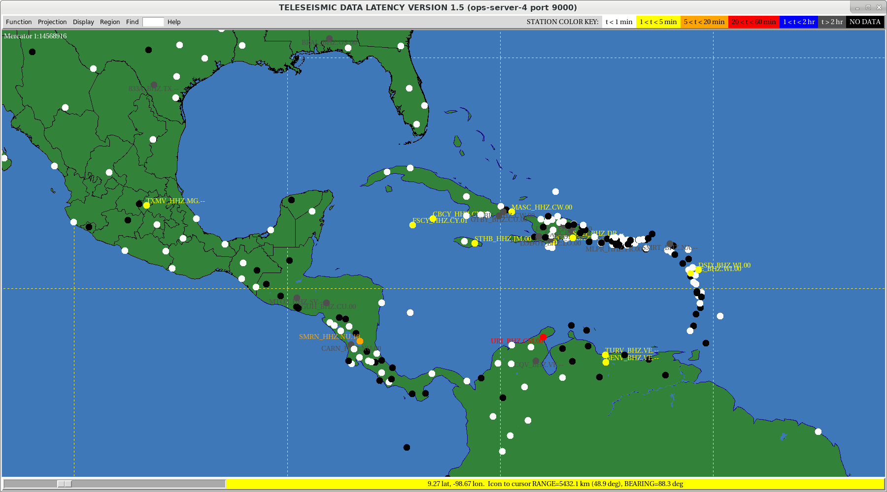
Sensing Network: Seismic – 4/20/23
Snapshot on 4/20/23
White Dots are Active

Slide 3
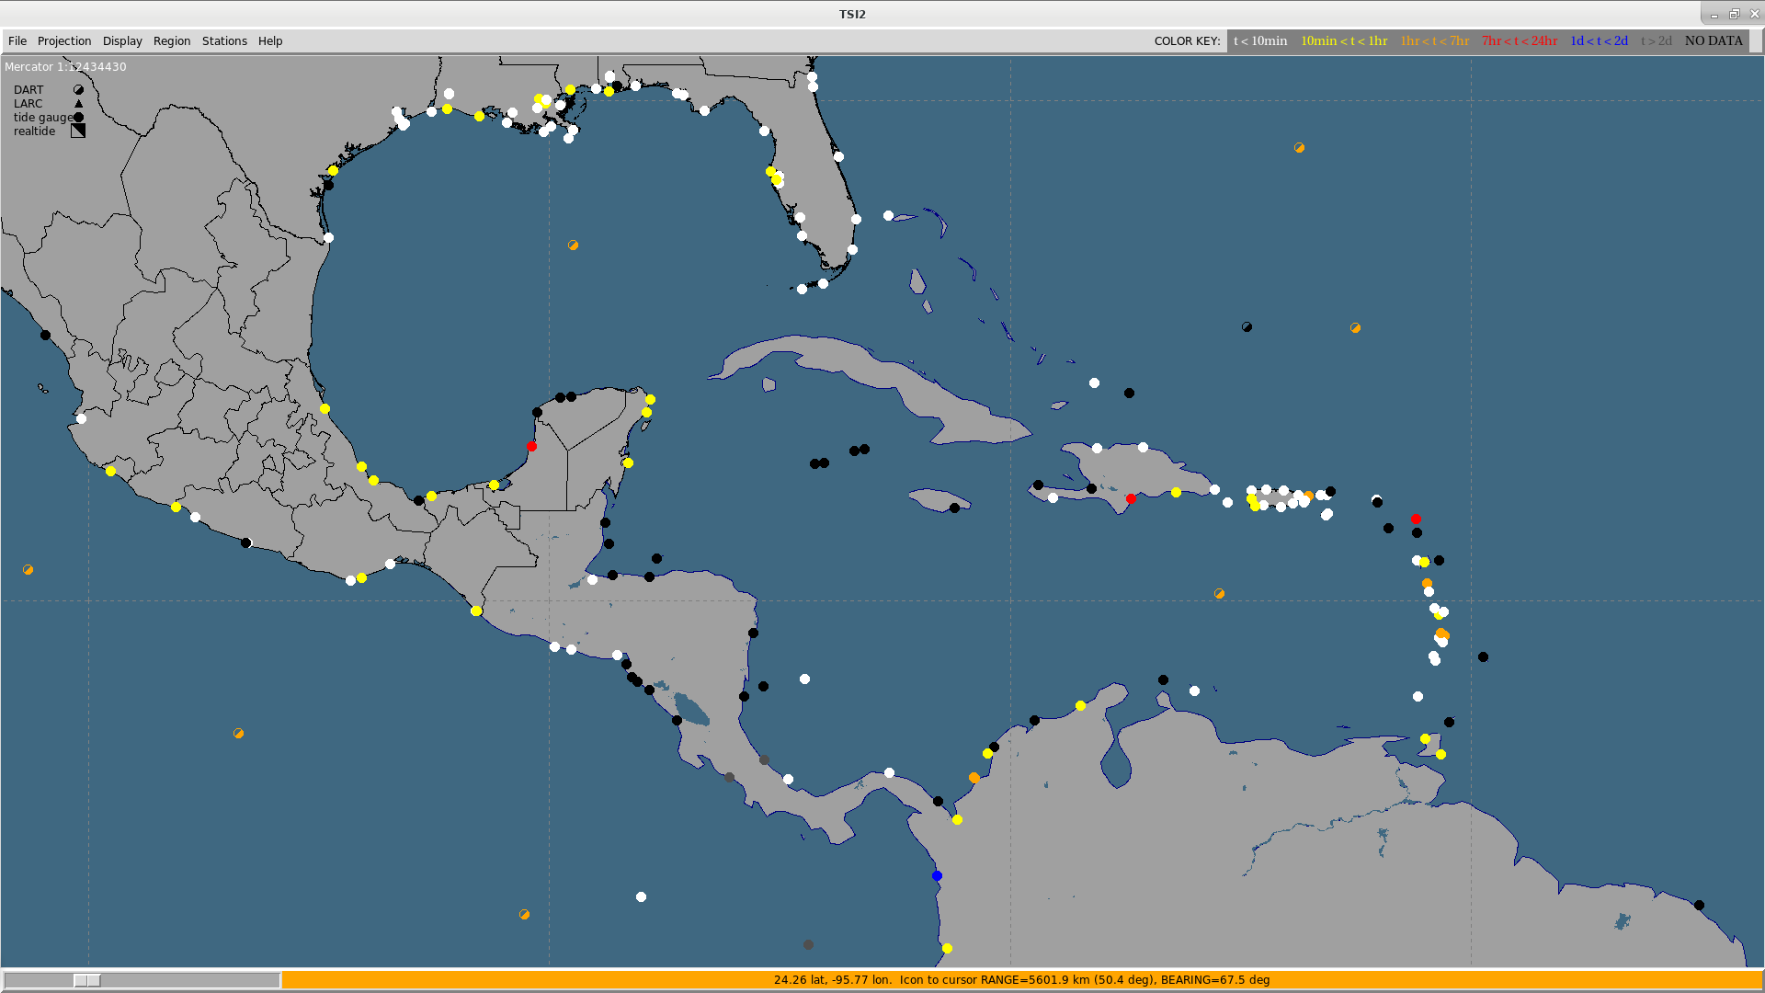
Sensing Network: Sea Level – 4/20/23
Half-Shaded Dots are DARTs
Snapshot on 4/20/23
White/Yellow/Orange Dots are Active

Slide 4
9 Message Events: 04/25/2021 – 04/20/2022
PTWC EARTHQUAKE PARAMETERS |  |  |  | PTWC PRODUCTS
Origin Time (UTC) | Location | Mw | Depth (km) | Type | # | Elapsed Time
08/12/2021 18:32 | SOUTH_SANDWICH_ISLANDS_REGION | 7.6 | 78 | INFO | 1 | 00:13:27
08/12/2021 18:32 | SOUTH_SANDWICH_ISLANDS_REGION | 7.6 | 78 | INFO | 2 | 00:48:59
08/14/2021 12:29 | HAITI_REGION | 7 | 10 | INFO | 1 | 00:09:39
08/14/2021 12:29 | HAITI_REGION | 7.2 | 10 | THREAT | 2 | 00:49:52
08/14/2021 12:29 | HAITI_REGION | 7.2 | 10 | THREAT | 3 | 01:48:52
08/16/2021 11:10 | SOUTH_SANDWICH_ISLANDS_REGION | 7.1 | 33 | INFO | 1 | 00:09:58
08/22/2021 00:45 | SOUTH_SANDWICH_ISLANDS_REGION | 7.1 | 10 | INFO | 1 | 00:08:57
08/22/2021 21:33 | SOUTH_SANDWICH_ISLANDS_REGION | 7.2 | 10 | INFO | 1 | 00:11:03
01/15/2022 04:26 | TONGA | 0.1 | 0 | INFO | 1 | 14:52:40
01/15/2022 04:26 | TONGA | 0.1 | 0 | INFO | 2 | 15:08:47
03/22/2022 16:35 | NORTHERN_MID-ATLANTIC_RIDGE | 6.7 | 10 | INFO | 1 | 00:10:57
09/04/2022 09:42 | CENTRAL_MID-ATLANTIC_RIDGE | 6.8 | 10 | INFO | 1 | 00:28:21
09/29/2022 03:03 | EAST_OF_THE_SOUTH_SANDWICH ISLANDS | 6.7 | 33 | INFO | 1 | 00:10:46

Slide 5
Message Events – Key Performance Indicators
PTWC EARTHQUAKE PARAMETERS |  |  |  | PTWC PRODUCTS |  |  | USGS PARAMETERS
Origin Time (UTC) | Location | Mw | Dep km | Type | # | Elapsed Time 10 min | ∆Mw 0.3 | ∆Dep (km) 30 | ∆Loc (km) 30
8/12/2021 18:32 | SOUTH_SANDWICH_ISLANDS_REGION | 7.6 | 78 | INFO | 1 | 00:13:27 | 0.1 | 31 | 23
8/12/2021 18:32 | SOUTH_SANDWICH_ISLANDS_REGION | 7.6 | 78 | INFO | 2 | 00:48:59 | -0.5 | 31 | 23
8/14/2021 12:29 | HAITI_REGION | 7.0 | 10 | INFO | 1 | 00:09:39 | -0.2 | 0 | 19
8/14/2021 12:29 | HAITI_REGION | 7.2 | 10 | THREAT | 2 | 00:49:52 | 0.0 | 0 | 19
8/14/2021 12:29 | HAITI_REGION | 7.2 | 10 | THREAT | 3 | 01:48:52 | 0.0 | 0 | 19
8/16/2021 11:10 | SOUTH_SANDWICH_ISLANDS_REGION | 7.1 | 33 | INFO | 1 | 00:09:58 | 0.2 | 16 | 17
8/22/2021 00:45 | SOUTH_SANDWICH_ISLANDS_REGION | 7.1 | 10 | INFO | 1 | 00:08:57 | 0.5 | 3 | 20
8/22/2021 21:33 | SOUTH_SANDWICH_ISLANDS_REGION | 7.2 | 10 | INFO | 1 | 00:11:03 | 0.1 | 4 | 7
1/15/2022 04:26 | TONGA | 0.1 | 0 | INFO | 1 | 14:52:40 | 0.0 | 0 | 0
1/15/2022 04:26 | TONGA | 0.1 | 0 | INFO | 2 | 15:08:47 | 0.0 | 0 | 0
3/22/2022 16:35 | NORTHERN_MID-ATLANTIC_RIDGE | 6.7 | 10 | INFO | 1 | 00:10:57 | 0.0 | 0 | 6
9/04/2022 09:42 | CENTRAL_MID-ATLANTIC_RIDGE | 6.8 | 10 | INFO | 1 | 00:29:21 | -0.1 | 0 | 18
9/29/2022 03:03 | EAST_OF_SOUTH_SANDWICH ISLANDS | 6.7 | 33 | INFO | 1 | 00:10:40 | 0.2 | 22 | 26

Slide 6
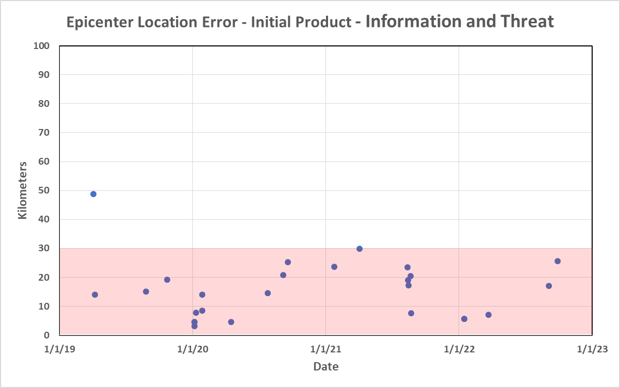
Epicenter Location Performance Since 2019

Slide 7
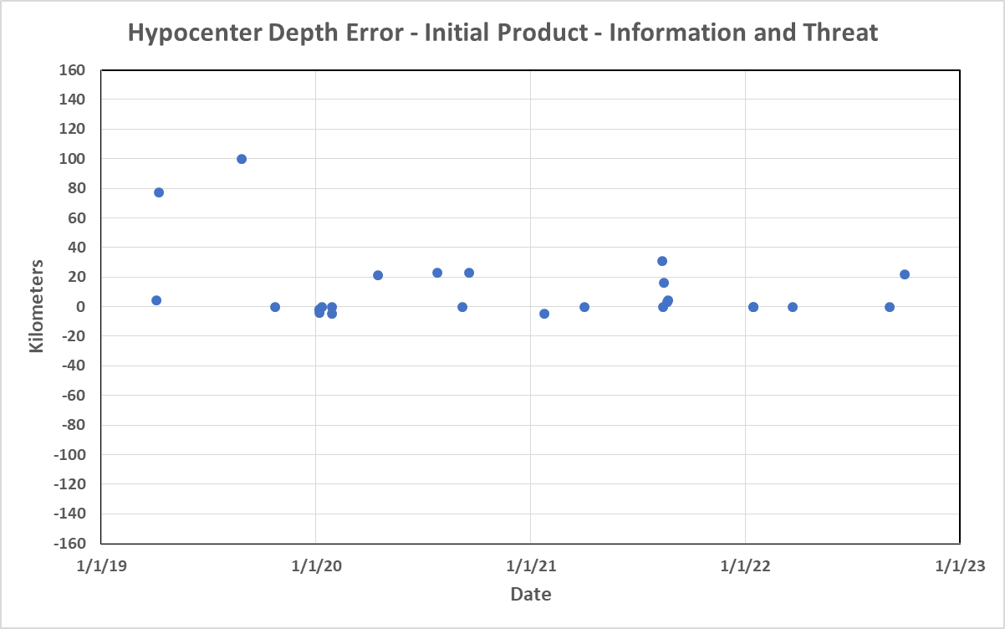

Depth Performance Since 2019

Slide 8
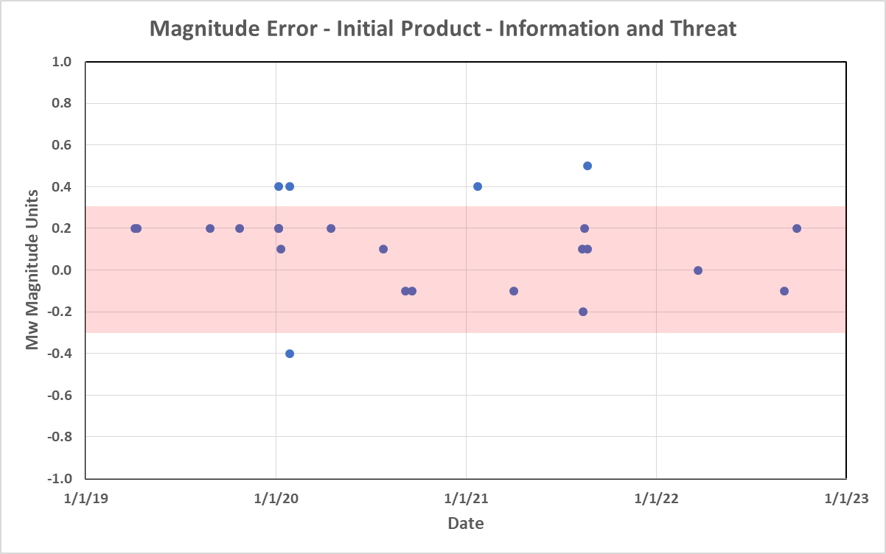
Magnitude Performance Since 2019

Slide 9
Three Noteable Events
1. 8/12/2021 South Sandwich Islands Earthquake and Tsunami
Multiple events – largest was an 8.1 – not quickly understood
Only one nearby sea level gauge – South Georgia Island (UK)
Amplitudes greater than 0.6m were recorded at South Georgia Island, in Argentina, and in South Africa
Tsunami was also widely recorded in the Pacific and Indian Oceans
No tsunami alerting system for southern Atlantic
ICG/PTWS has agreed to include this source region in its Seismic Source Zone
TOWS-WG recommends to explore expanding tsunami warning system coverage to southern Atlantic

Slide 10
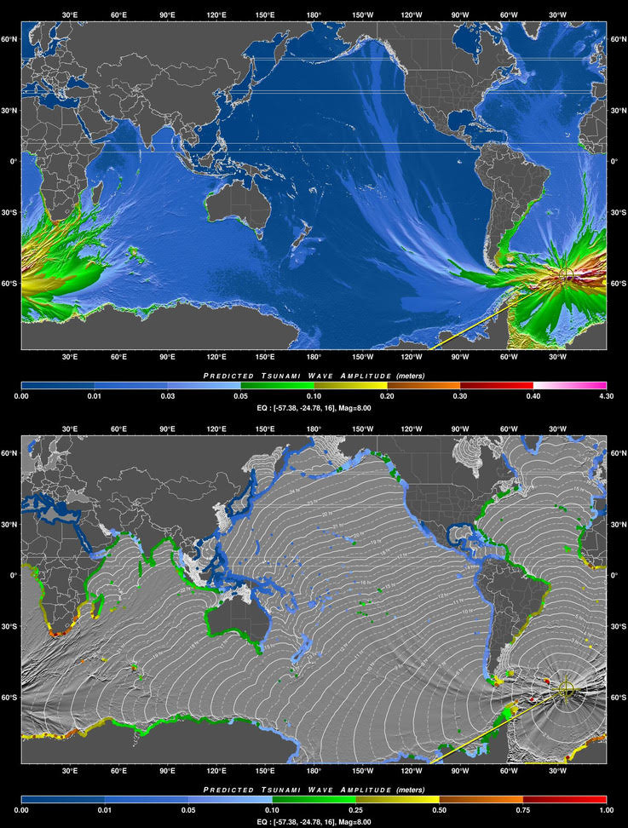
RIFT Simulation of 8/12/21 Tsunami
8/12/2021 South Sandwich Islands Earthquake and Tsunami
Multiple events – largest was an 8.1 – not quickly understood
Only one nearby sea level gauge – South Georgia Island (UK)
Tsunami was produced and recorded in Atlantic, Pacific and Indian Oceans
Amplitudes greater than 0.6m were recorded at South Georgia Island, in Argentina, and in South Africa
No tsunami alerting system for southern Atlantic
ICG/PTWS has agreed to

Slide 11
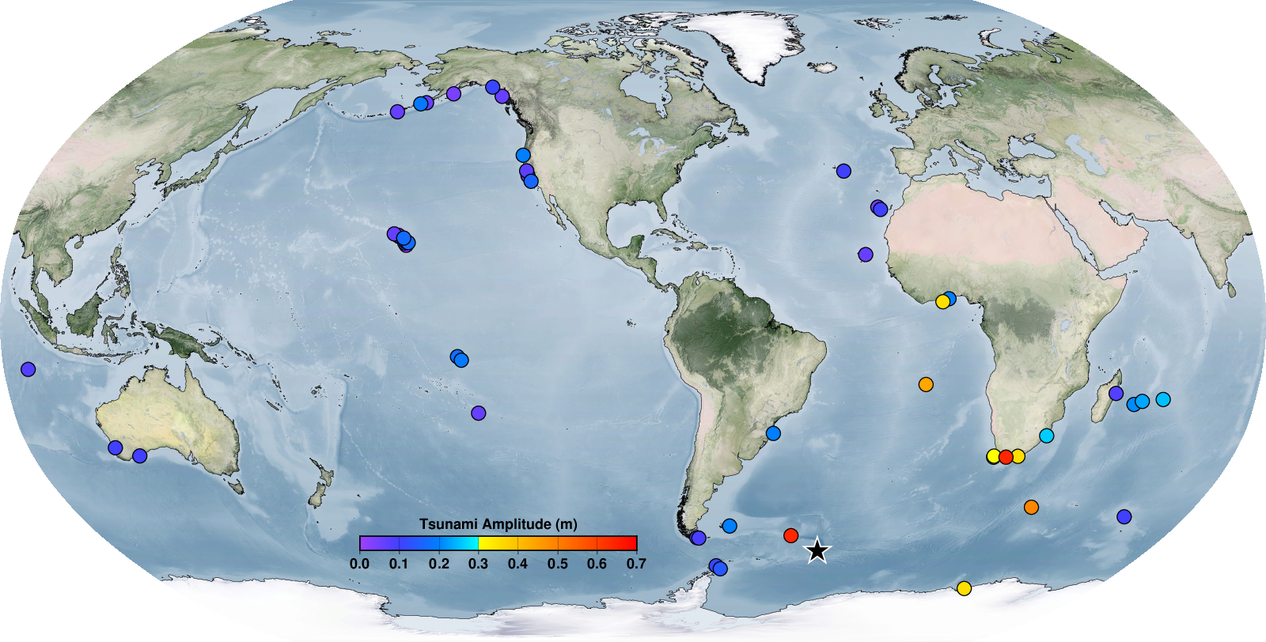
Gauge Amplitudes of 8/12/21 Tsunami

Slide 12
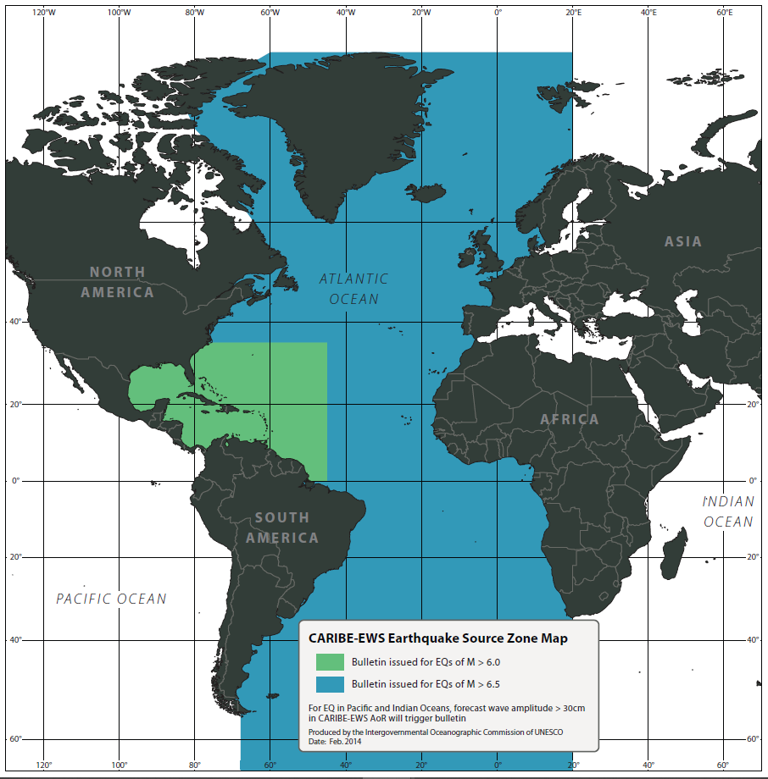
Earthquake Source Zone for the CARIBE-EWS

Slide 13
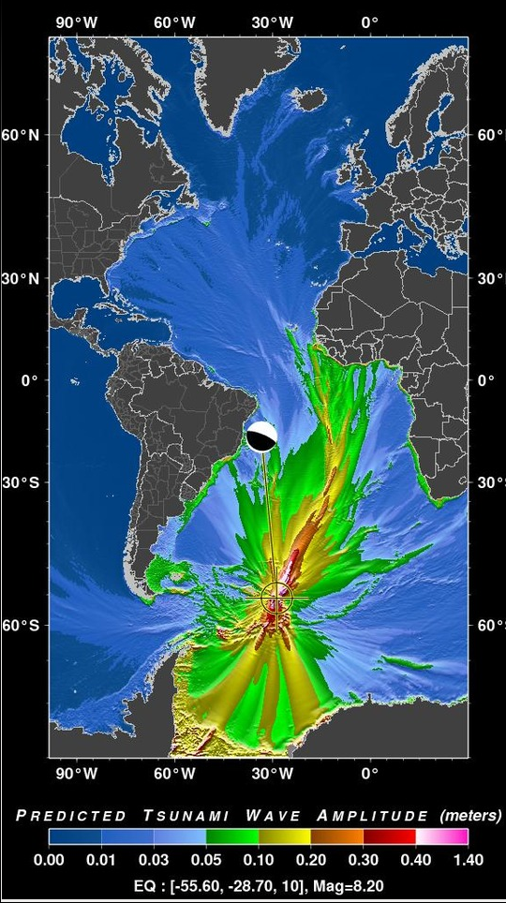
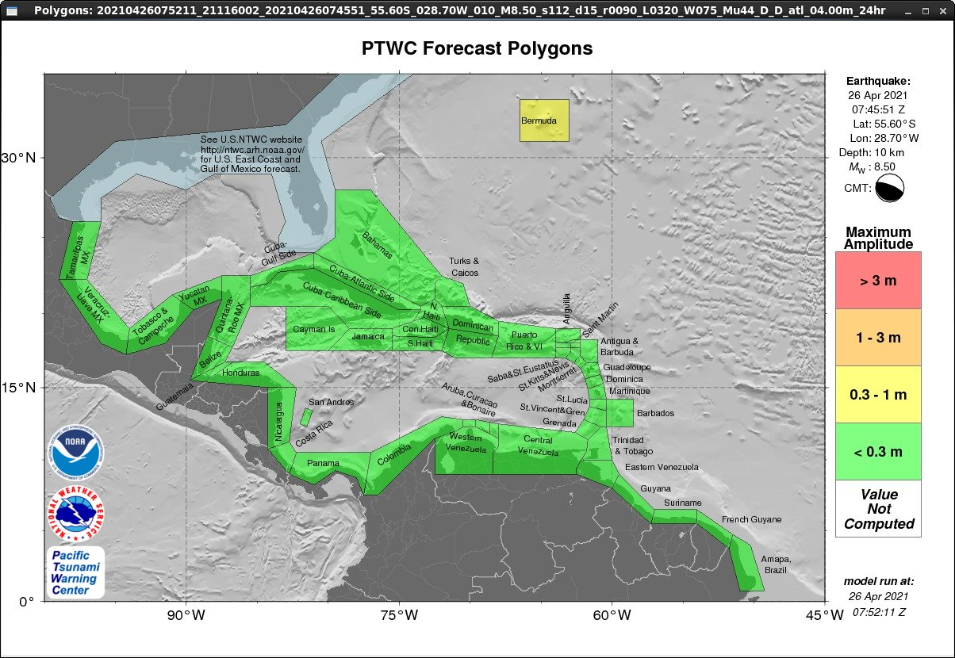
Remove Southern Atlantic from CARIBE-EWS ESZ?
Many CARIBE-EWS Information Statements for such events
An unlikely Mw 8.5 is only 0.3-1 m in Bermuda with 14-hr travel time
Make Southern Atlantic ESZ part of the PTWS – much closer to Chile
CARIBE-EWS still covered if there is a threat

Slide 14
Three Noteable Events
2. 8/14/2021 Haiti Earthquake and Tsunami
Initial Information Statement for Mw=7.0 was upgraded after 50 minutes to a Threat Message for upgraded Mw=7.2
Epicenter on the narrow Tiburon Peninsula – had to check for tsunami waves on both sides
Small tsunami waves, < 10 cm, recorded in Haiti and Mexico

Slide 15
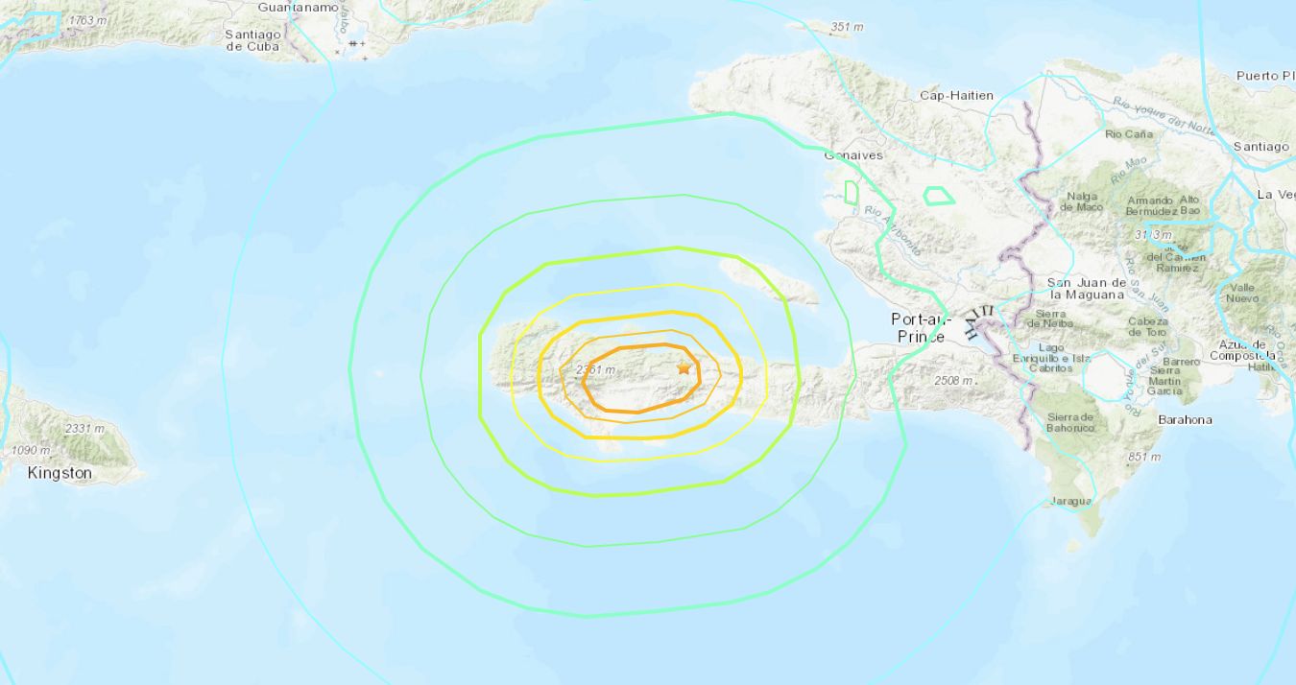
8/14/21 Mw 7.2 Haiti Earthquake
USGS
Modified Mercalli Intensity Contours – Maximum (orange) is 7.5

Slide 16
Three Noteable Events
3. 1/15/2022 Hunga Tonga Volcano eruption and tsunami
Explosive eruption of the Hunga Tonga – Hunga Ha`apai Volcano near Tonga
Tsunami runups > 10m in Tonga
Tsunami waves generated and observed in all the world’s ocean basins by the atmospheric disturbance
Equivalent to the 1883 explosive eruption of Krakatau?

Slide 17
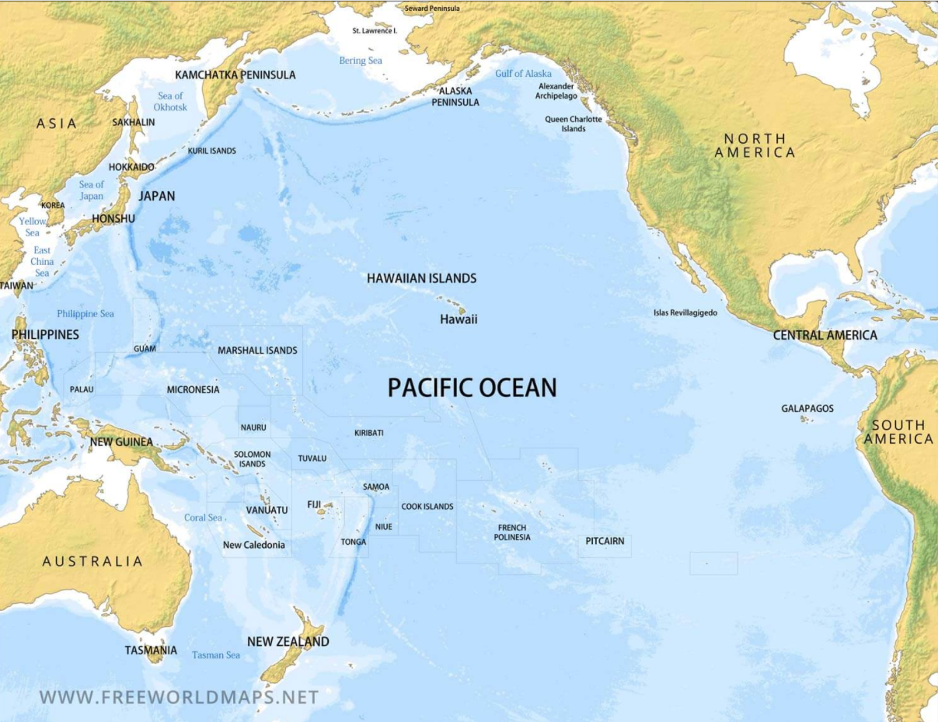
Geographic Awareness
Hunga Tonga – Hunga Ha`apai Volcano

Slide 18
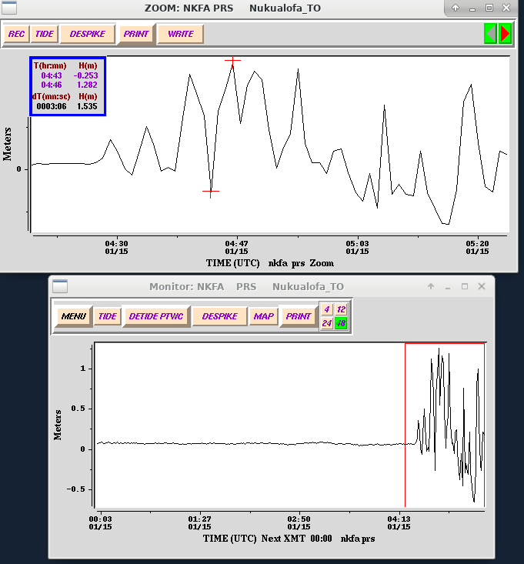
Tsunami arrival at Nuku`alofa
Tsunami signal at Nuku`alofa following the explosive eruption of Hunga Tonga

Slide 19
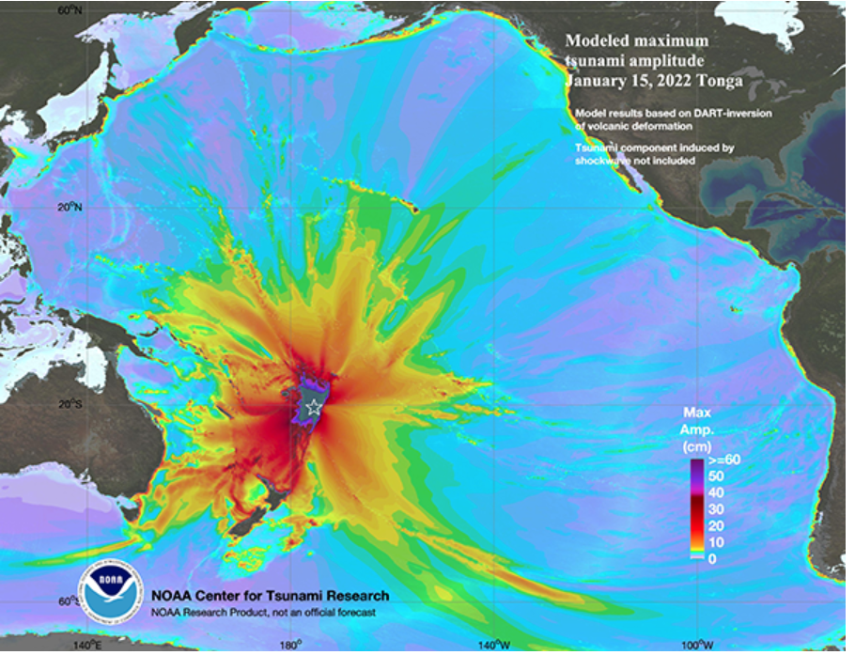
Modeled Tsunami Maximum Amplitude In the Pacific
Based on the Ocean Disturbance at the Volcano
Tonga Ridge

Slide 20
Sample Maximum Tsunami Amplitudes
Gauge | Amplitude
Nuku`alofa, Tonga | 0.82 m
Pago Pago, American Samoa | 0.62 m
Vanuatu | 1.41 m
Lifou, New Caledonia | 0.89 m
North Cape, New Zealand | 0.69 m
Kushimoto, Japan | 0.96 m
Rarotonga, Cook Islands | 0.90 m
Kahului, Hawaii | 0.83 m
Santa Cruz, Galapagos | 0.75 m
Coquimbo, Chile | 1.08 m
Arica, Chile | 1.22 m
Chanaral, Chile | 1.74 m
West of Tonga Ridge
East of Tonga Ridge

Slide 21
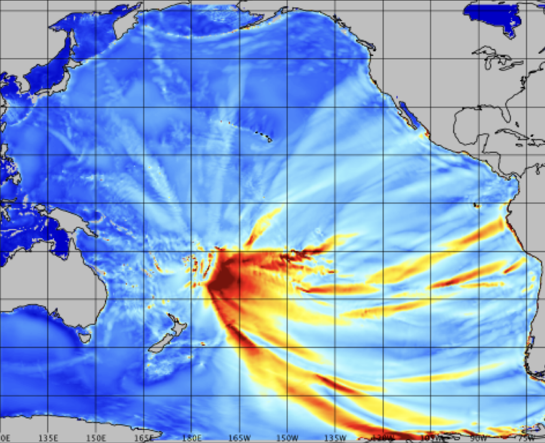

Modeled Tsunami Maximum Amplitude In the Pacific
Based on Atmospheric Pressure Wave Forcing
Tonga Ridge
Volcano

Slide 22
PTWC 1/15/21 Hunga Tonga Response
During Event
Tsunami detected quickly, but no automatic threat area or Pacific forecast since not an earthquake source and no earthquake parameters.
Could use fake earthquake parameters to generate PTWS text messages and threat areas and manually modify messages for the volcano source.
But dissemination problematic due to website expecting earthquake parameters. Ad hoc alternate dissemination methods had problems.
Information statements issued for the Caribbean when tsunami waves were observed there from atmospheric pressure wave
After Event
PTWS message code modified to handle any future Hunga Tonga tsunami
Forecast will be based on scaled 1/15/21 gauge amplitudes
Could this strategy be applied to any volcano using pre-run simulations and scaling to observations?

Slide 23
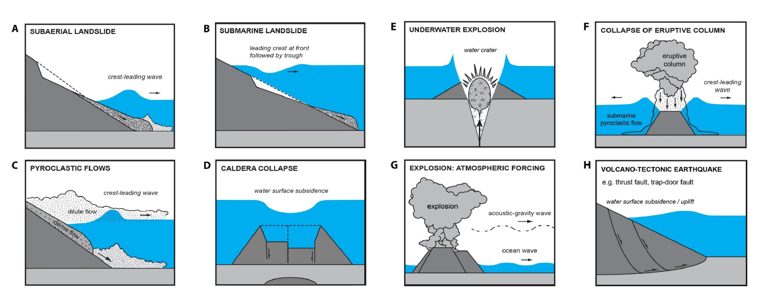
Tsunamis Generated by Volcanoes (TGVs)
Different Mechanisms for Tsunami-genesis by Volcanoes
(from the TOWS-WG Task Team Report on TGVs lead by Francois Schindele)

Slide 24
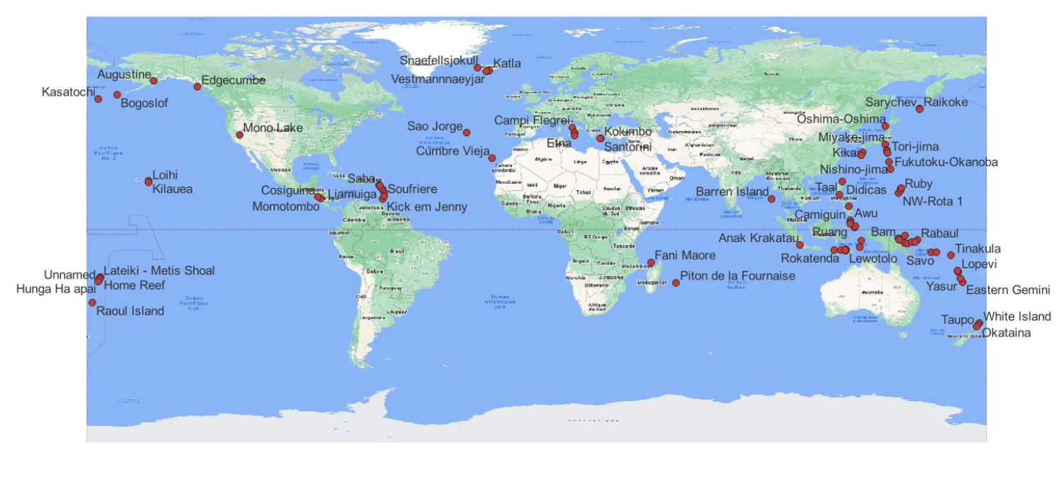
Tsunamis Generated by Volcanoes (TGVs)
Potentially Tsunamigenic Volcanoes
(from the TOWS-WG Task Team Report on TGVs lead by Francois Schindele)

Slide 25
PTWC Product Changes for ICG Review/Approval
Countries are in alphabetical order in threat lists
ETAs are grouped by country or territory
Observations are grouped by country or territory
Type of measurement is indicated
Region with initial threat based on ETA not on distance
Earthquake Magnitude | Designated Potential Tsunami Threat
 | Current | To Consider
7.1 - 7.5 | Within 300 km | Within 1 hour
7.6 - 7.8 | Within 1000 km | Within 2 hours
≥ 7.9 | Within 3 hours | Within 3 hours

Slide 26
Initial Message: Countries in Alphabetical Order
CURRENT
TEST... TSUNAMI THREAT FORECAST ...TEST
-------------------------------------------------
* THIS IS A TEST MESSAGE. HAZARDOUS TSUNAMI WAVES FROM THIS
EARTHQUAKE ARE POSSIBLE WITHIN 300 KM OF THE EPICENTER ALONG
THE COASTS OF
HONDURAS... BELIZE... AND GUATEMALA
PROPOSED
TEST... TSUNAMI THREAT FORECAST ...TEST
-------------------------------------------------
* THIS IS A TEST MESSAGE. HAZARDOUS TSUNAMI WAVES FROM THIS
EARTHQUAKE ARE POSSIBLE WITHIN 300 KM OF THE EPICENTER ALONG
THE COASTS OF
BELIZE... GUATEMALA... AND HONDURAS

Slide 27
Messages w/Forecast: Countries in Alphabetical Order
CURRENT: Already in alphabetical order
TEST... TSUNAMI THREAT FORECAST...UPDATED ...TEST
-------------------------------------------------
* THIS IS A TEST MESSAGE. TSUNAMI WAVES REACHING MORE THAN 3
METERS ABOVE THE TIDE LEVEL ARE POSSIBLE ALONG SOME COASTS
OF
BELIZE... GUATEMALA... AND HONDURAS.
* THIS IS A TEST MESSAGE. TSUNAMI WAVES REACHING 1 TO 3 METERS
ABOVE THE TIDE LEVEL ARE POSSIBLE ALONG SOME COASTS OF
MEXICO.
* THIS IS A TEST MESSAGE. TSUNAMI WAVES REACHING 0.3 TO 1
METERS ABOVE THE TIDE LEVEL ARE POSSIBLE FOR SOME COASTS OF
CAYMAN ISLANDS... CUBA... AND JAMAICA.

Slide 28
ETAs Organized by Country
CURRENT
TEST... ESTIMATED TIMES OF ARRIVAL ...TEST
------------------------------------------
* THIS IS A TEST MESSAGE. ESTIMATED TIMES OF ARRIVAL -ETA- OF
THE INITIAL TSUNAMI WAVE FOR PLACES WITHIN THREATENED
REGIONS ARE GIVEN BELOW. ACTUAL ARRIVAL TIMES MAY DIFFER AND
THE INITIAL WAVE MAY NOT BE THE LARGEST. A TSUNAMI IS A
SERIES OF WAVES AND THE TIME BETWEEN WAVES CAN BE FIVE
MINUTES TO ONE HOUR.
LOCATION REGION COORDINATES ETA(UTC)
------------------------------------------------------------
CIENFUEGOS CUBA 22.0N 80.5W 1530 03/23
SANTIAGO D CUBA CUBA 19.9N 75.8W 1540 03/23
BELIZE CITY BELIZE 17.5N 88.2W 1545 03/23
LA HABANA CUBA 23.2N 82.4W 1546 03/23
MONTEGO BAY JAMAICA 18.5N 77.9W 1549 03/23
PUERTO BARRIOS GUATEMALA 15.7N 88.6W 1608 03/23
KINGSTON JAMAICA 17.9N 76.9W 1629 03/23
SANTA CRZ D SUR CUBA 20.7N 78.0W 1822 03/23
NUEVA GERONA CUBA 21.9N 82.8W 1900 03/23
PROGRESO MEXICO 21.3N 89.7W 1907 03/23

Slide 29
ETAs Organized by Country
PROPOSED
TEST... ESTIMATED TIMES OF ARRIVAL ...TEST
------------------------------------------
* THIS IS A TEST MESSAGE. ESTIMATED TIMES OF ARRIVAL -ETA- OF
THE INITIAL TSUNAMI WAVE FOR PLACES WITHIN THREATENED
REGIONS ARE GIVEN BELOW. ACTUAL ARRIVAL TIMES MAY DIFFER AND
THE INITIAL WAVE MAY NOT BE THE LARGEST. A TSUNAMI IS A
SERIES OF WAVES AND THE TIME BETWEEN WAVES CAN BE FIVE
MINUTES TO ONE HOUR.
LOCATION COORDINATES ETA(UTC)
------------------------------------------------------
CUBA
CIENFUEGOS 22.0N 80.5W 1530 03/23
SANTIAGO D CUBA 19.9N 75.8W 1539 03/23
LA HABANA 23.2N 82.4W 1548 03/23
SANTA CRZ D SUR 20.7N 78.0W 1804 03/23
NUEVA GERONA 21.9N 82.8W 1816 03/23
BELIZE
BELIZE CITY 17.5N 88.2W 1545 03/23
JAMAICA
MONTEGO BAY 18.5N 77.9W 1549 03/23
KINGSTON 17.9N 76.9W 1604 03/23
GUATEMALA
PUERTO BARRIOS 15.7N 88.6W 1720 03/23
MEXICO
PROGRESO 21.3N 89.7W 1911 03/23

Slide 30
Observations Organized by Country
CURRENT
TEST... TSUNAMI OBSERVATIONS ...TEST
------------------------------------
* THIS IS A TEST MESSAGE. THE FOLLOWING ARE TSUNAMI WAVE
OBSERVATIONS FROM COASTAL AND/OR DEEP-OCEAN SEA LEVEL GAUGES
AT THE INDICATED LOCATIONS. THE MAXIMUM TSUNAMI HEIGHT IS
MEASURED WITH RESPECT TO THE NORMAL TIDE LEVEL.
GAUGE TIME OF MAXIMUM WAVE
COORDINATES MEASURE TSUNAMI PERIOD
GAUGE LOCATION LAT LON (UTC) HEIGHT (MIN)
-------------------------------------------------------------
PUERTO BARRIOS GT 15.7N 88.6W 1620 0.85M/ 2.8FT 24
PORT OF BELIZE BZ 17.5N 88.2W 1557 0.93M/ 3.0FT 26
ISLA MUJERES MX 21.3N 86.7W 1546 0.55M/ 1.8FT 18
CAYMAN BRAC KY 19.7N 79.8W 1543 0.46M/ 1.5FT 26
LITTLE CAYMAN KY 19.7N 80.1W 1530 0.61M/ 2.0FT 26
GUN BAY KY 19.3N 81.1W 1525 0.56M/ 1.8FT 26
GEORGE TOWN KY 19.3N 81.4W 1516 0.60M/ 2.0FT 20
PUERTO MORELOS MX 20.9N 86.9W 1514 0.61M/ 2.0FT 22
SIAN KAAN MX 19.3N 87.4W 1503 0.77M/ 2.5FT 14
CEIBA CABOTAGE HN 15.8N 86.8W 1457 2.16M/ 7.1FT 20
CARRIE BOW CAY BZ 16.8N 88.1W 1427 2.84M/ 9.3FT 24
PUERTO CORTES HN 15.8N 88.0W 1425 2.94M/ 9.7FT 22

Slide 31
Observations Organized by Country with Meas Type
PROPOSED
TEST... TSUNAMI OBSERVATIONS ...TEST
------------------------------------
* THIS IS A TEST MESSAGE. THE FOLLOWING ARE TSUNAMI WAVE
OBSERVATIONS FROM COASTAL AND/OR DEEP-OCEAN SEA LEVEL GAUGES
AT THE INDICATED LOCATIONS. THE MAXIMUM TSUNAMI HEIGHT IS
MEASURED WITH RESPECT TO THE NORMAL TIDE LEVEL.
COORDINATES TIME TSUNAMI MEAS
GAUGE LOCATION LAT LON (UTC) AMPLITUDE TYPE
-------------------------------------------------------------
GUATEMALA
PUERTO BARRIOS 15.7N 88.6W 1620 1.70M/ 5.6FT HF
BELIZE
PORT OF BELIZE 17.5N 88.2W 1557 1.86M/ 6.1FT CR
CARRIE BOW CAY 16.8N 88.1W 1427 5.69M/18.7FT HF
MEXICO
ISLA MUJERES 21.3N 86.7W 1546 1.10M/ 3.6FT TR
PUERTO MORELOS 20.9N 86.9W 1514 1.22M/ 4.0FT HF
SIAN KAAN 19.3N 87.4W 1503 1.55M/ 5.1FT CR
CAYMAN_ISLANDS
CAYMAN BRAC 19.7N 79.8W 1543 0.91M/ 3.0FT CR
LITTLE CAYMAN 19.7N 80.1W 1530 1.21M/ 4.0FT HF
GUN BAY 19.3N 81.1W 1525 1.11M/ 3.7FT TR
GEORGE TOWN 19.3N 81.4W 1516 1.21M/ 4.0FT HF
HONDURAS
CEIBA CABOTAGE 15.8N 86.8W 1457 4.31M/14.2FT CR

Slide 32
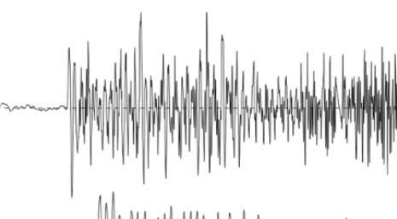
Measurement Type
Measurement Types:
HF = half of the maximum tsunami wave crest to trough
CR = middle (approximate current tide level) to maximum tsunami wave crest
TR = middle (approximate current tide level) to maximum tsunami wave trough
Maximum Crest
Maximum
Trough
Maximum Crest-to-Trough

Slide 33
Initial Threat Area by ETA Instead of Distance
THE ISSUE: Using distance to define the threat area may over-warn when the earthquake is in shallow water. The issue was raised following the January 28, 2020, Mw 7.7 earthquake north of the Cayman Islands and the subsequent Tsunami Threat Message with a potential threat for the Cayman Islands, Cuba, and Jamaica (based on the preliminary magnitude of 7.3).
The following table shows the change from distance to ETA for the ICG to consider.
Earthquake Magnitude | Designated Potential Tsunami Threat
 | Current | To Consider
7.1 - 7.5 | Within 300 km | Within 1 hour
7.6 - 7.8 | Within 1000 km | Within 2 hours
≥ 7.9 | Within 3 hours | Within 3 hours

Slide 34
Initial Threat Area by ETA Instead of Distance
For the Cayman earthquake case, however, the one-hour ETA for the PTWC preliminary magnitude of 7.3 encompasses an even larger area, designating the Cayman Islands, Cuba, Jamaica, and the Bahamas with a potential tsunami threat.
Had the PTWC preliminary magnitude been 7.7, that is the final USGS magnitude, then the potential threat would have extended to two hours ETA or to the Cayman Islands, Cuba, Jamaica, the Bahamas, Colombia, Haiti, the Dominican Republic, Honduras, Mexico, Puerto Rico, San Andres and Providencia, and Turks and Caicos.
So making this change dos not address the issue of over-warning using current procedures.
There may still be some benefit to using ETAs to set the threat limit, but it will require further study and discussion.

Slide 35
Communication Tests
PTWC continues to conduct monthly scheduled communication tests not requiring a response unless a problem is identified.
Unscheduled tests requiring a response have been halted due to PTWC’s current duty staff shortage (3 vacancies), but those tests need to be redesigned to better assess system readiness on a regular basis.
Japan’s Northwest Pacific Tsunami Advisory Center has gotten a better response in the PTWS by announcing these tests and conducting them during normal business hours. This doesn’t test 24x7 hair-trigger readiness, but it does ensure that communication methods are working.
With the approval of the ICG, PTWC will try this method on a quarterly basis.

Slide 36
Thank You
Charles McCreery, Chair
NOAA Pacific Tsunami Warning Center
charles.mccreery@noaa.gov

