Slide 1
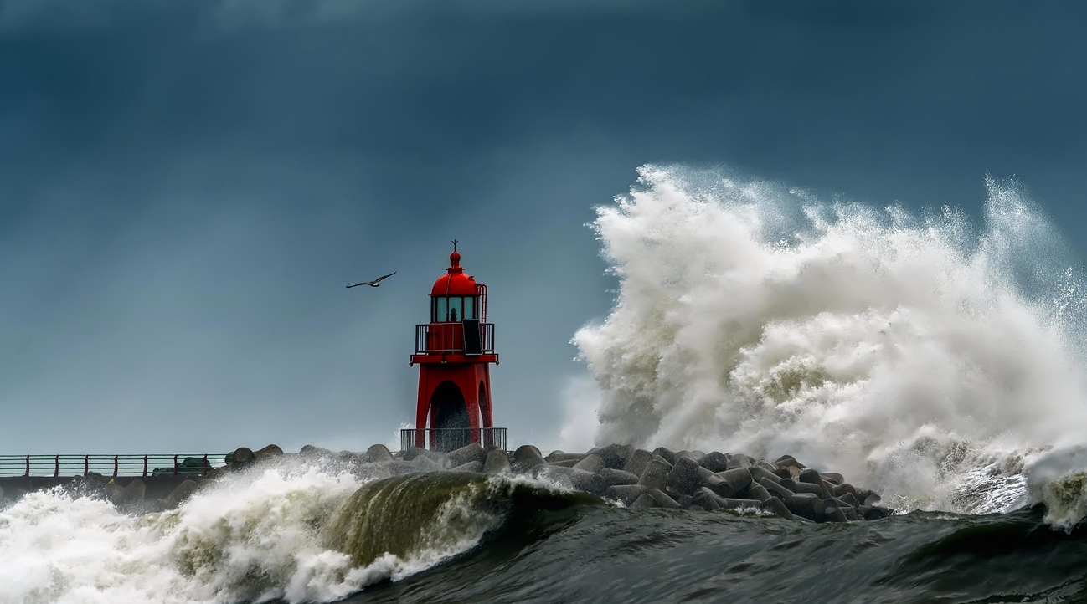

Leveraging Common Alerting Protocol (CAP) in tsunami early warning
Value
Tsunami CAP
Early Warnings for All
Vicente VASQUEZ GRANDA: vvasquez@wmo.int

Slide 2
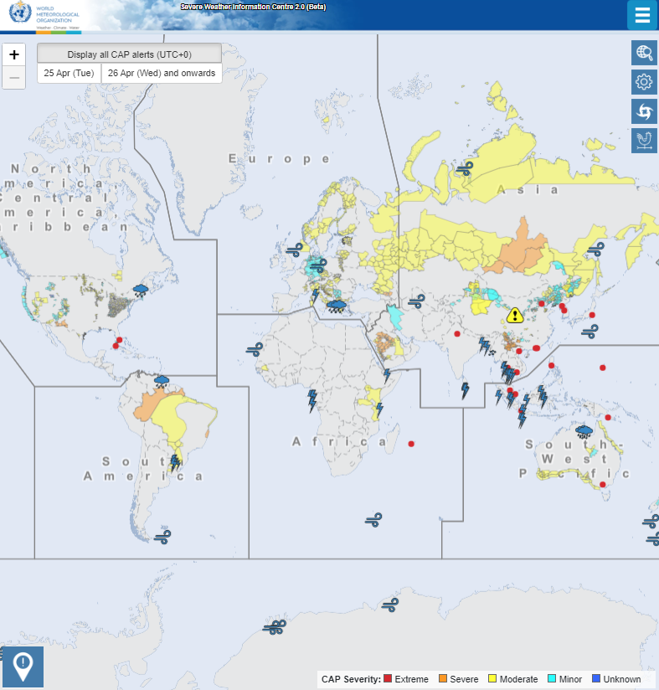
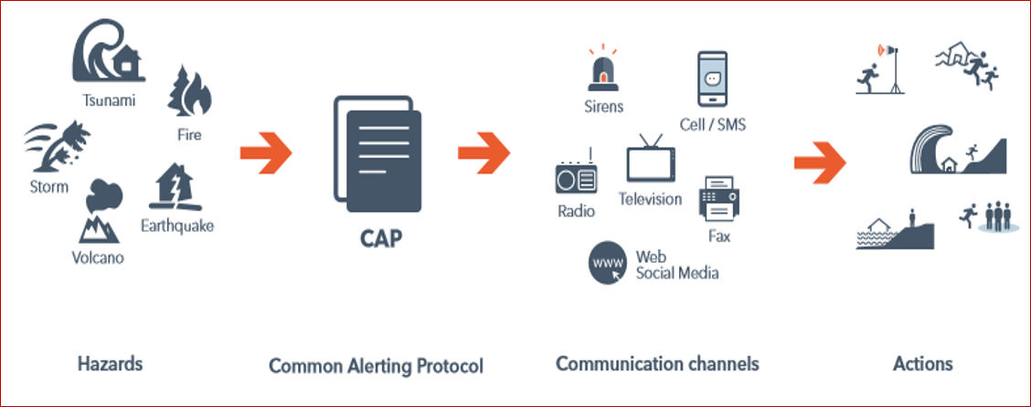
Common Alerting Protocol (CAP)
Effective early warning
Notes:
CAP is one key aspect of effective early warning and a single XML that disseminates quickly over multiple alerting channels. It is built for multi-hazard emergency alerts and a standard format for exchanging emergency alerts and notifications between different systems, platforms, and devices. CAP provides a standardized way of communicating critical information about a hazard, including its location, magnitude, and potential impacts, to a wide range of stakeholders, such as emergency responders, government officials, media, and the public.
The WMO-Registered Alerting Authorities validate and support the dissemination of only authoritative multi-hazard alerts. The Severe Weather Information Center (SWIC) shows the live feeds of CAP alerts from authoritative voices. We can define the value of early warnings as Timely, accurate, actionable advice from authoritative sources.
Credit: CAP alert by itself does not include everything about the emergency, it just carries some facts that everyone needs. (Source: ITU)

Slide 3
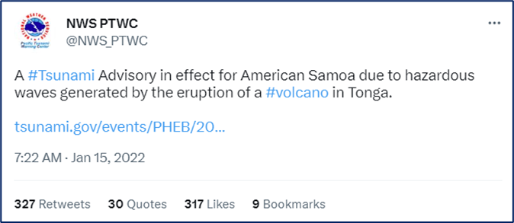
Tsunami CAP
AUDIENCE
--------
EMERGENCY MANAGERS... MEDIA... GENERAL PUBLIC
EVALUATION
----------
* A VOLCANO ERUPTION OCCURRED IN THE TONGA ISLANDS AROUND 527 PM SST ON FRIDAY JANUARY 14 2022.
* A HAZARDOUS TSUNAMI MAY HAVE BEEN GENERATED BY THIS NEARBY VOLCANO THAT COULD SOON IMPACT NEARBY COASTS.
* MONITORING IS UNDERWAY TO EVALUATE THE TSUNAMI THREAT.
* CURRENT OBSERVATIONS INDICATE THAT TSUNAMI IMPACTS IN AMERICAN SAMOA ARE GREATER THAN HAD BEEN FORECAST. THERE IS NOW THE THREAT OF HAZARDOUS TSUNAMI WAVES FLOODING LOW-LYING COASTAL AREAS OF AMERICAN SAMOA.
RECOMMENDED ACTIONS
-------------------
* PERSONS LOCATED IN LOW-LYING AREAS ALONG COASTS OF ALL OF AMERICAN SAMOA SHOULD MOVE IMMEDIATELY INLAND OR TO HIGH GROUND OR TO THE FOURTH FLOOR AND ABOVE IN A STEEL OR CONCRETE BUILDING.
* DO NOT RETURN TO EVACUATED AREAS UNTIL THE ALL CLEAR IS GIVEN BY LOCAL AUTHORITIES.
* PERSONS NEAR THE COAST SHOULD MOVE IMMEDIATELY INLAND OR TO HIGH GROUND OR TO THE FOURTH FLOOR AND ABOVE IN A CONCRETE BUILDING OF SIX STORIES OR MORE.
* STAY ALERT FOR FURTHER INFORMATION AND INSTRUCTIONS FROM AMERICAN SAMOA CIVIL DEFENSE AND EMERGENCY MANAGEMENT AGENCIES REGARDING THE TSUNAMI EMERGENCY.
* DO NOT RETURN TO EVACUATED AREAS UNTIL THE ALL CLEAR IS GIVEN BY LOCAL AUTHORITIES.
ESTIMATED TIMES OF ARRIVAL
--------------------------
* ESTIMATED TIMES OF ARRIVAL -ETA- OF THE INITIAL TSUNAMI WAVE ARE GIVEN BELOW. ACTUAL ARRIVAL TIMES MAY DIFFER AND THE
INITIAL WAVE MAY NOT BE THE LARGEST. A TSUNAMI IS A SERIES OF WAVES AND THE TIME BETWEEN WAVES CAN BE FIVE MINUTES TO ONE HOUR.
LOCATION REGION COORDINATES ETA(SST)
----------------------------------------------------------
TAFUNA TUTUILA 14.3S 170.7W 648 PM 01/14…
POTENTIAL IMPACTS
-----------------
* SEA LEVEL FLUCTUATIONS THAT ARE 3 FEET OR MORE ABOVE AND BELOW THE TIDE LEVEL ALONG SOME OR ALL COASTS.
* REPEATED FLOODING AND DRAINING OF LOW-LYING COASTAL AREAS.
* DESTRUCTION OF SMALLER COASTAL STRUCTURES.
* RAPIDLY FLOWING FLOOD WATER FILLED WITH HAZARDOUS DEBRIS.
* SECONDARY HAZARDS THAT MAY INCLUDE DOWNED POWER LINES...FIRES... AND HAZARDOUS MATERIAL SPILLS.
* THE HAZARD BEGAN AROUND 648 PM SST ON FRIDAY JANUARY 14 AND IT CAN PERSIST FOR MANY HOURS OR LONGER.
- Dissemination
Tsunami caused by Tonga eruption
Notes:
We now have a great opportunity for alerting authorities to reach people with targeted warnings, through public networks. For an alerting authority like the U.S. National Weather Service, this commercial public dissemination costs nothing extra. Global technology companies are also using their own resources and capabilities to help get the warnings out. The only requirement is that alerting authorities implement the CAP standard.
Here we can see an example of a tsunami CAP issued by US National Weather Service for American Samoa after Tonga eruption in Jan 2022. Dissemination of CAP warning in this case is shown for social media but it could also be disseminated via cell broadcasting as an SMS, radio and TV. The message can include information about the estimated arrival time of the tsunami, its expected height, and the areas that are likely to be affected. This information can then be used to initiate appropriate evacuation measures, activate emergency response plans, and disseminate information to the public through various channels.
Credit:
NOAA, https://tsunami.gov/events/PHEB/2022/01/15/22015050/2/WEZS40/WEZS40.txt
CAP-101 (wmo.int)

Slide 4
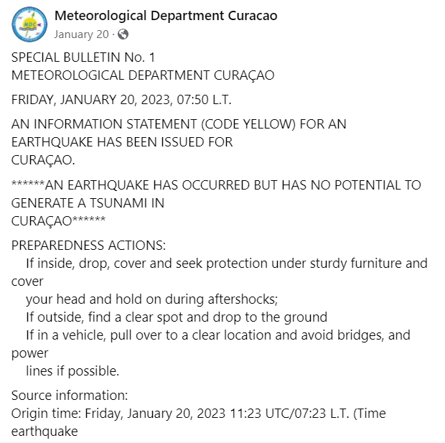

No potential Tsunami message caused by earthquake at Curaçao in 2023
sender: forecaster@weather.cw
sent: 2023-01-20T07:59:39-04:00
status: Actual
msgType: Alert
scope: Public
info:
language: en
category: Met
event: Message from the Meteorological Department Curacao
responseType: Execute
urgency: Expected
severity: Moderate
certainty: Likely
expires: 2023-01-22T07:59:08-04:00
senderName: Meteorological Department Curacao
headline: SPECIAL BULLETIN No. 1 - AN INFORMATION STATEMENT (CODE YELLOW) FOR AN EARTHQUAKE HAS BEEN ISSUED FOR CURAÇAO.
description:
AN EARTHQUAKE HAS OCCURRED BUT HAS NO POTENTIAL TO GENERATE A TSUNAMI IN CURAÇAO
instruction: PREPAREDNESS ACTIONS:
If inside, drop, cover and seek protection under sturdy furniture and cover your head and hold on during aftershocks; If outside, find a clear spot and drop to the ground
If in a vehicle, pull over to a clear location and avoid bridges, and power lines if possible.
web: http://www.meteo.cw
areaDesc: Curacao
Notes:
Here is another example from the meteorological department of Curaçao. Stressing the importance of communicating that the earthquake has not triggered the tsunami warning.
Credit:Meteorological Department Curacao | Willemstad Curaçao | Facebook

Slide 5
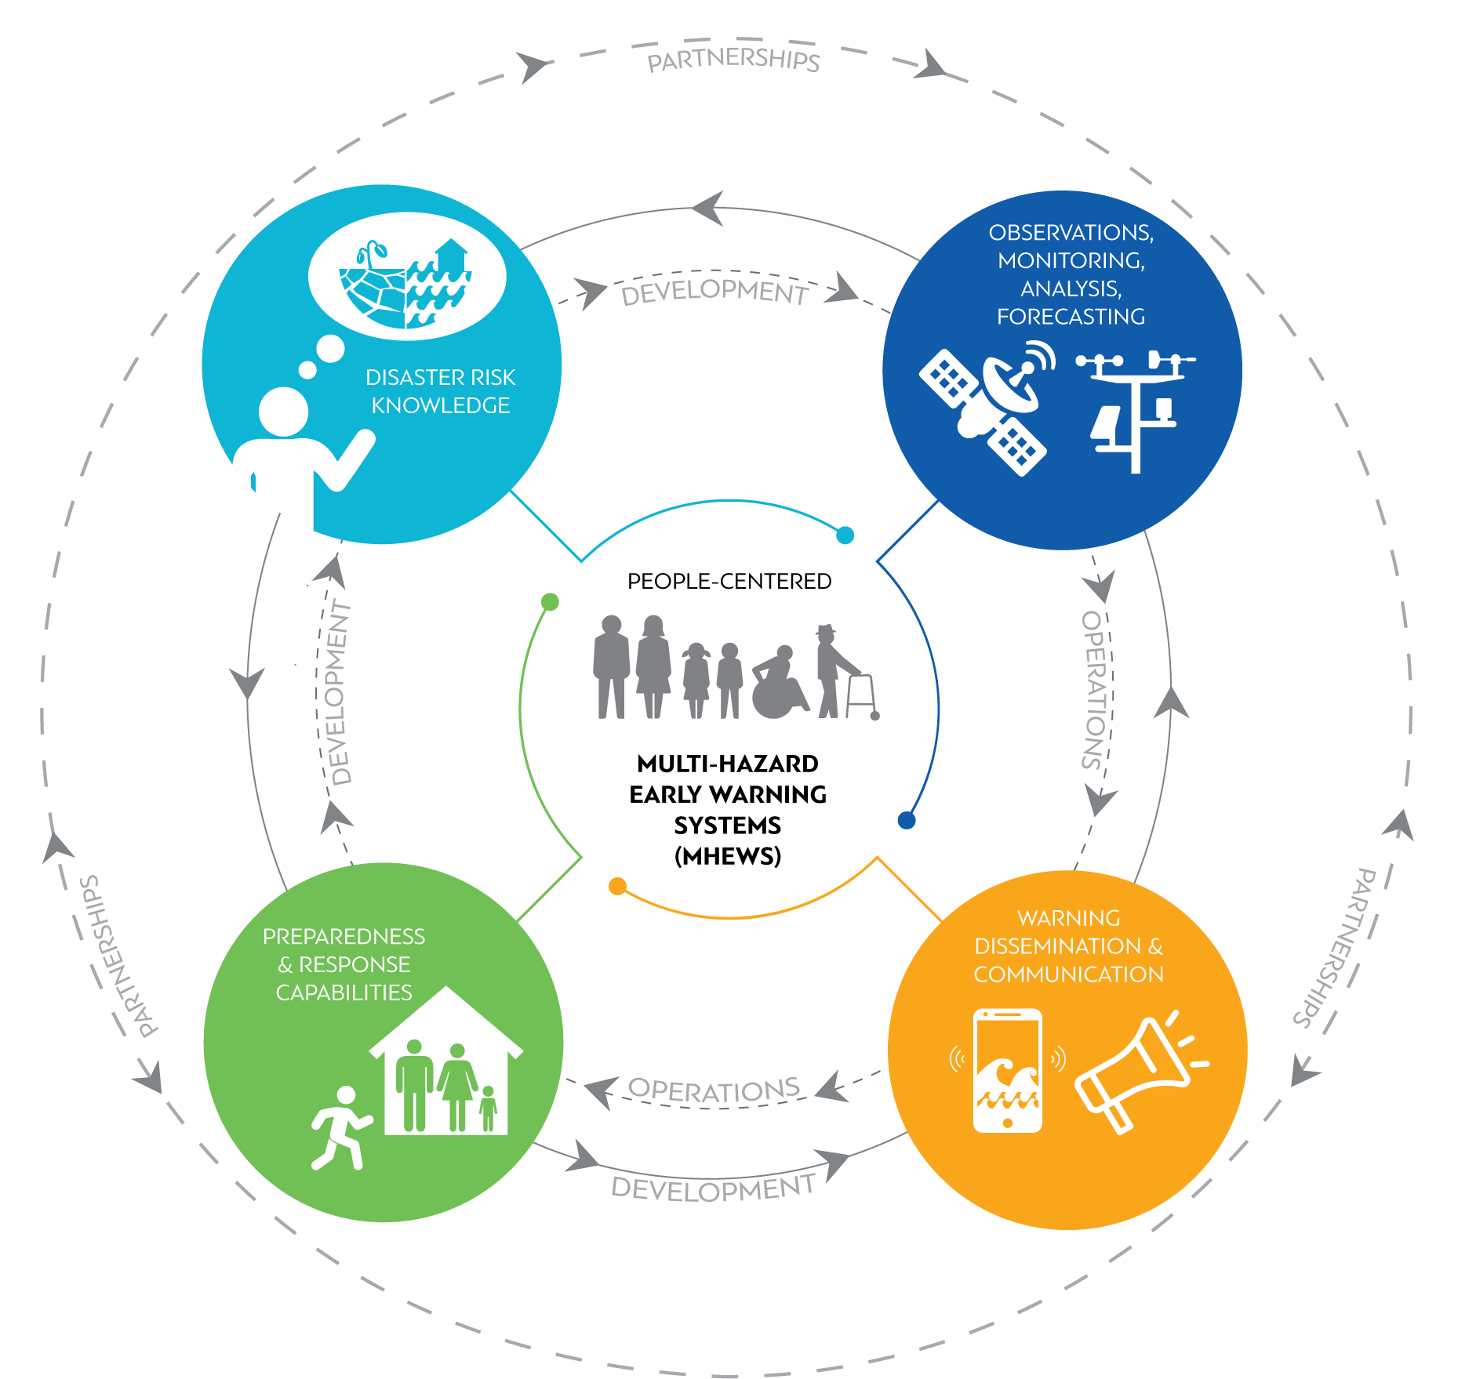

CAP and Early Warnings for All (EW4A)
Notes:
Tsunami CAP support WMO members in improving their disaster preparedness and response capabilities. They are also promoted as a WMO minimum standard for dissemination of warnings. Tsunami CAP implementation is at the core of the UN EW4A initiative.... to have everyone protected with early warnings.

