Slide 1



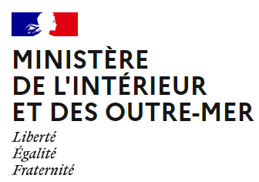

Update from TSP Cenalt (France)
12-13 April 2023
Steering Committee ICG/NEAMTWS, Unesco, Paris

Slide 2
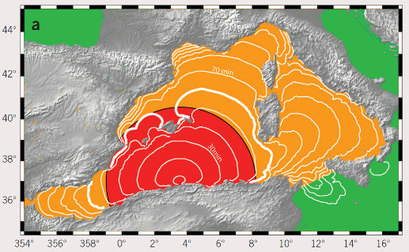

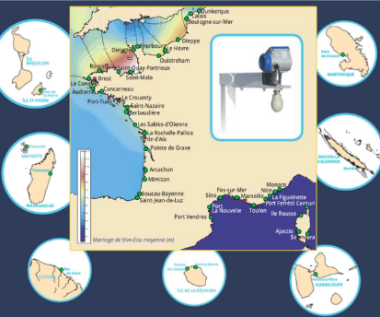
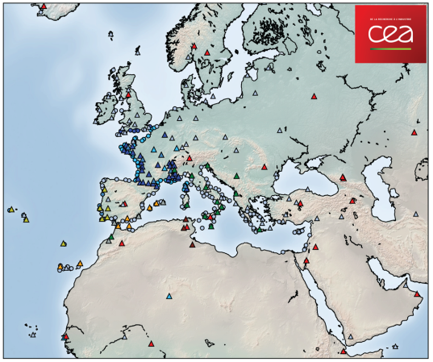

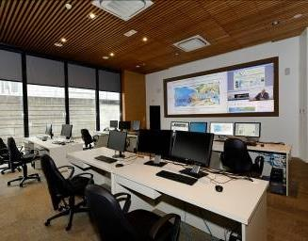
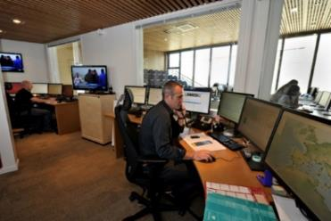

Tsunami monitoring in Cenalt
1 h 30
1 h
30 min
Twofold mandate
  Message to French Civil Security within 15 min after an earthquake in the area
  TSP mandate for the NEAM region
Operational networks
  Seismic data
  Sea level data: major modernisation 2021-2022 (SHOM)
    All data transmitted with redundancy and robustness

Slide 3
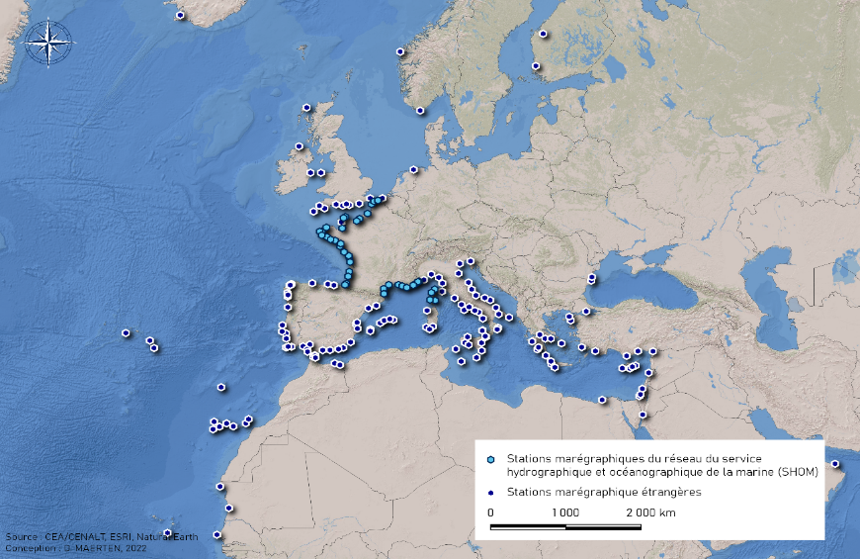
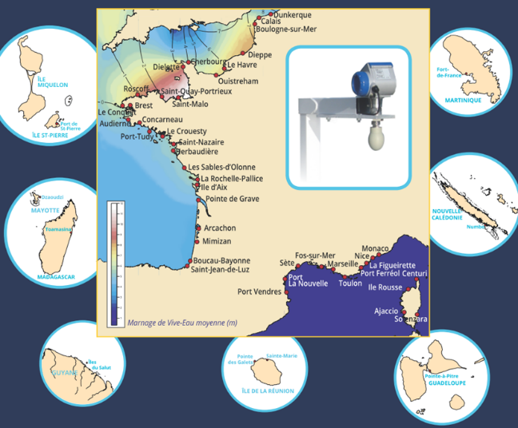
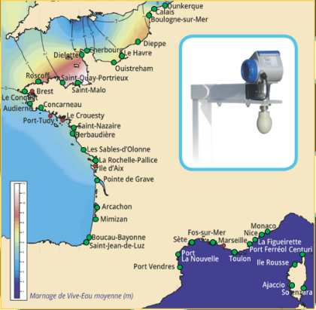
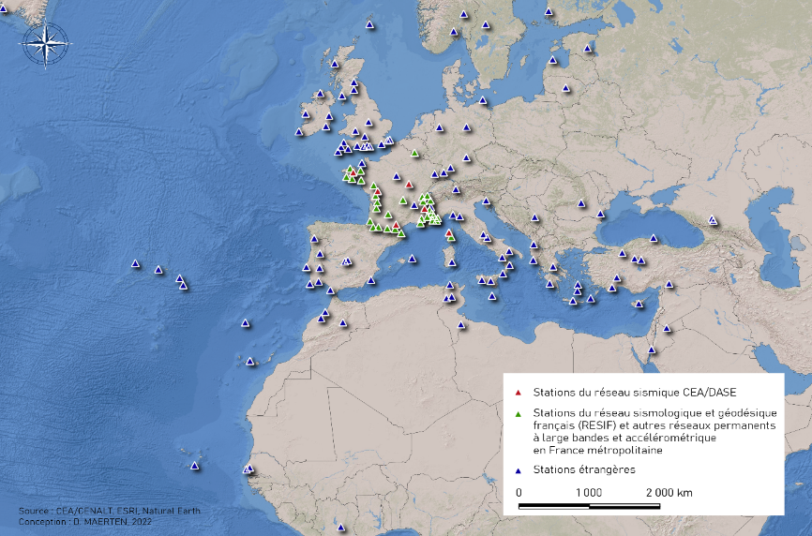
Networks
Backbone
41 SHOM (MPLS) (28 with IOC redundancy)
9 Portugal (MPLS)
37 Spain (MPLS)
36 Italy (MPLS)
Internet (VLIZ)
263 stations
Backbone
  Real time data from networks (national and partners) from robust and redundant telecommunication (MPLS, VSAT)
  Major renovation of the French sea level data RONIM network, completed in 2022
Backbone (redundant) 112 stations
4 FR (VSAT)
26 G (VPN)
7 RD (VSAT)
8 IPMA (MPLS)
35 IMS (MPLS)
8 IGN (MPLS)
17 INGV (MPLS)
7 GFZ (MPLS)
Internet
236 stations
Stations équipées d’une transmission satellite redondante

Slide 4

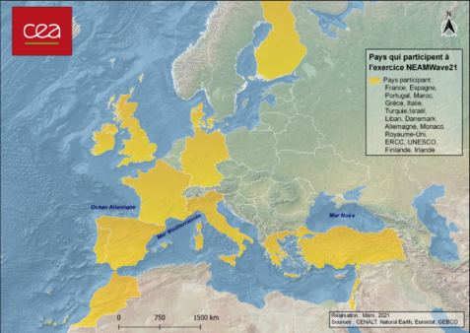
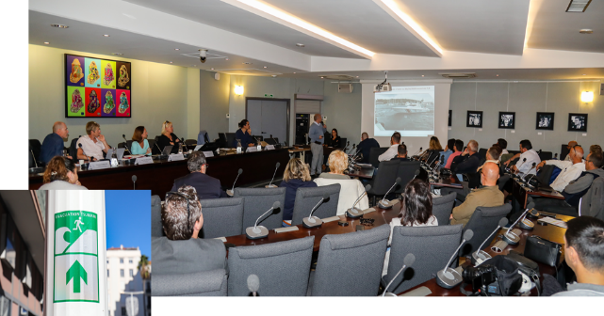

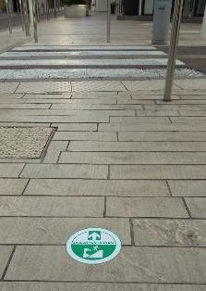
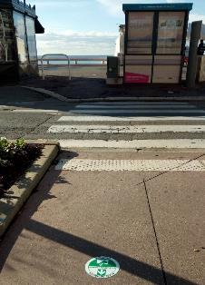
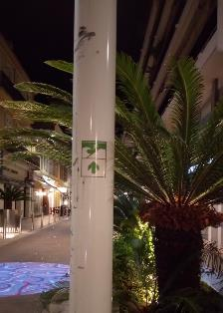
Exercising and communication
National monthly exercises with the French CPA
  Down to local scale, every 3 months
  Communication test otherwise
International level
  Monthly communication tests
  NEAMWave exercices
WTAD World Tsunami Awareness Day
  Local commitment of the Cannes municipality
Continuous training and outreach activities
  Sollicitations in July 2022 following Unesco statement (UN Ocean Conference, Lisbon, June 2022)
  Training for operators, for French CPA
  Outreach: media, school audience

Slide 5
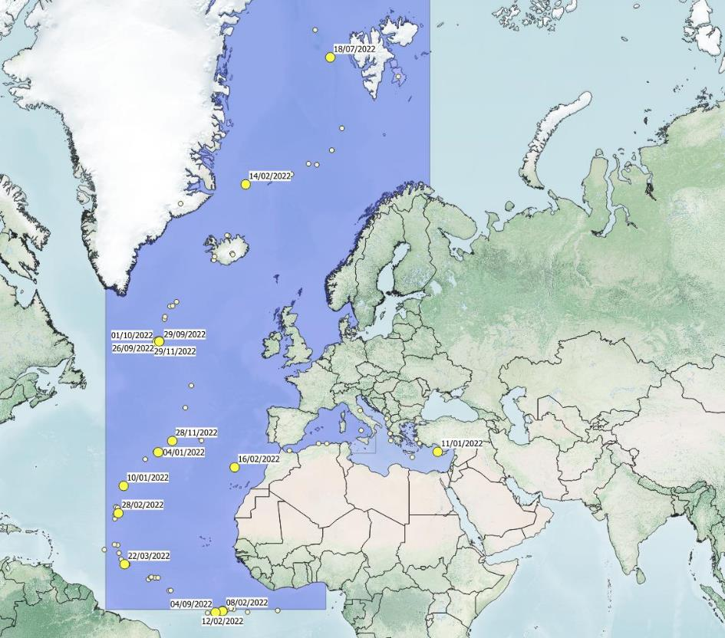
Report on 2022 events
3129 earthquakes processed in Cenalt worldwide
  Daily practicing
15 Information messages
  Atlantic Ocean

Slide 6

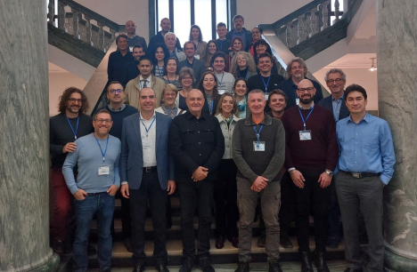

Other activities
  Meetings
    Task Team Operation, September 2022, Paris
    ICG 2022 → Expert Meeting, Naples (Nov 2022)
    Steering Committee 12-13 April 2022
  Global framework
    Towards Tsunami Ready recognition
      Set up of the national committee in France
    TT Tsunami Watch Operation (since Feb 2022)

Slide 7
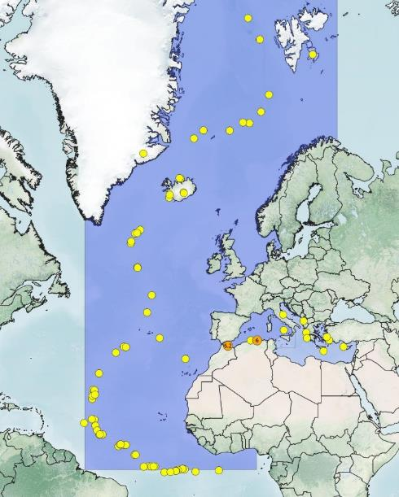
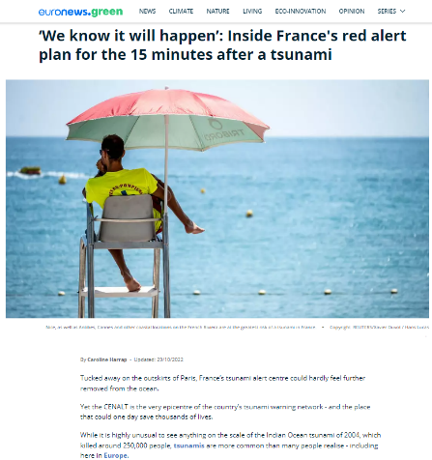

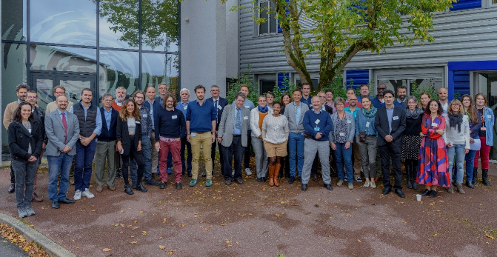
10 years of operation in Cenalt
83 national information messages
73 international information messages
2 international advisory messages
Tsunami observed
  29-30 September, 2022, scientific workshop in Cenalt
    ~40 scientists and representatives (national authorities, Unesco)
  27-28 September, 2022, TSP TT Operation meeting (Paris)
  10 October, 2022: visit by French authorities
  21 October, 2022: press visit

Slide 8
Perspectives 2023
Renewal of the IT system in parallel to the operation
Evolution of the format of the national messages
  Full name of the tide gauge stations
  Mention of the end of Cenalt sea level monitoring
Exercises
  Neamwave23
    Scenario with Portugal: 1761 Mw 8.5
  WTAD
    National exercise with a Mediterranean scenario
Support to TR initiatives
  Close interaction with Cannes municipality

Slide 9
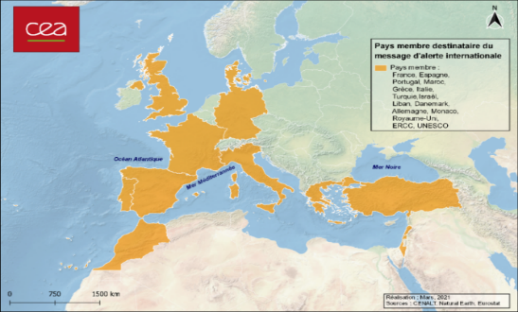
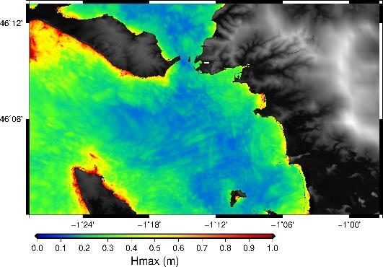
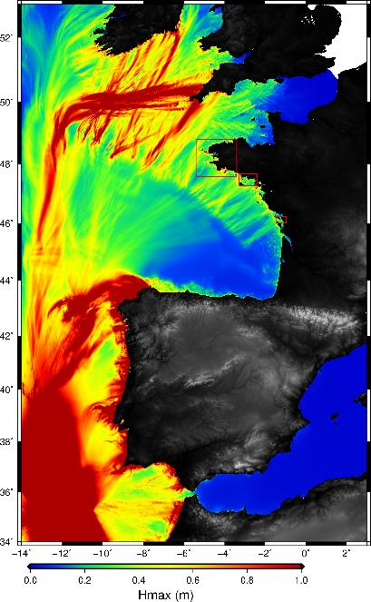
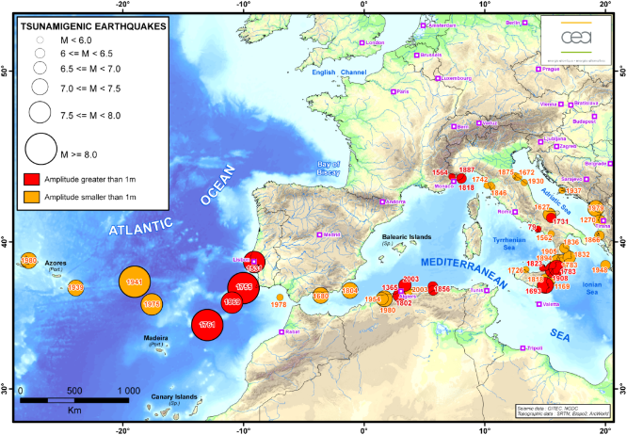
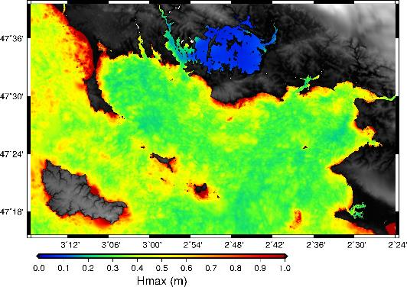
NeamWave23
  Scenario modeling regarding French coastline
    Earthquake in 1761 off Portgual, magnitude 8.5
    Typical coastal maximum heights ~ 1 m
Ile de Ré
Mw 8.5
La Rochelle
Gailler, 2023
Golfe du Morbihan
Belle Ile

Slide 10
Thank you for attention
CEA DAM/DIF
91297 Arpajon
France
helene.hebert@cea.fr

