Slide 1
Task Team on Tsunami Ready Progress in the Implementation of Tsunami Ready in the NEAM Region
co-chairs:
Ignacio Aguirre Ayerbe (Spain) & Elena Daskalaki (Greece)
ICG/NEAMTWS Steering Committee, Paris, 12-13 April 2023

Slide 2
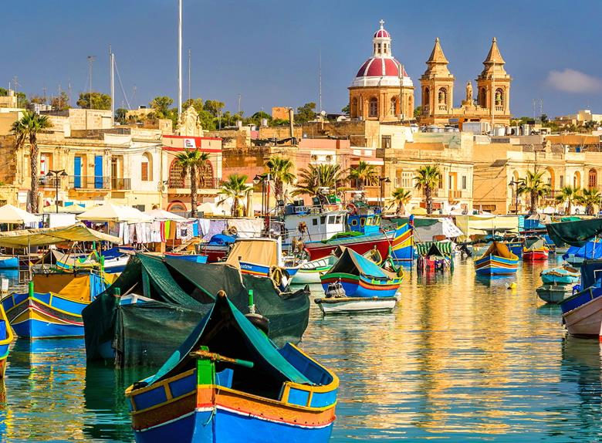
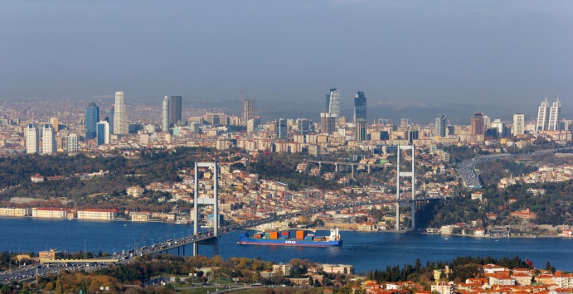
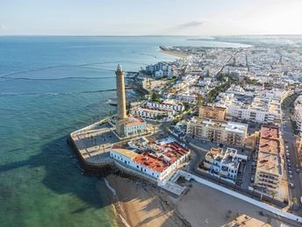
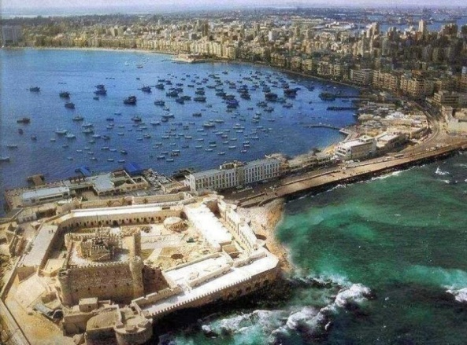
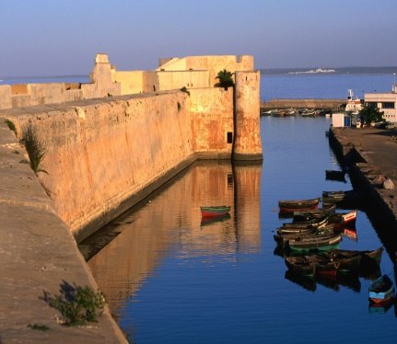
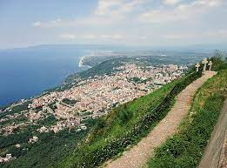
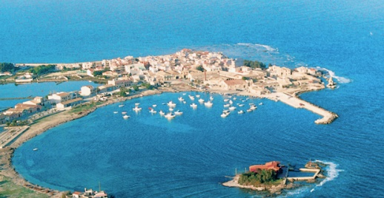
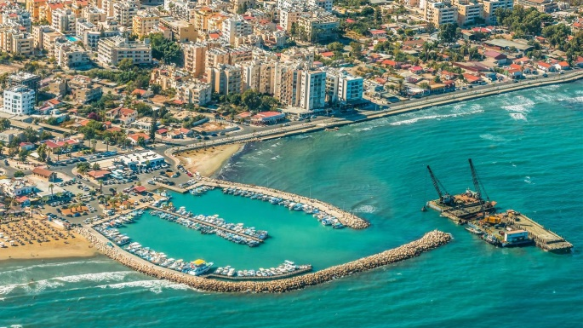
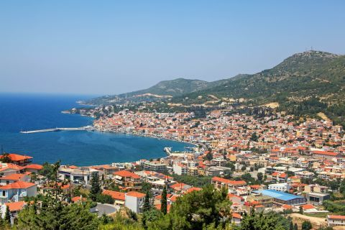
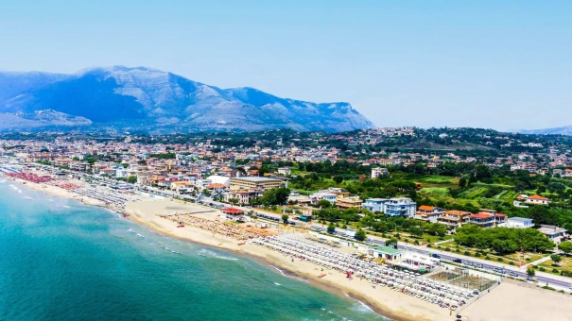
Tsunami Ready in the NEAM Region
9 Countries
11 Communities
Marsaxlokk
Istanbul
Cannes
Chipiona
El Jadida
Alexandria
Palmi
Marzamemi
Samos
Minturno
Larnaca
ICG/NEAMTWS Steering Committee, Paris, 12-13 April 2023

Slide 3
UNESCO/IOC Tsunami Ready Recognition Program
Manual and guide 74
The Tsunami Ready Recognition Program is a voluntary international community-based recognition program developed by UNESCO/IOC.
It aims to build resilient communities through awareness and preparedness strategies that will protect life, livelihoods and property from tsunamis in different regions.
It promotes the concept of readiness through actions → Process and Capacity → to meet 12 key indicators that serve as the standard for reducing tsunami risk at the community level.
https://oceanexpert.org/downloadFile/50068
It facilitates tsunami preparedness as an active collaboration of the public (community), community leaders, local and national emergency management agencies.
To advise countries that are currently in the process of implementing Tsunami Ready, to now follow the MG74 when submitting/applying for Tsunami Recognition.
The ICG Tsunami Information Centers (TICs) should facilitate the UNESCO/IOC Tsunami Ready Recognition Program in each region.
ICG/NEAMTWS Steering Committee, Paris, 12-13 April 2023

Slide 4
UNESCO IOC TSUNAMI READY INDICATORS
I | ASSESSMENT (ASSESS)
1 | ASSESS-1. Tsunami hazard zones are mapped and designated
2 | ASSESS-2. The number of people at risk in the tsunami hazard zone is estimated
3 | ASSESS-3. Economic, infrastructural, political, and social resources are identified
II | PREPAREDNESS (PREP)
4 | PREP‑1. Easily understood tsunami evacuation maps are approved
5 | PREP‑2. Tsunami information is publicly displayed
6 | PREP‑3. Outreach and public awareness and education resources are available and distributed
7 | PREP‑4. Outreach or educational activities are held at least three times a year
8 | PREP‑5: A community tsunami exercise is conducted at least every two years
III | RESPONSE (RESP)
9 | RESP-1. A community tsunami emergency response plan (ERP) is approved
10 | RESP-2. The capacity to manage emergency response operations during a tsunami is in place
11 | RESP-3. Redundant and reliable means to timely receive 24-hour official tsunami alerts are in place
12 | RESP-4. Redundant and reliable means to timely disseminate 24-hour official tsunami alerts to the public are in place
ICG/NEAMTWS Steering Committee, Paris, 12-13 April 2023

Slide 5
ASSESSMENT (ASSESS)
ASSESS-1. Tsunami hazard zones are mapped and designated
ASSESS-2. The number of people at risk in the tsunami hazard zone is estimated
ASSESS-3. Economic, infrastructural, political, and social resources are identified
ICG/NEAMTWS Steering Committee, Paris, 12-13 April 2023

Slide 6
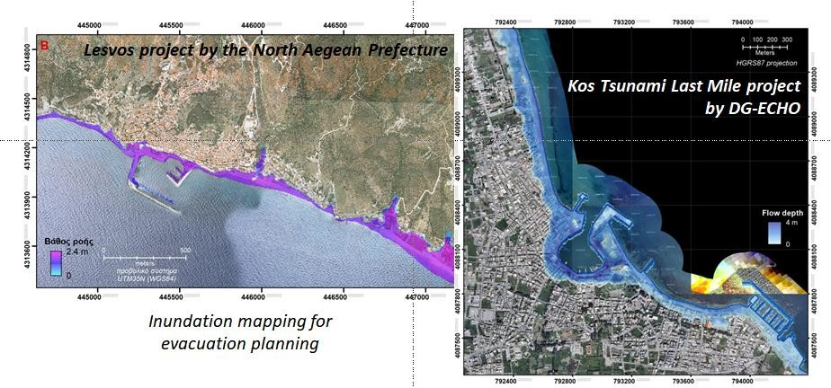
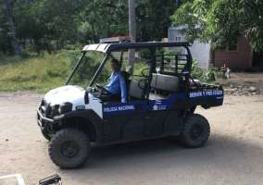
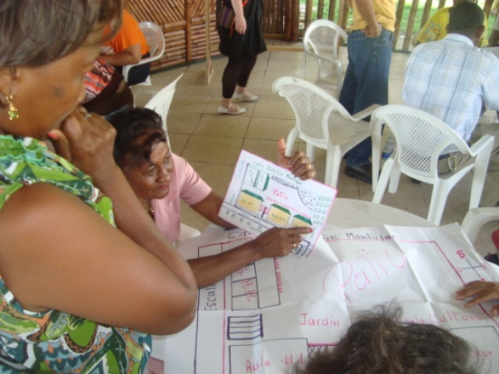
ASSESSMENT (ASSESS)
Source: Lesvos project and Tsunami Last Mile project, NOA
Source: Manuals and Guides 74
Source: Mr. Alfath Abu Bakar, BMKG Indonesia
ICG/NEAMTWS Steering Committee, Paris, 12-13 April 2023

Slide 7
PREPAREDNESS (PREP)
PREP‑1. Easily understood tsunami evacuation maps are approved
PREP‑2. Outreach and public awareness and education resources are available and distributed
PREP‑3. Outreach and public awareness and education resources are available and distributed
PREP‑4. Outreach or educational activities are held at least three times a year
PREP‑5: A community tsunami exercise is conducted at least every two years

Slide 8
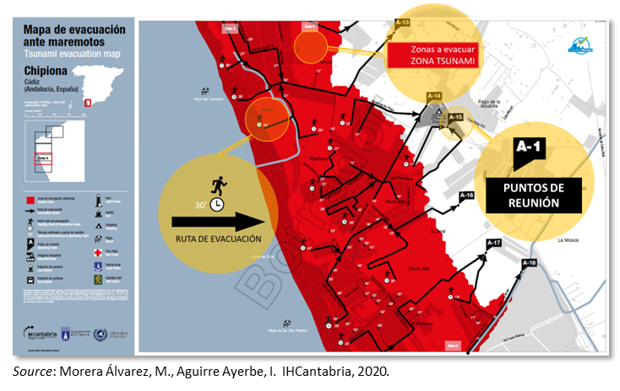
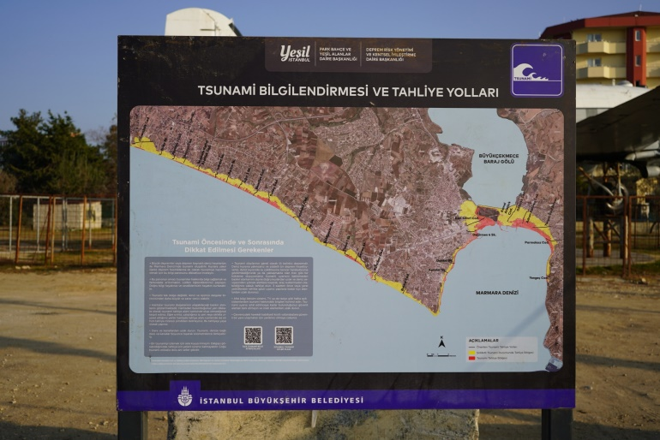
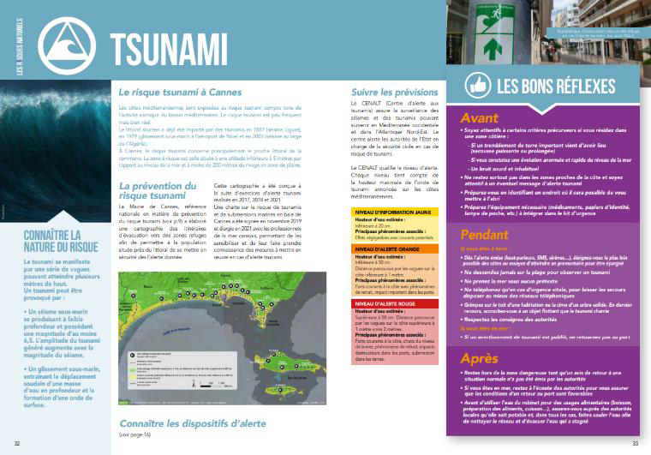
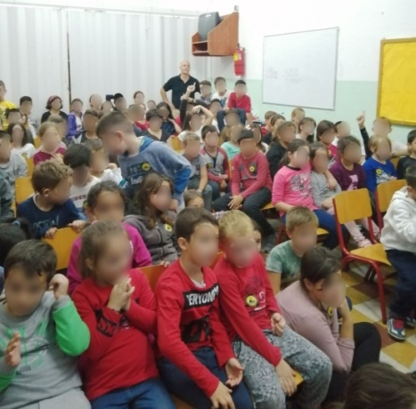
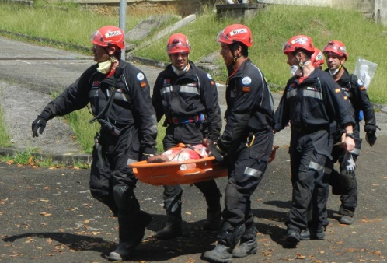
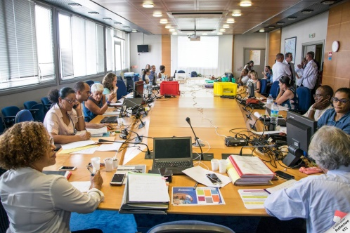
PREPAREDNESS (PREP)
Source: MORERA ALVAREZ, M. & AGUIRRE AYERBE, I., IHCantabria, 2020
Source: Dr. Musavver Didem CAMBAZ, KOERI
Source: Dr. Matthieu PÉROCHE, Univ. of Montpellier
Source: Tsunami Last Mile project, NOA
ICG/NEAMTWS Steering Committee, Paris, 12-13 April 2023

Slide 9
RESPONSE (RESP)
RESP-1. A community tsunami emergency response plan (ERP) is approved
RESP-2. The capacity to manage emergency response operations during a tsunami is in place
RESP-3. Redundant and reliable means to timely receive 24-hour official tsunami alerts are in place
RESP-4. Redundant and reliable means to timely disseminate 24-hour official tsunami alerts to the public are in place
ICG/NEAMTWS Steering Committee, Paris, 12-13 April 2023

Slide 10
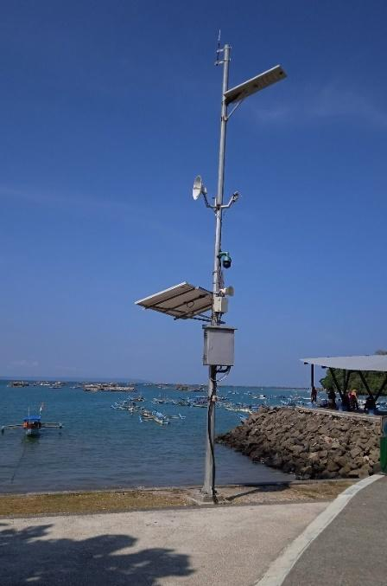
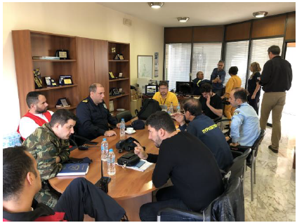
RESPONSE (RESP)
WITH
Smart Poles at four locations
Source: Tsunami Last Mile project, NOA
at least 3 of communication methods
Source: Dr. Nikos KALLIGERIS, NOA
Source: Dr. Derya I. VENNIN, UNESCO-IOC Tsunami Resilience Section
ICG/NEAMTWS Steering Committee, Paris, 12-13 April 2023

Slide 11
Tsunami Ready Indicators Summary

Slide 12
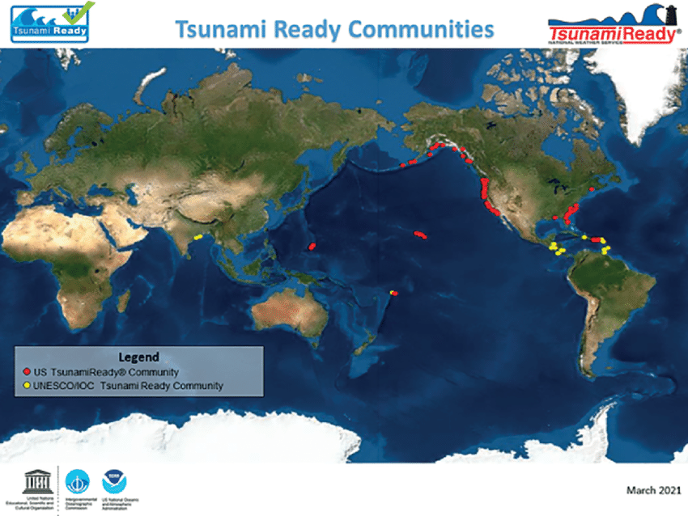
Tsunami Ready Communities
32 communities in
22 countries
(until April 2023)
&
199 communities in
16 States and Territories of U.S.
(until September 2022)
Source: Chacón-Barrantes, Silvia et.al. (2021). Advances in tsunami preparedness at the beginning of the Ocean Decade: the Costa Rica case. Ocean and Coastal Research. 69. 10.1590/2675-2824069.21021scb.
ICG/NEAMTWS Steering Committee, Paris, 12-13 April 2023

Slide 13
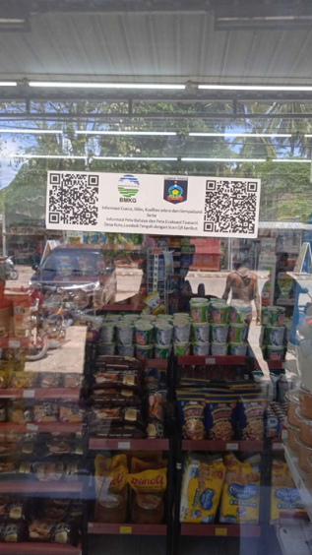
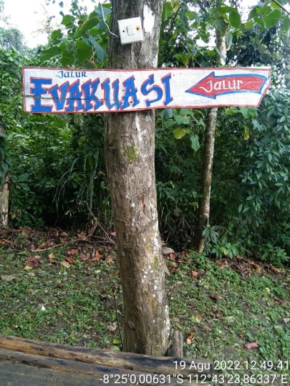
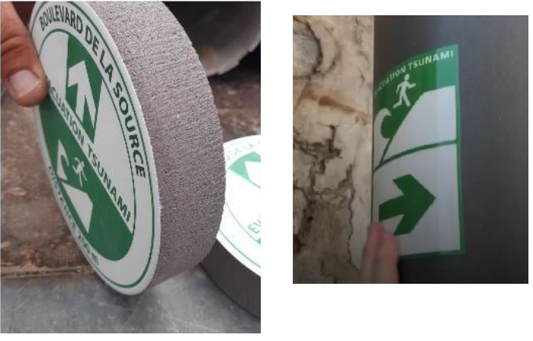
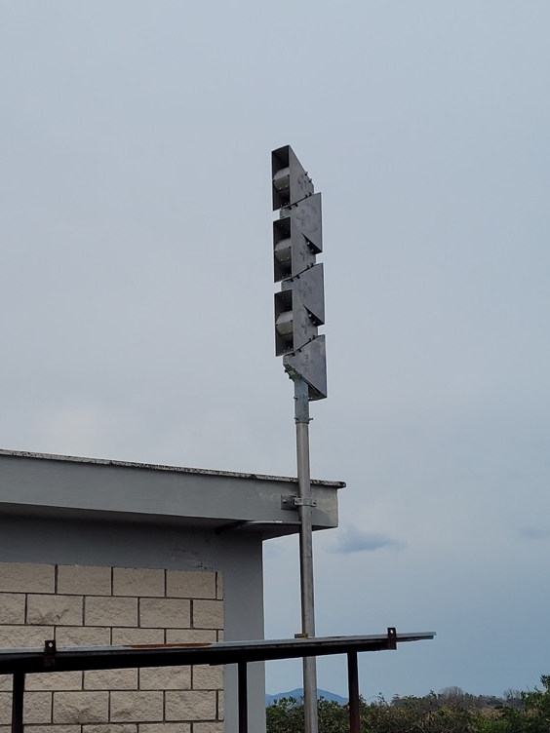
Tsunami Ready Challenges
Sirens & Signages
Reflective signage for night time evacuation.
Sound range limited.
Maintenance.
Natural disturbance.
Expensive.
Difficulties to get local elected officials to accept the signage because it materializes the tsunami risk (especially for municipalities oriented towards the tourism economy) .
Human characteristics
The community has never experienced a tsunami disaster.
Many people accept or give up on disaster, because they see it as a part of their fate.
Effort for adapting the tsunami signage and facilitating its integrations into the urban environment.
Using simple materials from painted wooden planks and installed in place that are easily seen by the public.
ICG/NEAMTWS Steering Committee, Paris, 12-13 April 2023

Slide 14
Tsunami Ready Challenges
Need for active and consistent engagement of all relevant organizations nationally.
Strong institutional support.
Maintaining sustainable funding.
Strong local political will.
Availability of tools and resources by scientists and actors of the crisis management.
More timely warnings with reduced uncertainties delivered to 100% at-risk Tsunami Ready communities.
ICG/NEAMTWS Steering Committee, Paris, 12-13 April 2023

Slide 15
Tsunami Ready Challenges
ICG/NEAMTWS Steering Committee, Paris, 12-13 April 2023

Slide 16
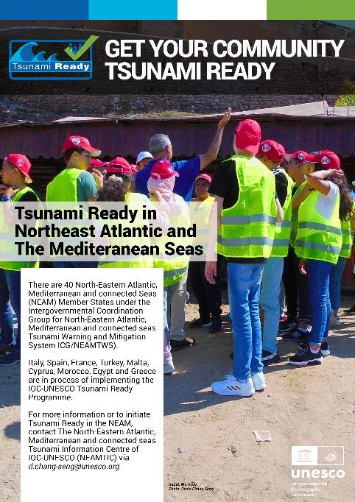
Get your community
Tsunami Ready
ICG/NEAMTWS Steering Committee, Paris, 12-13 April 2023

Slide 17
Thank you for attention
ICG/NEAMTWS Steering Committee, Paris, 12-13 April 2023

