Slide 1



ICG NEAMTWS
Task Team on Tsunami Ready
Co-chairs
Ignacio Aguirre Ayerbe (Spain)
Elena Daskalaki (Greece)
UNESCO IOC/ICG/NEAMTWS Steering Committee Meeting
12-13 April, Paris, France

Slide 2
  ICG NEAMTWS TASK TEAM TSUNAMI READY TASK TEAM TSUNAMI READY
INDEX of Agenda Item 9
Brief update of Work Plan and activities by Task Team on Tsunami Ready
Progress in the Implementation of Tsunami Ready in the NEAM Region

Slide 3

  ICG NEAMTWS TASK TEAM TSUNAMI READY BACKGROUND
ICG-NEAMTWS-WGs / TTs
24-26 Nov. 2020 (link)
ICG/NEAMTWS
XVII Session
24 - 26 Nov. 2021
(online)
ICG/NEAMTWS
XVII Session
Establishment of intersessional WGs and TTs
ICG/NEAMTWS
Steering Committee
8-12 April 2022
(online)
Nov. 2020
Nov. 2021
Jan. 2022
April 2022
WG4 proposed to set up a dedicated Group on Tsunami Ready within WG4 to start coordinating and implementing Tsunami Ready
The ICG/NEAMTWS decides to formally establish a Task Team on Tsunami Ready with Terms of Reference in Appendix 5
Establishment of the NEAMTWS TT on TR
and appointment of new cochairs
Establishment of First TT-TR Plan of Action (PoA) (requested during ICG/NEAMTWS XVII 2021
IOC Circular Letter No 2821
7 Dec. 2020
ICG-NEAMTWS XVII Decisions and recommendations
(Working Document 23 Nov 2021)
ICG-NEAMTWS XVII Session Report.
Approved TT-TR Plan of Action 2022
Draft Plan of Action

Slide 4

  ICG NEAMTWS TASK TEAM TSUNAMI READY TERMS OF REFERENCE
Terms of Reference
ICG/NEAMTWS Task Team on Tsunami Ready Mandate
Appendix 5 to Decisions and Recommendations ICG/NEAMTWS-XVII (2021)
The Task Team on Tsunami Ready Team will:
Promote the Tsunami Ready programme in the NEAM region and encourage Member States to join the program.
Coordinate and foster cooperation among NEAM countries and other regions worldwide on Tsunami Ready programme in place, as well as exchange knowledge, experiences and best practices.
Provide advice on the procedures to achieve a Tsunami Ready recognition.
Adapt the standards in NEAM region according to the IOC UNESCO Tsunami Ready guidelines.
Report to and have a strong interaction with the ICGNEAMTWS/WG4.

Slide 5

  ICG NEAMTWS TASK TEAM TSUNAMI READY PLAN OF ACTION
COLLABORATION AND COOPERATION EFFORTS !!
OTHER ICG RELATED INITIATIVES
ICG/NEAMTWS TT-TR
TOWS WG – TT DMP
Caribe EWS
Task Team Tsunami Ready Programme
Indian Ocean Tsunami Warning and Mitigation System
Working Group 3 - Tsunami Ready
NEAMTWS
Task Team - Tsunami Ready
ICG/NEAMTWS WG4
Ocean Decade Tsunami Pr.
ICG/NEAMTWS TRS
Tsunami Ready Coalition
CoastWAVE Project

Slide 6
  ICG NEAMTWS TASK TEAM TSUNAMI READY PLAN OF ACTION
Task Team on Tsunami Ready: Plan of Action for 2022-2023
Objectives | Objectives | Activity | Target / Result Indicators
1 | Membership of Tsunami Ready Task Team. | Confirm membership of the Task Team by former members of TR Group. | Official list of active TR-TT members.
2 | Promote community preparedness. Support and promote Tsunami Ready programme in NEAM region. | Monitoring of TR pilot projects in NEAM area. | TR initiatives already in place in NEAM region (TR indicators achievement). New TR candidates.
 |  | Interact with the WG4 group and foster its activities. | Online meetings with WG4 co-chairs.
3 | Encourage and support approval of NEAMTWS TR guidelines, as part of the downstream component of the ICG/NEAMTWS programme. | Establish communication with other ICGs TTs and WGs related to Tsunami Ready, to share/discuss knowledge, experiences and challenges. Identify critical points (and promote solutions to address them) of TR guidelines. This includes: Identify methodologies followed by each TR community to promote discussion on them (e.g., to define inundation areas, to generate adequate maps addressing local particularities, to communicate to local stakeholders, on alert dissemination methodologies). | Meetings and webinars (online meeting, and face-to-face). Summary report.

Slide 7
  ICG NEAMTWS TASK TEAM TSUNAMI READY PLAN OF ACTION
Task Team on Tsunami Ready: Plan of Action for 2022-2023
Objectives | Objectives | Activity | Target / Result Indicators
4 | Represent Tsunami Ready TT in ICG/NEAMTWS. | Represent TT-TR at meetings scheduled throughout the year 2022 and 2023. | Participation to the SC meeting/TR-TT presentations.
5 | Cooperation with other Working Groups and Task Teams. | Supporting where appropriate and providing feedback. | Participating in meetings and commenting on background documents as requested.

Slide 8

  ICG NEAMTWS TASK TEAM TSUNAMI READY ACTIVITIES DEVELOPED
Task Team on Tsunami Ready: Plan of Action for 2022-2023
Objectives | Objectives | Activity
1 | Membership of Tsunami Ready Task Team. | Confirm membership of the Task Team by former members of TR Group.
Total members of ICG/NEAMTWS TT-TR (April 2023) = 27
Initially, the TNCs were asked to propose members
(IOC Circular Letter No 2821)
Membership mechanism and list needs to be updated and cross-checked with the WG4 membership list.

Slide 9
  ICG NEAMTWS TASK TEAM TSUNAMI READY ACTIVITIES DEVELOPED
Task Team on Tsunami Ready: Plan of Action for 2022-2023
Objectives | Objectives | Activity
1 | Membership of Tsunami Ready Task Team. | Confirm membership of the Task Team by former members of TR Group.
Country | TT-TR member | TRRP in progress
Italy | ✓ | ✓
Spain | ✓ | ✓
Greece | ✓ | ✓
Turkey | ✓ | ✓
Israel | ✓
Lebanon | ✓
France | ✓ | ✓
Cyprus |  | ✓
Egypt |  | ✓
Morocco |  | ✓
Total members of ICG/NEAMTWS TT-TR (April 2023) = 27

Slide 10
  ICG NEAMTWS TASK TEAM TSUNAMI READY ACTIVITIES DEVELOPED
Task Team on Tsunami Ready: Plan of Action for 2022-2023
Objectives | Objectives | Activity
2 | Promote community preparedness. Support and promote Tsunami Ready programme in NEAM region. | a) Monitoring of TR pilot projects in NEAM area.
 |  | b) Interact with the WG4 group and foster its activities.
2a) A jointly monitoring is being carried out between TT-TR and Tsunami Resilience Section (TRS) Tech. Secretariat and CoastWAVE project coordinator.
2b) Two dedicated coordination meetings were held in Nov. 2022 and March 2023 between WG 4 and TT-TR.
Annual coordination meeting with TT-TR, WG4 and TRS Tech. Secretariat held in March 2023.
It is suggested to establish two annual coordination meetings between TT-TR, WG4 and TRS Tech. Secretariat .
It is recommended to re-send IOC Circular letter should to TNCs to request candidates for Tsunami Ready Programme.
For the next intersessional period, the organization of at least one annual activity for the promotion of the TRRP in NEAM should be incorporated into the PoA.

Slide 11
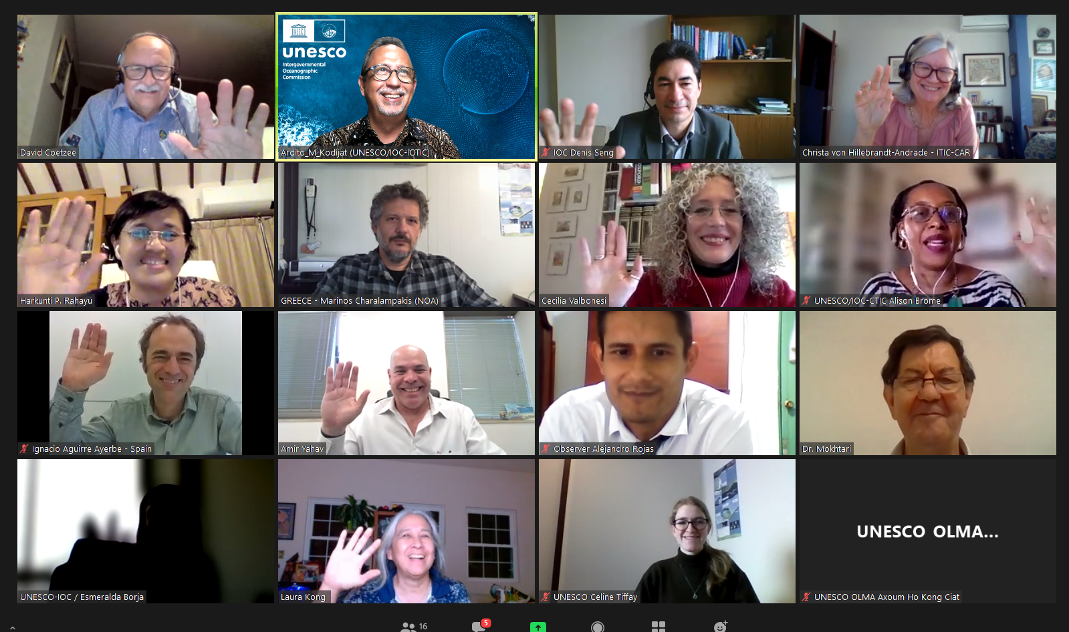
  ICG NEAMTWS TASK TEAM TSUNAMI READY ACTIVITIES DEVELOPED
Task Team on Tsunami Ready: Plan of Action for 2022-2023
Objectives | Objectives | Activity
3 | Encourage and support approval of NEAMTWS TR guidelines, as part of the downstream component of the ICG/NEAMTWS programme. | Establish communication with other ICGs TTs and WGs related to Tsunami Ready, to share/discuss knowledge, experiences and challenges. Identify critical points (and promote solutions to address them) of TR guidelines. Identify methodologies followed by each TR community to promote discussion on them (e.g., to define inundation areas, to generate adequate maps addressing local particularities, to communicate to local stakeholders, on alert dissemination methodologies).
3a) Contributions were made at the Inter ICG TOWS Task Team on Disaster Management and Preparedness – IOC UNESCO 21 -22 Feb. 2022 and 27-28 Feb. 2023 (both attended online).
3b,c) Work is in progress related to identifying Critical points based on current PRRT initiatives in NEAM countries and other ICGs, looking into solutions and methodologies followed by each PRRT community to address them, for further with the objective of promoting them.

Slide 12
  ICG NEAMTWS TASK TEAM TSUNAMI READY ACTIVITIES DEVELOPED
Task Team on Tsunami Ready: Plan of Action for 2022-2023
Objectives | Objectives | Activity
3 | Encourage and support approval of NEAMTWS TR guidelines, as part of the downstream component of the ICG/NEAMTWS programme. | Establish communication with other ICGs TTs and WGs related to Tsunami Ready, to share/discuss knowledge, experiences and challenges. Identify critical points (and promote solutions to address them) of TR guidelines. Identify methodologies followed by each TR community to promote discussion on them (e.g., to define inundation areas, to generate adequate maps addressing local particularities, to communicate to local stakeholders, on alert dissemination methodologies).
The guide MG74 is already approved. For next intersessional period, this objective should become “Based on the pioneering progress in the implementation of the TRRP in the NEAM region, identify critical points, possible solutions, the need to establish guidelines for the development of some indicators, and, if necessary and convenient, communicate the need to adapt MG74 to the NEAM region.”
It is also recommended to translate MG74 into other languages, at least for those who are implementing TRRP.
It is recommended to publish a short version of MG 74 (visual and simple brochure) to improve its dissemination at all levels.
It is recommended to establish regular interaction between ICG/NEAMTWS TT-TR and other ICGs.
It is suggested that ICG/NEAMTWS TT-TR representatives attend to, at least as observers, Inter ICG TOWS TT DMP meetings.

Slide 13
  ICG NEAMTWS TASK TEAM TSUNAMI READY ACTIVITIES DEVELOPED
Task Team on Tsunami Ready: Plan of Action for 2022-2023
Objectives | Objectives | Activity
4 | Represent Tsunami Ready TT in ICG/NEAMTWS. | Represent TT-TR at meetings scheduled throughout the year 2022 and 2023.
5 | Cooperation with other Working Groups and Task Teams. | Supporting where appropriate and providing feedback.
Participation (as observers) in the meeting of the Inter ICG TOWS Task Team on Disaster Management and Preparedness – IOC UNESCO 27-28 Feb. 2023.
Participation, organization and presentations at the Tsunami Ready Training Workshop of the IOC-UNESCO EU DG-ECHO CoastWAVE project 16-17 February 2023.
Participation and presentations at the ICG/NEAMTWS Experts Meeting: Implementing NEAMTWS 2030 Strategy, opportunities and actions to explore. Naples, 28-30 Nov. 2022.
Participation of TT TR members on the Webinar on Tsunami Risk Perception Studies Within the NEAM Region - November 2022.
NEAMTWS Local Tsunami Warning in the Context of Multi-Hazard Disaster Risk Mitigation: Requirements, Challenges, Opportunities & CoastWave project Tsunami Ready meeting. October 2022, Ispra, Italy.

Slide 14
  ICG NEAMTWS TASK TEAM TSUNAMI READY ACTIVITIES DEVELOPED
Task Team on Tsunami Ready: Plan of Action for 2022-2023
Objectives | Objectives | Activity
4 | Represent Tsunami Ready TT in ICG/NEAMTWS. | Represent TT-TR at meetings scheduled throughout the year 2022 and 2023.
5 | Cooperation with other Working Groups and Task Teams. | Supporting where appropriate and providing feedback.
Continuation object. 4 and 5…
African Conference on Priority Setting & Partnership Development for the UN Decade of Ocean Science for Sustainable Development, Current Status, Challenges and Opportunities - Side Event “Resilient and Safer Coasts”. Cairo, Egypt. May 2022.
NEAMTWS Workshop of Task Team Tsunami Ready and Working Group 4 on Multi Hazard Risk Perception Survey Contribution to the development of a Coastal Multi-Risk Perception, Preparedness, Resilience Study and Survey Questionnaire for Tsunami, Storm Surge and Sea Level Rise (IOC-UNESCO EU DG-ECHO CoastWAVE project CoastWAVE project) - April 2022.
Presentations of TT-TR progress at SC meeting. April 2022.
UN Ocean Decade - IOC Tsunami Unit Satellite Activity on Tsunami Ready. 5-7 April 2022, online.

Slide 15
  ICG NEAMTWS TASK TEAM TSUNAMI READY ACTIVITIES DEVELOPED
Task Team on Tsunami Ready: Plan of Action for 2022-2023
Objectives | Objectives | Activity
4 | Represent Tsunami Ready TT in ICG/NEAMTWS. | Represent TT-TR at meetings scheduled throughout the year 2022 and 2023.
5 | Cooperation with other Working Groups and Task Teams. | Supporting where appropriate and providing feedback.
Continuation object. 4 and 5…
Contribution to UNESCO/IOC Tsunami Ready Innovation Platform (https://globalplatform.undrr.org/) providing photos and videos for NEAM region for communities that TR Program is ongoing or to be implemented. March 2022.
Participation (as observer) in the meeting of the Inter ICG TOWS Task Team on Disaster Management and Preparedness – IOC UNESCO. 21 -22 Feb. 2022.
Monitoring and collection of material from the progress that is made so far in the communities that are, or aim to be included, in the UNESCO IOC Tsunami Ready recognition program for the presentation on Disaster Management Preparedness (TT-DMP) and share it with the co-chair of TOWS TT-DMP. February 2022.
It is suggested to establish two annual coordination meetings between TT-TR, WG4 and TRS Tech. Secretariat.
It is suggested to establish coordination meetings between TT-TR, WG4 and WG1, 2 and 3.

Slide 16
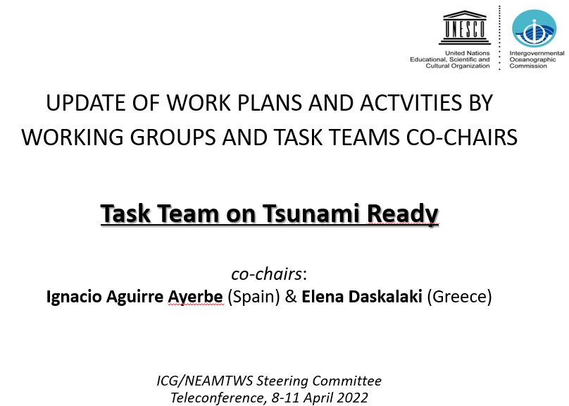
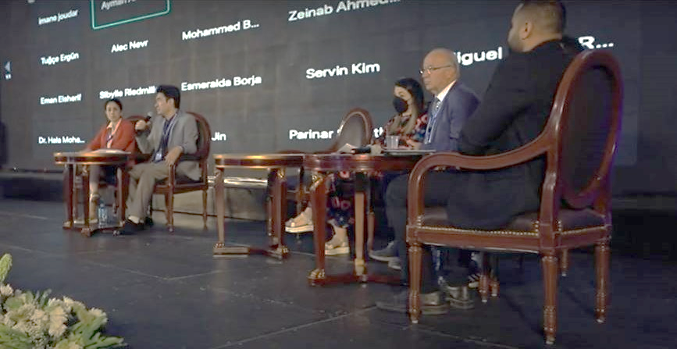
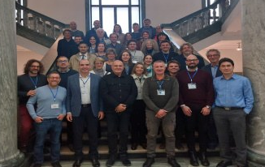
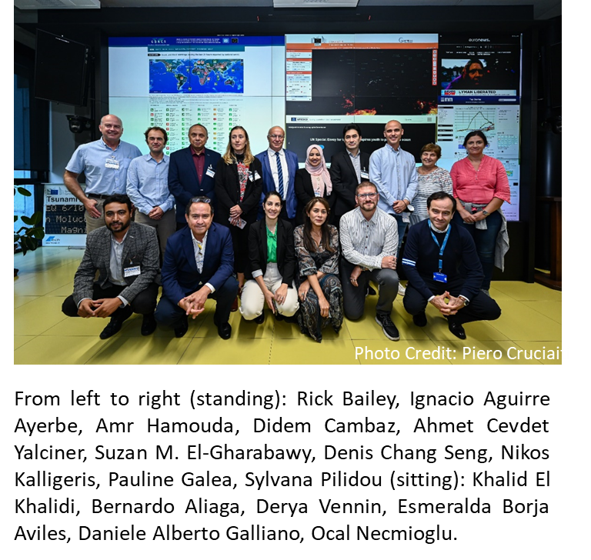

  ICG NEAMTWS TASK TEAM TSUNAMI READY ACTIVITIES DEVELOPED
Task Team on Tsunami Ready: Plan of Action for 2022-2023
Represent TT-TR at meetings scheduled throughout the year 2022 and 2023.
ICG/NEAMTWS Experts Meeting: Implementing NEAMTWS 2030 Strategy, opportunities and actions to explore. Naples, 28-30 Nov. 2022
African Conference Side Event “Resilient and Safer Coasts” - May 2022, Cairo, Egypt.
ICG/NEAMTWS Meeting Local Tsunami Warning in the Context of Multi-Hazard Disaster Risk Mitigation: Requirements, Challenges, Opportunities & CoastWave project Tsunami Ready meeting. October 2022, Ispra, Italy
Inter ICG Task Team on Disaster Management and Prepared. Feb., 2022, online.

Slide 17

  ICG NEAMTWS TASK TEAM TSUNAMI READY TT-TR FUTURE ACTIONS
DRAFT RECOMMENDATIONS AND FUTURE ACTIVITIES IDENTIFIED TO BE DISCUSSED WITH TT-TR TEAM MEMBERS AND WG4 TO REPORT AT ICG/NEAMTWS XVIII SESSION (NOV. 2023).
Recommendation/Activity | ToR | PoA
It is recommended to establish and report a membership mechanism and updated and cross-checked list with WG4 membership list. | 1 | 1
It is suggested to establish two annual coordination meetings between TT-TR, WG4 and TRS Tech. Secretariat. | 1, 5 | 2 *Adjustment of PoA
It is recommended to re-send IOC Circular letter should to TNCs to request candidates for Tsunami Ready Programme. | 1 | 2
For the next intersessional period, planning of at least one annual activity for the promotion and explanation of the TRRP in NEAM (face to facer and/or online), together with its benefits, should be incorporated into the PoA. | 1, 3 | O-2* *Adjustment of PoA
For the next intersessional period, Objective 3 of the PoA should become "Based on the pioneering progress in the implementation of the TRRP in the NEAM region, identify critical points, possible solutions, the need to establish guidelines for the development of some indicators, and, if necessary and convenient, communicate the need to adapt MG74 to the NEAM region.” | 3, 4, 2 | O-3* *Adjustment of PoA

Slide 18
  ICG NEAMTWS TASK TEAM TSUNAMI READY TT-TR FUTURE ACTIONS
DRAFT RECOMMENDATIONS AND FUTURE ACTIVITIES IDENTIFIED TO BE DISCUSSED WITH TT-TR TEAM MEMBERS AND WG4 TO REPORT AT ICG/NEAMTWS XVIII SESSION (NOV. 2023).
Recommendation/Activity | ToR | PoA
It is recommended to translate MG74 into other languages, at least for those who are implementing TRRP. | 1 | 3
It is identified the need and therefore it is recommended to publish a short version of MG 74 (visual and simple brochure) to improve its dissemination at all levels. | 1 | 3
It is recommended to establish strong interaction between ICG/NEAMTWS TT-TR and other ICGs. | 2, 3 | 3 *Adjustment of PoA
It is suggested that ICG/NEAMTWS TT-TR representatives to be invited to, at least as observers, Inter ICG TOWS TT DMP meetings. | 2, 3 | 3
It is suggested to establish coordination meetings between TT-TR, WG4 and WG1, 2 and 3. | 2, 3, 4 | 5
It is recommended to explore and strength collaboration with UNESCO/IOC Tsunami Ready Coalition. | 2 | 3
It is recommended to conduct a Survey Questionnaire after TRRP certification. | 1, 2 | 2,3
It is recommended to carefully review the ToR and adapt if necessary. | 1-5 | 1-5

Slide 19
Thank you!
ICG NEAMTWS
Task Team on Tsunami Ready
Co-chairs
Ignacio Aguirre Ayerbe (Spain)
Elena Daskalaki (Greece)
UNESCO IOC/ICG/NEAMTWS Steering Committee Meeting
12-13 April, Paris, France

