Slide 1

Harnessing multi-stakeholder partnerships to transform data into action UNITED NATIONS ENVIRONMENT PROGRAMME (UNEP)
Joana Akrofi,
GEMS Ocean Programme
GOOS 12th Steering Committee meeting, 25 - 26 April 2023

Slide 2
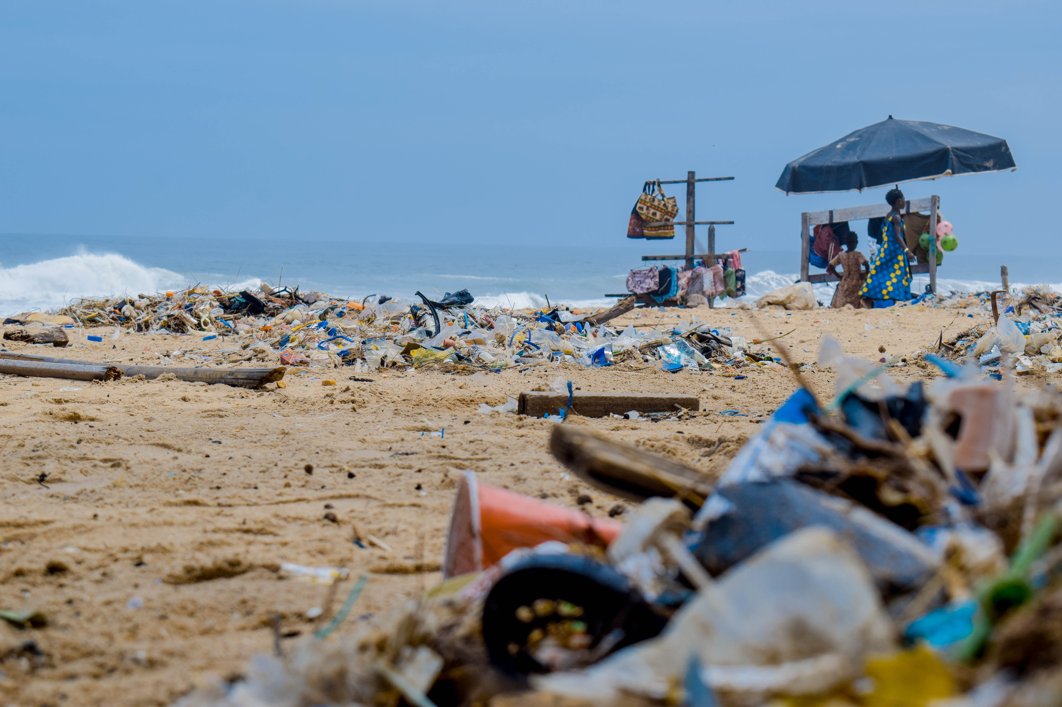


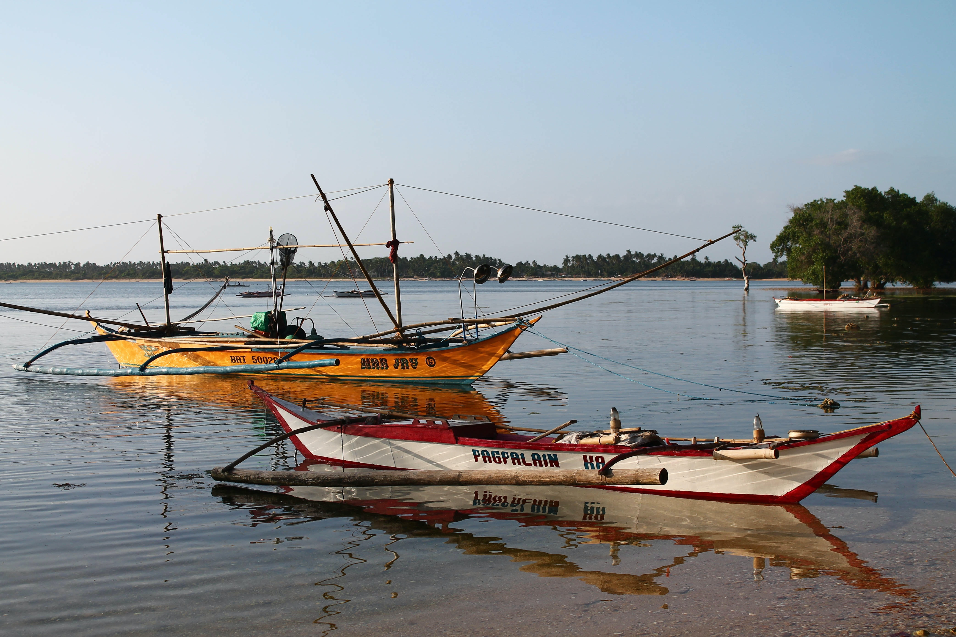
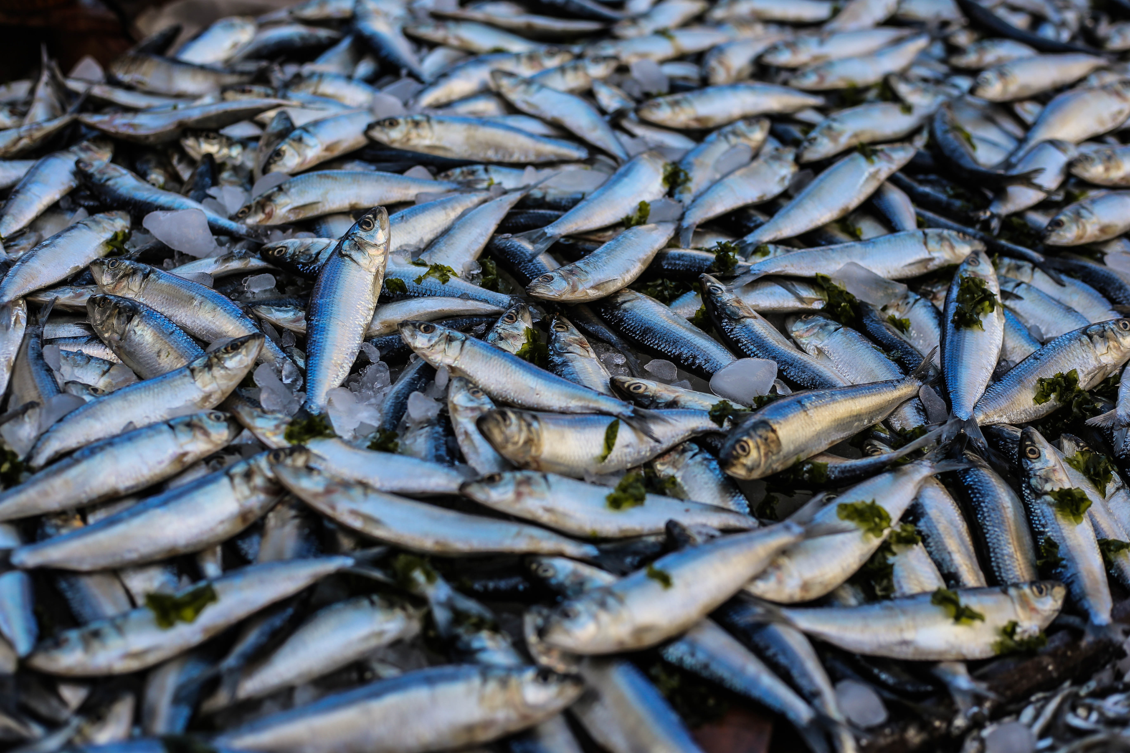
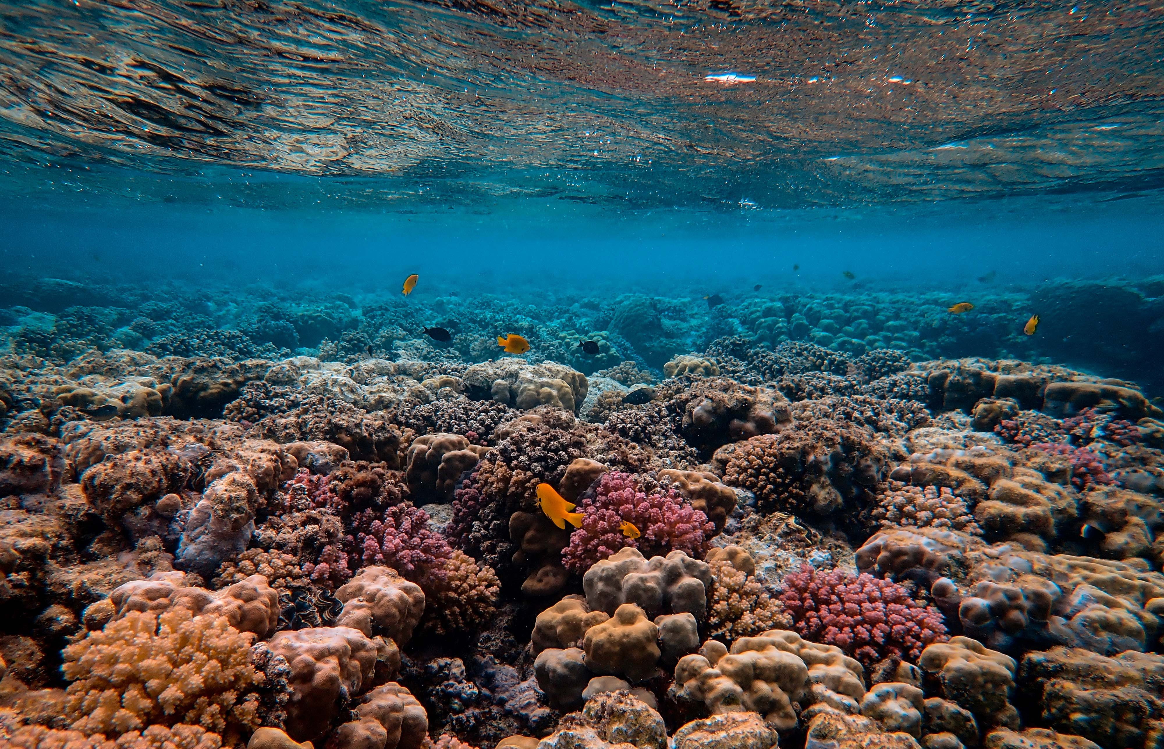
Notes:
Embedded in its Medium-Term Strategy for the period 2022-2025, the United Nations Environment Programme (UNEP) recognizes three interlinked planetary crises for urgent understanding, prioritization, and action: climate change, biodiversity loss, and pollution, all of which have undeniable direct and detrimental impacts on our ocean and coasts.

Slide 3




GEMS Ocean Vision and Mission
Vision
A global environment monitoring system that provides relevant open and easily accessible ocean and coastal data, analysis, and information, guiding actions to protect and sustainably use marine and coastal resources.
Mission
Co-design and convene a global Community of Practice across experts and society at large to provide capacity, analysis, innovation and synthesized information to decision and policy makers, civil society, international organizations as well as coastal communities worldwide in a holistic approach to keep the global ocean and coasts healthy and productive.

Slide 4
Strategic Goals
Problem 1: There are many observation and monitoring systems, but they are rather fragmented.
Problem 2: Many Small Island Developing States (SIDS) and Developing Countries don’t have the capacity and resources to undertake effective monitoring.
Problem 3: There is much information and data already but is not easily accessible and interpretable by non-experts.
GOAL 1: Promote and convene a transdisciplinary partnership approach focusing on sustainable coastal and ocean use and ecosystem health.
GOAL 2: Strengthen capacity development on key aspects of ocean monitoring especially in SIDS and Developing Countries
GOAL 3: Provide access to the use of quality assured, interoperable, open environmental data, analysis and sets of indicators to governments and stakeholders.
Notes:
GEMS Ocean focusses on the three following strategic actions:
Promote and convene a transdisciplinary partnership approach focused on sustainable coastal and ocean use and ecosystem health.
Strengthen capacity development on key aspects of ocean monitoring with a focus on Small Island Developing States (SIDS) and Developing Countries.
Provide access to the use of quality assured, interoperable, open environmental data, analysis and sets of indicators to governments, stakeholders and society at large.

Slide 5
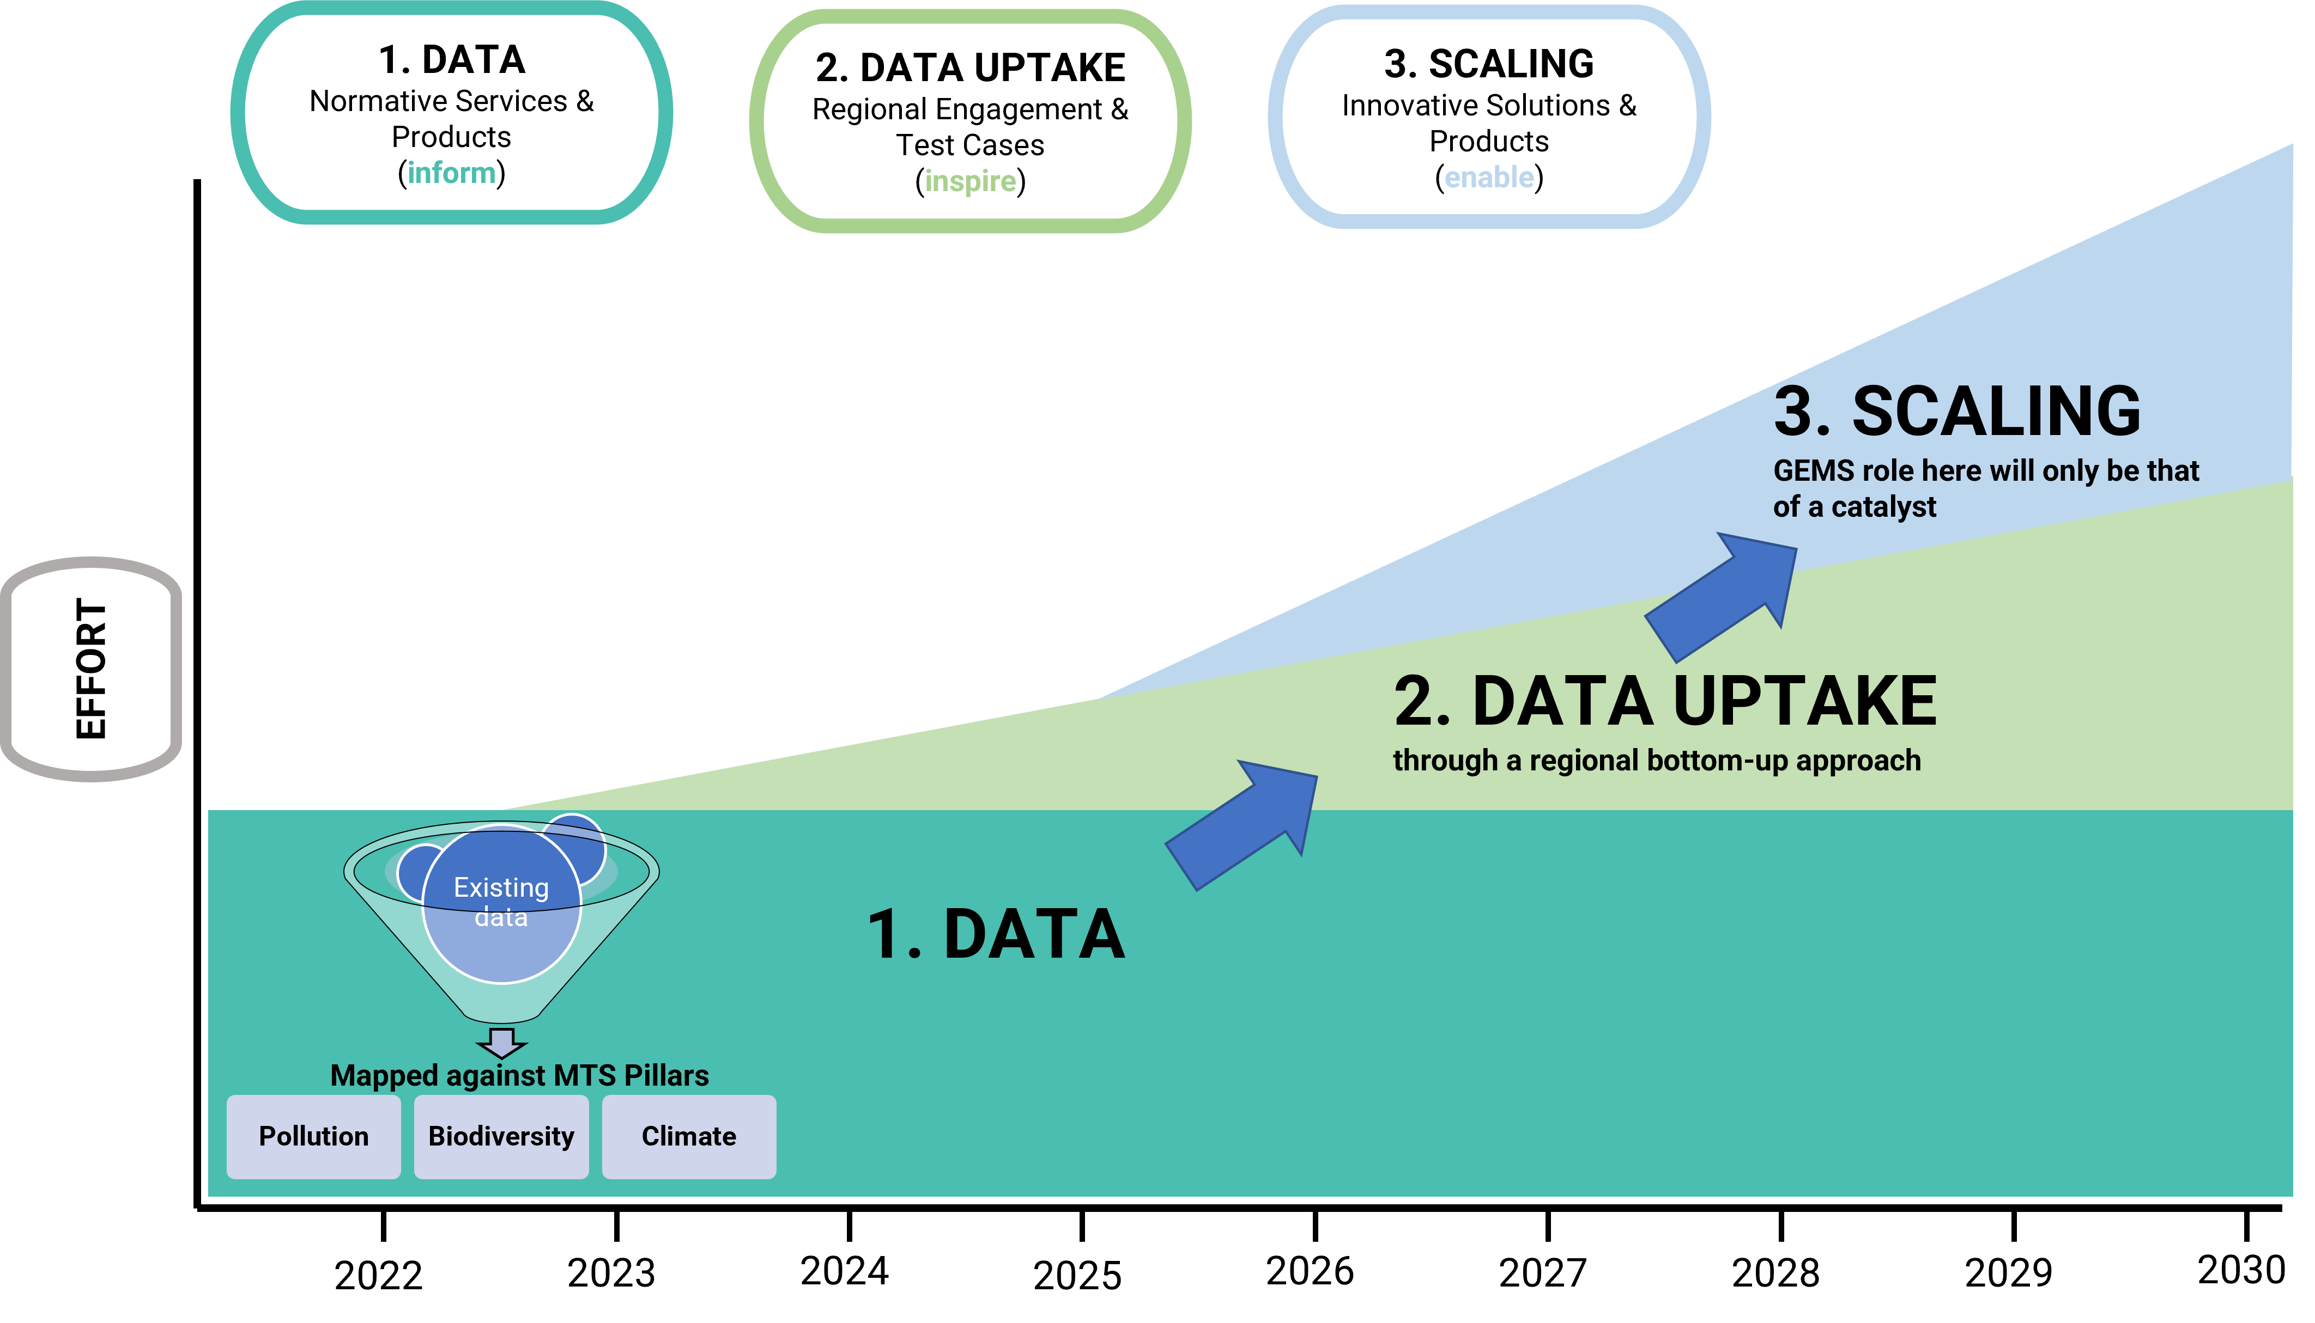
Delivery system
Notes:
GEMS Ocean over time in the 2030 Agenda framework strives to bring global monitoring and regular assessment to a rolling format, while increasingly shifting the focus to on-the-ground engagement in the regions and subsequent scaling up of successful and innovative solutions. This approach can be summarized in what we currently refer to as the GEMS Ocean “Delivery Model”. Following the motto “inform, inspire and enable”, it aims to illustrate how we want to move from data to more action on the ground.
The lower part on “Data” exemplifies that GEMS Ocean will filter the data already available on marine and coastal resources according to the three pillars of UNEP's Medium-Term Strategy (MTS) 2022-2025 - biodiversity, climate and pollution - and make them easily accessible to facilitate data uptake. In doing so, the brands of the data and knowledge asset holders will be made clearly visible at all times. Thus, one function of GEMS Ocean is to gather existing information from the data and knowledge asset holders, take stock of it, synthesize it, and make it available to member states and the public.
The middle part refers to “Data Uptake”. Here, GEMS Ocean will focus on the needs in the regions and explore how it can best facilitate the use of marine and coastal data on the ground through a bottom-up approach. Key will be to work with a wide range of partners to identify needs, build capacity where required, and find (innovative) solutions to specific problems.
In the upper part on “Scaling”, GEMS Ocean will play the role of a catalyst, highlighting what has worked successfully in the regions and advocating for further investment.

Slide 6
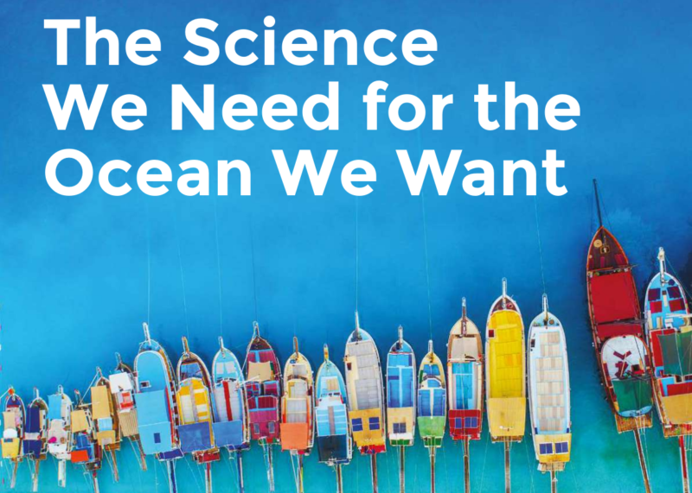
Endorsed Programme

Slide 7



OceanPrediction UNOD-CC
A predicted ocean based on a shared and coordinated global effort in the framework of the UN Ocean Decade
To galvanize and coordinate efforts towards the co-development and integration of worldwide ocean prediction activities, serving Decade objectives and in close collaboration with the Decade endorsed actions and other stakeholders

Slide 8
Strategic partnership for Africa
… with specific objectives for 2023
Community building: Integrate community assets from Oceanprediction DCC Regional Teams and UNEP Regional Seas
Cooperation on capacity building and ocean literacy: Deliver a plan for ocean literacy and capacity development that take advantage on both structures (special mention to ETOOFS guide)
Stablish the technical basis for future pilot forecasting services in Africa following the Tools, Standards and Best Practices ​designed by OceanPrediction DCC.
Notes:
GEMS Ocean focusses on the three following strategic actions:
Promote and convene a transdisciplinary partnership approach focused on sustainable coastal and ocean use and ecosystem health.
Strengthen capacity development on key aspects of ocean monitoring with a focus on Small Island Developing States (SIDS) and Developing Countries.
Provide access to the use of quality assured, interoperable, open environmental data, analysis and sets of indicators to governments, stakeholders and society at large.

Slide 9
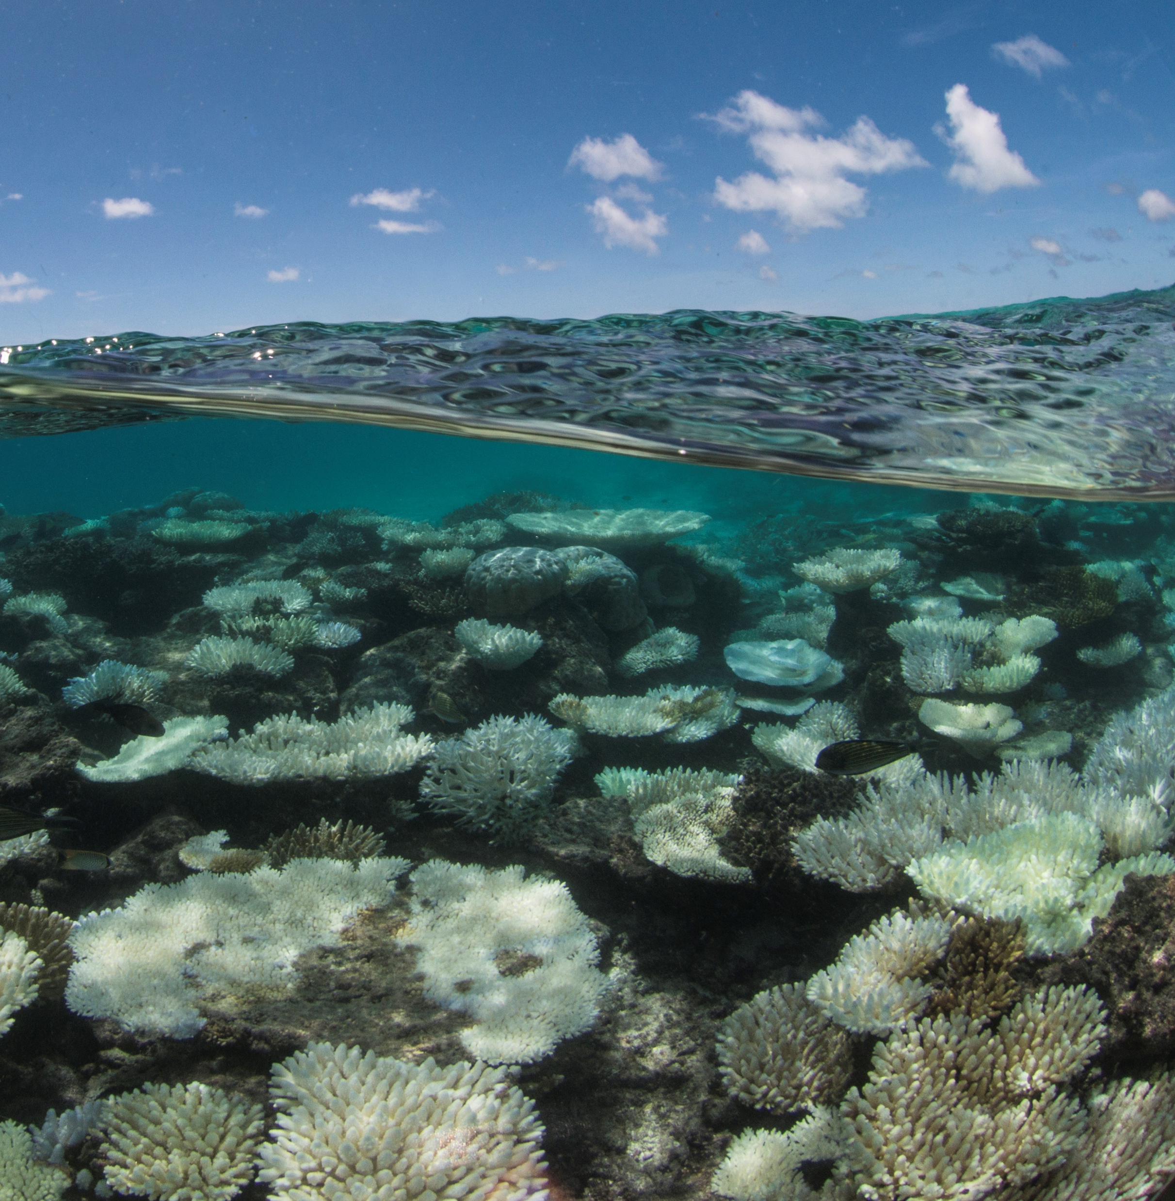
Defining GEMS Ocean focus
Work with communities and capacity building activities
Connection with Regional Seas, LMEs and Member States (priority setting, co-design, feedback, reporting support)
Matchmaking mechanism and user centric approach (i.e., engagement process down to community level to connect demand and supply)
Demand driven approach
Dynamic partnership model
Ground truthing of data

Slide 10
Background work
UNEP WCMC Study- Towards an integrated Global Environment Monitoring System for the Ocean and Coasts (GEMS/Ocean)
An overview of: The information being collected, and by who, in the land and coastal zones relating to activities and pressures that have the potential to impact coastal and oceanic systems and the services they provide; The interoperability of ocean, coastal and land-based information; The degree to which this information is sufficient to make evidence-based decisions which result in positive benefits for nature and people.
Study on Data challenges that affect the governance of the wider Caribbean Sea
A report detailing the data challenges and limitations faced by government stakeholders in the Caribbean region to inform the development of the Global Environment Monitoring on oceans and coasts (GEMS Ocean Programme) prepared by the World Resources Institute (WRI) in partnership with the GEMS ocean programme.
The Caribbean Digital Twin prototype (CDTp) an innovative initiative that aims to improve our understanding of the Caribbean region's coastal and ocean environment and ultimately inform policy making.
Invitation to work with the MSP Global Challenge Project with IOC-UNESCO.
Notes:
The CDTp will be supported by a Data Hackathon in the region, which will bring together experts and stakeholders to analyze and interpret data collected from the region, and understand constraints and opportunities for the development of the prototype.
The hackathon will help identify the critical environmental factors, including the state of the ocean, the health of the marine ecosystem, and the impact of human activities on these ecosystems. The results supported also by capacity building activities in the region, will be used to develop a digital twin prototype that will provide an almost real-time, virtual representation of the Caribbean region’s coastal and ocean environment.

Slide 11
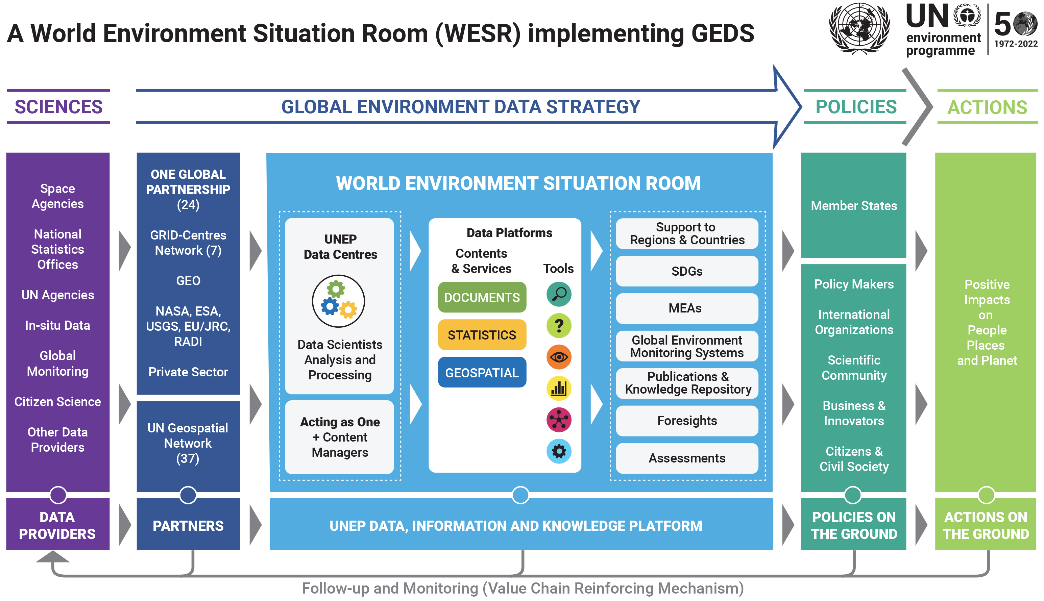
WESR

Slide 12
Recent events
Digital Ocean Forum (20-22 April) Paris, France
22nd Global meeting of the Regional Seas Programme (25-28 May) Mahe, Seychelles
Twenty-second meeting of the United Nations open ended informal consultative process on the oceans and law of the sea (6-10 June) New York, USA
UN Ocean Conference (26 June - 1 July) Lisbon, Portugal
Final Conference MSP-MED project (12-14 October) Rome, Italy
UN Decade Collaborative Center - Ocean Prediction on-line kickoff (11-12 January 2023)
Workshop on sharing industrial data for ocean-climate modelling 9th March 2023, IOC/UNESCO Paris, France
Seventh Session of the IOC Sub Commission for Africa and the Adjacent Island States (IOCAFRICA-VII) 15-17 March 2023, Nairobi, Kenya

Slide 13
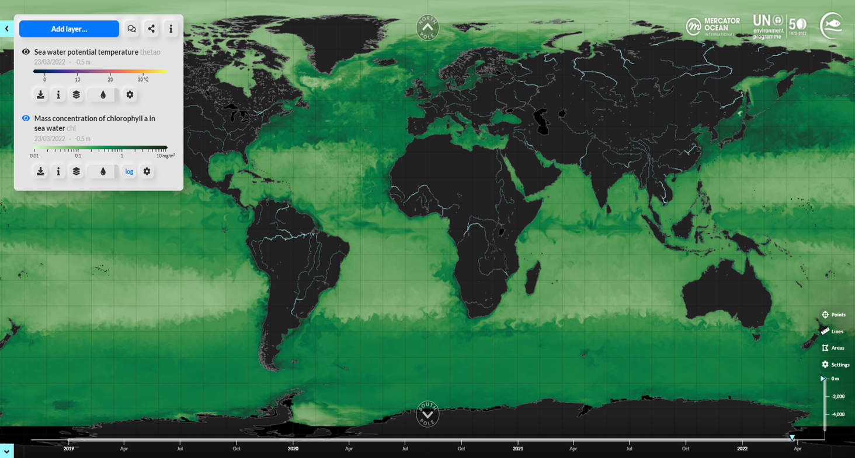
Thank you
goosocean.org

