Slide 1

Words from GOOS Sponsors
WMO
Albert Fischer, Director, WMO Integrated Global Observing System (WIGOS) Branch, Infrastructure Department
with input from: Michel Jean, Dominique Berod, Champika Gallage, Belén Martin Miguez, Mathieu Belbeoch, and others
GOOS 12th Steering Committee meeting, 25 - 27 April 2023

Slide 2
Unified Data Policy
 | Unified Data Policy – Resolution 1 (Cg-Ext(2021)) Core and recommended data in a global meteorological infrastructure
 | WMO Rolling Review of Requirements Defining observing requirements for WMO applications
 | Global Basic Observing Network Obligation to acquire and internationally exchange the most essential surface-based observations for (NWP) and climate reanalysis
 | Systematic Observations Financing Facility
 | Satellite observations
 | Greenhouse gas infrastructure initiative
 | WMO Integrated Processing and Prediction System
 | Early Warning for All initiative
 | Identifying and acting on joint priorities
RRR
GBON
SOFF
Space
GHG
WIPPS
EW4ALL
Notes:
Cover a number of topics of key interest to WMO and relevant for GOOS
More slides in the package than I will show

Slide 3
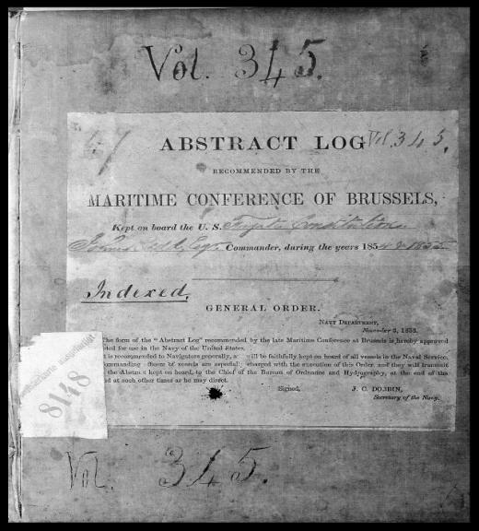
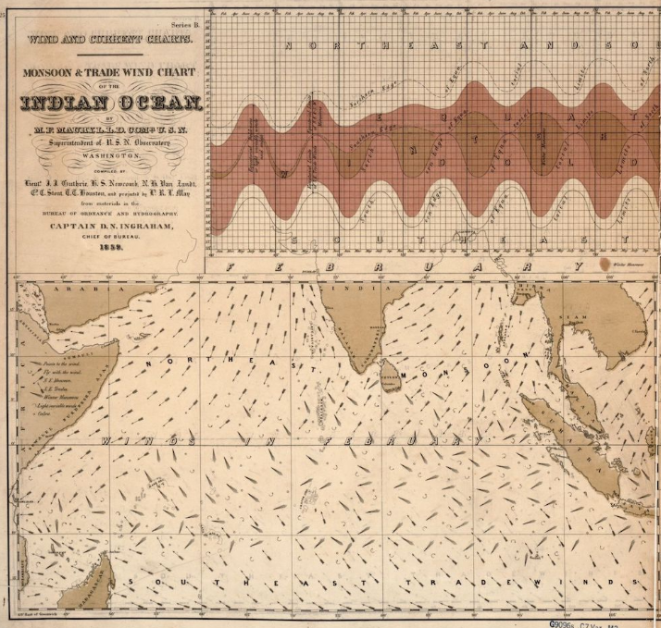
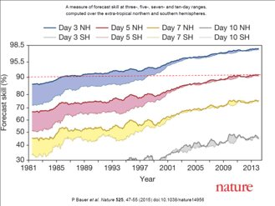

Unified Data Policy
WMO’s origins and data exchange
1853: The first international meteorological conference
  Brussels International Maritime Conference
  Standard format for ship logbooks
  Standards for making and recording weather and marine observations
1873 – 150 years ago: The First International Meteorological Congress, Vienna, led to founding of the International Meteorological Organization
1947 Convention – purposes of WMO: facilitate worldwide cooperation in observations and centres for provision of services, promote...systems for the rapid exchange of information
World Weather Watch and global Numerical Weather Prediction
Notes:
WMO’s origins are connected to the ocean
- to service delivery for growing marine trade from the industrial revolution
- to standardization for data exchange
- to a global infrastructure to create products
World Weather Watch
- built on global data exchange and the development of numerical models
- data exchange of both surface- and space-based observations
- agreed global processing centers
- estimated economic value of $120 bn per year of weather forecasting

Slide 4
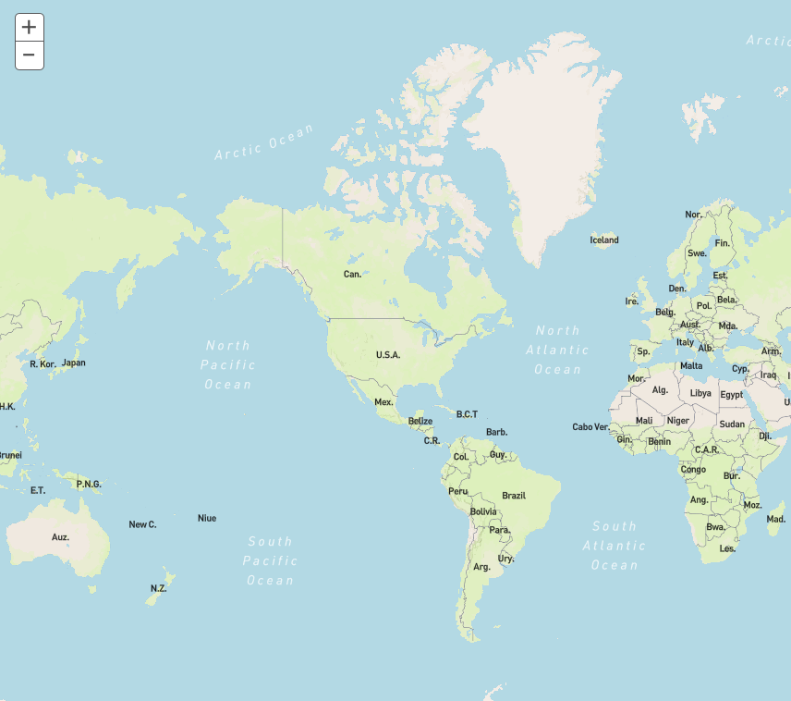
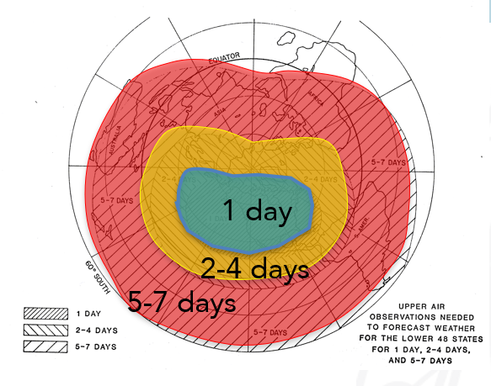
Unified Data Policy
“Weather and climate know no boundaries”
Lack of observations limits ability to monitor, understand and predict weather and climate, both locally and globally;
Weather prediction beyond 3-4 days for any location on the globe requires exchange of observations world-wide.
“In meteorology, ignorance knows no boundaries”
Example: Lack of observations in red area limits 7-10 day forecast skill in green area; weather/climate knowledge in red area poor!
Example: Required areal coverage of observational data for weather prediction over the United States for different ranges

Slide 5
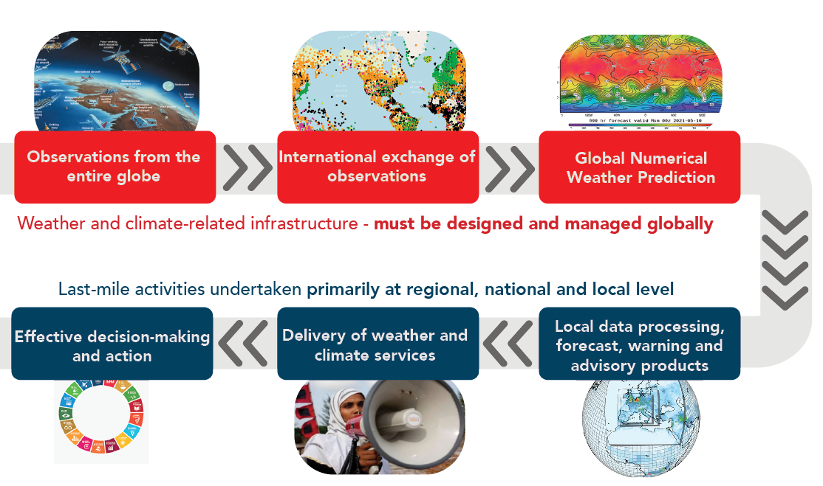
Unified Data Policy
Successful application of weather, climate, and water services
depend on a functioning meteorological value cycle
Global meteorological infrastructure
WIGOS integrated global observing system
WIS information system
WIPPS integrated processing and prediction system
Based on regulatory
and guidance material
Notes:
Weather and climate services depend on a value chain or cycle, that includes a global meteorological infrastructure
- WIGOS
- WIS
- WIPPS
Global data exchange is necessary for the global products that are then transformed at a regional, national, and local level into products and services that lead to user value and effective and safe decision-making
That global infrastructure is based on regulatory material, placing obligations on WMO Members, and guidance material.

Slide 6
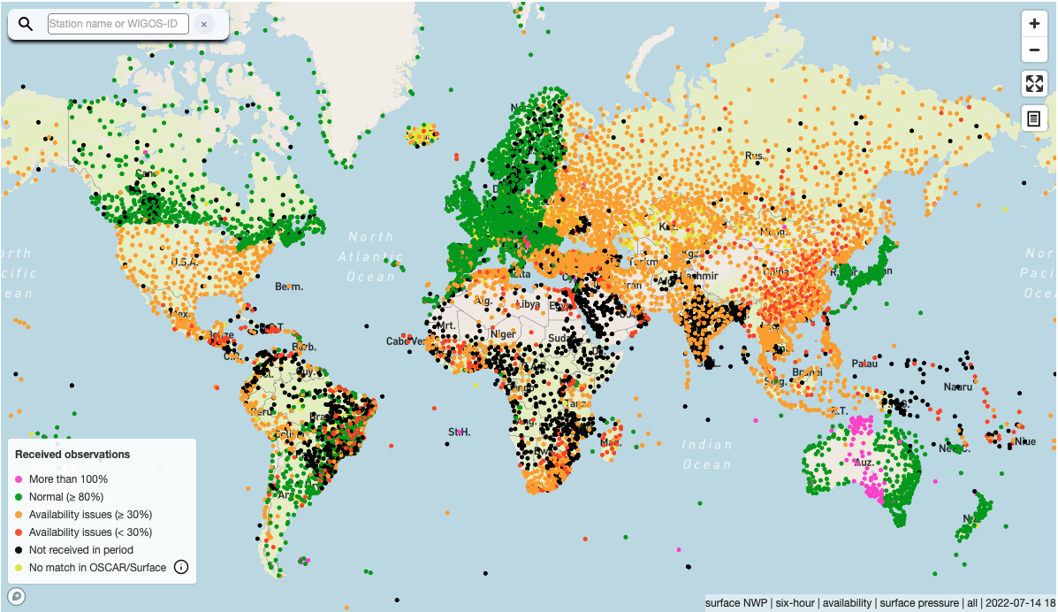
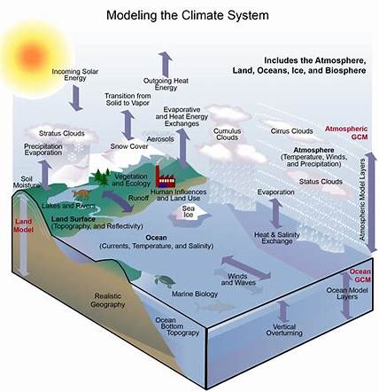
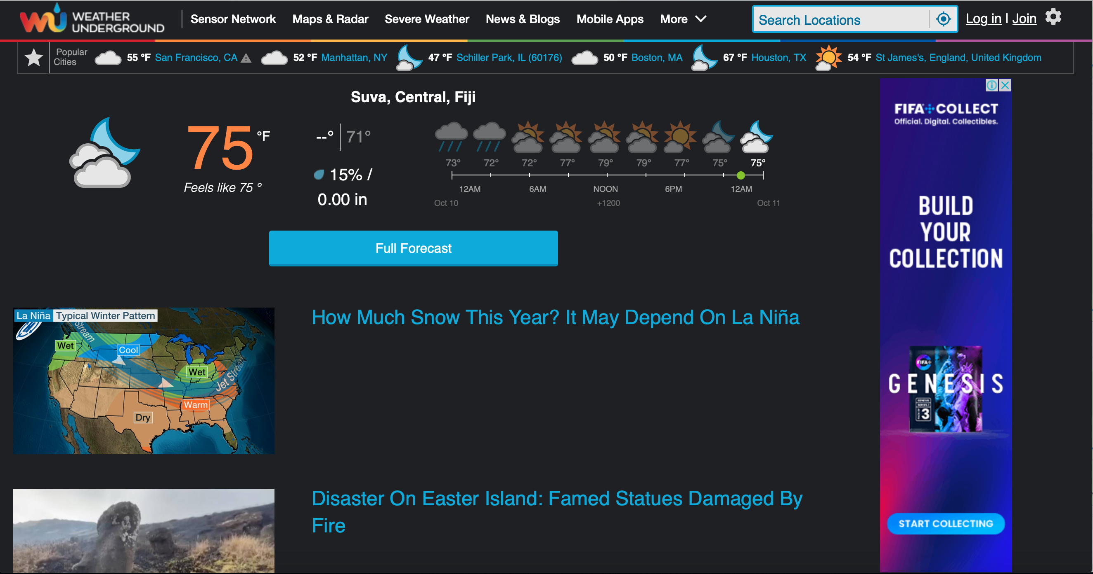
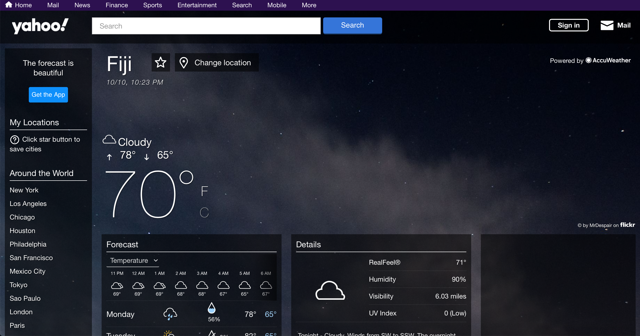
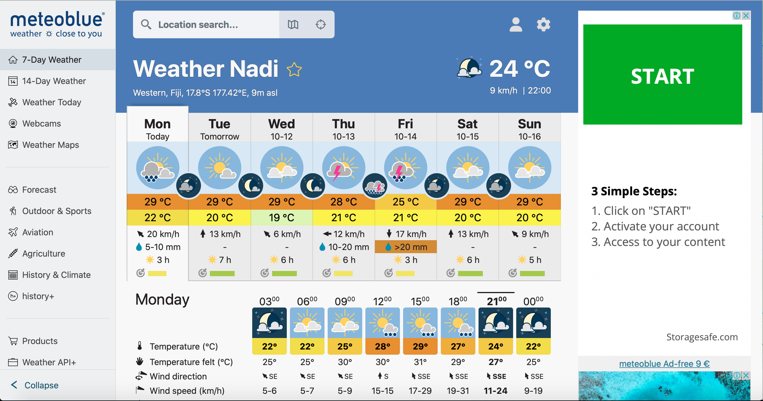
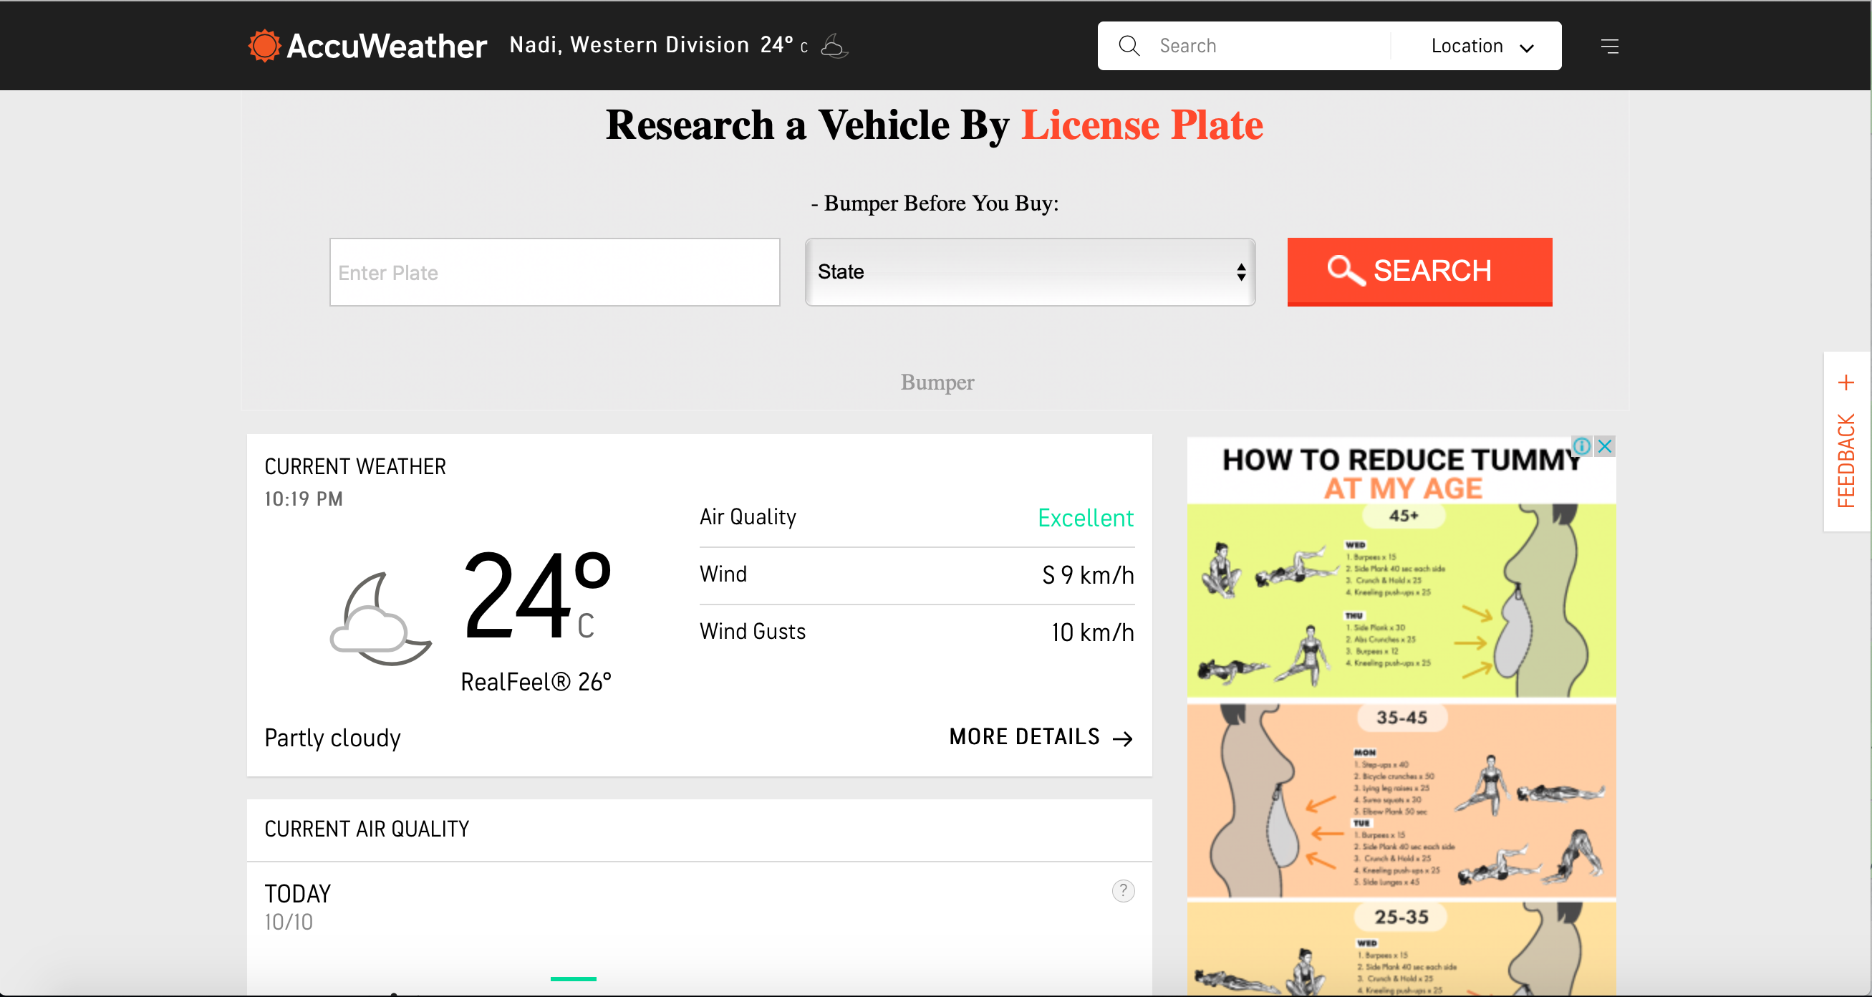
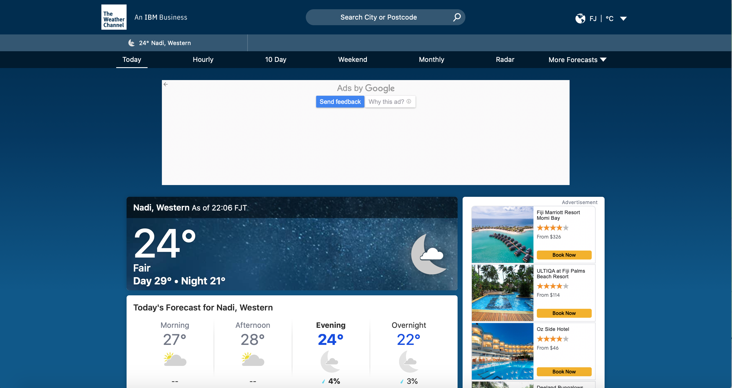
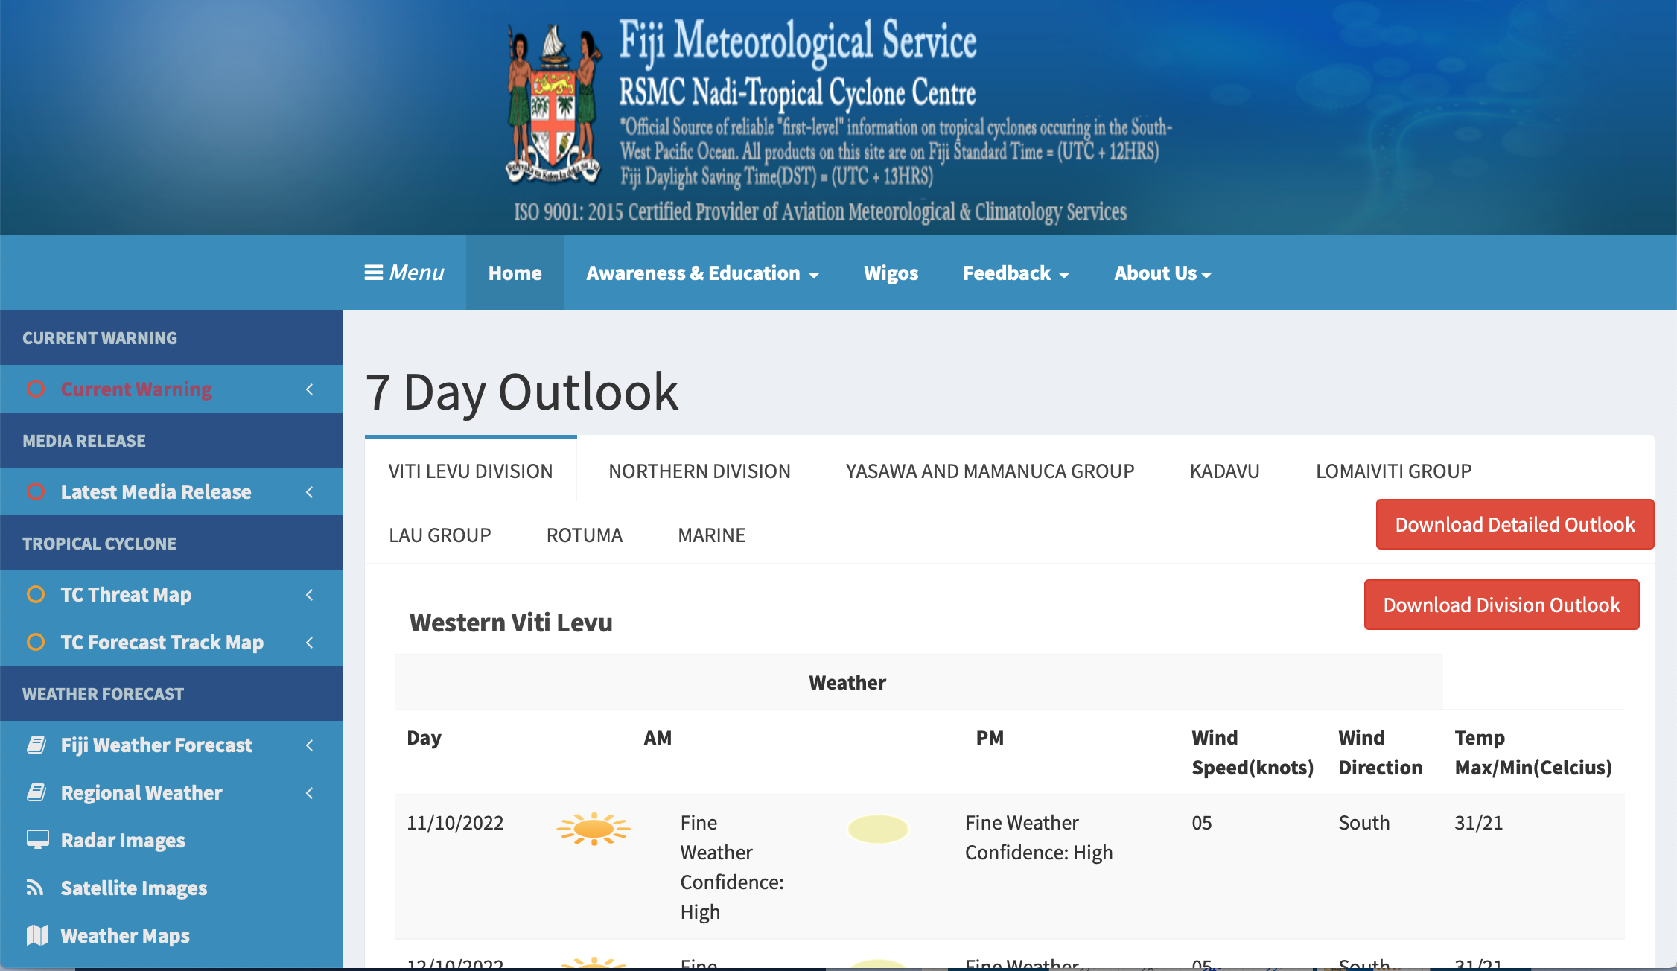
Trends that led to a new WMO data policy
Unified Data Policy
Concerns about persistent insufficient observational data coverage
Need to move toward integrated Earth system modeling
Opportunities and challenges related to the growing role of the private sector

Slide 7
Cg-Ext(2021), Resolution 1
Unified Data Policy
{The Congress …}
Agrees to have one unified data policy for all WMO domains and disciplines;
Decides that the scope of the data policy shall cover Earth system data exchanged among Members under the auspices of the WMO Convention and decisions of Congress, {…}
Adopts the following policy on the international exchange of Earth system data:
As a fundamental principle of WMO and in consonance with the expanding requirements for its scientific and technical expertise, WMO commits itself to broadening and enhancing the free and unrestricted international exchange of Earth system data;
Agrees further to maintain a two-tiered approach to the international provision and exchange of Earth system data via the following practice :
Members shall provide on a free and unrestricted basis the core data that are necessary for the provision of services in support of the protection of life and property and for the well-being of all nations, at a minimum those data described in Annex 1 to this resolution {…}
Members should also provide the recommended data that are required to support Earth system monitoring and prediction activities at the global, regional and national levels {…}

Slide 8
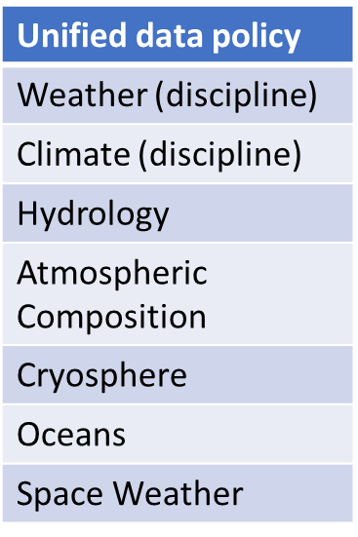
“Free and unrestricted exchange”
Unified Data Policy
What does it mean? Per Annex 4: ”Free and unrestricted means available for use, re-use and sharing without charge and with no conditions on use¹”;
¹Requests for attribution not considered a condition; attribution recommended
Disciplines and domains
Ocean core data (shall)
  Marine meteorological observations (WIGOS Manual, WMO No.-1160)
  Physical EOVs and physical ocean ECVs, part of GOOS network, programme, project
  Global analysis, prediction, and reanalysis fields produced by the WIPPS Global Processing Centres
  Watches, advisories, alerts for public safety
Recommended data (should)
  Other physical observations
  Biogeochemical and biological EOVs / ECVs
  BGC-Argo variables
Notes:
The data policy allows for attribution.
Annex 1 defines core data for the ocean

Slide 9
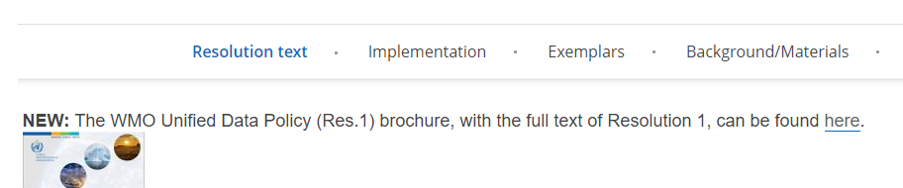
Unified Data Policy Implementation
Unified Data Policy
Definition of core data in Tech Regs and compliance monitoring:
Compliance monitoring started with GBON compliance monitoring and through the GDPFS/WIPPS Web portal.
Core observation data definition:
  Core satellite data/products defined by WIGOS Manual under consideration with CGMS and satellite agencies.
  Core hydrological observations and additional core data in other domains are being discussed for future inclusion in WIGOS Manual.
Core NWP products definition:
  The definition of core NWP products in GDPFS Manual to be adopted by Cg-19
  Global NWP, limited-area models, nowcasting, climate re-analysis products and tropical cyclone tracks are under consideration to be proposed as core products to INFCOM-3 (2024).
Collection of exemplars:
Collected and published for 6 exemplar types:
National policies and regulations
Free and unrestricted data exchange
  Sharing of recommended data to research and education community
Partnerships with non-NMHS entities
Attribution of data
  Attribution of recommended data
Coordination with WMO partners and stakeholders on data policy
Relationship between public sector data providers and private sector data users, and vice versa
WMO Unified Data Policy Resolution (Res.1) | World Meteorological Organization
Notes:
How does WMO go from words in a data policy to implementation?
For observations taken by meteorological services and for products generated by them, the path is quite clear: through the development of technical regulations and compliance monitoring.
GBON: a first application of core data, placing an obligation on all members to take the most essential meteorological data, including over EEZs
Processes underway for definition of satellite core data, and hydrological and other domain core data.
Definition of core NWP products to be adopted by Cg next month, other WIPPS products to be defined by core in coming years.

Slide 10
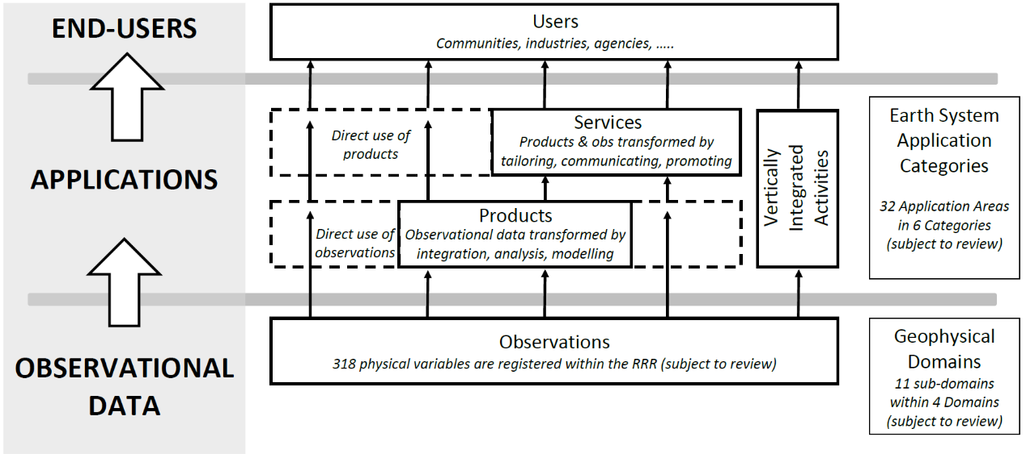
WMO (new) Rolling Review of Requirements a basis to define core observational data in Technical Regulations
RRR
RRR Earth System Application Categories
Space weather
Atmospheric
Oceanic
Hydrological & Terrestrial
Cryospheric
Integrated Earth System
Weather
Climate
Requirements
Observing Capabilities
Critical Review (gaps)
Statements of Guidance
(Core and recommended data)
Notes:
The RRR process helps WIGOS define observational needs across a number of application areas.
A new process is being put in place that broadens the RRR to an Earth System approach.
Historically, the RRR has been strongest in its engagement with NWP systems and impact studies, building on a series of Impact Workshops that take place about every four years – the next one being in Q2 of 2024 in Sweden, the first announcement for abstract submission will be released shortly. OceanPredict’s OSE team is represented on the Scientific Steering Committee of that workshop.
The new RRR process has benefited from engagement with GOOS and a larger ocean community including service providers and modelers.
While it has classed applications in categories by earth system domain, in fact weather applications draw on multiple domains, and this is even more true for climate applications. These are challenges that will need to be worked out as this process gets under way.

Slide 11
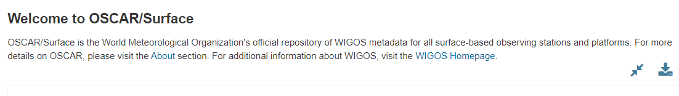
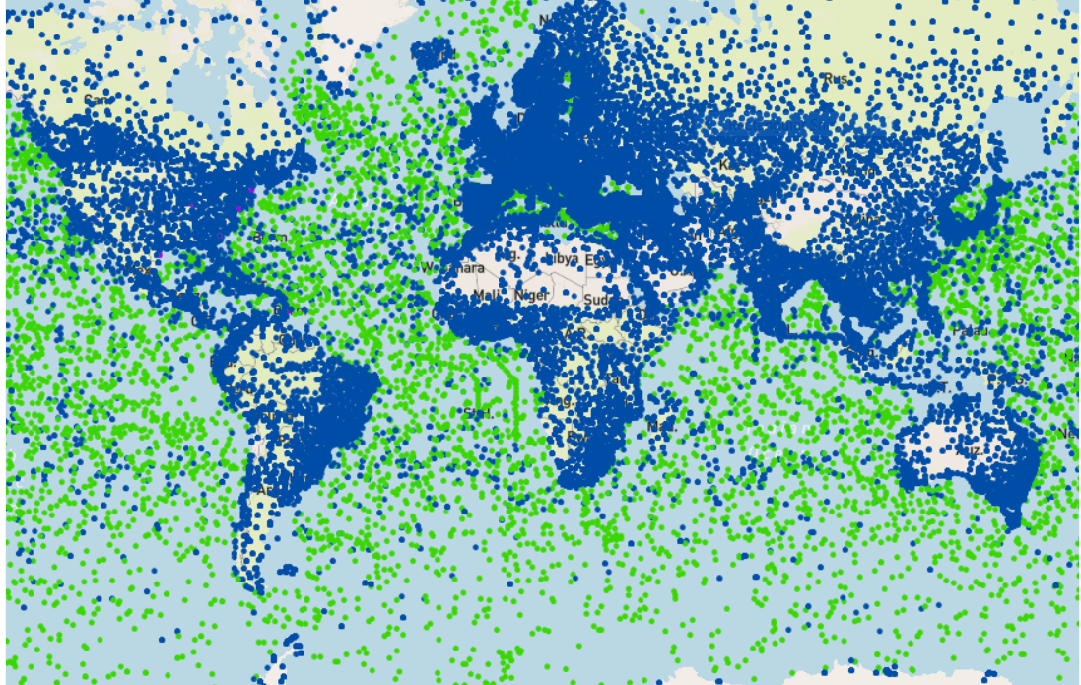

Observing capabilities
OSCAR Surface-based observations metadata
OceanOPS is the only metadata centre pushing information into OSCAR
RRR
Notes:
The RRR process helps WIGOS define observational needs across a number of application areas.
A new process is being put in place that broadens the RRR to an Earth System approach.
Historically, the RRR has been strongest in its engagement with NWP systems and impact studies, building on a series of Impact Workshops that take place about every four years – the next one being in Q2 of 2024 in Sweden, the first announcement for abstract submission will be released shortly. OceanPredict’s OSE team is represented on the Scientific Steering Committee of that workshop.
The new RRR process has benefited from engagement with GOOS and a larger ocean community including service providers and modelers.
While it has classed applications in categories by earth system domain, in fact weather applications draw on multiple domains, and this is even more true for climate applications. These are challenges that will need to be worked out as this process gets under way.

Slide 12
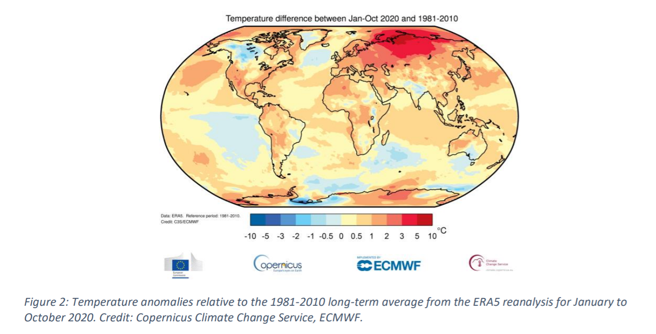
GBON
Global Basic Observing Network
Global numerical weather prediction (NWP) and climate reanalyses
Potential benefits of full implementation of GBON in countries with largest data coverage gaps estimated to be around USD 5 billion per year, due to improvements in weather prediction (weather alone, potential climate-related benefits not yet assessed)
Global NWP underpin all modern weather and climate services, at all spatial and temporal scales;
Global NWP are already coupled atmosphere-ocean-ice models
Global NWP systems used also for climate applications, via reanalysis: Reprocessing of multi-year sequences of past weather events using historical observations
Reanalysis: Primary source of information about climate, climate change; basis for climate prediction, projection and adaptation
Economic impact of climate analysis data, e.g. for adaptation likely to be even bigger
Notes:
A first clear application of the Unified Data Policy is the Global Basic Observing Network.
This responds to a persistent gap in surface-based observations exchanged in real time for global NWP
The economic analysis is based on a study done with the World Bank. Other estimates of the global annual value of numerical weather prediction across multiple economic sectors value these predictions at $120 bn per year. The estimated improvement if the gap could be filled is about a 5% improvement in the forecast skill, and so an assumed additional $5 billion in value per year.
These arguments helped the creation of the Systematic Observations Funding Facility (SOFF).

Slide 13
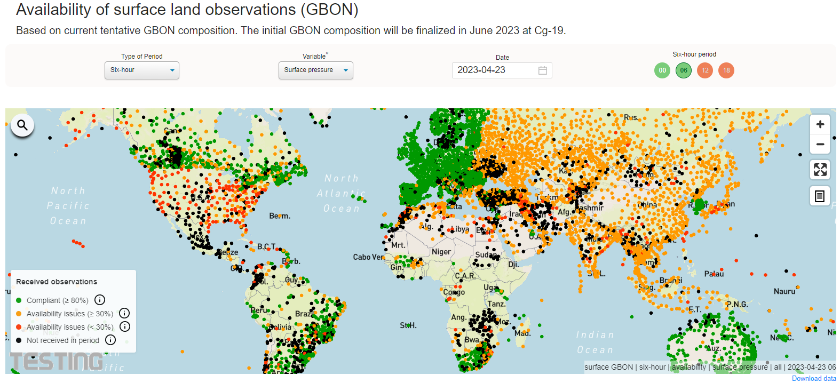
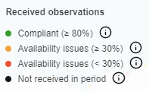
GBON
Status – basis for compliance monitoring
Based on proposed GBON station definition (to be adopted by Cg-19)
    GBON Requirements (WIGOS Manual)
    Surface-based (ground) – 4 variables every 200 km, every hour
    Upper air – radiosonde every 500 km, twice per day
    Marine – SST and SLP every 500 km, every hour, over EEZ; upper air every 1000 km, twice per day.
surface
WDQMS (dev. version) for 24 April 2023: data seen and used by global centres
Notes:
(check on why US was so bad in this report? – is this the GBON one)

Slide 14
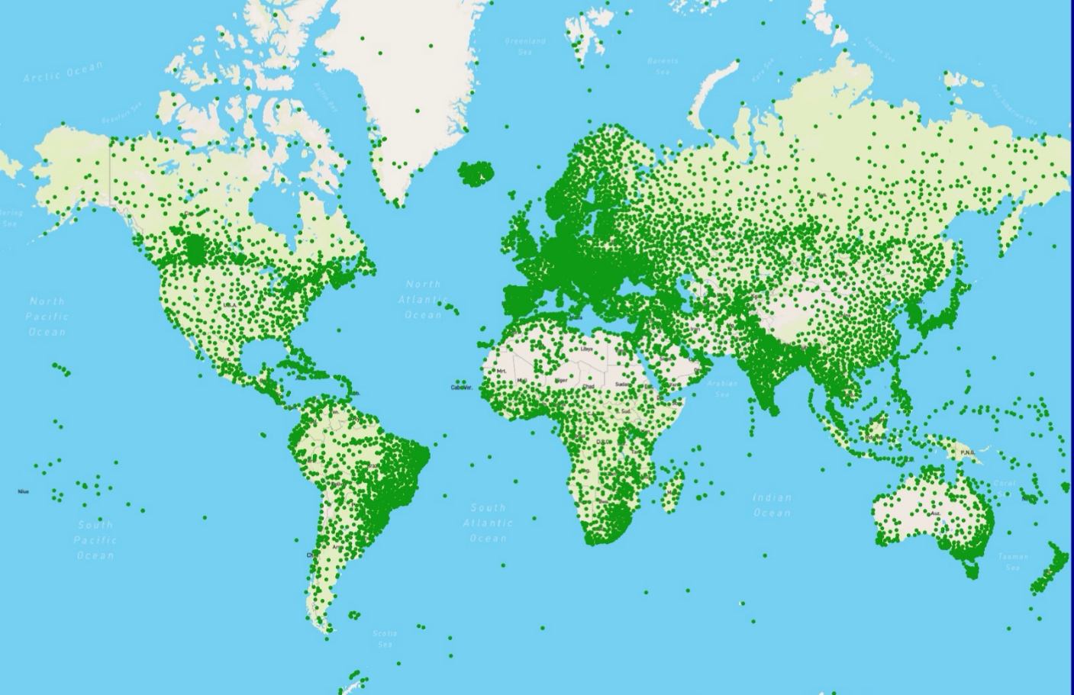
GBON
Regulations approved by WMO Congress in 2021
effective on 1 January 2023
GBON regulations establish commitment of all WMO Members to acquire and transmit in real time certain observations
SOFF has as its sole purpose to provide technical and financial support to the implementation and operation of GBON where it is most needed, in LDCs and SIDS
raised $65 million in first year
Notes:
(insert SOFF logo)

Slide 15
GBON
GBON and the ocean
Ocean observations used in global NWP and climate reanalyses
Potential for LDC and SIDS involvement with SOFF (raised $65m first year)
Country responsibility in EEZ, unclear responsibility in ABNJ
Marine meteorological variables (2) and upper air profiles in EEZs are already included in the Technical Regulations, but guidance material needs development
Principles of GBON expansion, into WIGOS manual (slow process)
  Main drivers? (what variables need to be observed according to RRR?)
  Input data for global Numerical Weather Prediction (NWP) and climate reanalysis?
  Clarity on the observing remit?
  Data requirements? (Science basis to define network & temporal densities available)
  Mandatory global exchange acceptable?

Slide 16
Ensuring continuity of satellite observations for NWP an analogy from another global commons: space
Space
Coordination Group for Meteorological Satellites (CGMS)
CGMS governed and operated by the participating satellite agencies (EUMETSAT lead). WMO is a member representing the key user community (IOC is also a member)
Cycle reviewing key documents:
CGMS Baseline
Description of the voluntary commitments of missions by CGMS agencies
WMO Gap Analysis
against WIGOS Vision document, described through RRR process
CGMS Risk analysis
Review of where risks of observational gaps are greatest
Cycle of updating these three documents, engaging agencies to make adjustments to the Baseline. Builds on national engagement between weather service and space agency.
Provide about 75% of the observational influence on NWP products.
Similarities and differences from
global ocean observing networks
Similarities
Global commons
Similar number of agencies/players, based on technical capability
Focus on sustained observations
Voluntary commitments
Differences
Key single driver: Global Numerical Weather Prediction, with estimated $120 billion annual value in different economic sectors
Dominance of operational agencies (but not only)

Slide 17
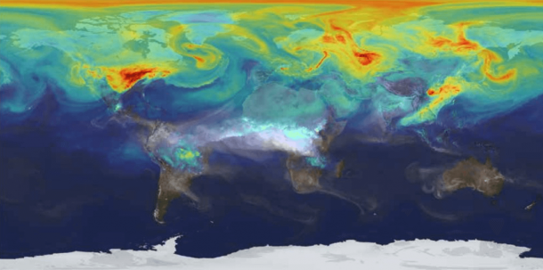
Greenhouse gas monitoring infrastructure initiative
Cg-19 (May 2023) will consider
GHG
Landscape analysis: who are the main actors and existing coordination mechanisms
Core GHG monitoring system capabilities and output data: characteristics of the modelling systems, requirements to QA/QC, characterization of the outputs
Input data requirements: observational data requirements, data gaps, components of the observing system, data exchange
Downstream applications and user services
WMO International Greenhouse Gas Monitoring Symposium 30 Jan – 1 Feb 2023
Subject to Cg approval: Implementation Plan for INFCOM-3 (Q2 2024)

Slide 18
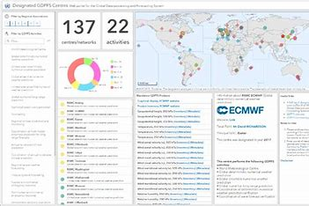
WMO Integrated Processing and Prediction System (WIPPS)
WIPPS
Formerly GDPFS, overseen by INFCOM Standing Committee on Data Processing for Applied Earth System Modelling and Prediction (SC-ESMP)
  Identify requirements users, assess gaps and advise on solutions for meeting user needs
  Support advancement and operationalization of seamless forecasting, modelling, prediction and projection
  Develop relevant regulatory and guidance material
  Enhance the capabilities of all Members
  Support emergency response activities
need for operational ocean prediction expertise
Exploring joint team between GOOS and WIPPS, building on ETOOFS

Slide 19

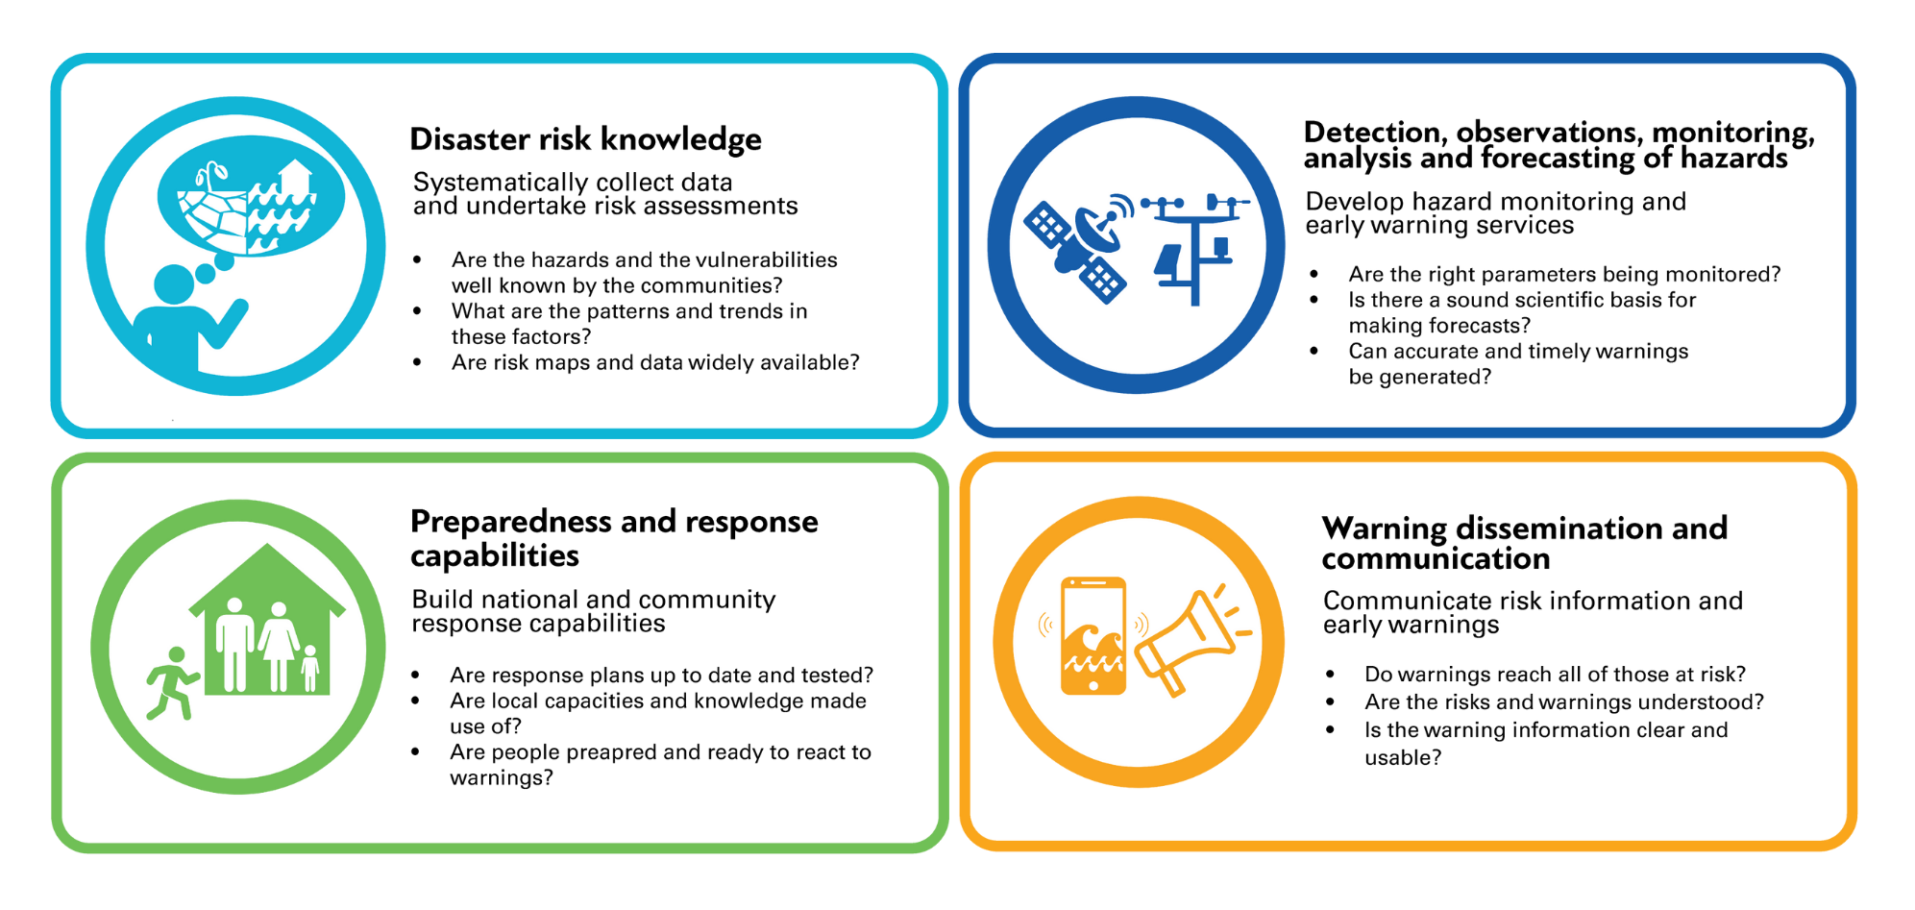
UN Early Warnings for All initiative
EW4ALL
WMO lead
Ensure by 2027 that all countries have a multi-hazard early warning system
Led by WMO on behalf of multiple UN agencies
InfCom will focus on priority hazards, ensuring global infrastructure is in place:
  Heat, drought, flood, tropical storms

Slide 20
Agreeing and acting on joint priorities
Where are we now
  WMO has high interest in ocean observations and prediction systems, for weather and climate, strong convening power, global regulatory and guidance framework
  Multiple avenues of coordination: Joint WMO-IOC Collaborative Board, GOOS Steering Committee, Advisory Group on Ocean to INFCOM – need to clarify action and added value of each
  Shared structures: OceanOPS (WMO-IOC, GOOS), OOPC (GOOS-GCOS)
  Unclear governance (outdated GOOS MoU, path to/from WMO decision-making in INFCOM and its SCs after reform, about shared structures)
Where could we go?
  An ocean observing and modeling community (for weather and climate) that leverages WMO infrastructure (WIGOS, WIS, WIPPS; regulatory and guidance material) – and helps WMO work with partner organizations, including at the national level
  Clearer definition of requirements, gaps, and guidance on observing design, including evaluation of impact: RRR, Impacts workshop and Ocean Observing Co-Design (GOOS Strategic Objectives SO 3 and 5)
  Advocacy, engagement for ocean observations from met services (SO 2 and 6)
  Expansion of ocean observations in EEZs through GBON and SOFF support (SO 6 and 9)
  More effective governance of high seas observations, clearer WMO co-sponsor role (SO 11)

Slide 21
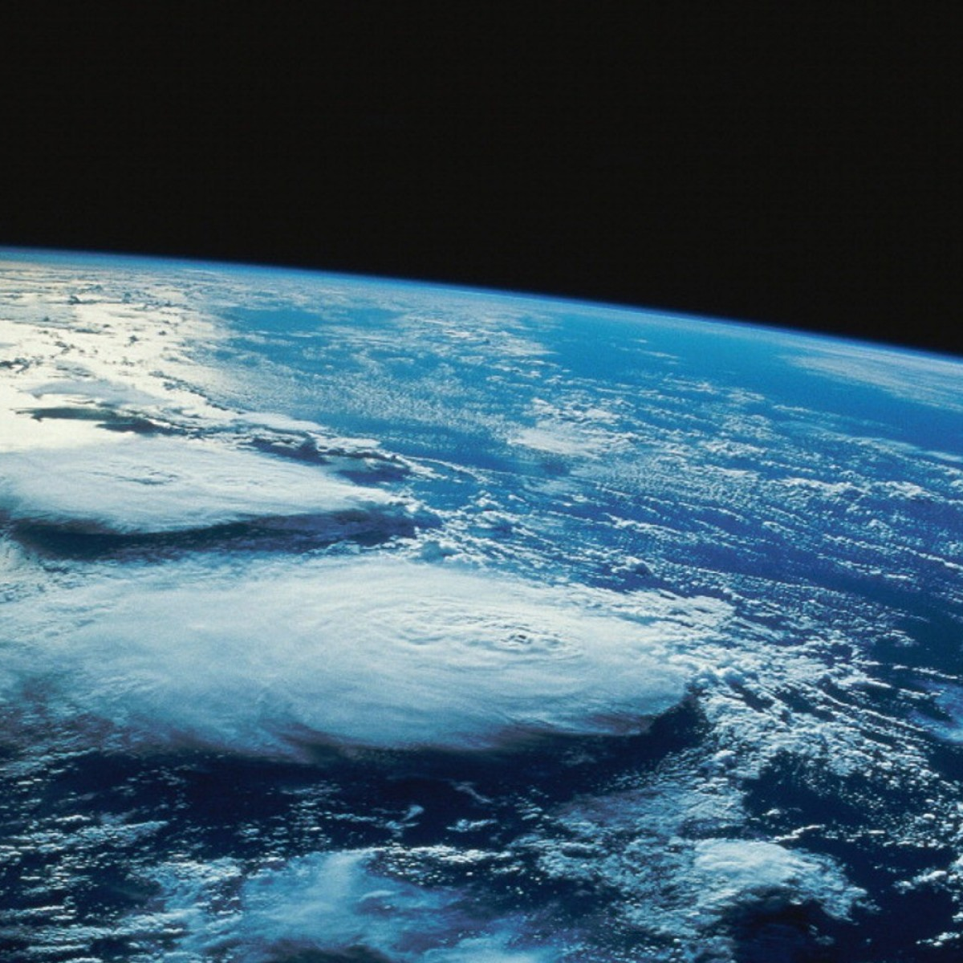
Thank you
goosocean.org

