Slide 1
ICG/CARIBE-EWS Chair Report 2021-2023
Silvia Chacón Barrantes

Slide 2
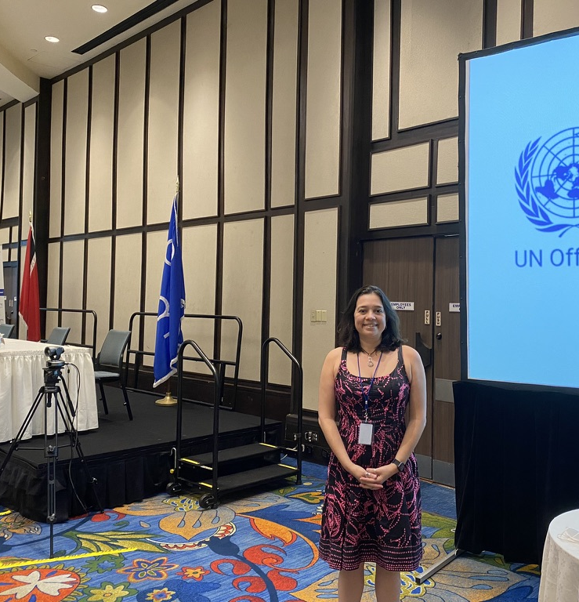
Measuring effectiveness of MHEWS
Course on Measuring Effectiveness of Multi Hazard Early Warning System Through Sendai Framework Target (g) and Custom Indicators
Trinidad, 10-11 May 2022
Organized by UNDRR
Visited the Office of Disaster Preparedness and Management (ODPM)
Visited Mayaro: posible Tsunami Ready project

Slide 3
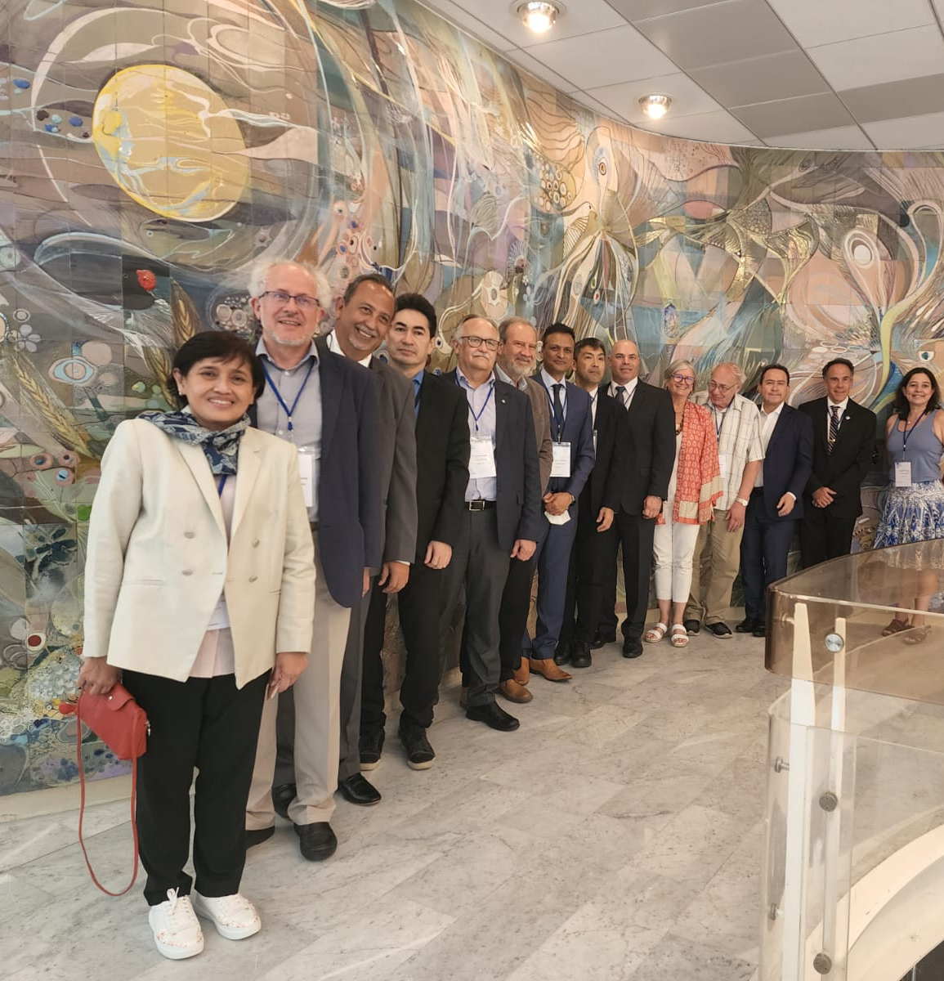
OD Tsunami Program Scientific Committee
Two in-person meetings
June 2022
January 2023
Two online meetings
February 2022
September 2022
It is open to receive projects and activities

Slide 4
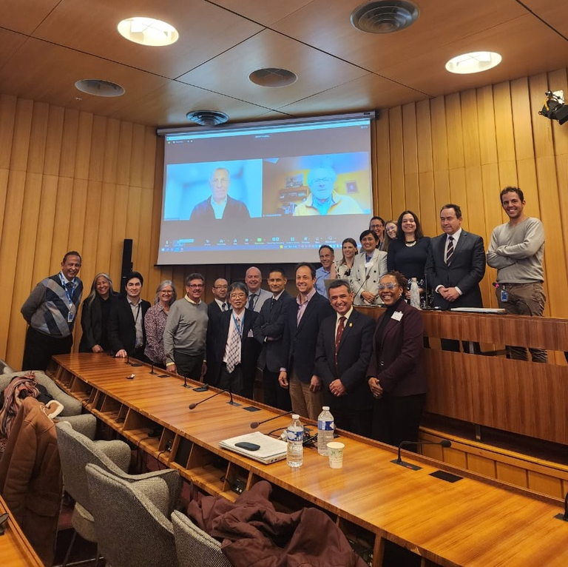
Working Group on Tsunamis and Other Hazards Related to Sea Level Warning and Mitigation Systems (TOWS-WG)
2022: XV meeting online
2023: XVI meeting in person

Slide 5
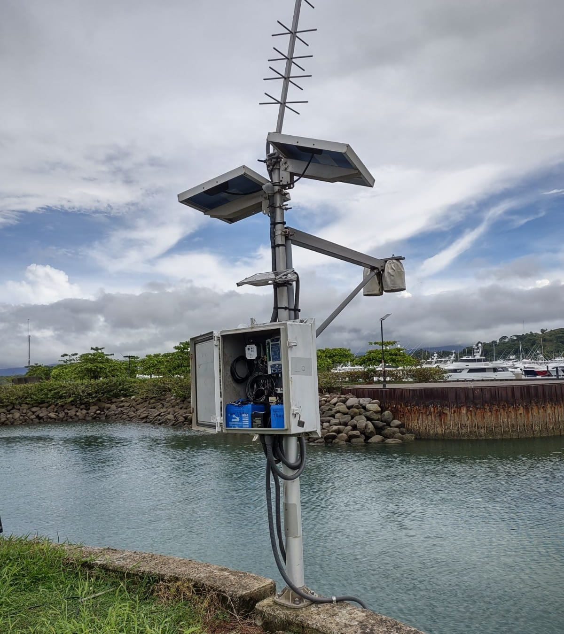
Training for Sea Level Operators in Spanish
To be held in Costa Rica
November 2023
Joint IHO – IMO – IOC organization and funding
All Latin American countries, including the Caribbean

Slide 6
Poster and paper HTHH tsunami in the Caribbean

