Slide 1
INTERGOVERNMENTAL COORDINATION GROUP FOR THE TSUNAMI AND OTHER COASTAL HAZARDS WARNING SYSTEMS FOR THE CARIBBEAN AND ADJACENT REGIONS
Barbados National Progress Report 2023
Sixteenth Session, April 24 -28, 2023, Costa Rica
Presented by
Mr. Fabian Hinds - Co-chair, Task Team Tsunami Ready & Coastal Planner, Coastal Zone Management Unit
Created by
Ms. Racquel Davis – Meteorologist 1 – Barbados Meteorological Services

Slide 2
Presentation Outline
Barbados Team
The Technical Standing Committee on Coastal Hazards (TSCCH)
Priority areas over the last year:
  Tsunami Standard Operating Procedure (SOP)
  Warning Communication and Dissemination
  National Sea Level Network
  Information on tsunami occurrence/activities
  Tsunami related websites
  National Programmes and activities information
Future plans

Slide 3
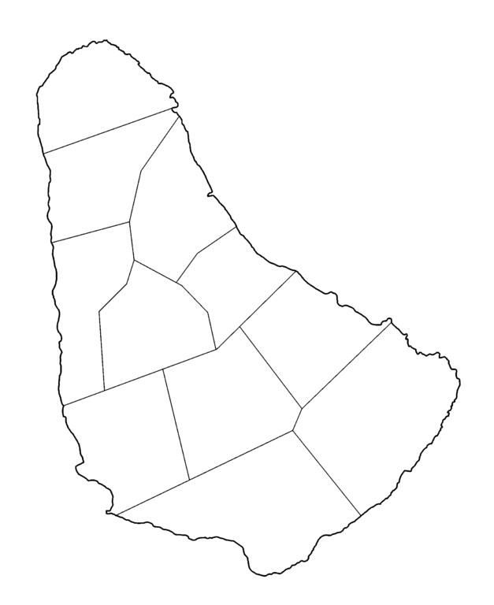
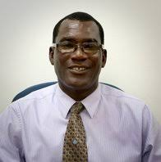
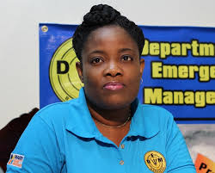
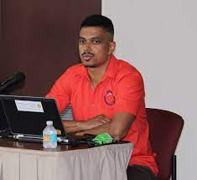
Barbados Team
Dr. Leo Brewster – Director of Coastal Zone Management Unit (CZMU) and Tsunami National Contact (TNC). Represents Barbados in the coordination of international tsunami warning and mitigation activities.
Ms. Kerry Hinds – Director of the Department of Emergency Management (DEM) and Tsunami Advisor. Manages Tsunami Mitigation in Barbados along with Dr. Leo Brewster.
Mr. Sabu Best – Director of Barbados Meteorological Services (BMS), Tsunami Warning Focal Point/Warning Centre. The 24 x 7 contact person, who is available at the national level for rapidly receiving and issuing tsunami event information (such as warnings).

Slide 4
The Technical Standing Committee on Coastal Hazards (TSCCH)
1. Coastal Zone Management Unit (CZMU), (Co-Chair)
2. Department of Emergency Management (DEM), (Co-Chair)
3. The Barbados Meteorological Services (BMS),
4. The Barbados Police Service (TBPS)
5. Barbados Government Information Service (BGIS),
6. Ministry of Innovation, Science & Smart Technology: Telecommunications Unit,
7. Planning and Development Office
8. The Ministry of Home Affairs and Information
9. The Ministry of Finance, Economic Affairs and Investment
10. The Ministry of Tourism and International Transport

Slide 5
TSCCH Continued
11. Ministry of Energy and Business Development
12. The Barbados Defence Force (BDF)
13. The Barbados Fire Service (BFS),
14. Ministry of Transport, Works and Water Resources; Drainage Division,
15. Ministry of the Environment and National Beautification (Blue Economy): Fisheries Division,
16. Ministry of Education, Technological and Vocational Training (METVT),
17. National Conservation Commission (NCC),
18. Barbados Hotel and Tourism Association (BHTA),
19. Barbados National Union of Fisherfolk Organizations (BARNUFO),
20. Barbados Light and Power Company Limited (BL&P),

Slide 6
TSCCH Continued
21. Barbados Port Inc. (BPI),
22. Ministry of Youth, Sports and Community Empowerment,
23. Ministry of People Empowerment and Elder Affairs (MPEEA),
24. Barbados Council for the Disabled (BCD),
25. Barbados Chamber of Commerce and Industry (BCCI),
26. Barbados Building Standards Authority,
27. Caribbean Institute for Meteorology and Hydrology (CIMH),
28. Caribbean Disaster Emergency Management Agency (CDEMA) and a
29. Community Representative.

Slide 7
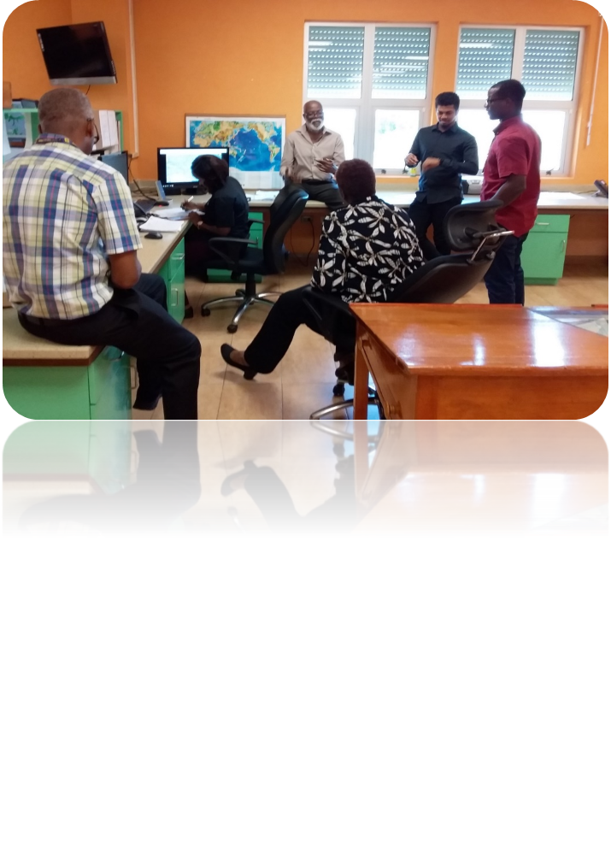
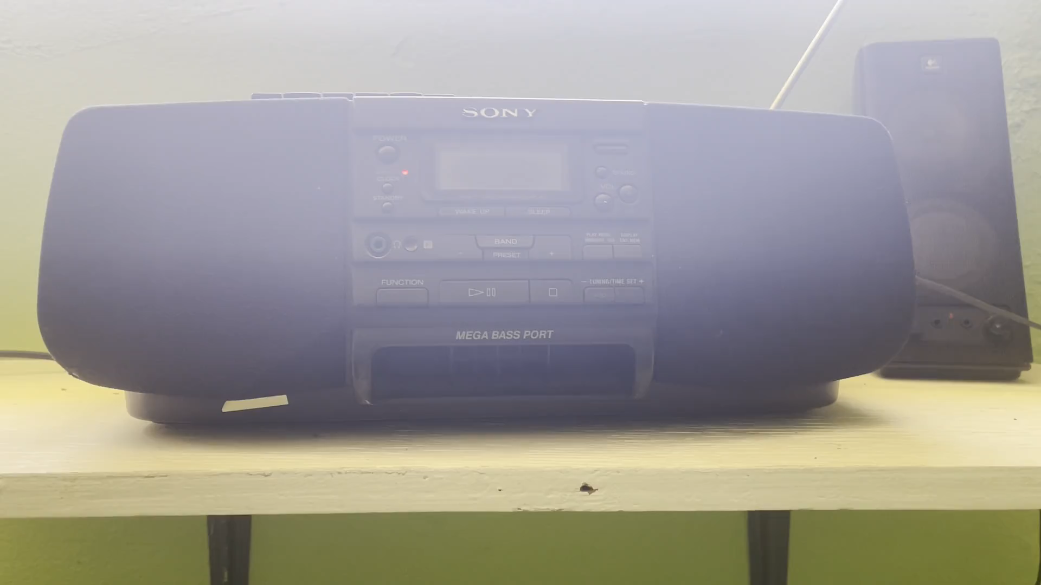
Tsunami Standard Operating Procedure (SOP)
Updating and testing the SOP

Slide 8
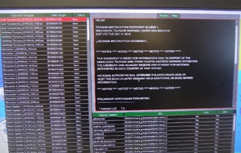
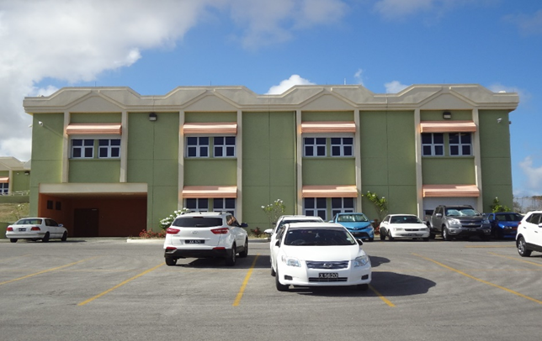
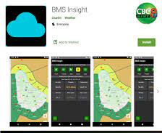
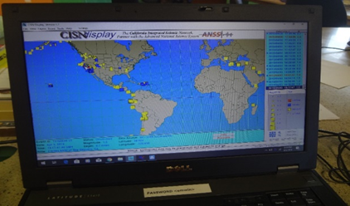
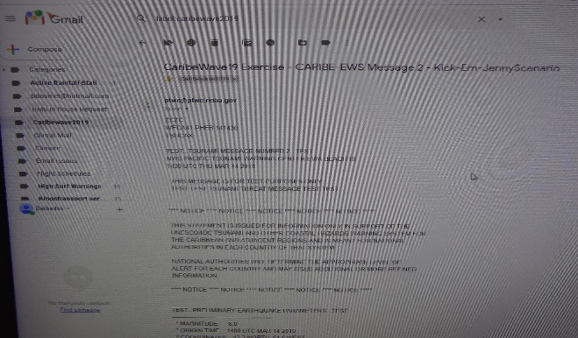
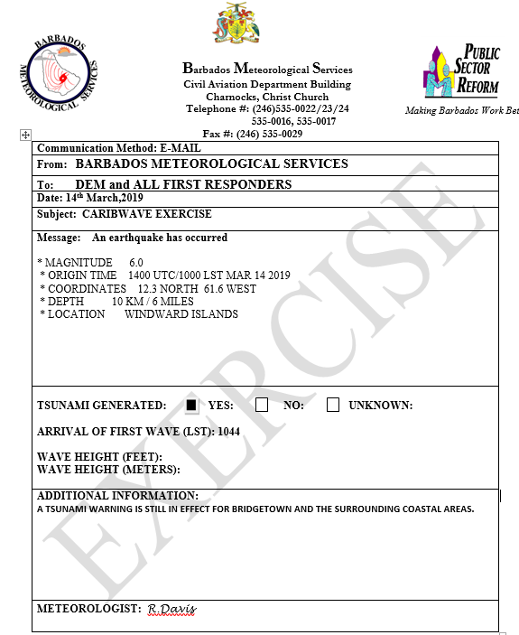
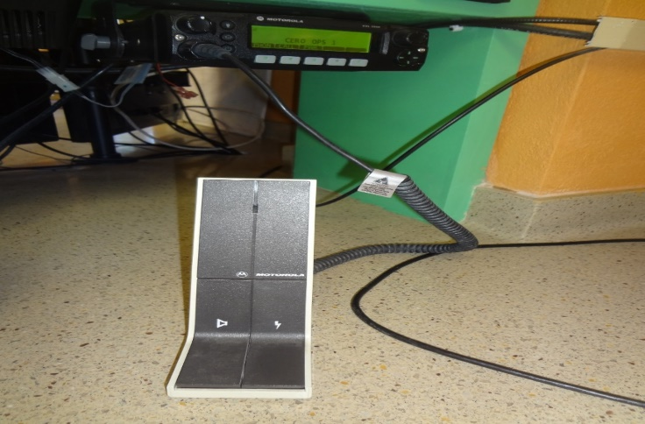
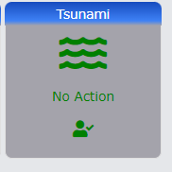

Warning Communication and Dissemination

Slide 9
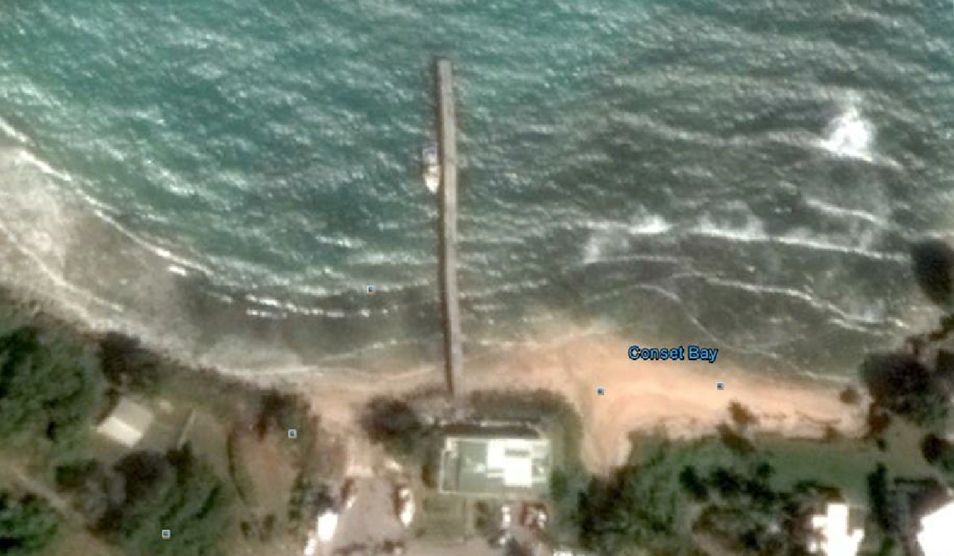
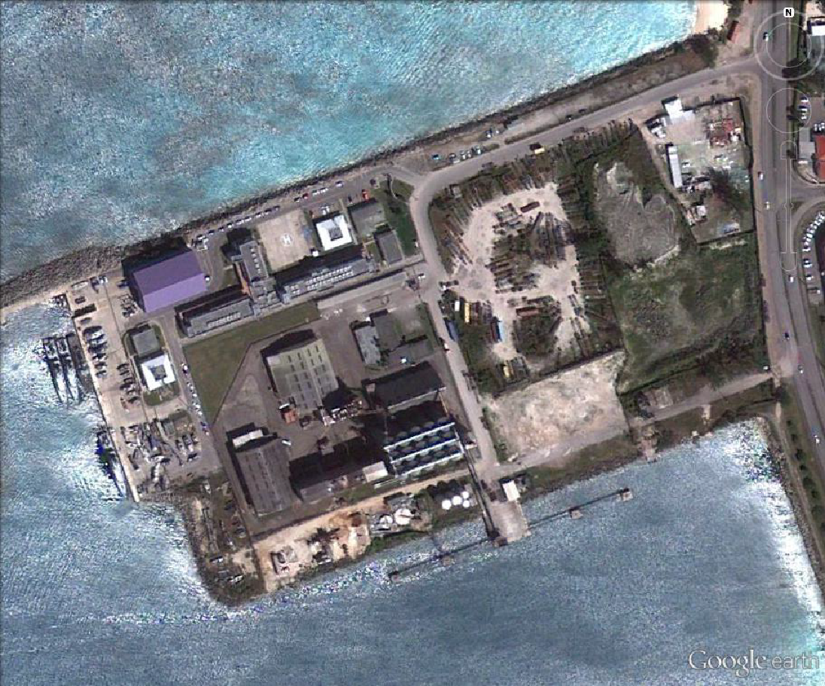
National Sea Level Network
Station Name | Location | Latitude | Longitude | Sensors
Port St. Charles | St. Peter North West Coast | 13.263 | -59.6446 | Tide Gauge (working) Radar Sensor (working) Aqua Bubbler (working) Pressure Level (working)
Barbados Coast Guard | St. Michael | Not provided | Not provided | Radar Sensor (working)
Bridgetown Port | St. Michael | 13.108 | -59.629 | Sea Level Station (Decommissioned)
Consett Bay | St. John | 13.17994 | -59.4664 | Radar Sensor (working)
Consett Bay, St. John
Radar Sensors Location
Barbados Coast Guard

Slide 10
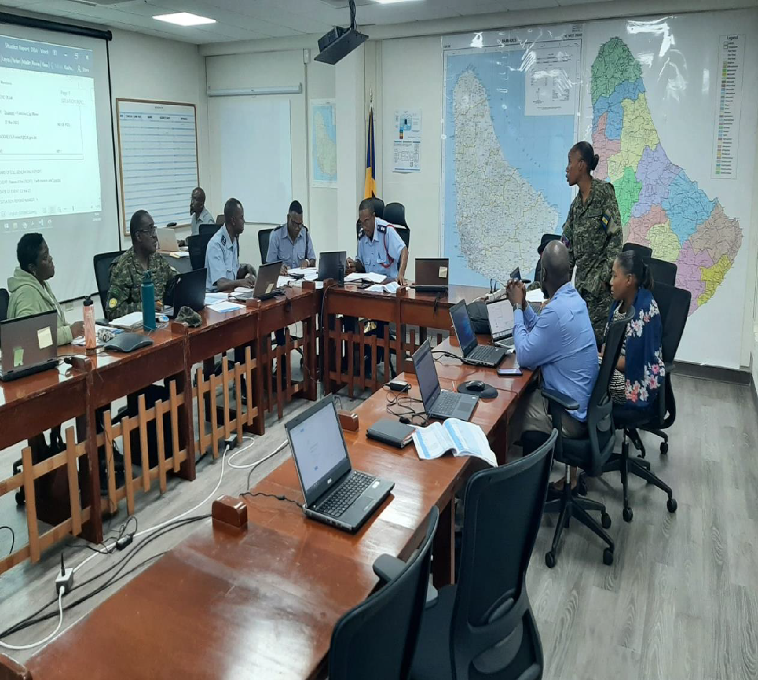
Information On Tsunami Occurrence/Exercises
Members of the National Emergency Management System in the National Emergency Operations Centre responding to the tsunami threat. (Exercise Caribe Wave 2023)

Slide 11
Web sites (URLs) of National Tsunami-Related Agencies
DEM Website: https://dem.gov.bb/
DEM Facebook Page: https://www.facebook.com/dem246/
DEM Twitter Page: https://twitter.com/dem_barbados
DEM Instagram: https://www.instagram.com/dem.barbados/?hl=en
Government Information Service (GIS) Website: gisbarbados.gov.bb/
GIS Facebook Page: https://www.facebook.com/gisbarbados/
GIS Twitter: https://twitter.com/gisbarbados/
GIS Instagram: https://www.instagram.com/gisbarbados/?hl=en
Public Affairs Department (PAD)Facebook: https://www.facebook.com/padbarbados/
Public Affairs Department Twitter: https://twitter.com/padbarbados
PAD Instagram: https://www.instagram.com/padbarbados/
Barbados Meteorological Services (BMS): https://www.barbadosweather.org/
BMS Facebook: https://www.facebook.com/BarbadosMeteorologicalService/
BMS Instagram: https://z-p42.www.instagram.com/barbadosmetservices/?hl=es

Slide 12
National Programmes and Activities Information
Executive Summary:
  Public education and awareness programme with focus on the involvement of coastal communities, the private sector - especially the Tourism sector, the disabled community and the youth population.
  Mass Notification and Alerting Mechanisms by improving the National Multi-Hazard Early Warning System.
Narrative:
  2020-2023 period the TSCCH was significantly impacted by COVID-19. However, the TSCCH was able to convene virtually and achieve the Tsunami Ready designation for Shermans to Mullins and start the process for achieving Tsunami Ready designation for two new coastal segments.

Slide 13
National Programmes and Activities Information
Narrative:
  Barbados under the guidance of TSCCH achieved its first Global Tsunami Ready Recognition for the area Shermans, St. Lucy to Mullins in St. Peter – June 2020.
  The BMS introduced impact-based forecasting in 2020. This was followed by the introduction of the BMS Insights Application for smart phones in 2021.
  In 2022, Barbados launched the Tsunami Ready initiative for two communities, Porters to Holders Hill, St. James and Garrison, St. Michael to Rendezvous, Christ Church. Barbados. These two communities are expected to receive their official Tsunami Ready certification by the end of 2023.
  At present, work is being undertaken with relation to the upgrade of the CAP Mass Alerting System to improve its operability and reach.
  The Barbados population has been informed on tsunami and other coastal hazards through public awareness and education activities which targets coastal communities, the Tourism Sector stakeholders, the disabled community, school population and the general public.

Slide 14
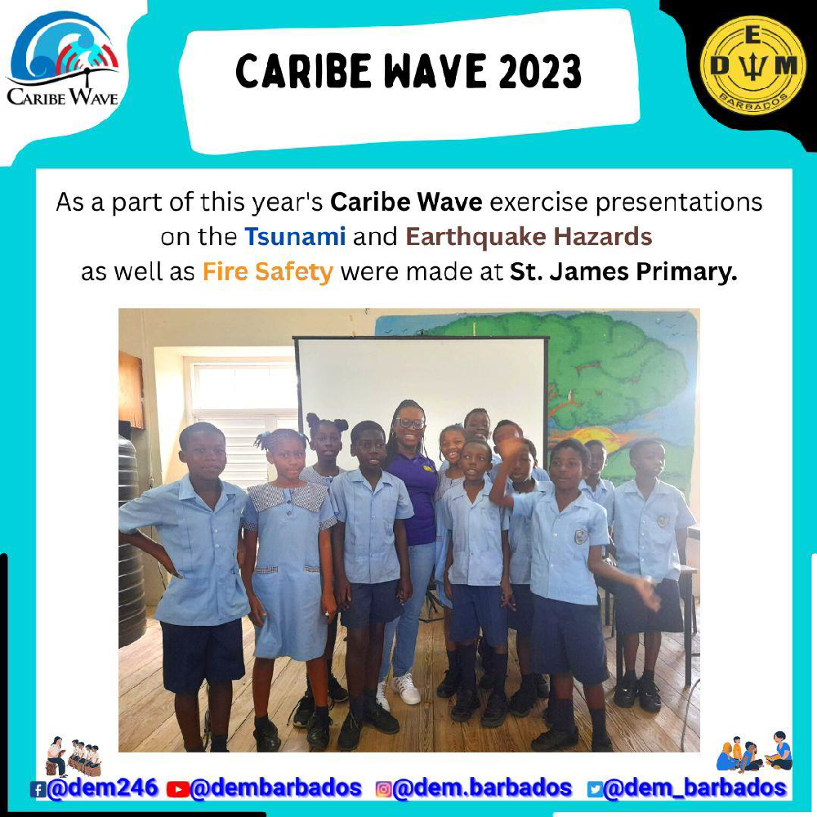
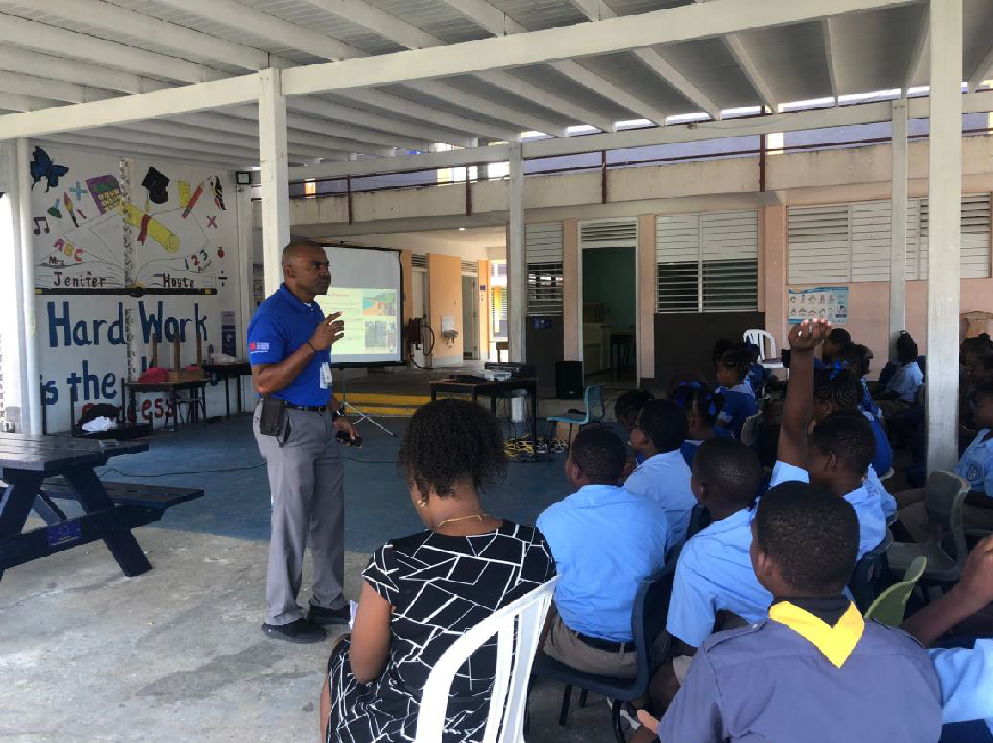
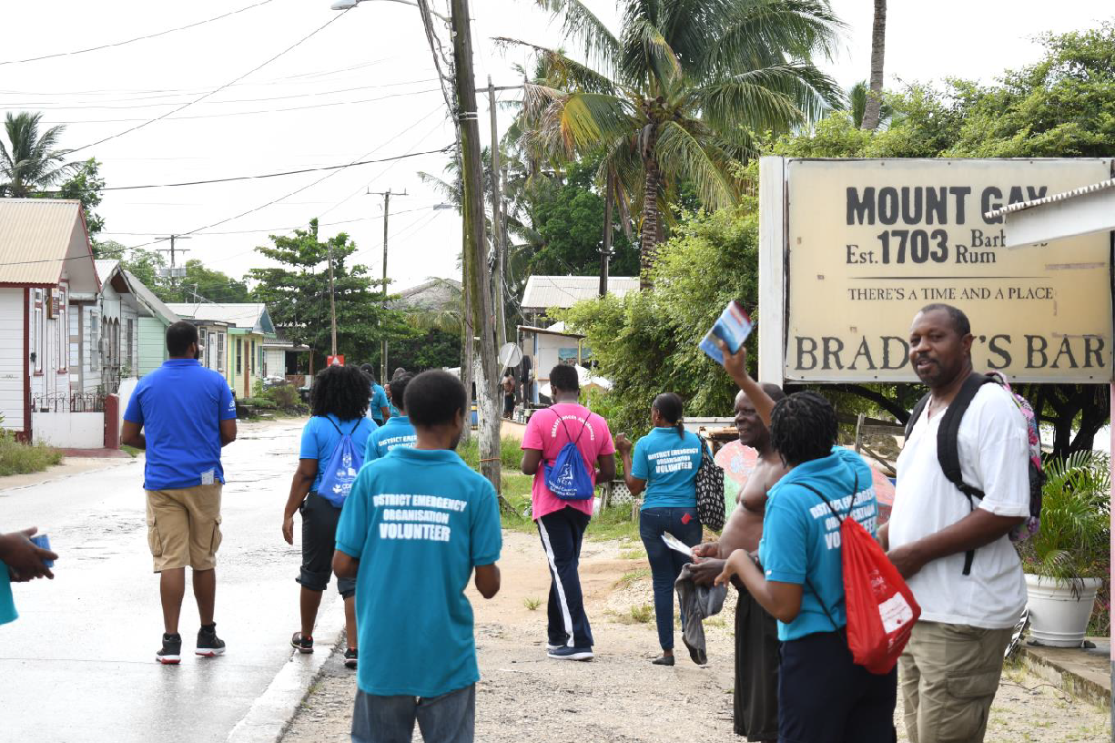
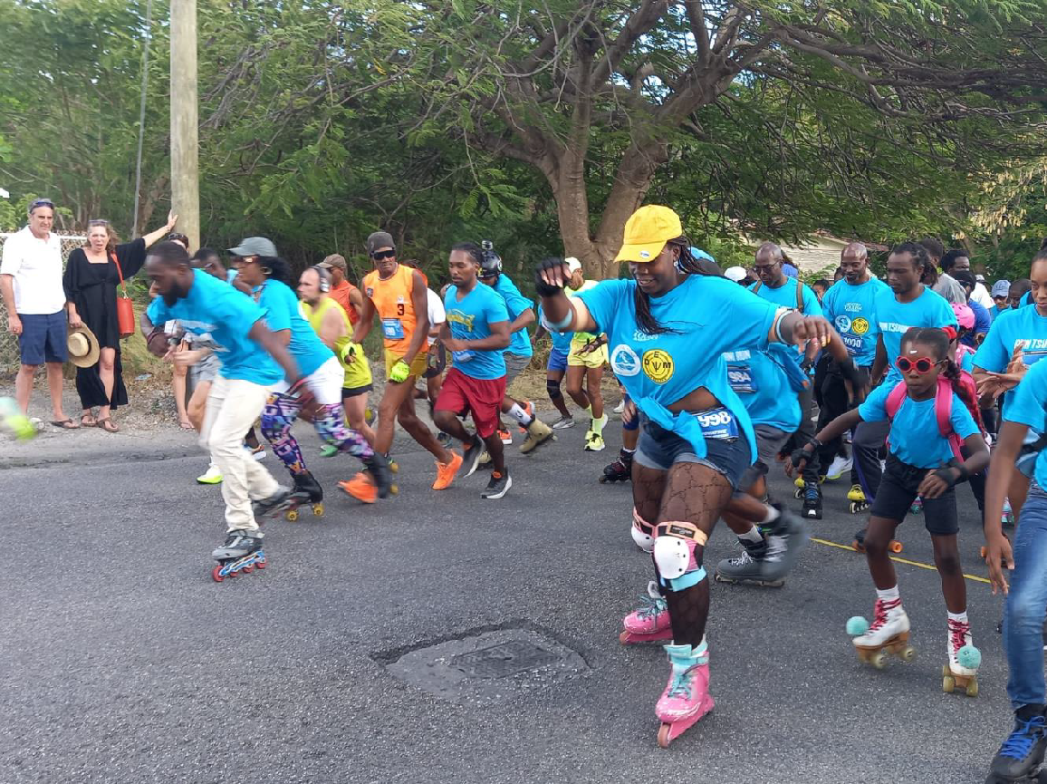

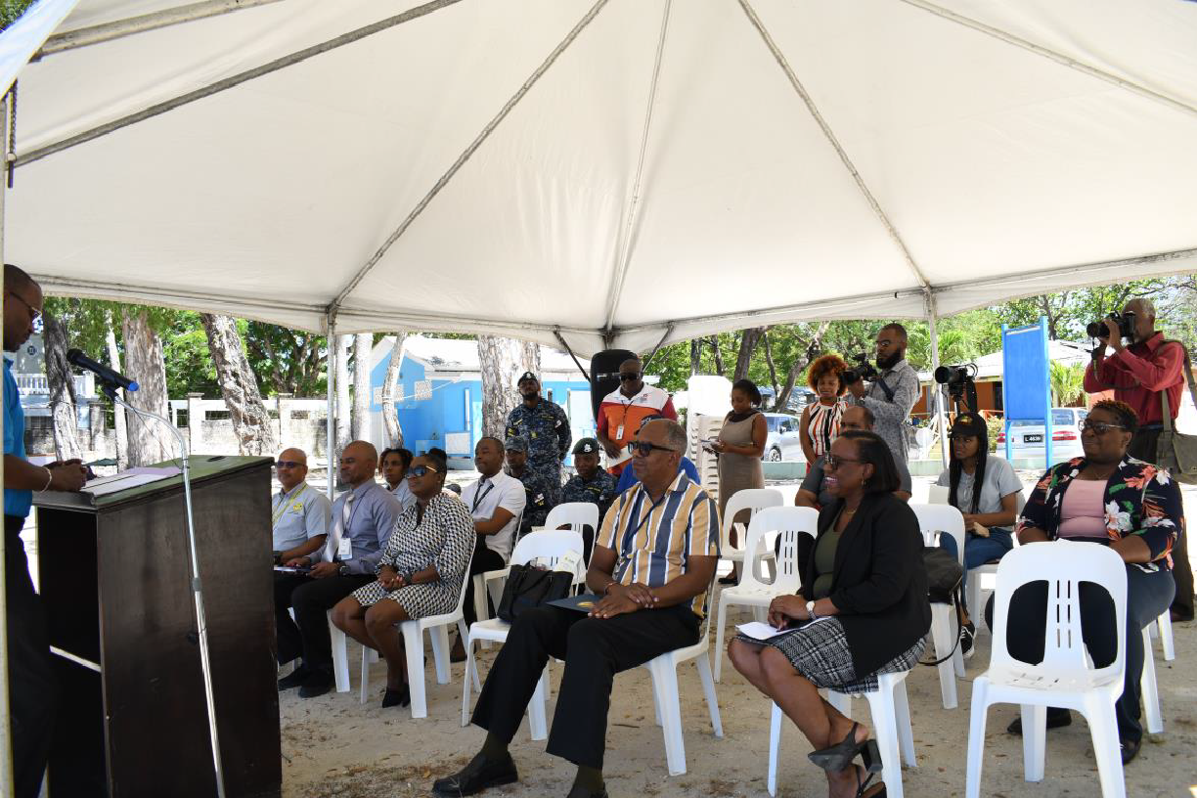
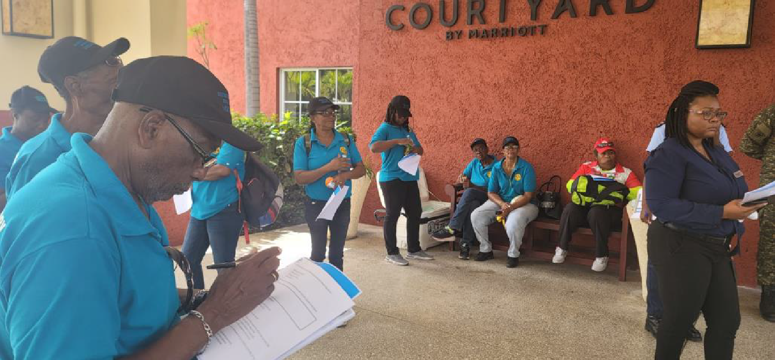
Activities Relating to the National Tsunami Public Awareness Programme January 2022 - March 2023

Slide 15
Future Summary Plan
Continue updating SOP and Protocols.
Continued testing CAP and BMS Insight app.
Continue providing support for National tsunami and coastal hazard program.
Continue implementing National Coastal Risk Information and Planning Platform (NCRIPP).
Continue to support Caribbean Tsunami Information Center (CTIC) as the host country.
Continue working with communities to increase levels of awareness.
Implementation of coast community vulnerability assessment to provide a profile of communities in the national vulnerability grid.
The completion of more tsunami ready designated tsunami communities.
Detection system:
  Training for emergency response and warning center personnel.
  The CZMU has worked towards making sure all equipment is fully functioning.

Slide 16
Thank You

