Slide 1
Report on TOWS-WG XVI
inter-ICG Task Team on
Disaster Management and Preparedness
members on behalf of ICG/NEAMTWS:
Marinos Charalampakis (Greece)
Cecilia Valbonesi (Italy)
Steering Committee of the ICG/NEAMTWS
Teleconference, 12-13 April 2023

Slide 2
Progress made during the intersessional period
• WAVE exercises conducted:
- In the Caribbean (CARIBE WAVE 23) on March 23, 2023, with two different scenarios: (i) a tsunami generated by a magnitude 7.6 earthquake located on the Gulf of Honduras and (ii) a tsunami caused by a flank collapse of the Mount Pelée volcano.
- In the Pacific regions (PacWave 22) last year, with the Hunga-Tonga Hunga-Ha'apai Volcanic Eruption and Tsunami as a scenario and objectives to (i) test the HTHH PTWC Interim Procedures and PTWS Products and (ii) the regional communication and cooperation.
- In the Indian Ocean will be conducted in 2023 and it will integrate with the implementation of Tsunami Ready Program in local community. The scenario will simulate a tsunami generated from non tectonic event.

Slide 3
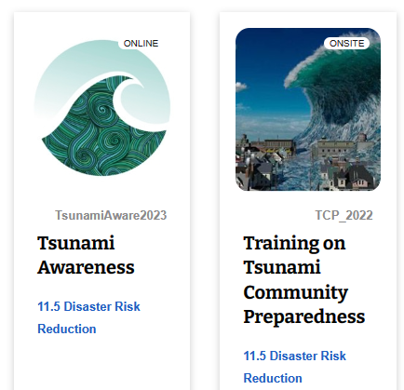
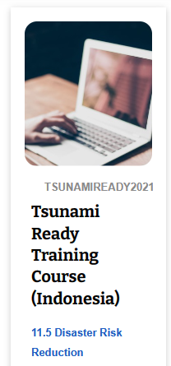
Progress made during the intersessional period
• Efforts of the Indian Ocean Tsunami Information Centre (IOTIC) and International Tsunami Information Centre (ITIC) in preparing Tsunami Awareness, UNESCO/IOC Tsunami Ready and Tsunami Evacuation Maps, Plans and Procedures (TEMPP) training through the Ocean Teacher Global Academy (OTGA) platform and hybrid training workshops and training videos.
Under the IOC Ocean Teacher Global Academy (OTGA) platform, ITIC training courses will cover: Tsunami Awareness; Tsunami Early Warning Systems; Tsunami Evacuation Maps, Plans and Procedures; Tsunami Warning
Center and Emergency
Management Response SOPs;
and Tsunami Warning Center
Competencies.

Slide 4
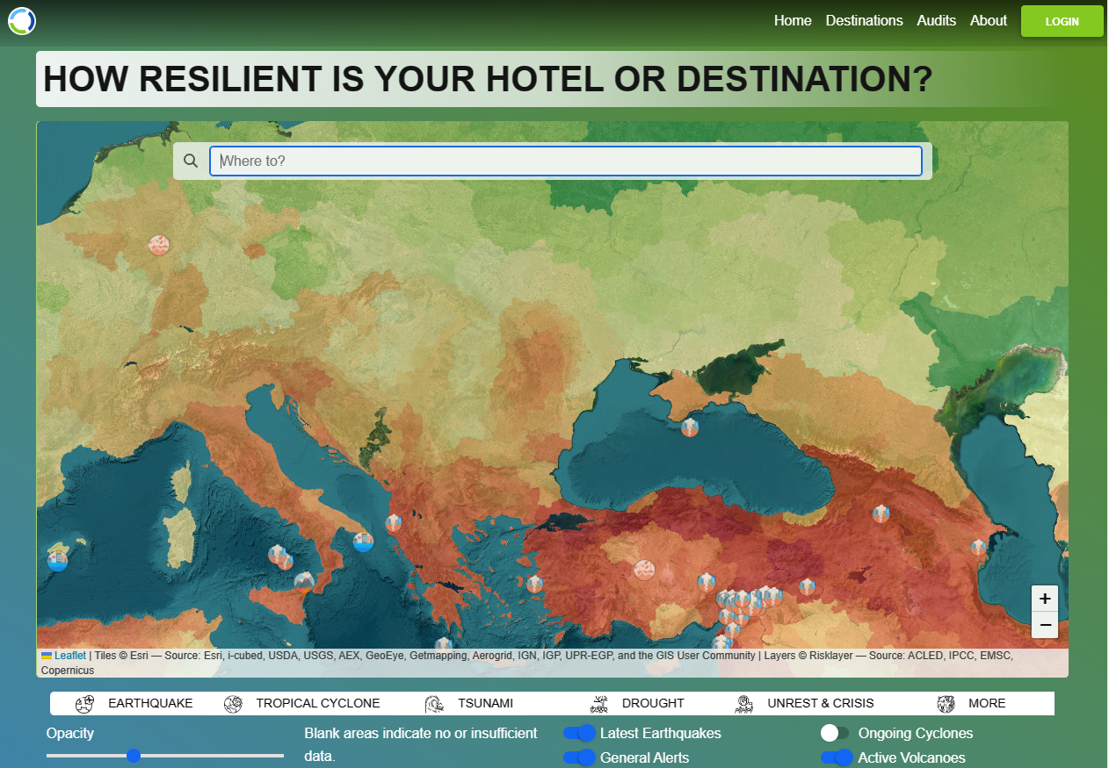
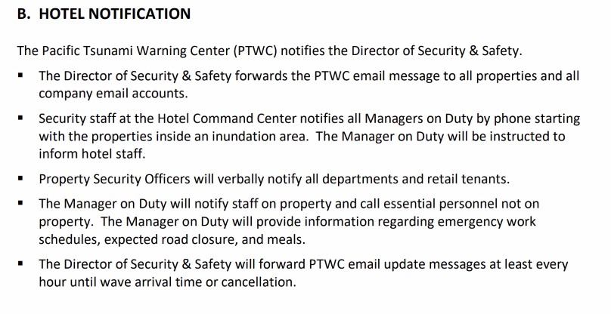
Progress made during the intersessional period
• Initiatives of the Hotel Resilient Programme in Bali, Indonesia, as a benchmarking and certification of hotels and resorts for disaster risk management (multi-hazard including tsunami) and climate change
adaptation, as well as the example for a major hotel in Waikiki,
Hawaii, USA.

Slide 5
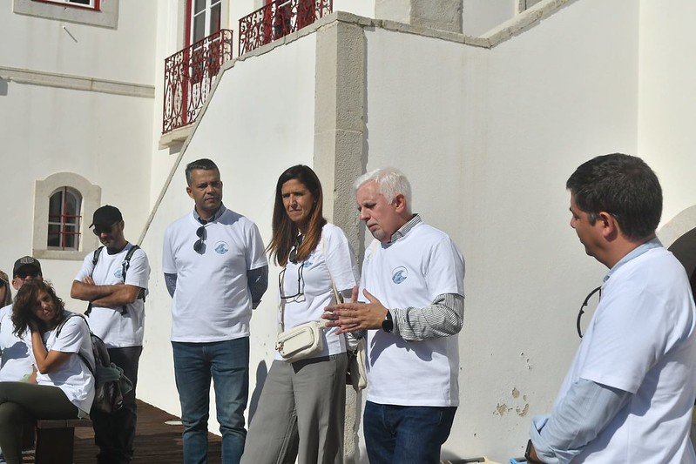
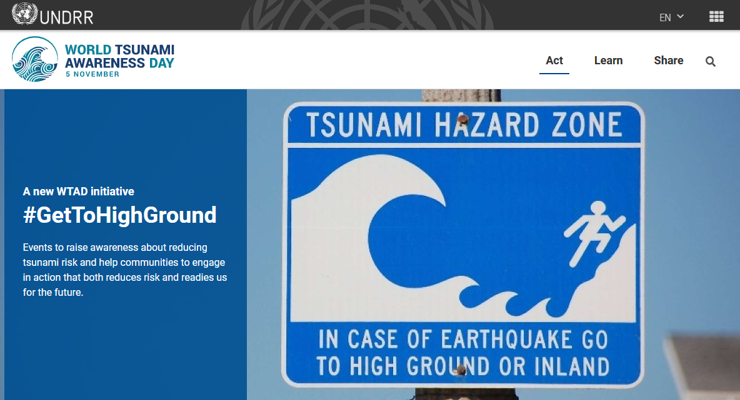
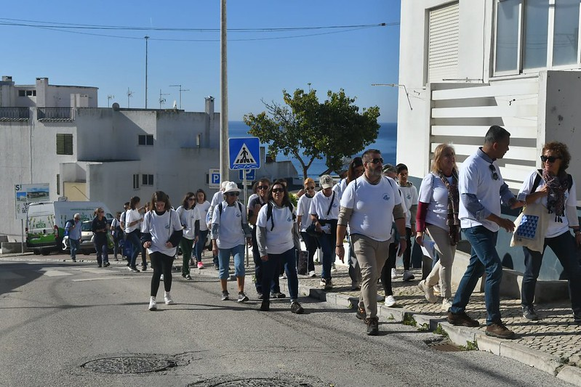
Progress made during the intersessional period
• Activities undertaken by the respective regions for World Tsunami Awareness Day (WTAD) 2022, and as part of this, the strong engagement in the #GetToHighGround Initiative, and the success achieved through United Nations Disaster Risk Reduction (UNDRR) and IOC collaboration.
• Continued progress in the implementation of UNESCO/IOC Tsunami Ready in the NEAM, IO, PO and Caribbean and Adjacent regions. Development of a questionnaire in the Caribbean and Adjacent regions to receive feedbacks from the Tsunami Ready communities on their implementation process.

Slide 6
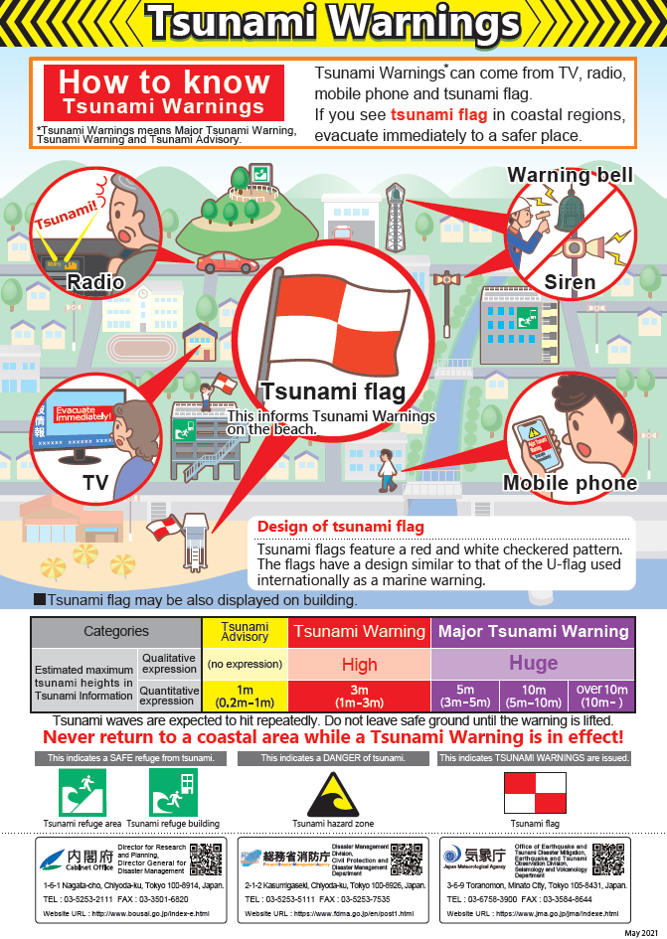
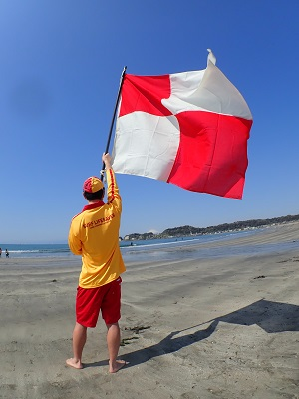
Progress made during the intersessional period
• Japan has defined a flag called “Tsunami Flag” as a visual
communication method of tsunami warning in order to dissemi-
nate tsunami warning to people with hearing difficulties and
people at the beach (used since June 2020).
U Flag is an international signal
flag that means "Danger in the
path of your ship" , while it is often
used overseas as a flag for
Emergency evacuation from the sea.
• Work of the Intergovernmental Coordination Group for the Pacific Tsunami Warning and Mitigation System (ICG/PTWS) to develop a National Tsunami Warning Centre (NTWC) Competency Framework (2017), and the ITIC’s leadership to pilot training courses based on the Framework.

Slide 7
Recommendations to the 32nd IOC Assembly (2023) to instruct the regional ICGs
• Add the task to the Terms of Reference of the ICGs and TICs to facilitate the implementation and functioning of the UNESCO/IOC Tsunami Ready Recognition Programme.
• Add the role of ICGs in their Terms of Reference, as regional Steering Committees for the Ocean Decade Tsunami Programme.
• Undertake sub-regional exercises as part of WAVE Exercises, as an efficient way to further engage Member States on exercises as appropriate.
• Follow the initiative of ICG/PTWS to enable sub-regional live information sharing during tsunami events to inform neighboring country decision-making.
• Caribbean Tsunami Information Center to share Tsunami Ready survey questionnaire and feedback forms on implementation process to receive information from the UNESCO/IOC Tsunami Ready communities.

Slide 8
Recommendations to the 32nd IOC Assembly (2023) to instruct the regional ICGs
• Encourage the standard text in the UNESCO/IOC Tsunami Ready signage for vertical evacuation, such as “Go to the designated building for vertical evacuation”, when there is no high ground and/or could not go inland, based on the importance of building codes and structural checks by mandated authorities.
• Properly inform the public on the validity of the recognition, as indicated on the UNESCO/IOC Tsunami Ready signage and certificate under the UNESCO/IOC Tsunami Ready logo.
•Explore and inform the TOWS-WG TT-DMP on mechanisms for recognition of UNESCO/IOC Tsunami Ready similar standards already in place in some countries.
• to instruct the ITIC to pilot the Draft PTWS NTWC Competency Framework for endorsement by PTWS with the goal to develop a global framework for all ICGs to use.

Slide 9
Recommendations to the 32nd IOC Assembly (2023) to request the IOC Secretariat to
• Provide a timely update of the UNESCO/IOC Tsunami Ready database.
• Explore how to develop an automated application system for UNESCO/IOC Tsunami Ready application and renewal.
• Enhance the renewal process of UNESCO/IOC Tsunami Ready by learning about the renewal experience in the United States TsunamiReady® program.
• Facilitate the finalization of the OTGA basic tsunami training materials. as soon as possible to support the UNESCO/IOC Tsunami Ready.

Slide 10
Further instructed the TT-DMP to
• Prepare a guideline for mainstreaming tsunami disaster risk reduction for coastal urban development planning.
• Prepare a guideline for critical infrastructures from tsunami impacts e.g., AirportGetReady to Tsunami.
• Update the Tsunami Hotel Guide (IOC Manuals and Guides 69) developed by NEAMTWS in 2012 to include the ITIC materials and other recent documents, and translate in other languages, including other lessons learned.

Slide 11
Thank you for your attention!
Steering Committee of the ICG/NEAMTWS
Teleconference, 12-13 April 2023

