Slide 1
ICG/NEAMTWS
Steering Committee Meeting
12-13 April 2023, Paris, France
Report on TOWS-WG XVI
Other Items
Denis Chang Seng Programme Specialist and
ICG/NEAMTWS Technical Secretary
Tsunami Resilience Section
UNESCO IOC

Slide 2
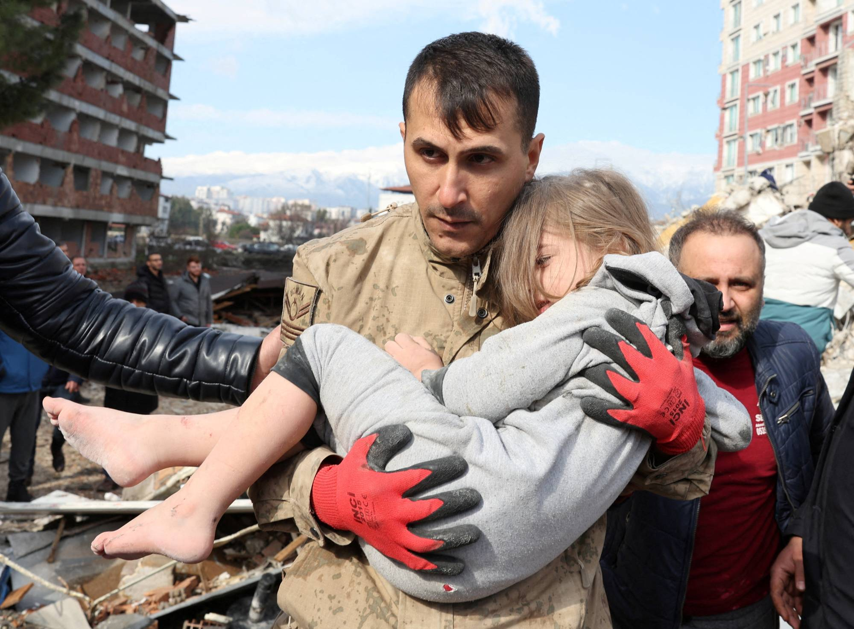
Credit: Reuters
The Group expressed its solidarity with the people who are affected by the Turkiye-Syria earthquake on 6 February 2023
Special Report to IOC Assembly, June 2023 on the event?

Slide 3
The Group noted the expanded services to be offered by Galileo European Global Navigation System in 2024 for satellite-based dissemination of targeted alerts to the population and the Galileo demonstration examples to be carried out in France, Germany, Cyprus, and Belgium and the workshop planned in February 2024
Welcomed the offer of the Galileo Programme to provide relevant documents, storylines, protocols, guidelines and manuals to support the design of the demonstration examples.

Slide 4
The Group proposed joint IUGG and IOC Tsunami Symposium prior to ICG/PTWS meeting in September 2023 in Tonga.
The Group decided to organize a Scientific Symposium and recommended an Organizing Committee be composed by a representative from the Indonesian Agency for Meteorology, Climatology and Geophysics (BMKG), two Co-chairs nominated by the TT-TWO and TT-DMP, the Chair of the ODTP Scientific Committee, a representative of the IUGG-Joint Tsunami Commission, and a representative of each of the TICs.

Slide 5
The Group accepted with appreciation the offer of the Government of the Republic of Indonesia to host the symposium in December 2024 as part of the plans by the Intergovernmental Coordination Group for the Indian Ocean Tsunami Warning and Mitigation System (ICG/IOTWMS) to commemorate the 20th Anniversary of the Indian Ocean Tsunami of 2004.
.

Slide 6
The Group recommended the IOC Assembly at its 32nd Session in 2023 to endorse the 10-Year Research, Development and Implementation Plan of the Ocean Decade Tsunami Programme with the proposed modifications, including those proposed by the inter ICG Task Teams.
The Group noted with appreciation the nomination of Dr Laura Kong as the chair of the UNESCO/IOC Tsunami Ready Coalition.

