Slide 1
Intergovernmental Coordination Group for the Tsunami Early Warning and Mitigation System in the North-eastern Atlantic, the Mediterranean, and connected seas
Steering Committee Meeting 2023.04.12
Maria Ana Baptista Chair of ICG/NEAMTWS

Slide 2
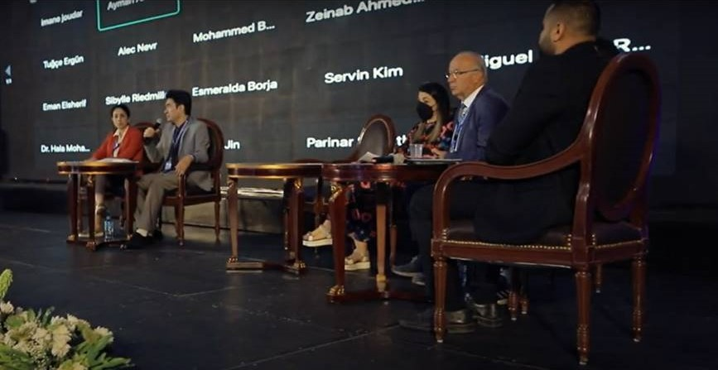
KEY ACTIVITIES
1. NEAMTICTWS Workshop on Multi-Hazard Risk Perception Questionnaire Survey, 5 April 2022 (Online)
ICGNEAMTWS Steering Committee 2022 (Online) ICG/NEAMTWS SC, 8 - 11 April 2022
ICGNEAMTWS Secretariat organized and supported the Resilient and Safer Coasts Side event - African Conference on Priority Setting & Partnership Development for the UN Decade of Ocean Science for Sustainable Development, Current Status, Challenges and Opportunities Resilient and Safer Coast, 11 May 2022, Cairo, Egypt – Chai ICG-NEAMTWS online participation
Report to TOWS 2023.03.02
Maria Ana Baptista Chair of ICG/NEAMTWS

Slide 3
KEY ACTIVITIES
4. IOC –EXECUTIVE Council June 2022 UNESCO, Paris
Report to TOWS 2023.03.02
Maria Ana Baptista Chair of ICG/NEAMTWS

Slide 4
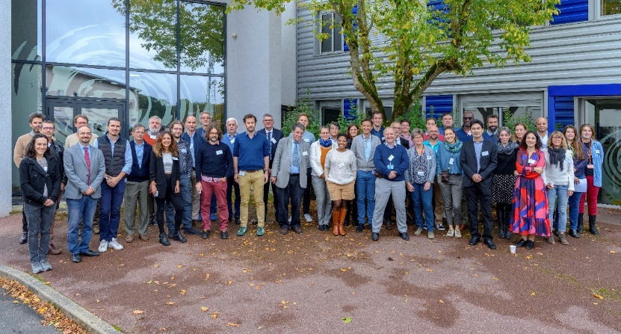
KEY ACTIVITIES
5 . Safe Thessaloniki conference on Civil Protection
29 September 2022
Scientific Workshop on the occasion of CENALT anniversary 29-30 September 2022
Report to TOWS 2023.03.02
Maria Ana Baptista Chair of ICG/NEAMTWS

Slide 5
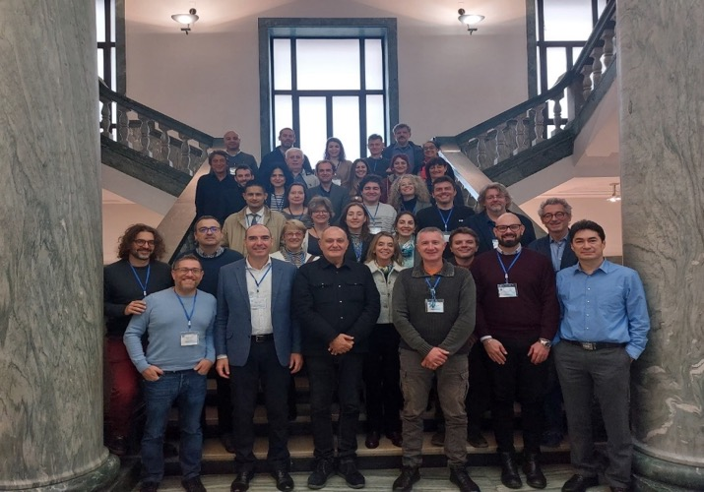
KEY ACTIVITIES
11. Organized and supported the ICG/NEAMTWS Experts Meeting,28 - 30 November 2022, Naples, Italy (Hybrid) Implementing NEAMTWS 2030 Strategy Opportunities and Actions to Explore co-organized by the National Institute of Geophysics and Volcanology (INGV), University of Napoli “Federico II” and IOC-UNESCO, 28-30 November 2022, Naples, Italy.
PILLARS OF NEAMTWS SRATEGY:
Tsunami Hazard and Risk Assessment
Detection Warning and Dissemination
Awareness and Response
Report to TOWS 2023.03.02
Maria Ana Baptista Chair of ICG/NEAMTWS

Slide 6
KEY ACTIVITIES
12. TSPs response: - Deadly and Damaging Earthquake in Türkiye and Syrian Boarder, Tsunami-related Sea Level Anomalies Detected in Türkiye + Report Team assessment (Prof Ahmet Yalciner) worth to point out that our ICG did an exercise back in 2017 with smaller earthquake magnitude 7.5
13. Special Steering Committee dedicated to the next NEAMWAVE exercise
ICG/NEAMTWS- 18 Session in Nov 2023, Egypt
Thank you for your attention!
Report to Steering Committee 2023.03.02
Maria Ana Baptista Chair of ICG/NEAMTWS

