Slide 1
Tsunami Service Provider Hellenic National Tsunami Warning Centre
Institute of Geodynamics
National Observatory Athens
Steering Committee of the ICG/NEAMTWS
Teleconference, 12-13 April 2023

Slide 2
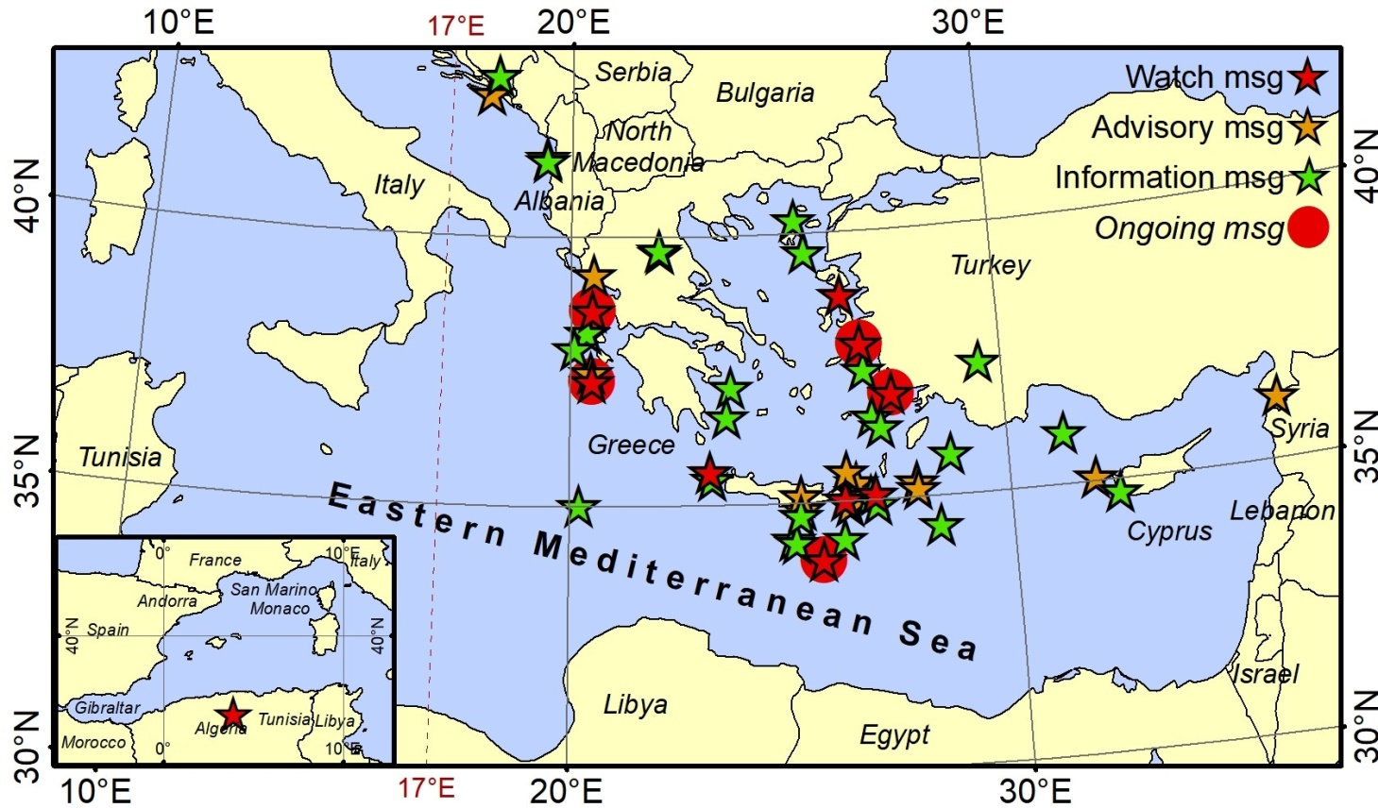
Operational activities
6 Tsunami Warning Messages since the last Steering Committee meeting in April 2022
no | Date | Time (UTC) | Region | Lat | Lon | Magnitude | Alert Level
46 | 22-Apr-22 | 21:07:49 | Bosnia and Herzegovina | 43.00 | 18.16 | 5.8 | Information
47 | 31-Aug-22 | 10:10:11 | Dodecanese Isl. | 37.42 | 26.83 | 5.7 | Information
48 | 08-Sep-22 | 07:36:24 | Ionian Sea | 37.94 | 20.11 | 5.6 | Information
49 | 02-Oct-22 | 04:04:01 | Crete | 34.3 | 26.21 | 5.5 | Information
50 | 25-Jan-23 | 12:37:05 | Eastern Mediterranean | 35.78 | 28.70 | 5.8 | Information
51 | 20-Feb-23 | 17:04:29 | Türkiye – Syria border region | 36.13 | 36.17 | 6.3 | Advisory

Slide 3
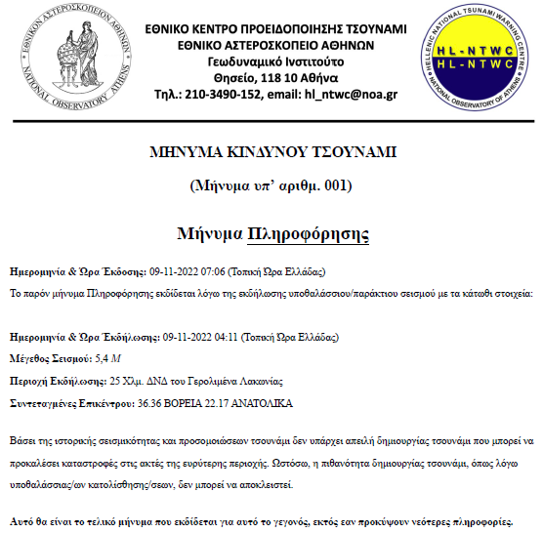
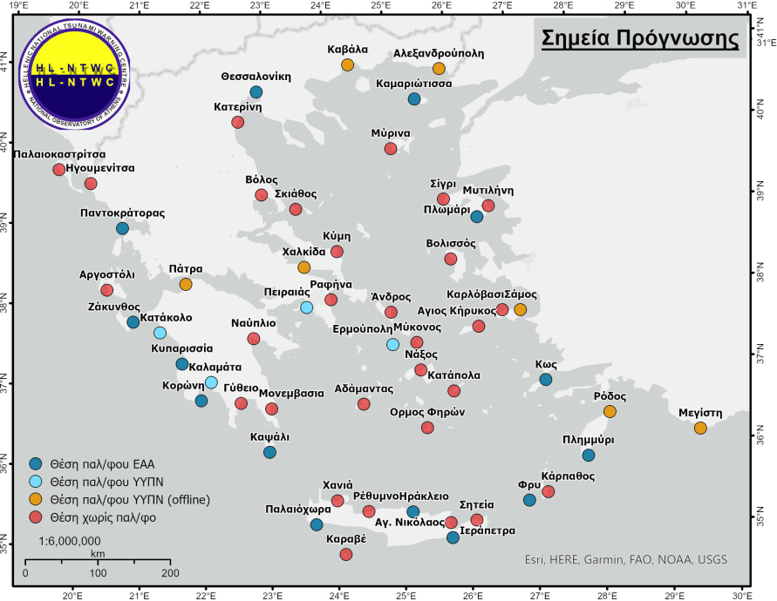
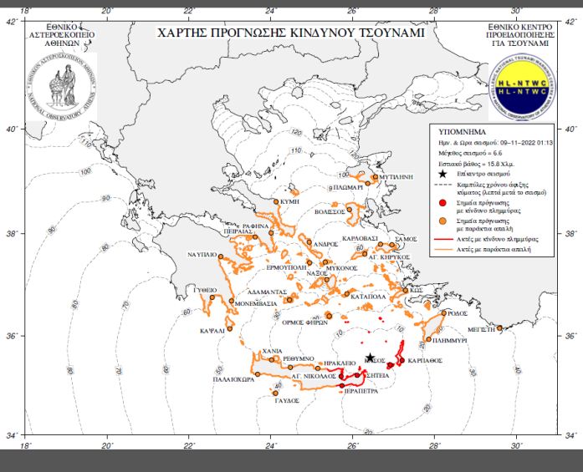
Operational activities
Finalized and in operational use since August 2022:
National messages in Greek language with map.
Updated Forecast Points list.

Slide 4
Scientific/Research activities
HL-NTWC is participating in the following projects and initiatives:
• Aristotle-eENHSP (2020-)
• CoastWAVE (2022-2024)
• Geo-INQUIRE (2022-2025)
• EPOS Tsunami TCS (2021-)
• BALANCE (2021-2022)
• new project submissions….

Slide 5
Participation
HL-NTWC participated in the following workshop and meetings:
AGITHAR meetings: Malaga in June 2022 & Prague in September 2022.
NEAMTWS TSPs meeting, 27-28 September 2022, Paris & online two meetings.
Scientific workshop dedicated to the CENALT 10 year anniversary CENALT, 29-30 September 2022
Workshop on the Requirements, Challenges, Opportunities for Local Tsunami Warning Systems in the Context of Multi-Hazard Disaster Risk Mitigation in the North-Eastern Atlantic and Mediterranean Region, 4–5 October 2022, Ispra, Italy.
CoastWAVE project ”Tsunami Warning and Emergency Management SOP workshop”, 5-6 October 2022, Ispra, Italy, organized by IOC-UNESCO.
NEAMTWS Experts Meeting - Implementing NEAMTWS 2030 Strategy Opportunities and Actions to Explore, 28-30 November 2022, Naples, Italy.

Slide 6
Participation
WTAD 2022
A table-top exercise with the National CPA was initially scheduled for November but was postponed for 2023. The TTX will include activation of the national emergency operating centers, as well as simulation of the Emergency Communication Service for message dissemination to the public, through 1-1-2.
Nicosia Risk Forum 2022, Larnaka, Cyprus. This year’s theme of #NRF2022 was focused on “Challenges of the Effects of Climate Crisis”. Invited talks about risk related projects and initiatives:
NEAMTWS from the Greek Tsunami Service Provider perspective
CoastWAVE project Greece

Slide 7
Developments
Operational challenges
• Proximity of tsunamigenic faults to coastal communities -> small available time window for warning.
• Absence of deep-water sensors - long delay in confirming tsunami generation by the Tsunami Service Providers if TGs not available in the near field.
Ongoing developments
• A tender for the purchase of 12 new tide gauges is underway for 2023.
• Preparation of local SOPs, following the guidelines and recommendations
of the National SOP.
• Use of Emergency Communication Service for message dissemination to
the public, through 112 - already operational, fine tuning is needed.
• Development of a national tsunami warning page to publish information related to tsunami
events for the public.
Future developments in NEAM
• Deploy regional deep water sensors – take advantage of smart cable initiatives.
• Improve tsunami forecasting capabilities using region-specific methodologies.
• Create framework for tsunami warning for non-seismic sources.

Slide 8
*
Steering Committee of the ICG/NEAMTWS
Teleconference, 12-13 April 2023

