Slide 1
Volcanoes tsunami and Meteotsunamis
Report on TOWS-WG XVI
Task Team on Tsunami Watch Operations
Members on behalf of ICG/NEAMTWS
Alessio Piatanesi (Italy)
Helene Hebert (France)

Slide 2
Background
The TOWS Working Group noted with appreciation the progress made during the intersessional period, including
  Work of the Ad Hoc Task Teams on Meteotsunamis and Tsunamis Generated by Volcanoes (TGV) under the TT TWO
A bit of history (IOC/TOWS-WG-XIV, IOC/TOWS-WG-XV)
  2020: team on atypical tsunami sources
  2021: preliminary report circulated to the TT TWO members
    Topics: (1) non megathrust earthquakes, (2) other geophysical sources (landslides, volcanoes), (3) meteotsunami
  2022: decision to establish a specific Ad Hoc Team on Meteo-tsunamis under the Task Team on Tsunami Watch Operations (TT TWO) chaired by Mr Mike Angove (USA) and an Ad Hoc Team on Tsunamis Generated by Volcanoes chaired by Dr François Schindelé (France)

Slide 3
Ad-hoc Team on Meteotsunami (1)
Chair: Mike Angove Co-Chair: Dr. Ivica Vilibic, Contributors: Dr. Alexander Rabinovich, Dr. Sebastian Monserrat, Dr. J Sepic, Dr. Vasily Titov, Dr. Emile Okal, Dr. Mohammad Heidarzadeh and Dr. Charitha B. Pattiaratchi.
Purpose
  Review current global status and advise on gaps related to MT monitoring and warning systems.
  Identify guidelines for Standard Operating Procedure (SOP) development to monitor and warn for MTs.
  Review relationships and coordination required between TSP/NTWC and Regional/National Meteorological Services activities to monitor and warn for MTs.

Slide 4
Ad-hoc Team on Meteotsunami (2)
At present, all operational MT alert products are addressed within the standing procedures of National or Regional meteorological services. This report does not consider shock-wave induced tsunamis such as HTTU.
Meteotsunami (MT) occurrence is common along virtually all coastlines. Only infrequently does MT pose a significant risk to life and property and this is typically in areas with particularly strong MT forcing characteristics such as the Balearic Islands region of the Mediterranean sea.
Outside of dedicated MT EWS’, MT alerting procedures are inconsistent and present risks. The Global Tsunami Warning System can play a supporting role in terms of making direct tsunami detection.

Slide 5
Ad-hoc Team on Meteotsunami (3)
A future unified system in which a combination of direct tsunami detection from the ever-expanding global tsunami sensing network and NWP-based MT forecasts is considered worthwhile.
MT only form under a narrow range of parameters related to water depth and the translational speed of the source disturbance. This makes it possible to thoroughly characterize the MT risk for virtually any coastline in the world. Local understanding of the MT threat posed to a given coastline is critical to ensuring the phenomena is addressed through Met services.

Slide 6
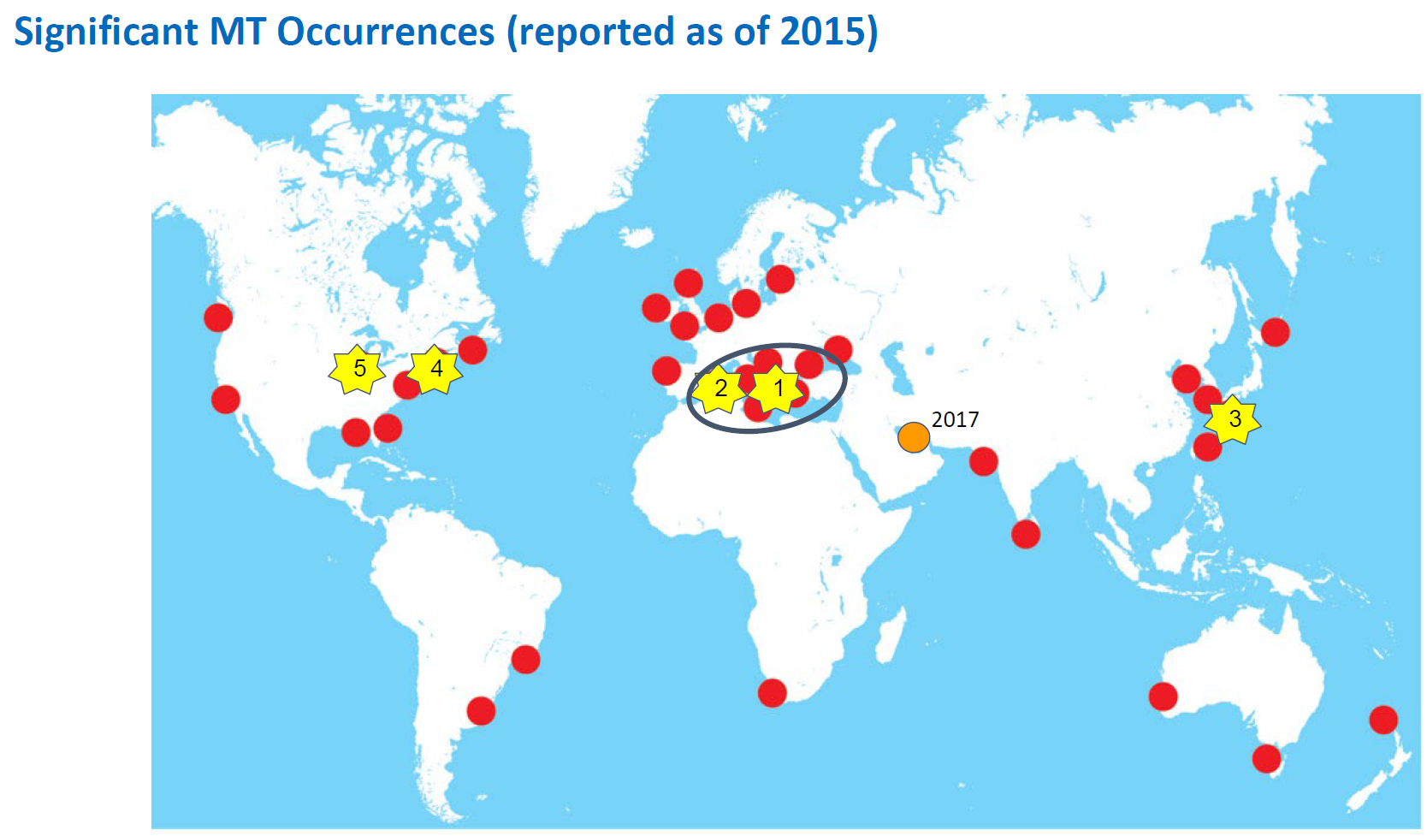
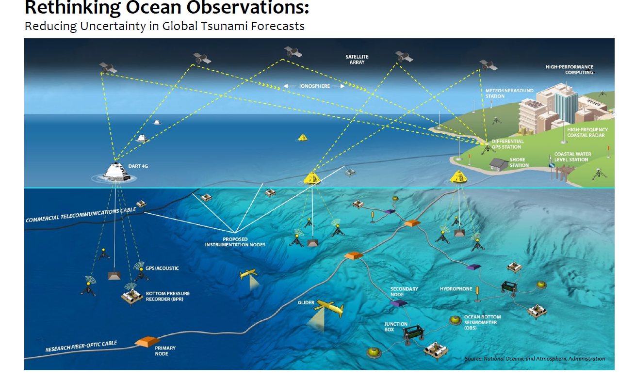
Ad-hoc Team on Meteotsunami (4)

Slide 7
Ad-hoc Team on Meteotsunami (5)
General Standard Operating Procedure Guidance
  Understanding risk: Member states prone to MTs should conduct detailed risk assessments
  Available Detection networks: Identify instruments available that can detect MT within area of responsibility
  Triggering considerations: Ensure tsunami detection instruments are tuned to alarm or trigger upon detecting tsunamis
  Communications: States with at-risk coastal areas should pay careful attention to communications status
Reflection on Organizational Relationships and Considerations
  Dedicated or generalized MT systems?
  Combining NWP-based coupled models with direct, high-density, targeted tsunami observations?

Slide 8
Ad-hoc Team on Meteotsunami (6)
Recommendations
  The Group commended the work of the Ad Hoc Team on Meteotsunamis.
  The Group acknowledged that meteotsunamis are a meteorological driven phenomenon, and as such, better clarifying the roles of NMHS and WMO will be critical in supporting the development of any potential future detection and alerting service for meteotsunamis.
  The Group decided to continue the Ad Hoc Team on Meteotsunamis to finalise its report, recommended that WMO experts be engaged to assist in this task, and also acknowledged that WMO requests the WMO-IOC Joint Collaborative Board to discuss tsunami related issues with respect to meteotsunami, to clarify the roles and responsibilities for the WMO and UNESCO/IOC, and how best to strengthen collaboration for supporting Member States.

Slide 9
Ad-hoc Team on Tsunami Generated by Volcanoes (1)
Chair François Schindelé (France); Contributors: Laura Kong ( US, ITIC) ; Emily Lane (New-Zealand) ; Raphaël Paris (France); Maurizio Ripepe (Italy) ; Vasily Titov (US)
Report
  0 Introduction and background
  1 Tsunami generated by volcanic activity
  2 Numerical modeling of volcanic tsunamis
  3 Volcanic tsunami hazard assessment (Stromboli)
  4 Volcano monitoring requirements for tsunami warning (Stromboli)
  5 Volcanic tsunami warning systems and SOPs (Stromboli, Anak Krakatau)
  6 Recommendations
Appendix 1: results of a survey organized in order to
  To get as much information as possible related to the volcano observatories activities on tsunami monitoring
  A list of Volcano observatories located close to sea or oceans was established
Appendix 2: list of tsunamigenic volcanoes

Slide 10
Ad-hoc Team on Tsunami Generated by Volcanoes (2)
A primary objective of the TGV Team is to make a list of the volcano observatories that monitor and warn of volcanoes that may generate tsunamis, including what type of networks and methods are used
  A list of 89 potentially tsunamigenic volcanoes has been established upon precise criteria
    Activity during XXth and XXIst centuries
    Of a specific type among
      A/ Steep-flanked strato volcano whose main eruptive centre is less than 7 km from the coast (Stromboli, Soufrière Hills)
      B/ Belongs to a complex of eruptive centres in a partly submerged caldera (e.g. Krakatau, Indonesia).
      C/ A submarine volcano with shallow-water vents, whose activity and flank instability are clearly potential sources of tsunamis (e.g. HTHH eruption in 2022)
      D/ A shield volcano (ocean island) showing evidence of flank deformation, such as Kilauea volcano in Hawaii, and Piton de la Fournaise in Reunion Island.

Slide 11
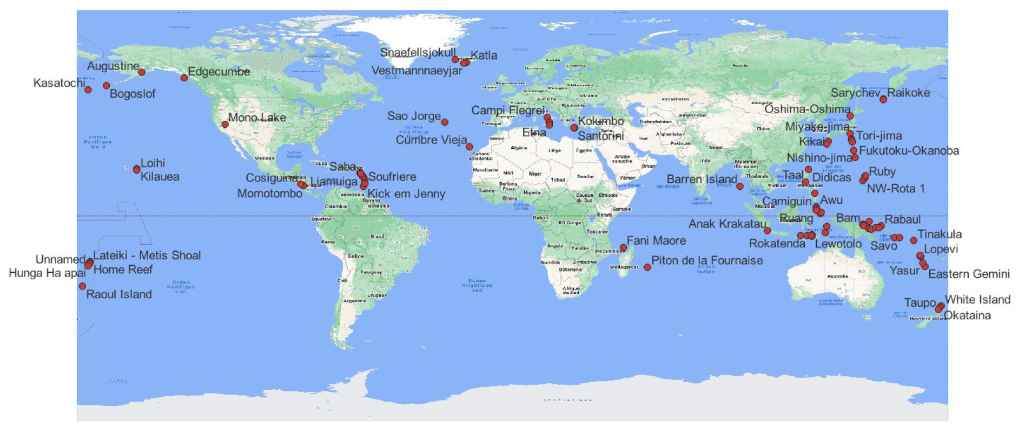
Ad-hoc Team on Tsunami Generated by Volcanoes (3)
GIS synthesis under construction

Slide 12
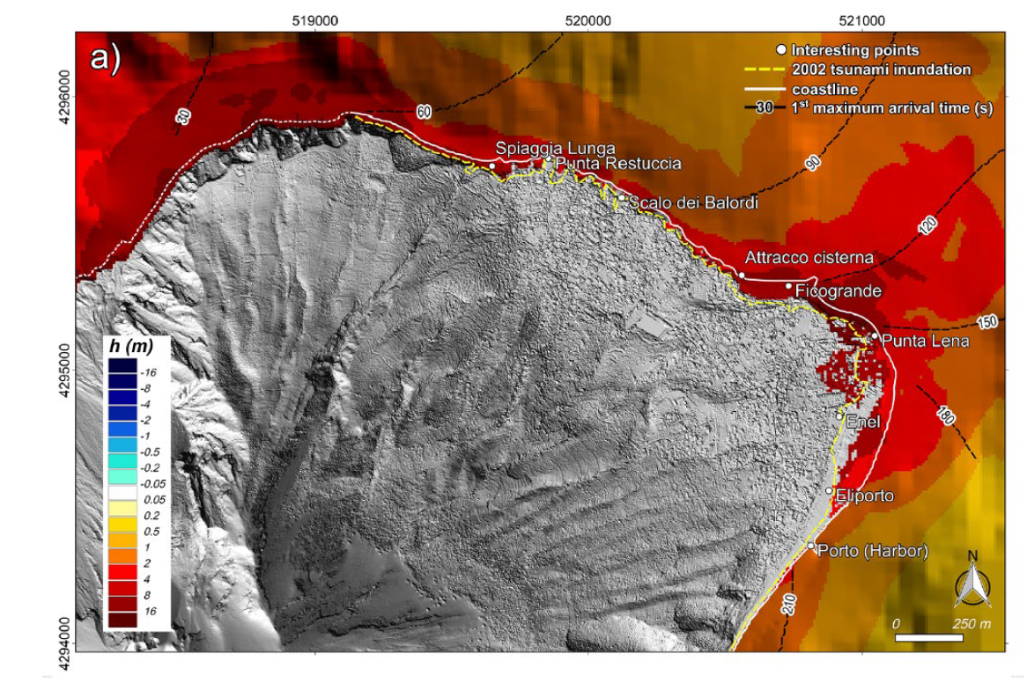
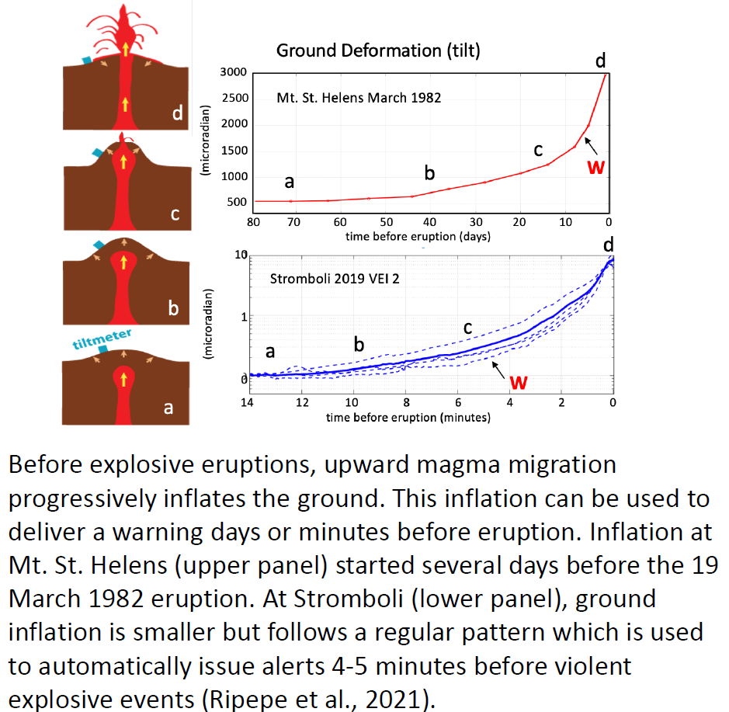
Ad-hoc Team on Tsunami Generated by Volcanoes (4)
2 Numerical modeling of volcanic tsunamis
  Generation, propagation, inundation
3 Volcanic tsunami hazard assessment (Stromboli)
4 Volcano monitoring requirements for tsunami warning (Stromboli)

Slide 13
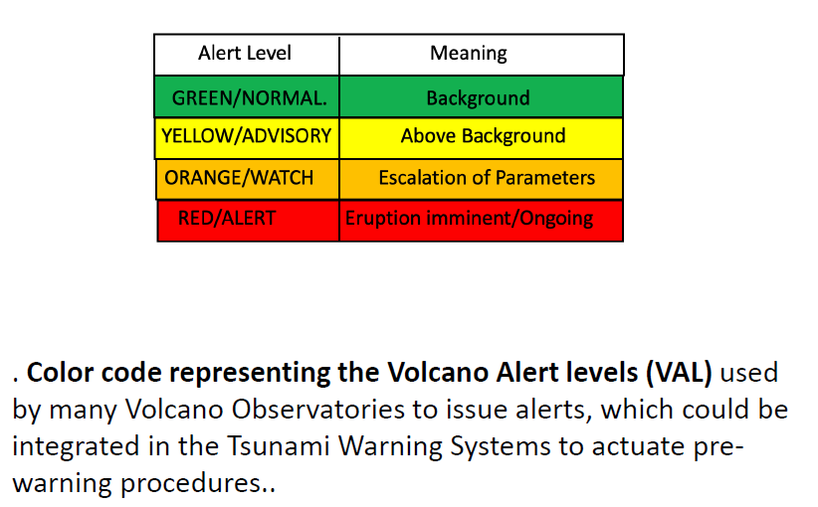
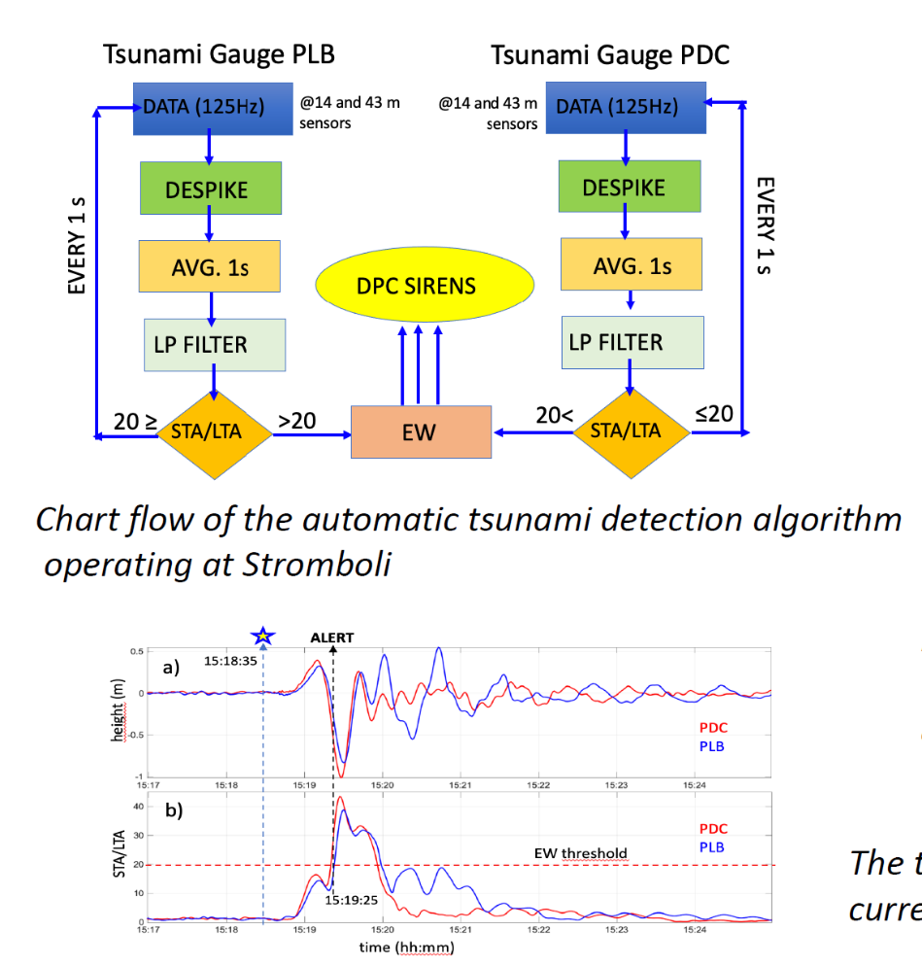
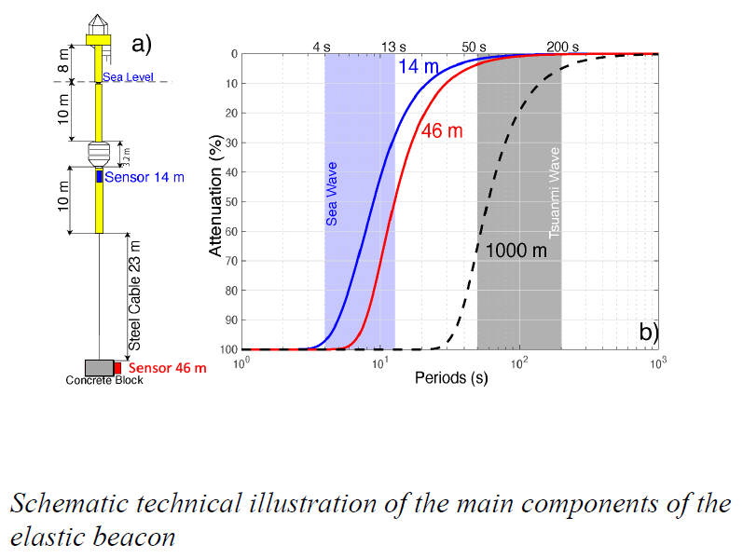
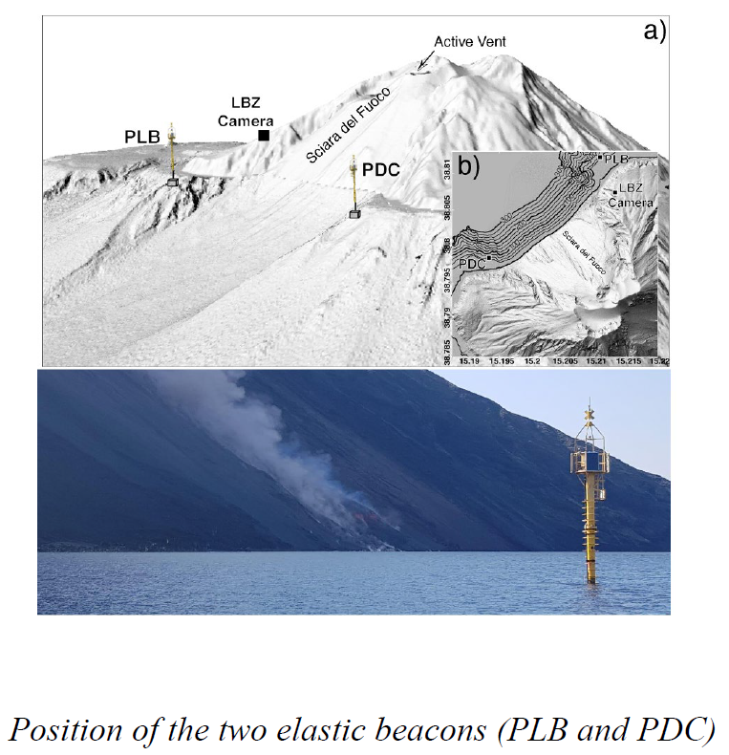
Ad-hoc Team on Tsunami Generated by Volcanoes (5)
4 Volcano monitoring requirements for tsunami warning (Stromboli)
5 Volcanic tsunami warning systems and SOPs

Slide 14
Ad-hoc Team on Tsunami Generated by Volcanoes (6)
Recommendations
  The TOWS Group commended the work of the Ad Hoc Team on Tsunamis Generated by Volcanoes.
  The Group decided warning systems for tsunamis generated by volcanoes should be considered and coordinated as part of the UNESCO/IOC global Tsunami Warning and Mitigation System, and also when possible be part of a MHEWS.
  The Group decided to continue the Ad Hoc Team on Tsunamis Generated by Volcanoes in order to complete its report in time for tabling at the IOC Assembly at its 32nd Session in 2023 by the Chair of TOWS-WG.

