Slide 1
NWPTAC Report
ICG/PTWS SC
March 6-9, 2023
Yutaro TAIRA
Northwest Pacific Tsunami Advisory Center (NWPTAC)
Japan Meteorological Agency (JMA)

Slide 2
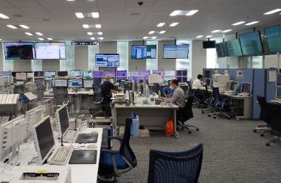
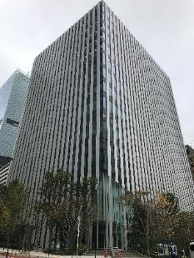
NWPTAC Major Activities (Dec. 2021 – Feb. 2023)
Mar. 01, 2022 EPOS6 (Tokyo) started operation
Apr. 12, 2022 Communications Test
Sep. 14, 2022 EPOS6 (Osaka) started operation
Oct. 13, 2022 Live Communications Test for the PacWave22
Feb. 07, 2023 Communications Test
Japan Meteorological Agency
Operation Room of NWPTAC (JMA)

Slide 3
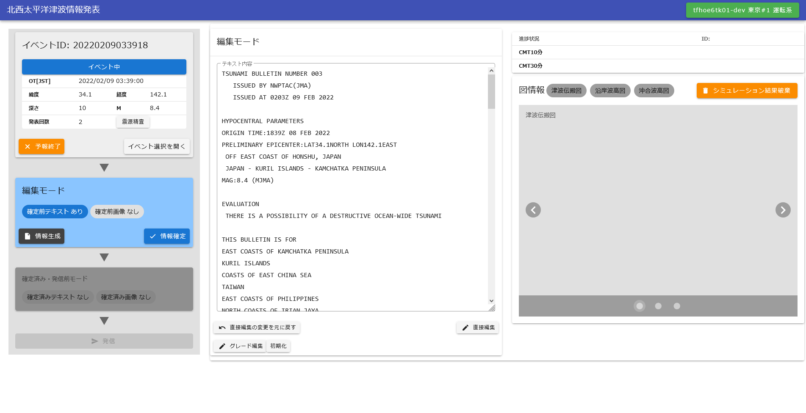
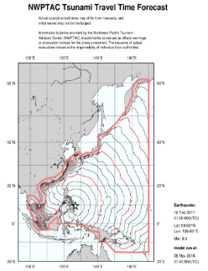
EPOS6
〇The operating system of the Earthquake and Tsunami Observation Information Service has been updated.
This system is called Earthquake Phenomena Observation System (EPOS).
〇A new system (EPOS6) has been installed at the Tokyo Headquarter and the Osaka Regional Headquarter. These two systems have the same functions.
〇In the case of Tokyo system is down, we can issue NWPTAs using the Osaka system from Tokyo.
operation screen for NWPTAs of EPOS6

Slide 4
NWPTA Issuance (December 2021 – February 2023)
 | Date | Time (UTC) | Lat./Lon. | Location | Mag | T1*¹ | T2*¹
1 | Mar. 13, 2022 | 21:06 | 14.1N/119.4E | Luzon, Philippines | 6.7 | 18
2 | Mar. 16, 2022 | 14:36 | 37.7N/141.7E | Off Fukushima Prefecture, Japan | 7.3 | 8 | 33
3 | Mar. 22, 2022 | 17:41 | 23.5N/121.6E | Taiwan | 6.6 | 49
4 | May 09, 2022 | 06:23 | 24.0N/122.5E | Near Yonaguni Island, Japan | 6.6 | 8
5 | Jul. 27, 2022 | 00:43 | 17.9N/120.4E | Luzon, Philippines | 6.8 | 17 | 50
6 | Sep. 11, 2022 | 23:47 | 6.4S/146.5E | Papua New Guinea | 7.7 | 33 | 88^{*2}
7 | Sep. 17, 2022 | 13:41 | 23.0N/121.2E | Taiwan | 6.6 | 13 | 49^{*2}
8 | Sep. 18, 2022 | 06:44 | 23.0N/121.1E | Taiwan | 7.2 | 12 | 45^{*2}
9 | Oct. 25, 2022 | 14:59 | 17.9N/120.6E | Luzon, Philippines | 6.8 | 18 | 43
10 | Nov. 22, 2022 | 02:03 | 09.8S/159.6E | Solomon Islands | 7.3 | 20
11 | Jan. 18, 2023 | 06:06 | 02.8N/127.1E | Northern Molucca Sea | 7.2 | 14 | 42
12 | Feb, 25,2023 | 21:25 | 0.6S/249.9E | New Britain Region P.N.G. | 6.5 | 25
*1) T1, T2: Elapsed time from Eq. origin time to Issuance 1st/2nd NWPTA Products (minutes)
*2) Graphical products were provided.

Slide 5
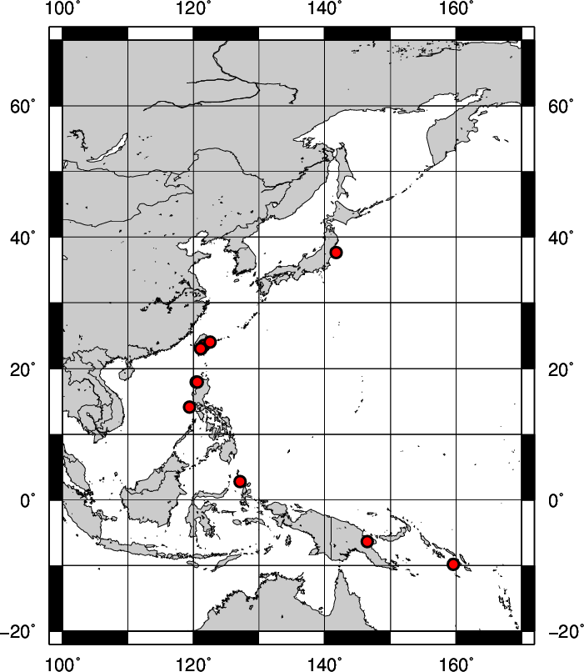
Earthquake locations for which NWPTA were Issued
(December 2021 – February 2023)
issued for 12events

Slide 6
Communication Tests
NWPTAC conducts communication tests basically twice a year since 2012.
Thanks to the coordination of the secretariat and the member states,
the situation seems to be becoming better.
The same countries (Federated States of Micronesia, Palau, and Solomon Islands) have not responded to communication tests recently.

