Slide 1
FUTURE GOALS AND PERFORMANCE MONITORING
TOWS Task Team on Disaster Management Preparedness (TT-DMP)
SARAH-JAYNE MCCURRACH (NZ)
ICG/PTWS WG1 CO-CHAIR
ICG/PTWS TT CHAIR PTWS KPI
MARY RENGIFO (COL)
ICG/PTWS WG1 TT CO-CHAIR KPI

Slide 2
TERMS OF REFERENCE ICG/PTWS-TT FUTURE GOALS & PERFORMANCE MONITORING
Work with all IOC-ICG’s to develop a consistent Global Framework for Goals and Performance Monitoring of Tsunami Warning & Mitigation Systems.
Work with all IOC-ICG’s to establish a performance baseline with the means to accurately identify shared activities, opportunities and resources required to help meet the identified goals.
Ensure a Global Framework for Goals and Performance Monitoring is aligned with the
• Sendai Framework for Disaster Risk Reduction
• United Nations Decade of Ocean Sciences for Sustainable Development – A Safe Ocean
• IOC Tsunami Programme
• Tsunami Ready Programme
• ICG/PTWS Strategy 2022-2030
Develop material to support implementation and ongoing use of a Global Framework for Goals and Performance Monitoring. This must include clear expectations for all ICG Member States, guidance, and standards.
Present a model to all IOC-ICG’s for the ongoing monitoring and evaluation of the Framework, to ensure the process and delivery is sustainable. This must include a process for all ICGs to detail gaps, opportunities, and improvements in regard to their evaluation against a Global Framework for Goals and Performance Monitoring.
Develop an online survey aligned with a Global Framework for Goals and Performance Monitoring. The survey must be easily accessible to all Member States, comprehensive and fair, with the ability to develop ‘real-time’ evaluations.

Slide 3
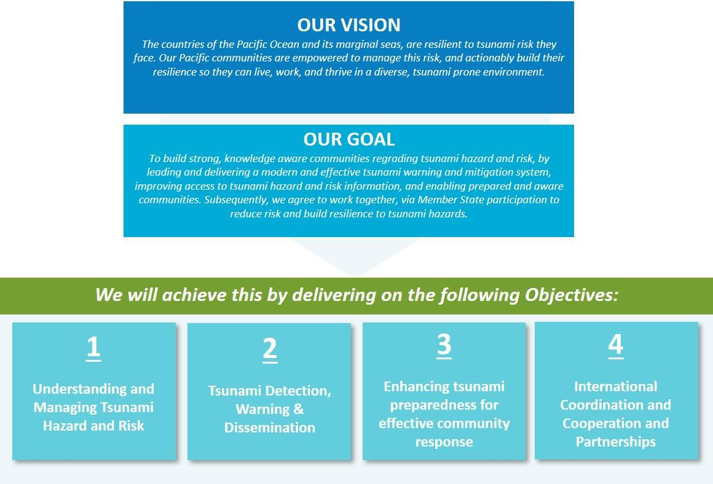
GLOBAL GOALS AND PERFORMANCE MONITORING
Sendai Framework for Disaster Risk Reduction 2015-2030
United Nations Decade of Ocean Sciences for Sustainable Development – A Safe Ocean – Daft Ocean Decade Tsunami Program
IOC Tsunami Programme – people centred EWS; aims at reducing the loss of lives and livelihoods from worldwide tsunamis; assess tsunami risk; educate communities at risk implement; multi-hazard disaster reduction strategies.
Tsunami Ready – enabling communities to reach a high level of tsunami resilience
ICG/PTWS Strategy 2022-2039

Slide 4
DEVELOPING AN IOC GLOBAL PERFORMANCE MONITORING FRAMEWORK
Develop a consistent global performance monitoring framework, which includes data collection tools/questionnaire and reporting formats.
Final draft available
Notes:
The pandemic has provided an example of how probabilities of occurrence for disaster events have needed to be rapidly described and communicated to communities, who are in turn, making risk-based decisions on information provided by governments and officials. This is something the PTWS can reflect on when assessing our work programmes going forward, notably regarding the communication of tsunami hazard and risk.
The first assessment round completed by Member States, resulted in several suggestions for improvements in the framework model and the associated online survey. Given the TOWS KPI Task Team is developing a ‘Global IOC KPI Framework’ (linked closely to Inter-ICG Task Team on Disaster Management and Preparedness), to improve the consistency of all ocean basin performance, it was agreed all feedback would be taken into the development of the new local framework, rather than amending the PTWS KPI Framework. This is because we anticipate the Global IOC KPI Framework will replace the PTWS KPI Framework.

Slide 5
GLOBAL GOALS & TARGETS
Goals:
GOAL 1: Understanding and Managing Tsunami Hazard and Risk
GOAL 2: Tsunami Detection, Warning & Dissemination
GOAL 3: Enhancing tsunami preparedness for effective community response
GOAL 4: Tsunami event response and recovery
GOAL 5: Global ocean coordination, cooperation and partnerships (Working Group/ICG Leaders Only)
Expectations are to:
Monitor and evaluate against this framework
Provide yearly reports via the annual ICG meeting structures
Participate in annual TOW’s meetings/workshops on global basin assessments, presenting gaps, opportunities and improvements regarding the framework evaluation.
Prioritize actions in order to improve tsunami risk management in each ICG
.

Slide 6
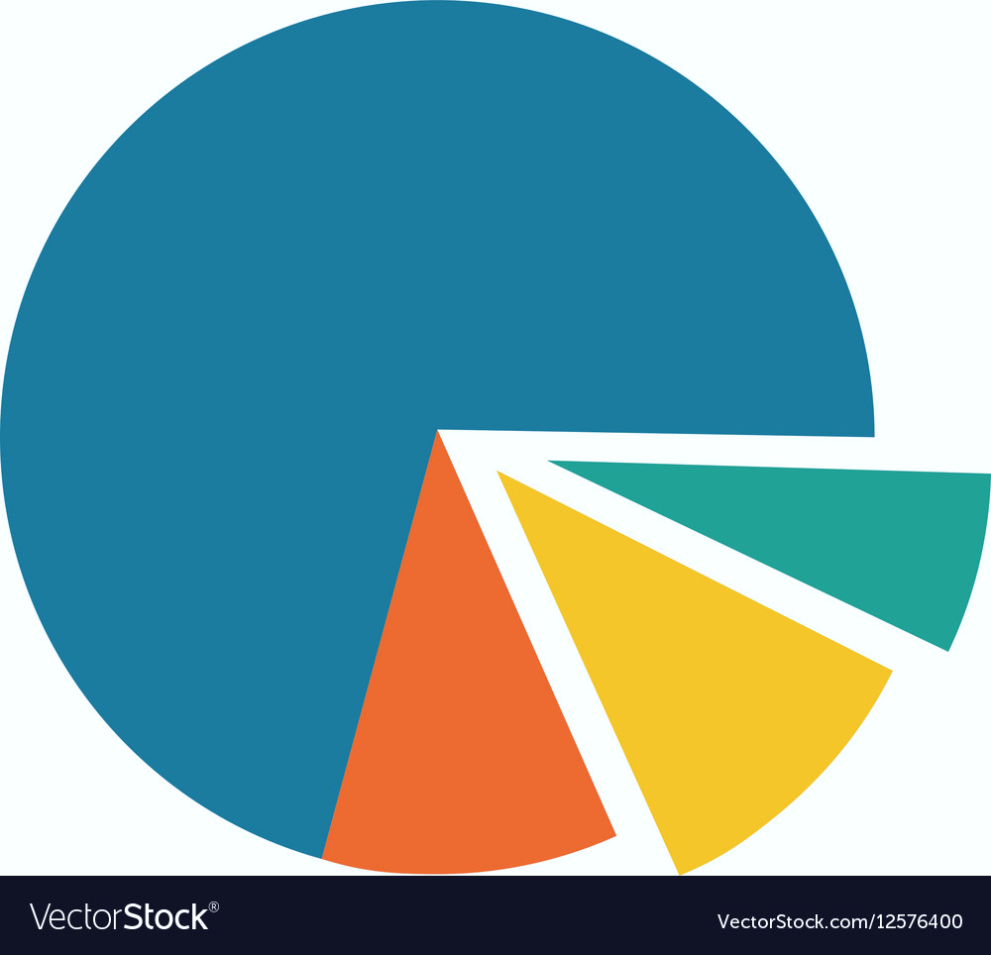
GLOBAL FRAMEWORK ACCESS
Web-based Portal
Hosted on IOC site
Algorithm functionality
Real-time graphs
Fair and ethical
Easy, accessible and simple (yet comprehensive) National, ICG and Global reporting
ONGOING ACTIONS
Coordination with UNESCO COI to develop ToR for supporting the web portal - In progress
Development questionnaire to be published in the web portal
.

