Slide 1
World Tsunami Awareness Day (WTAD) 2023
Rosalind Cook
Head, Campaigns and Community, Communications Unit, UNDRR
February 2023

Slide 2

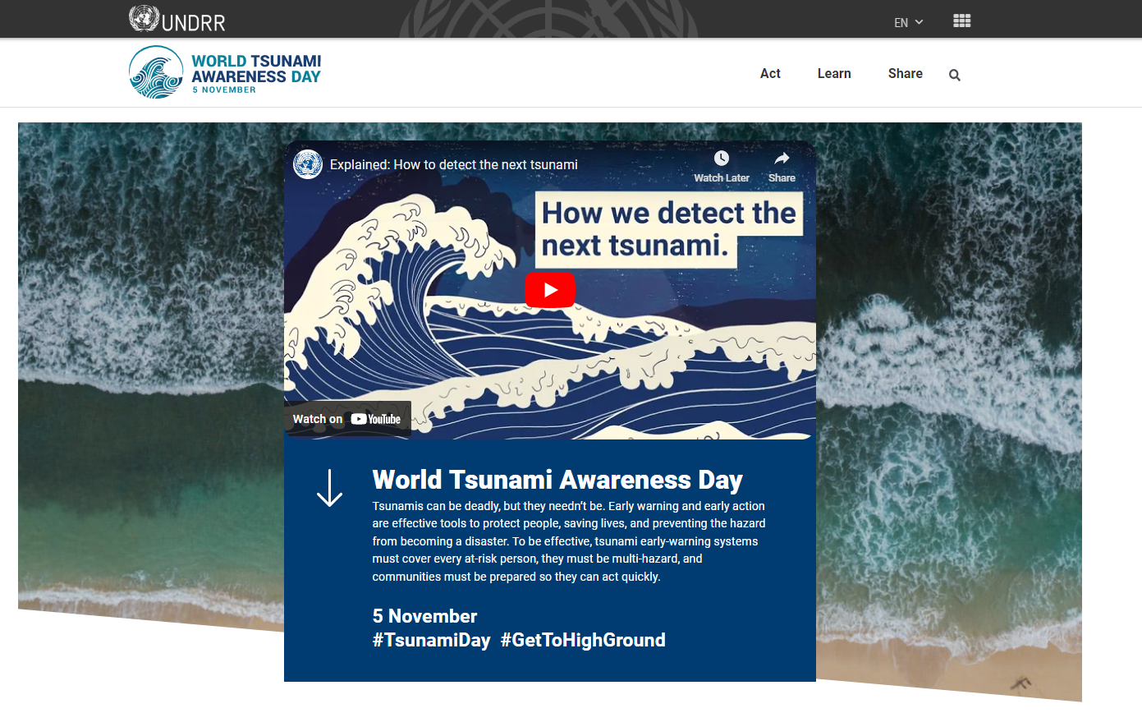
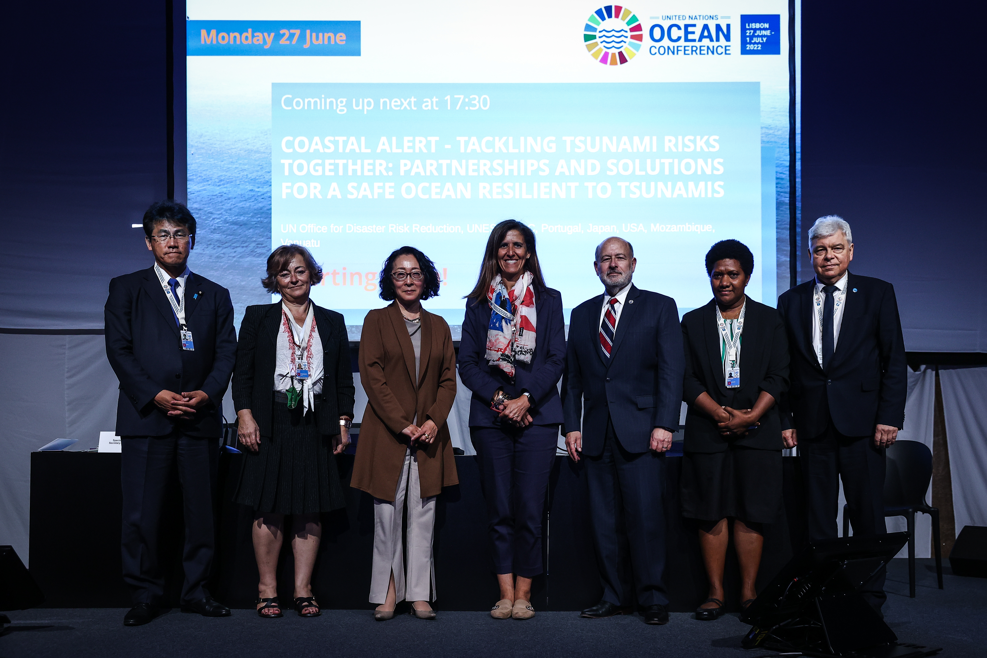
WTAD 2022: Early Warning Systems for All
Connecting high level political support to citizens on the ground to drive change
UN Oceans Conference side event, June UN SG: “Early Warnings for All” Action plan
High level event in New York, 4 November “Early Warning and Early Action Before Every Tsunami”
Documentary “Tsunami Day: Tsunami Messages: Forget Me Not”, UNDRR Americas Office
SRSG’s Op-ed: Jakarta Post, “Early warning, early action to keep communities safe”
Partnership with UNESCO IOC
4.3k users with around 9k view pages; #TsunamiDay - in the top 50 trending in India

Slide 3
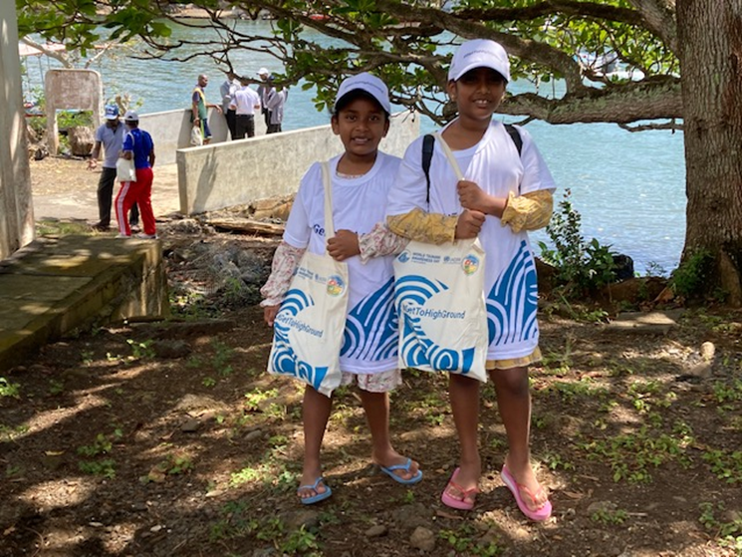
2023 WTAD Theme
Fighting Inequality for Resilient Future #ResilienceForAll #BreakTheCycle #TsunamiDay

Slide 4

2023 WTAD Key Messages
Inequality creates the conditions that lead people to become exposed and vulnerable to disasters, such as tsunamis. The poorest and most at-risk are disproportionately impacted, thus furthering inequality. Reducing vulnerability to disasters includes addressing poverty, exposure and vulnerability.
We must accelerate implementation of the Early Warnings for All initiative to ensure everyone on earth is covered by early warnings in the next four years, prioritizing the most at-risk communities.
An early warning system can be effective only when the population is well aware of the tsunami phenomenon and knows what to do in case of an emergency. This means ensuring that at-risk populations have equal access to information and evacuation routes.
Member States must prioritise their commitments to achieving the Sendai Framework and SDGs, especially reduction of poverty and inequality, while urgently addressing disaster risk and vulnerability with a focus on the most vulnerable countries, local governments and communities.
Member States must engage, listen to, build capacity of and empower groups in all DRR decision making. Countries must ensure that the most at-risk including older persons and persons with disabilities are meaningfully included.
Global decision makers must make our financial system fit for purpose in delivering finance for the most climate-vulnerable countries. We need to deliver economic resilience for the most at-risk from disasters.

Slide 5
The Four Objectives for 2023 WTAD
1. PROMOTE: good practices on tackling inequality, promoting an all of society approach in reducing tsunami risk and increasing the availability of access to multi‑hazard early warning systems to reduce tsunami risk in line with the Early Warnings for All Action plan and the Sendai Framework;
2. ADVOCATE: connecting between high level advocacy and practical community engagement, including bridging the MidTerm Review of the Sendai Framework implementation, recommendations of the UN Ocean Conference and UN Ocean Decade with the IOC-UNESCO Tsunami Ready programme across the regions of the Indian Ocean, Pacific Ocean, Caribbean, North-East Atlantic, Mediterranean and Connecting Seas and #GetToHighGround initiative.
3. RECOGNISE: focus on communities which are most at risk from tsunamis, where the greatest action needs to be undertaken on reducing tsunami risk and raising public awareness through schools, museums, and other communication channels in support of Resilience For All;
4. CAMPAIGN: call for #ResilienceForAll, mobilizing political commitment and communities at risk to #GetToHighGround, improve access to multi‑hazard early warning systems, with a focus on tsunami and ocean-related risk, emphasize fighting inequality for successful DRR to secure a future where everyone is has reduced risk from tsunamis.

Slide 6

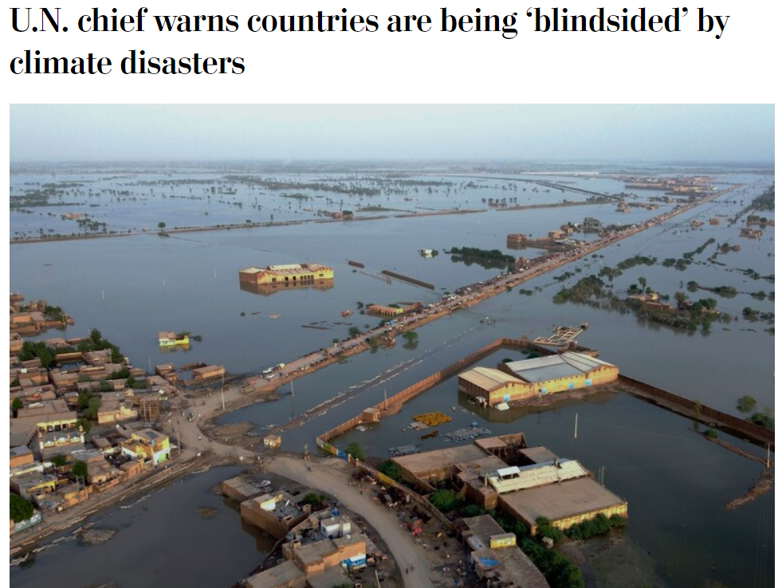
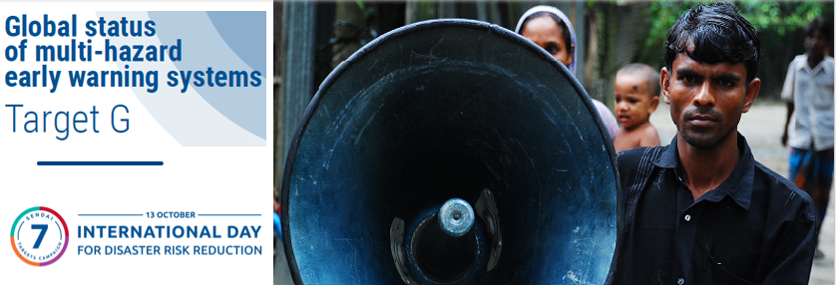
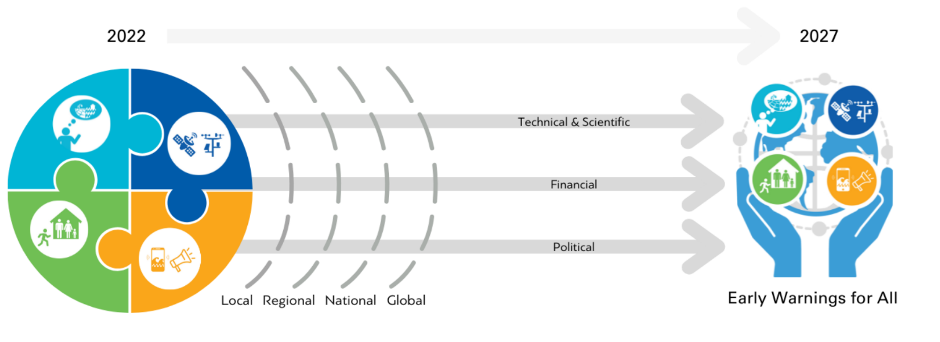
Early Warnings for All
Notes:
The UN-SG announcement of Early Warnings for All initiative is a key opportunity to accelerate early warning coverage. The EW4ALL initiative raises the ambition of the Target G of the Sendai Framework by calling for universal early warning by 2027. As the initiative kicks-off with an Action Plan at the COP27, we also need to gear up to ensure its full-scale implementation.
The present report serves as a comprehensive baseline for the EW4ALL initiative.
The application of the Sendai Framework metrics and data remain very much valid for the new initiative. For instance, as we have seen in this report, the Target G data provides a national index of MHEWS. We have also partnered with WMO to recently launch a set of custom indicators which are also quantifiable in a scale of 0 to 1. Thus, a combination of the Target G data and custom indicators provides a good basis for both coverage and effectiveness of MHEWS. This, combined with data from WMO and other partners, is a very good basis to monitor the implementation of the EW4ALL initaitive.

Slide 7

WTAD 2023: Key Activities
• GetToHighGround Campaign, which calls for a culture of tsunami and coastal hazards awareness for all people at risk in
• NY high level event in collaboration with UNESCO IOC
• Social and Digital Activation toolkit with social cards, customizable cards, videos, dedicated WTAD webpage
• Close collaboration with the Government of Japan, partners and Regional Offices;
• A key focus on inclusion and last mile outreach in the 2023 Early Warnings for All report
• Media engagement
Branding refresh: replaces

Slide 8
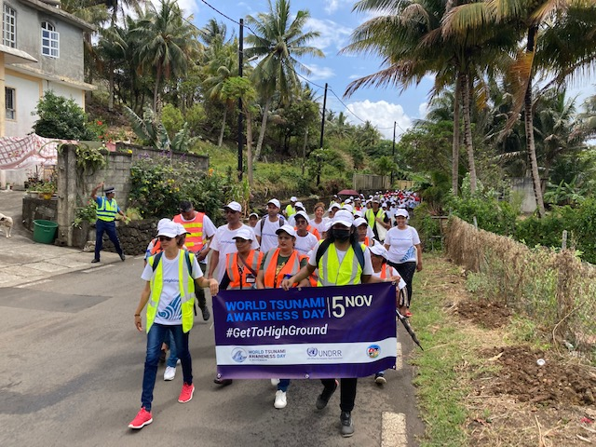
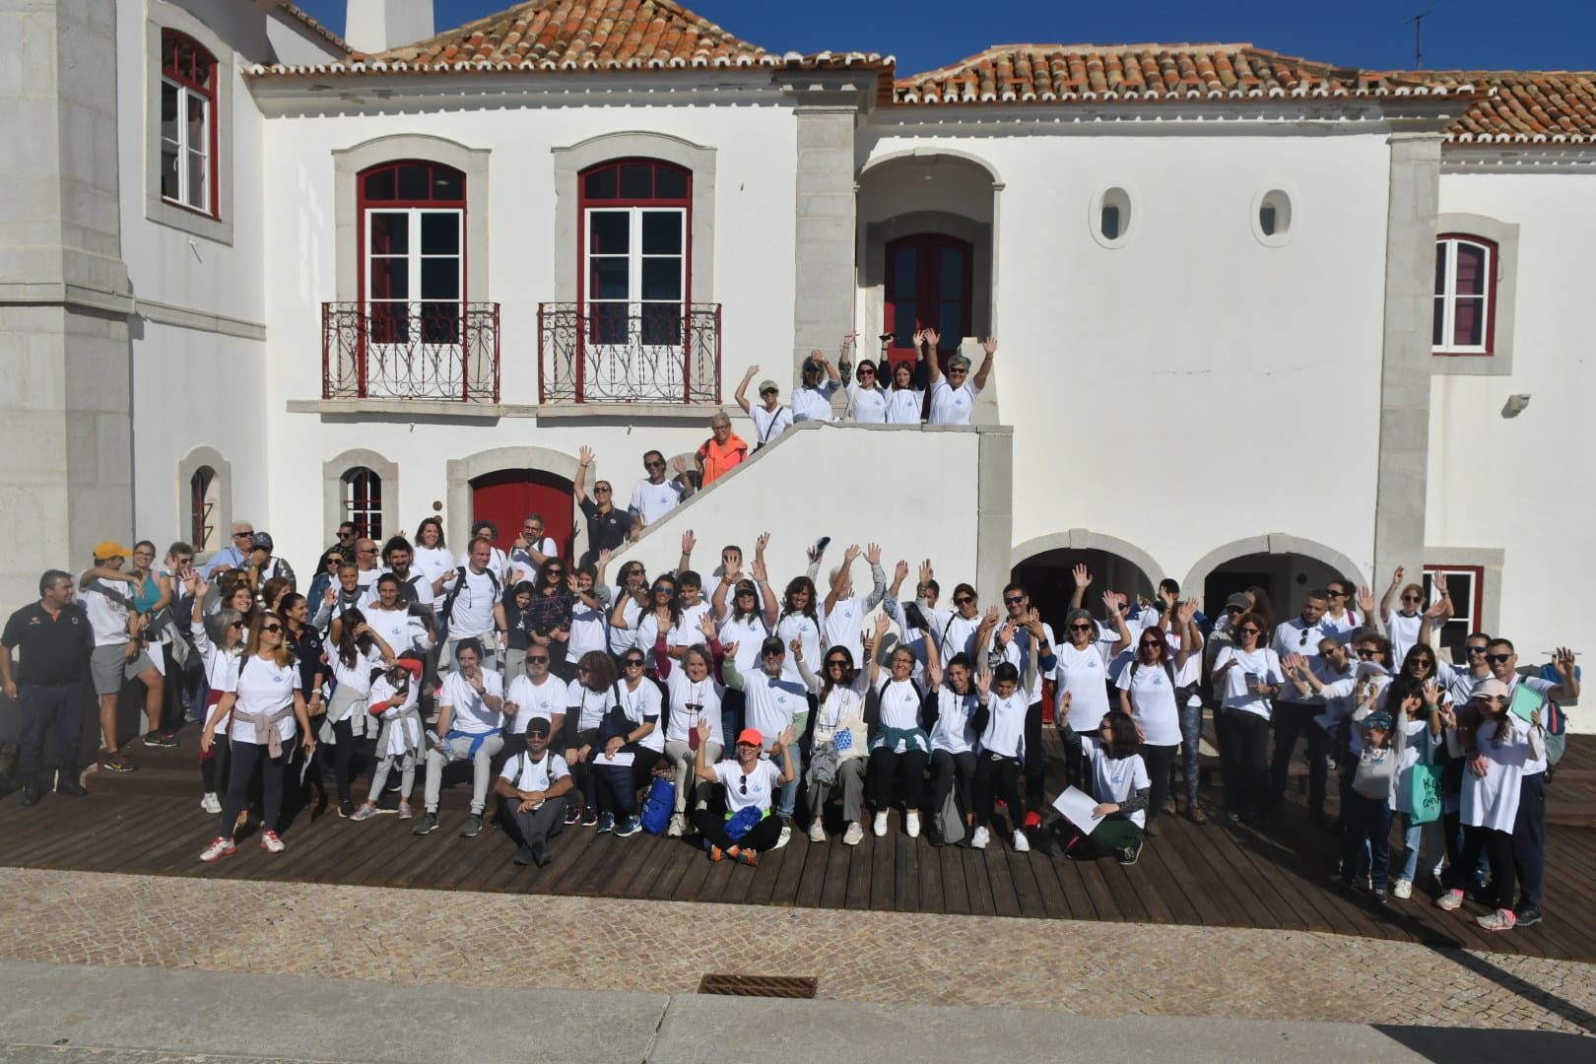
#GetToHighGround Campaign
Citizen Engagement: Building a culture of tsunami and other coastal hazards awareness for all people at risk
#GetToHighGround- public facing campaign
Engaging citizens in fun walks of the tsunami evacuation routes
Joint UNDRR/UNESCO IOC call
Supported by Indonesia, Samoa, Ecuador, Cook Islands, Portugal, Mauritius, joined by my more than 4000 people
Flagship launch in Mauritius and Portugal, 5 November
Mauritius, Quatre Souers: inclusive walk
Portugal, Sesimbra: Secretary of State for Home Affairs Patricia Gaspard

Slide 9
Rosalind.cook@un.org

