Slide 1
ICG/PTWS activities from February 2022 to February 2023
NISHIMAE Yuji
Chair, ICG/PTWS

Slide 2
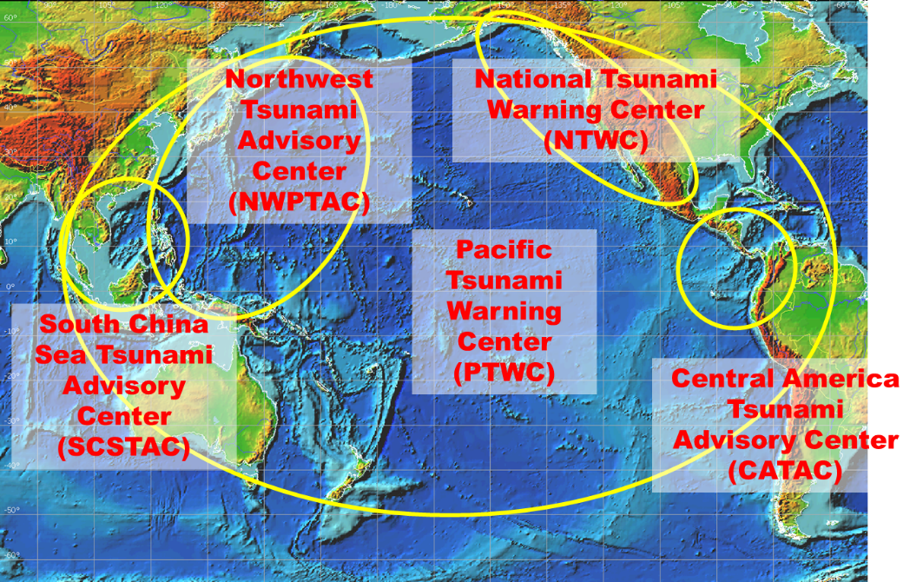
TSPs in the Pacific
Five TSPs
PTWC, NWPTAC, SCSTAC, CATAC, and NTWC in the USA

Slide 3
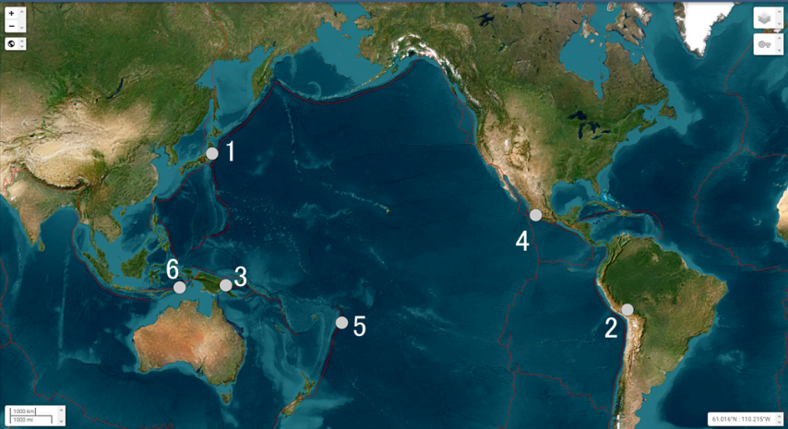
Significant Events from Feb.2022 to Feb. 2023( M>7.0)
No | Time | Latitude | Longitude | Depth | Mag | Mag type | Max. tsunami height (m)
1 | 2022-03-16T14:36:30.997Z | 37.71 | 141.58 | 41 | 7.3 | mww | 0.31**
2 | 2022-05-26T12:02:21.110Z | -14.91 | -70.29 | 236 | 7.2 | mww | no tsunami
3 | 2022-09-10T23:47:00.233Z | -6.29 | 146.50 | 116 | 7.6 | mww | no tsunami
5 | 2022-09-19T18:05:08.217Z | 18.46 | -102.96 | 27 | 7.6 | mww | 0.79*
5 | 2022-11-11T10:48:46.710Z | -19.29 | -172.15 | 37 | 7.3 | mww | 0.12*
6 | 2023-01-09T17:47:35.038Z | -7.07 | 130.00 | 105 | 7.6 | mww | 0.09*
Earthquake Source Parameters by USGS
Tsunami height by;
*: NGDC/WDS Global Historical Tsunami Database
**: Japan Meteorological Agency

Slide 4
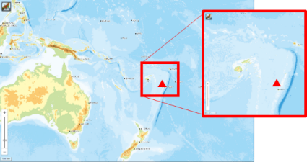
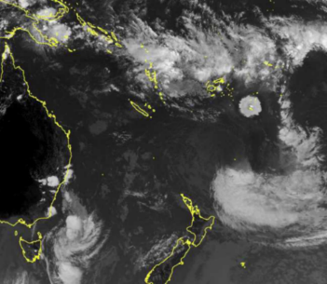
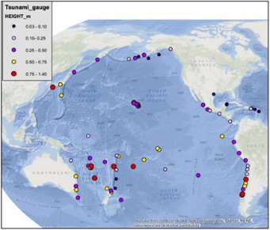
PTWS responses to15 January 2022, Hunga-Tonga-Hunga-Ha'apai Volcanic Eruption and Tsunami
Hunga-Tonga-Hunga-Ha'apai Volcano erupted on 15 January 2022.
Tsunami waves were observed at not only near tide gauges but also distant tide gauges.- Larger than 1 meter in California of USA, Chile, Japan.
PTWS held Debrief meetings three times; 20 January, 3, 10 February.
  Objectives of the meeting
    Interim Volcanic Tsunami SOP – What to do if it happens again.
    Review what happened in TWCs – share experiences with TWCs : what was available, what was not
Location of Hunga-Tonga Hunga-Ha'apai volcano
Ash cloud detected by the meteorological satellite Himawari-8
maximum tsunami amplitude reported by PTWC on 15 January
Notes:
Next topic is the PTWS's response to 15 January 2022, Hunga-Tonga-Hunga-Ha'apai Volcanic Eruption and Tsunami.
Tsunami was generated by the explosion and hit the coasts of Tonga. Tusnami gave damages to Tonga.Tsunami height reahed to 15m to 20m and three people were killed. Tsunami waves were observed across the Pacific basin. Tsunami amplitude was lager than 1 meter in California, Chilies and Japan.
PTWS held Debrief meetings three times; 20 January, 3, 10 February.
Objectives of the meeting is to review what happened in TWCs sharing experiences with TWCs
Another objective is to make Interim Volcanic Tsunami SOP in preparation for the future event of the Hunga-Tonga-Hunga-Ha'apai Volcano.

Slide 5
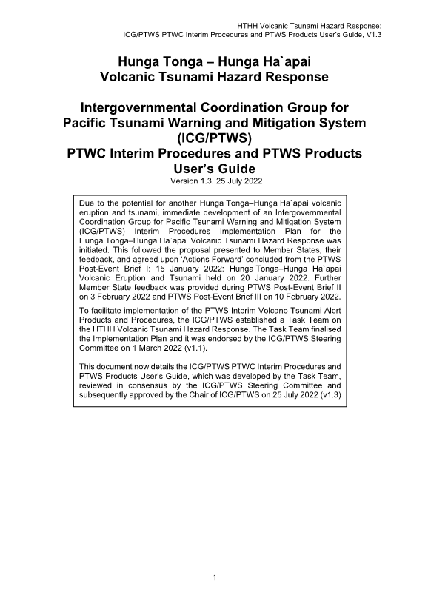
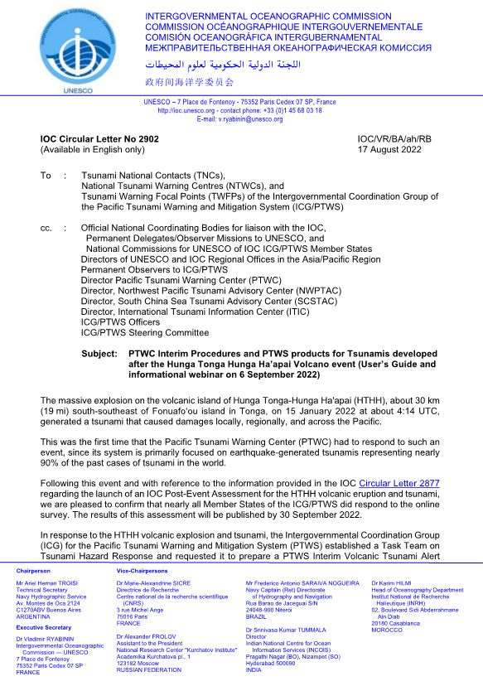
PTWS Interim Procedures Implementation Plan & Users Guide
Preparation for the future event – What to do if the event happens again.
Small temporary task team was established to work for implementation plan.
Tsunami amplitudes are forecasted by scaling observed maximum amplitudes observed across the Pacific from the January 15 event with observed amplitudes for any future event, starting with the observed amplitudes at Nuku`alofa and the NZG DART.
PTWC provides special products for a HTHH volcano generated tsunami.
17 August : User’s Guide Published (CL-2902)
6 September : ICG/PTWS HTHH Interim Procedures and PTWS Products Informational Webinar
PICT drill in the PacWave 2022 to test interim procedures
Notes:
A small task team was established to consider the interim procedures to the future event. Mechanism of tsunami generation is complcated and has not clear yet. It is challenging to forecast tsunami and issue tsunami warning.
Tsunami amplitudes are forecasted by scaling observed maximum amplitudes observed across the Pacific from the January 15 event with observed amplitudes for any future event, starting with the observed amplitudes at Nuku`alofa and the NZG DART.
PTWC provides special products for a HTHH volcano generated tsunami.
The user's guide is not finished and the task team is working hard toward completion.

Slide 6
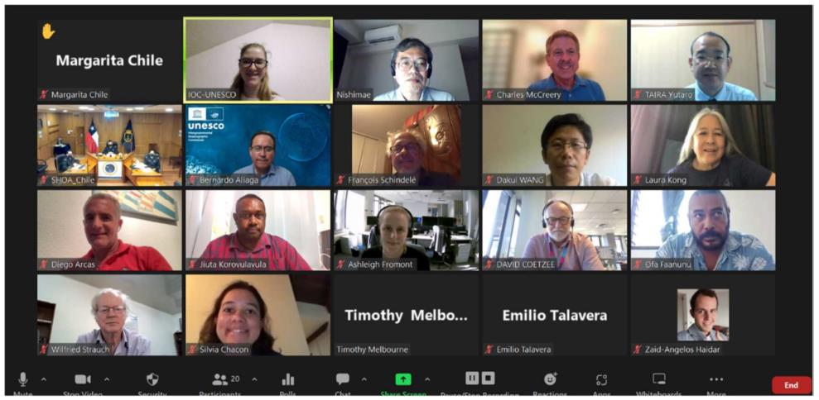
PTWS Steering Committee (online) (July 12, 2022)
The Kingdom of Tonga offered the host country for the PTWS 30th session in September 2023.
The PTWS-SC discussed “HTHH PTWC Interim Procedures and PTWS Products – User’s Guide”.
  User’s Guide was published on 17th August 2022 (CL-2902)
  Official endorsement in the PTWS 30th Session
The PTWS-SC decided the next PTWS-SC will be held back-to-back with the next TOWS-WG.
  The next PTWS-SC meeting will be held from 6th March to 9th March.

Slide 7
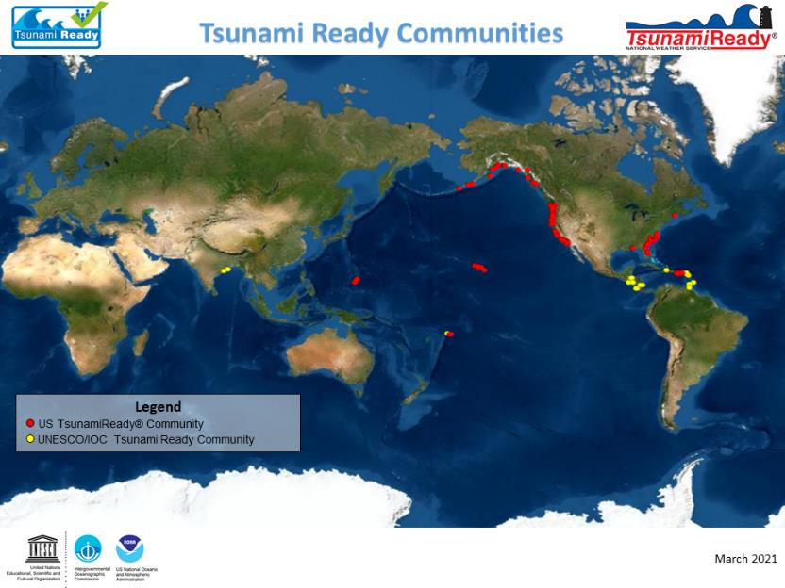
IOC/UNESCO Tsunami Ready Recognition Program
Honduras
  Cedeño
Costa Rica
  Ostional
  Samara
  Tamarindo
  Playas El Coco
  Quepos
  Uvita-Bahía
Samoa
  Savaia, Upolu
El Salvador
  La Libertad
  Tamanique
Guatemala
  San Jose
  Sipacate
Panama
  Puerto Armuelles
Ecuador
  Galapagos

Slide 8
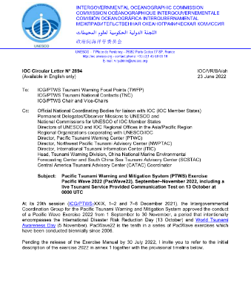
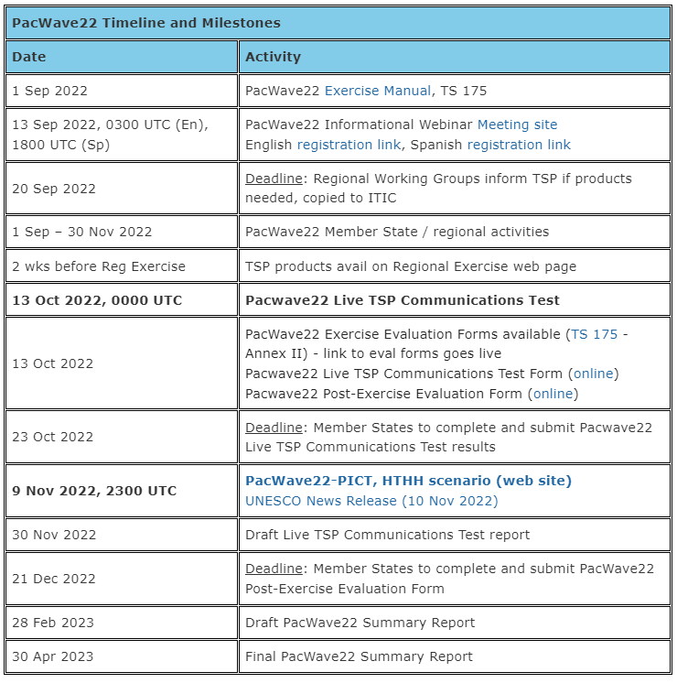
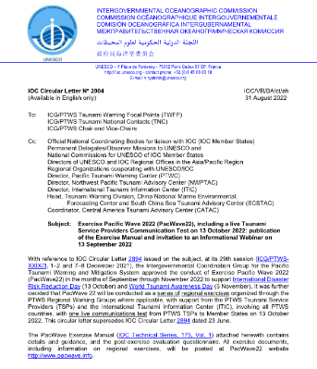

Exercise Pacific Wave 2022
23rd June: PacWave 22 was announced (CL-2894).
31st August: PacWave 22 manual was distributed (CL-2904).
13th September : Informational Webinar
13th October 0000 UTC: Live Communications Test was conducted by the TSPs
  PTWC, NWPTAC, SCSTAC and CATAC sent the test message.
PICT Regional Exercise
  2nd November: Exercise Pacific Wave 2022 - Pacific Island Countries and Territories (PICT) Informational Webinar
  2300 UTC 9 Nov to 0100 UTC 10 November: PICT Regional Exercise
    Exercise Scenario: HTHH eruption and tsunami on 15 January, 2022
  16th November: Exercise Pacific Wave 2022 - Pacific Island Countries and Territories (PICT): Cold Wash and Debrief

Slide 9
Activities of Working Groups and Task Teams
17th – 19th October 2022: Seventh Meeting of Oceania Regional Seismic Network (ORSNET)
20th October 2022: Seventh Session of the ICG/PTWS Working Group 2 Task Team on Seismic Data Sharing in the Southwest Pacific
16th January 2023: ICG/PTWS WG2 Task Team on TSPs
  PTWC, CATAC, NWPTAC,SCSTAC and ITIC
2nd to 3rd February 2023: Ninth Meeting of the ICG/PTWS Regional Working Group on Tsunami Warning and Mitigation for Pacific Island Countries and Territories, Nadi, Fiji

Slide 10
Plans in ICG/PTWS
ICG/PTWS Steering Committee Meeting
Venue: IOC/UNESCO (Paris)
Date: 6th to 9th March, 2023
ICG/PTWS 30th Session
  Venue: Kingdom of Tonga
  Date: middle of September, 2023
Scheduled and unscheduled communications test of TSPs
Preparations for Exercise Pacific Wave 2024

Slide 11
Thank you very much for your kind attention.

Slide 12
Hunga-Tonga-Hunga-Ha'apai Volcanic Eruption and Tsunami
15 January 2022HTHH Eruption（太平洋全域で津波を観測、トンガで被害、遠く離れた米、チリ、日本等で被害）
Post Brief meeting was held three times (2022/1/ ,2/3 ,2/10).
Implementation plan
Users Guide
2022/9/6 : ICG/PTWS HTHH Interim Procedures and PTWS Products Informational Webinar
PICT drill in the PacWave 2022

