Slide 1
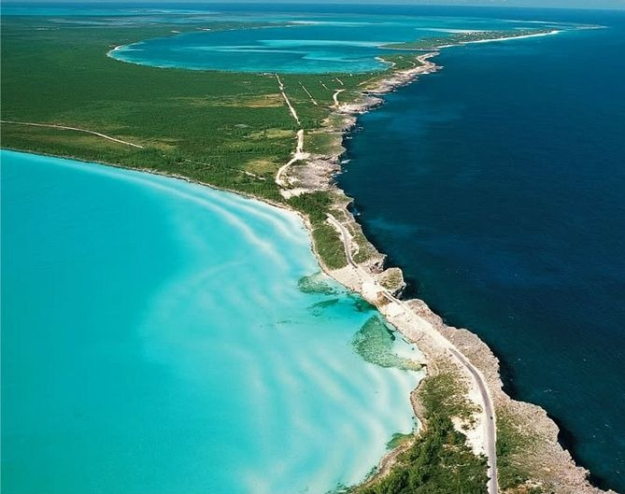
ICG/CARIBE-EWS
Silvia Chacón-Barrantes
Chair

Slide 2
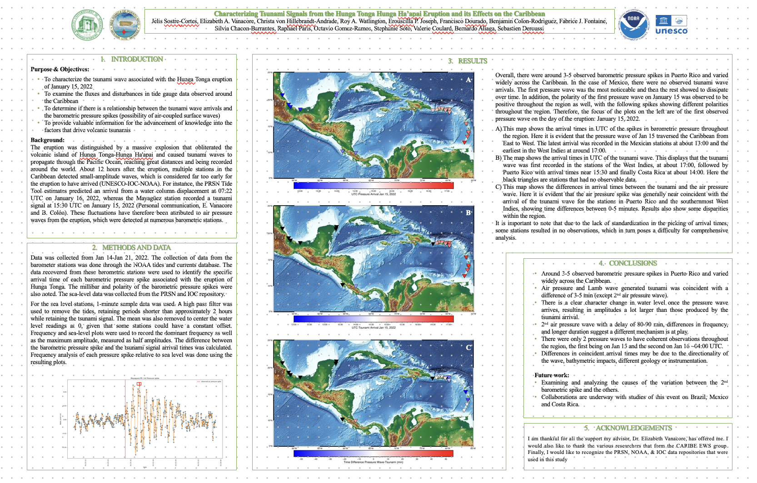
Events
No events during the intersessional period.
HTHH tsunami
  Detected in at least 15 TG in the Caribbean
  Poster presented at AGU 2022
  Paper currently under preparation

Slide 3
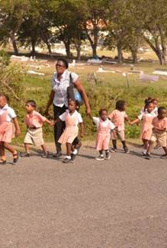

Tsunami Ready
2 renewals (British Virgin Island, St. Kitts & Newis)
1 new (Old Harbour-Jamaica)
3 in progress (Puerto Plata-DR, Sabana Grande-DR, St. George-SVG)
Funding by
  NORAD: for 3 more (Barbados, Jamaica, Trinidad & Tobago)
  USAID:
    working on 3 more (Barbados, Dominica, St. Lucia)
    1 future (Cayman Is.)
Prepared questionnaire on TR implementation

Slide 4
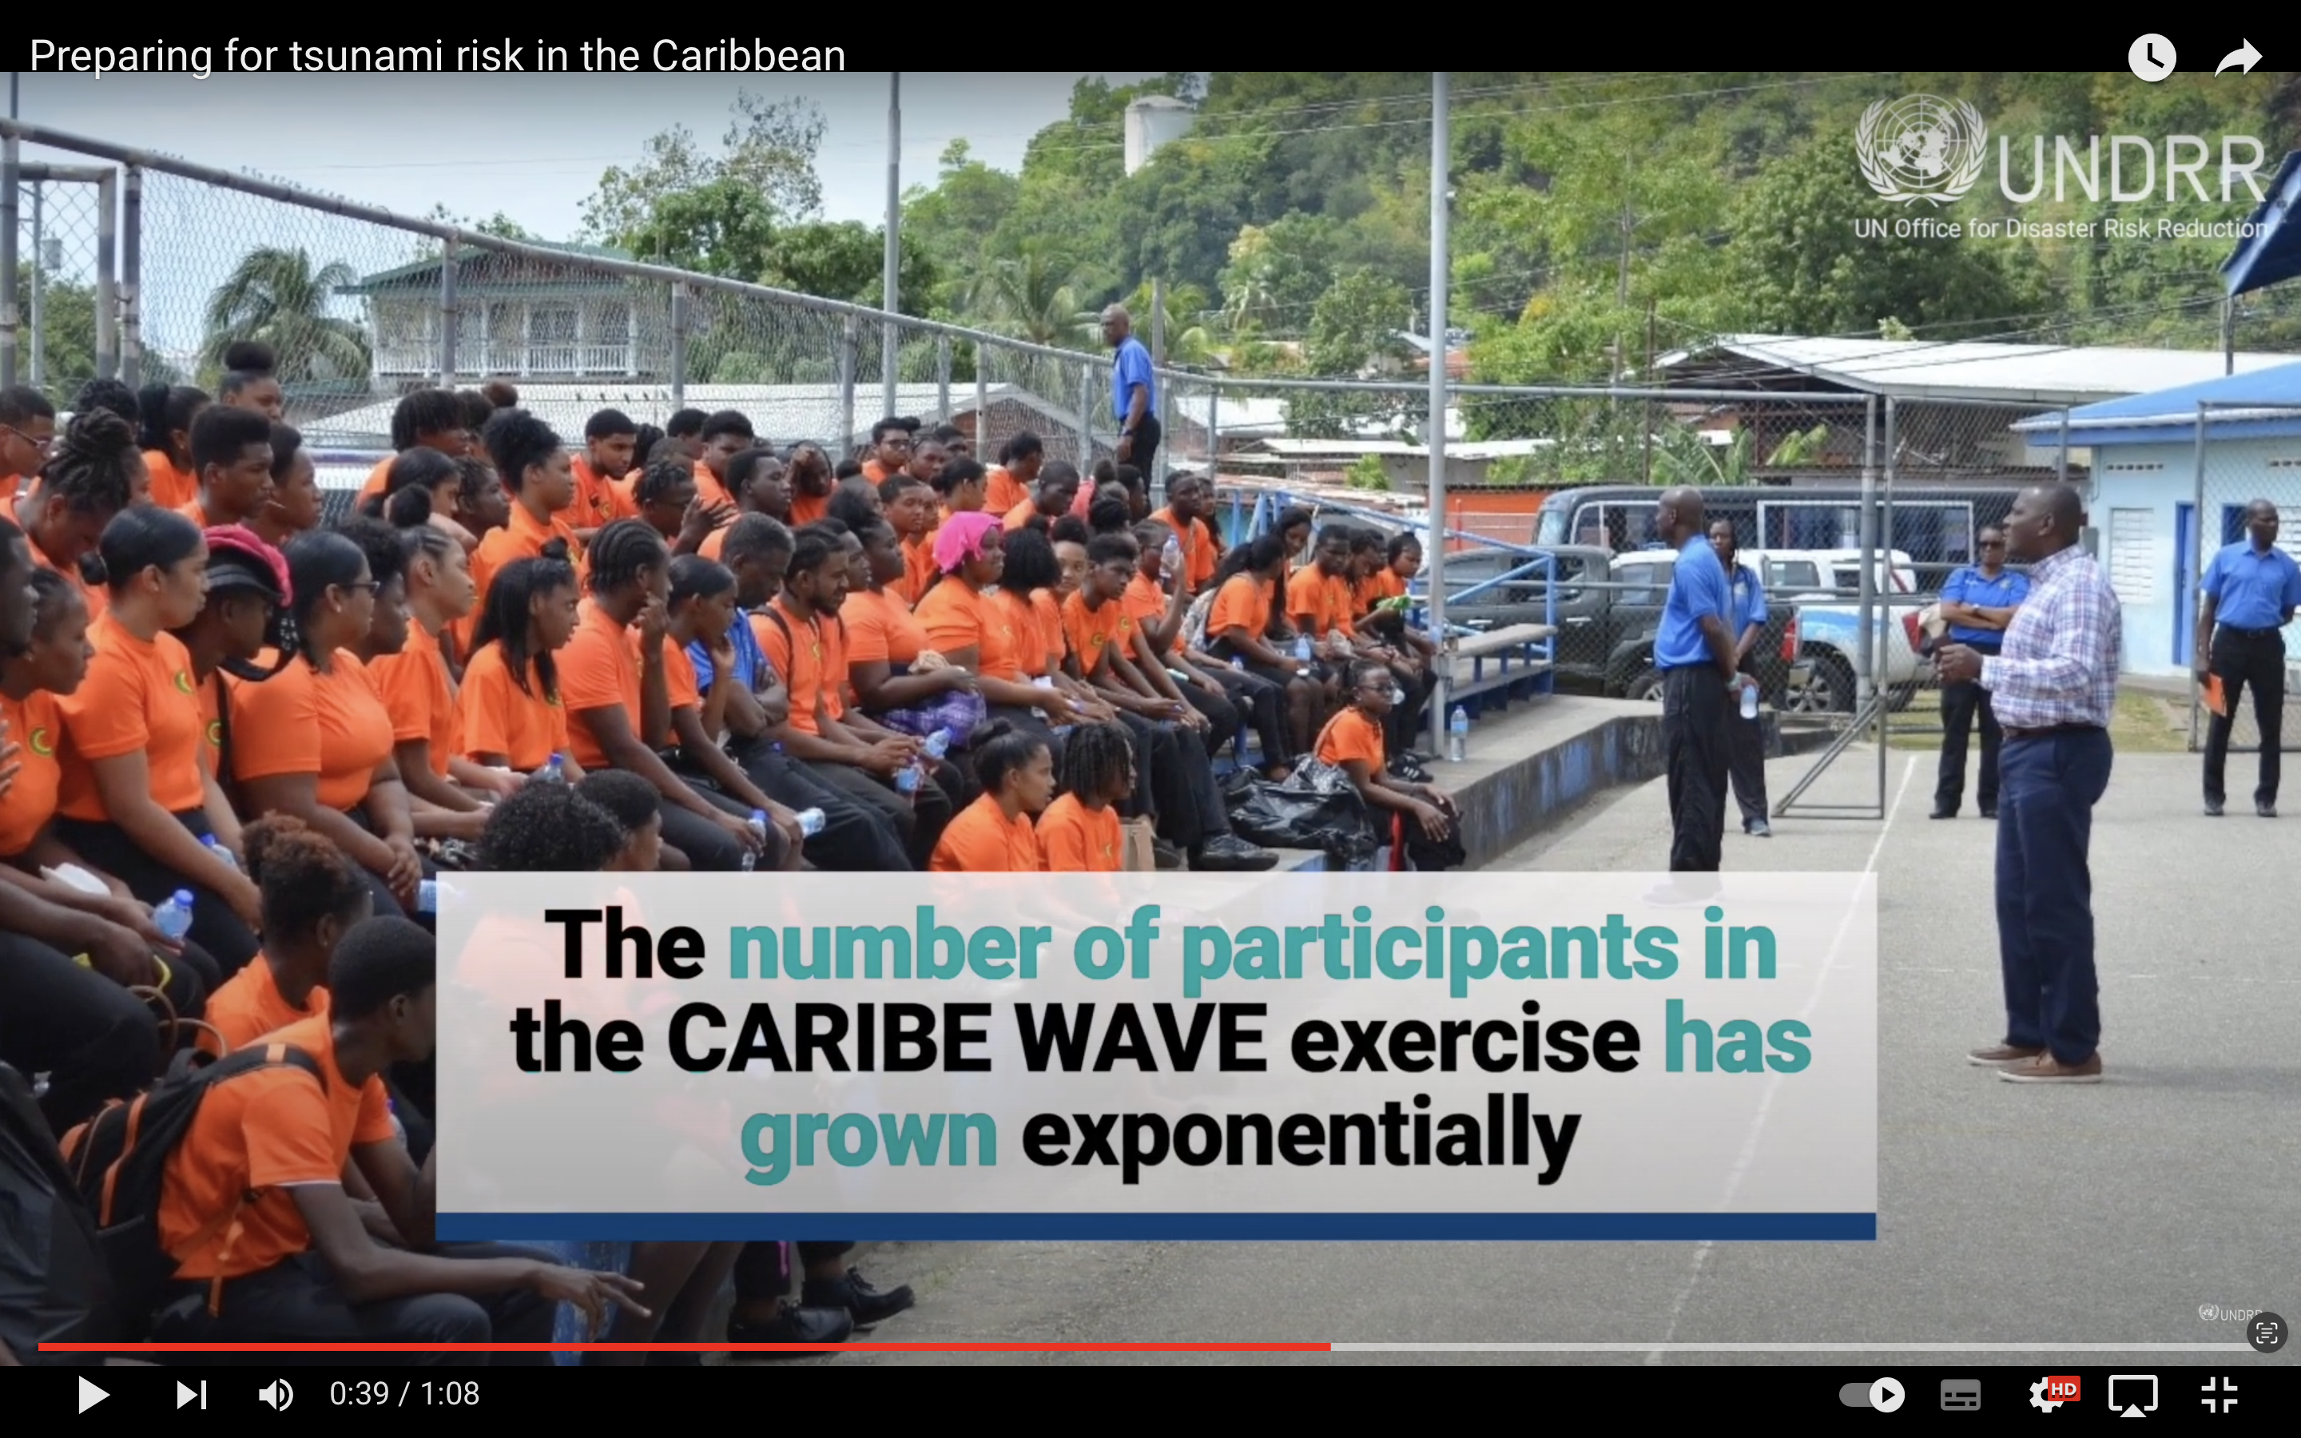
World Tsunami Awareness Day
UNDRR supported videos on CaribeWave as part of MHEW

Slide 5
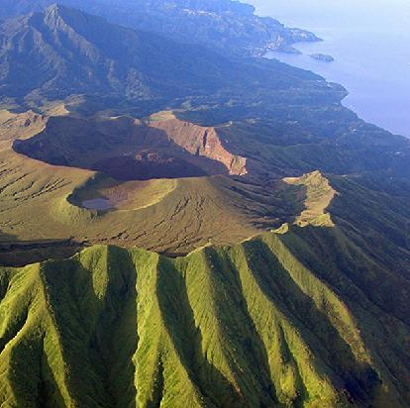
Volcanic
Work in the Caribbean assisted handling of HTHH event in the Pacific
Products will be tested during Caribe Wave 2023
Working on implement a MoU with the Seismic Research Center (SRC) using St. Vincent La Soufriere as case study.

Slide 6
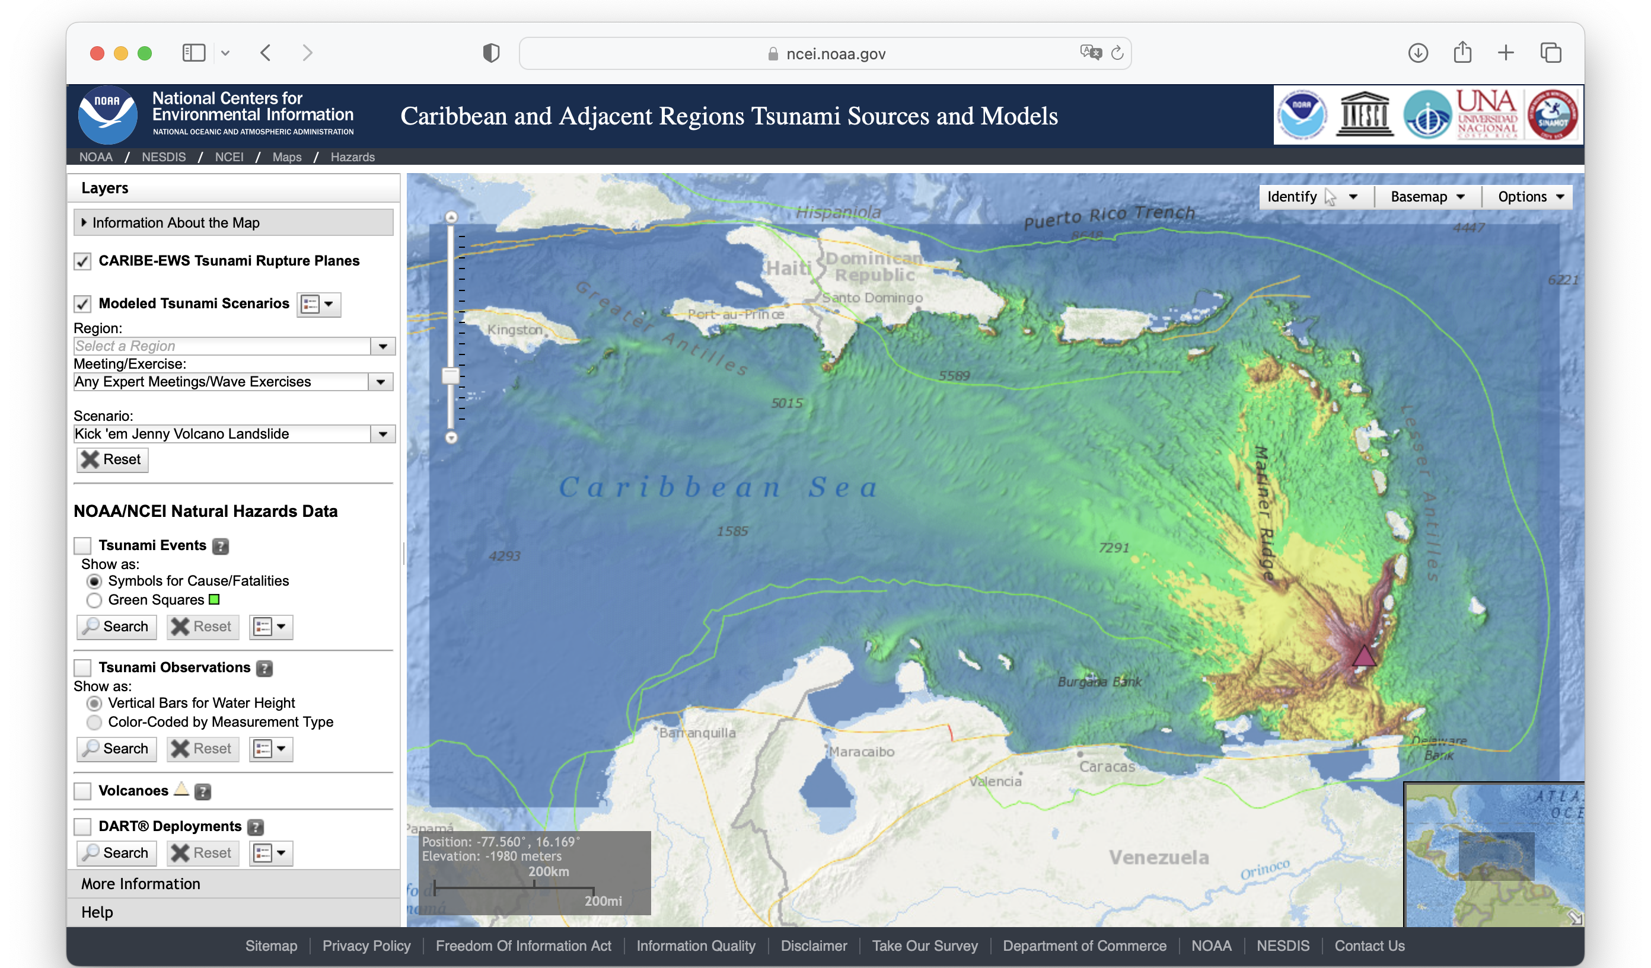
WG2 on Hazard Assessment
Working on non-seismic sources
  Choosing criteria
  Identifying possible invited experts
  Compiling sources (modeled and not modeled)
  Will be incorporated to CATSAM

Slide 7
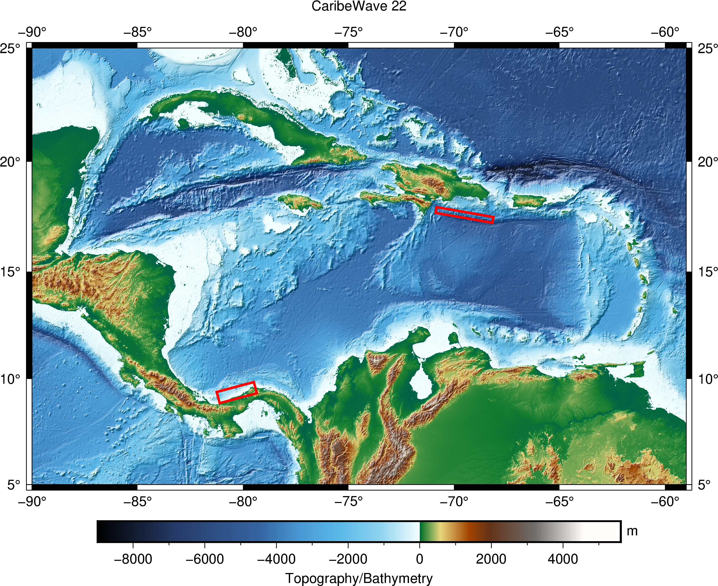
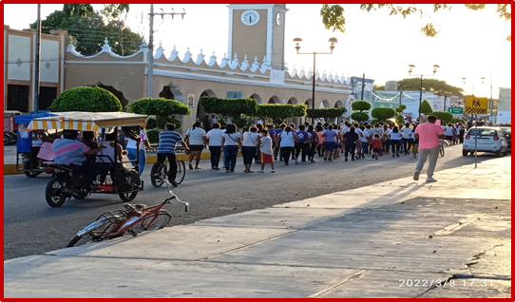
CARIBE WAVE 22
Earthquake and Tsunami Scenarios
Western Muertos Trough
Northern Panama
March 10, 2022
48 Member States and Territories participated
413,285 people were directly engaged.
Scenario | Origin Time | Mw | Epicenter
Western Muertos Trough | 14:00:00 UTC March 10, 2022 | 8.0 | 17.5⁰N, 69.5⁰W
Northern Panama |  | 8.3 | 9.3⁰N, 80.3⁰W

Slide 8
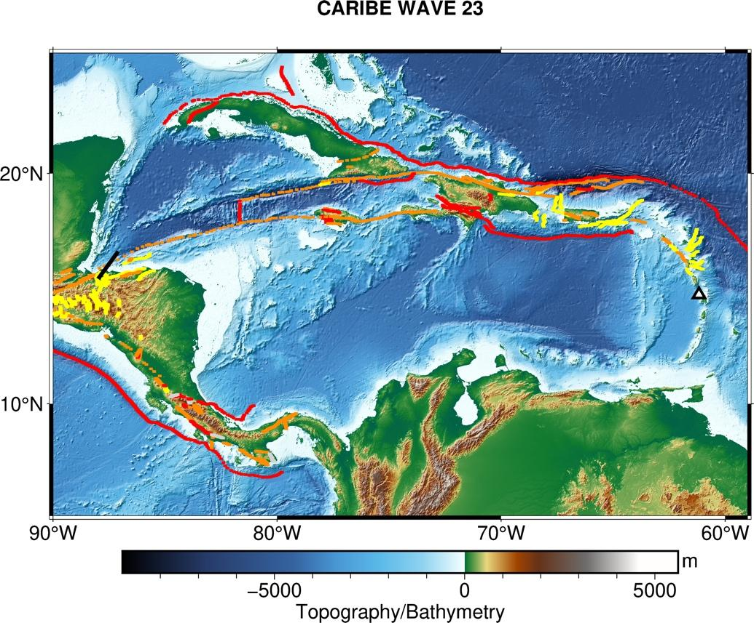
CARIBE WAVE 23
Earthquake and Tsunami Scenarios
Gulf of Honduras
Mount Pelée
Testing Volcanic Products.
MS Feedback Critical
Scenario | Origin Time | Mw | Epicenter
Gulf of Honduras | 14:00:00 UTC 23 March 2023 | 7.6 | 16.07⁰N, 87.54⁰W
Mount Pelée |  |  | 14.48⁰N, 61.10⁰W

Slide 9
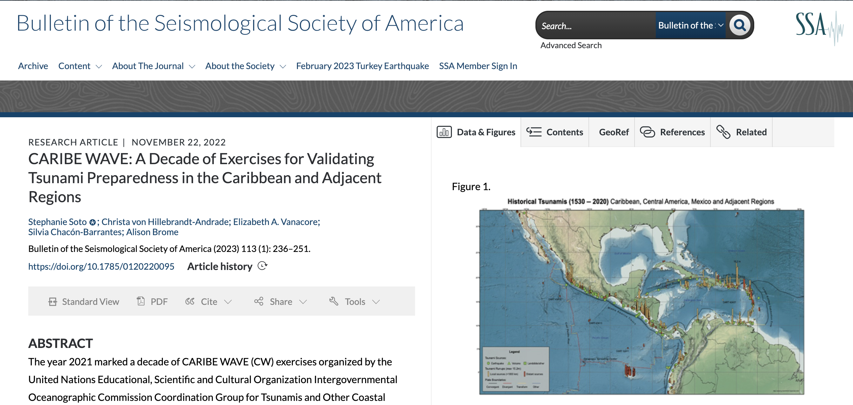
CARIBE WAVE Article in BSSA
https://pubs.geoscienceworld.org/ssa/bssa/article/113/1/236/618916/CARIBE-WAVE-A-Decade-of-Exercises-for-Validating

