Slide 1
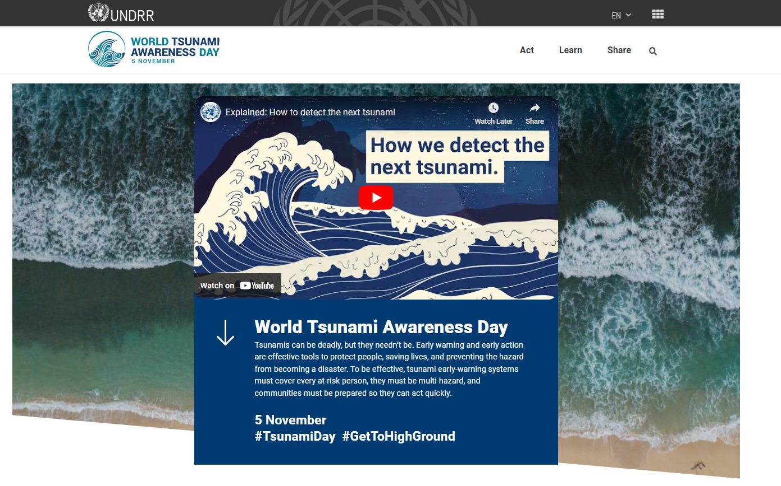
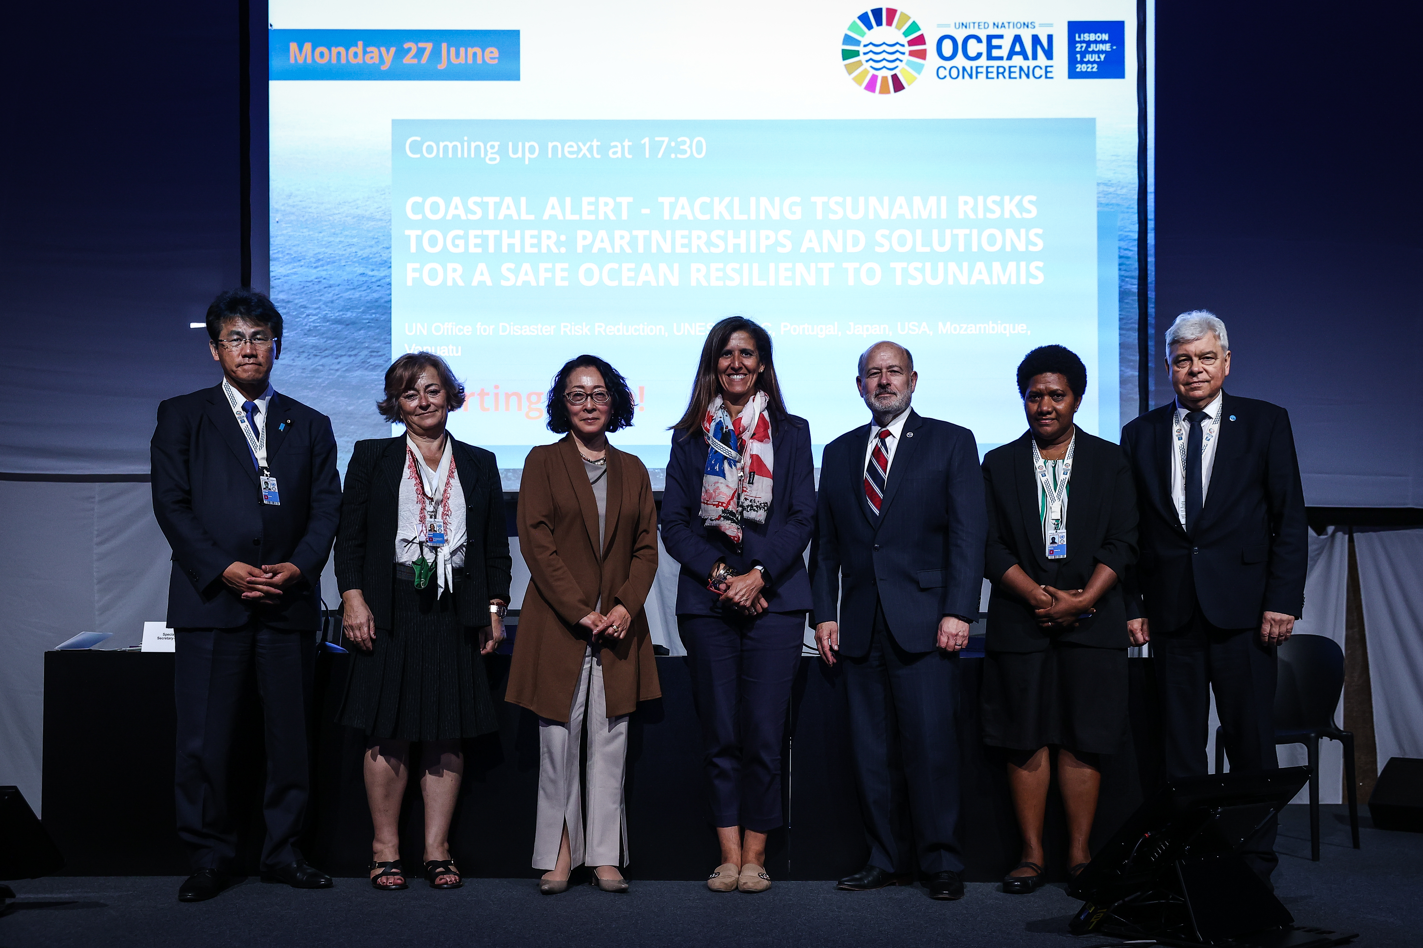
WTAD 2022: Early Warning Systems for All
Political Engagement: Fostering high level political support to drive change
UN Oceans Conference side event, June UN SG: “Early Warnings for All” Action plan
High level event in NY, 4 November “Early Warning and Early Action Before Every Tsunami”
Documentary “Tsunami Day: Tsunami Messages: Forget Me Not”, premiere 15 Nov, ROAMC
SRSG’s Op-ed: Jakarta Post, “Early warning, early action to keep communities safe”
Partnership with UNESCO IOC
4.3k users with around 9k view pages; #TsunamiDay - in the top 50 trending in India

Slide 2
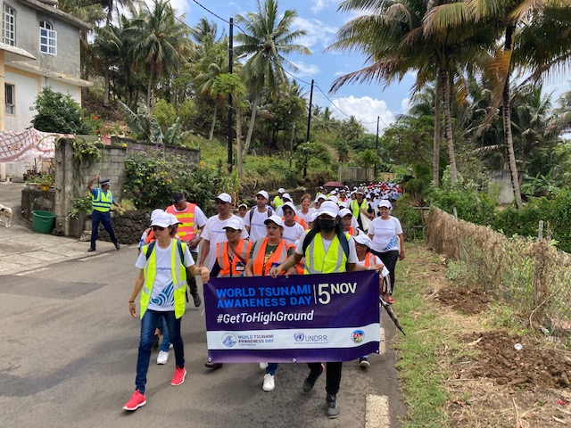
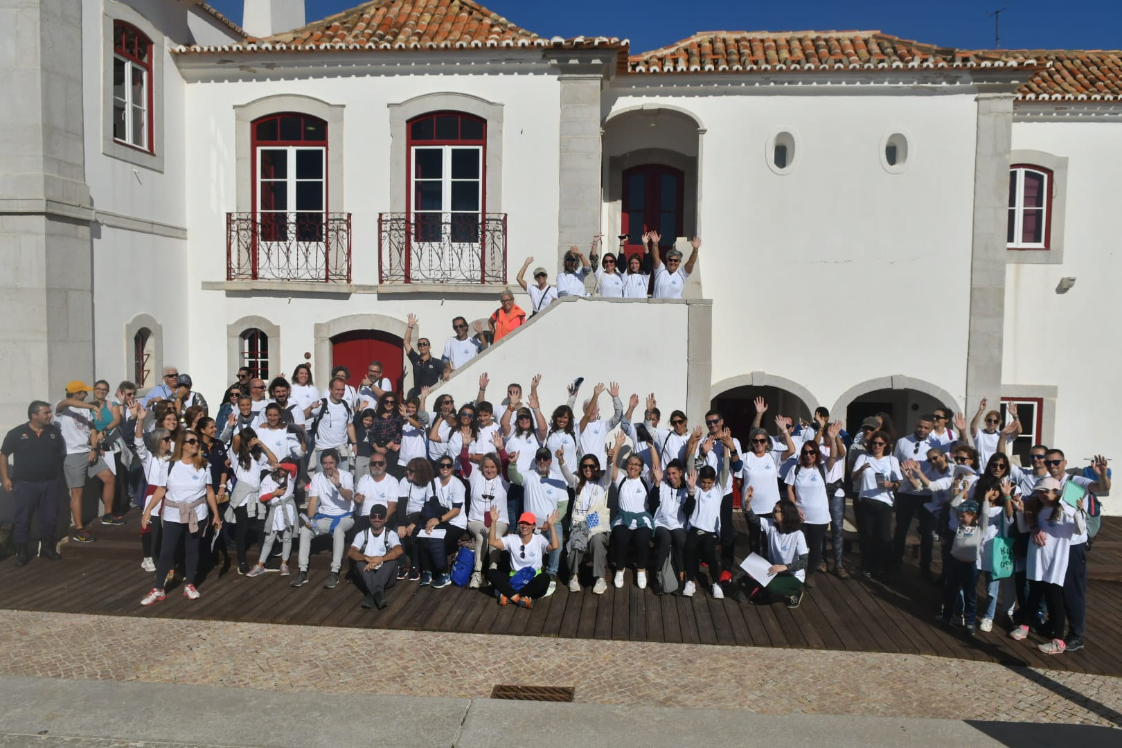
WTAD 2022: Early Warning Systems for All
Citizen Engagement: Building a culture of tsunami and other coastal hazards awareness for all people at risk
#GetToHighGround- public facing campaign
Engaging citizens in fun walks of the tsunami evacuation routes
Joint UNDRR/UNESCO IOC call
Supported by Indonesia, Samoa, Ecuador, Cook Islands, Portugal, Mauritius, joined by my more than 4000 people
Flagship launch in Mauritius and Portugal, 5 November
Mauritius, Quatre Souers: inclusive walk
Portugal, Sesimbra: Secretary of State for Home Affairs Patricia Gaspard

Slide 3
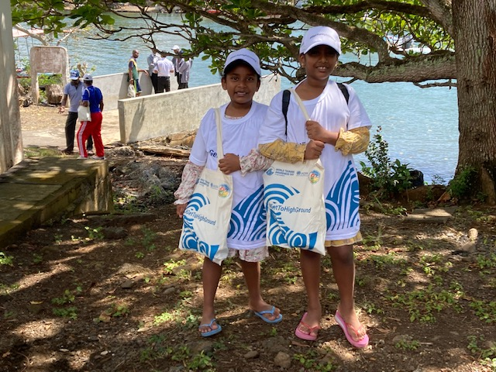
WTAD 2022: Early Warning Systems for All
What’s next?
#GetToHighGround initiative:
Supporting all citizens at risk from tsunamis to have coverage of early warning systems in the next 5 years
Engaging more Member States, MCR2030 cities and partners to mobilize citizens
Engaging and advocating to decision makers on the importance of EWS coverage, using strategic communications to drive change
Working closely with our key partners including UNESCO-IOC, WMO and the UN system

