Slide 1
 | MEETING OF THE INTER-ICG TASK TEAM ON DISASTER MANAGEMENT AND PREPAREDNESS INTERGOVERNMENTAL OCEANOGRAPHIC COMMISSION UNESCO
 | 27 - 28 February 2022 - Hybrid
NEAMTWS-WG 4-Cecilia Valbonesi

Slide 2
Pillar 3- Awareness and Response
Risk perception studies
A study on global RP studies (Cugliari et al., Frontiers, 2022)
New regions in central-southern Italy + a national sample (Cugliari et al., NHESS, 2022; Cerase and Cugliari, Sustainability, 2023)
Specific studies in schools and other stakeholders (online questionnaire – mobile phones)
Tsunami Ready
Several advancements in the 3 Italian pilot sites
New requests (Otranto, …)
Report «Prevention of tsunami risk in italian municipalities through the application of the Tsunami Ready guidelines: influences of the international paradigm on regulatory framework and criminal liability» (translated, in press).

Slide 3
Pillar 3- Awareness and Response
CAT website updates
24 News in 2022 (Italian and English)
New features on the home page map and on contents
“Viral” video on 2022 Samos tsunami (LINK)
WTAD 2022 activities
Report in WG4 (Nov. 30)
Notes:
Minturno-Stomboli-Messina-Reggio di Calabria

Slide 4
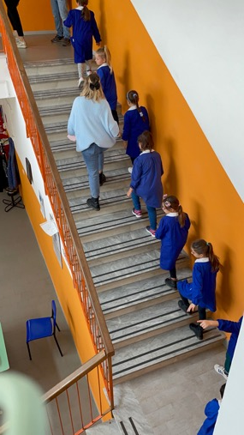
Tsunami Ready
Several advancements in all the three pilot municipalities
Minturno:
WTAD 2022: school vertical evacuation
Two sirens systems installed and tested in February 2023 (several news on TV etc.)
Meeting NTRB-LTRB

Slide 5
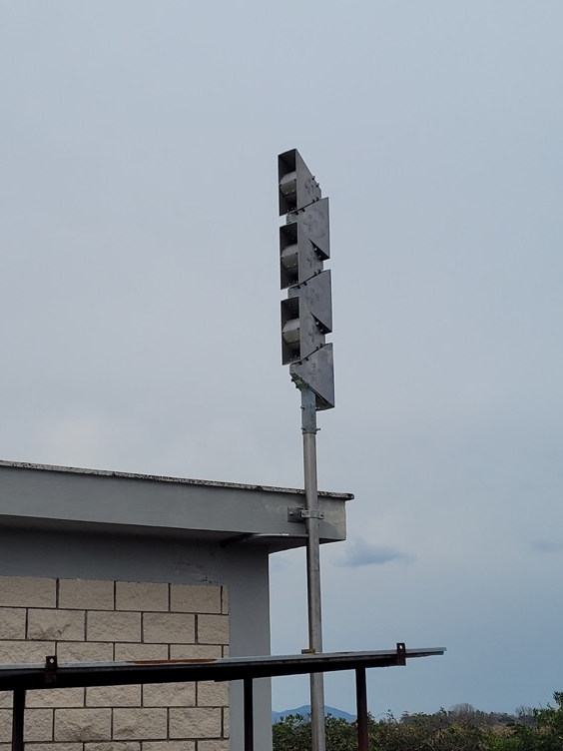
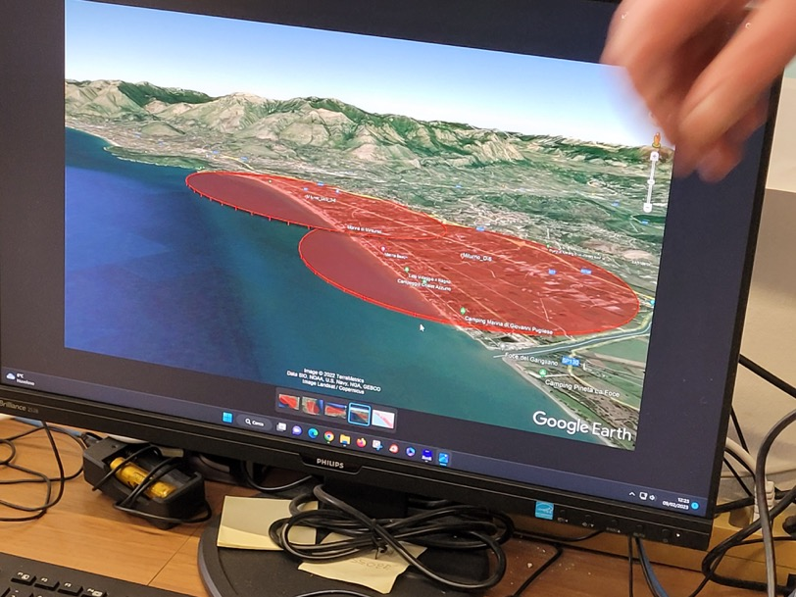
Minturno: Sirens (Feb. 2023)

Slide 6
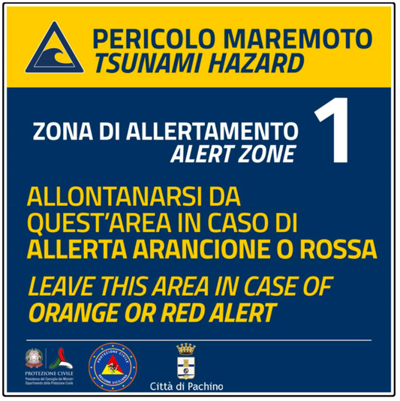
Tsunami Ready
Pachino - Marzamemi
CP plan with tsunami risk approved by Municipal Council on October 2022
Released App for sirens and risk warning panels activated (February 2023)
Full-scale Exercise on Nov. 2022
Several TV and newspapers news

Slide 7
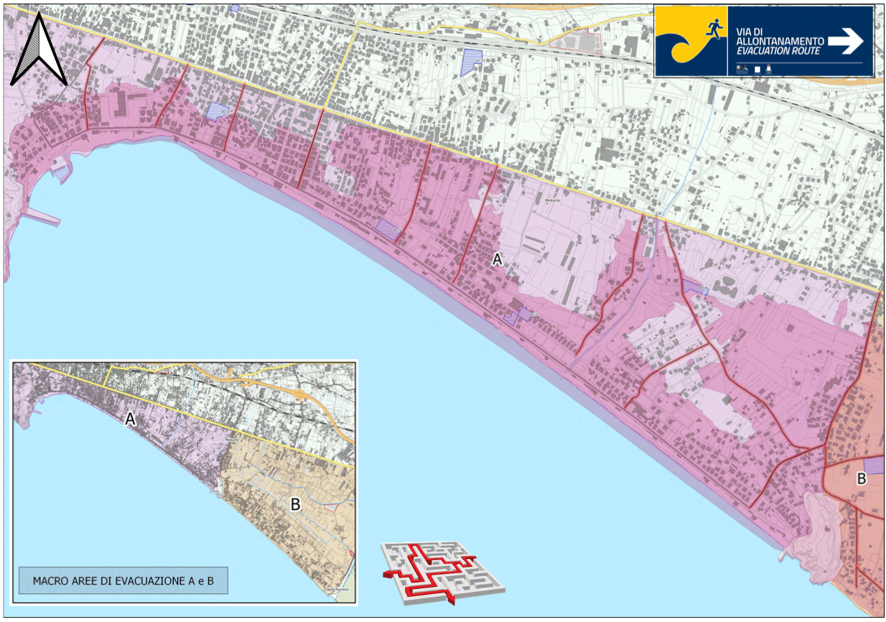
Minturno CP plan in preparation

Slide 8
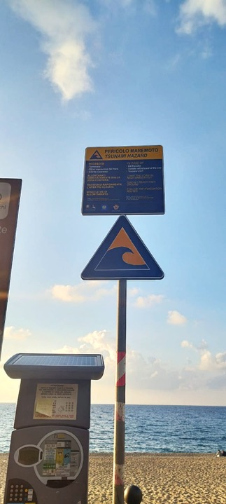
Tsunami Ready
Palmi:
Participation in the national SismaExe exercise on Nov. 4
Signage completed
CP plan implemented
School seminars planned in March 2023

Slide 9
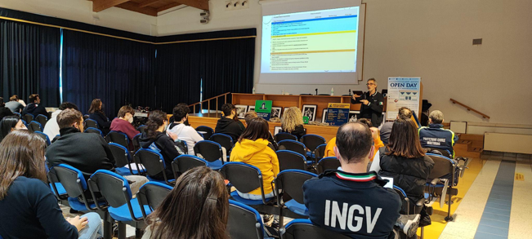
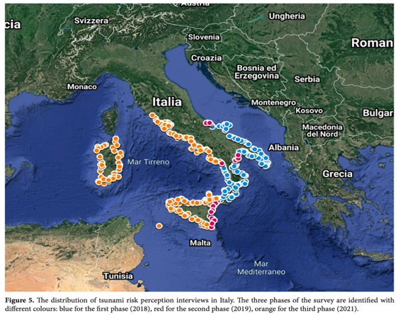
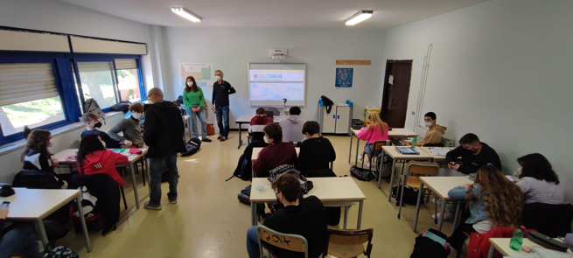
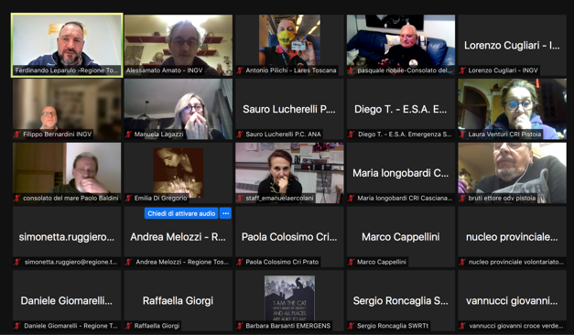
Information activities in schools, with CP volunteers, with risk perception assessment
Minturno (TR candidate)
Tivoli (Rome)
Tuscany CP volunteers (Io Non Rischio)

Slide 10
Thank you for your attention
Notes:
As testified by this Factsheet, for about 15 years we have been building the NEAMTWS

