Slide 1
Day 2: Activity 3 SOP- Exercise
Instructions

Slide 2
EXERCISE - Outline
Use and interpret tsp products
Apply a tsunami warning scenario to participant developed SOPs
Describe actions taken by stakeholder agencies to tsunami warning
Demonstrate knowledge through ‘Press Conference’
Receive comment from trainers and other participants

Slide 3
Generalized Scenario Timeline
Time 0: EQ occurs with strong ground shaking
Time A: Initial EQ info, or outside data
Time B: Initial PTWC new products
Time C: Initial waves arrive at coastline
Time D: Initial sea level gauge readings
Time E: PTWC last forecast issued
Time F: Country warning cancellation
Time G: Country All-Clear for some communities

Slide 4
Exercise Format
Groups of NTWC and NDMO stakeholders
During Exercise, Groups ‘execute’ SOPs
SOPs should be timeline-driven (actions based on time after earthquake)
The Exercise will follow this format:
Controller give scenario inject. Each Group discusses and take actions. Followed by next inject
Each Group uses laptop or paper to log actions
Each Group has Reporter and Recorder
Post-Evaluation, Press Conference

Slide 5
EXERCISE - Format
Modified Functional (separate NTWC / NDMO)
Real time, but Controllers can advance / slow clock
2 Groups (NTWC, NDMO): Take action based on their SOPs
NTWC – Greece
NDMO – Greece
NTWC and NDMO physically separate

Slide 6
Exercise- Conduct
PTWC new product messages
Inject events
Each Group simulate interactions between stakeholders, or through Controllers
Document actions and responses, answers/best practices for report-back
Notes:
6

Slide 7
EXERCISE CONTROL
Exercise Controllers will control the pace and can suspend or advance the exercise Clock.
Controllers also act as any outside agencies and individuals (i.e. media, prime minister, etc.) not physically present in the room for exercise interaction with TWC & DMO groups.

Slide 8
GUIDANCE
Each NTWC and NDMO is responsible for:
MESSAGES THEY WILL ISSUE (CONTENT)
Controller will provide EQ parameters, Tsunami arrivals, expected heights, observations, other situation injects
WHEN MESSAGES ISSUED (HOW OFTEN)
Within each country, NTWC and NDMO communicate with each other / to their country
National Agencies can contact other countries if they would like, especially if there are already pre-arranged information sharing agreements
=> USE TEMPLATES AND CHECKLISTS YOU DEVELOPED

Slide 9
GROUND RULES
All communications or products must pass through Controller
Methods of communication are:
Fax, telephone, radio, SMS, e-mail, satellite phones, twitter, other
Product written out and includes: From, To, Message time and Message content

Slide 10
CONSIDERATIONS
What is the Message and what does that mean?
What is the Hazard?
What is the Risk from this Hazard?
Is there an immediate action the Group needs to take right now?
Consider contingencies or back up plans in the event of system failures
Who must the Group notify in the DMO, Government, public, and the media?
Who will do this?
Notes:
10
Earthquake or NTWC – messages – (Time)
What action do you take
Activate EOC? (demonstrate Checklist)
Discuss means of transmission
Who do you call? (time) (Show call Lists)
Make a random sampling of “test” call to determine POC accuracy (Time)
Travel time for responders to arrive at EOC
Hazard/Risk Assessment - (What is A Hazard, what is Risk) Message Evaluation (what status is your jurisdiction is based on location of event in relation to your AO)
Ask what is the criteria? Do they have a guideline…are the criteria different?
What is their next action? Closures/Evacuations
Issue Alert? (Direct Information Dissemination)
(Public Alert Systems ppt presentation)
What does their message say? (Verbage)
Official Alert means
Media

Slide 11
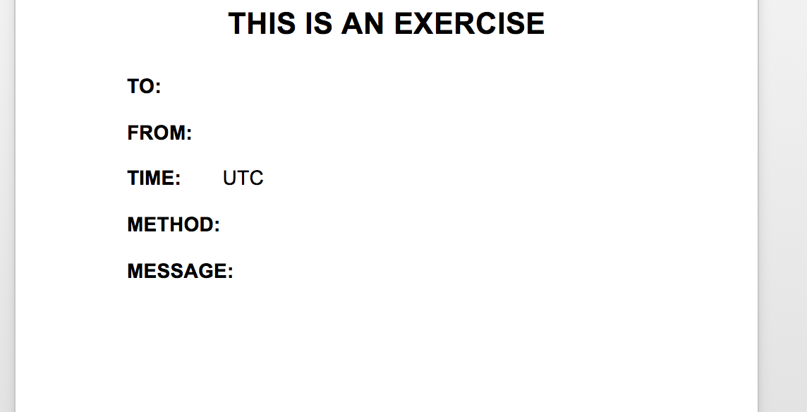
EXERCISE MESSAGES

Slide 12
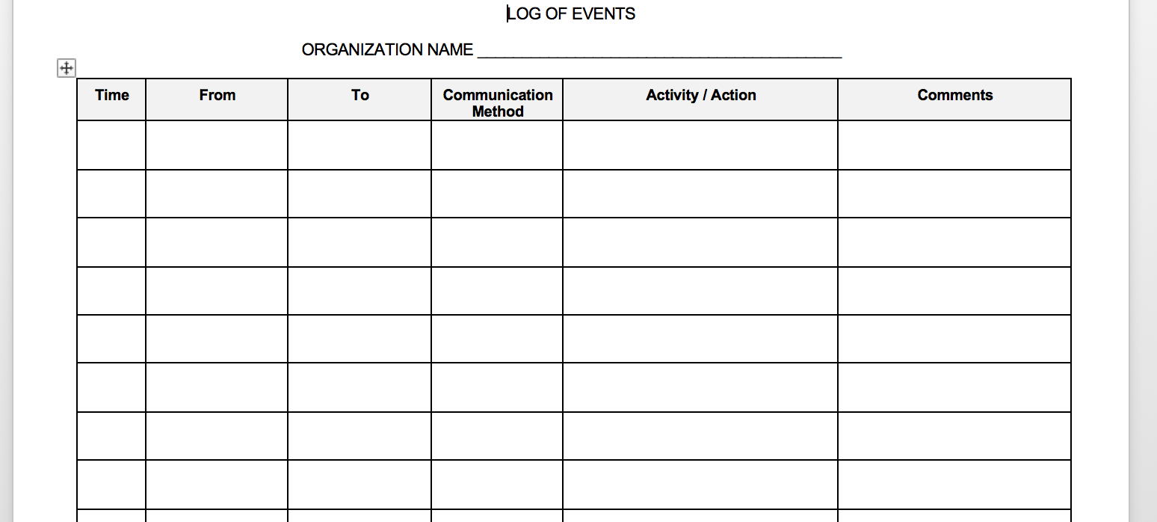
EXERCISE LOG

Slide 13
EVALUATION - Press Conference
Preparation Press Conference – 1600-1630 (30 min)
Press Conference – 1630 – 1720 (50 min)
Group statements (NTWC/NDMO) – 10 min each
Media Question and Answer – 30 min
Group Statements should focus on
What was supposed to happen
What went well – Sustainable
What needs work – Improvement
Did we accomplish our Goals?
What are your recommendations

Slide 14
Preparation - ACTIONS
Meet in your Group
Discuss SOPs (both individual and together as ‘country’)
Decide who will receive INJECTS by email
Decide who will log actions
Decide who will do Press Conference (NTWC-NDMO)

