Slide 1
NTWC – EMA SOPS
Identify Stakeholders. Specify roles.
Describe end-to-end (detection to evacuation)
Warning Communication Flow Chart (Activity 2a)
  Who does What
  Regional – Local
  Warning, Watch, Information Alerts
Timeline-driven SOPs (Activity 2b)
  Who does What and When
  Time, Products, Actions

Slide 2
Tsunami Warning Chain
  Who does What
  Regional / Local
  Alert Levels / Message

Slide 4
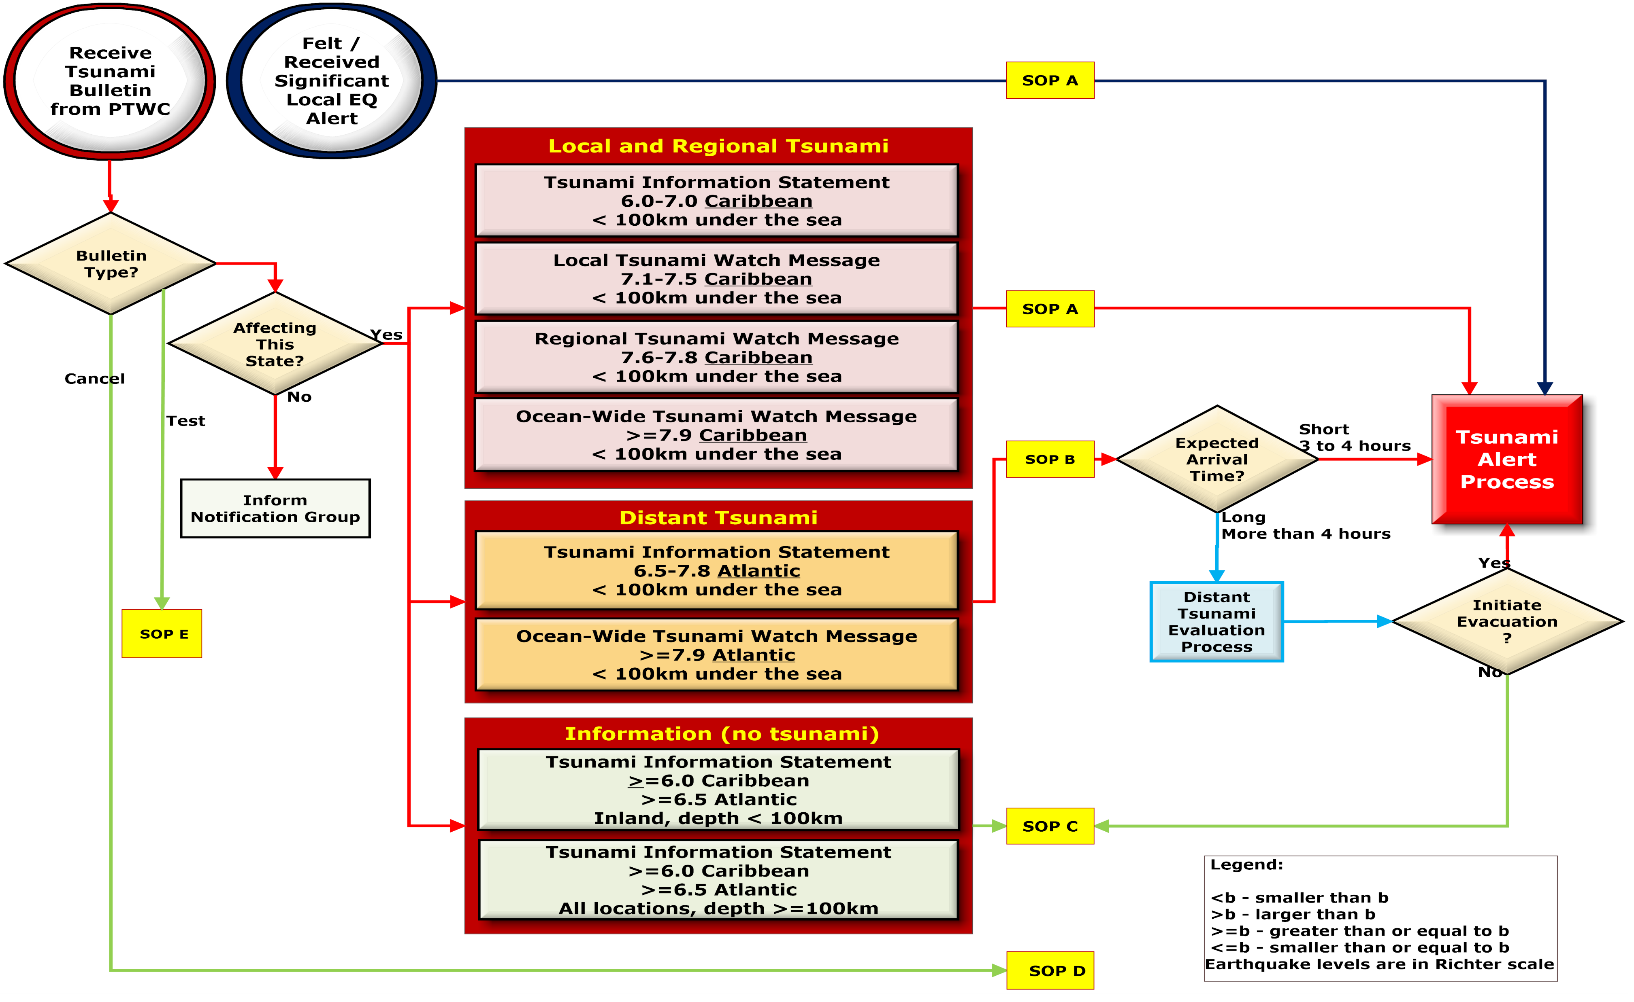

Slide 5
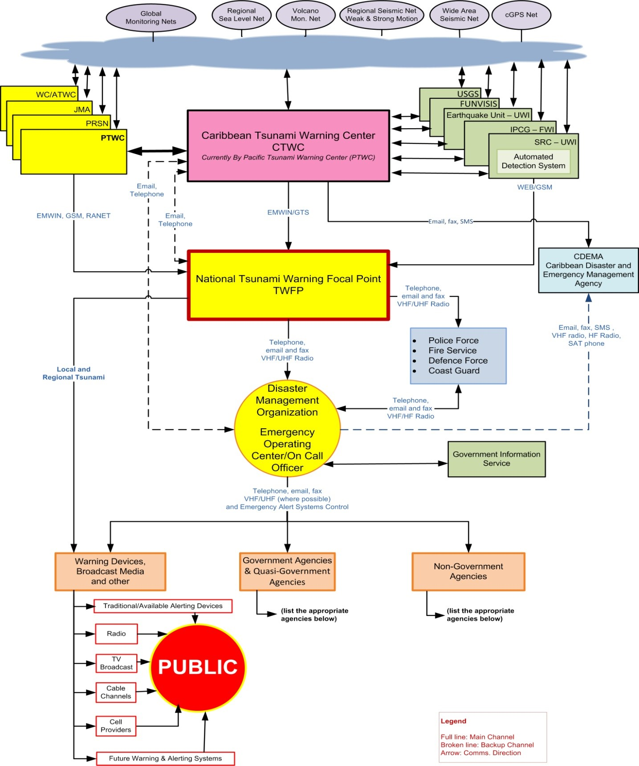

Slide 6
RMI TSUNAMI PRODUCTS COMMUNICATION FLOW CHART
PTWC
ISSUE PRODUCTS
NEW ENHANCED TSUNAMI PRODUCTS
TEXT PRODUCTS TO ALL, INCL PUBLIC
TEXT PRODUCTS TO ALL, INCL PUBLIC
WSO MAJURO
NEMCO
Analysis of Products and Determination of Threats
Notify the NDC Chair
(with recommendations)
Further
Analysis
NO
YES
Cabinet/NDC Members
ISSUE:
WATCH (Potential Threat 3-6 hrs) I WARNING (Potential Treat <3hrs)
Coordinate Evacuation
EOC Activated
Radio Station
TV Station
News Paper
Public Safety
Local Govt
Tourist Operators
Embassies
Public Safety - Traffic Control
MOE - Shelter/Transportation
MIA - Manage Shelter
Municipalities - Support coordination
PW - Road clearing/heavy equipments
General Public I Outer Islands Communities
RMI NATIONAL WEATHER SERVICE July 2015

Slide 7
Example – Tsunami Warning Communication Flow
Notes:
Example from Yap State, Micronesia for Local Tsunami, with delegated authority to issue Warning and Evacuation due to urgency of alert

Slide 8
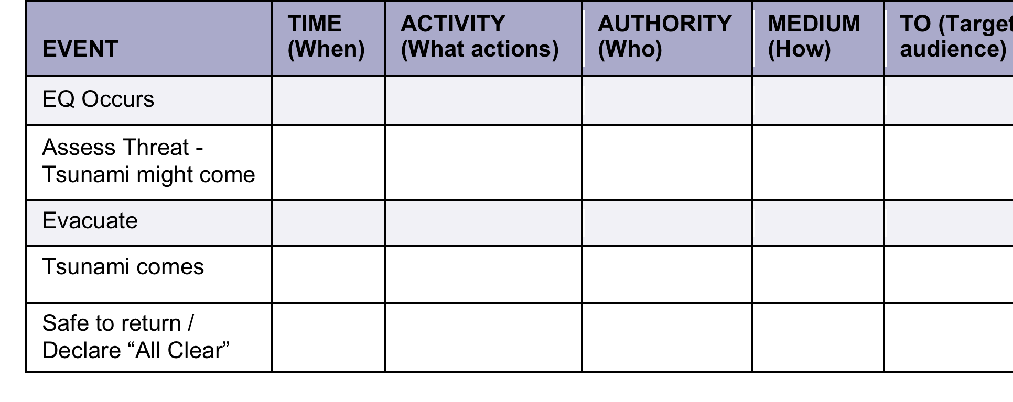
Timeline-driven SOPs
  Planning for seamless, effective response. Manage expectations.
  Specify critical actions / decision points. What decision, and when it must occur
  Add TIME to Communication Flow Chart
  When, What, Who, How, To whom

Slide 9
Tsunami Warning SOPs are timeline-driven
TSUNAMI ACTION TIME LINE | TIME min after EQ | OBSERVATION | ACTION PTWC | ACTION NTWC | ACTION EMA / Local Auth
 | 0 | Strong ground shaking locally
 | 1-5 |  | Alarm triggers
 | 5-15 | Tsunami might come | Msg 1 | Alarm CISN triggers
 | 15-30 |  | Msg 2 Forecast | WARNING | EVACUATION
 | 30-60 | Tsunami confirmed | Msg 3 SL obs | Confirm Dangerous Tsunami
 | 1-2+ hrs |  | Msg 4+ SL obs | Monitor and report SL obs
 | 2-8+ hrs | Dangerous waves stop | Msg 5+ Last Msg | CANCEL WARNING | Search and Rescue
 | 3+ hrs | Safe to Return |  |  | ALL-CLEAR

