Slide 1
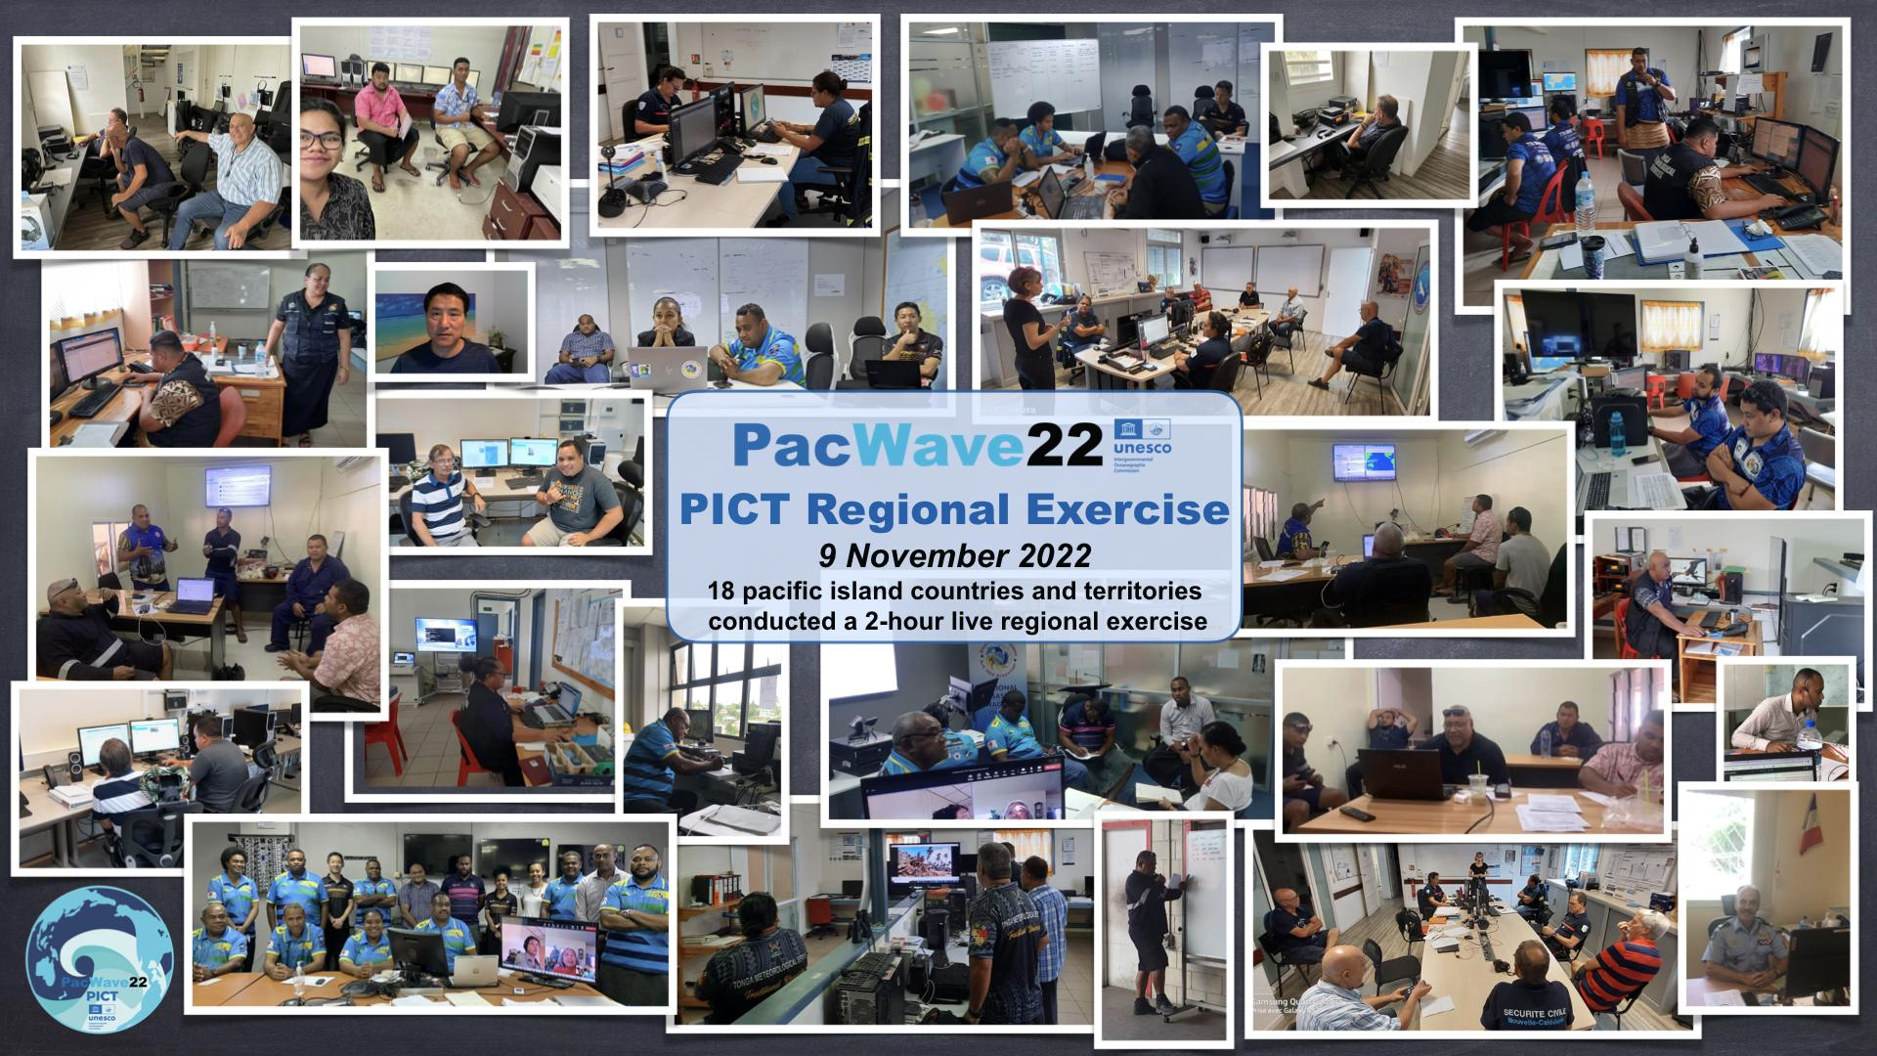
PacWave22-PICT Regional Exercise Cold Wash and Debrief - 16 November 2022

Slide 2

PacWave22-PICT Regional Exercise Cold Wash and Debrief
Welcome and Agenda
1. Welcome and Agenda - (5 min) - L. Kong
2. Exercise Overview - (10 min) - A. Jamelot
3. Exercise Observations and Feedback - (45 min) J. Korovulavula
3.1 Objective 1 : HTHH Interim products
3.2 Objective 2 : Regional cooperation using WhatsApp, E-mail, HF Radio
4. Discussions, Q&A - (10min) - J. Korovulavula
5. Way Forward, Reminders and Closing - (10 min) - L. Kong
PacWave22-PICT Regional Exercise Debrief - 16 November 2022

Slide 3
2. Exercise Overview
Planning (1)
PacWave22 PICT regional exercise organization decided end of July 2022 (PTWS Regional Working Group PICT)
IOC Circular Letter 2908 issued on 27 September 2022) announcing exercise
Date, Time, Length: 2300 UTC 9 Nov - 0100 UTC 10 Nov 2022, 2 hours
Format: Live Table Top Exercise
Scenario: HTHH Volcanic Eruption and Tsunami (15 January 2022)
Exercise Objectives:
Test the HTHH PTWC Interim Procedures and PTWS Products (IOC Circular Letter 2902), and whether the HTHH PTWS products are interpreted by PICT Member States accurately and in a timely manner, and
Test regional communication and cooperation between PICT Member States, and the value of information sharing in facilitating national tsunami alert decision-making.
PacWave22-PICT Regional Exercise Debrief - 16 November 2022

Slide 4
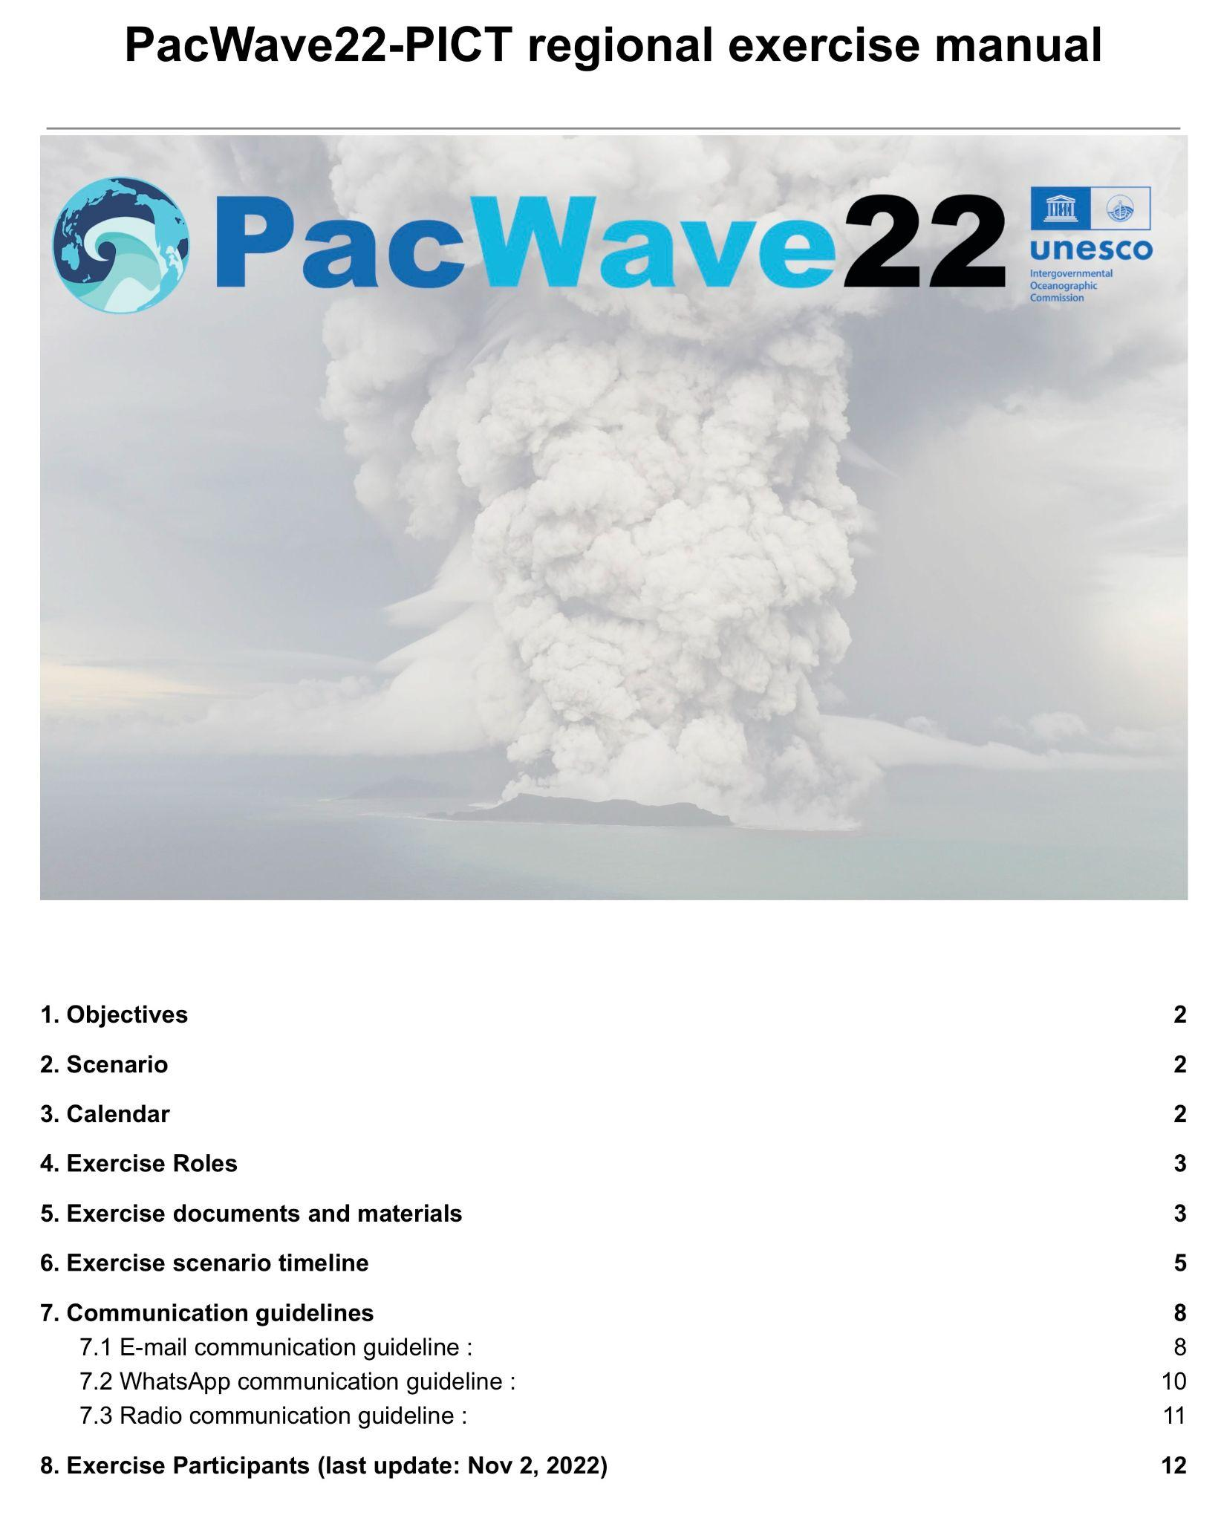
2. Exercise Overview
Planning (2)
Registration should have closed on 7 October, but was kept open to 1 November (date of last registration received) to allow greatest participation
Due to late Registration
Final Exercise Manual could not be shared with all participants until just 2 days before the Exercise … completely out of initial calendar
Test of communication by Listserv was performed 24 hours before start of exercise
Listserv and WhatsApp additions continued until Exercise time
WhatsApp connection instructions were not clear - some did not know that they needed to load the app onto their mobile phone.
PacWave22-PICT Regional Exercise Debrief - 16 November 2022

Slide 5
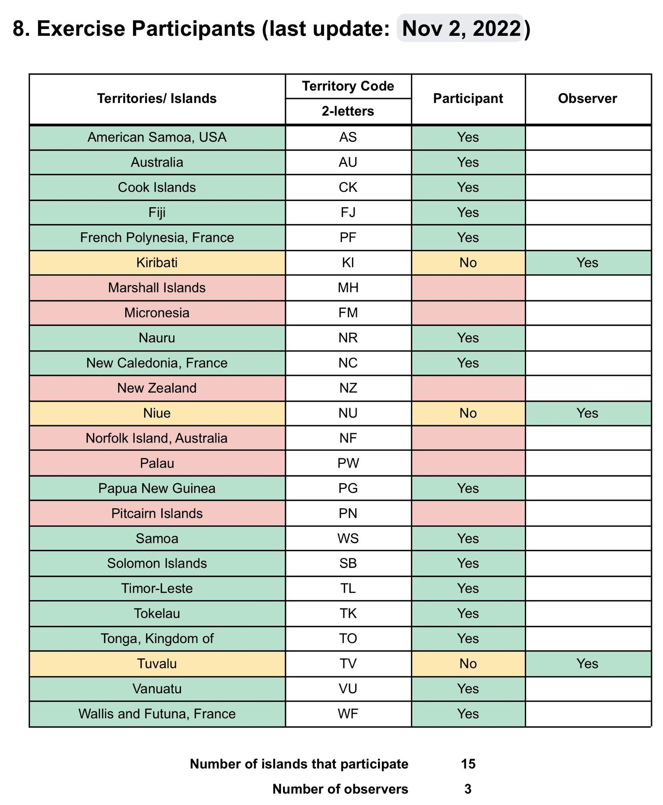
2. Exercise Overview
Participation
18 Pacific Island Countries and Territories
(15 Players, 3 Observers)
Total participants : ~ 80 persons
2 Controllers
Anthony Jamelot, CPPT/PF
Jiuta Korovulavula, IOC
4 External Observers
Laura Kong, Carolina Hincapie, ITIC
Bernardo Aliaga, IOC
Chip McCreery, PTWC
PacWave22-PICT Regional Exercise Debrief - 16 November 2022

Slide 6
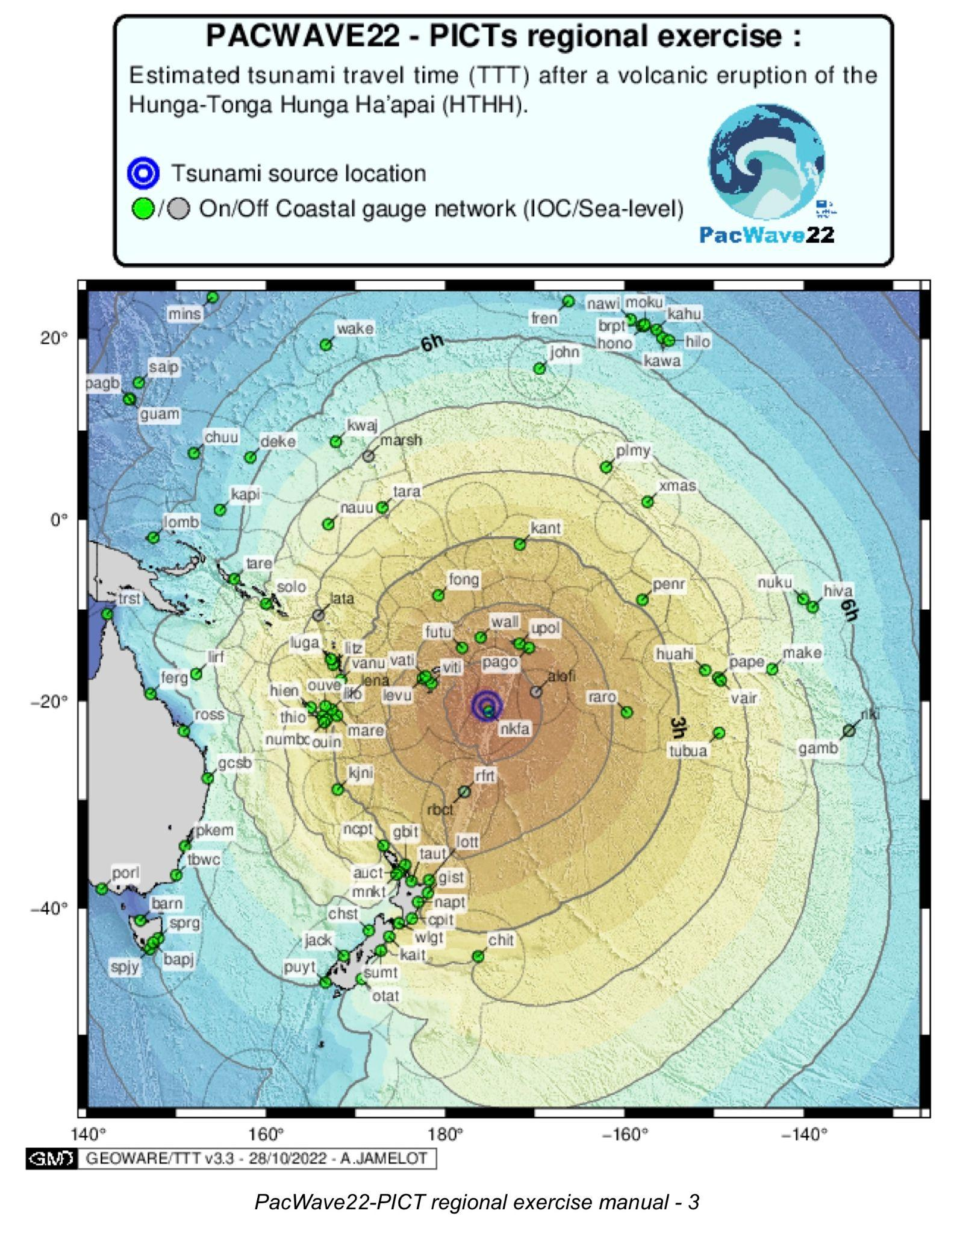
2. Exercise Overview
Conduct and Format
Live Table Top, simulating HTHH eruption and tsunami Used actual observations from 15 January, and PTWS PTWC HTHH Interim Procedure Products (implemented 15 March 2022).
Players in own country / offices
3 Communication methods: Dedicated E-mail Listserv, PacWave22-PICT WhatsApp group chat, HF Radio
Conduct
Controllers simulated 4 PTWC bulletins injects sent by e-mail using Listserv and notified to WhatsApp group
All information was immediately shared (no delay or review), 5 mails were not distributed because sent from an unregistered email into Listserv.
HF Radio communication tests between Players
PacWave22-PICT Regional Exercise Debrief - 16 November 2022

Slide 7
2. Exercise Overview
General review of communication methods
1. Dedicated E-mail listserv (hosted by ITIC):
63 messages exchanged - 2255 UTC 09 Nov to 0126 UTC 10 Nov 2022
Messages sent by controllers : 7
Messages sharing information : 18
Acknowledgement receipt : 38
Messages held : 5 ( 3 from AU, 2 from TO ) - mails sent from unregistered address to the Listserv.
AS, CK, FJ, NC, NR, NU, PF, PG, SB, TO, WF, WS, Controller
First tsunami information shared by mail at OT+20 min ( Wed Nov 9 23:20 UTC ) from Fiji,
Early Tonga messages were held at the beginning because sent from an unregistered email address.
PacWave22-PICT Regional Exercise Debrief - 16 November 2022

Slide 8
2. Exercise Overview
General review of communication methods
2. WhatsApp group - PacWave22-PICT
89 messages exchanged - 2255 UTC 09 Nov to 0100 UTC 10 Nov 2022
Messages sent by controllers : 11
Test messages sharing event/tsunami information : 26
Medias sharing event/tsunami information : 19
Acknowledgment receipt : 5
Other medias (Audio, Office pictures, …) : 8
Communication issue : 10
HF Radio check : 10 (At the beginning only)
AU, FJ, NC, NR, PF, PG, TO, WF, WS, Controller
First information shared by Tonga 9 min after the Origin time at ( Wed Nov 9 23:09 UTC )
A total of 45 relevant information shared
PacWave22-PICT Regional Exercise Debrief - 16 November 2022

Slide 9
2. Exercise Overview
General review of communication methods
3. HF Radio :
Communication test to define best frequency
A dedicated WhatsApp Group has been created during the exercise to facilitate the technical HF Radio exchange.
TO, FJ, NC, NR
PacWave22-PICT Regional Exercise Debrief - 16 November 2022

Slide 10
3. Exercise Observations and Feedback
3.1 Objective 1 : Test HTHH PTWC Interim Procedures and PTWS products
Floor is open to Players
for comments and feedback on the HTHH PTWC bulletins and interim products used during the exercise
Did you test your HTHH (volcano response) SOPs?
Did you understand PTWC HTHH products? Were they useful?
PacWave22-PICT Regional Exercise Debrief - 16 November 2022

Slide 11
3. Exercise Observations and Feedback
3.1 Objective 1 : Test HTHH PTWC Interim Procedures and PTWS products
Floor is open to Observers
for comments and feedback on the HTHH PTWC bulletins and interim products used during the exercise
PacWave22-PICT Regional Exercise Debrief - 16 November 2022

Slide 12
3. Exercise Observations and Feedback
3.2 Objective 2 : Test a regional cooperation
Listserv : tsunami-picts@list.woc.noaa.gov
WhatsApp Group : PacWave-PICT
HF Radio
A dedicated WhatsApp Group has been created during the exercise to facilitate the technical HF Radio exchange.
Floor is open to Players, then Observers
Was the information shared valuable for decision-making?
What communication method was most useful?
What was good? What was bad?
PacWave22-PICT Regional Exercise Debrief - 16 November 2022

Slide 13
Discussions - Q&A
Did anyone continue to play the exercise at a National scale after the 2- hours ?
Any ideas for improvements or other tools that could be useful for regional cooperation ?
Would you like to test again on a next Regional Exercise (PacWave24)?
Does anyone wants to comment on the WhatsApp message exchange for the Tonga event Mw 7.3 last 11 November ?
PacWave22-PICT Regional Exercise Debrief - 16 November 2022

Slide 14
Reminders
Pacwave22 Live TSP Communications Test Form - 13 Oct, 2022
https://www.surveymonkey.com/r/pacwave22_comm
7 PICT / 26 responses
[Fiji, Cook Islands, Australia, New Caledonia, French Polynesia, United States, Samoa]
PacWave22 Post-Exercise Evaluation Form - 21 Dec, 2022
https://www.surveymonkey.com/r/pacwave22_eval
0 PICT / 6 responses
PacWave22-PICT Regional Post-Exercise Evaluation Form - 21 Dec, 2022
https://www.surveymonkey.com/r/PacWave22_PICTs
4 / 18 responses
[Samoa, French Polynesia, Australia, New Caledonia]
PacWave22-PICT Regional Exercise Debrief - 16 November 2022

Slide 15
Thank you

