Slide 1
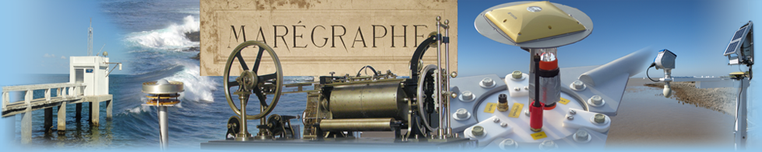




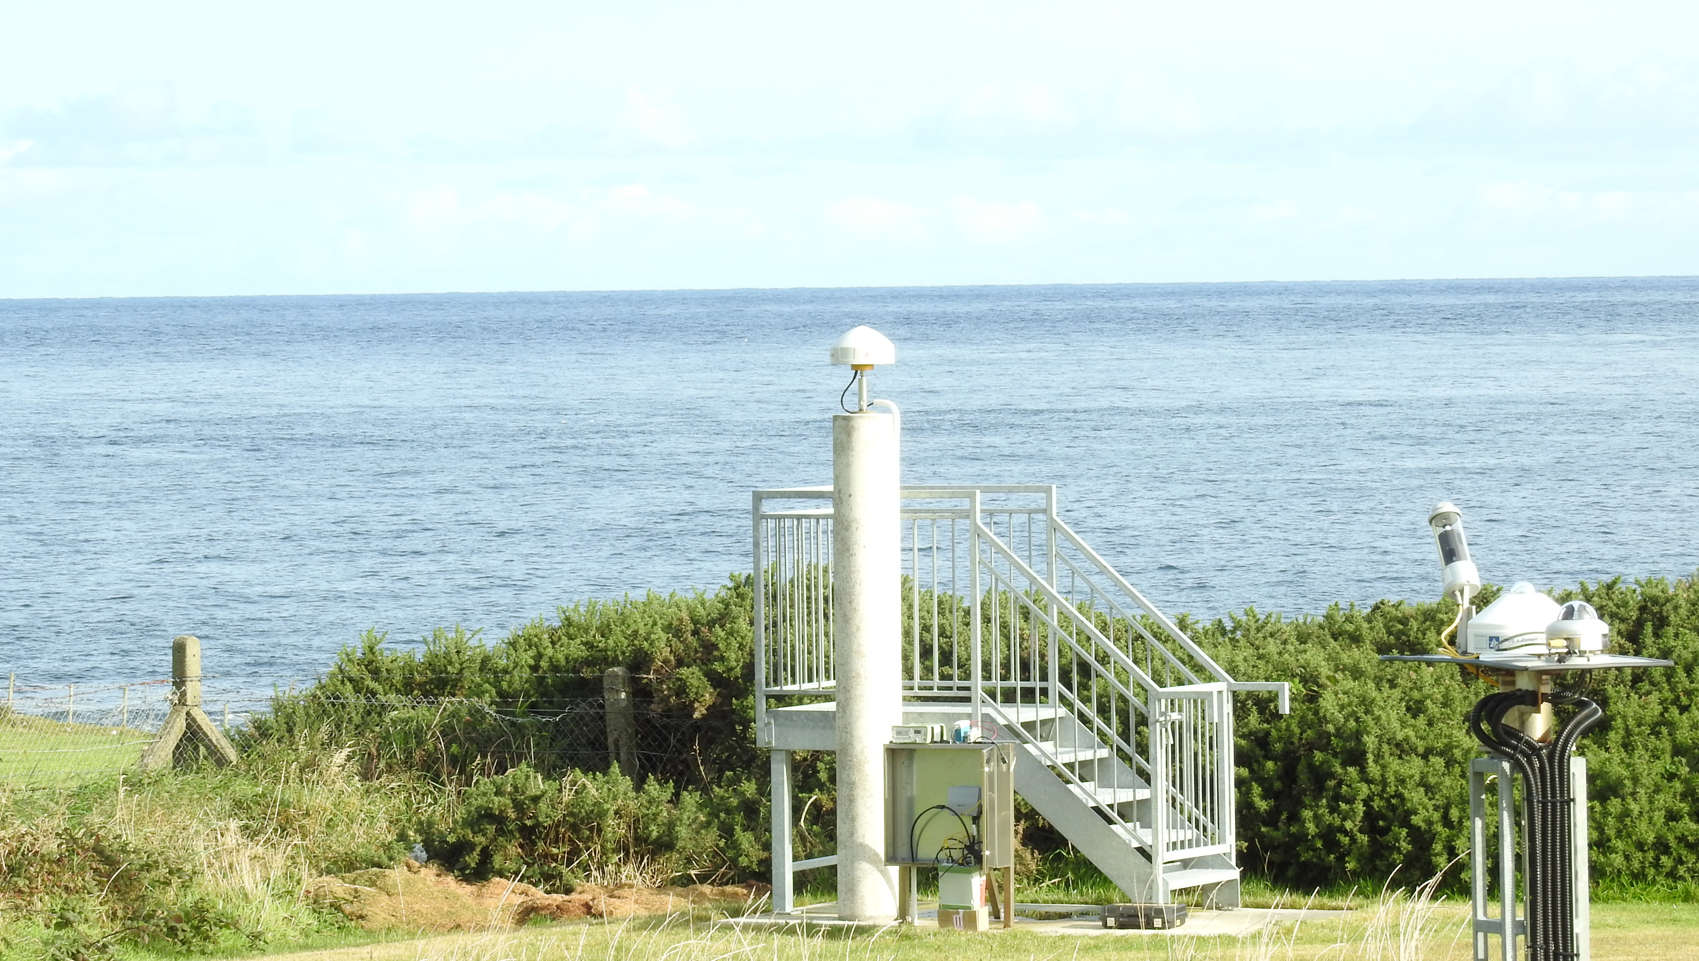
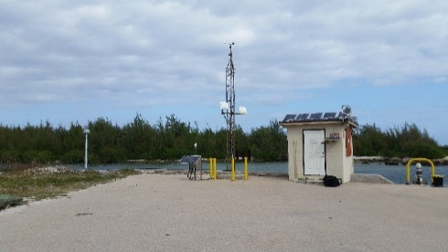
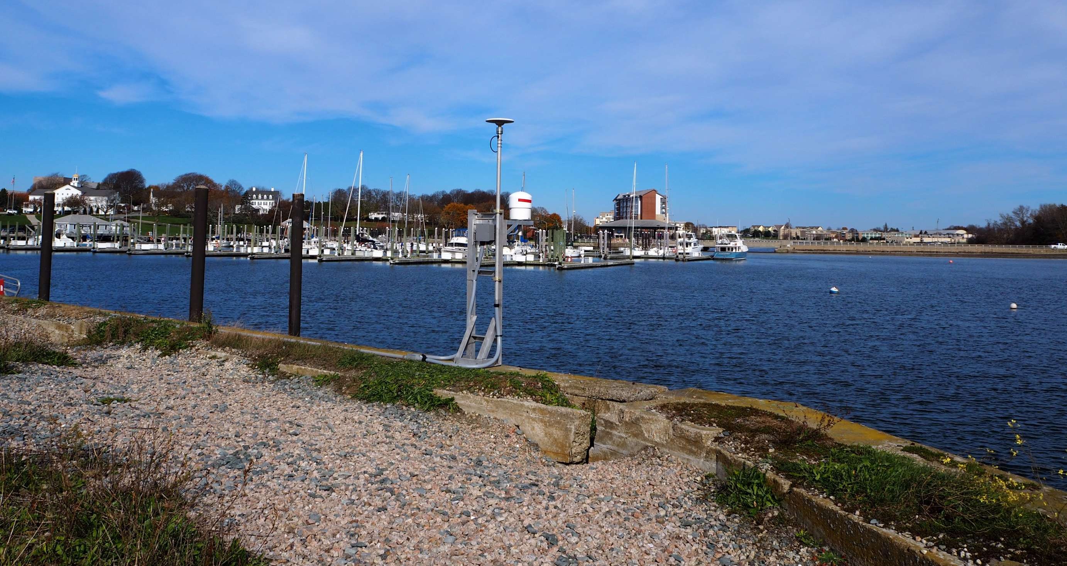


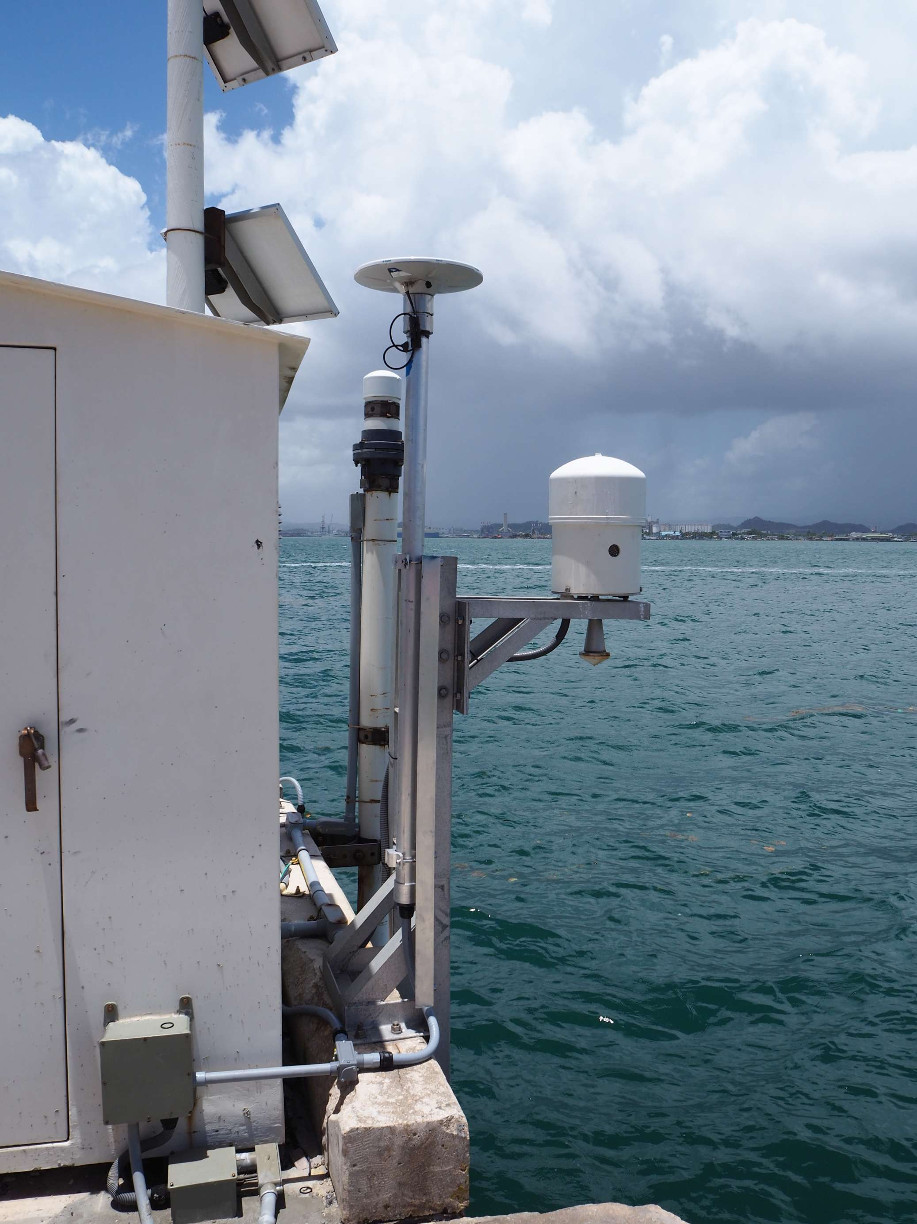
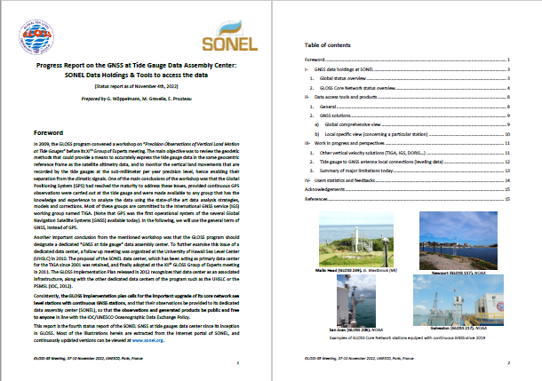
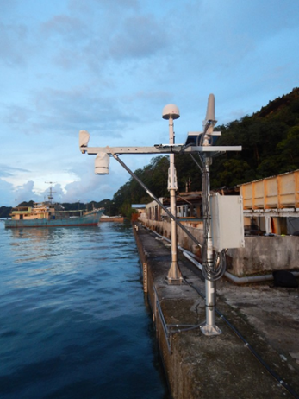
Malin Head (239)
Wake Is. (105)
Newport (157)
Fifth status Report on GNSS@TG
GLOSS Data Assembly Centre SONEL
Presented by Guy Wöppelmann
guy.woppelmann@univ-lr.fr
Médéric Gravelle
Elizabeth Prouteau
Mikael Guichard
San Juan (206)
Detailed report coming soon online (SONEL / GLOSS)
Palau (120)
XVIIth GLOSS Group of Expert Meeting – UNESCO, Paris 2022

Slide 2
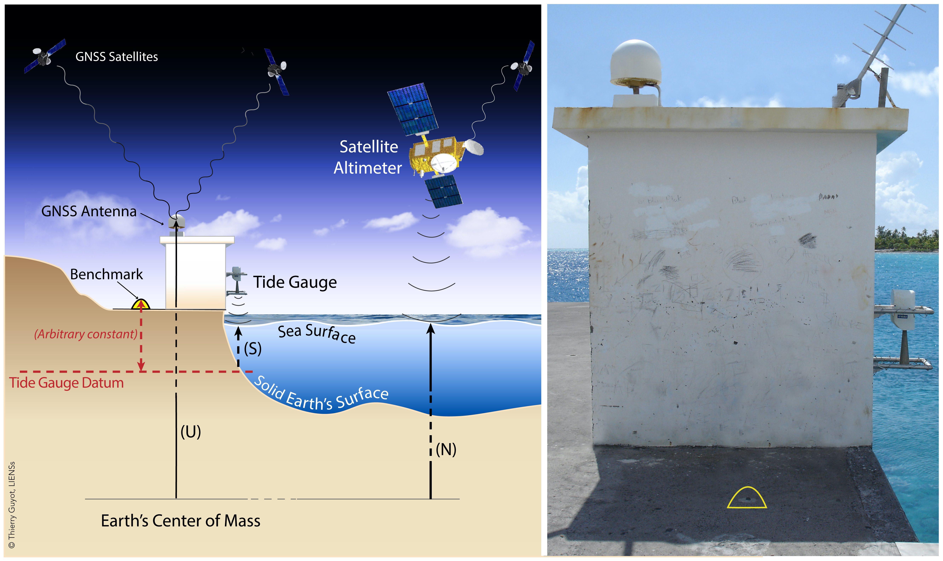
Status Report on GNSS@TG
Two important issues addressed here:
TG co-located or nearby a GNSS station with data available
Geodetic tie between GNSS antenna & TG datum (benchmark)
Notes:
Who is operating GNSS stations at TG? TG operators, Hydrographers, Surveyors, geodetic agencies, harbours
2 issues are addressed in this status report:
What TGs are co-located with a GNSS station or have a GNSS nearby, with data availability following IOC/UNESCO data policy?
What stations have a geodetic tie between the GNSS antenna and the TGZ?
Remind of the rationale for GNSS@TG
SL is chaging : How much? Where? Why?
Why is important to anticipate. RSL is what matters for society

Slide 3
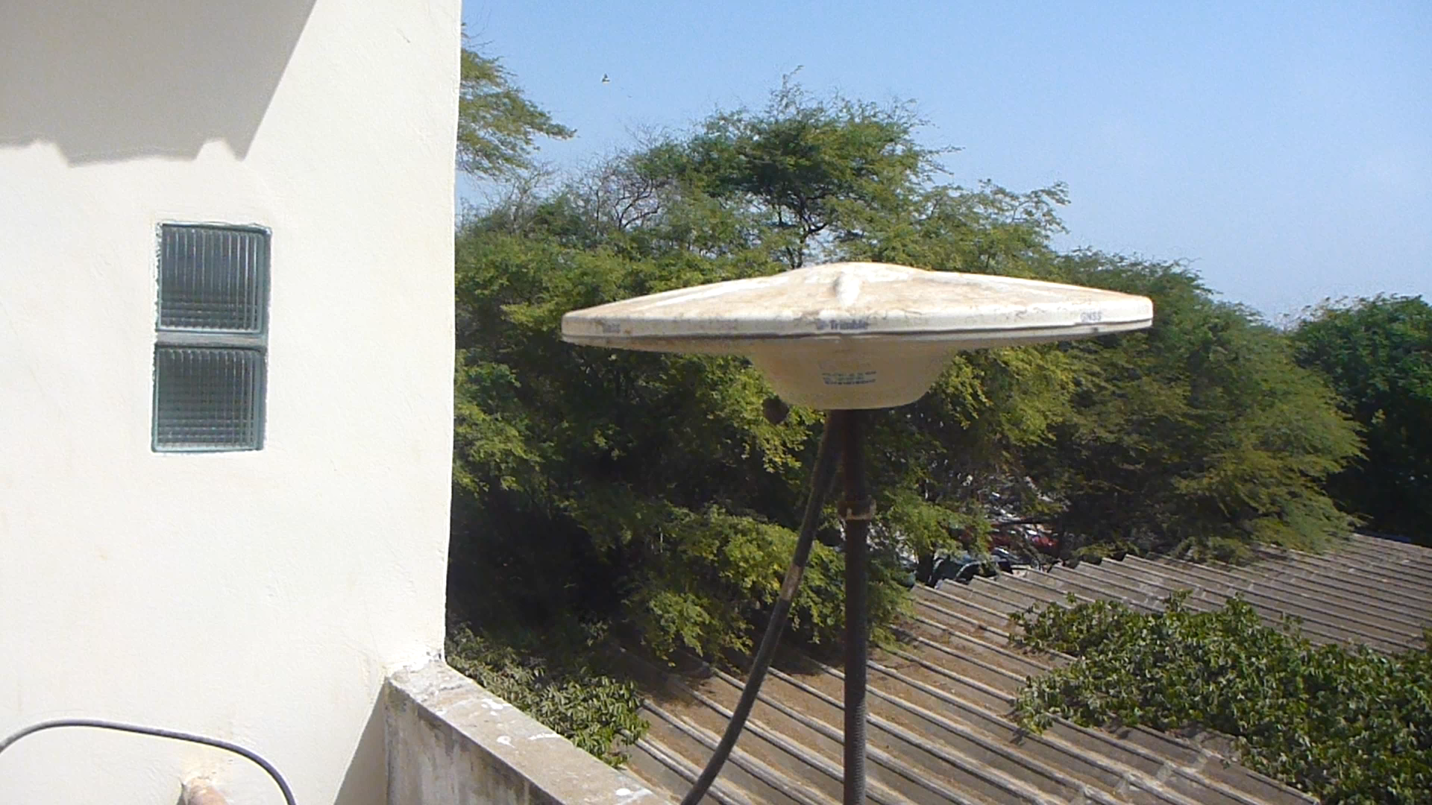
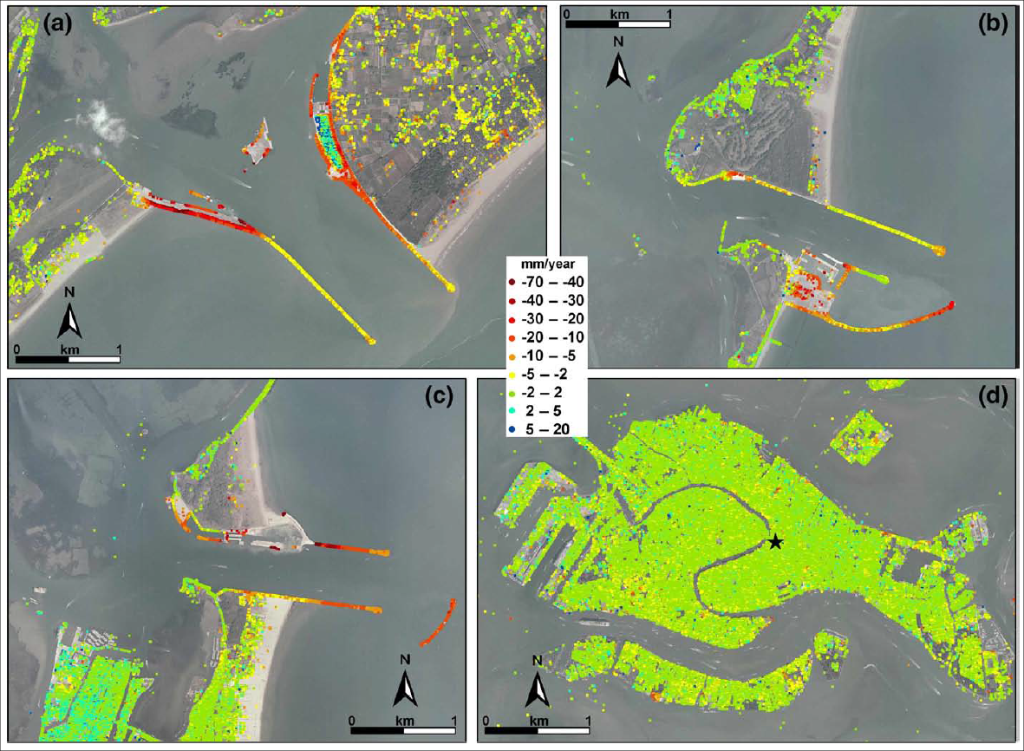

Status Report on GNSS@TG
1st issue: TG co-located or nearby a GNSS station with data available
geodetic-quality GNSS equipment (antenna & receiver) + monumentation
continuously operating over long time periods (> 10 years)
free data policy in line with the IOC/UNESCO data exchange policy
co-located = affected by the same vertical land motion (VLM)
nearby (>10 m) = issue of potential local differential motion → trend
Strozzi et al. (2009)
Notes:
2 issues are addressed in this status report:
What TGs are co-located with a GNSS station or have a GNSS nearby, with data availability following IOC/UNESCO data policy?
What stations have a geodetic tie between the GNSS antenna and the TGZ?
Remind of the rationale for GNSS@TG
SL is chaging : How much? Where? Why?
Why is important to anticipate. RSL is what matters for society

Slide 4
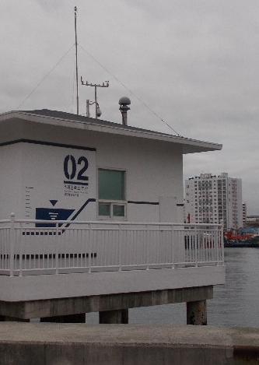
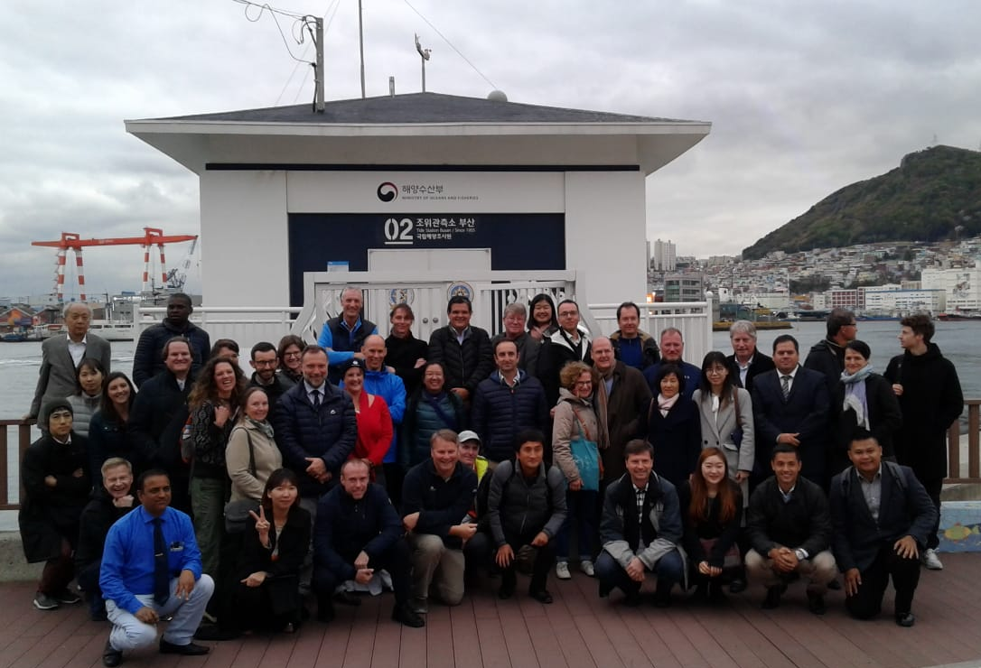
Status Report on GNSS@TG
2nd issue: Geodetic tie between GNSS antenna & TG datum (benchmark)
easy / simple, if co-located (repeat every 3-5 years)
relatively simple within 500 m (up to 1,000 m) separation distance, but requires repetition with a yearly frequency (!) at the beginning then can be loosen.
consider installing a GNSS on top of the TG for distances > 1 km
or if you did not succeed to convince the owner agency to release the data!
Pusan (GLOSS #84)
GNSS (PUSW) at ~200m from the GLOSS Tide Gauge, but
data not available to GLOSS/SONEL (following IOC data policy)
Notes:
2 issues are addressed in this status report:
What TGs are co-located with a GNSS station or have a GNSS nearby, with data availability following IOC/UNESCO data policy?
What stations have a geodetic tie between the GNSS antenna and the TGZ?
Remind of the rationale for GNSS@TG
SL is chaging : How much? Where? Why?
Why is important to anticipate. RSL is what matters for society

Slide 5
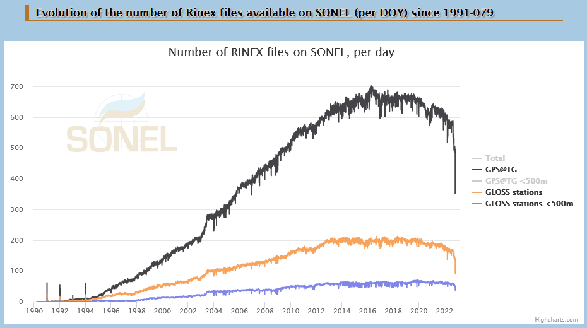
GNSS observations at/near Tide Gauges
mostly due to decommissioned stations
(most are not committed to GLOSS)
https://www.sonel.org/-GPS-.html?lang=en#id148
Notes:
In 2017: 58 (65); 173 (189)
Temporal view of active stations & data availability
- 23 Japanese stations in 2003
- Decrease in the # since 2016 (124 to 166 decommissioned since 2017)

Slide 6
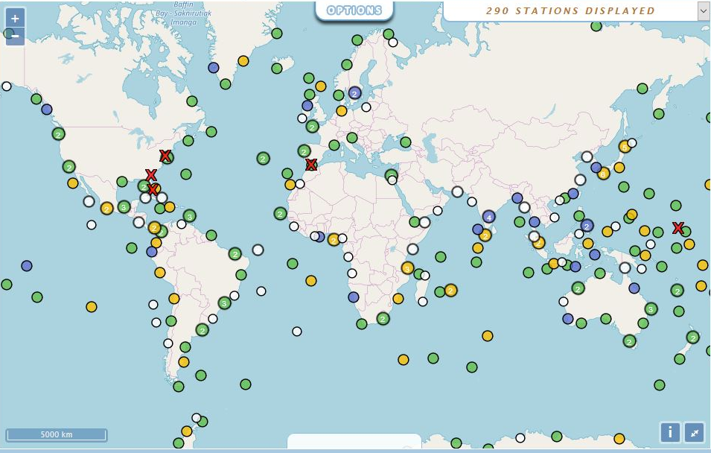
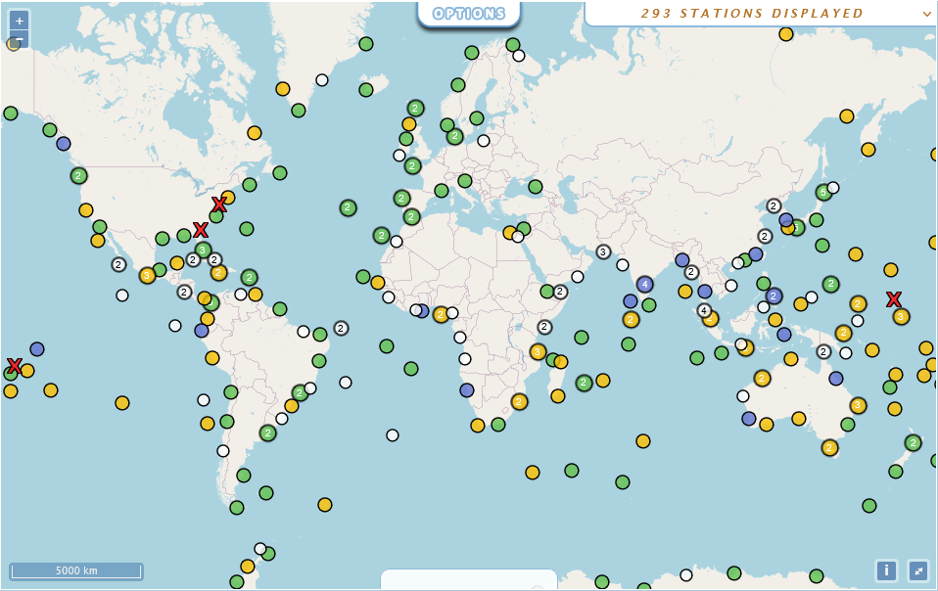
Status on GNSS@GLOSS Stations
200 GLOSS stations co-located or nearby
a GNSS stations (68%)
113 with active GNSS
(136 in 2019)
87 dormant GNSS
(55 in 2019)
5 decommissioned
GNSS (6 in 2019)
19 nearby GNSS, but
data not available (22)
69 with no nearby GNSS
identified in SONEL (71) using NGL database
online map (updated daily): https://www.sonel.org/-GLOSS,81-.html
Notes:
In 2019: 200 (active+dormant); 113 active; 87 dormant; 5 decommssioned; 19 likely active but data not available, 69 no nearby GNSS
In 2019: 219 (active+dormant); 136 active; 55 dormant; 6 decommissioned; 22 likely active but data not available; 71 no nearby GNSS
In 2017: 212 (active+dormant); 151 active; 39 dormant; 1 decommissioned; 21 likely active but data not available; 75 no nearby GNSS

Slide 7
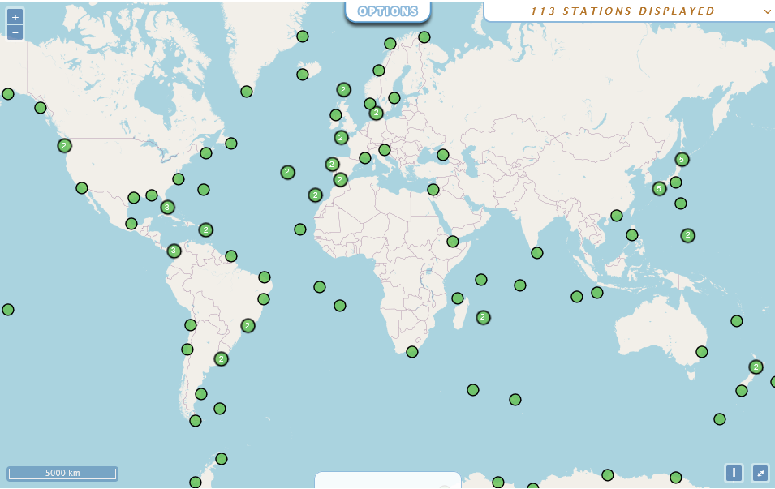
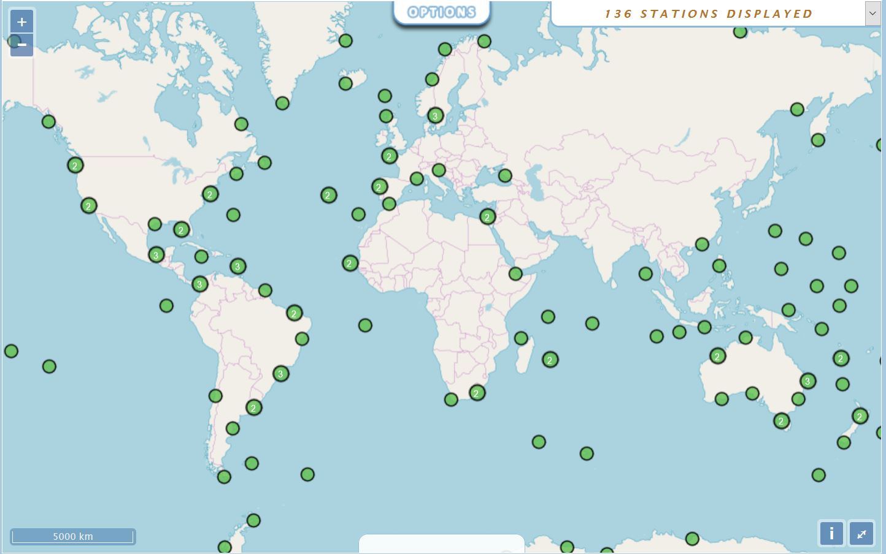
Focus on GNSS@GLOSS Stations
113 with an active GNSS nearby (38%)
online map (updated daily): https://www.sonel.org/-GLOSS,81-.html
Notes:
In 2019, 136 (46%)

Slide 8
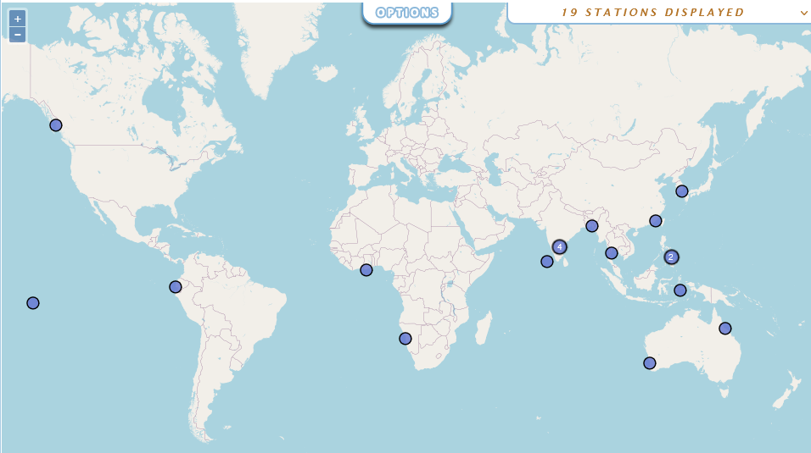
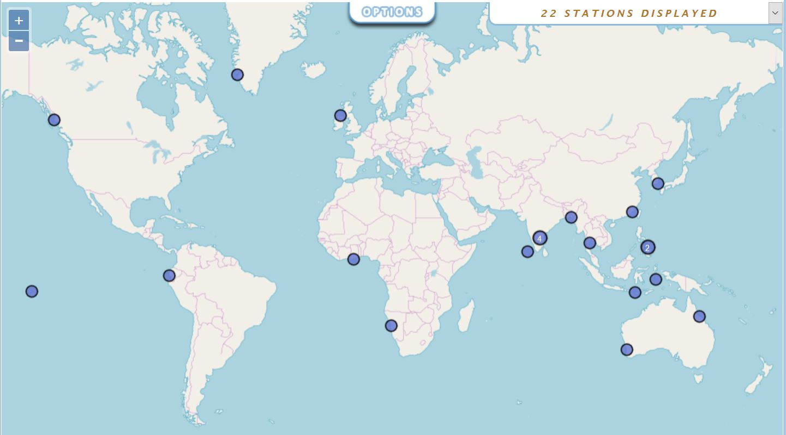
Focus on GNSS@GLOSS Stations
Identified nearby GNSS, likely operational, but
data not available (6%) to SONEL/GLOSS (following IOC data policy)
Godthab, DNK
Prince Rupert, CAN
Malin Head, IRL
Pusan, KOR
Chittagong, BGD
Xiamen, CHN
Legaspi, PHL
La Libertad, ECU
Ko Lak, THA
Davao Gulf, PHL
Takoradi, GHA
Cochin
Chennai/madras
Marmagao
Minicoy
Vishakhapatnam
IND
Ambon, IDN
Nuku Hiva, FRA
Waikelo, IDN
Townsville, AUS
Walvis Bay NAM
Fremantle, AUS
online map at: https://www.sonel.org/-GLOSS,81-.html

Slide 9
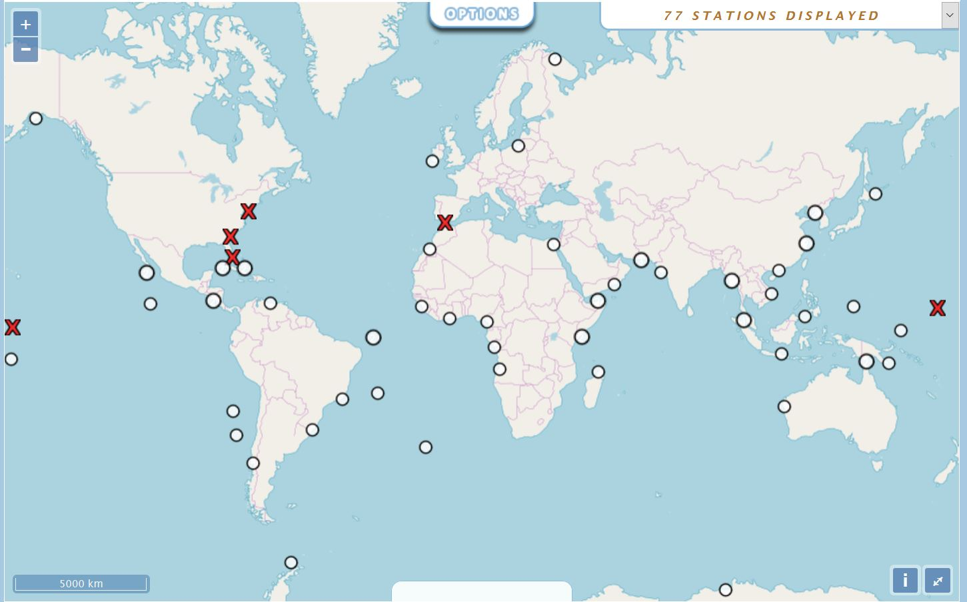
Focus on GNSS@GLOSS Stations
Decommissioned GNSS stations (5)
No nearby GNSS identified by SONEL/GLOSS (69)
Seward, USA
Atlantic City USA
Gibraltar UK
Fort Pulaski USA
Virginia Key USA
Kwajalein,USA
Christmas Is.
Rangiroa, Fr
Dzaoudzi, Fr (Mayotte)
online map at: https://www.sonel.org/-GLOSS,81-.html
Notes:
In 2019, 6 decommisioned & 71 with no nearby GNSS identified using NGL
Virginia Key & Gibraltar back on line from decommissioned but Rangiroa dismantled ! (temporarily)
Seward (Alaska) has now a GNSS as well as Dazoudzi (Mayotte)

Slide 10
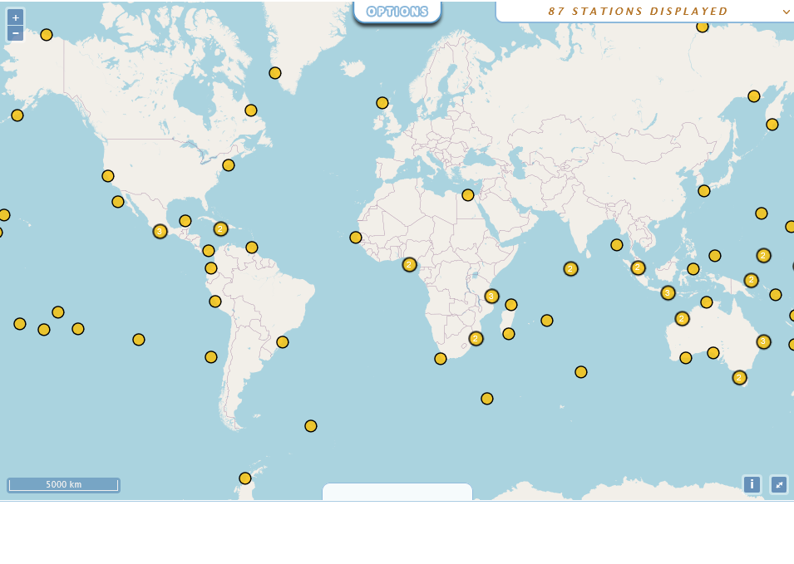
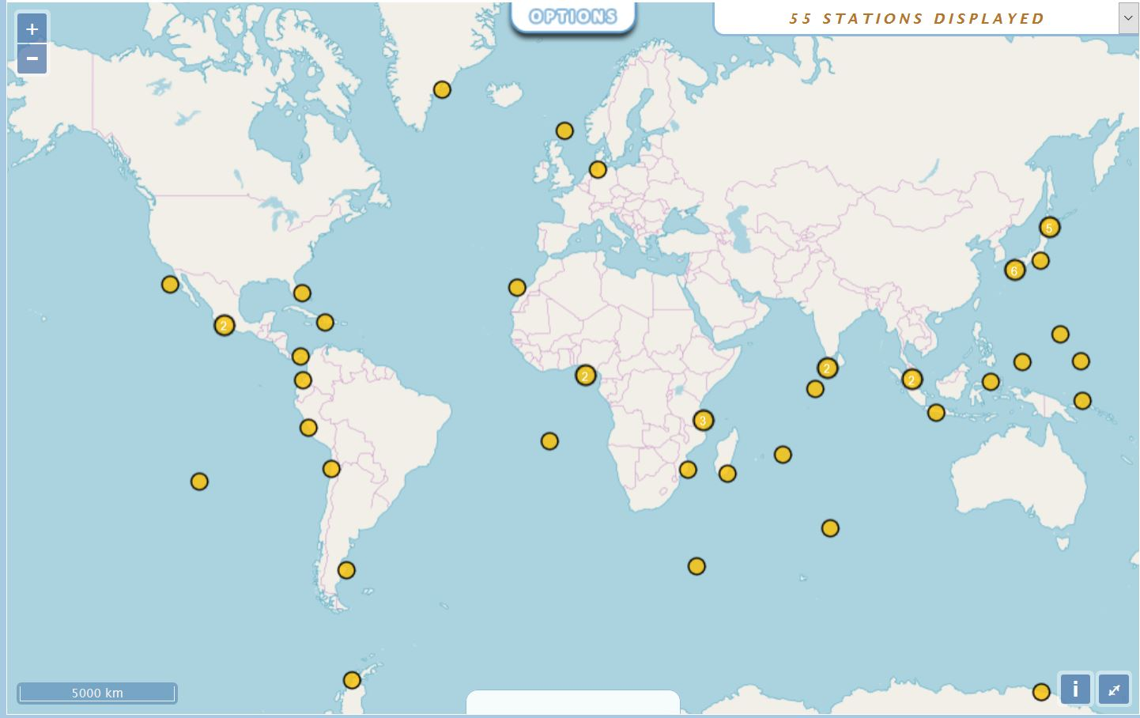
Focus on GNSS@GLOSS Stations
87 Dormant GNSS (29%) : no data within the last 30 days
online map at: https://www.sonel.org/-GLOSS,81-.html
Notes:
In 2019, 55 were dormant (19%)

Slide 11

Questions or comments
Notes:
In 2017: 58 (65); 173 (189)
Temporal view of active stations & data availability
- 23 Japanese stations in 2003
- Decrease in the # since 2016 (124 to 166 decommissioned since 2017)

Slide 12
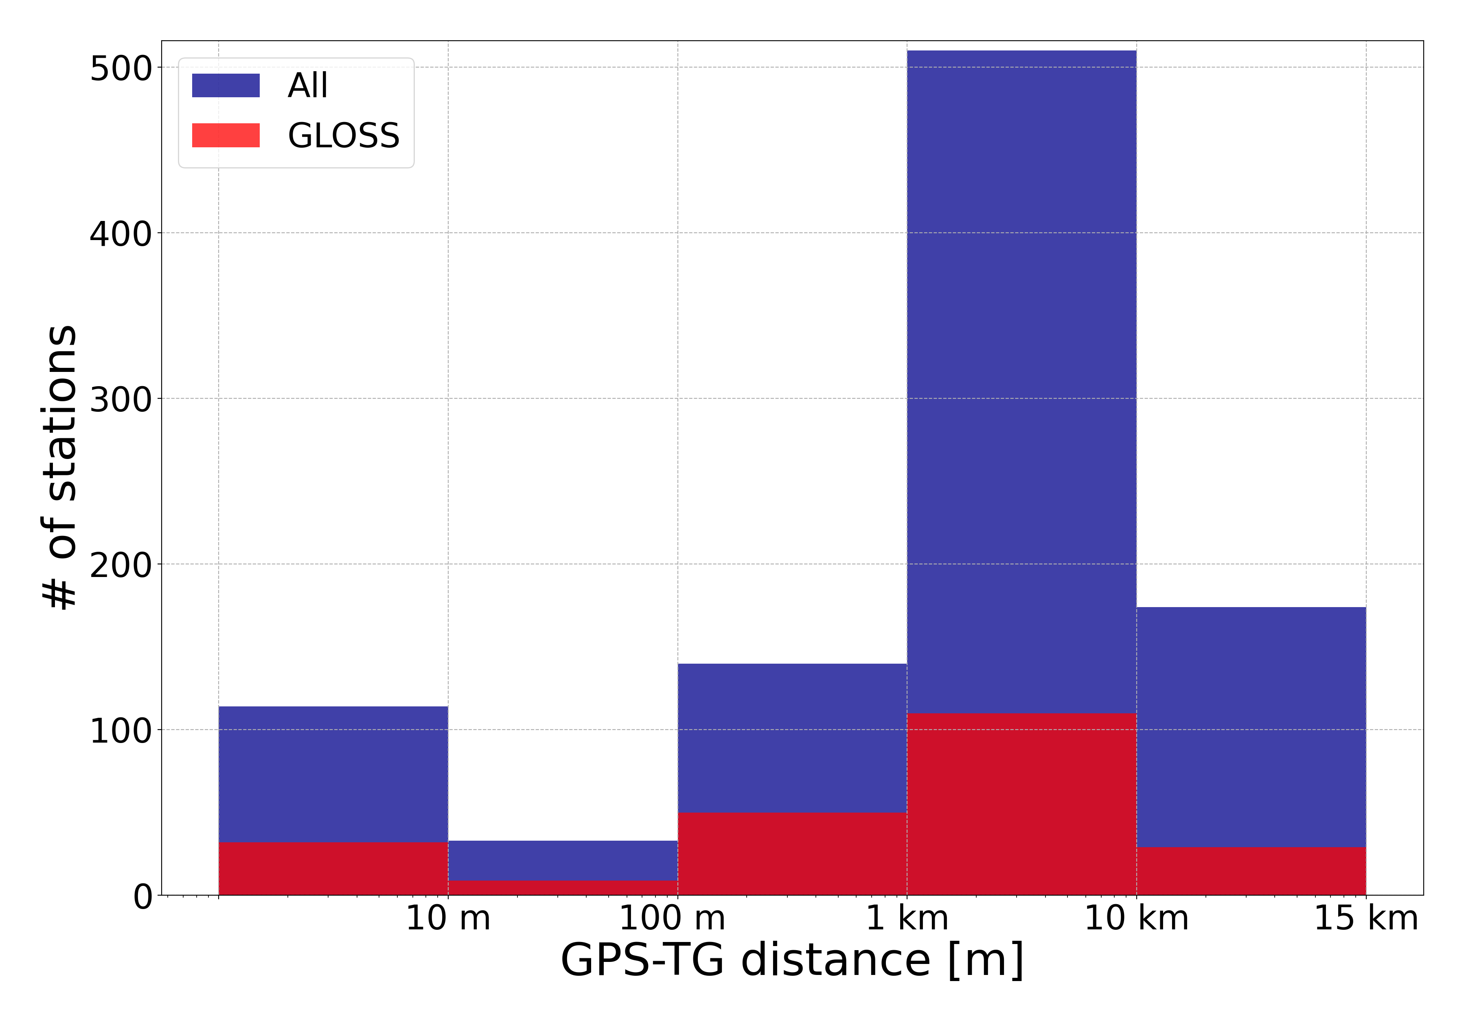
2nd issue on GNSS@TG – Leveling Tie
2nd issue: Geodetic tie between GNSS antenna & TG datum (benchmark)
easy / simple, if co-located (repeat every 3-5 years)
relatively simple within 500 m (up to 1,000 m) separation distance, but requires repetition with a yearly frequency (!) at the beginning then can be loosen.
consider installing a GNSS on top of the TG for distances > 1 km
or if you did not succeed to convince the owner agency to release the data!

Slide 13
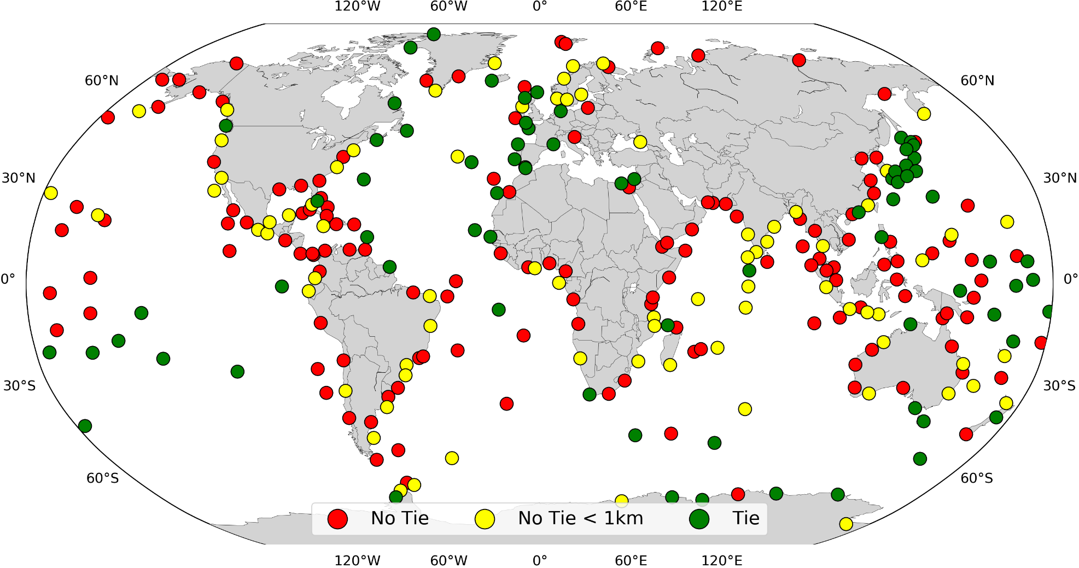
Status on GNSS@GLOSS leveling tie
No leveling available in SONEL (77) but GNSS@TG within 1,000 m
Action list (item 7) agreed at GE15 in 2017
Potential for a substantial improvement is within reach if TG operators include the GNSS antenna in their next leveling control.
Effective reduction from 116 to 77 missing ties from 2017 to 2019
Mostly thanks to EU project GOCE++ (Andersen et al. (2018)
Extraction from leveling reports is tedious & long (time-consuming)
Varied formats and level of information (manual extraction)
Revisiting a simplest exchange format (json5) in progress
AGU Session in 2018 with NOAA colleagues
Chairs: N.Kinsmann (NOAA), M.Craymer (NRCan), M.Gravelle (SONEL)
Notes:
- Figure 11: Geodetic connections available in SONEL for the GLOSS Core Network. In yellow are highlighted those for which this is missing, but the tide gauge is within 1 km from the nearest GNSS station; thus, the potential for a substantial improvement is within reach if tide gauge operators include the GNSS antenna in their next leveling control. There were 116 within 1km with no tie, now it has decreased to 77.
- Titre: "Integration of GNSS into Water Level Observation Networks: Priorities, Technologies, and Benefits«
Chairs: Nicole Kinsmann (NOAA), Adria Schneck (NOAA), Michael Craymer (NRCan), et moi.

