Slide 1


Action item 6.3 from 16th GLOSS GE meeting (Busan, April 2019)
Médéric Gravelle, Mikael Guichard & Guy Wöppelmann
« Make GNSS vertical land motion rates from other [than ULR Analysis Centre] processing sources [i.e., GFZ, JPL, NGL] available on SONEL web-site »
3rd international GNSS data re-analysis campaign (2019-2021)
(New release of the International Terrestrial Reference Frame, ITRF2020)

Slide 2








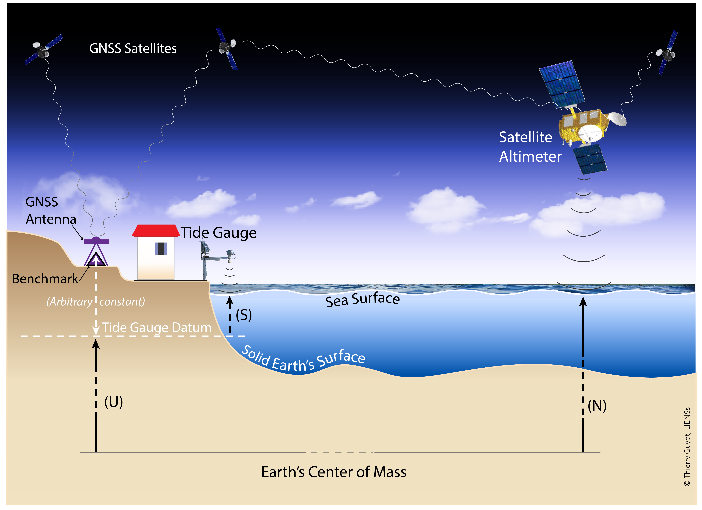




Background on SONEL Data Assembly Center (GNSS component)
…
…
…
…
Individuals directly providing raw data
…
1050+ stations nearby TG / 150+ agencies / 67 countries
Over 6 400 000+ daily files of raw GNSS data
(a.k.a. Rinex files)
USERS
WG (TIGA)
BLT
ULR
As many as 1056 station
position time series & velocities,
depending on AC interests
Notes:
SONEL acts as a classical IGS DC, but dedicated to GNSS data near TGs. Actually, its GNSS component was developed for TIGA-PP (2000s)
It collects daily RINEX files at 30s & metadata (logfiles) from a large variety of sources : GDC, RDC, and LDC (the latter not necessarily IGS)
Number of stations, agencies, countries & RINEX, as of 23 June 2022
These files are available to anyone, whether it is an IGS, or not. Obviously, TIGA ACs did process the data, at least.
But other groups can too. This is the case of the NGL/UNR, whose products have become popular for many geophysical...
SONEL then collects position time series and velocities from the TIGA ACs, if available (e.g., GFZ & ULR)
(SONEL) makes them available in a centralized & uniform way to the sea level users community via its web portal.
A few words now on the applications of this community.

Slide 3
Status & activities to fulfill GLOSS GE request
NGL solution(s) available within 2019 year of the action item expression 
  Contact (G.Blewitt, C.Kreemer), agreement, procedures, data collection, archiving, updating, formatting, website coherence & distribution
  May 2019 (NGL08 in ITRF2008), then major update in March 2022 (NGL14 in ITRF2014)
JPL solution available 
  Contact (M. Heflin), same steps as above till distribution
  January 2020 (JPL14 in ITRF2014), then updated in April 2022 (Repro-3, longer time series)
GFZ solution available 
  Contact (T. Schöne, B. Männel), same steps…
  June 2020 (GT2 in ITRF2014) , then updated in Nov. 2022 (Repro-3, longer time series)
3rd international GNSS data re-analysis campaign (2019-2021)
(New release of the International Terrestrial Reference Frame, ITRF2020)
→ new updates in the near future (likely beginning of 2023)
Notes:
The first group that we contacted was the NGL (partly because G.Blewitt was pioneer in advocating the use of GPS for TG monitoring in the 90s)
Then, JPL in January 2020, and last with the other TIGA AC at GFZ (We can discuss later on, why GFZ sol. was not available earlier as a TIGA AC)
We will report on this action net week at the GLOSS DC meeting planned in Ostend.
Let’s have a look at the distribution of these solutions through the SONEL web portal.

Slide 4
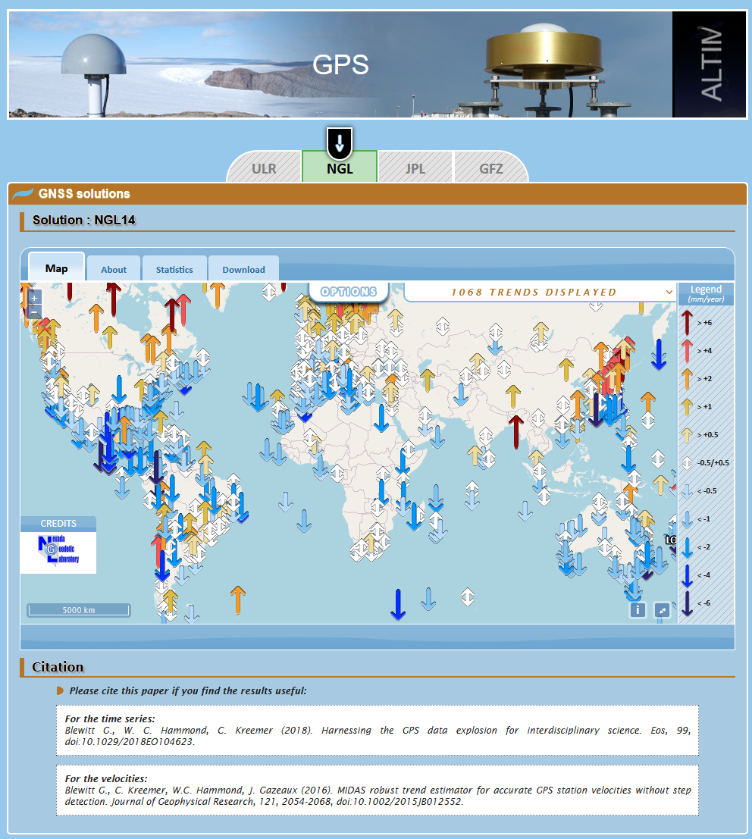
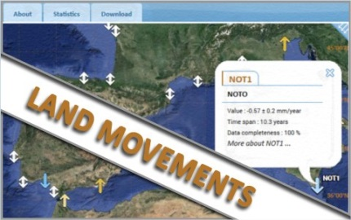
http://www.sonel.org/-Vertical-land-movement-estimate-.html
GPS vertical velocity fields
Note: incl. RF stations
Notes:
- A brief overview of the SONEL web portal and display of the various selection, starting with NGL

Slide 5
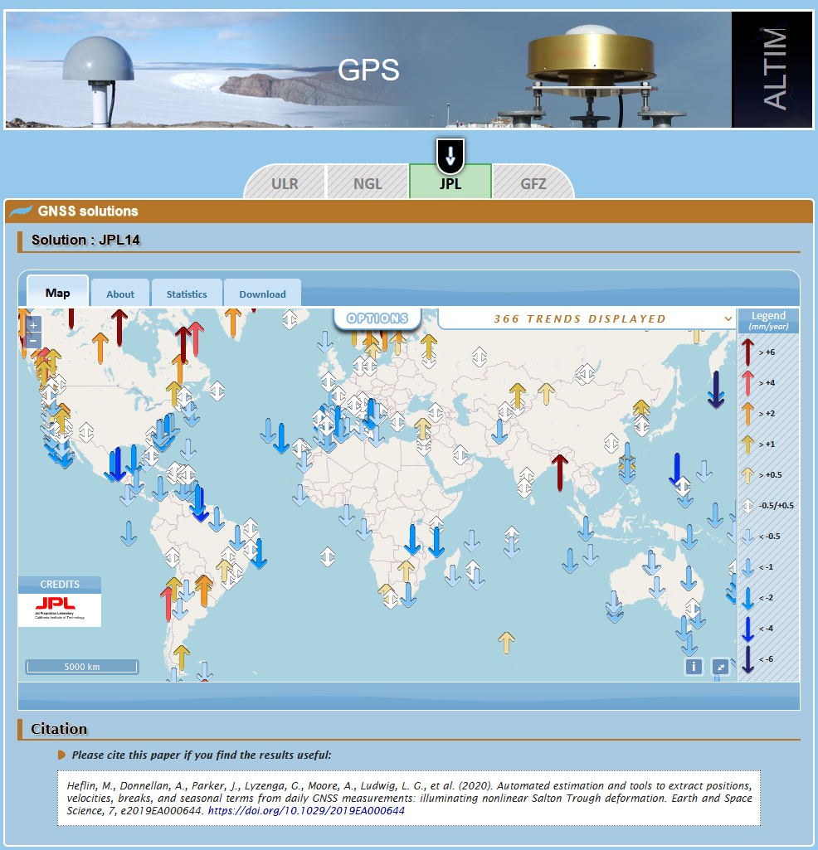
http://www.sonel.org/-Vertical-land-movement-estimate-.html
GPS vertical velocity fields
Repro-3
Notes:
- Note that the (IGS) JPL AC has less stations 366 stations nearby TGs, which is simply due to the original station selection not being driven by the SL app.

Slide 6
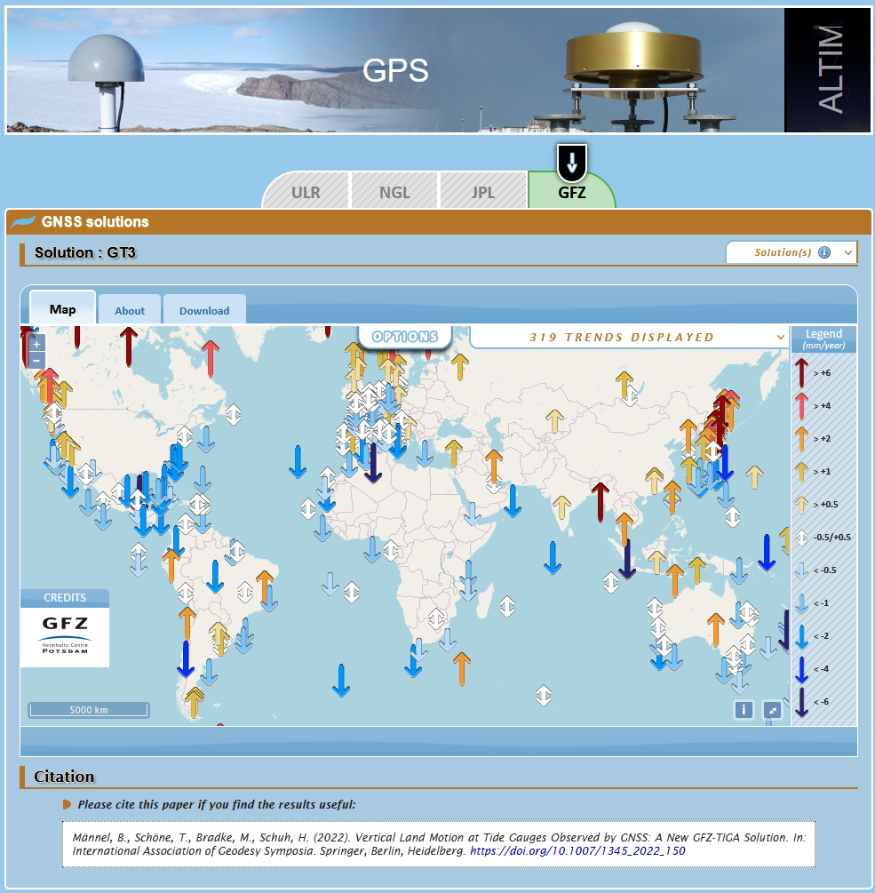
http://www.sonel.org/-Vertical-land-movement-estimate-.html
GPS vertical velocity fields
Repro-3
TIGA
Notes:
Regarding GFZ, the work is in progress to update with GFZ-repro3 solution.
The # of stations was similar to the # in ULR solution, i.e. 579 in GT2.
Now, decreased to 319 : no longer a dedicated processing for TIGA…

Slide 7
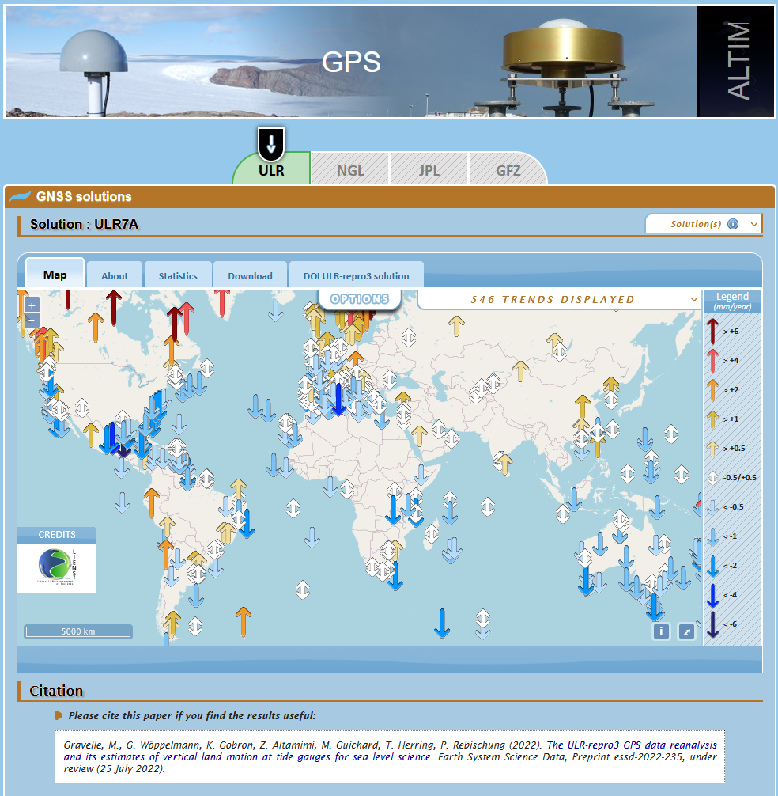
http://www.sonel.org/-Vertical-land-movement-estimate-.html
GPS vertical velocity fields
Repro-3
TIGA

Slide 8
Status & activities to fulfill GLOSS GE request
NGL solution(s) available within 2019 year of the action item expression 
  Contact (G.Blewitt, C.Kreemer), agreement, procedures, data collection, archiving, updating, formatting, website coherence & distribution
  May 2019 (NGL08 in ITRF2008), then major update in March 2022 (NGL14 in ITRF2014)
JPL solution available 
  Contact (M. Heflin), same steps as above till distribution
  January 2020 (JPL14 in ITRF2014), then updated in April 2022 (Repro-3, longer time series)
GFZ solution available 
  Contact (T. Schöne, B. Männel), same steps…
  June 2020 (GT2 in ITRF2014) , then updated in Nov. 2022 (Repro-3, longer time series)
First feedbacks from users as soon as February 2020
  “Having several solutions available is extremely useful, it provides a grasp of the agreement and robustness of GPS velocity estimates at each location”
Notes:
Kiko Calafat: tener varias soluciones es muy util, al menos para mi, porque me da una idea de la consistencia y robustez de las velocidades en cada ubicacion.

Slide 9
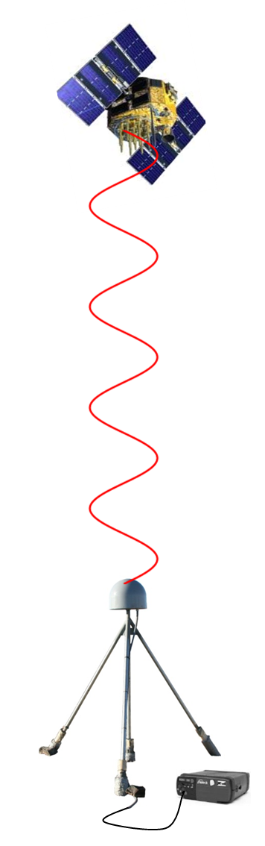
From raw GNSS measurements
to station position → time series → velocities
GNSS measurement analysis step → position(s)
  Raw GNSS measurements consist of propagation delays of EM signals
  Each (daily) GPS position is obtained after modelling and inversion of GPS measurements, which consist of (phase) range measurements through the atmosphere to satellites of (approximately) known position
  Alignment to the Terrestrial Reference Frame (ITRF, the best possible)
  Different choices in the analysis strategy can yield different positions
Position time series analysis step → vertical velocities
  Modelling/parameterization at the time series level includes: outliers, position offsets, periodic signals, non-tidal loading, post-seismic relaxation, colored noise, …
  Different analysts may adjust different parameters to the (already different) position time series
Notes:
Where do the differences come from?
As most of you are GNSS-experts, you know that there are at least two major steps where these (differences) can arise.
The 1st concerns the analysis of raw GNSS measurements to obtain daily (weekly) position time series
It can implicitly or explicitly include the RF alignment, and the choice of the strategy to achieve this alignment
The 2nd step is concerned with the time series analysis to derive estimates of the parameters of interest (e.g. velocity)
The approach can be parametric or non-parametric, as it is the case for the NGL group using MIDAS by GB in 2016
Let’s have a look at how the different solutions compare…

Slide 10
Conclusions & Perspectives
GPS does not measure positions (neither other GNSS)
  From raw data to position (estimate),
  and from time series to velocity (estimate)
Multiple GPS solutions from acknowledged groups within IGS & beyond (NGL)
  with differences that can be statistically significant arising from expert choices in
  the raw measurement model (e.g., atmosphere propagation, forces acting on satellite)
  the position time series analysis (e.g., step discontinuities in parametric modelling)
  the reference frame (realization, alignment)
  the time correlated noise and uncertainty estimation
Feedbacks from SONEL users as early as February 2020
  “Having several solutions available is extremely useful, it provides a grasp of the agreement and robustness of GPS velocity estimates at each location”
Perspectives (many)
  Bring supplemental information to the non-expert users : inter-comparison, combination ?
  Issue to be addressed within an international framework,
  opportunity of the IAPSO Commission on Mean Sea Level and Tides ?
  …
Notes:
Kiko Calafat: tener varias soluciones es muy util, al menos para mi, porque me da una idea de la consistencia y robustez de las velocidades en cada ubicacion.

Slide 11
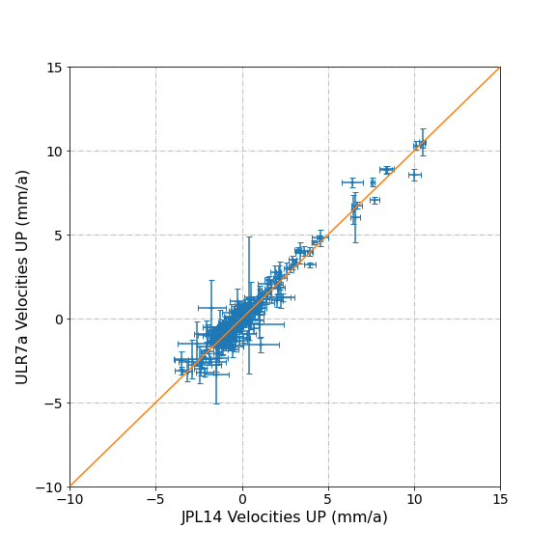
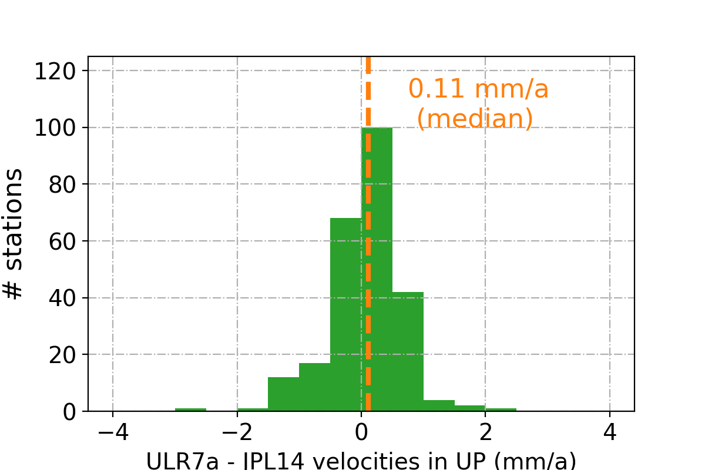
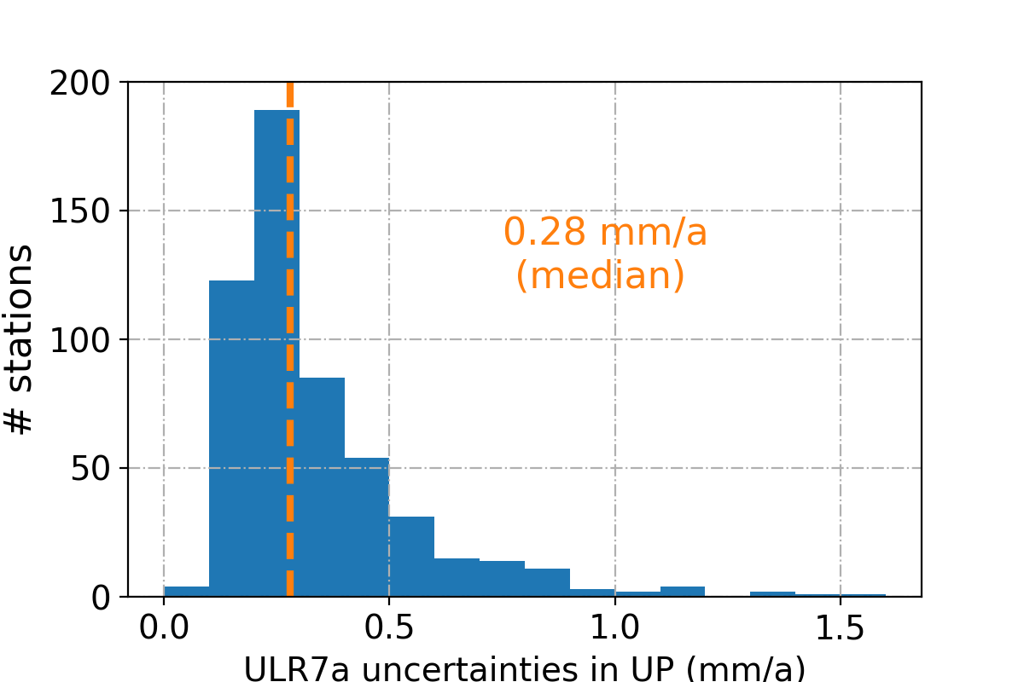
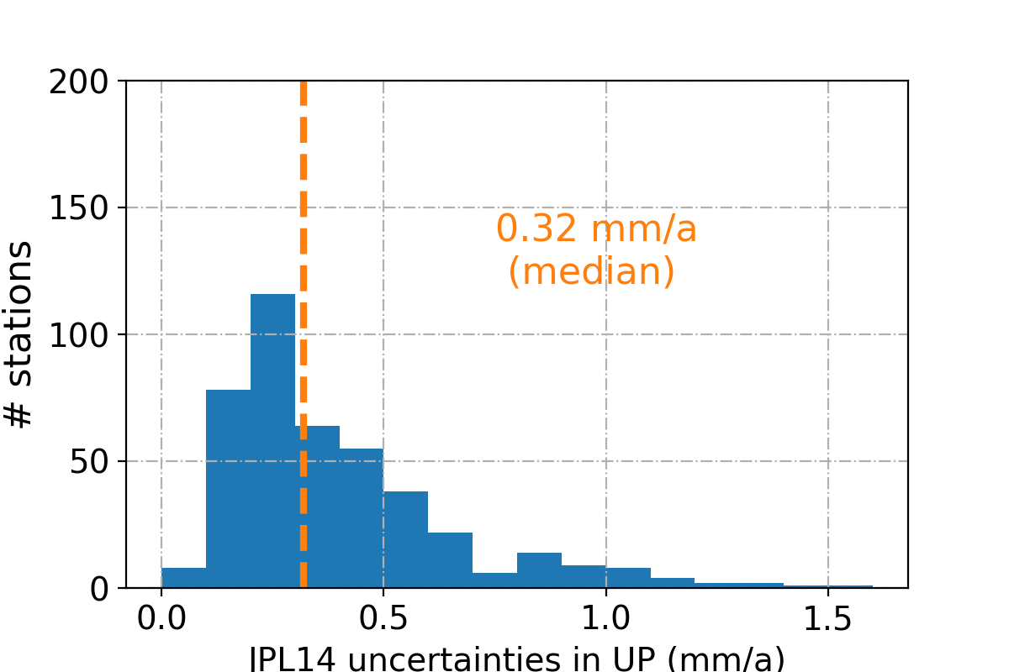
GPS vertical velocities : ULR vs JPL (NASA)
Source: https://sideshow.jpl.nasa.gov/post/series.html (Heflin et al. 2019)
  # stations in common : 248
  RMSE : 0.58 mm/a (WRMSE = 0.44 mm/a)
    RMSE of 1.0 mm/a using IGS-repro2 vers.
Notes:
The RMS of differences between JPL and ULR velocities has reduced to 0.6 mm/a (instead of 1.0 mm/a using repro2)
with a median difference of 0.11 mm/a indicating no obvious RF alignment bias.

Slide 12
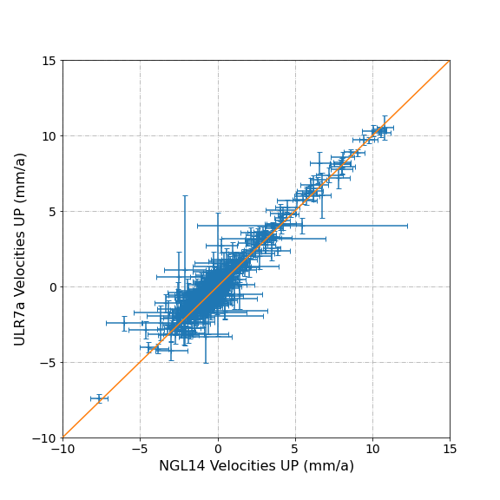
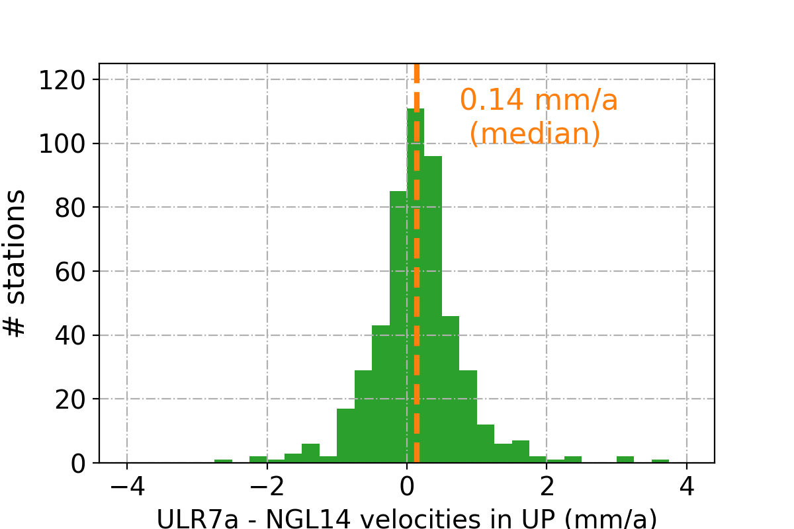
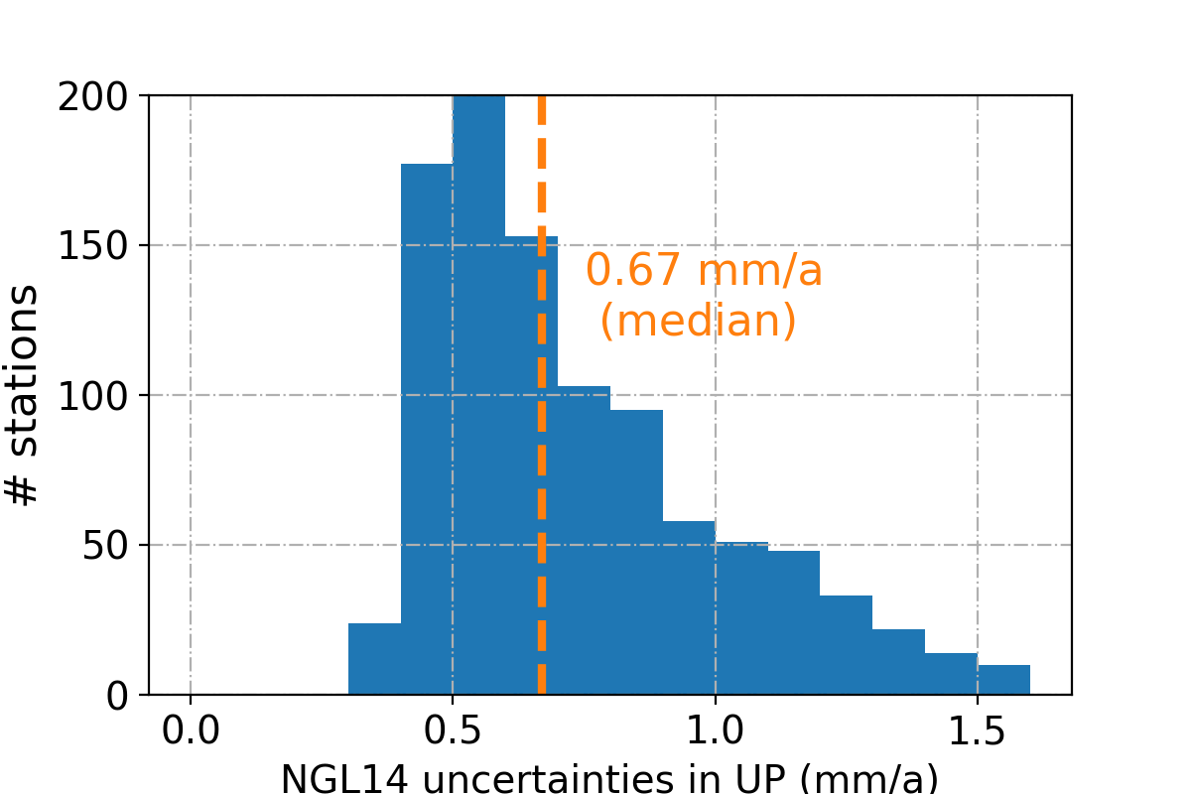
GPS vertical velocities : ULR vs NGL
Source: http://geodesy.unr.edu/ (Blewitt et al. 2018)
  # stations in common : 504
  RMSE : 0.67 mm/a (WRMSE = 0.49 mm/a)
    RMSE o 0.85 mm/a using IGS-repro2
Notes:
The RMS of differences between ULR & NGL velocities has also reduced to 0.66 mm/a, instead of 0.85 mm/a,
with a median difference of 0.14 mm/a indicating no obvious RF alignment bias.
Note that here the NGL solution has not participate to repro3 or repro2. They use the JPL products (orbits & clocks) in a strategy as uniform as possible, complying with most IGS standards for repro., implemented in GipsyX

Slide 13
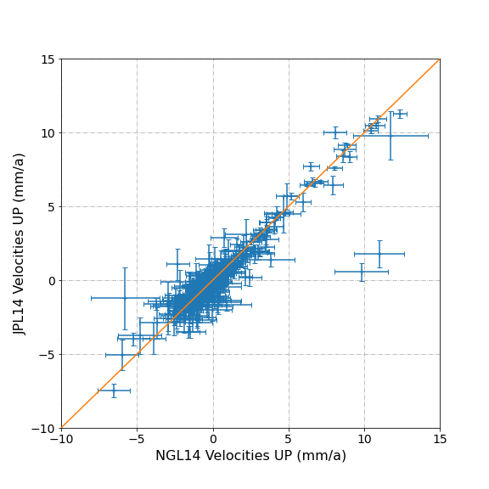
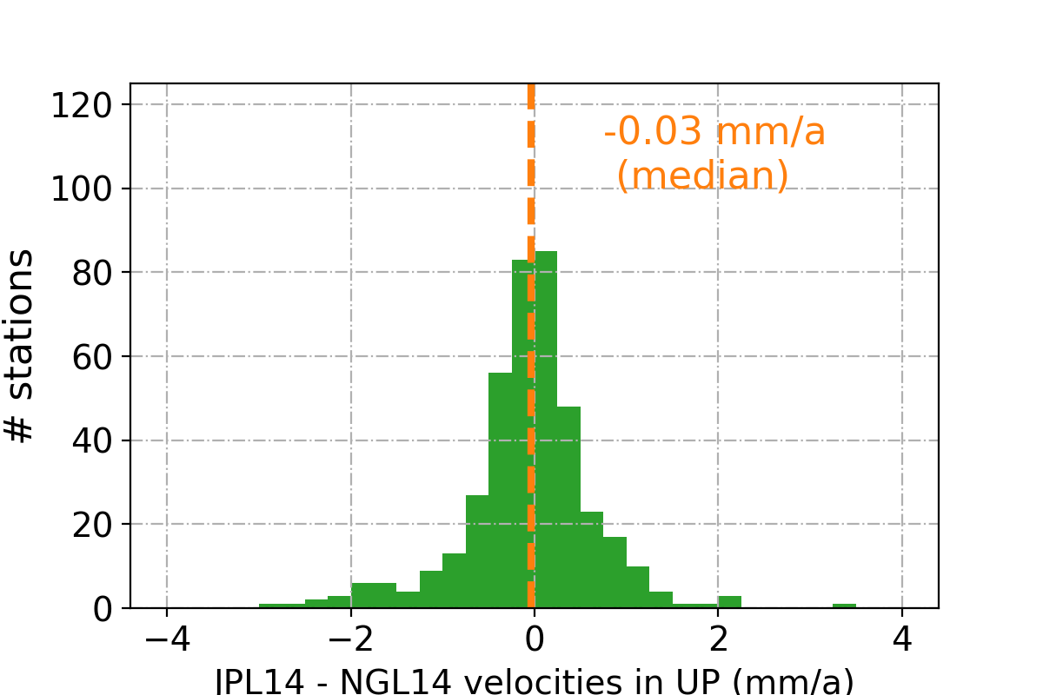
GPS vertical velocities : JPL vs NGL
Source:: https://sideshow.jpl.nasa.gov/post/series.html (Heflin et al. 2019)
http://geodesy.unr.edu/ (Blewitt et al. 2018)
Sources:
  # stations in common : 408
  RMSE : 1.01 mm/a (WRMSE = 0.58 mm/a)
    Same software (GipsyX)
    & same data analysis strategy at the raw measurement step (models, corrections)
Notes:
Finally, RMS (differences) between JPL & NGL is 1.0 mm/a with a median 0.0 mm/a, which could be anticipated (JPL products).
We see the largest RMS between JPL and NGL.
This is interesting as both use GipsyX for 1st major step, whereas they differ for the 2nd step: JPL using a LSQ parametric approach but not NGL (MIDAS non-parametric algorithm).
Now, I would like to turn to a local SL user-driven case study, involving the stations of Brest in France and Newlyn in UK to further highlight similarities and differences that can arise to the non-expert GNSS users.

Slide 14
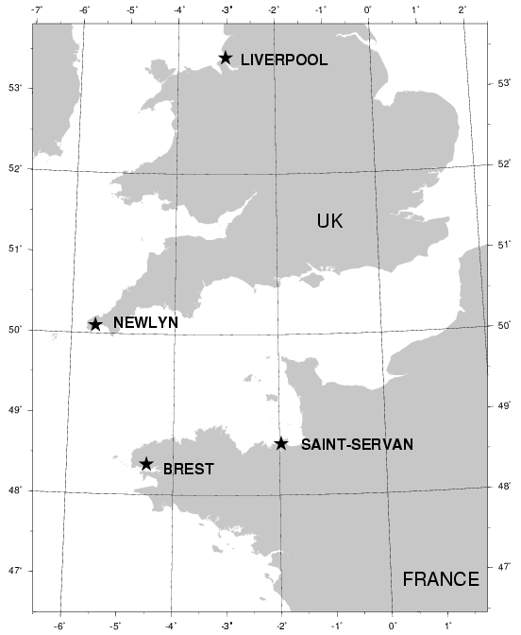
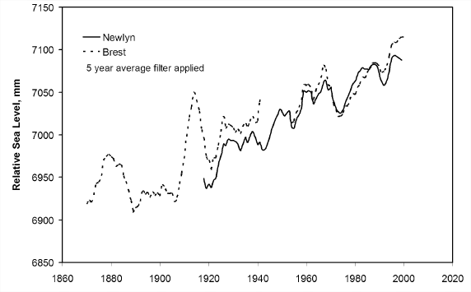
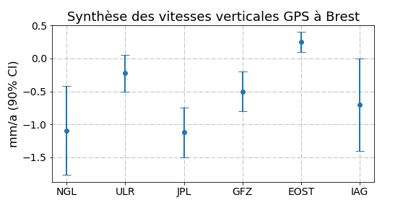

Case study of Newlyn versus Brest
 | Newlyn | Brest | Différence
Marégraphe | 1.8 ± 0.1 mm/a | 1.4 ± 0.1 mm/a | 0.4 mm/a
~210 km
Douglas (2008):
Brest: 1.3 ± 0.1 mm/yr
Newlyn: 1.7 ± 0.1 mm/yr
(common period)
Subsidence at Newlyn (-0.4 mm/a) ?
GPS (JPL) | -0.45 ± 0.3 mm/a | -1.1 ± 0.3 mm/a | 0.65 mm/a
GPS (NGL) | -1.2 ± 0.4 mm/a | -1.1 ± 0.4 mm/a | -0.1 mm/a
GPS (ULR) | -0.5 ± 0.2 mm/a | -0.2 ± 0.2 mm/a | -0.3 mm/a
GPS (GFZ) | -0.55 ± 0.3 mm/a | -0.5 ± 0.3 (< 2015.9)
GPS (IAG WG) | -0.7 ± 0.1 mm/a | -0.7 ± 0.1 mm/a
GPS (EOST/ITES) | -0.8 ± 0.2 mm/a | +0.3 ± 0.2 mm/a | -0.5 mm/a
Notes:
The map on the left shows the location of these two stations,
and the plot is from Douglas (2008) who noted the differences in SL trends over the common period during the 20thC
Douglas claimed the diff. was significant and tried to find out the cause (without convincing success).
I reproduced the trends here on the top, they are similar within the error bars, in particular the difference.
This difference could be explained by a subsidence of…, or the stronger subsidence than Brest of this magnitude
Let’s search at SONEL portal to see whether the larger RSL trend at Newlyn could be confirmed by this hyp.
I first show the JPL which actually is the closest to the anticipated subsidence at Newlyn as… However,…
I then went to NGL (which has become popular among non-expert GNSS geophysicists since the EOS article in 2018).
Prudence avec les résultats GNSS. On est aux limites de l’état des connaissances et de la précision.
Les valeurs centrales, bien sûr, mais aussi les incertitudes …
plus on avance, plus grandes sont les incertitudes… car on sait mieux les évaluer)
Rappel résultats TG:
Brest : 1.4 +/- 0.1 mm/a [1900;1990]; 2.8 +/- 0.6 mm/a [1991;2016]; 0.0 +/- 0.1 mm/a [1807;1900[
Newlyn: 1.8 +/- 0.1 mm/a [1915;1990]; 4.0 +/- 0.6 mm/a [1991;2016]
>> Autrement dit, différence de 1.8 – 1.4 = 0.4 mm/a, est-ce NEWL subside ? -0.4 mm/a ?
Résultats GPS :
BRST: -0.22 +/- 0.17 mm/a (ULR7a); {-0.10 +/- 0.11 mm/a (ULR6b)}; -1.12 +/- 0.23 mm/a (JPL14); -1.09 +/- 0.41 mm/a (NGL14)
NEWL: -0.50 +/- 0.18 mm/a (ULR7a); {-0.28 +/- 0.14 mm/a (ULR6b)}; -0.45 +/- 0.31 mm/a (JPL14); -1.16 +/- 0.39 mm/a (NGL14)
Différences par centre d’analyse :
NGL14 >> différence (NEWL – BRST) -0.1 mm/a (trop faible)
JPL14 >> +0.7 mm/a (amplifie la différence!)
ULR6b >> -0.18 mm/a (réduit la différence de 45%)
ULR7a >> -0.28 mm/a (réduit la différence de 70%)

Slide 15

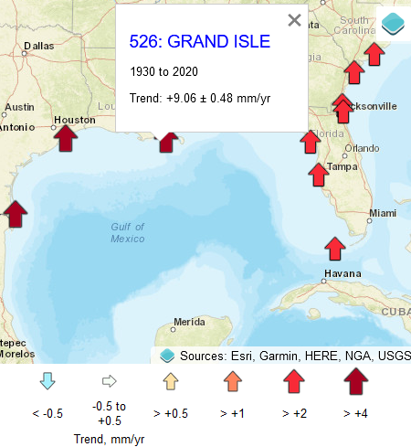
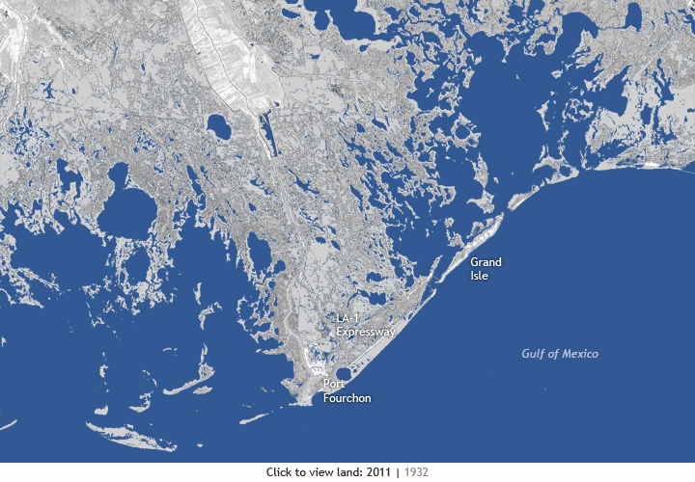
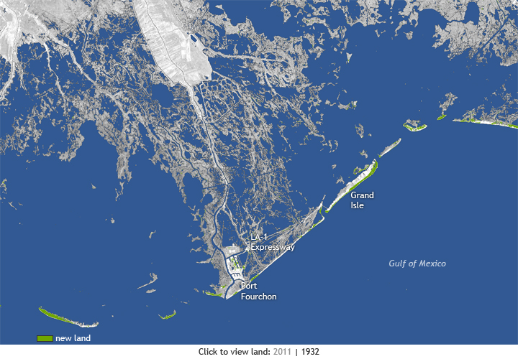
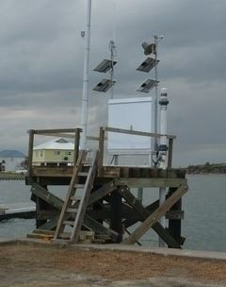
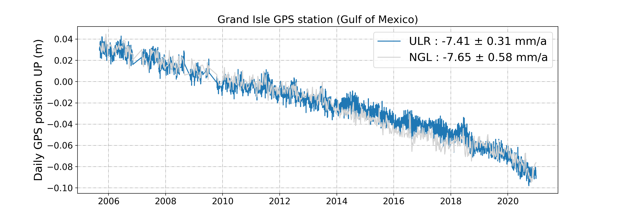
Another illustration with multiple solutions (Grand Isle)
Maps by NOAA Climate.gov team (Stephen Gill)
Tide gauge
Tide gauge
1932
2011
Marégraphe de Grand Isle
Notes:
GRIS is at 100 m from the TG.
http://www.climatewatch.noaa.gov/image/2013/underwater-land-loss-in-coastal-louisiana-since-1932
Kolker et al. (2011). Temporal patterns of subsidence are closely linked to subsurface fluid withdrawal and coastal land loss, and suggest changes in withdrawal rates can both increase and decrease rates of subsidence and wetland loss.

Slide 16
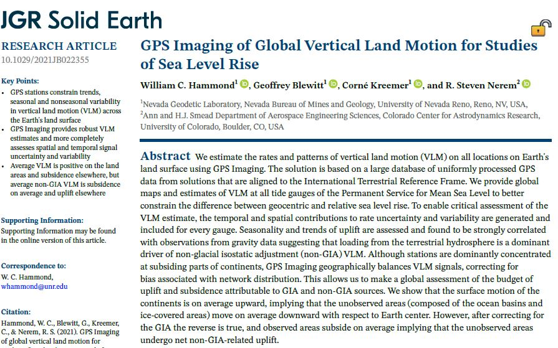
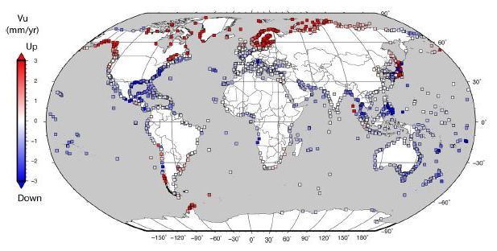
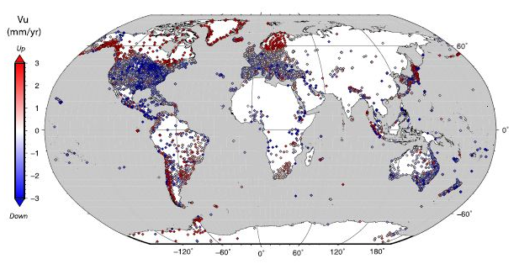
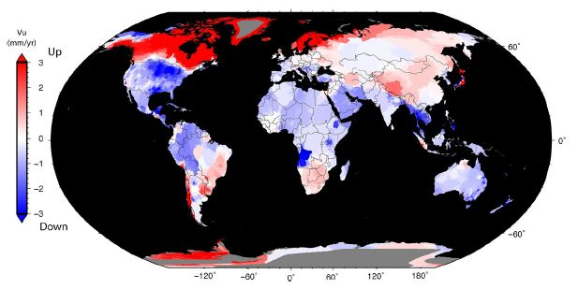
Vertical rates (GPS imaging) at tide gauges of PSMSL dataset
Notes:
Figure 10. Vertical rates at tide gauges of the Permanent Service for Global Mean Sea Level (Holgate et al., 2013).
See Supplementary Table S1 for rates at each tide gauge along with list of GPS stations that contributed to the rate and associated temporal and spatial uncertainty parameters.

Slide 17
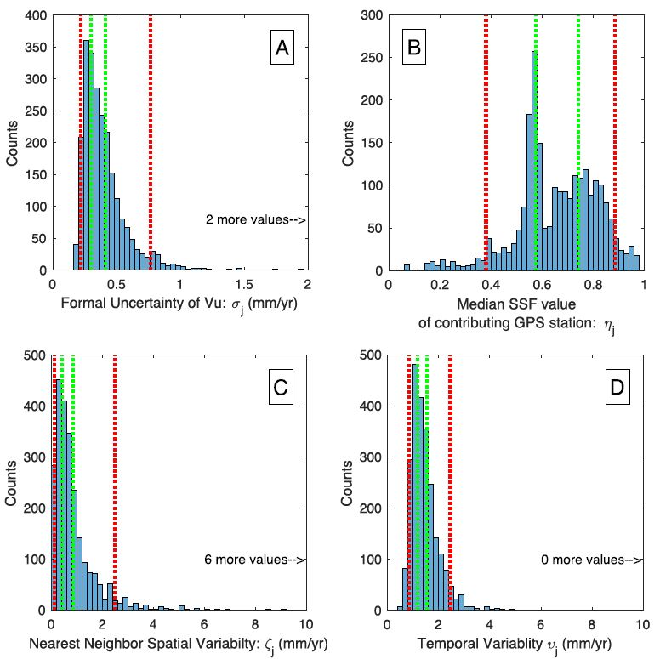
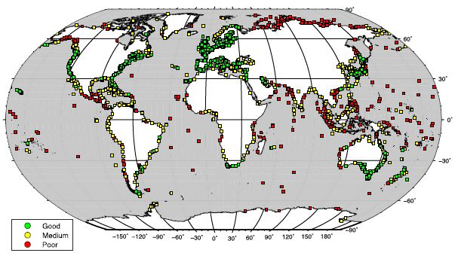
33.1% fall into the « good » category
15.5% fall into the « poor » category
51.4% (remainder) medium quality
Notes:
Figure 12. Histograms of the uncertainty parameters of GPS Imaged vertical land motion (VLM) rates at tide gauge locations.
MIDAS rate uncertainty,
ssf value at distance to nearest GPS station,
nearest neighbor variability, and
temporal rate variability.
Vertical bars (green) indicate terciles separating lower, middle, and upper third of data and limits of 5% and 95% percentiles of the data (red dashed lines).
These are used to divide tide gauge stations into sets with good, medium, and poor GPS estimates of VLM (see Figure 13).
Figure 13. Map indicating by color whether vertical land motion estimate at tide gauge location is good (green), medium (yellow), or poor (red) according to criteria discussed in text.
We consider a VLM constraint at a tide gauge “good” if it none of its uncertainty measures lies in the worst tercile. This corresponds to the condition A < 0.42 mm/yr, D < 0.86 mm/yr, C < 1.54 mm/yr, and B > 0.57.
In this case, the 33.1% of the tide gauges fall into this “good” category.
We call a VLM constraint “poor” if any of its uncertainty are in the 95% percentile, that is, among the worst 5% of the values.
In this case, the 15.5% of the tide gauges fall into this “poor” category
The remaining tide gauges have medium quality, and these comprise 51.4% of the gauges.

