Slide 1
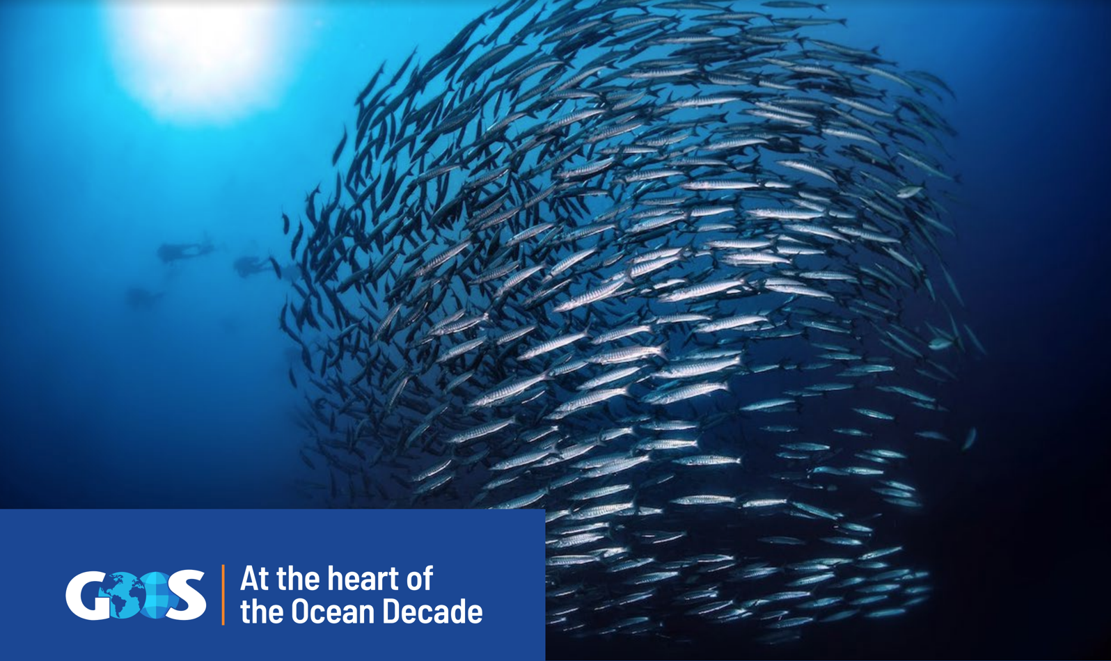

Slide 2
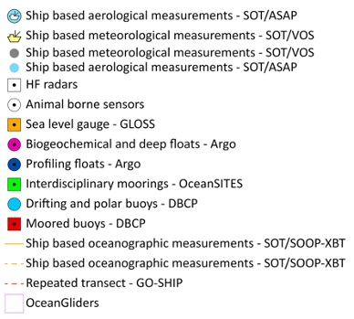
GOOS Today
84 countries, 8,700+ observing platforms, 13 global networks
More than 100,000 observations per day - delivering an accessible, safe and productive ocean
Global observing networks, e.g. Argo, GO-SHIP, GLOSS, Drifting Buoys, plus emerging networks, e.g., OceanGliders, HF Radar.
“The weather forecasting systems will run off the rails if they don’t have the surface pressure information over the ocean to constrain them” - Lars Peter Riishojgaard, Director of the Earth System Branch WMO
www.ocean-ops.org/reportcard2022
Notes:
In the last 30 years, GOOS developed -
Mature networks drifting buoys, voluntary observing ships, tide gauges, Argo floats, and emerging networks; HF Radar, ocean gliders
Ocean Observing is big science

Slide 3
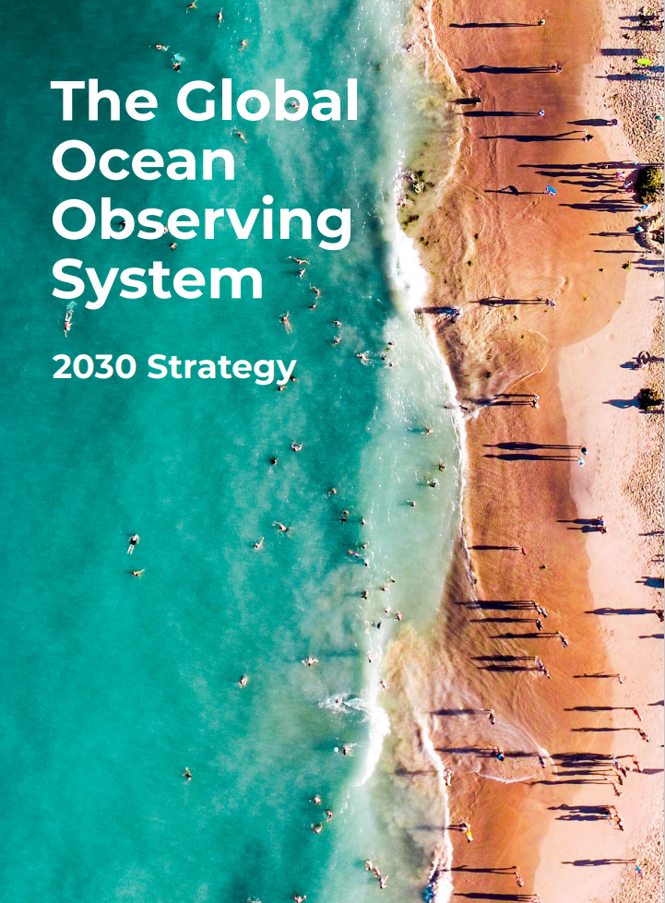
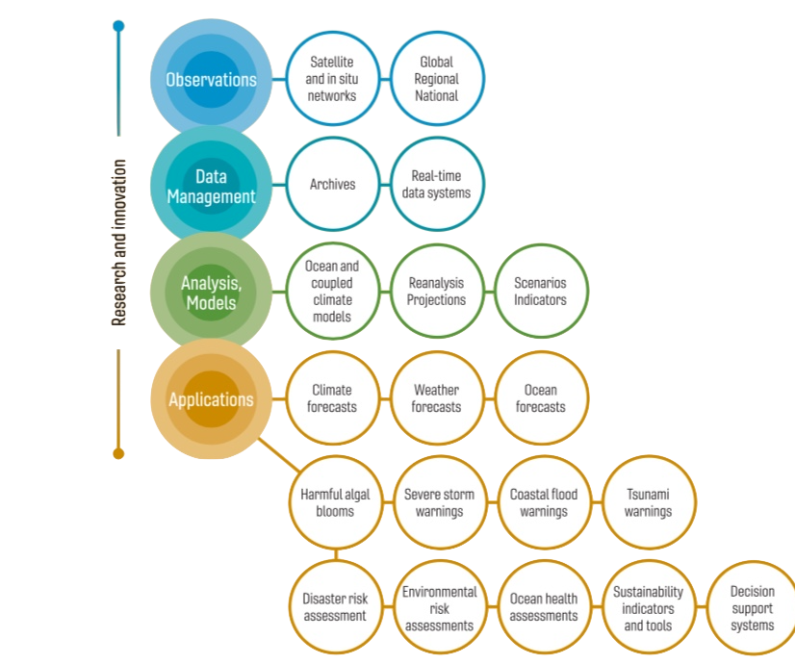
Underpinning a wide range of applications

Slide 4
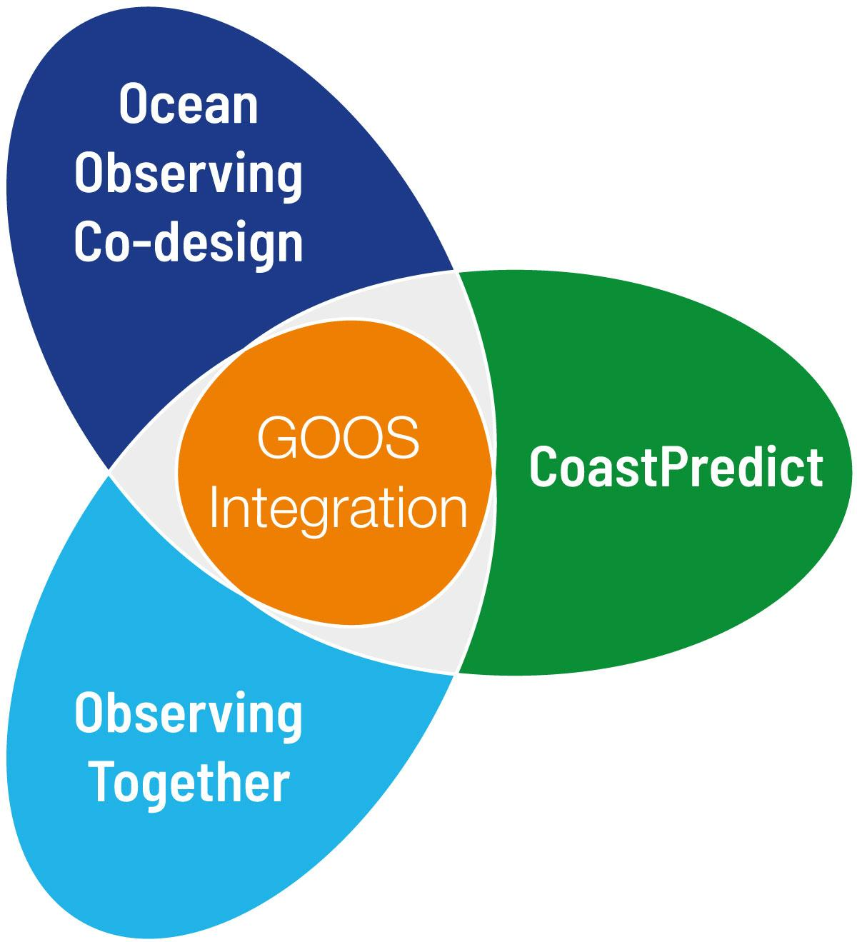
3 TRANSFORMATIVE PROGRAMMES FOCUSING ON KEY AREAS OF:
CO-DESIGN
COASTAL OCEAN
CAPACITY DEVELOPMENT
Notes:
Strengthen and evolve the Ocean Observing System

Slide 5
Transformational for GOOS and the Ocean Decade
Ocean Observing Co-Design Transforming our ocean observing system assessment and design processes
CoastPredict
Revolutionising Global Coastal Ocean observing and forecasting
Observing Together
Connecting ocean observers and the communities they serve to transform ocean data access and availability
Co-chairs:
David Legler, NOAA, USA
Sabrina Speich, IPSL, FRANCE
Co-chairs:
Nadia Pinardi, UNIBO, ITALY
Joaquín Tintoré, SOCIB, SPAIN
Villy Kourafalou, Univ. of Miami, USA
Co-chairs:
Molly Powers, SPC, FIJI
Alvaro Scardilli, Naval Hydrographic Service, ARGENTINA

Slide 6
Transforming our ocean observing system assessment and design process
Programme leadership: David Legler, NOAA; Sabrina Speich IPSL; Emma Heslop, IOC/UNESCO
Programme support: Andrea McCurdy, Ocean Leadership; Mairéad O’Donovan, GOOS - IOC UNESCO; Ann-Christine Zinkann, NOAA
This programme is endorsed by the UN Decade of Ocean Science
Notes:
Demands for ocean information are on the rise. We have the tools, and the technologies. OUr aim is indeed to transform how we think and implement our ocean observing system. We will move towards a system driven by users and stakeholders and more quickly showing benefit to ocean observing investment.
Acknowledging my co-chairs Sabrina and Emma and our expanding international team of expert partners supporting our activities.
THe response to this workshop and to the Exemplar development discussions has been, well, simply incredible. We’ve had over 300 registrants to today’s meeting.

Slide 7
Exemplars – how they work
CO-DESIGN: a continuous, collaborative, iterative process involving all stakeholders - observing system implementers, data managers, modeling/assessment, service providers & / or users
Exemplars
> focus on specific user groups > map value chain & evaluate existing connections to identify appropriate level of ‘user’ to participate in co-design
> elevate collaboration with existing elements of the value-chain i.e.
ocean observing system components / modelling / services > co-develop observing system design, assess Return On Investment > develop recommendations for addressing gaps in the value-chain
Develop best practices
Implement recommendations as part of GOOS infrastructure
tools that track, evaluate, and communicate recommendations
Notes:
This statement sums up the ambition of the Ocean Observing Co-Design programme. By 2030 we want to have processes and tools that will be modular and globally applicable to evaluate observing systems in order to inform investment. Sponsors will be able to ask key questions about cost and benefit and receive clear answers.

Slide 8
ACHIEVEMENTS SO FAR!
Carbon Cycle
First set of exemplars around use areas
Design an ocean observing system, its products and services with stakeholders
Determined lessons learned and challenges of successful co-design
Give voice and visibility to community needs
Engage with stakeholders, funders, government departments and communities
Determine the value chain, from the observations through to end users
MarineLife 2030
Storm Surge
Marine Heatwaves
Tropical Cyclones
Boundary Currents
Notes:
The outcomes of the programme will be modular diagnostics and tools for reporting …. For example digital scenario tools that work backwards from an intended impact to give a priority plan for observing.

Slide 9
WORKSHOP JUNE 2022 LEARNINGS
Resourcing co-design processes incl. effective engagement with users
Paradigm shift away from conventional measure of scientific success
Demonstrate benefits to society
Optimising observations to address user needs
Collaboration across the value-chain
Notes:
We are building initial capacity through the use of exemplars, these are focused projects targeting an identifiable societal need and for which there are promising capabiliies across some parts of the value chain.
These exemplars are intended to develop and demonstrate a co-design process that is dynamic, interactive, and inclusive. Of course key to each exemplar is the engagement of stakeholders.
THese exemplars are just the first set of what we anticipate will be an expanding set of needs, inspired and driven by stakeholders for specific purposes of high societal relevance and need.
THe focus of these exemplars will help provide a voice, visibility, and attract interest of others who will make it successful.

Slide 10
SUPPORTERS FORUM
Interactive sessions unveiling Programme’s first innovative Co-Design Projects and provide an opportunity to explore collaborate to progress this pivotal initiative for GOOS
OCG Networks | 28.11
GOOS and other coordination groups | 29.11
Regional Ocean Observing Systems | 05.12
National ocean observing and forecasting | 06.12
Open Co-Design session | 12.12
Ocean Prediction groups | 13.12
*OCG - Observations Coordinations Group
Notes:
We cannot achieve everything in one workshop! This initial workshop will be very focused on 3 aims:
Advance preparations of proposals outlining activities to progress their co-design activities with an intention to propose these exemplar activities to funders later this year
Draft a paper on our current understanding of ocean observing co-design principles and practices
Develop appropriate materials and prepare to advertise these exemplar co-design projects at upcoming UN Ocean Confernece and other venus
Thank you all for joining us today

Slide 11
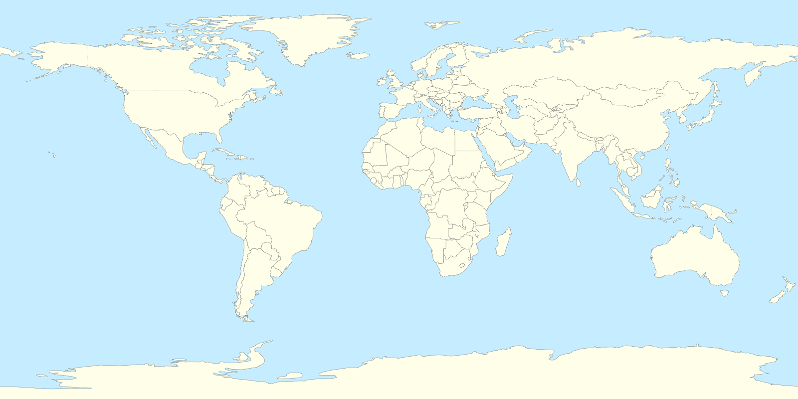
PILOT AREAS
Carbon
ML
MHW
B Currents
MHW
Trop Cyclones
MHW
MHW
Trop Cyclones
Trop Cyclones
ML
MHW
MHW
B Currents
MHW = Marine Heatwaves ML = Marine Life

Slide 12
Meeting stakeholder needs and making every observation count
Co-chairs: Molly Powers (Pacific Community)
Alvaro Scardilli (Naval Hydrographic Service, Argentina)
This programme is endorsed by the UN Decade of Ocean Science

Slide 13
PRINCIPLES FOR PROJECTS:
Aim is sustained ocean observations, i.e. not one-off research project observations;
Engagement with GOOS components (networks, systems, etc);
Adherence to using and / or contributing to creating community adopted best practices;
Adherence to FAIR [findable, accessible, interoperable, and reusable] data principles;
Willingness to share experience and lessons learnt across Observing Together
Willingness to engage in co-design activities to improve observing system fit for purpose and to optimise the observations to inform stakeholder decision-making

Slide 14
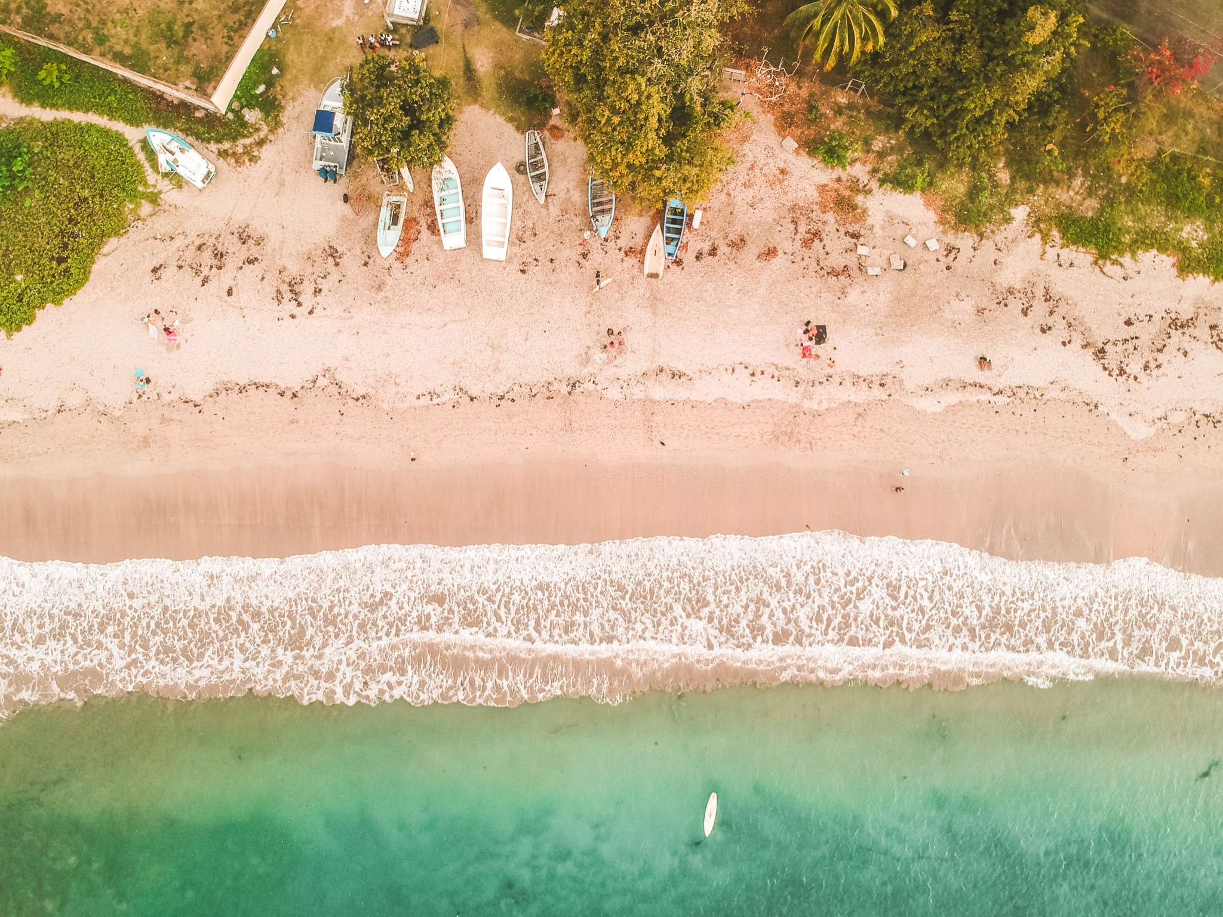
NATIONAL OBSERVING SYSTEMS DEVELOPMENT
Enhancing ocean observing system within the Republic of Mauritius
Enhancement of hydrographic and oceanographic observations in the Kingdom of Morocco
enhancement of ocean knowledge and forecasting by developing and enhancing national system
contribute to the regional programmes of African / Indian Ocean regions
strengthen capacity in terms of platforms and network development
develop modelling capabilities
benefit from and adhere to best practices
Photo by Guillaume Baudusseau on Unsplash

Slide 15
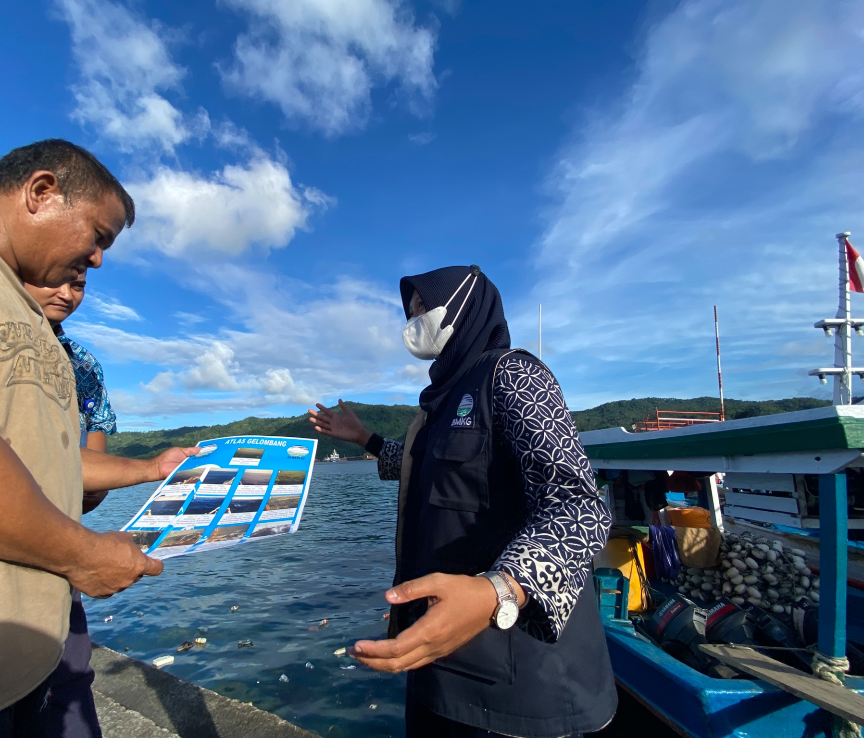
END-USER ENGAGEMENT
Fisherman Weather Field School (BMKG Indonesia)
AtlantOS-Connect
engagement with communities to support understanding of the information provided by weather and ocean services for the benefit of people’s safety
optimisation of fishing & aquaculture activities
awareness of equipment vital role, to reduce vandalism
connecting observing to end-user communities via national & regional entities
identify common challenges and needs of coastal communities
Photo © BMKG / Sekolah Lapang Cuaca Nelayan (SLCN)

Slide 16
NEW OBSERVERS
Sailing 4 Science (NTNU Norway)
focus on remote, understudied coastal ocean often coinciding with SIDS or low income communities, where capacity building must be carefully co-designed
deploy frugal innovation, and cost-effective observation tools that exploit recent transformative technologies
data collection will be important for ocean literacy and awareness activities
Notes:
The co-created, crowd-sourced data is valuable in itself but the collection process will be important ocean literacy and awareness activities additionally.

Slide 17
Revolutionising Global Coastal Ocean observing and forecasting
Nadia Pinardi, University of Bologna
Villy Kourafalou, University of Miami
Joaquín Tintoré, Balearic Islands Coastal Observing & Forecasting System
Emma Heslop, GOOS, IOC/UNESCO
This programme is endorsed by the UN Decade of Ocean Science

Slide 18
CoastPredict update: ENDORSED PROJECTS
Focus Area 1:
Integrated observing and modelling for short term coastal forecasting and early warnings
CORE PROJECT: PredictOnTime will develop systems to observe and predict natural extreme events in the global coastal ocean 2 x AFFILIATED PROJECTS
Focus Area 2:
Earth system observing and modelling for coastal climate monitoring and downscaling
CORE PROJECT: Future Coastal Ocean Climates - downscaled projects for coastal ocean climates and impacts
AFFILIATED PROJECT: European Knowledge Hub on Sea Level Rise
Focus Area 3:
Solutions for integrated coastal management
AFFILIATED PROJECT
>Mangroves as Nature-based Solutions to Coastal Hazards in Eastern Ghana
10 world ocean areas
where
CORE projects
will be piloted
Focus Area 4:
Coastal ocean and human health
Focus Area 5:
International open and free access to coastal information
CORE PROJECT: Coastal Ocean Resource Environment
Focus Area 6:
Equitable coastal ocean capacity

Slide 19
The challenge: expand operational oceanography to the global coastal ocean
The CoastPredict solution:
coastal new technologies and best practices
LARGE SCALE
COASTAL SCALE
● MOORED BUOY ARRAYS
● SOOP EXPANDABLE
SATELLITE SENSING:
SEA LEVEL,
SEA SURFACE
TEMPERATURE,
SEA SURFACE SALINITY,
COLOR, WINDS
● DRIFTING BUOYS
(SURFACE AND SUBSURFACE)
● GLIDERS
HF RADAR HR SATELLITE
AERIAL SURVEYS/DRONES
TIDE GAUGES
REPEATED MULTIPARAMETRIC SECTIONS
COASTAL RADARS
CITIZEN SCIENCE MONITORING
●AUTONOMOUS UNDERWATER
VEHICLES
CABLED MULTIPARAMETRIC STATIONS
● RIVER RUNOFF AND LOADING
MONITORING
SEDIMENT/WQ MONITORING
Real time with
international
standards
and protocols,
open and
free data
OBSERVING
SYSTEM
MODEL PHYSICS
PRIMITIVE EQUATION (> 1-5 KM)
TURB. PARAMETERISATIONS
MODEL PHYSICS
PRIMITIVE EQUATION (<1- 5 KM)
● TURBULENCE AND LIGHT
SUBMODELS
RIVER CATCHMENT
AND ESTUARIES
Short term
predictions
and climate
coastal
downscaling
DATA ASSIMILATION
OPTIMAL INTERPOLATION
3-DVAR, KALMAN FILTER
DATA ASSIMILATION
● KALMAN FILTERS
● ADJOINT MODELS
BIOCHEMICAL MODELS
● PELAGIC COMPARTMENT
● BENTHIC CLOSURE
PREDICTING
SYSTEM
BIOCHEMICAL MODELS
● PELAGIC COMPARTMENT
● BENTHIC-PELAGIC COUPLING
● SEDIMENT DYNAMICS
ATMOSPHERIC FORCING
OPERATIONAL ANALYSES AND FORECASTS FROM GLOBAL SCALE MODELS
ATMOSPHERIC FORCING
OPERATIONAL ANALYSES AND FORECASTS FROM LIMITED AREA MODELS
Notes:
CoastPredict is going to develop both observing and modelling for predictions considering the experience at the large scale. For the Coastal scale CoastPredict is going to start new networks with emerging technologies, developing the international standards and develop new modelling to consider the emerging definition of the global coastal ocean and the need of calibrated/validated coastal models

Slide 20
HOW CAN THE PROGRAMMES ALIGN AND SUPPORT OOPC ACTIVITIES?
Co-Design
Supporters Forum Session for GOOS Panels - November 29 @ UTC 1400
GOOS Implementation Plan actions - potential synergies relate to Ocean Observing Co-Design - focal points to engage with relevant exemplars?
CoastPredict
Core projects engagement - coastal climate Focus area?
CoastPredict General Assembly January 17-18 2023
Observing Together
Support the projects as expertise required

Slide 21
Thank you
goosocean.org
Programme support:
Mairéad O’Donovan m.o-donovan@unesco.org

Slide 22
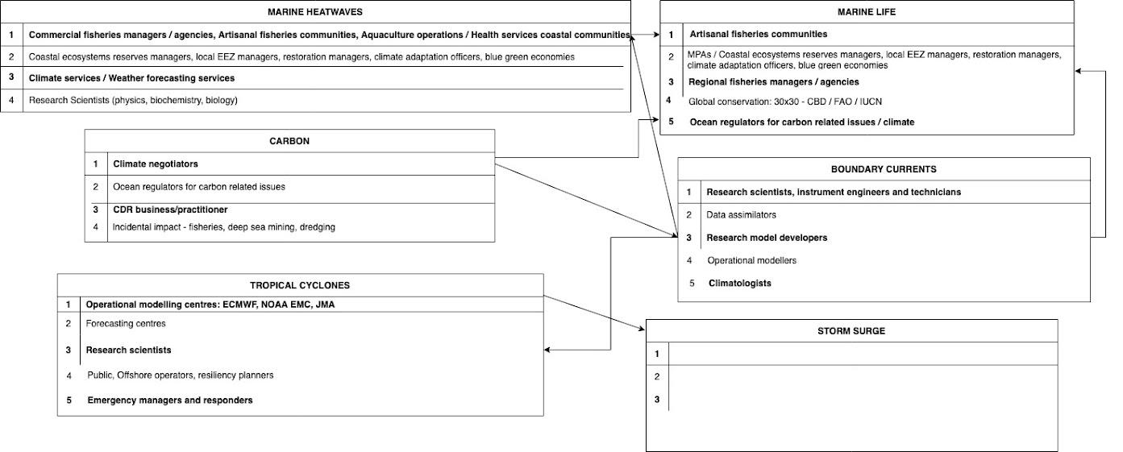
TARGET USER COMMUNITIES

Slide 23
CoastPredict update: DECADE COLLABORATIVE CENTRE for COASTAL RESILIENCE hosted by University of Bologna
Started 1 Sept 2022
All agreements between UNIBO and funders concluded
Director nominated: N.Pinardi
Office space defined
Two personnel units joining Oct. 5 and 17: Junior programme specialist and admin person
Senior Programme Specialist/Chief Scientist call for application published
Next week calls: 1) Senior Communication Officer; 2) Information system Officer
International representatives procedures being established

