Slide 1

Intergovernmental Coordination Group for the
Pacific Tsunami Warning and Mitigation System (ICG/PTWS)
Exercise Pacific Wave 2022 (PacWave22)
Informational Webinar
13 September 2022, 0300 UTC - English / 1900 UTC - Spanish
Margarita Martinez, SENAPRED, Chile
Emilio Talavera, INETER, Nicaragua
Co-Chairs, Task Team on PacWave22
Notes:
Good afternoon
On behalf Emilio Talavera and i I would like to welcome to you all to this meeting.

Slide 2
Informational Webinar: Overview (1)
  1900 - 1905 1. Bienvenida, palabras de apertura (5 min) – Co-del ICG/PTWS, Dr. Strauch.
  1905 - 1920 2. Resumen, IOC CL y Manual (15 min) - TT PacWave Presidentes, Sr. Emilio Talavera y Margarita Martinez
  1920 - 2000 3. Ejercicios Regionales (10 min/Región)- GT SEP, Teniente Jorge Matus
  Herramientas para generar productos para ejercicios (10 min) - ITIC, Carolina Hincapie
  2010 - 2025 5. Preguntas y respuestas (15 min) - Presidentes de TT PacWave, Sr. Emilio Talavera y Margarita Martínez.
  2025 - 2030 6. Comentarios de clausura (5 min) - Presidente del ICG/PTWS, S Dr. Strauch.
Notes:
To answer questions related to PacWave22 as the Communication Test, Regional Exercises, available Tools and Post-Exercise Evaluations, the IOC and Pacwave22 is hosting this informational webinar

Slide 3
Manual (2)
  Objetivos
    Probar las comunicaciones de los TSP del PTWS A LOS Puntos focales de alerta de tsunamis (TWFP) y los NTWC de los Estados miembros interesados.
    Probar la comunicación, la cooperación y la preparación nacionales dentro de cada uno de los países participantes.
    Probar la comunicación y cooperación regional entre los estados miembros y sus TSP.
    Apoyar el desarrollo de procedimientos y productos de tsunami por parte de CATAC, un nuevo TSP potencial (en espera de la aprobación de CATAC de la funcionalidad completa por parte de los órganos rectores de la COI)
Notes:
the manual update involves a series of actions.
Among these we highlight:
The specifics characteristics of pacwave2022.
if there is any member country that already have settle a date for the Pacwave exercises
We need to ask this to the countries once the circular letter is sent. I propose to ask by e-mail this information, July 14.
The manual also include details about the evaluation tools.
The second questionaire will be used for the countries' individual excercises.
We hope the countries can address objetive b and c trough these excercises
Could you please explain it in more details
Questionnaire that we will use to asses Pacwave exercise :
We need to asses both the live test communication test that will be held 13 October this questionnaire will address objective a test communication test from the approved and developing tsunami service providers.
And other questionarire where will be addressed to gather informatón regarding objetive b, c and d if its approved in the .

Slide 4
Manual: Exersice and dates (3)
  Prueba de comunicaciones del proveedor de servicios de tsunamis.
    La prueba de comunicación en vivo ocurrirá a las 0000 el 13 de octubre de 2022.
    Los Estados miembros deben tener en cuenta cuándo recibirán el mensaje de prueba de comunicación en vivo e informar a través del formulario de evaluación posterior al ejercicio.
    El formulario debe completarse antes del 23 de octubre de 2022 a más tardar.
    Mensajes ficticios de ejercicios (Anexo I)
Notes:
The aim of the webinars is to answer questions related to the conduct of PacWave22, the ITIC and IOC will host PacWave22 informational webinars on 17 August 2022, 1900 UTC 24 August 2022, at 0300 UTC. Connection details will be sent to all PTWS TNCs and TWFPs via email
We need to discuss the topics that we want to address in the webinar
What things do you think we can talk about in the seminars
Regarding the speakers
Spanish: Margarita and Emilio
English : Carolina/Laura
French: Antoine
I know you have a lots of experience with tsucat, so do you think it could be a good topic to talk about
Emilio do you thin you could take care of catac matters.
iuta I would like to ask you if you could be a speaker a webinar

Slide 5
Manual: Exersice and dates (3)
  Los países pueden optar por realizar su propio ejercicio siguiendo los objetivos de PacWave22 en cualquier momento entre el 1 de septiembre y el 30 de noviembre.
      Formulario de evaluación posterior al ejercicio. El formulario debe completarse a más tardar el 21 de diciembre de 2022.
Notes:
The aim of the webinars is to answer questions related to the conduct of PacWave22, the ITIC and IOC will host PacWave22 informational webinars on 17 August 2022, 1900 UTC 24 August 2022, at 0300 UTC. Connection details will be sent to all PTWS TNCs and TWFPs via email
We need to discuss the topics that we want to address in the webinar
What things do you think we can talk about in the seminars
Regarding the speakers
Spanish: Margarita and Emilio
English : Carolina/Laura
French: Antoine
I know you have a lots of experience with tsucat, so do you think it could be a good topic to talk about
Emilio do you thin you could take care of catac matters.
iuta I would like to ask you if you could be a speaker a webinar

Slide 6
Manual: Further guidance (4)
  Planes y procedimientos de alerta de tsunamis y orientación de emergencia.
  Directrices sobre cómo planificar, realizar y evaluar ejercicios de tsunami.
  Preparación comunitaria para la evacuación ante tsunamis: desde inundaciones hasta mapas de evacuación, planes de respuesta y ejercicios.
  Día Internacional para la Reducción de Desastres y Día Mundial de Concientización sobre Tsunamis
  Programa de Reconocimiento UNESCO/COI Tsunami Ready
Notes:
The aim of the webinars is to answer questions related to the conduct of PacWave22, the ITIC and IOC will host PacWave22 informational webinars on 17 August 2022, 1900 UTC 24 August 2022, at 0300 UTC. Connection details will be sent to all PTWS TNCs and TWFPs via email
We need to discuss the topics that we want to address in the webinar
What things do you think we can talk about in the seminars
Regarding the speakers
Spanish: Margarita and Emilio
English : Carolina/Laura
French: Antoine
I know you have a lots of experience with tsucat, so do you think it could be a good topic to talk about
Emilio do you thin you could take care of catac matters.
iuta I would like to ask you if you could be a speaker a webinar

Slide 7
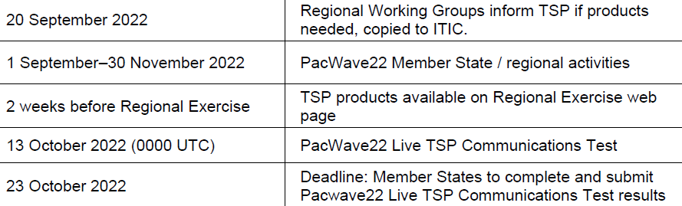
IOC CL N°2904 -31 of August 2022 (5)

Slide 8
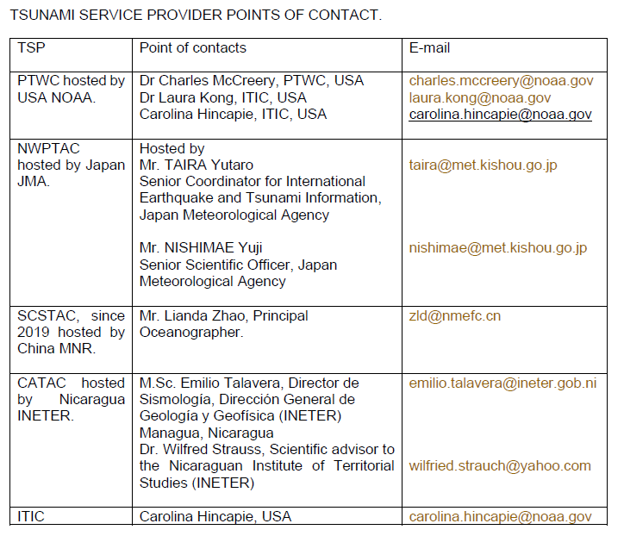
Manual: Points of contact (6)
Notes:
Regional Groups that would like to organize a joint exersice should contact the relevant TSP focal point, with copy to the ITIC, before the 20 of September. And refer to the specific user guide for the different products.

Slide 9
PacWave22 Task Team Members
Members
Mr Emilio Talavera (Nicaragua, Co-Chair) emilio.talavera@gf.ineter.gob.ni ; emilio.talavera@ineter.gob.ni [puede que el primer correo este desactivado]
Ms Margarita Martinez (Chile, Co-Chair)
Dr Charles McCreery, PTWC, USA charles.mccreery@noaa.gov
Dr Laura Kong (USA) laura.kong@noaa.gov
David Coetzee, NZ david.coetzee@nema.govt.nz
Mr Lianda Zhao, China zld@nmefc.cn
Jorge Matus, SHOA, Chile jmatus@shoa.cl
Carolina Henriquez, Chile chenriquez@shoa.cl
Laura González, Colombia l.gonzalez@dimar.mil.co
  Jo Guard - New Zealand
    Chip McCreery – USA, PTWC
Silvia Chacon – Costa Rica, CA-PAC ChairJasón Pérez, Colombia contaminacion.marina@cco.gov.co [consultar si tiene un correo personal]
Members
Anthony Jamelot, French Polynesia jamelot@labogeo.pf
Céline Barre (France) celine.barre@gouv.nc
Francois Schindele, France francois.schindele@gmail.com
Rodolfo Alvarado, Guatemala ralvarado@insivumeh.gob.gt
Yuji Nishimae, Japan nishimae@met.kishou.go.jp ; nishimae-yxmbtjh20vw@outlook.com [ el primer correo tiene limitaciones de hasta 1 o 2 MB para adjuntos]
Jorge Rodriguez, Panama jfrodriguez@pancanal.com
Eric Chichaco, Panama echichaco@yahoo.com ; eric.chichacor@up.ac.pa
Carolina Hincapie, ITIC, USA carolina.hincapie@noaa.gov
Sara Mitchell (New Zealand) sara.mitchell@nema.govt.nz

