Slide 1
Outline
15th Meeting of the Working Group on Tsunamis and Other Hazards related to Sea Level Warning and Mitigation Systems (TOWS-WG-XV
Report by Chair of ICG-NEAMTWS
Maria Ana Baptista
24 February 2022
(online)

Slide 2
Outline
1. Activities
2. Documentation
3. Nominations of TNC and TWFC
4. New Instruments
5. Intersessional Working Groups And Task Teams
6. 2023

Slide 3
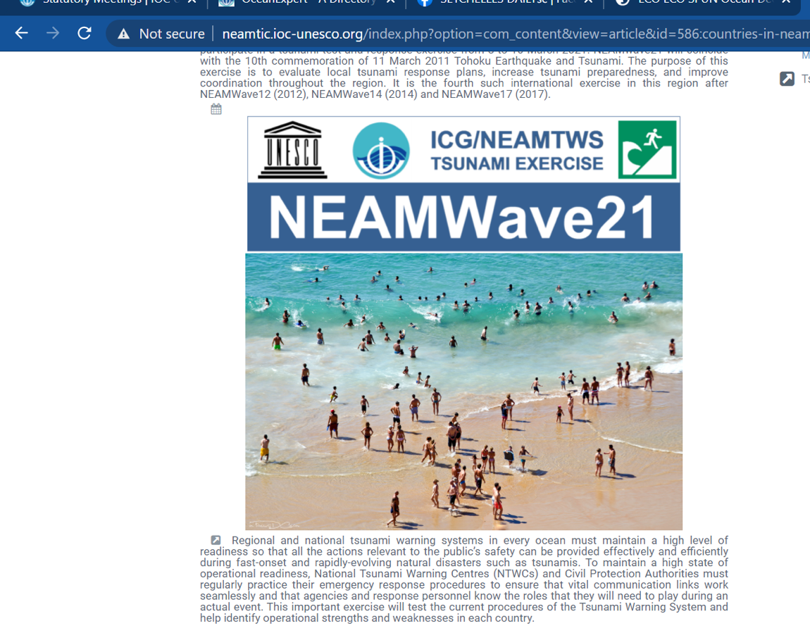
NEAMWAVE EXERCISE MARCH 2021
1. Activities - Exercise
The fourth tsunami exercise ‘NEAMWave21’ was conducted from 8 to 10 March 2021, corresponding to the 10th commemoration of the 11 March 2011 Tohoku Tsunami. Three different exercise scenarios were utilised for the North-Eastern Atlantic, and Central and Eastern Mediterranean regions, structured, and organised in 3 phases: Phases A, B and C.
The five accredited Tsunami Service Providers (TSPs) in the region issued exercise messages using three different scenarios prepared for the:
Eastern Mediterranean;
Central Mediterranean;
North-Eastern Atlantic domains.
Last event recorded Tonga tsunami was recorded in all tide stations of Portugal and Atlantic coast of Spain

Slide 4
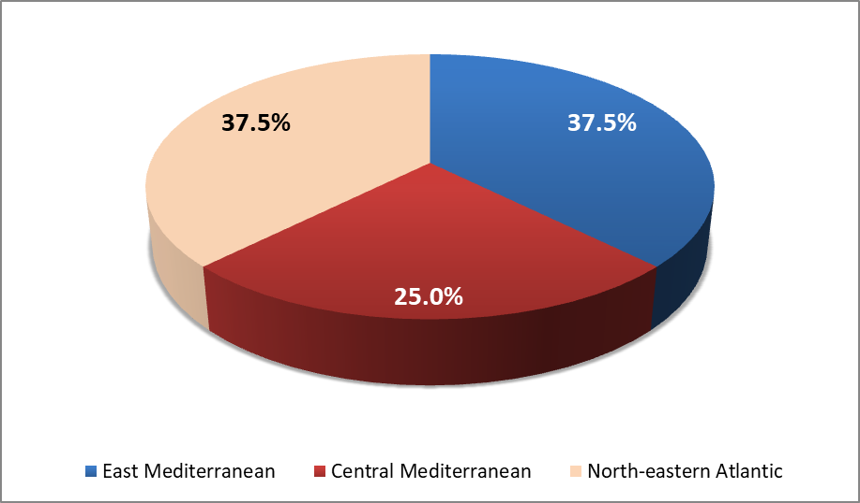
1. Activities - Exercise
08.03.2021, TSPs KOERI (Turkey) and NOA (Greece) executed one joint scenario in the Eastern Mediterranean based on an M7.7 earthquake along the western segment of the Cyprian Arc.
09.03.2021 TSP INGV (Italy) conducted a single scenario in the Central Mediterranean based on an earthquake of magnitude M7.9 occurring at the subduction interface of the Calabrian Arc.
On 10 March 2021, TSP CENALT (France) and TSP IPMA (Portugal) executed one joint scenario representing the North-Eastern Atlantic domain based on the 1755 M8.6 Lisbon earthquake that triggered a major tsunami
Member state participation in phase A (early warning)
detection of the earthquake event and the timely provision of the alert messages by the TSPS
The ICG/NEAMTWS in its 17th session notes, the positive results of the fourth tsunami exercise for the region. The group thanked the Co-Chairs of the Task Team on Exercises - Marinos Charalampakis and Ceren Ozer and members for drafting the NEAMWave21 Evaluation Report (in preparation)

Slide 5


1. Activities – CoastWave project
Among other scientific projects running in Europe The Group welcomed the approval of a new IOC European Union DG-ECHO (European Civil Protection and Humanitarian Aid Operations) NEAMTWS project on:
“Strengthening the Resilience of Coastal Communities in the North-Eastern Atlantic, Mediterranean Region to the Impact of Tsunamis and Other Sea Level-Related Coastal Hazards." CoastWave project
Kick-off meeting took place last 21 December 2021
Total: 1.2 M Euros
benefitting countries | North Eastern Atlantic and Mediterranean Sea: Cyprus, Egypt, Greece, Malta, Morocco, Spain, and Turkey
Technical Advise | France and Italy
Area of influence | 40 NEAMTWS Member States
Period | 01/09/2021 --- 30/03/2024

Slide 6
CoastWave project objectives
1. Activities – CoastWave project
Improved understanding of tsunami and sea-level related risks.
Better communication strategies to govern sea-level related risk
Enhanced real time detection and monitoring capacities
Improved framework for the sustainability of the existing Inexpensive Device for Sea Level (IDSL) Network
Improved alert/warning capacity
At least seven Tsunami Ready recognized communities by 2023

Slide 7

1. Activities - WTAD
The ICG/NEAMTWS,
Recognized the continued awareness raising efforts on tsunami hazards and preparedness by Member States during the intersessional period in line with and as a contribution to World Tsunami Awareness Day, 5 November 2021;

Slide 8
1. Activities - WTAD
The ICG/NEAMTWS,
Appreciated
the Tsunami Exercises conducted in Malta and France to commemorate the World Tsunami Awareness Day (WTAD);
Recognized the continued awareness-raising efforts on tsunami hazards and preparedness by the Member States.
An increasing number of MS organized activities on WTAD: Egypt, Greece, France, Italy, Malta, Portugal, Spain, Turkey
France Tsunami Exercise WTAD 2021

Slide 9
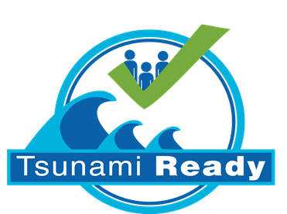
1. Activities – Tsunami Ready
The ICG-NEAMTWS in its 17 th session appreciated the progress and work carried out by The Tsunami Ready Group, within the Working Group 4, on Public Awareness, Preparedness and Mitigation during the intersessional period;
The ICG-NEAMTWS further appreciated the progress made by the communities of Bouches-du-Rhône and Cannes (France); Kos (Greece); Israel; Minturno, Pachino, Palmi (Italy); Marsaxlokk (Malta); Azores, Cascais, Lagos, Lisboa, Madeira, Portimão, Setúbal (Portugal); Chipiona (Spain), Bodrum and Istanbul (Turkey) towards becoming Tsunami Ready and prepared;

Slide 10
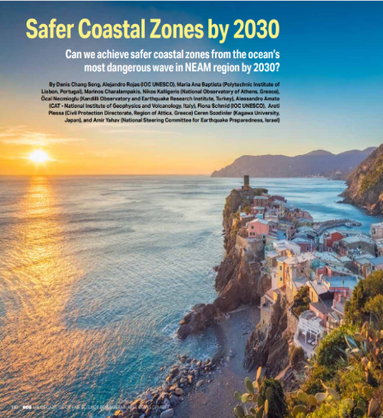
2. Documentation
ICG/NEAMTWS NEAMWave21 Exercise Manual
ICG/NEAMTWS Status on Tsunami Education Awareness and Preparedness in NEAM region (Under Final Review)
Publication in ECO Magazine
ICG/NEAMTWS 2030 Strategy (to be published soon)
Coastal Multi-Hazard Risk Perception, Resilience and Survey Questionnaires to contribute to the implementation of the new project concerning understanding and communication strategies of tsunami and other sea-level related risks.

Slide 11
3. Nominations of TNC and TWFC
The ICG/NEAMTWS,
Welcomed the TNC and TWFP nominations of Libya;

Slide 12
4. New Instruments
The ICG-NEAMTWS acknowledges the support of the European Commission (EC) and the Joint Research Centre (JRC) in capacity development, including infrastructure and research and new sea-level instrumentation and provision of measurements, especially for the Last Mile Project Phase 2 implemented in Malta
The ICG-NEAMTWS also acknowledges and recognizes the new sea level observation network launched by Italy to help enhance the detection, monitoring of tsunamis, and other sea level hazards in the Mediterranean Region
http://neamtic.ioc-unesco.org/index.php?option=com_content&view=article&id=592:italy-launches-new-sea-level-observation-network-to-help-enhance-the-detection-monitoring-of-tsunamis-and-other-sea-level-hazards-in-the-mediterranean-region&catid=400:news&Itemid=674

Slide 13
  5. Intersessional Working Groups And Task Teams
Working Group 1 - Hazard Assessment and Modelling
Working Group 2 and 3 - Seismic, Geophysical and Sea Level Measurements and Sea Level Data Collection and Exchange, Including Offshore Tsunami Detection and Instruments
Working Group 4 - Public Awareness, Preparedness and Mitigation Task Team on Tsunami Ready
Task Team on Operations
Task Team on Documentation
Task Team on Tsunami Ready

Slide 14
2022-23….
Next November 2022 the 18th session of ICG/NEAMTWS will be held face to face
To organize and conduct the NEAMWave 23 tsunami exercise within the first week of the World Tsunami Awareness Day, 5 November 2023.
The group will follow the ongoing SMART Cable initiatives to improve TWS in the future

Slide 15
Thank you for your attention!

