Slide 1


The Ocean Decade - Updates
Fifteen Meeting of the Working Group on Tsunamis and Other Hazards related to Sea Level Warning and Mitigation Systems (TOWS-WG-XV)

Slide 2

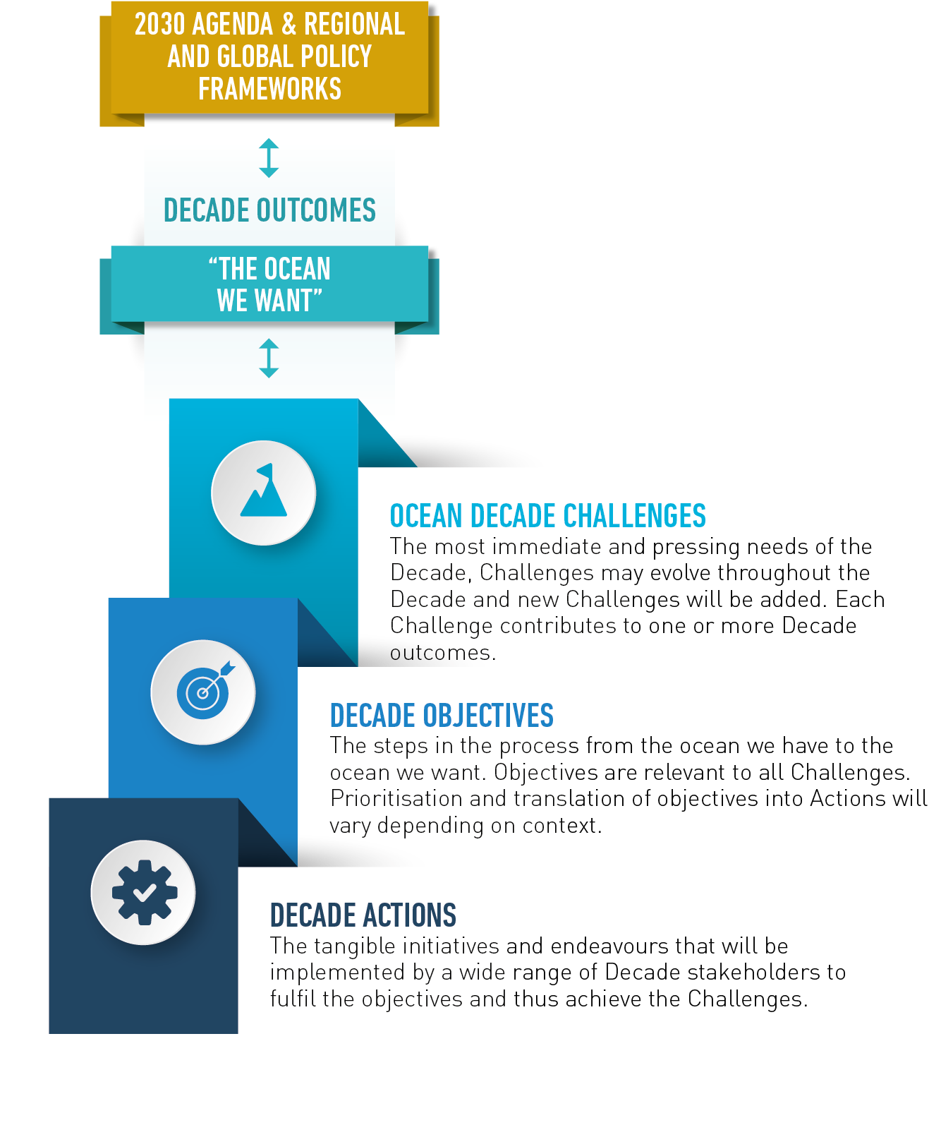
Moving to action in the Ocean Decade
31 global programmes
42 in-kind or financial contributions
83 projects populating programmes
10 UN led Decade Actions
> 300 Decade Activities
Call for Decade Actions No. 01/2020
Observations & prediction
Multiple ocean stressors
Deep sea / mesopelagic management
Coastal resilience
Fisheries
Cultural values / OL
Regional programmes
Cross-cutting initiatives

Slide 3
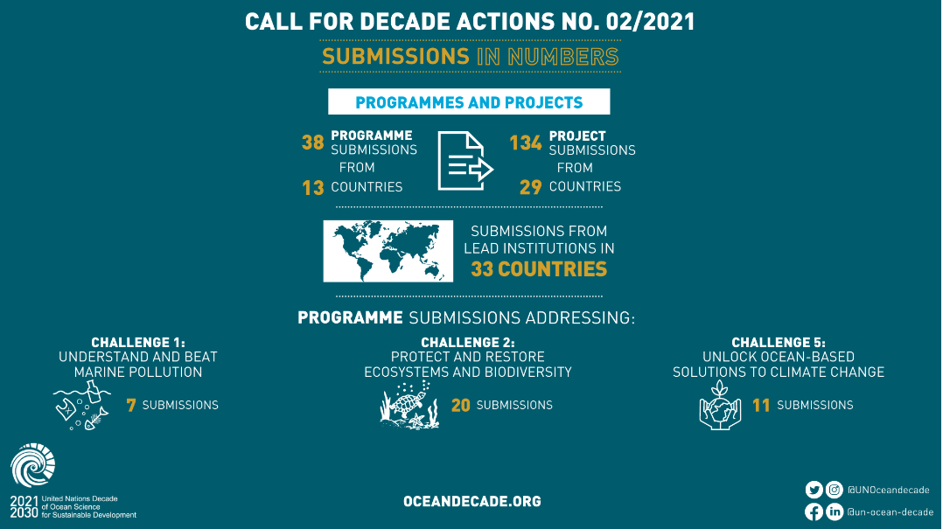
Notes:
Decade Action Framework –regular call for Decade action

Slide 4
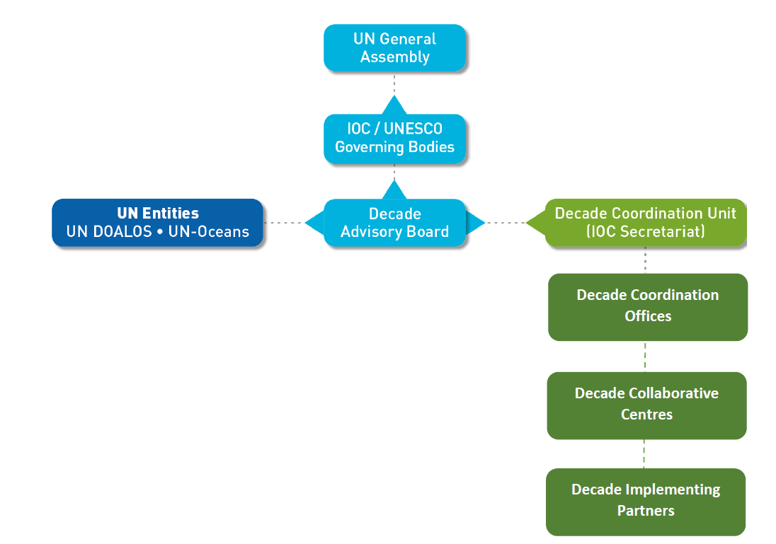
Building the architecture of the Ocean Decade
Decade Coordination Unit (DCU) growing steadily with new secondments being developed with France and Norway and potential support from US
Five Collaborative Centres relatively well advanced in planning:
  North East Pacific
  Innovation and Solutions
  Ocean Prediction
  Coastal Resilience
  Indian Ocean
First Decade Implementing Partners announced in December – European Marine Board and JPI Oceans

Slide 5
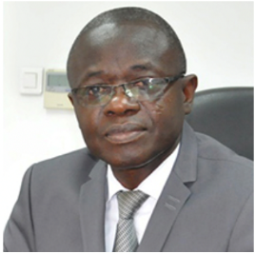
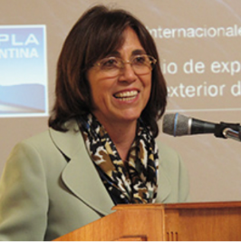
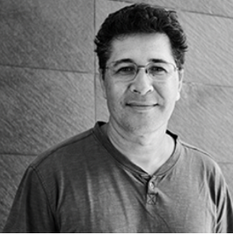
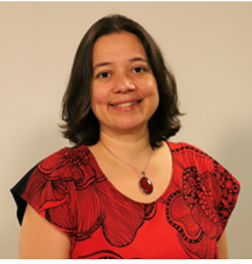
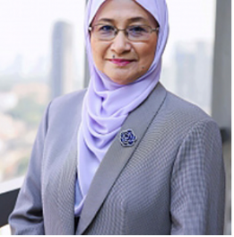
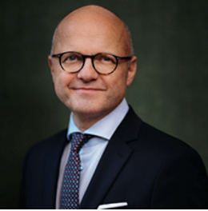
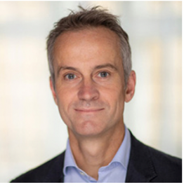
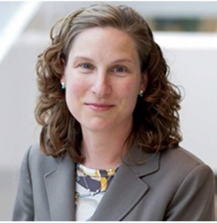
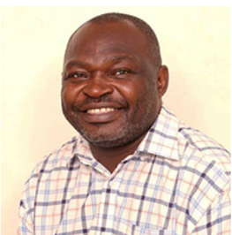
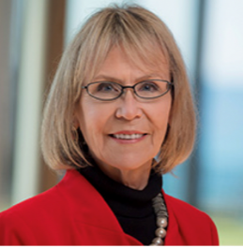
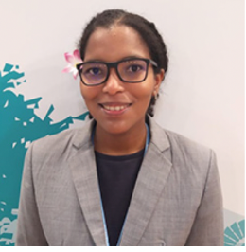
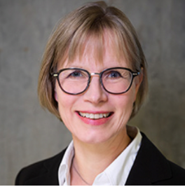
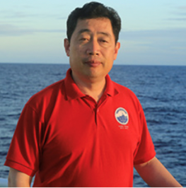
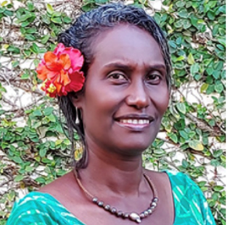
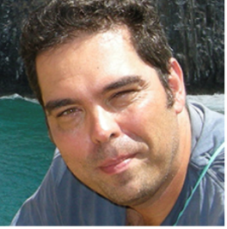
Ocean Decade Advisory Board
Professor Kouadio Affian
Côte d’Ivoire
Dr. Frida Maria Armas-Pfirter
Argentina
Dr. Tamatoa Bambridge
French Polynesia
Dr. Silvia Chacón Barrantes
Costa Rica
Dr. Nor Aieni Haji Mokhtar
Malaysia
Vidar Helgesen
Sweden, Co-Chair
Professor Gideon Henderson
United Kingdom
Charlotte Hudson
United States
Dr. James Gitundu Kairo
Kenya
Dr. Margaret Leinen
United States, Co-Chair
Angelique Pouponneau
Seychelles & United Kingdom
Dr. Bente Pretlove
Norway
Dr. Fangli Qiao
China
Dr. Katy Soapi
New Caledonia
Dr. Alexander Turra
Brazil
Notes:
243 nominations received of very high quality and diversity
Selection Panel of IOC Chair and Officers met twice to discuss candidates and establish a group that contained diversity across:
Sectors
Genders
Generations
Geographies
Margaret Leinen and Fangli Qiao have kindly accepted to continue on the DAB and ensure continuity from the EPG and IDAB group
Announcements of the full group will be made next week – Circular Letter and public communications
First meeting in January 2022

Slide 6
2022 Calls for Decade Actions
Call for Decade Actions No. 03/2022
15 April 2022 – July 31 2022
Call for Decade Actions No. 04/2022
15 October 2022 – 31 January 2023
Possible themes: blue food, sustainable ocean economy
Possible themes to be determined through gap analyses
Notes:
No less than the global Champions of ocean sciences
Insittuional members (Govt, UN, Philan, Private. )
Patrons are leaders that take on a personnal commitment in promoting investment in ocean scinece in the context of the Decade Alliance)

Slide 7

IOC Contribution to Ocean Decade
Current IOC activities & programs have strong contribution to Ocean Decade Challenges
----------
Opportunity for IOC to use Decade as unifying framework to deliver its mandate
REGISTERED IOC ACTIVITIES:
- Ocean Observing Co-Design (GOOS)
- Observing Together (GOOS)
- Ocean Best Practices (GOOS / IODE)
- Ocean Literacy With All (OL)
- OTGA
- PacMan
- eDNA Project
IOC INVOLVEMENT IN ENDORSED DECADE ACTIONS:
- CoastPredict
- Ocean Acidification Research for Sustainability
- Global Ocean Oxygen Decade
IOC ACTIONS IN PLANNING PHASE:
- Ocean Decade Tsunami Programme (IOC/A-31/3.4.1.Doc(1))
- ODIS
- OBIS
- WOD with NOAA
- Involvement in development of blue carbon programme
FUTURE PERSPECTIVES:
- Regional coordination via WESTPAC and other RSBs
- GOOS and IODE as hosts of Decade Coordination Offices
- Regional priority actions (& enabling activities) with a focus on Africa and SIDS
- Knowledge based ocean management tools
- Capacity development
- Ocean Decade ‘digital ecosystem’
- Tsunami Decade Programme

Slide 8
Ocean Decade Informal Working Groups
Monitoring and Evaluation
Data Coordination Platform
Provides support to the DCU on the development of an operational monitoring and evaluation system to track progress and outcomes on key measures
Proposed approach to be submitted to Decade Advisory Board in Q1 2022
Provides support to DCU to reinforce and focus efforts to significantly enhance ocean data and information over the course of the Decade
25 experts from various industries, fields and stakeholder groups
Technology & Innovation
Communications Advisory Group
Provides advice on Technology & Innovation to support Decade vision
12 diverse members drawn from academia, industry, finance and government
Hosting virtual side session at Ocean Sciences Meeting 2022
Provides strategic advice on how to optimize communications and marketing outreach with target audiences as well as activation of key Decade initiatives, including GenO campaign
More than 20 communications and marketing experts that collaborate in 4 task groups

Slide 9
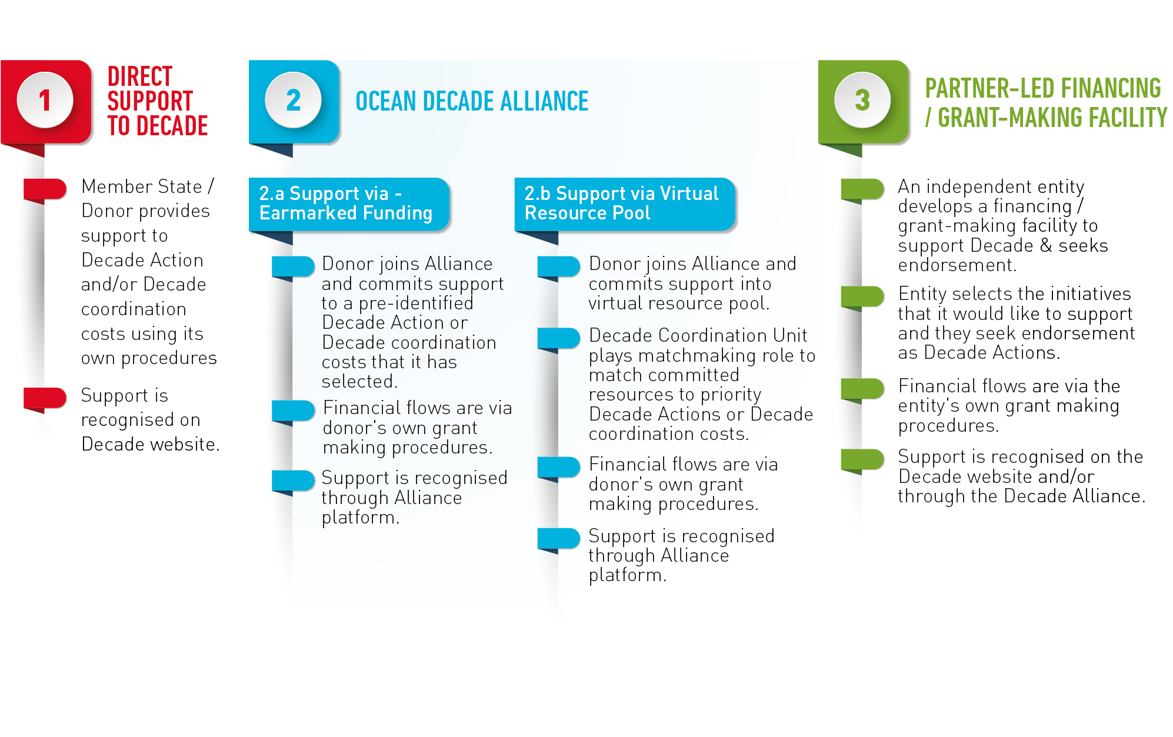
Approach to Resource Mobilisation
The Ocean Decade is not a funding mechanism but access to new funding is a key benefit for partners
Ocean Decade approach to resource mobilisation based on alignment of priorities
Decade aims to offer flexible and diverse ways for partners to support Decade Actions and coordination costs through financial or in-kind support
Notes:
Before going into the a description of the role of the Alliance, a few w
The Decade is a voluntary initiative, Not a funding mechanism, nor a convention with assessed contributions
Having said this, to achieve the ambition of the Decade, we need increase funding – (GOSR estimates that about 2% in average of the national research budgets are going to science, SDG 14 is one the least funded SDG by philanthropy)
About creating an enabbling environment for investment in transformative ocean science solutions,
Who should investments by governents, private sector, philantropy, international financing institutions (eg infrastrucutre invesments, loans /grants)
- Access to fundin between the proponents of actions and the potential beneficiairies and investors in Decade action is essential
Aligning priorities at national level, regioanl, international, with the Decade priority areas (10 challenges, to be updated and reviewed regularly)
Decade aims to offer flexible and diverse ways for partners to support Decade Actions and coordination costs through financial or in-kind support
Direct support to the Decade coordination costs (Canada, Korea, Portugal, Norway, Sweden, Fugro ) – engagement, communication, enabling activities, ECOPs
Support via eamarked funding
Pre-identified decade action or theme, DCU play match making role in identifying Decade actions in need of funding meeting criterial
Take example of DFO making resoruces available to fund sponsored Decade call for aciton
Support through partner partner led financing facility

Slide 10
Ocean Decade Alliance – Ambitions in 2022 and Beyond
Expanding membership with priority on members of a High Level Panel for a Sustainable Ocean Economy
Regular operational meetings of Alliance Sherpas to determine 2022 Action Plan and individual workplans for Patrons
Development of a joint statement on unlocking ocean science investment for launching at a high level Alliance event at the UN Ocean Conference
Engaging Alliance members in new initiatives and commitments to be announced at milestone events e.g. Sustainable Ocean Planning initiatives, Calls for Decade Actions for Africa and SIDS, support to Pacific coordination etc.
Notes:
No less than the global Champions of ocean sciences
Insittuional members (Govt, UN, Philan, Private. )
Patrons are leaders that take on a personnal commitment in promoting investment in ocean scinece in the context of the Decade Alliance)

Slide 11
Ocean Decade Alliance – Current Members
Patrons of the Ocean Decade Alliance
Institutional Members
H.E. Hon. Uhuru Kenyatta President of the Republic of Kenya
H.E. Marcelo Rebelo de Sousa, President of the Republic of Portugal
His Serene Highness Prince Albert II, Sovereign Prince of Monaco
Her Royal Highness Princess Lalla Hasnaa, President, Mohammed VI Foundation for Environmental Protection
Ms. Inger Andersen, Executive Director, United Nations Environment Programme
Ms. Wendy Schmidt, Founder, Schmidt Ocean Institute
Dr. John Schubert AO, Chair, Great Barrier Reef Foundation
Canada
Kingdom of Norway
Kingdom of Sweden
Republic of Kenya
Republic of Korea
Republic of Portugal
International Seabed Authority
United Nations Environment Programme
Great Barrier Reef Foundation
Mohammed VI Foundation for Environmental Protection
Prince Albert II of Monaco Foundation
Schmidt Ocean Institute
Officine Panerai
Fugro
Notes:
No less than the global Champions of ocean sciences
Insittuional members (Govt, UN, Philan, Private. )
Patrons are leaders that take on a personnal commitment in promoting investment in ocean scinece in the context of the Decade Alliance)

Slide 12
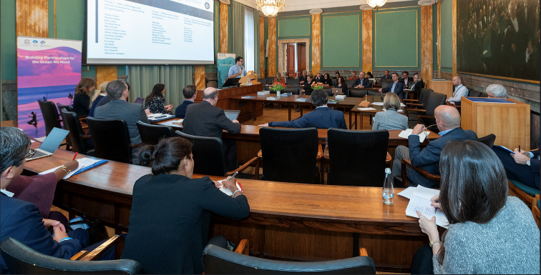
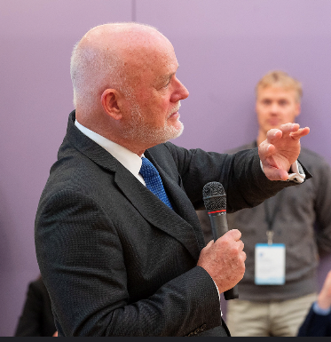
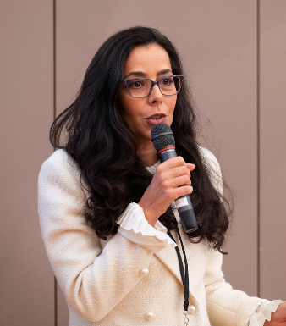
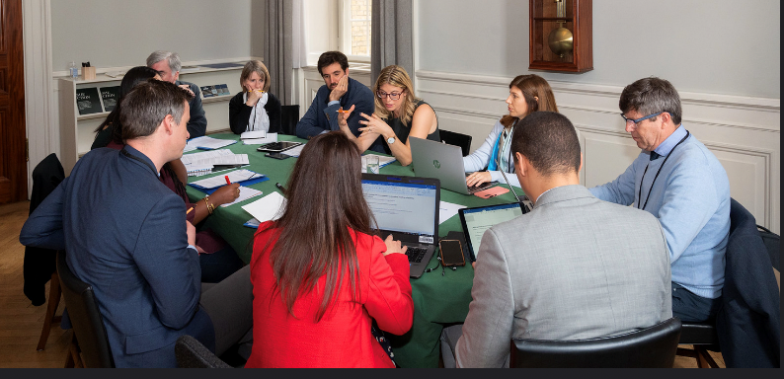
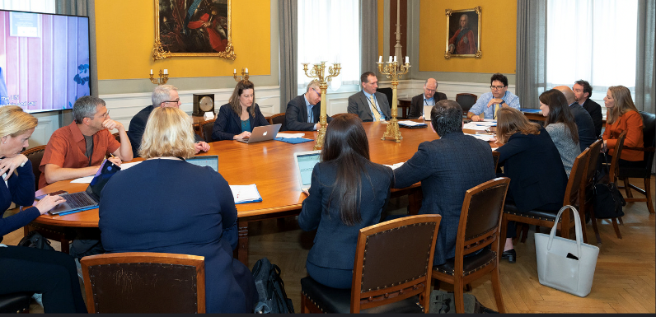
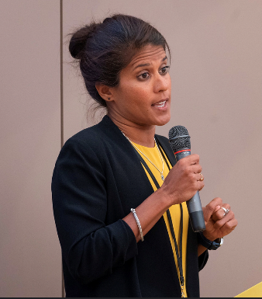
Stakeholder Engagement: Foundations Dialogue
Global network of more than 25 foundations that was established to provide a forum for dialogue and collaboration within the philanthropic community
Action plan is structured around geographic and thematic working groups to catalyse new commitments and partnerships as well as recruit new members
Second Foundations Dialogue Meeting to be hosted the Mohammed VI Foundation for Environmental Protection in early June to develop announcements and commitments for UN Ocean Conference in Lisbon

Slide 13

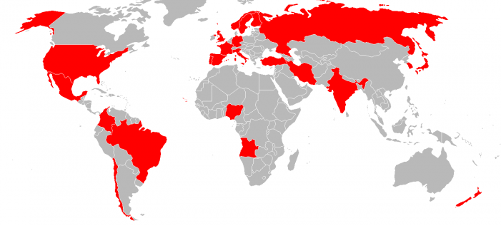
National Decade Committees & Regional Taskforces
Global footprint of 25 National Decade Committees (NDC)
Ambition to increase coverage and engagement with NDCs – new resources in DCU to achieve this
High priority targets for expansion include LDCs and SIDS – potential to develop mentoring role for more developed NDCs
7 regional taskforces with diverse mandates and activities => aim to create stronger links to NDCs and transform action plans to operational programmes
Regional initiatives:
Africa (under development)
Arctic
Mediterranean
Pacific SIDS
Southern Ocean
West Pacific
Western Tropical Atlantic
Established NDCs
Notes:
More NDCs are needed - mentoring role of well established NDCs for new committees:
Create understanding of benefits
Support establishment
Provide support to initiatives and activities

Slide 14
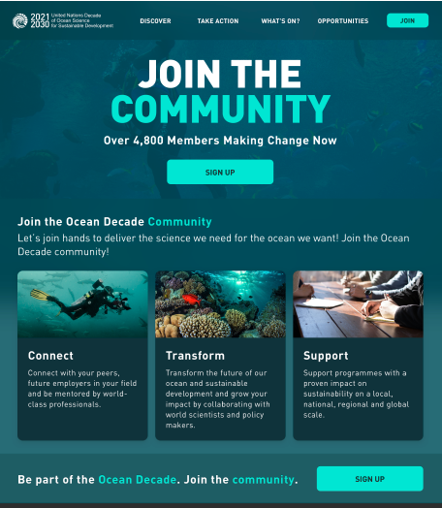
Stakeholder Engagement: Global Stakeholder Forum
2400+ registered users!
Online community platform for the Ocean Decade – “LinkedIn” of the Decade
At the heart of the new Ocean Decade website with successful soft launch in October at forum.oceandecade.org
Provides space for National Decade Committees, Communities of Practice, ECOPs, other groups and their members
Portal for engagement with Ocean Decade e.g. submission of Decade Actions, registration for events etc.
Facilitates sharing of information on events, news resources and Decade Actions
Interest in establishing
Notes:
Regional and national engagement key to translation of global priorities to local context
Exciting amount of activity emerging at regional and national levels- Decade is not prescriptive but aims to provide guidance
Regional taskforces / planning groups in at least 7 regions and with leadership of IOC regional subsidiary bodies – leading to action plans or Decade Actions
NDCs are strongly encouraged as voluntary groups to coordinate stakeholder, facilitate information flows and facilitate national involvement in Decade Actions
Already in 24 countries and being established in many others – IOC has organised several discussions and sent out survey to MSs
Survey indicated good alignment across the roles and mandate of NDCs but need to increase diversity in many of the committees
Guidelines provide soft guidance for new and existing Committees
Regional and national groups will be able to interact also across the GSF

Slide 15
2022 Milestones
One Ocean Summit
Brest 9-11 Feb
UN Ocean Conference
Lisbon 27 June – 1 July
BBNJ
New York 7-18 March
CBD COP15 TBC
Kunming 25 April – 8 May
Monaco Blue Initiative
Monaco 20-21 March
Our Ocean
Palau 13-14 April
Blue Climate Summit
French Polynesia 14 - 20 May
Major role in science and education workshops
Confirming role in high level segment
Side event and re-release of non-paper on IOC role in a BBNJ ILBI
Side event on innovation and technology
Side event and commitments focused on Pacific SIDS support and engagement
Decade endorsed summit with commitments and incubation of projects in SIDS
Multiple events throughout conference. Launch of high level statement from Ocean Decade Alliance and announcements related to Sustainable Ocean Planning and support to SIDS and Africa
Notes:
Sherpa’s meeting every 6-8 weeks

Slide 16
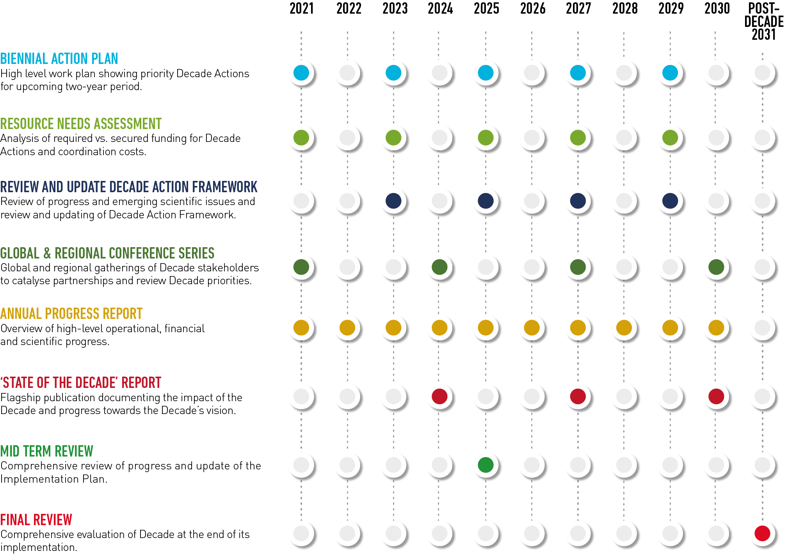
Adaptive Management of the Ocean Decade
“
M&E activities will underpin adaptive management and evolution of the Ocean Decade over the next 10 years.

