Slide 1
ICG/PTWS Report
TOWS-WG-XV 24,25 February, 2022
NISHIMAE Yuji
Chair of ICG/PTWS

Slide 2
Contents
ICG/PTWS-XXIX Session
PTWS Responses to the 15 January 2022, Hunga-Tonga-Hunga-Ha'apai Volcanic Eruption and Tsunami

Slide 3
ICG/PTWS-XXIX Session (1)
Online meeting (1-2 and 7-8 December, 2021)
116 participants from 27 countries attended.
Seven recommendations adopted
Recommendation ICG/PTWS-XXIX.1 ICG/PTWS Governance
Recommendation ICG/PTWS-XXIX.2 Understanding Tsunami Risk
Recommendation ICG/PTWS-XXIX.3 Tsunami Detection , Warning and Dissemination
Recommendation ICG/PTWS-XXIX.4 Disaster Risk Management and Preparedness
Recommendation ICG/PTWS-XXIX.5 Start of Operation of Central America Tsunami Advisory Center (CATAC)
Recommendation ICG/PTWS-XXIX.6 Task Team on Future Goals and Performance Monitoring
Recommendation ICG/PTWS-XXIX.7 UN Decade of Ocean Science for Sustainable Development (2021-2030)
ICG/PTWS officers for the next term
Chair: Mr NISHIMAE Yuji (Japan)
Vice-Chair: Dr Wilfried STRAUCH (Nicaragua)
Vice-Chair: Mr. David COETZEE (New Zealand
ICG/PTWS-XXX session
Hosted by Japan, November 2022

Slide 4
ICG/PTWS-XXIX Session (2)
PacWave22
PacWave22 period: September through November 2022
Regional exercises
Live communication tests on 13 October 2022
ICG/PTWS medium term strategy 2022-2030
Four Strategic Objectives
Understanding and Managing Tsunami Hazard Risk
Tsunami Detection, Warning & Dissemination
Enhancing tsunami preparedness for effective community response
International Coordination and Cooperation and Partnerships
UN Decade of Ocean Science for Sustainable Development (2021-2030)
Establishment of Task Team on the Ocean Decade under the PTWS SC
Change of the Earthquake Source Zone of the PTWS
Expansion of ESZ of the PTWS to the southernmost Atlantic including the South Sandwich Islands
Central America Tsunami Advisory Center (CATAC)
PTWS decided to admit the start of CATAC’s full functionality on the interim service in January 2022.

Slide 5
ICG/PTWS-XXIX Session (3)
Established Task Teams
Task Team on UN Ocean Decade
Task Team on PacWave Exercises
Task Team of the Tsunami Service Providers (TSPs) under WG2
Task Team on Capacity Development and Services under the Regional WG in the South China Sea Region
Dissolved Task Teams
Task Team on PacWave20 Exercises upon publication of the report
Task Team on Establishment of a South China Sea Tsunami Advisory Center under the Regional WG in the South China Sea Region

Slide 6
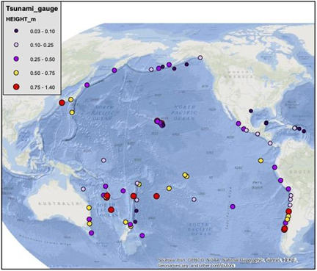
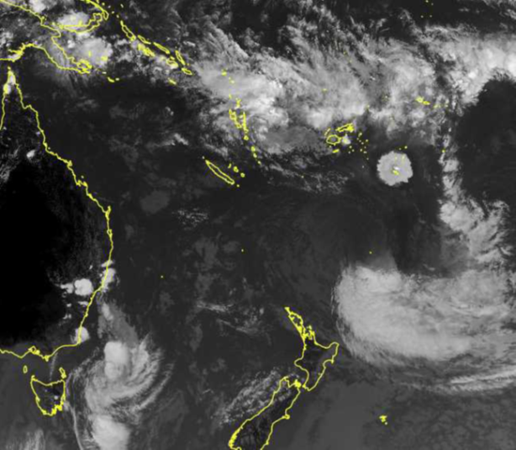
PTWS responses to15 January 2022, Hunga-Tonga-Hunga-Ha'apai Volcanic Eruption and Tsunami
Hunga-Tonga-Hunga-Ha'apai Volcano erupted on 15 January 2022.
Tsunami waves were observed at not only near tide gauges but also distant tide gauges.- Larger than 1 meter in California of USA, Chile, Japan.
PTWS held Debrief meetings three times; 20 January, 3, 10 February.
Objectives of the meeting
Interim Volcanic Tsunami SOP – What to do if it happens again.
Review what happened in TWCs – share experiences with TWCs : what was available, what was not
maximum tsunami amplitude reported by PTWC on 15 January
maximum tsunami amplitude reported by PTWC on 15 January

Slide 7
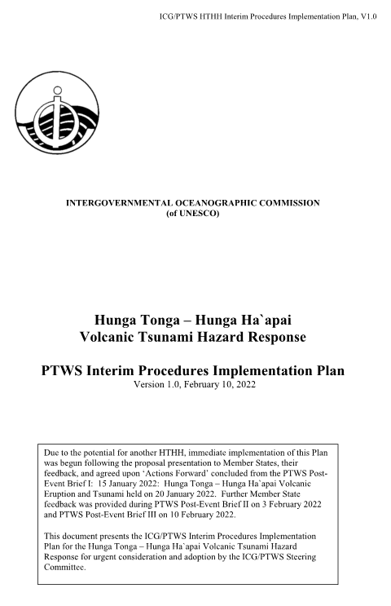
PTWS Interim Procedures Implementation Plan
Preparation for the next event – What to do if the event happens again.
Small temporary task team was established to work for implementation plan.
Tsunami amplitudes are forecasted by scaling observed maximum amplitudes observed across the Pacific from the January 15 event with observed amplitudes for any future event, starting with the observed amplitudes at Nuku`alofa and the NZG DART.
PTWC provides special products for a HTHH volcano generated tsunami.

Slide 8
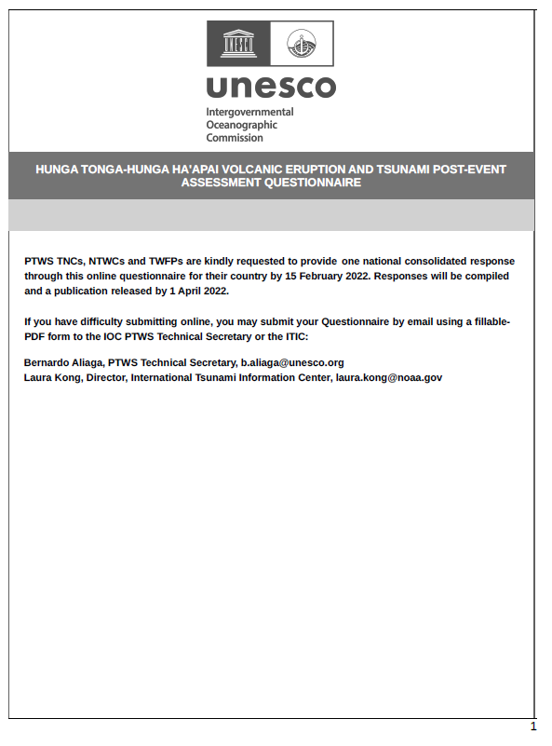
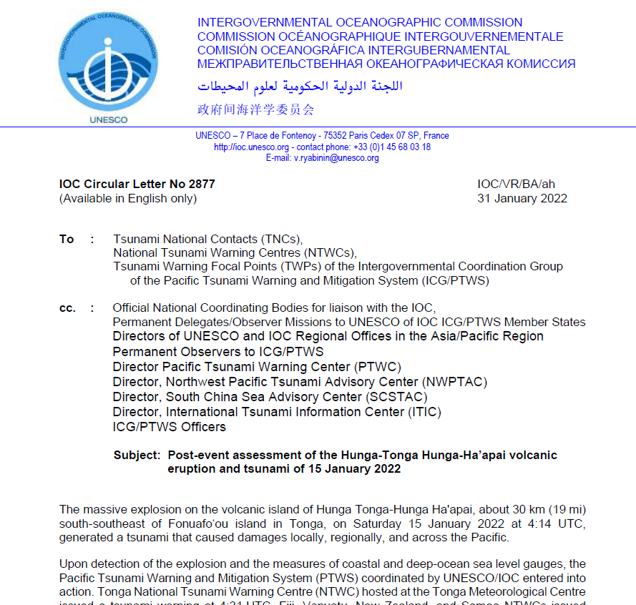
Questionnaire for post-event assessment
Due Date: February 15, 2022
Expected Publish: April 2022

Slide 9
Thank you very much for your kind attention.

