Slide 1
IOC Tsunami Ready
web site
TT DMP 22 Feb 2022
Item 3.2.
Laura Kong, ITIC

Slide 2
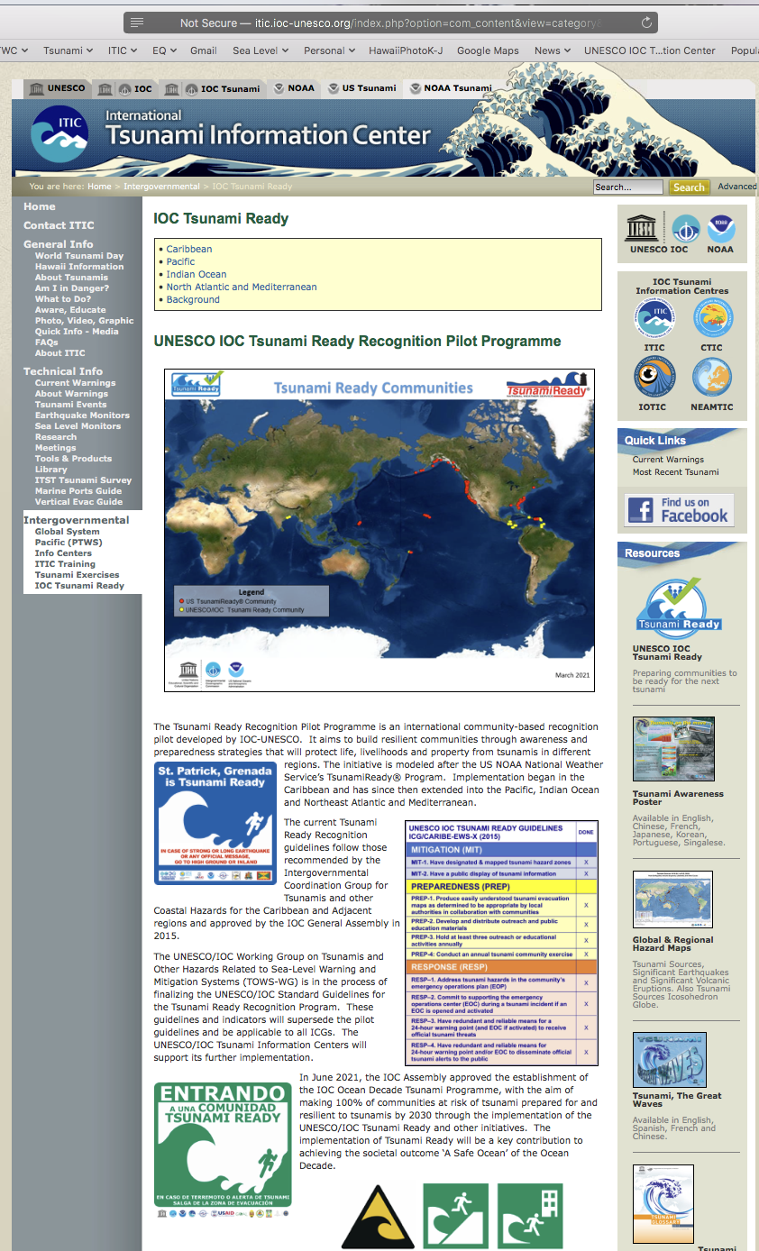
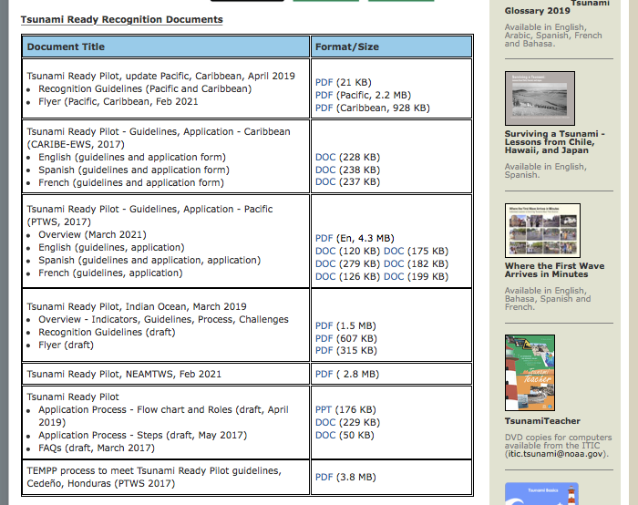
Currently, TR Pilot.
After Pilot becomes Programme, home page will be updated
ITIC host Tsunami Ready web site:
www.tsunamiready.org
http://itic.ioc-unesco.org/index.php?option=com_content&view=category&id=2234&Itemid=2758

Slide 3
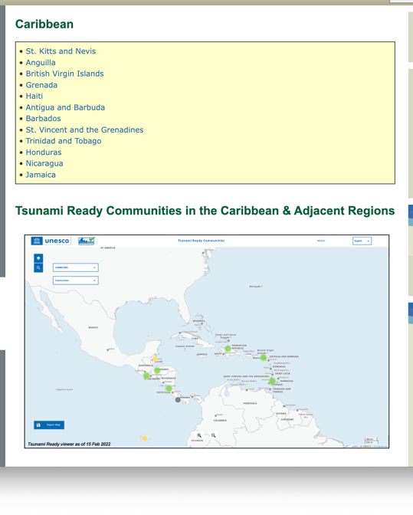
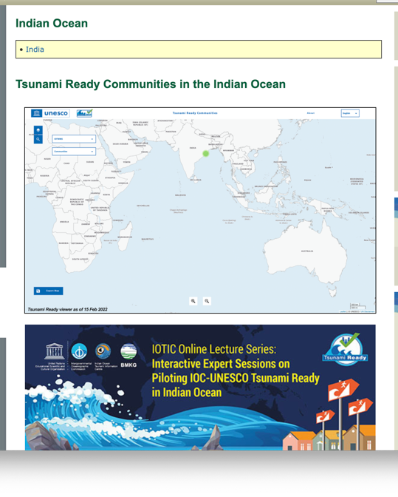
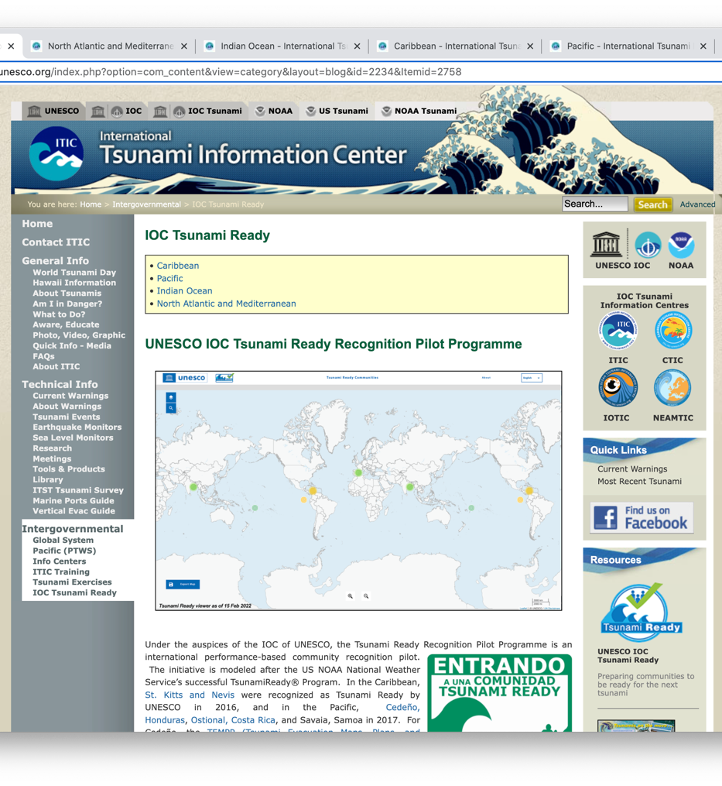
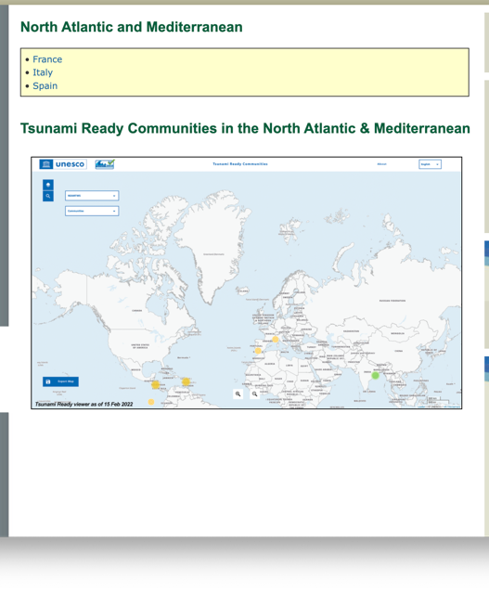
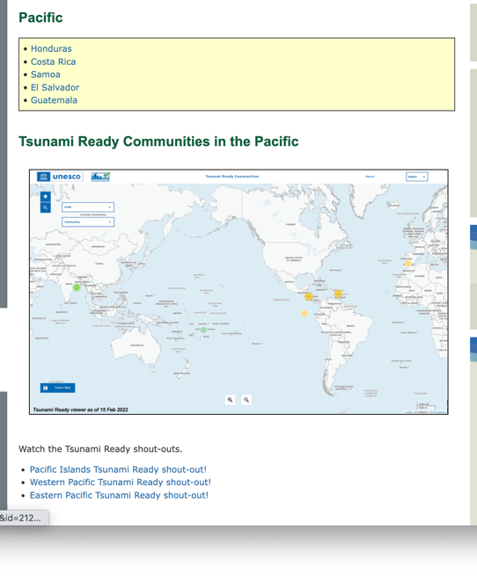
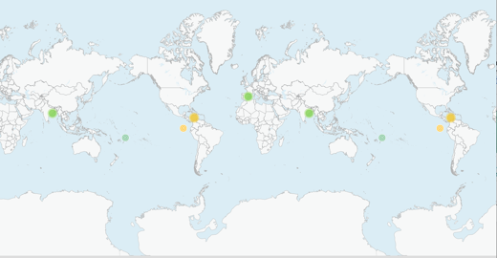
Web site features
Home Page – Information – what, how, FAQs, status (Tsunami Ready Viewer)
Links to
Background and History
ICG regions (Caribbean, Indian Ocean, North Atlantic and Mediterranean, Pacific)
Draft

Slide 4
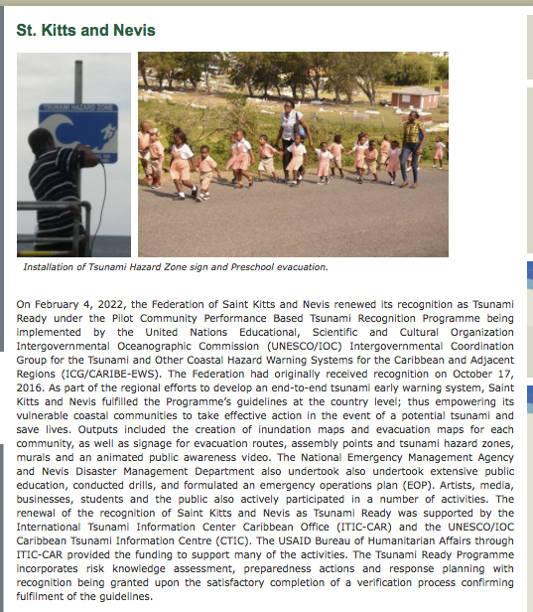
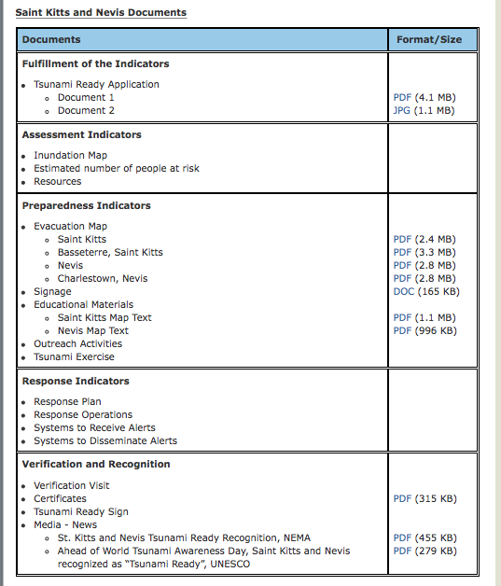
Web site features
Links to
ICG regions (Caribbean, Indian Ocean, North Atlantic and Mediterranean, Pacific
For each Region, by Country, TR recognized communities
Summary, Tsunami Ready Application and Supporting Documents (Assessment, Preparedness, Response, Verification and Recognition)

