Slide 1
MEETING OF THE INTER-ICG TASK TEAM ON DISASTER MANAGEMENT AND PREPAREDNESS 21-22 Feb 2022
JOINT SESSION 9
PLANNING FOR OCEAN DECADE
Engagement/Contributions of UNESCO IOC Towards GP2022, Third MHEWS Conference (MHEWS-III) and WiA Guide
Tsunamis nexus with other coastal hazards (Multi-Hazard Early Warning Systems)
Presented by Denis CHANG SENG, PhD Programme Specialist
Tsunami Unit, Technical Secretary (ICG/NEAMTWS) Global Ocean Observing System (GOOS) IOC Focal point for MHEWS/ IN-MHEWS IOC of UNESCO

Slide 2
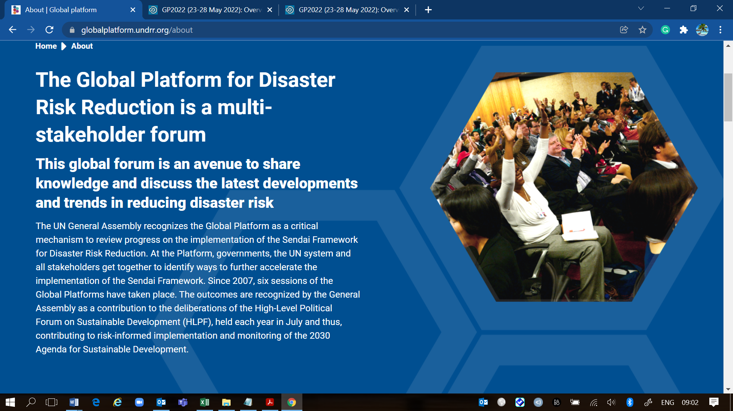
Seventh Session of the Global Platform for Disaster Risk Reduction (GP2022), Bali Indonesia 23-28 May 2022
High Level Message
From Risk to Resilience: Towards Sustainable Development for All in a COVID-19 Transformed World

Slide 3
GP2022 Themes
MAIN THEMES
CROSS CUTTING THEMES

Slide 4
GP2022 Dialogues and Thematic Sessions
HLD 2: Strengthening Disaster and Climate Risk Governance at National and Local Levels for Accelerated Progress on Sustainable Development: 5 Applications TS 1: Improved Understanding and Governance of Systemic Risk-Unpacking the 2022 Global Assessment Report:1 application TS 2: Data Challenges and solutions for disaster risk management: 1 application TS 3: Breaking the Silos-Towards Multi-hazard, Multi-Sectoral Approaches to Mangagng Risk: 2 applications TS 8: Leave No One Behind – Empowering the Most at Risk through Social Protection: 2 applications TS 9: Resilient and Inclusive Recovery in Urban Context: 1 application TS 11: Building a Better Future: Investing in Infrastructure Resilience for All: 1 application TS 12: Cooperation Across Borders for Strengthened Capacity: 1 application TS 13: Embedding Risk in Investment Decision: 1 application TS 15: Early Warning and Early Actions: 20 applications
Organizing Team Members for TS 1, TS 3, TS 8 and TS 15
Panelist: No successful nominations

Slide 5
UNESCO IOC Events Submitted
1.My Coastal City is Getting Ready
UNESCO, IOC/ CLT & UNDRR
1. The Girl and the Tsunami
Pacifico Creative Risk Communications
IOC/UNESCO & UNDRR
2. Recognizing Tsunami Ready: A New Meaning to Community Awareness and Preparedness
UNESCO-IOC/ BMKG
2. Recognizing Tsunami Ready Communities
UNESCO-IOC
3. Futures Thinking on Disaster Risk Reduction and Resilience
UNESCO, UNDRR, UNDP Acc Lab, & U-INSPIRE Alliance

Slide 6
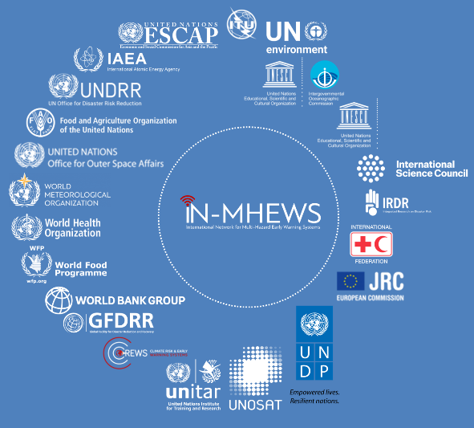
Multi-Hazard Early Warning Systems
IN-MHEWS
Third Multi-Hazard Early Warning Conference (MHEWC-III)
Words into Action Guide Multi-hazard Early Warning Systems

Slide 7
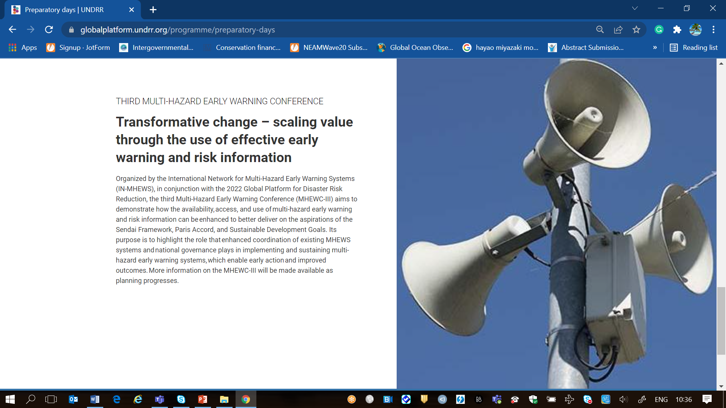
I. Third Multi-Hazard Early Warning Conference (MHEWC-III)
MHEWS III, 21-22 May 2022, Bali, Indonesia
Concept note prepared lead by WMO, supported by UNDRR, IOC/ UNESCO
8 Themes Multi-sector governance of EWS - Enablers of transformative change Inclusive EWS Impact-based forecasting Anticipatory action Risk Communication Monitoring, evaluation and learning Advocacy, communication and advancing global policy agendas Science, Technology and Innovation

Slide 8
II. Words into Action Guide Multi-hazard Early Warning Systems
2017
2018
Today
Source: WiA Ref Group, IN-MHEWS

Slide 9
WiA Guide Objective
2017
2018
Today
Objective: Provide advice for governments, stakeholders & partners on how to institutionalize, operate, monitor and strengthen people-centred inclusive approaches for multi-hazard and comprehensive end-to-end EWS that enables early action to protect livelihoods, people and assets.

Slide 10
Outline of content
2017
The proposed chapters are:
Chapter 1: Introduction: building on existing guidelines, partnerships and networks
Chapter 2: Early Warning – Early Action within climate and disaster risk management systems
Chapter 3: Establishing, strengthening and sustaining effective inclusive, people-centered multi-hazard EWS
Chapter 4: Measuring effectiveness and assessing the socio-economic benefits of EWS
Chapter 5: Recommendations and pathways for strengthening multi-hazard EW-EA value chain.
2018
Today

Slide 11
Membership and Composition
CEMADEM / IFRC / JRC
FAO
IFRC
ITU
UNDP
UNDRR
UNESCAP
UNESCO
UNESCO / UNESCO-IOC
UNICEF
UNITAR
UNOOSA/UN-SPIDER
WFP
WHO
WMO

Slide 12
Timeline & Roles Reference Group
Nov - Jan
Jan-March 22
3rd Reference Group meeting (Feedback WiA draft)
1st Reference Group meeting (Inception)
2nd Reference Group meeting (Review content)
Call for Good Practices
Reach out to partners requesting contributions to specific chapters
Follow-up on gaps
Drafting WiA guide
Preparation Public Consultation
Oct
Jan
April
Consultation with Reference Group on:
Composition RG
WiA Outline
Partners that should contribute to chapters
Categories for call for Good Practices
Reference Group supports:
Good practices selection (RG members support specific categories)
Identify gaps & agree on way forward
Reference Group supports:
Development of working session planned during the MHEWC
Promote good practices during WMD
Consultation with Reference Group on:
Revise draft
Provide feedback (inputs as required) in writing & during RG meeting

Slide 13
Timeline & Roles Reference Group
Public Review including sessions during MHEWC
June
4th Reference Group meeting (Review final draft)
Aug/ Sept
International Day for Disaster Risk Reduction 2022
Update WiA guide based on comments revised during public review
Develop draft dissemination Strategy
Copy-editing, design including infographic
Coordinate launch of WiA guide
May
July
Oct
Reference Group supports:
Thematic consultation sessions during MHEWC
Share outcomes & feedback with consultant
Consultation with Reference Group on:
Final draft
Feedback on dissemination strategy
Reference Group supports:
Launch preparation as agreed
Reference Group supports:
Launch event
Promotion of WiA guide through networks

Slide 14
END

