Slide 1
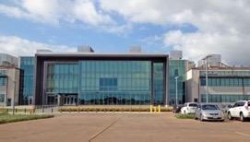
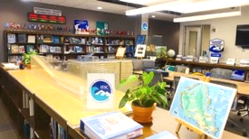
Agenda 3.4 International Tsunami Information Center (ITIC) Report
ITIC
Dr. Laura Kong
Director, ITIC, USA NOAA
Cdr. Carlos Zuniga Christa von Hillebrandt
Associate Director, ITIC, Chile SHOA Deputy Director, ITIC, USA NOAA
Manager, ITIC Caribbean Office
https://vimeo.com/192771669

Slide 2



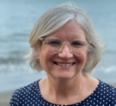
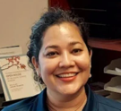




ITIC – Who we are
ITIC - established 1965 (IOC-IV.6), USA agreed to host
Support Member States (Technical improve TW (timely accurate), Capacity Building, Awareness, Event / Post-Tsunami data coll)
OFFICE - US NOAA NWS
Director – Dr. Laura Kong
Deputy Director, ITIC Caribbean Office - Christa von Hillebrandt-Andrade
Support CTIC, CARIBE-EWS (eff Sept 1 2021, former Caribbean Tsunami Warning Prog, est. 2010)
Scientist (Oceanographer) – Carolina Hincapie-Cardenas
Technical Information Specialist - vacant
Information Technology Specialist – Tammy Fukuji
Admin Support Assistant – Art Sonen
Student interns (part, full-time): 1-2 year-round, 2-4 Summer
ASSOCIATE DIRECTOR – established 1974( IOC/ITSU-IV.1, non-USA)
Cdr. Carlos Zuniga (Chile, SHOA Navy), 2013 (Chile since 1998)

Slide 3

ITIC Mandate (1977) – Intersessional Activities
www.tsunamiwave.org
http://itic.ioc-unesco.org/index.php
Monitor, recommend improvements
Events – improving warning and response
Tsunami Warning Decision Support Tools
Assist in establishing national, regional systems
Capacity Building, Training
IOC Wave Exercises
UN Decade for Ocean Science for Sustainable Development
Information resource - preparedness / education (create, compile, share)
Guides, Manuals, Best Practices, Awareness materials
Information resource - historical tsunamis (collect, compile, share)
Database, global and regional hazard, post-event surveys

Slide 4
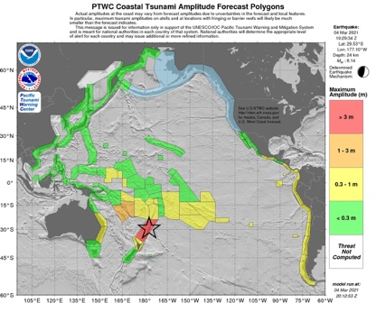
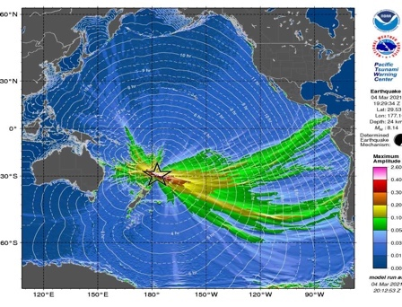
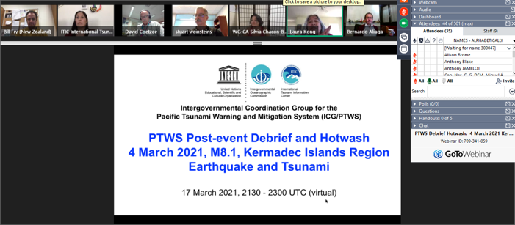
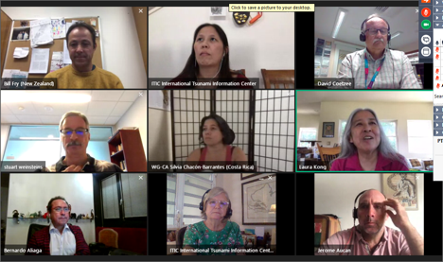
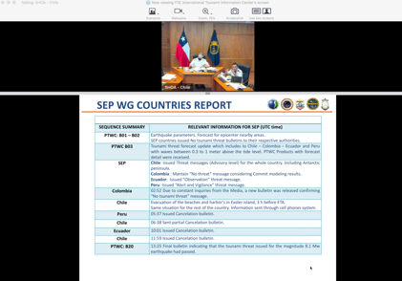
Improving TW: 4 March 2021 – Kermadec Islands – Debrief Hotwash
3 shallow EQs Tonga-Kermadec Trench, north of NZ (M7.3, M7.4, M 8.1, @ 13:27, 17:41, 19:28 UTC)
M8.1 EQ triggered tsunami observed locally and across Pacific Basin
Debrief - 17 March 2021 – virtual
67 persons, 14 expert panelists representing 27 countries and 1 regional organization.
http://www.ioc-tsunami.org/index.php?option=com_oe&task=viewEventAgenda&eventID=2995.
Video / Audio recordings, translation and subtitles in English and Spanish for the PTWC and NZ briefs.
Response, Lessons learned - TSP PTWC, NZ, PICT, Southeast Pacific, Central America
Feedback – Actions Forward

Slide 5
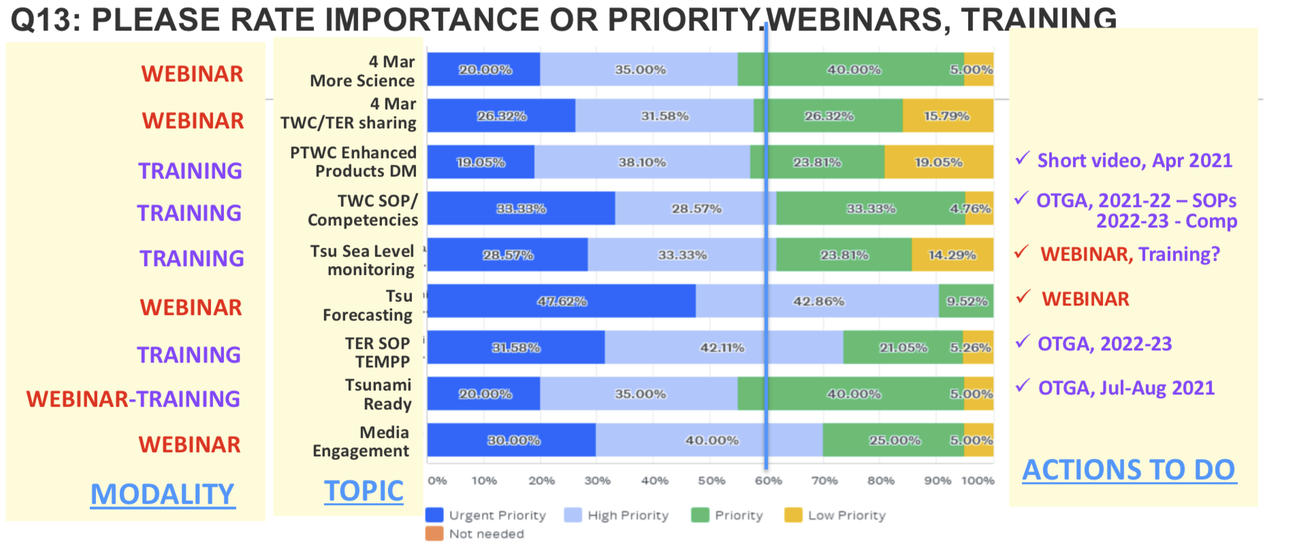
Debrief Feedback – Actions Forward

Slide 6

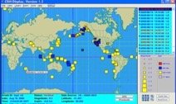
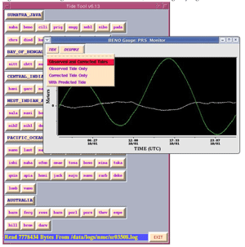
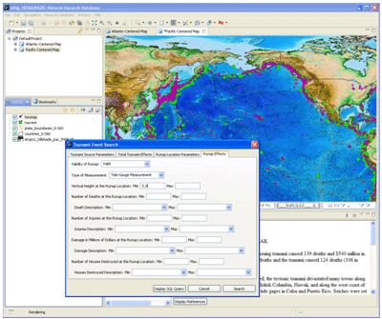
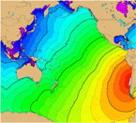
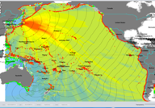
Tsunami Warning Decision Support Tools ITIC-distributed, supported
Listserv (IOC TWFP, NTWC, TNC) – TSP emerg broadcast, Other needs
Tsunami Bull Board (ITIC, 1995) 507 science/tsu/govt (Sept 2021)
Since 1 April 2021, new server. NEW ADDR FOR POSTING: tsunami_bb@list.woc.noaa.gov
Real time EQ Display (CISN, USGS / NTHMP, 2005), 346 v2.0.238 (Sept 2021)
Real-time Sea Level monitoring
Tide Tool – TWC operations monitoring (PTWC, 2005) v10.68
IOC Sea Level Monitoring web site (IOC, 2008)
Tsunami Travel Time Software (ITIC, NGDC, 2007) – SDK4.0.1
Tsunami Historical Database Online (WDS-NCEI), Offline (TsuDig, NCEI, ITIC, 2009)
Tsunami Hazard Assessment Tools (2017) – PMEL, ITIC
ComMIT/MOST - => OTGA TEMPP hybrid 2022-2023
Tsu Coastal Assessment Tool (TsuCAT v4.3) – => 2022 TR Community Exercises

Slide 7
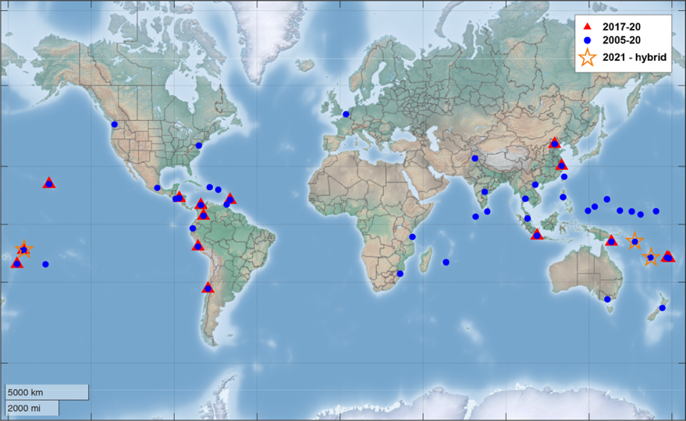
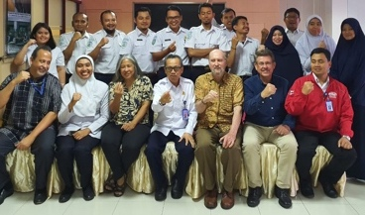
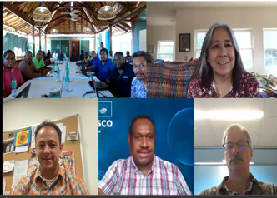
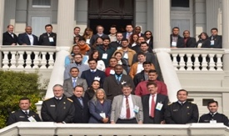
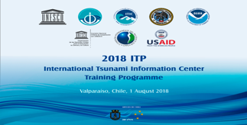
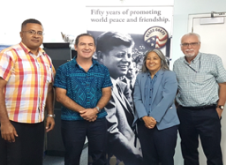
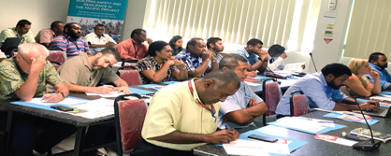
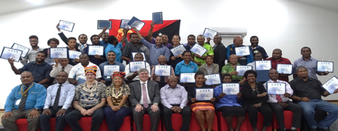
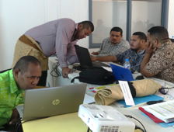
ITIC - IOC TSUNAMI CAPACITY BUILDING (2005-2021, >130 trainings)
2019
Caribbean, SOPS
Colombia, End-to-end, SOPs
Hawaii (global, 2-week), End-to-end, SOPs
Papua New Guinea, End-to-end, SOPs
PICT, TEMP 1 - Inundation Model / Map
Tonga (2-week), NTWC Competency pilot
2020: January, Indpnesia, TWC ops
2021:
IOC Ocean Teacher Global Academy (OTGA) ITIC, Indonesia BMKG Specialized Training Centres
Support IOC UN Decade Tsunami Programms
Transition in-person to online/hybrid training
November, Hybrid – live remote, in-person review / discussion
Review and Update of SOPs – training workshop
4 days each: Solomon Islands, Fiji, Vanuatu
2022: Sept?, ITP-Hawaii in New Zealand – postponed 2020
Courses
Awareness (1 day)
TEWS (1 wk)
TWC & TER SOPs (1wk)
TEMPP (5 1-wk)
ITP-HAWAII IN CHILE, 2018
PEACE CORPS, SUVA
ITP-FIJI, 2017
ITP-TONGA, 2019
ITP-INDONESIA, 2020
TWC & TWC SOPs, SOLOMONS, 2021
ITP-PNG, 2018

Slide 8
OTGA work plan (2021-2023): ITIC and Indonesia BMKG, work with other TICs
Course | Length (hrs) | Date | Audience - TWM tsunami warning and mitigation | Language | Comments * Interest by other RTCs to teach
ITIC: Tsunami Awareness - overview covering hazard assessment, warning, preparedness, mitigation, response | 4-8 hrs | Q4. 2021 | All levels, no background necessary. | Eng, Span | Standard content with options for regional customization. (*)
BMKG/IOTIC: Tsunami Ready (IOC MG 74) - Overview of guidelines, process for establishing TR Programmes and recognizing TR communities | 4-8 hrs | Q4 2021 | Govt and NGOs responsible or interested in preparedness, in TR | Eng, Span | Standard content with options for regional customization.
ITIC: Tsunami Early Warning Systems (TEWS) - components of, requirements for robust, reliable, effective TWS | 40 hrs | 2022 | Agencies responsible for TWM in country | Eng, Span | Standard content with options for regional customization. (*)
TEMPP (Tsunami Evacuation Maps, Plans, and Procedures, IOC MG 82) 1. Identifying Inundation Areas, 2. Developing Evacuation Maps, 3. Developing Response Plans and Standard Operating Procedures, 4. Exercising | 4 40-hr module, Tot 160 hrs | 2022 - 2023 | Scientists, govt, and NGOs involved in preparedness | Eng | (*) Sequential training and product development with outcome community recognized UNESCO IOC Tsunami Ready.
ITIC: Tsunami Warning and Emergency Response Standard Operating Procedures (SOPs) (IOC MG 76) - procedures and protocols used successful tsunami warning |  | 2022 | Agencies involved in TW and TER | Eng | Standard content. (*)
ITIC: TWC Staff Basic Competencies - Information and skill requirements for TWC staff. Topics: science of earthquakes and tsunamis, analysis methods, tools and techniques for monitoring, assessing tsunami threat, issuing alerts, cancelling tsunami warnings | 120 hrs | 2023 | TWC staff | Eng, Span | Standard content with options for regional customization. (*)
BMKG/IOTIC: Tsunami Hazard and Risk Assessment (IOC MG 49 Japan example, IOC MG 52 Indian Ocean) | 40 hrs | 2022 | Scientists, univ, agency resp for TWM in country | Eng, Span | Standard content with options for regional customization. (*)

Slide 9
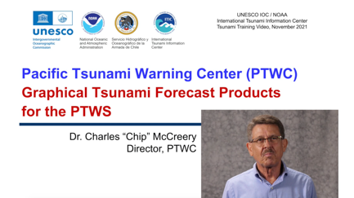
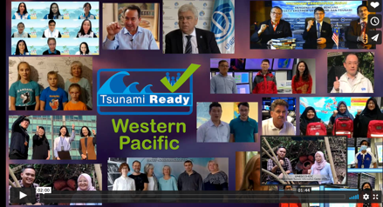
Training and Informational Videos – 2021-2022
PTWC Enhanced Products, Staging (Pacific, Caribbean) (EN-SP-FR) 22,15 min each – Oct-Dec 2021
Link: https://vimeo.com/showcase/8956022
Password: T$unamiVideos (password protect since products not public)
TWC Operations – What happens at PTWC during an event? (EN) 45-60 min in 2-3 parts – Jan 2022
Tsunami Forecasting (EN) (request from 4 Mar 2021 debrief) 30 min – Feb 2022
Exercise Informational Videos (EN, SP, FR): 3 min each
Get Pacific Tsunami Ready Shout-out (Western, PICT, Eastern) – WTAD 2021
Exercise Pacific Wave – Dec 2021
Exercise Caribbean Wave – Jan 2022

Slide 10
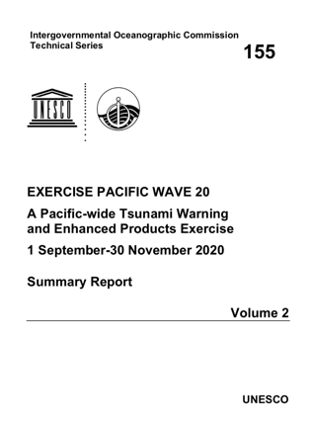
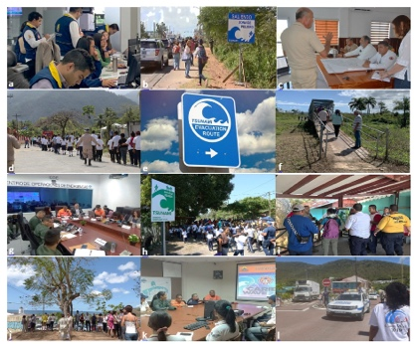
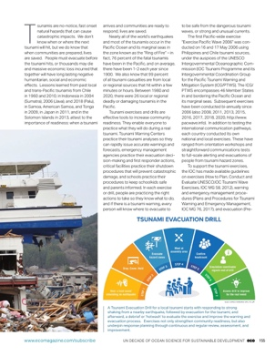
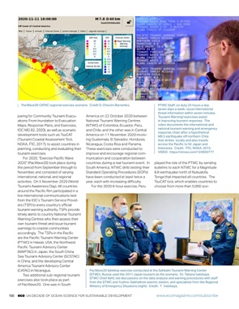
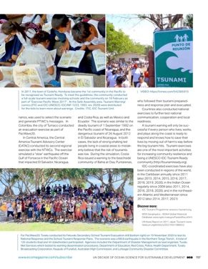
IOC Wave Exercises
PACWAVE Task Team, Host web site: pacwave.info
CARIBE WAVE Task Team, Host web site: caribewave.org
Exercise Pacific Wave 2006-2020 UN Decade Special Issue (ECO magazine)
Global harmonization of post-exercise evaluations, TOWS Task Team Disaster Management Preparedness
CW 2019 Activities

Slide 11
UN Decade Support - Pacific, Caribbean, 2021-2023
Reduce time and increase certainty of forecasts for Local Tsunami Warning Advancing Tsunami Detection and support cable initiatives and SMART pilots - - Vanuatu/NC (ITIC lead for training), Indonesia CBT, NZ-Antarctica, Portugal CAM2, Mediterranean MEDUSA, Caribbean
100% at risk communities are prepared and resilient (Pacific, Caribbean) – Facilitate, participate Tsunami Ready Board, Training, Awareness materials, etc) and execute TR Pilots – 2021-2023 funding (USAID). Explore partner with SPC
Pacific – Fiji, Marshall Islands (Majuro), Micronesia (Pohnpei, Chuuk, Yap), Palau
Caribbean – Dominica, St Lucia, Barbados
Capacity Building: Create online / hybrid training through OTGA Courses: Tsunami Awareness, Tsunami Ready (Indonesia BMKG/IOTIC), TEMPP, TEWS, TWC/TER SOPs, NTWC Competencies
Collaborations and partnerships with other stakeholders to advance Multihazard Early Warning Systems
Tropical Americas and Caribbean Regional Decade Planning Group and lead for Safe Ocean Working Group.

Slide 12

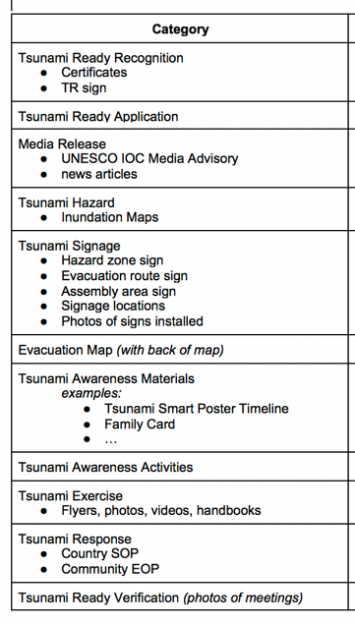
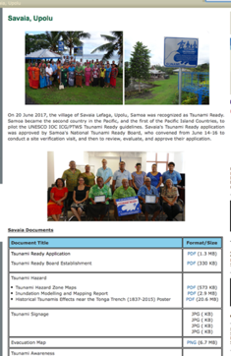
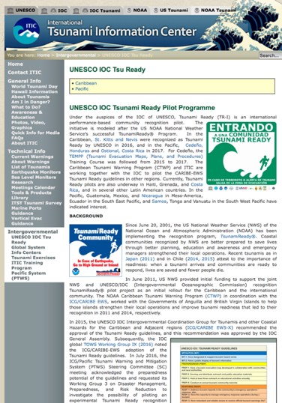
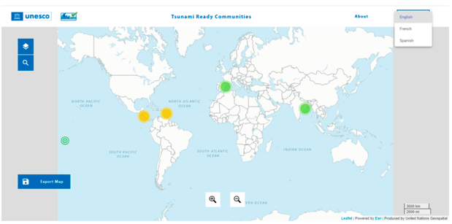
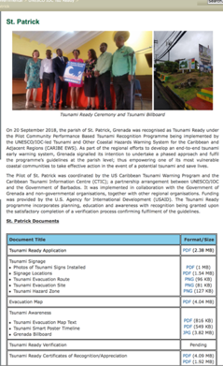
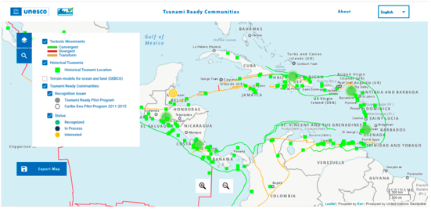
ITIC Services: UNESCO IOC Tsunami Ready web site
PTWS, CARIBE-EWS, IOTWMS, NEAMTWS recognized communities
Facilitated by TICs
Interactive Map (live Dec 2021)
www.tsunamiready.org

Slide 13
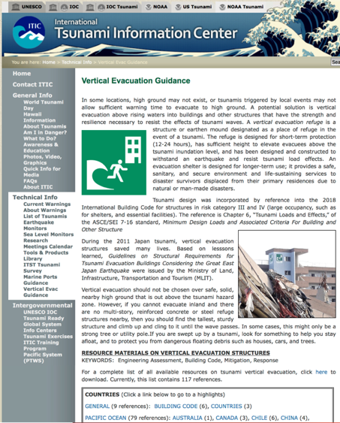
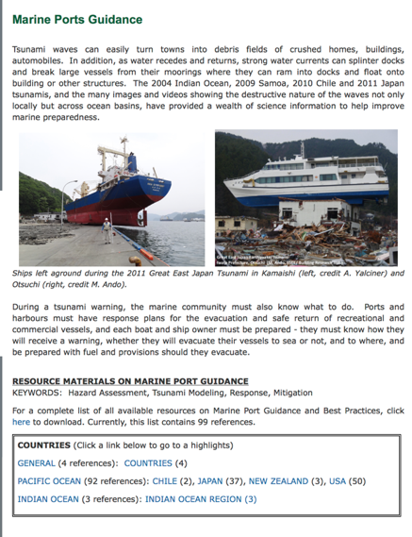
ITIC Services – Compile, Share Best Practices
PTWS and TOWS actions
Request Member States to share guidance, building codes, examples
Vertical Evacuation
117 refs from Pacific, IO, NEAMTWS
http://itic.ioc-unesco.org/index.php?option=com_content&view=article&id=2070&Itemid=2927
Marine Preparedness – Ports and Harbors
100 refs from Pacific, IO
http://itic.ioc-unesco.org/index.php?option=com_content&view=article&id=2071&Itemid=2926

Slide 14
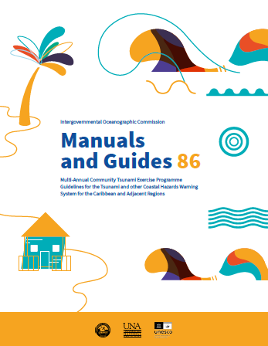
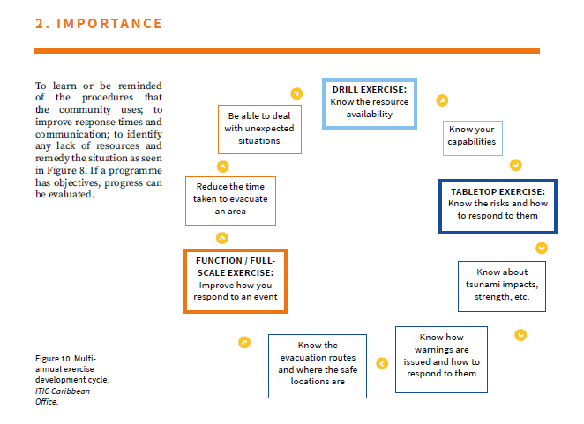
ITIC Services – Community Guide
IOC Manual and Guides 86
Multi-Annual Community Tsunami Exercise Programme Guidelines for the Tsunami and other Coastal Hazards Warning System for the Caribbean and Adjacent Regions
With Collaboration of EMIZA (French Emergency Management Agency-original manual) and National University of Costa Rica (Formatting)
English
Link coming soon!

Slide 15
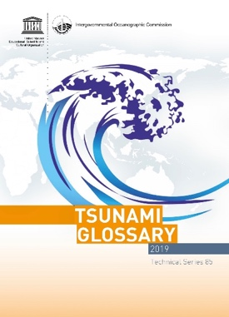
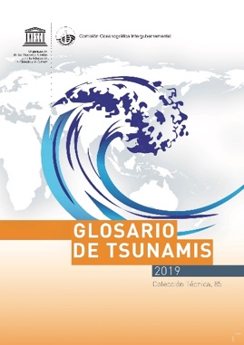

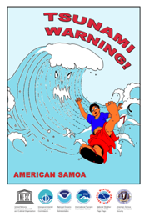
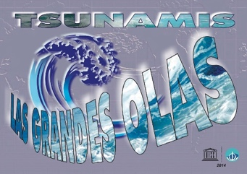
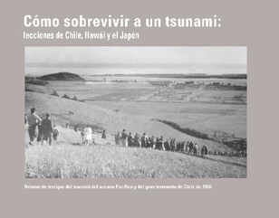
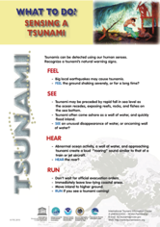
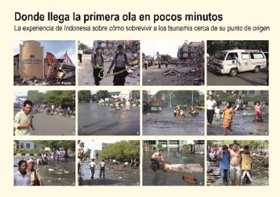
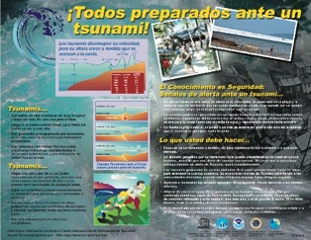
ITIC Awareness materials – update, new, printed, EN, SP http://itic.ioc-unesco.org/index.php?option=com_content&view=category&layout=blog&id=1075&Itemid=1075
Tsunami Glossary 2019 (printed En, Sp) => updating 2022
Tsunami Warning! Comic Amer Samoa (en) (IOC/INF1223) and English (update 2020)
Tsunami Great Waves, Surviving Tsunamis Lessons Learned (1960, 2010 Chile) Where the First Wave Arrives in Minutes (2004, 2006 Indonesia) Tsunamis on the Move, Sensing a Tsunami

Slide 16
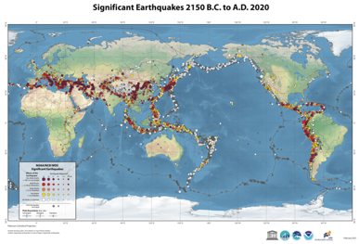



ITIC Awareness materials – update - printed http://itic.ioc-unesco.org/index.php?option=com_content&view=category&layout=blog&id=1075&Itemid=1075
ITIC-NCEI Hazard Posters - updated to 2020 (no print) / 2021 (to print in 2022)
Global Tsunami Sources – poster, icosahedron
Significant Earthquakes
Significant Volcanic Eruptions

Slide 17




ITIC Awareness materials – update, new, some printed http://itic.ioc-unesco.org/index.php?option=com_content&view=category&layout=blog&id=1075&Itemid=1075
ITIC – NCEI posters Regional Historical Tsunami Effects
Caribbean, Central America, Mexico (update 2020, EN SP) - printed
Tonga Trench (update 2017)
Papua New Guinea/Solomons (2019) - printed
Vanuatu / New Caledonia, New Hebrides (draft 2021)

Slide 18






Tsunami Events Time-Lapse Animation (1850 to Present)
Educational
Interactive
clickable events
timeline (timeline slider)
map (zoomable, moveable)
Time range: 1850 to present
global distribution of data
more accurate reporting of event details
reasonable time length for general public (2-3 min)
All validities displayed
Linked to NCEI database
allows for updates
user to access for detailed information
Mobile Friendly -> further improvements pending
https://www.ncei.noaa.gov/maps/tsunami-events/
September 2021
Event info
Mobile view (Android phone)
National Oceanic and Atmospheric Administration ⎸National Centers for Environmental Information
Notes:
Implemented with TypeScript, React, and the latest ArcGIS API for JavaScript.

Slide 19
Thank You Muchas Gracias
Dr. Laura Kong
Director, ITIC, USA NOAA
Cdr. Carlos Zuniga Christa von Hillebrandt
Associate Director, ITIC, Chile SHOA Deputy Director, ITIC, USA NOAA
Manager, ITIC Caribbean Office

