Slide 1

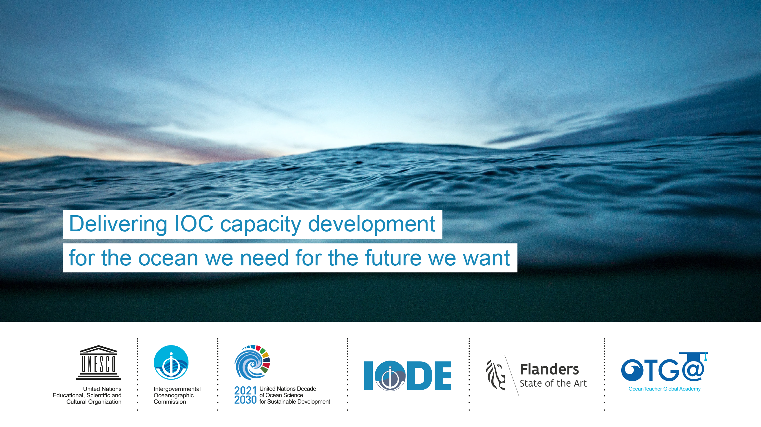


OceanTeacher
Global Academy:
IOC’s Capacity
Development Tool
Cláudia Delgado
Greg Reed
Peter Pissierssens
UNESCO/IOC Project Office for IODE

Slide 2
IOC Capacity Development Strategy
Output | Activity
1. Human Resources Developed | 1.1 Academic (higher) education 1.2 Continuous professional development 1.3 Sharing of knowledge and expertise / community building 1.4 Gender balance
2. Access to physical infrastructure established or improved | 2.1 Facilitating access to infrastructure (facilities, instruments, vessels)
3. Global, regional and sub-regional mechanisms strengthened | 3.1 Further strengthening and supporting secretariats of regional commissions 3.2 Enhance effective communication between regional sub commission secretariats and global programmes as well as other communities of practice (inc. other organisations)
4. Development of ocean research policies in support of sustainable development objectives promoted | 4.1 Sharing of information on ocean research priorities 4.2 Developing national marine science management procedures and national policies
5. Visibility and awareness increased | 5.1 Public information 5.2 Ocean Literacy
6. Sustained (long-term) resource mobilization reinforced | 6.1 In-kind opportunities 6.2 Financial support by MS to IOC activities
OTGA Contribution to IOCs Capacity Development

Slide 3
IOC
Capacity Development
Strategy
Output | Activity | Action
1. Human Resources Developed | 1.2. Continuous Professional Development | 1.2.1. Promote and assist with the organization of training courses, workshops and ‘summer schools’ relevant to the IOC mandate
 |  | 1.2.2 Establish, or collaborate with other organizations on, a internship/fellowship programme (including on-board training)
 |  | 1.2.3 Establish and collaborate with other organizations on, a visiting lecturer programme
 |  | 1.2.4 Promote and assist with the establishment of regional training (and research) centres relevant to the IOC mandate
 |  | 1.2.5 Promote the sharing of the training materials
OTGA Contribution to IOCs Capacity Development

Slide 4
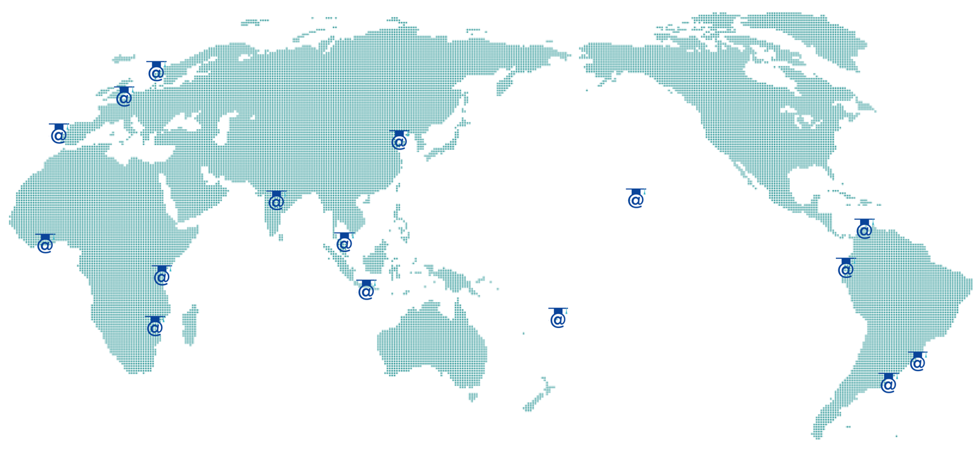

OceanTeacher
Global Academy
E-Learning Platform (eLP)
Network of RTCs/STCs (n=17)

Slide 5
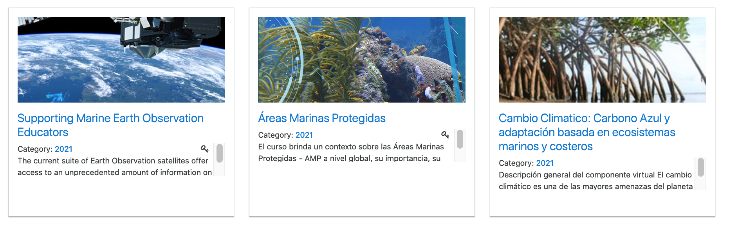
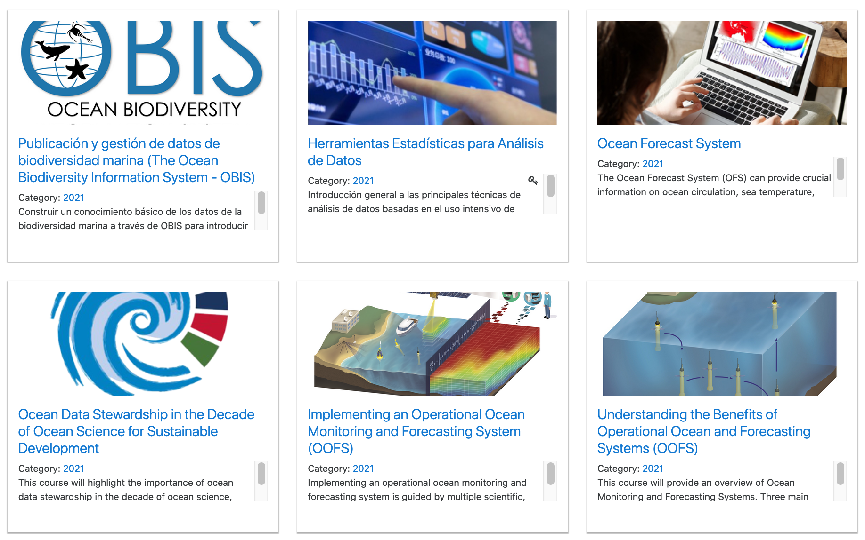
OTGA activities (2021)
32 online, synchronous courses
6 courses adapted for self paced mode
5 courses hosted (partners)
Over 3250 applications (for 27 courses)
Over 1100 started a course
English, Spanish, Portuguese
Over 9400 registered users
Alumni System

Slide 6




Design and Delivery of Training Services
The UNESCO/IOC Project Office for IODE is certified as a Learning Services Provider
Learning Content
Methods of Learning Transferring
Specify aims, scope,
outcomes and methods of Learning Services
Specify aims, scope, Outcomes and methods of Learning Services
Syllabus/Learning Content
Facilitation Methods
Learning / Teaching Methods
Group activities
Learner Assessment Methods
Hands on exercises
Learning Services Provider
Curriculum
Communicate
Interested Parties
Learners
1
Learning Outcomes
Regulatory Agencies
2
Feedback
Industry
Deliver
3
Sponsors

Slide 7
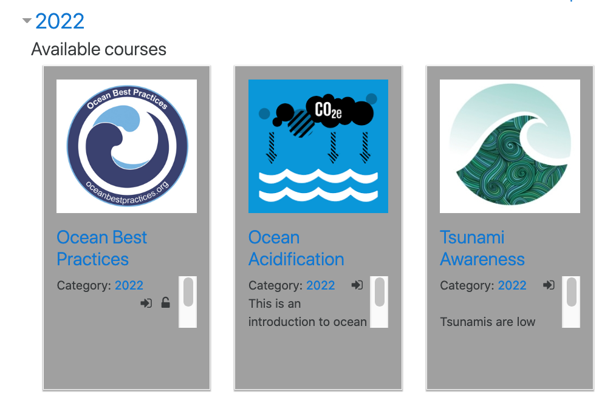
(Self paced) courses in production phase
(Not yet)
Tsunami Awareness
Ocean Acidification
Ocean Best Practices
Ocean Data Management
…

Slide 8

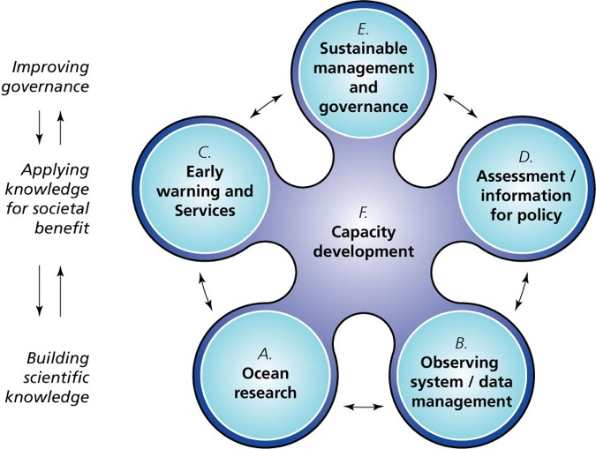
IOCs High Level Functions
Cross cutting Function

Slide 9

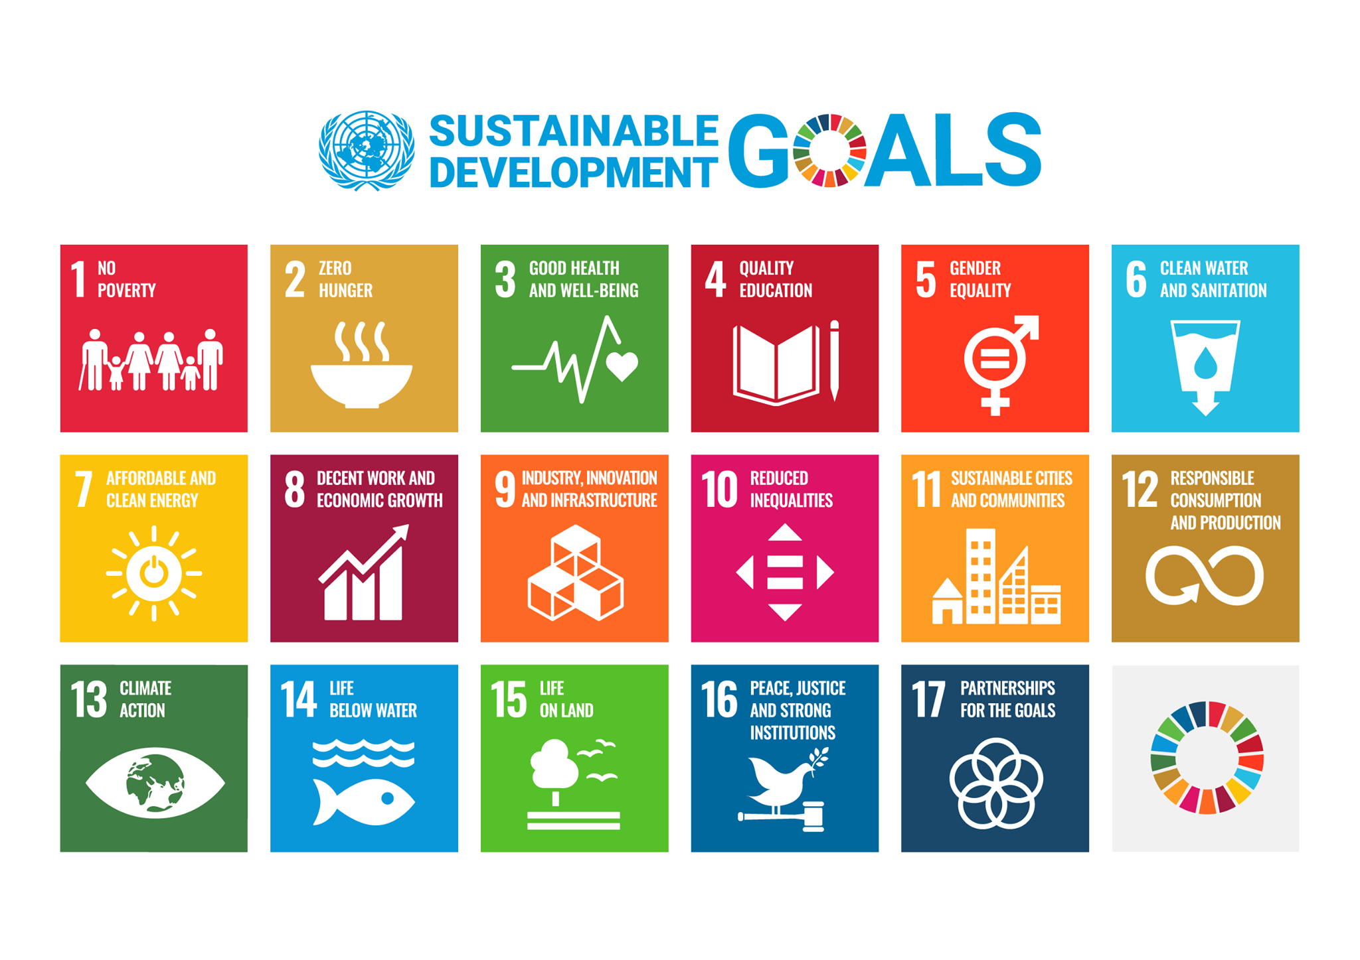

Beyond UNESCO IOC
UN Ocean Decade (OTGA endorsed Ocean Decade Project)
SDGs:
  4: Quality Education
  5: Gender Equality
  9: Innovation and Infrastructure
  11: Sustainable Cities and Communities
  13: Climate Change
  14: Life Below Water
Qingdao Declaration on the use of ICTs for education and lifelong learning
Sendai Framework for Disaster Risk Reduction
SIDS Accelerated Modalities of Action (SAMOA) Pathway

Slide 10















Beyond UNESCO IOC
Delivering as One
Training Hub
Note: not all partner organisations shown

Slide 11
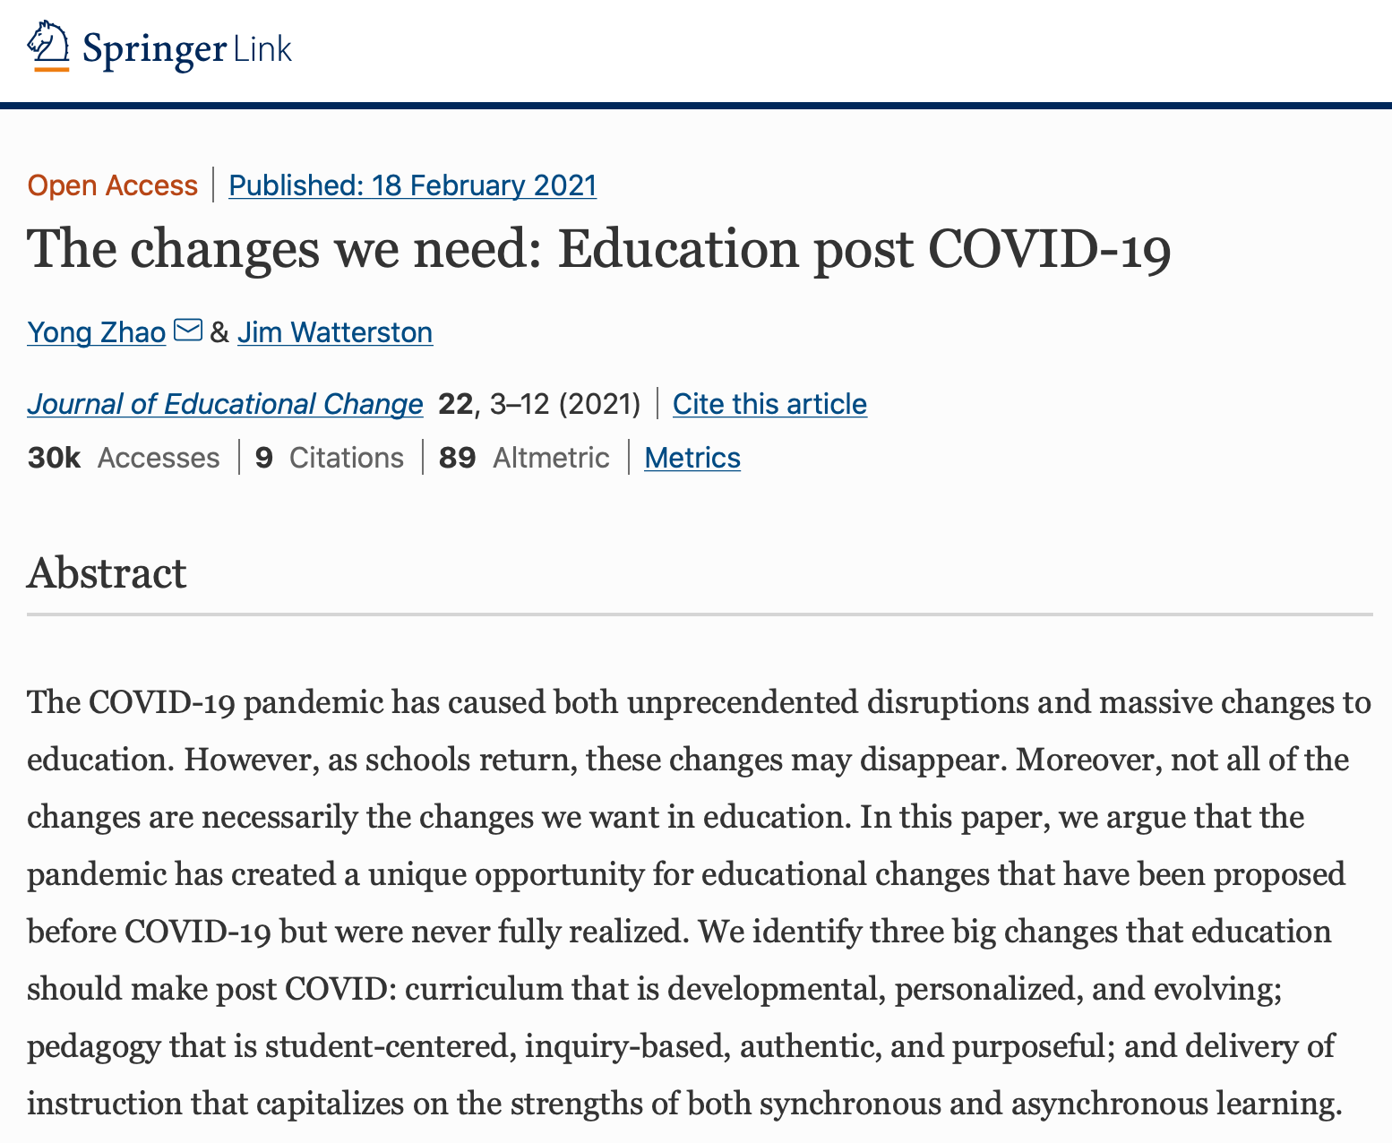
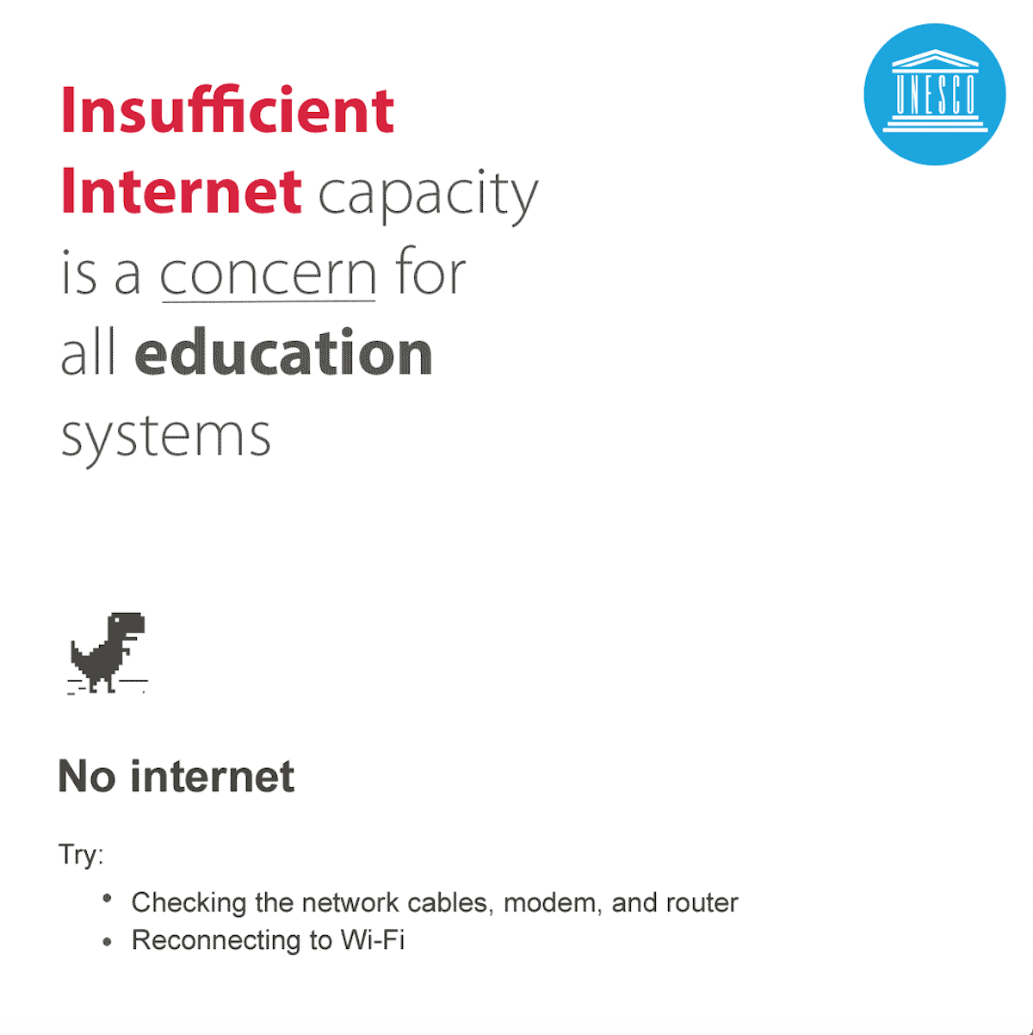
The changes we need:
Education post COVID-19
#LearningNeverStops

Slide 12

Ocean Training post COVID-19
Astronauts are trained on Earth

Slide 13
Delivering as One
www.ioc-cd.org
www.oceanteacher.org
ioc.training@unesco.org

