Slide 1
The IOC Ocean InfoHub Project
3rd Session of Group of Experts on Capacity Development (GE-CD III)
1-2 December 2021
Lucy Scott
UNESCO/IOC Project Office for IODE
L.Scott@unesco.org

Slide 2
Background
The First Joint Meeting of the Task Teams of the IOC Group of Experts Capacity Development on Capacity Development requirements of Member States and implementation of a Clearing House Mechanism for the Transfer of Marine Technology was held at UNESCO/IOC Headquarters, 13-14 March 2019.
All regions reported that such a mechanism would be instrumental to the further development of ocean science capacity in the countries. All regions expressed preference for an online central portal integrating the data and information harvested from regional/sectoral CHM portals. The respondents identified the need for a series of nodes rather than one global central node but using technology that allows interoperability between the nodes. The majority of respondents had recommended a “A hybrid model: online central portal with deep-links to regional/sectoral CHM portals”.
Background
OIH Overview
Current status
Three regions
Training courses

Slide 3
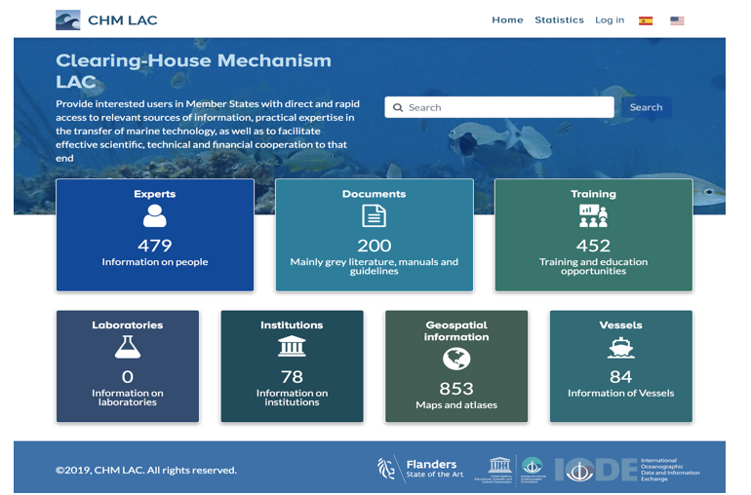
Background
Based on this, INVEMAR (Colombia) developed a pilot CHM for the Latin America and Caribbean region, in the context of the Caribbean Marine Atlas (CMA-II) project. The pilot “Clearing-House Mechanism LAC) (http://portete.invemar.org.co/chm) is a hybrid model, with a centralized portal that provides access to information sources identified by the users as most relevant (Databases on Training and Education resources, List of experts, Research vessels,..) and integrated from a number of existing web sources developed and maintained under IOC (OceanExpert, Ocean Teacher Global Academy, ODISCat)
Background
OIH Overview
Current status
Three regions
Training courses

Slide 4
Ocean InfoHub Project Overview
The IOC Ocean InfoHub Project (OIH) is a global initiative to improve access to marine and coastal data and information.
It is a three year project that commenced in April 2020
The project is funded by the Government of Flanders (Kingdom of Belgium)
The objective of the project is to develop interoperability between existing information systems, thus improving the flow of information to end users.
Background
OIH Overview
Current status
Three regions
Training courses

Slide 5
Three related initiatives
The Ocean InfoHub Project
IOC Ocean and Data information system Catalogue of data sources (ODISCAT), currently describes over 3000 online sources of marine & coastal data in 16 categories
The Ocean Data and Information System
The three projects are very closely linked.
The OIH Project has developed the first phase of the architecture underpinning ODIS, and is concerned with involving user communities and establishing proof-of-concept of ODIS.
OIH
ODIS-
CAT
ODIS
Background
OIH Overview
Current status
Three regions
Training courses

Slide 6
OIH links IOC databases
The OIH will first work with global IOC-associated online resources – including:
OceanExpert : People
AquaDocs : Documents and Publications
The GOOS/IODE Ocean Best Practices System (OBPS)
Data: the Ocean Biodiversity Information System (OBIS)
Data: the World Ocean Database (WOD)
extended by partnerships with EurOcean, Marinetraining.eu, EMODNET, and other sources in the IOC ODIS Catalogue of Sources (ODIScat).
Background
OIH Overview
Current status
Three regions
Training courses

Slide 7
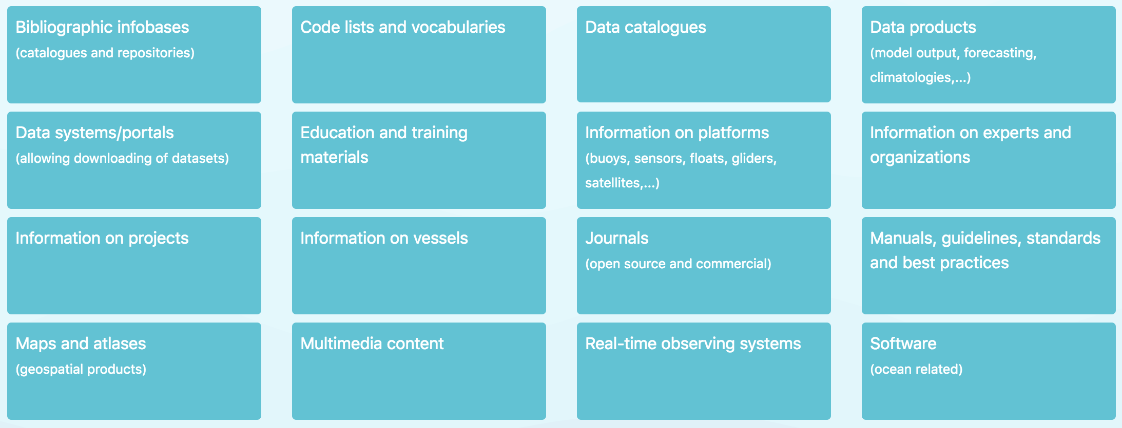
Initial data types
People and institutions/organizations
Documents
Spatial data/maps
Training opportunities
Vessels (research opportunities)
Projects
Data categories in ODIS-Cat
Background
OIH Overview
Current status
Three regions
Training courses

Slide 8
ODIS-Architecture
Ocean
Data
Portal
Thematic Hub
Ocean
Best
Practices
OIH
Global Hub
World Ocean Database
OBIS
Ocean
Expert
Ocean
Docs
A global ODIS (Ocean Data and Information System) architecture will be developed to enable interoperability with local, regional and thematic infrastructures.
This will be developed with willing and able OceanInfoHub early adopters (co-design)
Lightweight schema.org based implementation patterns
Regional Hub
Regional Hub
Thematic Hub
Regional Hub
NationalHub
Thematic Hub
NationalHub
NationalHub
NationalHub

Slide 9
Overview of project status
The Project has five work packages. The work plan is on track with no major technical delays.
WP1: Project management, coordination and evaluation
WP2: Technology development
WP3: Establishment and initial support the global hub and regional nodes
WP4: Training and capacity development of regional nodes
WP5: Communication, user marketing and feedback
Background
OIH Overview
Current status
Three regions
Training courses

Slide 10
Overview of project status
April
2020
May
2020
September
2020
January
2021
March
2021
April
2021
May
2021
August
2021
October
2021
Agreed way forward for ODIS-arch
6 priority themes agreed
Project commencement
First ODIS proof of concept complete
(Ocean Expert, marineTraining.eu)
OBPS
indexed
SG-OIH-1
AquaDocs
indexed
SG-OIH-2
Project tools and WG teams in place
WP2 contractor
hired
OBIS
indexed
CORDIO’s MaspaWIO
indexed
Background
OIH Overview
Current status
Three regions
Training courses

Slide 11
ODIS-architecture Proof-of-concept
OIH
Global Hub
Thematic Hub
(MarineTaining.eu)
Ocean
Best
Practices
World Ocean Database
A global ODIS (Ocean Data and Information System) architecture has been developed, tested and fully documented to enable interoperability with local, regional and thematic infrastructures
OBIS
Ocean
Expert
Aqua
Docs
Regional hub Africa (IOCAfrica)
Regional hub LAC (CHM-TMT)
Thematic Hub (CORDIO MASPAWIO)
Regional hub PSIDS
SPC
Regional hub PSIDS SPREP
Indexed in the OIH graph
Online but independent, with development work ongoing
Marine Institute (IE)
Thematic Hub
In total, we are working with 28 implementation partners
NationalHub
NationalHub
NationalHub

Slide 12
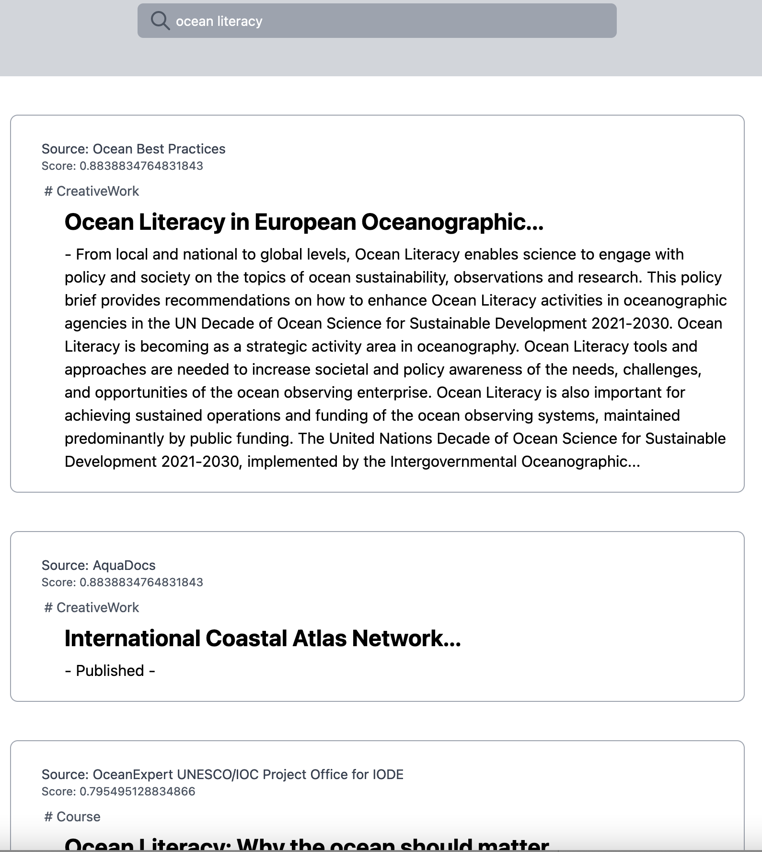
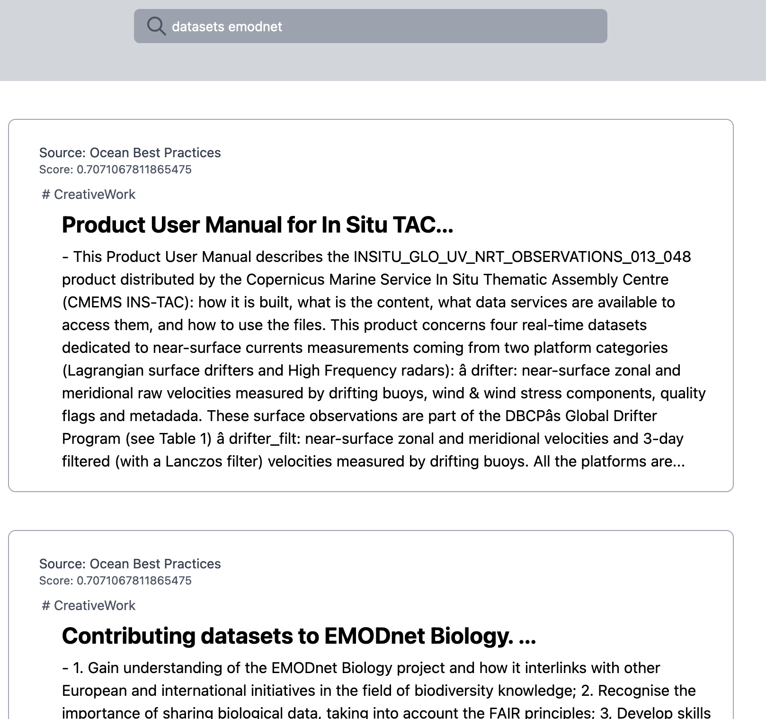
Overview of project status
A reference implementation of the global hub server side architecture demonstrates the facility to search across the existing seven working implementations. This is available online.
https://oceans.collaborium.io/index.html
Background
OIH Overview
Current status
Three regions
Training courses

Slide 13
Three pilot regions
African region,
Latin America and Caribbean region, and the
Pacific Small Island Developing States
These three regions have participated in the development of the proposal for the Ocean InfoHub Project and will take a lead on pilot projects to test interoperability between existing information hubs.
Background
OIH Overview
Current status
Three regions
Training courses

Slide 14
Three pilot regions
Regional nodes
Regional nodes are currently online independently:
IOCAfrica: https://www.ioc-africa.org/
INVEMAR CHM-TMT: http://portete.invemar.org.co/chm#/
SPREP and SPC: https://www.spc.int/, https://www.sprep.org/
We also do have regional data in the global OIH knowledge graph
The global hub search portal will showcase the three regions.
OIH-supported development work within each of the regions is actively bringing additional regional partners into the network.
Background
OIH Overview
Current status
Three regions
Training courses

Slide 15
Training courses
IOC/OTGA/OIH Training course: Implementing the Ocean Data and Information System (ODIS) architecture. 25-29 October 2021 [online]
Training course materials also contributed to:
ICAN9 Session III – Sharing your Atlas with the World (OceanInfoHub & Schema.org)
IOC/OTGA/RTC/Tianjin 2021 training course Course: Ocean Data Stewardship in the Decade of Ocean Science for Sustainable Development (oceanteacher.org).
2022: Additional courses will be held in Spanish and French
Background
OIH Overview
Current status
Three regions
Training courses

Slide 16
OIH Project contributions to the CD chapter of the Decade
The OIH is needs driven, with investment in tools that have been requested by regions
The OIH will optimise the exchange of knowledge, information and learning
It responds to national and regional priorities
It will respect cultural and geographic diversity (regional identity of hubs, including language)
Targets knowledge generators and users
Builds on and strengthens existing resources
Focuses on the transfer of local knowledge,
on supporting early career scientists,
and on remedying gender disparity by increasing access to information, technologies and opportunities.

Slide 17
In conclusion
The OIH will facilitate better access to global databases, but also better visibility of national and regional data holdings.
Users can more easily discover what they need.
Regions and countries can learn from each other; Africa, Pacific and LAC regions
OIH contributes to the CD chapter of the UN Decade of Ocean Science for Sustainable Development by providing an opportunity for partners and users to contribute to, and access the UN Ocean Decade global data ecosystem while also offering capacity development opportunities to all to participate equitably.

Slide 18
Thank you
https://oceaninfohub.org

