Slide 1
WMO Infrastructure Commission (INFCOM) -
Standing Committee on Earth Observing Systems and Monitoring Networks (SC-ON)
Exploring Collaboration SC-ON with the Hydrological-Meteorological Equipment Industry (HMEI) Association
Sid Thurston (USA, vice-Chair, SC-ON, NOAA Manager Global Drifter Program)
DBCP-37 11 November, 2021
8. Engagement With the Commercial Sector

Slide 2
Key Questions for DBCP-37 Q&A Discussion
key issues you would like raised through the Industry dialogue?
What key technologies or areas most need innovation?
What experiences have you had engaging with Private Sector and any opportunities you see to constructively engage?

Slide 3
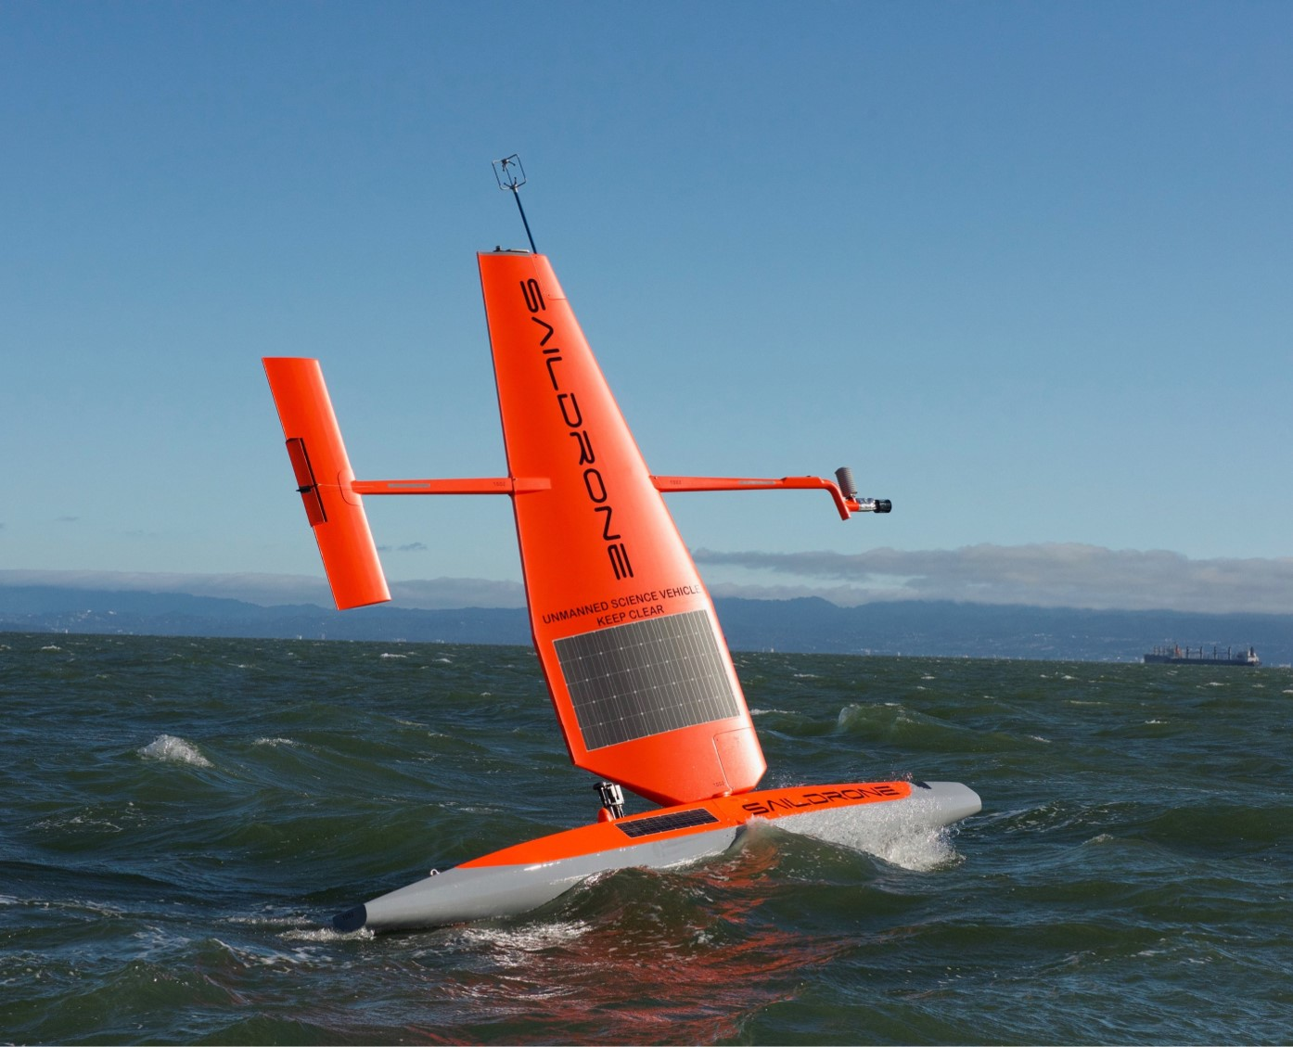
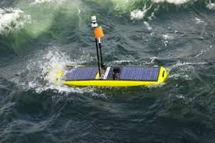
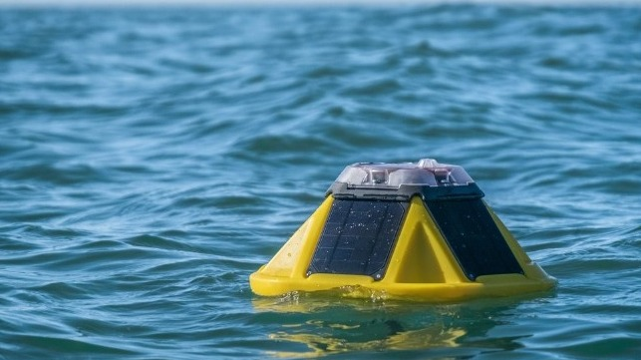
Rapid Expansion of Ocean Observations, Products and Services
Compared to National Agencies and Academic Research Institutions, the Commercial Sector currently contributes a relatively small percentage to global ocean observations,
Commercial sector engagement in this space is rapidly increasing,
Commercial Interests go beyond the acquisition of ocean data to also delivering sea state forecasts and other ocean products and services,
HMEI can help to serve as a focal point for commercial ocean observing instrument and service providers to engage more effectively with Global Public and Academic Sectors,
For additional information please contact Sidney.Thurston@noaa.gov
A screenshot of the interactive map of the Global Ocean Observing System

Slide 4
WMO Public-Private Engagement
Over the last years, WMO, in cooperation with various partners, has been developing a new approach for greater engagement between the public, private and academic sectors operating in the global weather enterprise.
In 2018 and 2019 – at the 70th Session of its Executive Council and the 18th Session of the World Meteorological Congress – WMO refined guidance and policies to encourage and enable Members to pursue mutually beneficial partnerships and engagement with all sectors and stakeholders in order to enhance weather, climate and water services for business, individuals and society as a whole.

Slide 5
HMEI Background
HMEI represents and promotes the views of over 140 Private sector companies
Objectives are to advance the technologies, standards, operational uses and sustainability of Equipment, Software, Systems, and Services supporting the Global Weather Enterprise,
Office in WMO Headquarters, Geneva.

Slide 6
SC-ON Has Met With HMEI Two Times
Meeting Objectives:
Scope opportunities and common interests,
Produce practical, actionable recommendations for increasing interactions and enhancing coordination between HMEI and SC-ON,
Highlighted the Recent Rapid Expansion of Commercial Sector in Ocean Observations and Services,
Prompts/questions for Discussion:
Where is HMEI currently engaged with WMO Expert Teams (ET)?
What are SC-ON & HMEI mutual priorities that will benefit from enhanced and sustained interactions?
How can we identify new POCs to increase and sustain coordination between HMEI and SC-ON in key areas?

Slide 7
Areas of Common Interest
SC-ON and HMEI representatives identified the following areas of common interest:
User requirements (feasibility of manufacturers to respond to requirements; or feeding user requirements for those private sector actors delivering services),
Quality monitoring,
Metadata collection,
Data availability,
Surface Observing Networks,
Oceanography, e.g. ocean wave measurements,
Satellite observations, integration of in situ and satellite observations,
Implementation of WIGOS Station Identifiers,
Radio-Frequencies,
Capacity development.

Slide 8
Collaboration SC-ON ⬄ HMEI
Topics of interest for a possible collaboration:
Earth Observing System Design and Evolution:
Actual and new requirements for observations capabilities already available, in development, needed
Environmentally sustainable measurements
To contribute the view of private-sector observation providers
WIGOS Tools:
Interest of HMEI in contributing to WIGOS metadata and WIGOS monitoring
Provision of different and equally important view on the WIGOS tools
Oceans:
Recent Rapid Expansion of commercial observations: equipment and services, including delivering of forecasts. How to evolve expansion in a concerted way, and how could HMEI contribute to this
Hydrology and Cryosphere:
To be identified.

Slide 9
Collaboration SC-ON ⬄ HMEI
Collaboration with HMEI already initiated:
Satellites:
Discussions initiated with HMEI for establishing interface to commercial satellite operators
Radiofrequencies:
Important exchange for an early enough protection of radio frequencies needed for new technologies
Aviation based Observations:
HMEI Members already part of Joint Expert Team:
Water vapour (WVSS manufacturer),​
Aircraft communications/software (Data Service Providers),​
Other ABO platforms e.g. ADS and TAMDAR (ICAO and FLYHT).
WICAP is a good example for the collaboration with the industry​

Slide 10
Follow-up Actions
Actions to follow up:
Identify types of communication, and then role of various actors in WMO and HMEI. (Chair SC-ON / WMO ET Coordinator of HMEI),
HMEI to provide list of topics of interest to SC-ON,
The two Secretariats are encouraged to discuss and assist HMEI and SC-ON Chair on issues of common interest,
Encourage direct communication of HMEI with the ET Chairs. Start with ET-WT, JET-ABO, ET-SSU,
HMEI to establish a chart of participants from HMEI in WMO groups and expert teams,
Discussion of proliferation of commercial observations (Vice-Chair SC-ON with WMO ET Coordinator),
HMEI to identify candidate for participating as a member in SC-ON
A Third Meeting in Early 2022.

Slide 11
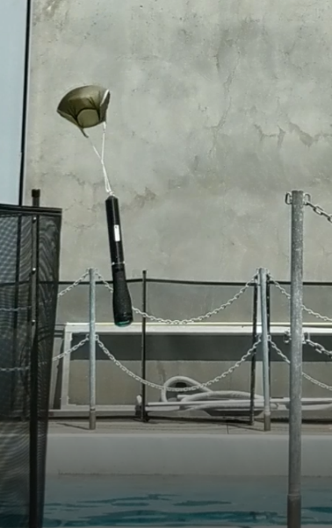
Thank you
Merci

