Slide 1
India Tsunami Buoy Network
DBCP – NO.37, Virtual Mode, 8 – 11 November 2021
Chair - Dr. R. Venkatesan
Co Chair - Dr Christopher Moore NOAA USA

Slide 2
25 September 2021
Proposed workshop of the ITP on tsunami detection.
Other activities in the intersessional period.
Future plan

Slide 3
Tsunami Warnings Service Requirements Survey
Background
`To help guide an international workshop which will explore novel ways to detect and monitor tsunamis.
Workshop will be hosted by the WMO/IOC DBCP in collaboration with the IOC Working Group on Tsunamis and Other Hazards Related to Sea-Level Warning and Mitigation Systems (TOWS-WG) and the IOC Tsunami Unit.
Workshop will focus on innovative, cost-effective tsunami detection and monitoring solutions driven by the requirements that we are seeking through this survey.

Slide 4
continued
This survey is being sent to national agencies/centres with a responsibility for tsunami early warnings.
Three requirement categories:
Customer/user requirements
Operational requirements and
Technology requirements.

Slide 5
Country Report India
Achievement of Tsunami buoy Network in India
Sustain Tsunami buoy network from 2007 onwards
Technology advancement in Tsunami buoy System - Indian Tsunami buoy and Bottom Pressure Recorder System
Tsunami detection Technology to be re-visited by experts apart from BPR technology
Submerged Tsunami Buoy –Technology is transferred to Industry

Slide 6
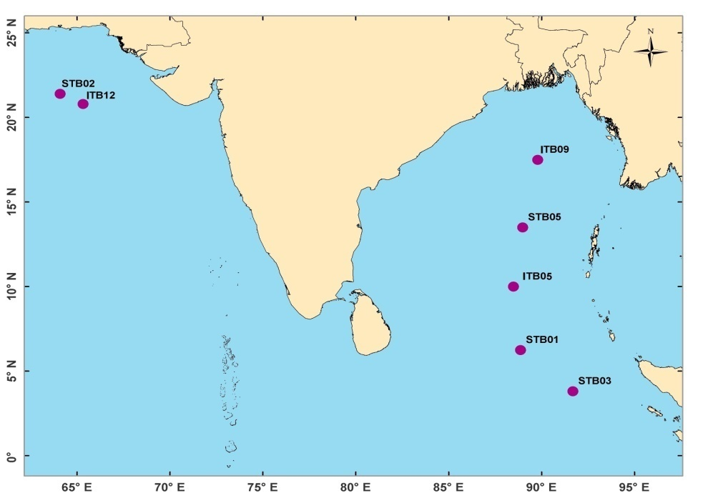
Status of Tsunami Buoy Network
7 Tsunami buoys established in Indian ocean
4 SAIC BUOY (STB1 , STB2, STB03, STB05)
3 NIOT Buoy with Sonardyne BPR (ITB05, ITB09, ITB12)
SAIC buoy and Indian Tsunami Buoy (ITBS) data linked with NDBC and data available in DART II format continuously
ITB 09 deployed with Indigenous CPU (DART II format).
Development of Indigenized Tsunami buoy System
Temperature recorded by BPR
S. No. | Station Name | Latitude (°N) | Longitude (°E) | Location | Maintained by
1 | STB01 | 06.2 | 88.8 | BoB | INCOIS
2 | STB02 | 20.8 | 65.3 | AS | INCOIS
3 | STB03 | 03.8 | 91.7 | BoB | INCOIS
4 | STB05 | 13.5 | 89.0 | BoB | INCOIS
5 | ITB05 | 10.2 | 88.5 | BoB | NIOT
6 | ITB09 | 17.7 | 89.6 | BoB | NIOT
7 | ITB12 | 19.9 | 67.0 | AS | NIOT
Planned Network | Currently network | Tsunameter Types | Local Reception | Data to GTS | Data to FTP | Data Formats | Vandalized Stations
7 | 8 4 NIOT (ITBS) 4 SAIC | SAIC – STB, Indian Buoy Sagar Bhoomi & BPR Sonardyne | Yes | Yes Through INCOIS | No | DART | ITB12 (19.9N/67.0E)

Slide 7
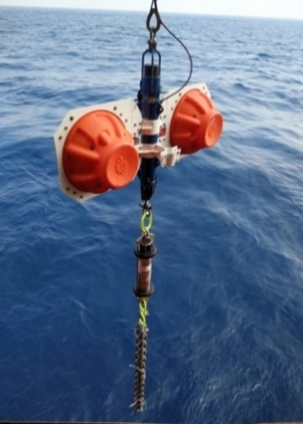
Technological Developments
Development of Indian Tsunami Buoy system
Development includes tsunami surface buoy system and Bottom Pressure recorder unit(6000 m rated).
Facility for redundant Electronic chain for fool-proof operation.
Design enables us easy to track even after surfacing.
Configurable data transmission interval from (1 to 6 hours).
DARTII Message format implemented for message compatibility with global community.
Power consumption 35 mA (earlier version 100 mA) @ 14.4 V DC.
Capable of real time data transmit INMARSAT/IRIDIUM
DART Message format implemented all Indian Tsunami Buoys with 6 hrs transmission interval and the data is being shared with NDBC through INCOIS.
Indigenized BPR Deployment will be planned in March 2020 due to COVID pandemic situation couldn’t take it up immediately.
Sagar Bhoomi – Indian Tsunami Buoy – Patent filed

Slide 8
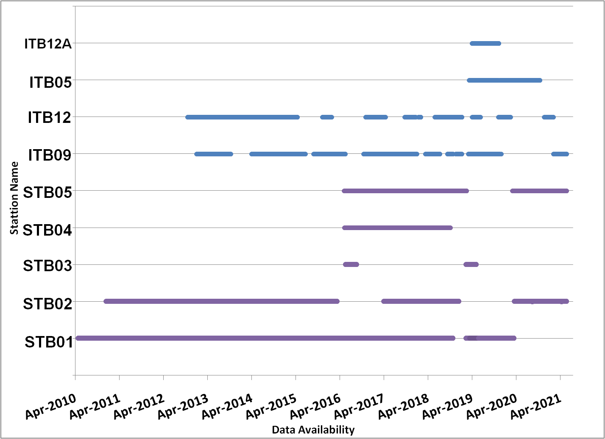
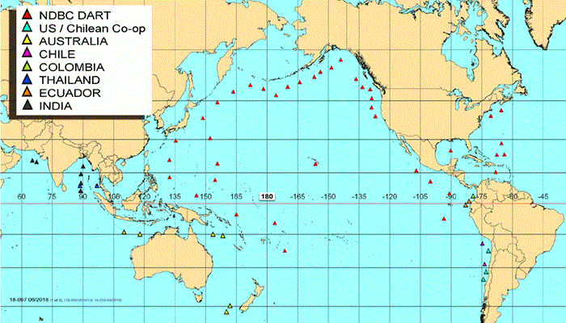
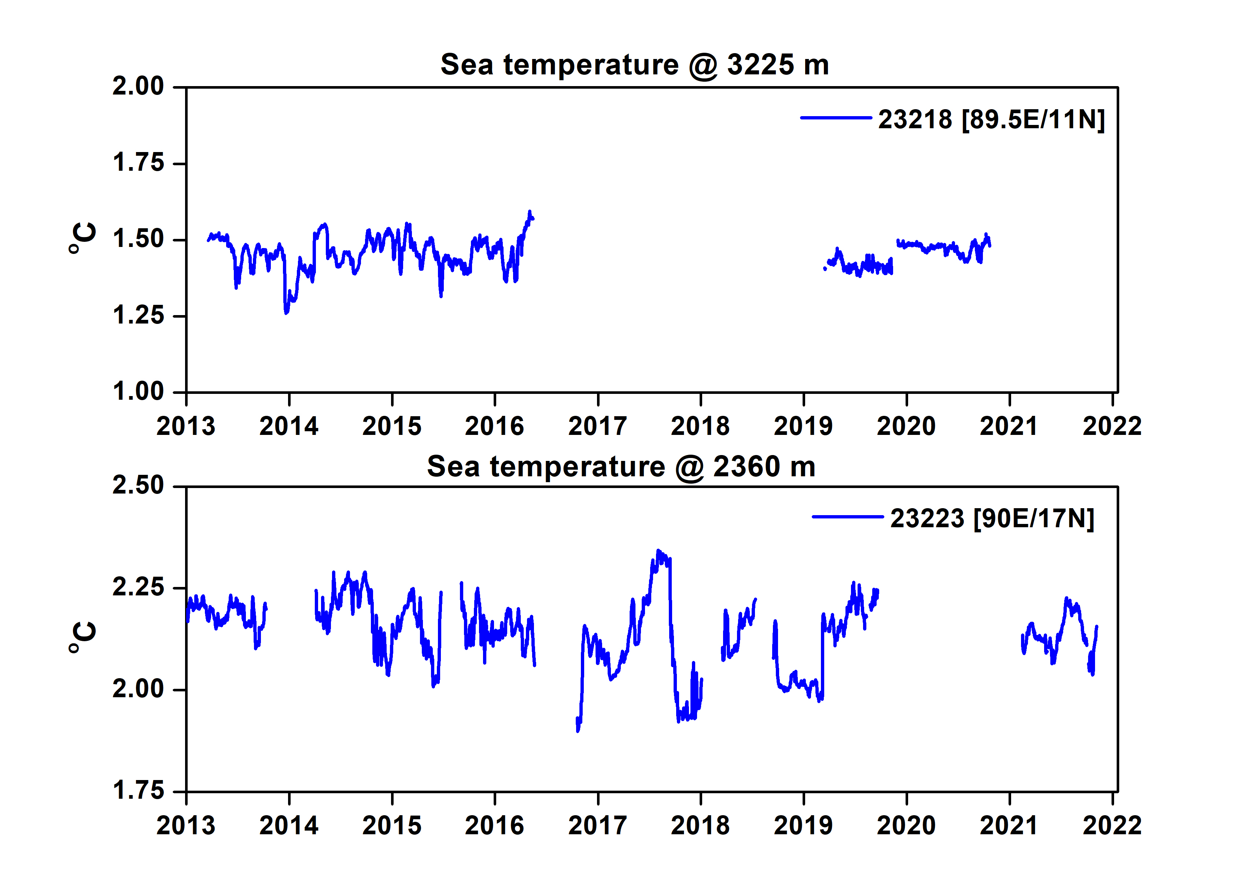
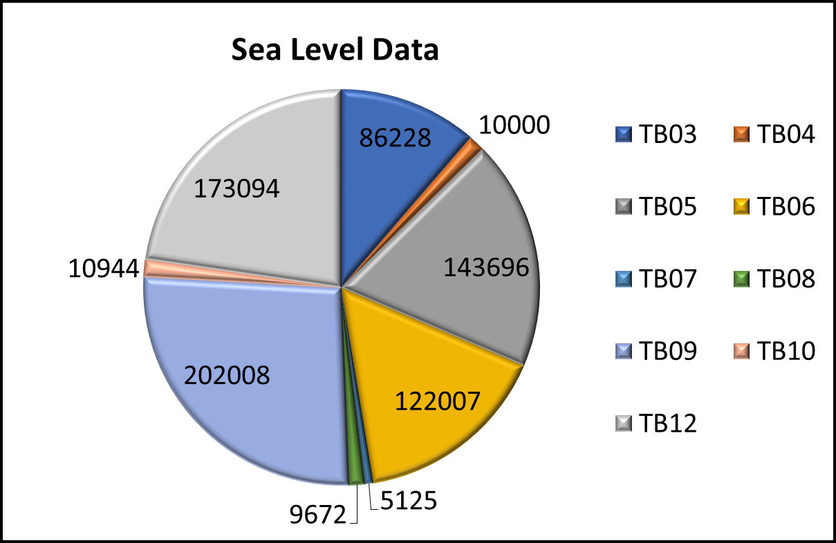
Data availability of Tsunami Buoys
https://www.ndbc.noaa.gov/dart.shtml

Slide 9
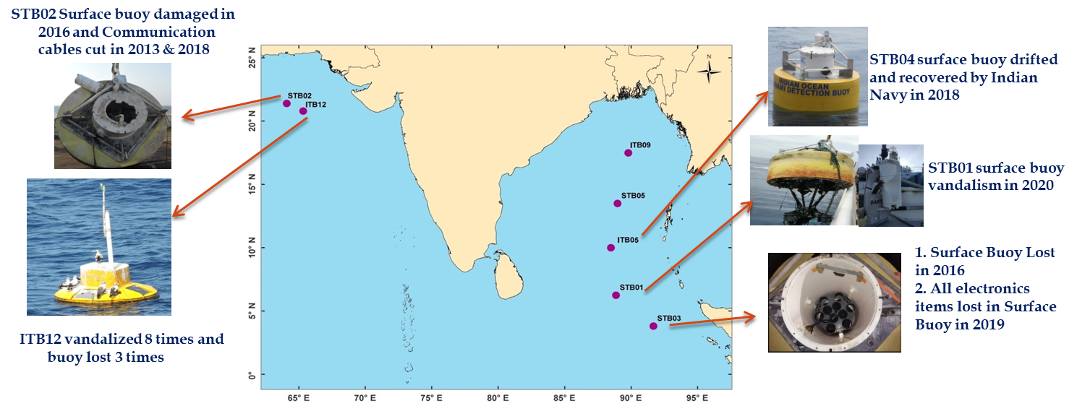
Challenges
Due to COVID 19 pandemic situation , planned maintenance activities are cancelled and three Tsunami systems working out of seven.
Sustenance of buoys in open ocean is a big challenge
IRIDIUM Telemetry Being pursued for observational needs with Government of India - Partial success.
Vandalism
2 Indian Tsunami Buoy got vandalized in Arabian Sea
1 SAIC Tsunami Buoys got Vandalized in Bay of Bengal

Slide 10
Thank you for your attention

