Slide 1
USA National Report
DBCP–37, 8-11 Nov 2021
Rick Lumpkin, Rick.Lumpkin@noaa.gov
Input from Tara Clemente, Karen Grissom, Robert Jensen, Ignatius Rigor, and Rory Toon

Slide 2

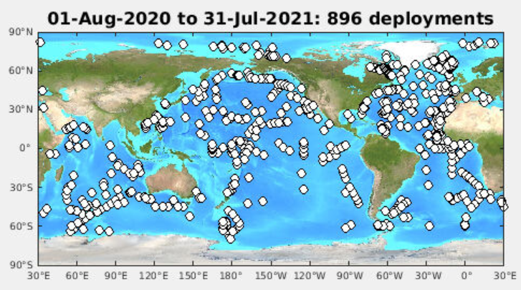
Global Drifter Program

Slide 3
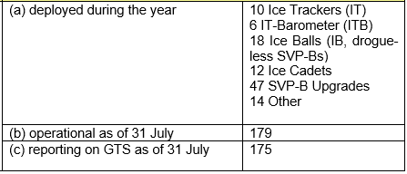
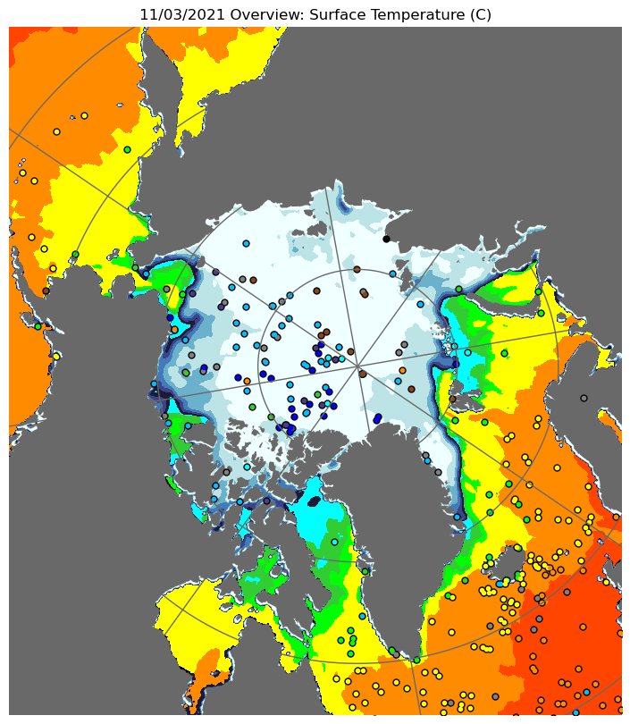
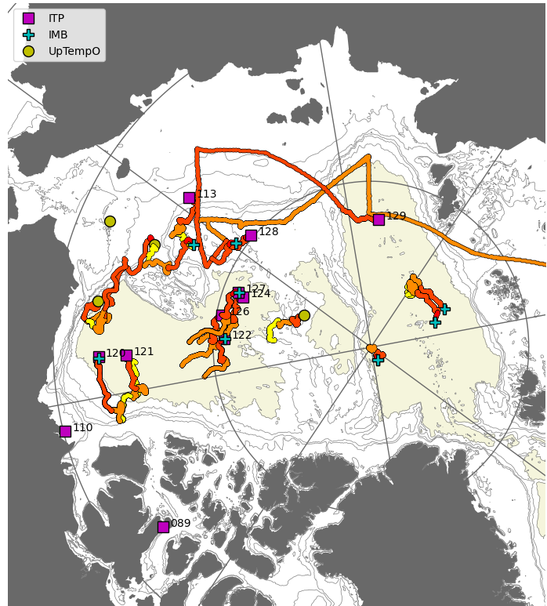
US Interagency Arctic Buoy Program (USIABP)

Slide 4
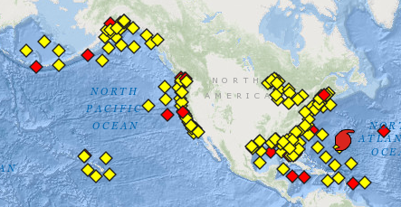
NDBC Coastal Weather Buoys
NDBC Moored Buoys (MET/OCEAN), showing stations reporting in the last 8h (yellow) or not (red). Figure from http://www.ndbc.noaa.gov/obs.shtml. This image is for 1 October 2021.

Slide 5
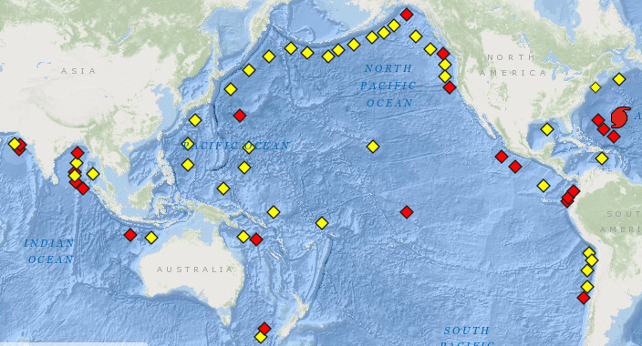
NDBC Tsumameters
: International Tsunami Network status, showing stations reporting in the last 24h (yellow) or not (red). Figure from http://www.ndbc.noaa.gov/obs.shtml. This image is for 1 October 2021.

Slide 6
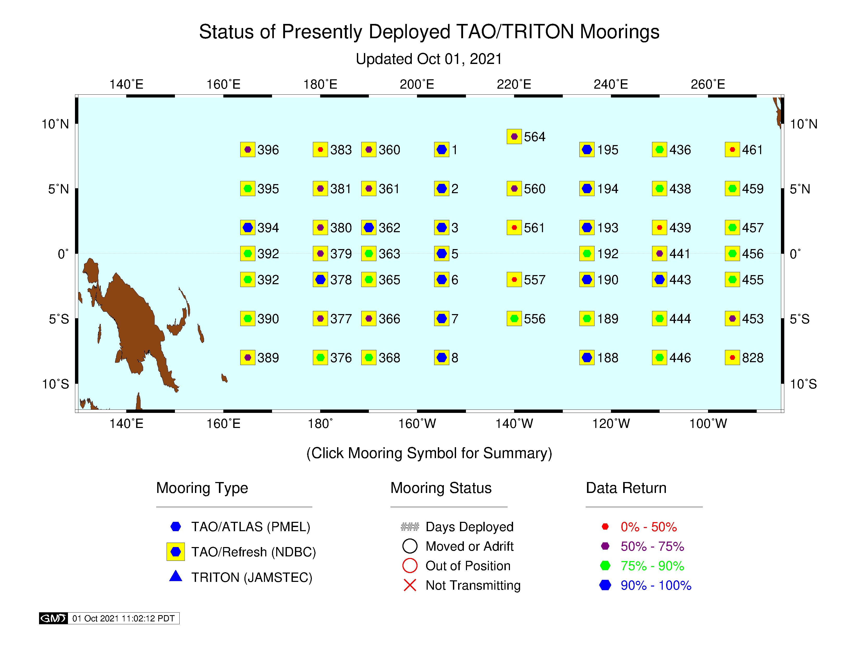
Tropical Atmosphere Ocean (TAO)
NDBC Tropical Atmosphere Ocean (TAO) Array and TRITON Array status on 1 October 2021. The numbers indicate how many days have passed since last servicing (ideally <365). Figure from http://www.pmel.noaa.gov/tao/global/status/.

Slide 7
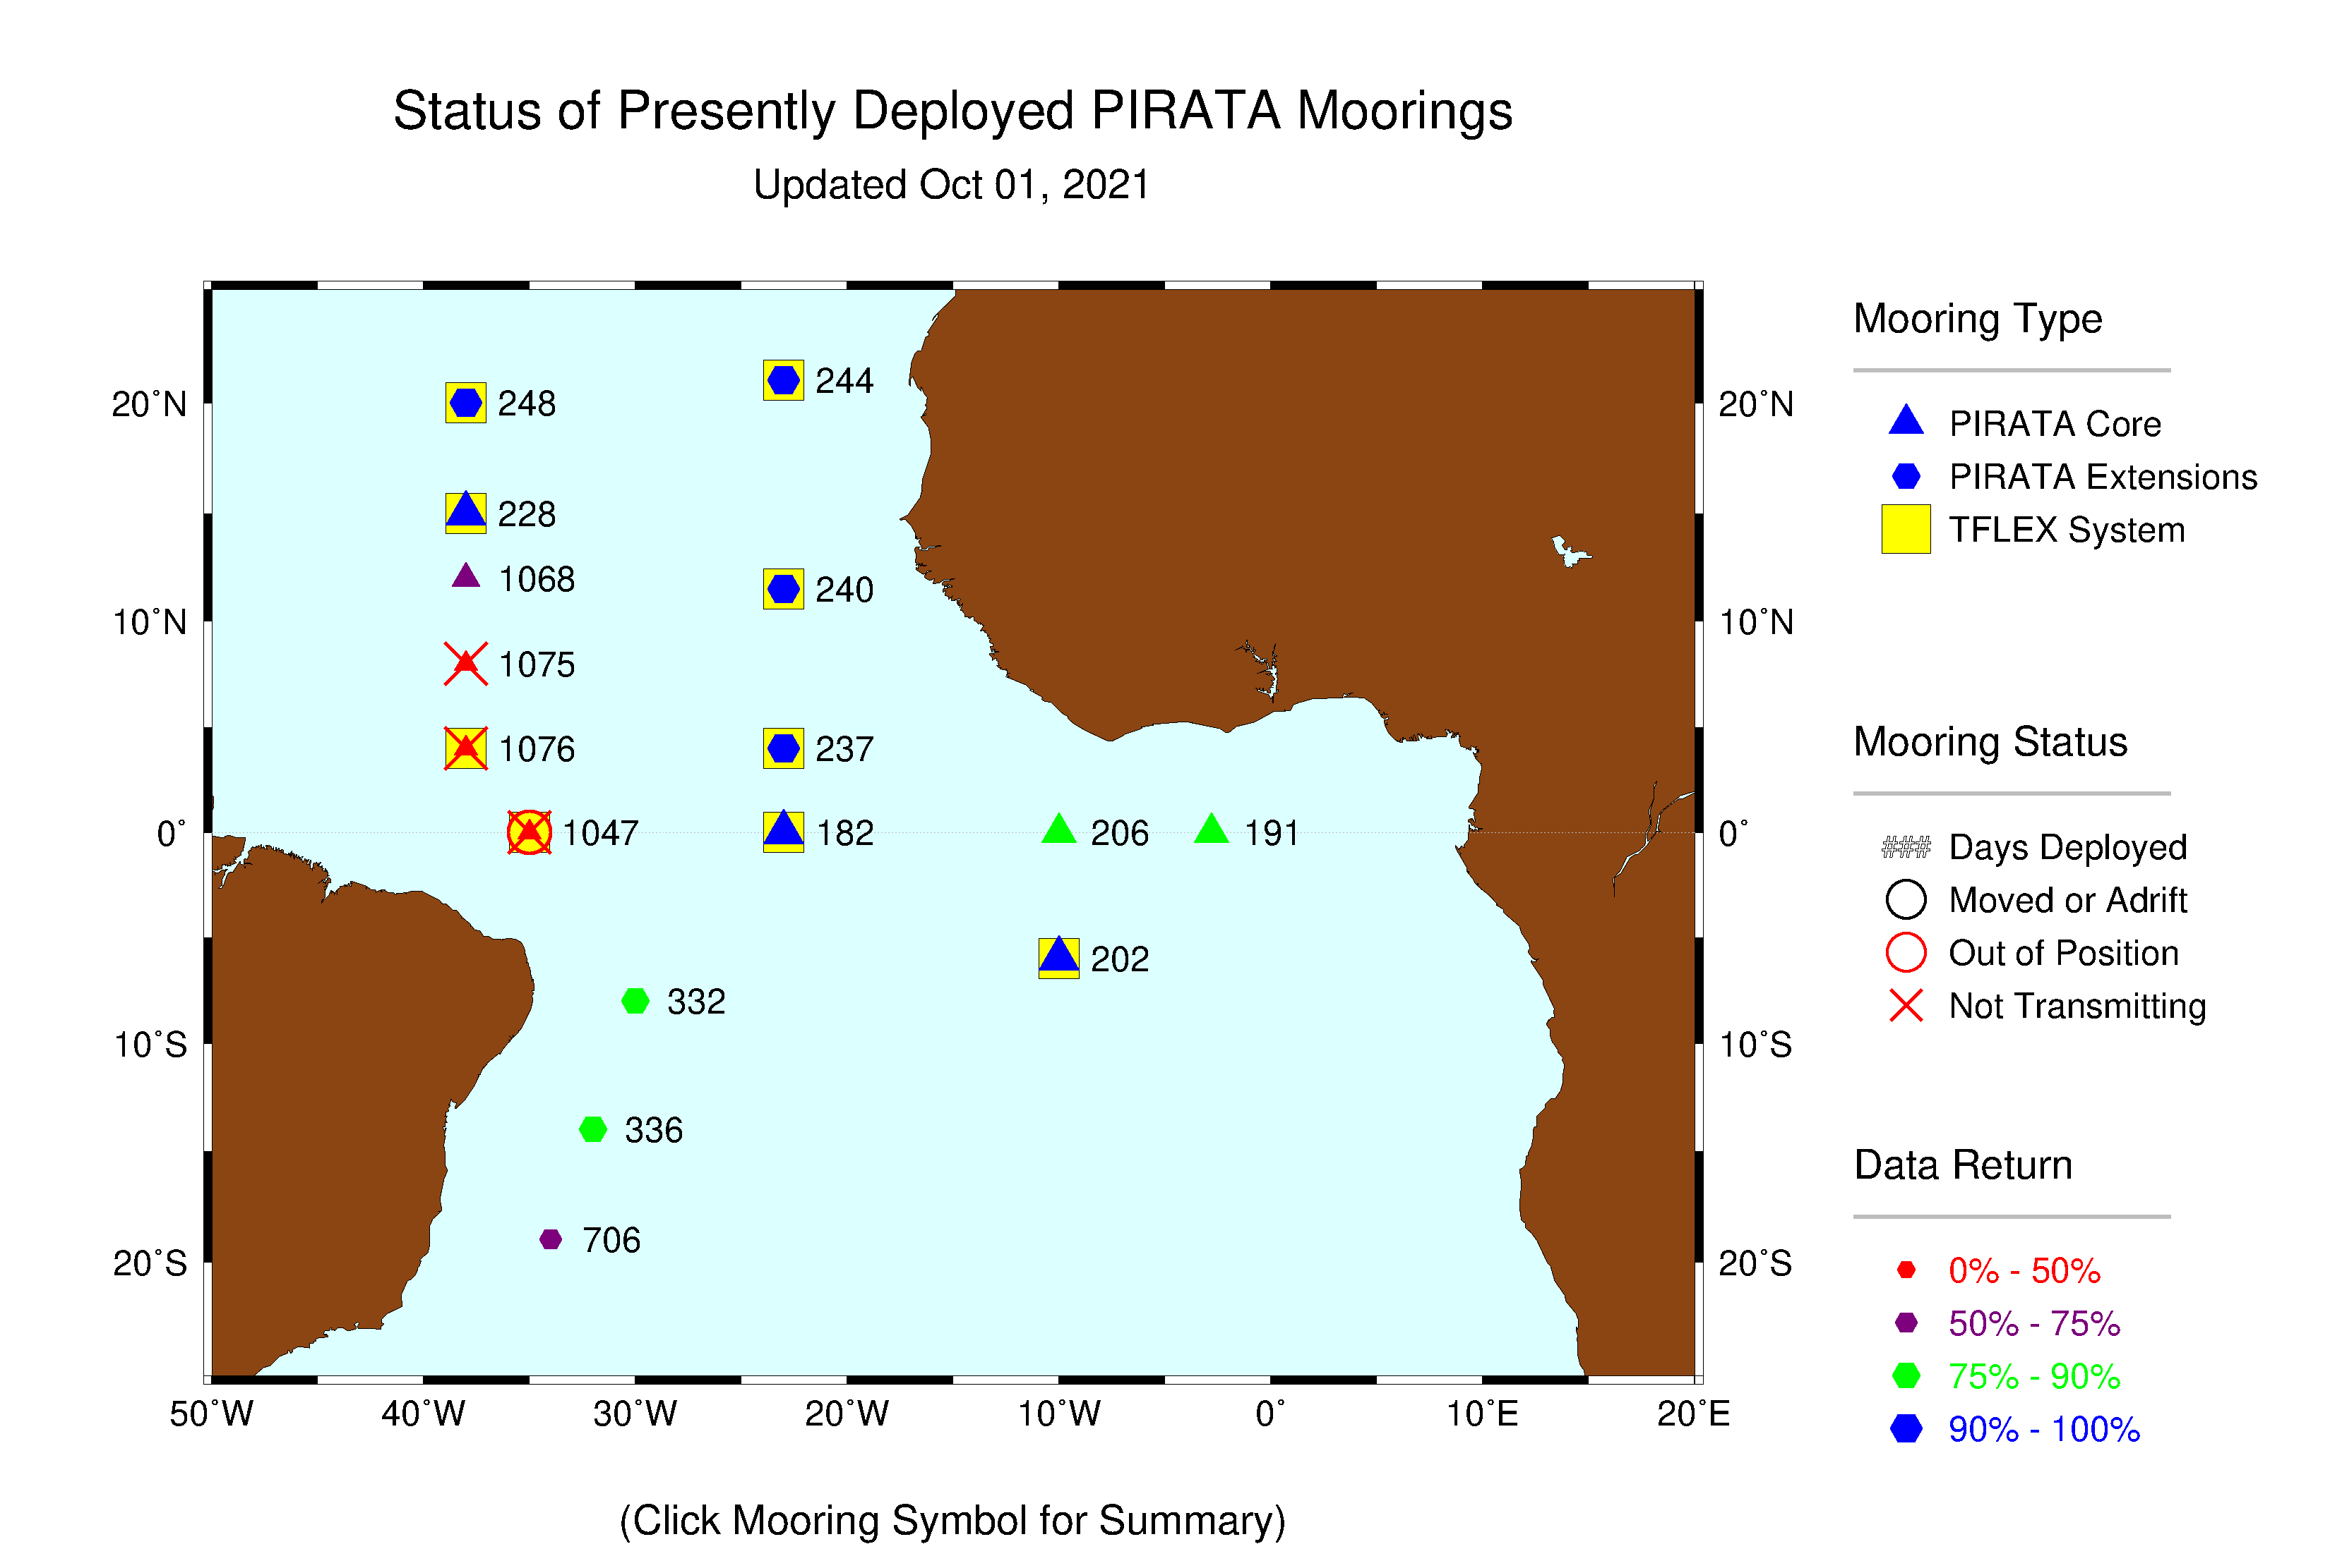
Prediction and Research moored Array in the Tropical Atlantic (PIRATA)
(a) deployed during the year | 18 surface toroids
(b) operational as of 31 July | 16 surface toroids
PIRATA Array including PMEL/AOML Northeast Extension status on 1 October 2021. The numbers indicate how many days have passed since last servicing (ideally <365). ). Figure from http://www.pmel.noaa.gov/tao/global/status/.

Slide 8
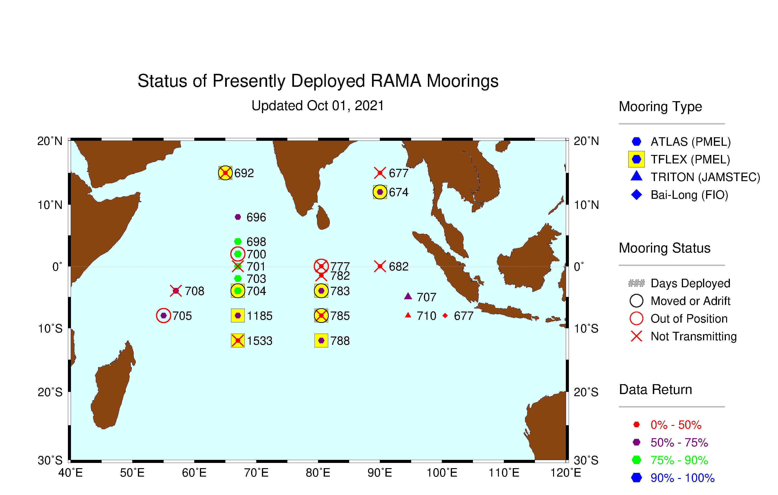

Research Moored Array for African-Asian-Australian Monsoon Analysis and prediction (RAMA)
International RAMA Array status on 1 October 2021. The numbers indicate how many days have passed since last servicing (ideally <365). Figure from http://www.pmel.noaa.gov/tao/global/status/.

Slide 9

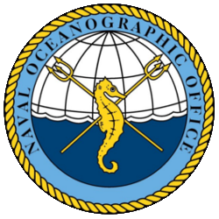
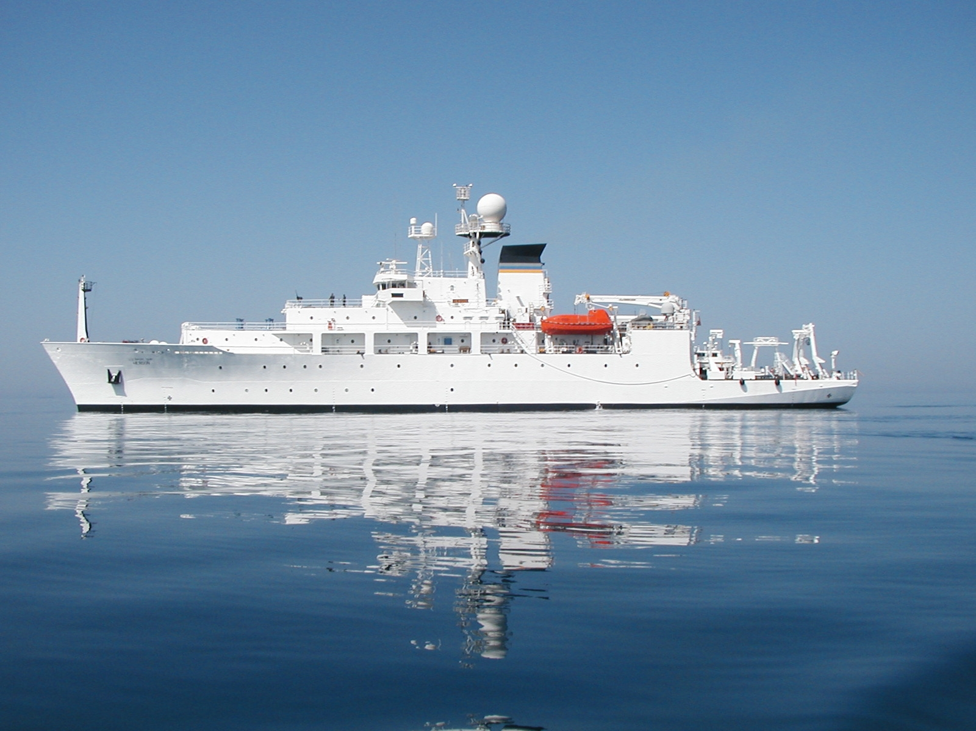
Naval Oceanographic Office (NAVOCEANO)

Slide 10
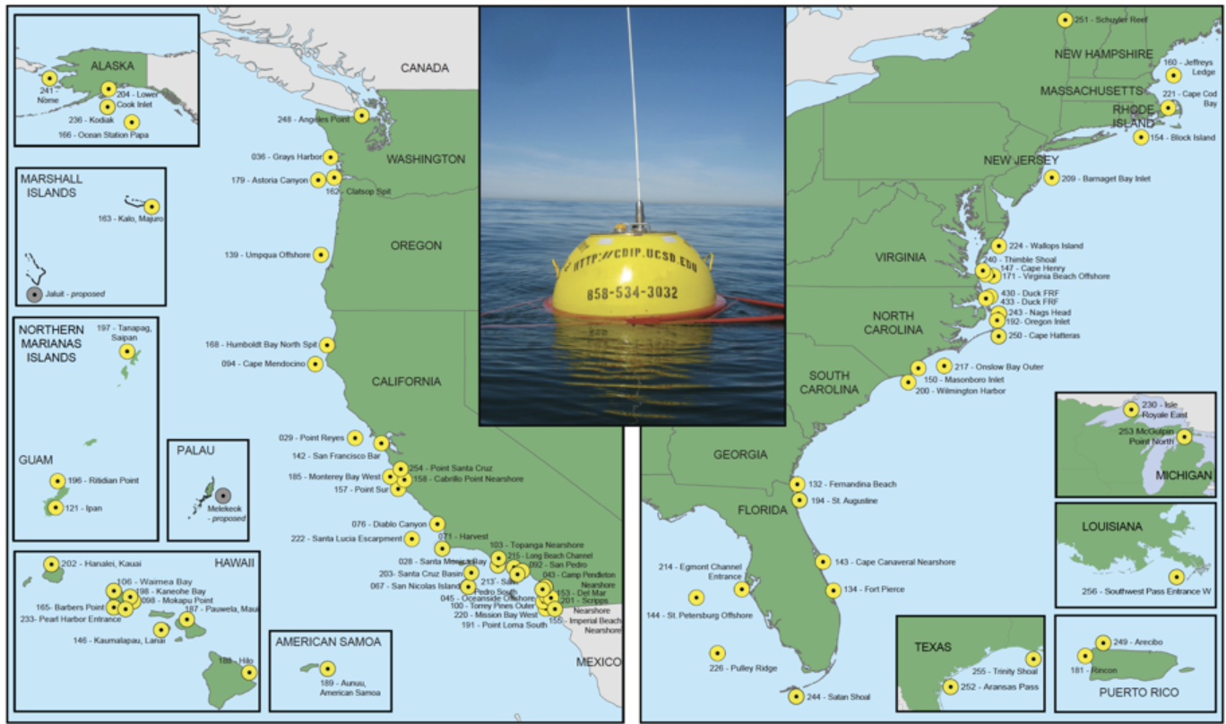
Coastal Data Information Program (CDIP)

Slide 11
Key Successes/Highlights
A new generation mooring data acquisition system, named TELOS, is currently being tested with two prototype moorings near Hawaii. These systems will offer increased flexibility for adding instruments and increasing real-time data transmission resolution.
The Bay of Bengal Large Marine Ecosystem Project (BoBLME) supports a PMEL-designed system for CO₂ and ocean acidification observations at one RAMA site. Ancillary turbulence observations are provided by Oregon State University Chipods. GEOMAR provides subsurface dissolved oxygen sensors in the Atlantic oxygen minimum zone. Two LOCEAN surface CO₂ systems were deployed in FY 2020. Dalhousie University Ocean Tracking Network acoustic monitors are deployed on all RAMA and PIRATA surface moorings.

Slide 12
Data usage
Data used for weather prediction, ocean state estimation, and monitoring climate change globally.
51 peer-reviewed research papers published in the intersessional period that rely on data from these buoy programmes (see US national report).

