Slide 1
DBCP National Report
DBCP – 37, VIRTUAL, 8-11 November 2021
Chow Chi Kin
Hong Kong, China
(ckchow@hko.gov.hk)

Slide 2
Current Programme
Name/Agency : Hong Kong Observatory
Number and type of buoys : 5 MetOcean SVP-I-BDGS
Purpose of programme : monitor tropical cyclone activities, particularly on genesis and changes in intensity and structure
Main deployment areas : South China Sea & western North Pacific
Vandalism incidents
(1) None by the end of Aug 2021
(2) Two incidents in Sep / Oct 2021 : the buoys were captured by passing vessels near the shore of Taiwan and East China

Slide 3
Planned Programme (2022)
Name/Agency : Hong Kong Observatory
Number and type of buoys : 5 MetOcean SVP-I-BDGS
Purpose of programme : monitor tropical cyclone activities, particularly on genesis and changes in intensity and structure
Main deployment areas : South China Sea & western North Pacific

Slide 4
Technical Developments
Buoy Design
(1) MetOcean Surface Velocity Program (SVP) drifting buoy attached with a holey sock drogue
(2) All five drifting buoys deployed in 2021 were under the collaboration with NOAA via the Barometer Upgrade Scheme of the Global Drifter Programme (GDP), member of the Data Buoy Cooperation Panel (DBCP)
Instrumentation
Equipped with GPS, Iridium transceiver, pressure sensor and temperature sensor

Slide 5
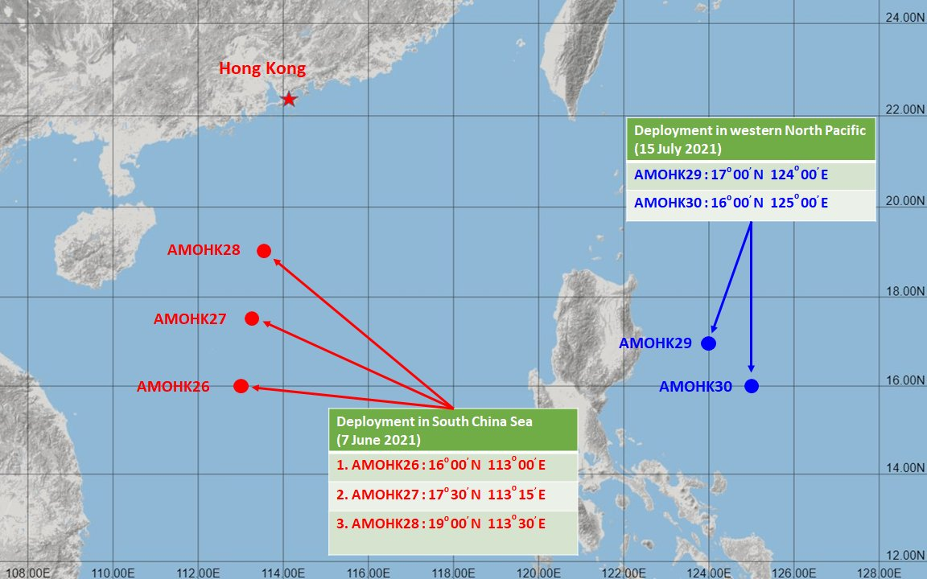
Deployment Locations

Slide 6
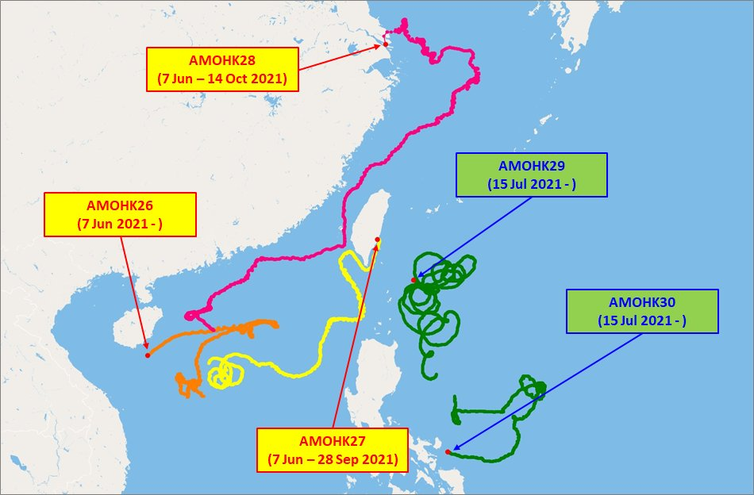
Trajectory of Buoys (up to 31/10/2021)

Slide 7
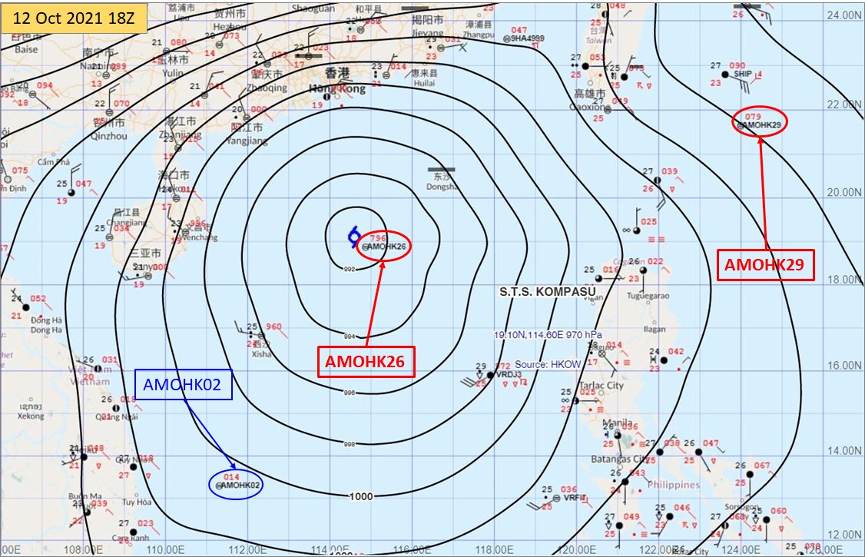
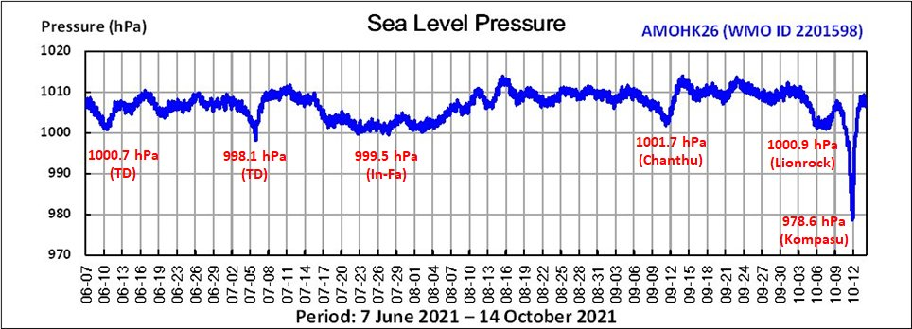
Key Observation (1)
Drifting buoys “AMOHK26” recorded the lowest pressure of 978.6 hPa near the centre of Typhoon Kompasu (2118)
“AMOHK26” recorded the lowest pressure of 978.6 hPa near the centre of Typhoon Kompasu (2118) over the South China Sea on 12 October 2021

Slide 8
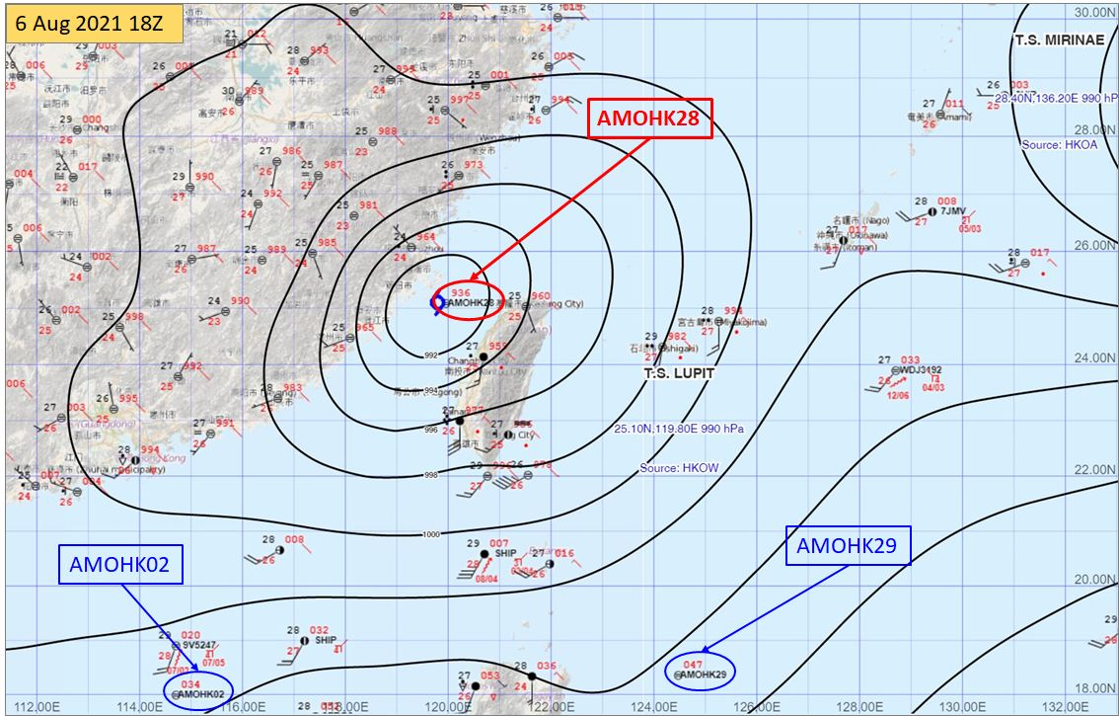
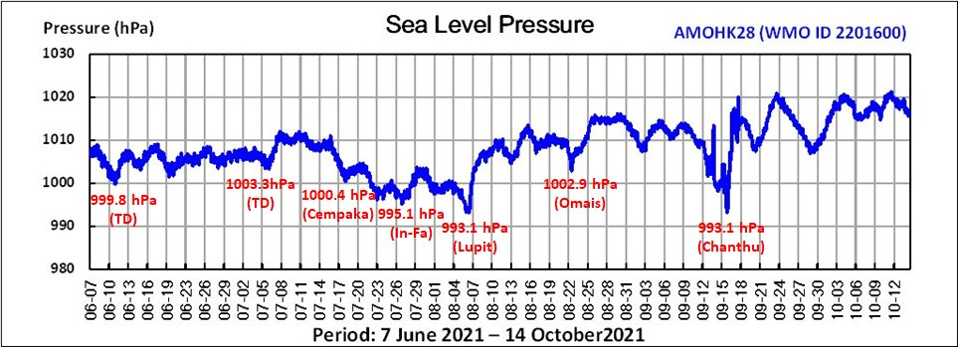
Key Observation (2)
Drifting buoys “AMOHK28” recorded the lowest pressure of 993.1 hPa near the centre of Tropical Storm Lupit (2109)
“AMOHK28” recorded the lowest pressure of 993.1 hPa near the centre of Tropical Storm Lupit (2109) over Taiwan Strait on 6 August 2021

Slide 9
Publications
Member Report, Hong Kong, China
ESCAP/WMO Typhoon Committee
15th Integrated Workshop (Dec 2020)

Slide 10
User Impact
All buoys were successfully deployed as planned with the assistance of two HKVOS despite the COVID-19 pandemic.

Slide 11
Additional Comments
QC
(1) Performance of pressure and temperature sensor is checked before deployment
(2) Real-time buoy data are closely monitored using a dedicated webpage
(3) Quality of pressure and temperature are checked against observations from nearby land stations & VOS
Communications
Hourly data transmission via Iridium
Buoy Lifetime
Typically one to a few months

Slide 12
Additional Comments (cont.)
Data Accessibility
Data are processed and distributed on GTS once received
New Observations : Nil
Additional Requirements
Wave and wind measurements near the sea surface
DBCP linkage : Nil

Slide 13
Thank you!

