Slide 1
DBCP National Report China
DBCP – 37, VIRTUAL, 8-11 November 2021
YUE Xinyang
yue_xin_yang@outlook.com

Slide 2
Current Programme
AGENCY:Ministry of Natural Resources(SOA), China Meteorological Administration, Ministry of Ecology and Environment, Chinese Academy of Sciences
1. Deployed during August 2020—July 2021: 48
2. Operational as of 31 July:
64 Moored buoys
80 Argo floats
3 Drifting buoys
27 Other type of buoys
3. Reporting on GTS as of 31 July: 83
4. Main deployment areas:
China Seas and adjacent waters, Tropical Western Pacific，
Tropical Indian Ocean, the Arctic Ocean
5. Vandalism incidents: 21
6. Purpose of the programme:
research, operations, forecasting and etc.

Slide 3
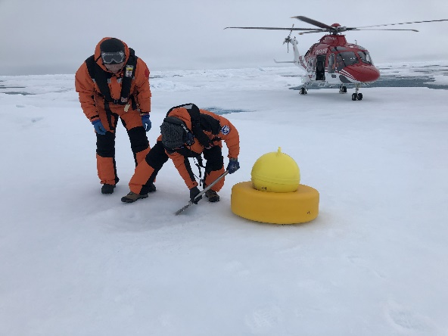
Planned Programme(s)
Number and type of buoys planned for deployment in next 12 months | Deploy location
6 moored buoys | China Seas and adjacent waters, Tropical Western Pacific, the Arctic Ocean
AGENCY:
SOA
Purpose of the programme:
research, operations, forecasting and etc.

Slide 4
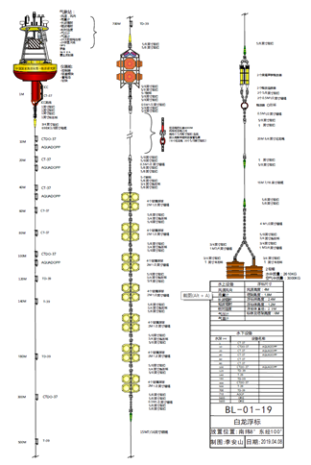
Technical Developments
China is developing the second generation of Bailong buoy to meet the requirement of marine observation development, it will have multi-function such as intelligent, networking and information transformation. The HM2000-02 Argo float and the H4000 Argo float have been designed and developed based on the HM2000 Argo float. In recent years, the buoy has adopted modern sensor technology, automatic control technology, special data analysis software and communication network.

Slide 5
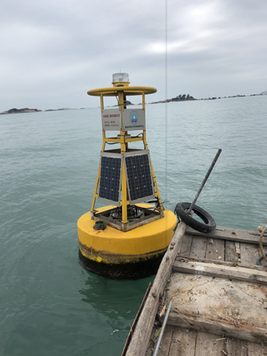
Technical Developments
CDMA and dual Beidou transmission mode are gradually implemented in Chinese operational buoy, which has effectively reduced communication costs.

Slide 6
Publications & User Impact
Publications
Ref | Title | Type
1 | The data collection and operation system for deep ocean buoy. | Technical developments
Other issue
At present, the COVID-19 outbreak is under control in China, and the buoy observation network is less affected by the pandemic. Various tasks are progressing steadily, and offshore buoys are operating normally.
The international cooperation is stagnated due to COVID-19, and the maintenance of oversea buoys is difficult.

Slide 7
Thank you!
谢谢
YUE Xinyang
yue_xin_yang@outlook.com

